Slide 1
4.Business environment
The awareness of how environment in which company takes place is changing can be considered as the factors of success of each company.
At its simplest business environment can be divided into competitive environment and macro- environment.
Macro – environment – wider environment, social, political and economic setting in which organizations operate.

Slide 2

Definition of goals

Slide 3
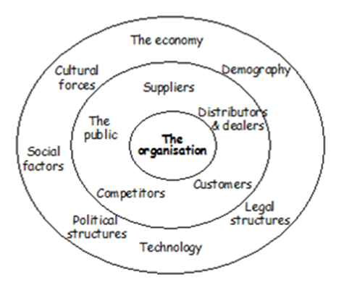
Macro – environment – wider environment, social, political and economic setting in which organizations operate.
Competitive environment – including company, its immediate competitors and customers ( Porter 5 forces)
Source: Oxford college of marketing)

Slide 4
Macro-economic environment – methods of analysis
PESTLE analysis
Politics
governement type and policy, funding grants
Economy
Inflation and interest rates
Labour and energy costs
Social
Population, education, media
Lifestyle, fashion, culture
Technology
Emerging technologies, web
Information and communication
Legal
Regulations and standards
Employment law
Environment
Weather, green and ethical issues
Pollution, waste, recycling

Slide 5
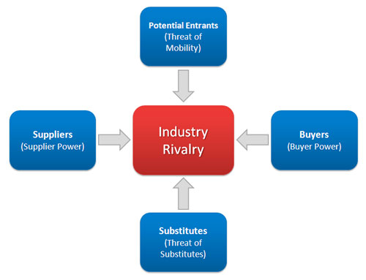
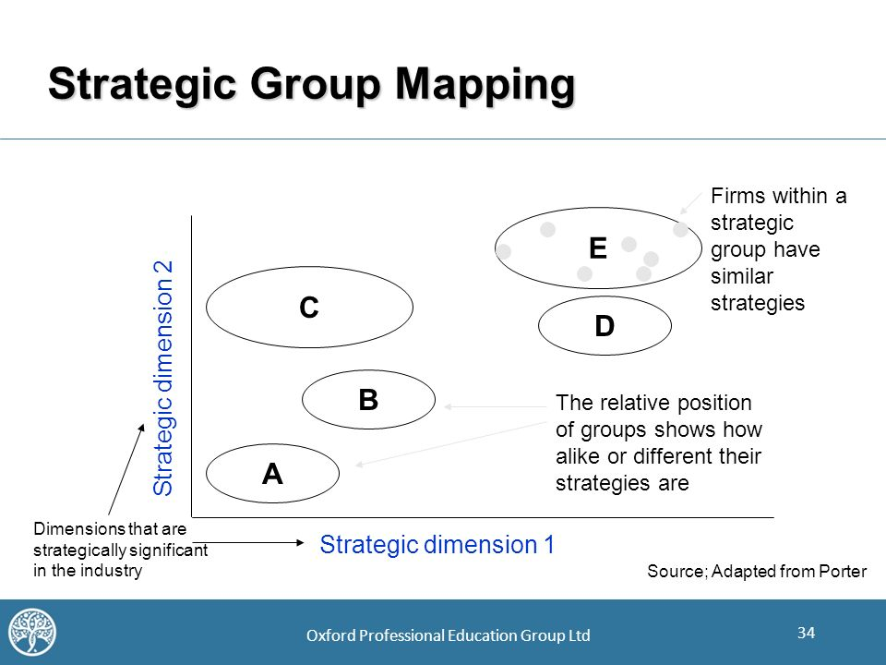
Competitive environment
Porter´s five forces
Strategic group mapping
(zdroj: Oxford Professional Education Group)

Slide 6
Porter´s 5 forces - Rivalry among existing companies
  this rivalry is likely to be most intense where a number of conditions prevail:
    Where the competitors in the industry are roughly evenly balanced in terms of size and/ or market share.
    During periods of low market growth
    Where exit barriers are high.
    Where product differentiation is low
    Where fixed costs are relatively high.

Slide 7
Porter´s 5 forces – The threat of market entry
Organization should also consider the potential for new entrants to emerge. Entry barriers can be low where the following hold:
  Cost of entry are low
  Existing or new distribution channels are open to use
  Little competitive retaliation is anticipated.
  Differentiation is low
  There are gaps in the market.

Slide 8
Porter´s 5 forces – The threat of substitutes
Substitution can increase competitiveness of an industry for a number of reasons.
  By making existing technologies redundant
  By incremental product improvement

Slide 9
Porter´s 5 forces - Bargaining power of suppliers
Suppliers tend to have more bargaining power where the following hold:
  Suppliers are more concentrated than buyers
  Cost of switching suppliers are high
  Suppliers´offerings are highly differentiated.

Slide 10
Porter´s 5 forces - Bargaining power of buyers
Buyers tend to be more powerful in the supply chain where the following is true:
  They are more concentrated than sellers
  There are readily available alternative sources of supply
  Buyers switching costs are low.

Slide 11
Porter´s 5 forces - Competitivness drivers
Where the following industry characteristics are present, expect greater levels of competition:
There is little differentiation between offers
Industry growth rates are low
High fixed costs need to be recovered
High supplier switching costs
Low entry barriers
High exit barriers

Slide 12
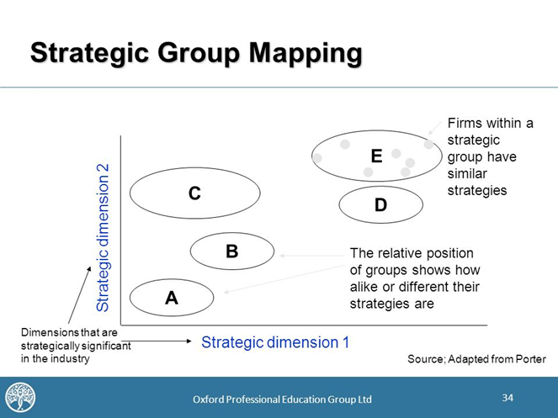
Map of strategic groups
Strategic group is composed of firms within a industry following similar strategies aimed at similar customers or customers groups.

Slide 13
Variables for the composition of the map of strategic groups:
Sales
Size of the company
Product range
Pricing
Distribution
Targeting and segmentation
Etc.
The identification of strategic groups is fundamental to industry analysis
Understanding the dynamics of existing strategic groups can be productive to understand their vulnerability to competitive attack.

Slide 14
Mapa strategických konkurenčních skupin
Product range(number of products)
A
B
5000
C
3000
D
F
E
1000
Dumping
Medium
High
Price

Slide 15
Customer analysis
What we need to know about customer ( market research):
Current information:
  Who are the prome market targets?
  What gives them value?
  How can they be brough closer?
  How can they be better served?
Future information:
  How will customers and their need and requirement change?
  Which new customers should we pursue?
  How should we pursue them?

Slide 16
Current customers
The roles of current customers may differ as follows:
The initiator
The influencer
The decider
The purchaser
The user

Slide 17
CUSTOMERS
WHO is involved in buying and consuming?
WHY Do they buy/use the product?
WHERE Dothey buy?
HOW Do they use the product?
WHEN Do they buy/use product?
WHAT Are their choice criteria?

Slide 18
Future customers
Types of change essential to customer analysis:
1) Changes in existing customers: their wants, needs and expectations.
2) Changes come from new customers emerging as potentialy more attractive targets. ( change in living standars etc.)

Slide 19
Competitor analysis
„If you know your enemy as you know yourself, you need not fear the result of a hundred battles“ (Sun Tzu, 4th century BC)
Competitive benchmarking – the process of measuring company´s strategies and operations against „ best-i-class“ companies, both inside and outside your own industry.
4 steps of benchmarking:
  Identifying who to benchmark against
  Identifying what aspects of business to benchmark
  Collecting relevant data to enable processes and operations to be compared
  Comparison with own processes

Slide 20
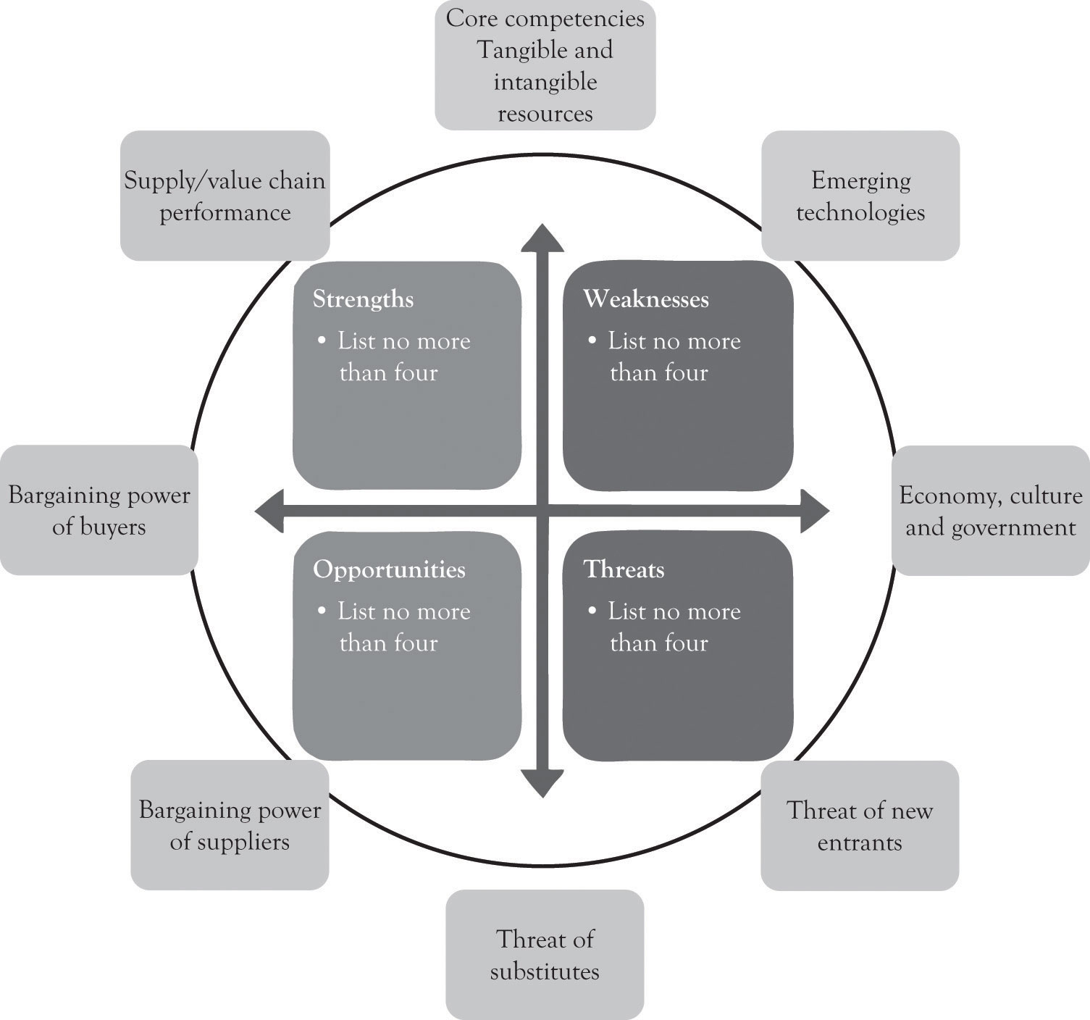
Relation between external and internal environment.
Source: Key Drivers for Quick SWOT Analysis, http://2012books.lardbucket.org

Slide 21
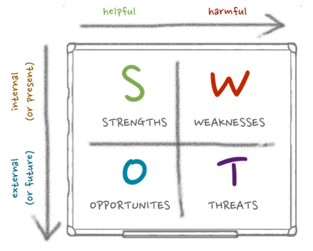
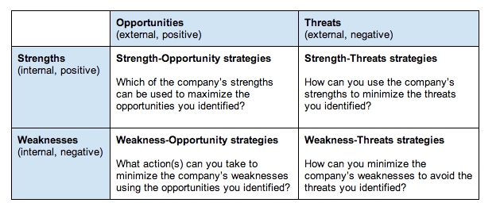
SWOT - strategies

Slide 22
Life cycle of product / industry
Demand
Introduction
Growth
Maturity
Decline
Time

Slide 23
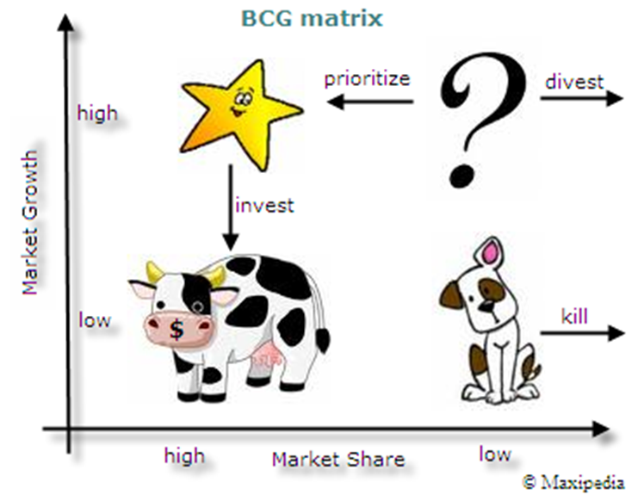
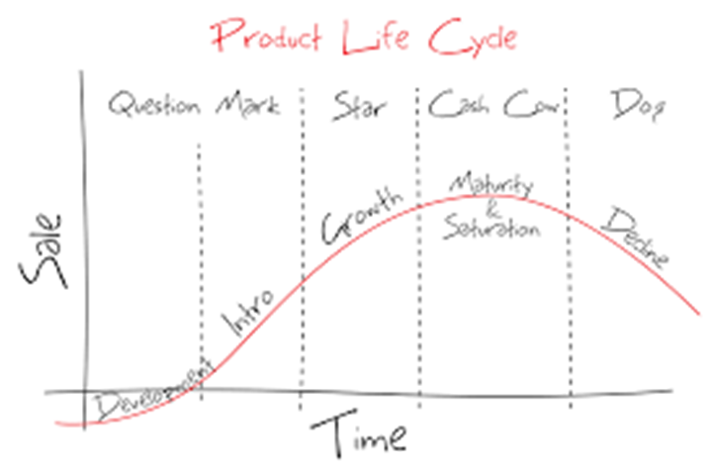
Life cycle of product / industry
http://www.convinceandconvert.com/content-marketing/how-the-product-life-cycle-improves-content-marketing/

