Slide 1
Business and its external environment

Slide 2
Content
Business and value engineering
  Business economics and microeconomic
  Porter´s value chain
  Primary and support activities of the company
  Material, informational and financial flows of the company

Slide 3
Business and value engineering
A business (enterprise, a company or a firm) is an organizational, economical and legal entity and made up of an association of people involved in the provision of goods and services to consumers , in order to achieve specific declared goals.(Aaker, 2010, wikipedia.org)
Business as an activity can be divided into(Appleby, 1987):
  People demanding goods and services - consumers
  People involved in obtaining, arranging and transforming basic materials into finished products – producers
  People involved in distribution the products to customers and others, or those involved in providing financial services.

Slide 4
  Business economics and microeconomics
Efficiency : relation between inputs and outputs
  Allocative (Pareto) efficiency: any changes made to assist one person would harm another.
  Productive efficiency: no additional output can be obtained without increasing the amount of inputs, and production proceeds at the lowest possible average total cost.
  These definitions are not equivalent: a market or other economic system may be allocatively but not productively efficient, or productively but not allocatively efficient.
  There are also other definitions and measures. All characterizations of economic efficiency are encompassed by the more general engineering concept that a system is efficient or optimal when it maximizes desired outputs (such as utility) given available inputs. (Source:wikipedia.org)

Slide 5
Business economics and microeconomics
Economic efficiency (used in microeconomics): Production of a unit of goods is considered to be economically efficient when that unit of goods is produced at the lowest possible cost.
There are two concepts of efficiency⁽¹⁾:
Technological efficiency (TE)occurs when it is not possible to increase output without increasing inputs. TE is an engineering matter. Given what is technologically feasible, something can or cannot be done.
Economic efficiency(EE) occurs when the cost of producing a given output is as low as possible. EE depends on the prices of the factors of production. Something that is technologically efficient may not be economically efficient. But something that is economically efficient is always technologically efficient.
(1) Moffatt, Mike. (2017, February 25). The Definition and Concepts of Economic Efficiency. Retrieved from https://www.thoughtco.com/definition-of-economic-efficiency-1147869

Slide 6
Factors of production
Basic factors of production : Land, labor, capital.
  Primary factors: land, labor, and capital goods
  Secondary factors: material and energy ( are obtained from land, labor and capital)
The number and definition of factors varies, depending on theoretical purpose or economic school.
Recent authors add the list of factors of production with - knowledge, information, human capital, skills etc.
Productivity - is expressed as the ratio of output to inputs (factors of production) used in a production process, i.e. output per unit of input

Slide 7
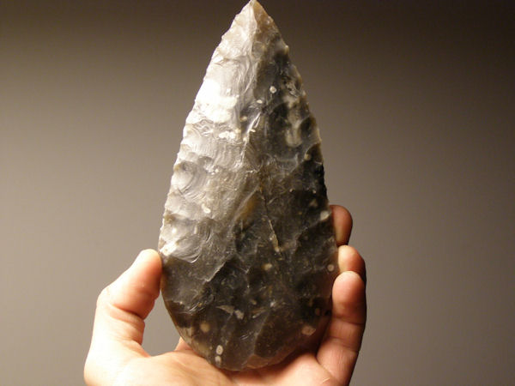

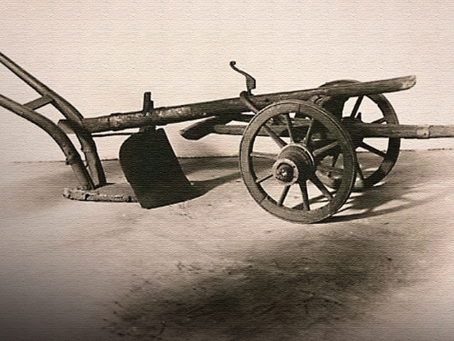
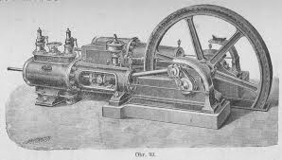
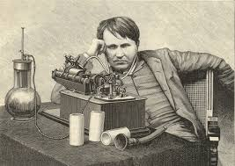
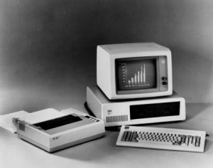
Productivity

Slide 8
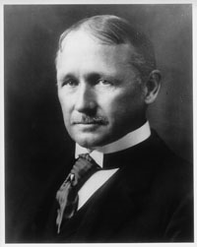
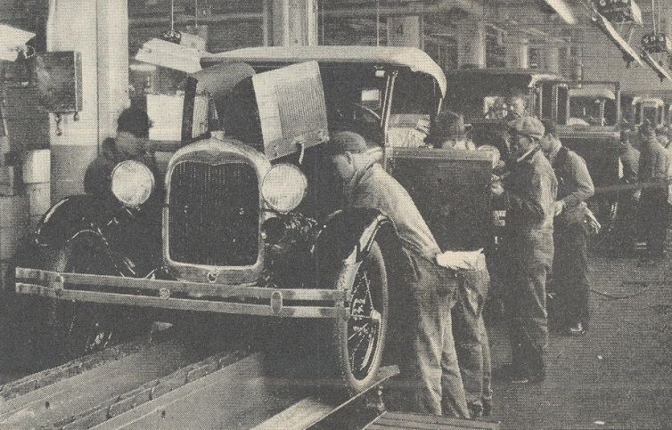
Productivity and management principles
Principles of scientific management – F. W. Taylor
Each worker should have a large, clearly defined, daily task.
Standard condition are needed, to ensure the task is more easily accomplished.
High payment to be made for successful completion of task. Workers should suffer loss when they failed to meet the standards laid down. ( Appleby, 1987)
Based on the time and motion study, eliminating ‘false’, ‘slow’ and ‘useless’ movements of laborers. Results: fast and successful completion of task.
This conception was also used by the Henry Ford - the system of work is known as Fordism – effective mass production.

Slide 9
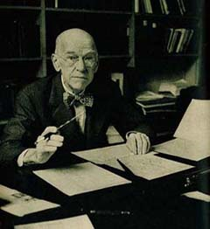
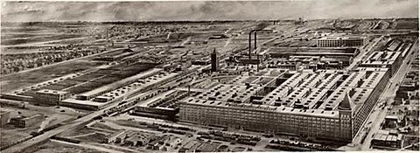
Productivity and management principles
Human relations school– G. E. Mayo – Hawthorne experiment – psychological experiment at Hawthorne plant of the Western Electric Company.
Attention focused on the components of job and work satisfaction on the part of employees.
Result – The understanding of a person´s needs would enable a manager to use more accurate methods to motivate subordinates.

Slide 10

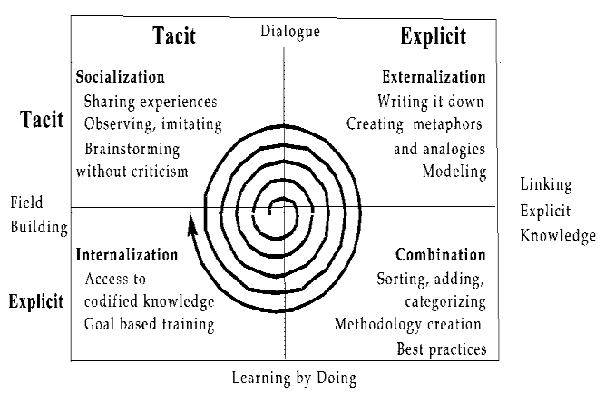
Productivity and management principles
Knowledge management - P. Drucker, I. Nonaka, H.Takeushi
Forms of knowledge (Nonaka & Takeuchi, 1995):
Explicit: information or knowledge that is set out in tangible form.
Implicit: information or knowledge that is not set out in tangible form but could be made explicit.
Tacit: information or knowledge that one would have extreme difficulty operationally setting out in tangible form.
„Tacit" knowledge is Nonaka and Takeuchi's example of the kinesthetic knowledge that was necessary to design and engineer a home bread maker, knowledge that could only be gained or transferred by having engineers work alongside bread makers and learn the motions and the "feel" necessary to knead bread dough (Nonaka & Takeuchi, 1995).
Source: researchgate.net

Slide 11
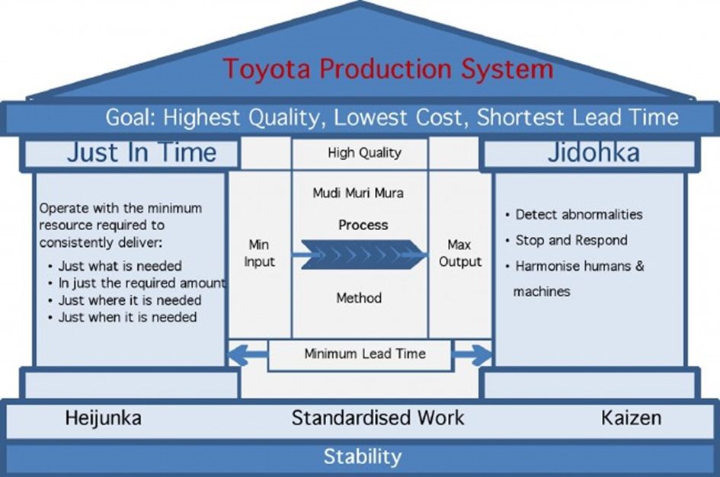
  Knowledge management in production example of Toyota Company

Slide 12
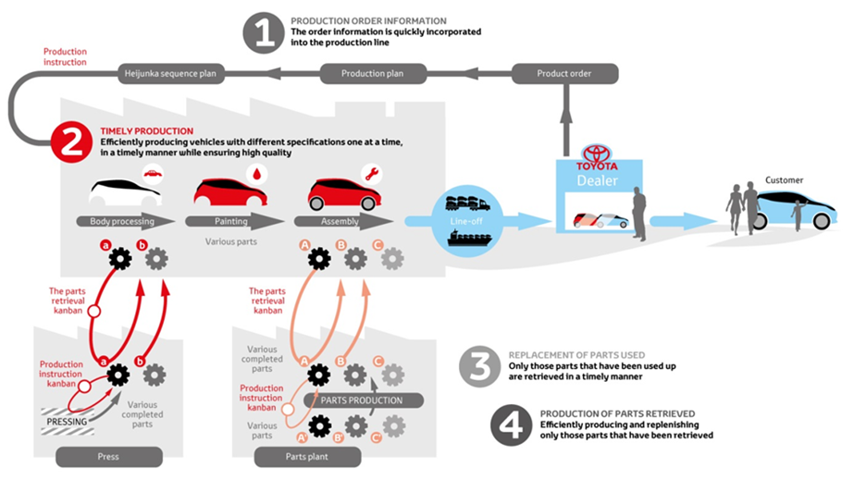
Knowledge management in production example of Toyota Company
https://www.youtube.com/watch?v=Tc9IQLJl4AU

Slide 13
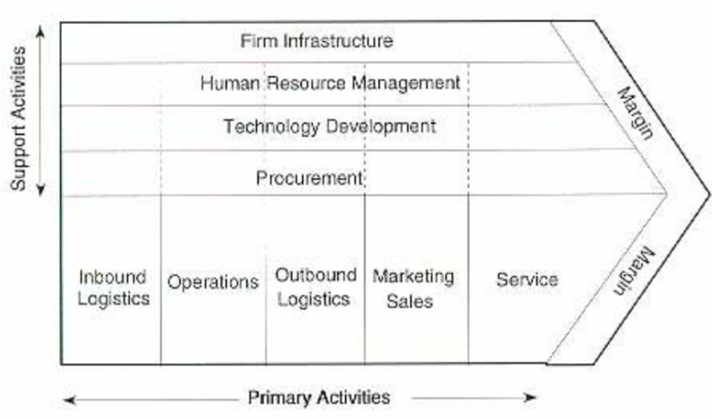
Porter´s value chain

Slide 14
Porter´s value chain
A value chain is a set of activities that a firm operating in a specific industry performs in order to deliver a valuable product or service for the market (Porter, 1985).
Primary activities(Porter, 1985).
Inbound Logistics: arranging the inbound movement of materials, parts, and/or finished inventory from suppliers to manufacturing or assembly plants, warehouses, or retail stores
Operations: concerned with managing the process that converts inputs (in the forms of raw materials, labor, and energy) into outputs (in the form of goods and/or services).
Outbound Logistics: is the process related to the storage and movement of the final product and the related information flows from the end of the production line to the end user
Marketing and Sales: selling a product or service and processes for creating, communicating, delivering, and exchanging offerings that have value for customers, clients, partners, and society at large.
Service: includes all the activities required to keep the product/service working effectively for the buyer after it is sold and delivered.
Porter’s Value Chain - Primary Activities: A Summary

Slide 15
Porter´s value chain – primary activities)
Primary Activities | Inbound Logistics | - Receipt of inputs (materials) - Storage - Stock Control - Internal Distribution of Inputs
 | Operations | - Transformation of inputs into final product - Use of Labour - Manufacturing Technologies
 | Outbound Logistics | - Distribution of finished goods - Stock Control & Inventory - Distribution of final product to buyers
 | Sales & Marketing | - Advertising - Promotional Activity - Persuading People to buy
 | Service | - After sales support
Porter’s Value Chain - Primary Activities: A Summary
(Source: http://strategy-models.blogspot.cz/2011/06/use-of-porters-1985-value-chain.html)

Slide 16
Porter´s value chain
Support activities(Porter, 1985).
Infrastructure: consists of activities such as accounting, legal, finance, control, public relations, quality assurance and general (strategic) management.
Technological Development: pertains to the equipment, hardware, software, procedures and technical knowledge brought to bear in the firm's transformation of inputs into outputs.
Human Resources Management: consists of all activities involved in recruiting, hiring, training, developing, compensating and (if necessary) dismissing or laying off personnel.
Procurement: the acquisition of goods, services or works from an outside external source

Slide 17
Porter´s value chain – support activities
Support Activities | Procurement | - Purchasing of Resources - Purchasing of inputs
 | Technology Development | - Technology to support primary activities & operations
 | Infrastructure | - Leadership Structure/Management - Planning/processes - Finance - Information Systems
 | Human Resource Management | - Recruitment - Selection - Training - Reward & Motivation
Porter’s Value Chain - Secondary Activities: A Summary
(Source: http://strategy-models.blogspot.cz/2011/06/use-of-porters-1985-value-chain.html)

Slide 18
Construction of value chain of the company
Creation of value chain according Magretta(2012) :
To define the basic operations andactions, used within the industry to create value for the customer.

Slide 19
Construction of value chain of the company
Ikea value chain:
RandD
Inbound logicstic
Operations
Outbound logistic
Marketing and sales
Services
Private Cabinet maker
Inbound logicstic
Operations
Outbound logistic
Marketing and sales
Services
Inbound logicstic
Operations
Outbound logistic
Sales
IKEA - suppliers

Slide 20
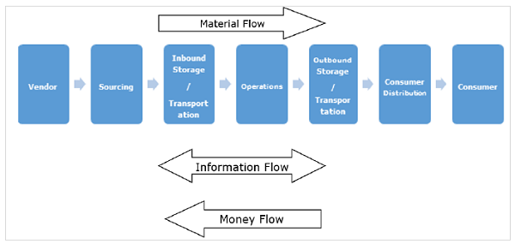
Material, information and money flow²
Withon supply chain management

Slide 21
Material, information and money flow²
There are three different types of flow in supply chain management:
In short, to achieve an efficient and effective supply chain, it is essential to manage all three flows properly with minimal efforts. It is a difficult task for a supply chain manager to identify which information is critical for decision-making. Therefore, he or she would prefer to have the visibility of all flows on the click of a button.
Material Flow - includes a smooth flow of an item from the producer to the consumer. This is possible through various warehouses among distributors, dealers and retailers.
2 - https://www.tutorialspoint.com/supply_chain_management/supply_chain_management_process_flow.htm

Slide 22
Money flow - On the basis of the invoice raised by the producer, the clients examine the order for correctness. If the claims are correct, money flows from the clients to the respective producer. Flow of money is also observed from the producer side to the clients in the form of debit notes.
Information/Data flow - comprises the request for quotation, purchase order, monthly schedules, engineering change requests, quality complaints and reports on supplier performance from customer side to the supplier. From the producer’s side to the consumer’s side, the information flow consists of the presentation of the company, offer, confirmation of purchase order, reports on action taken on deviation, dispatch details, report on inventory, invoices, etc.

Slide 23
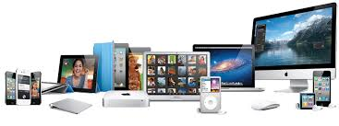
CASE STUDY – Apple Inc.

Slide 24
Business model – Apple Inc. (Source: https://research-methodology.net/apple-value-chain-analysis/)
Apple Inc. Inbound logistics
Apple works with hundreds of suppliers around the globe and maintains a highly sophisticated supply-chain management. Apple’s purchase commitments typically cover its requirements for periods up to 150 days. CEO Tim Cook is known for his strategy of getting suppliers to compete with each-other and he has reduced the numbers of suppliers considerably after becoming CEO in 2011.
Apple Inc. Operations
Apple operations are divided into the following reportable operating segments: Americas, Europe, Greater China, Japan, Rest of Asian Pacific
Apple operations are conducted by 116,000 full-time equivalent employees as of September 2016.Outsourcing of manufacturing to locations with lower costs of resources is the main source of value for Apple operations. Specifically, only some models of Mac computers are manufactured in USA and Ireland and the majority of Apple products are outsourced to manufacturing units based in Asia.

Slide 25
Apple Inc. Outbound logistics
Apple outbound logistics involves warehousing and distribution of ready iPhones, iPads, Mac computers and other products produced by the company. E-commerce sales is rightly acknowledged by the company as a massive source of value in terms of inbound logistics, because e-commerce is more cost effective compared to sales via Apple Store. Due to the efforts of the company in this direction, Apple Inc. has become the third largest retailer in the US in terms of size of e-commerce business, only behind Amazon.com and Wal-Mart Stores Inc. Specifically, Apple Inc. has e-commerce sales of USD 12 billion and this figure accounts to about 5.1 per cent of company’s total sales

Slide 26
Apple Inc. Marketing and Sales
Apple sells its products through the following seven sales channels:
Apple retail stores, Apple online store, Direct sales force, Third-party cellular network carriers, Wholesalers, Retailers, Value-added resellers
During 2016, the company’s net sales through its direct and indirect distribution channels accounted for 25 per cent and 75per cent , respectively, of total net sales.Apple advertising budget has been increasing consistently since the takeover of Tim Cook as CEO in 2011 to reach a record of USD 1.8 billion in 2015. Interestingly, the company chose not to disclose its marketing budget for 2016.

Slide 27
Apple Inc. Service
Apple is famous for exceptional quality of customer services during all three stages: pre-purchase, during the purchase and post-purchase. The company maintains Apple experience centres in major cities around the globe where anyone can use its products to become convinced about the quality. Apple sales assistants are usually trained and polite young males and females who are technically savvy and happy to demonstrate product features and capabilities. Post-purchase customer service is also impressive with unique iPhone trade-in programs that allow iPhone users to upgrade their phone to newer models with additional payment.

Slide 28
