Slide 1
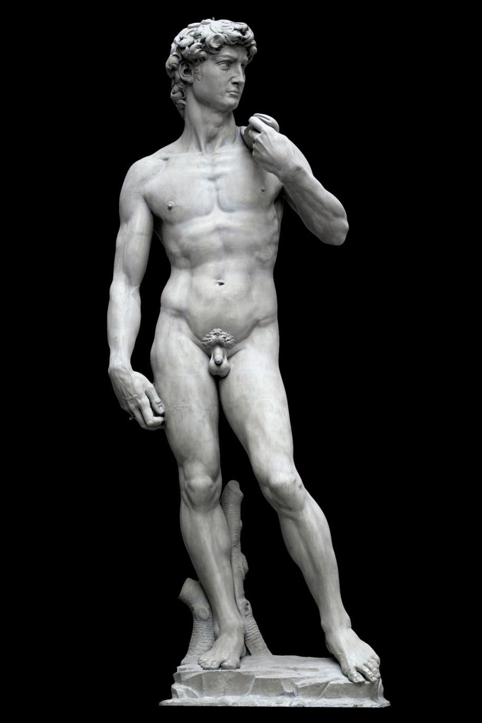
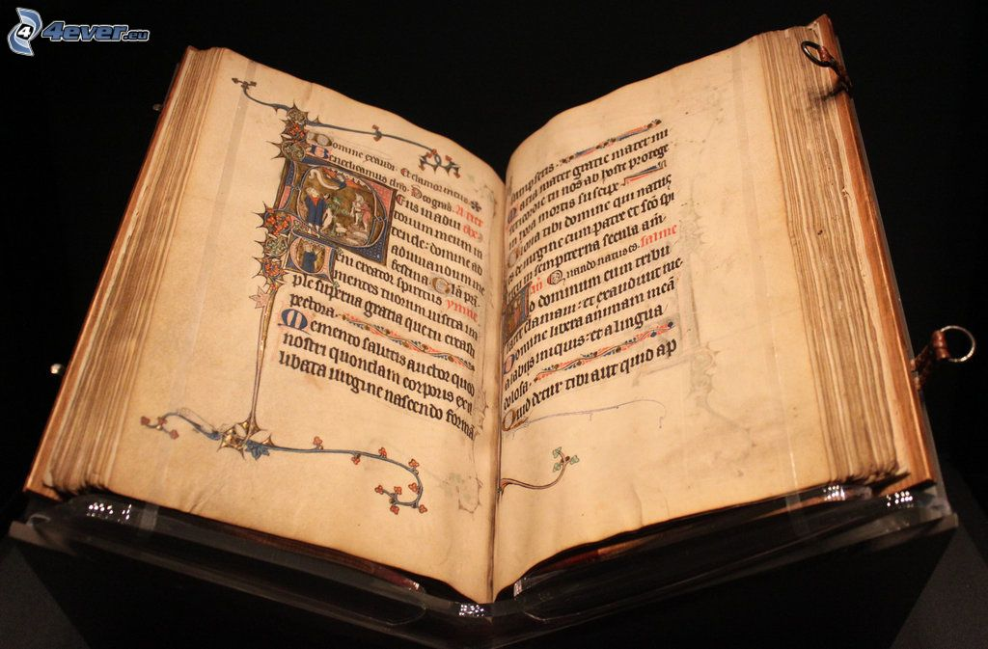
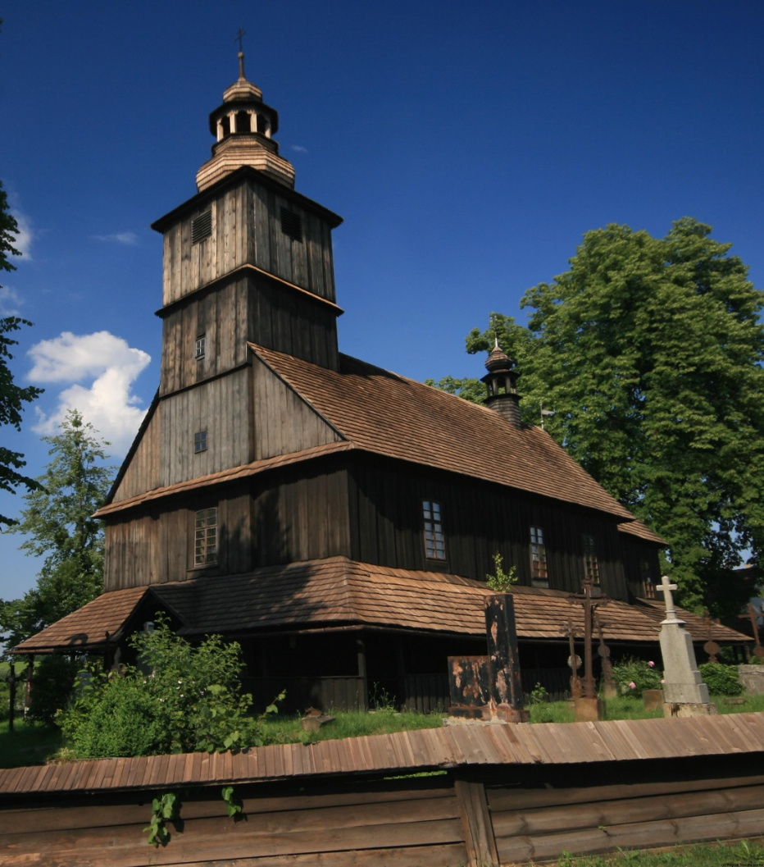

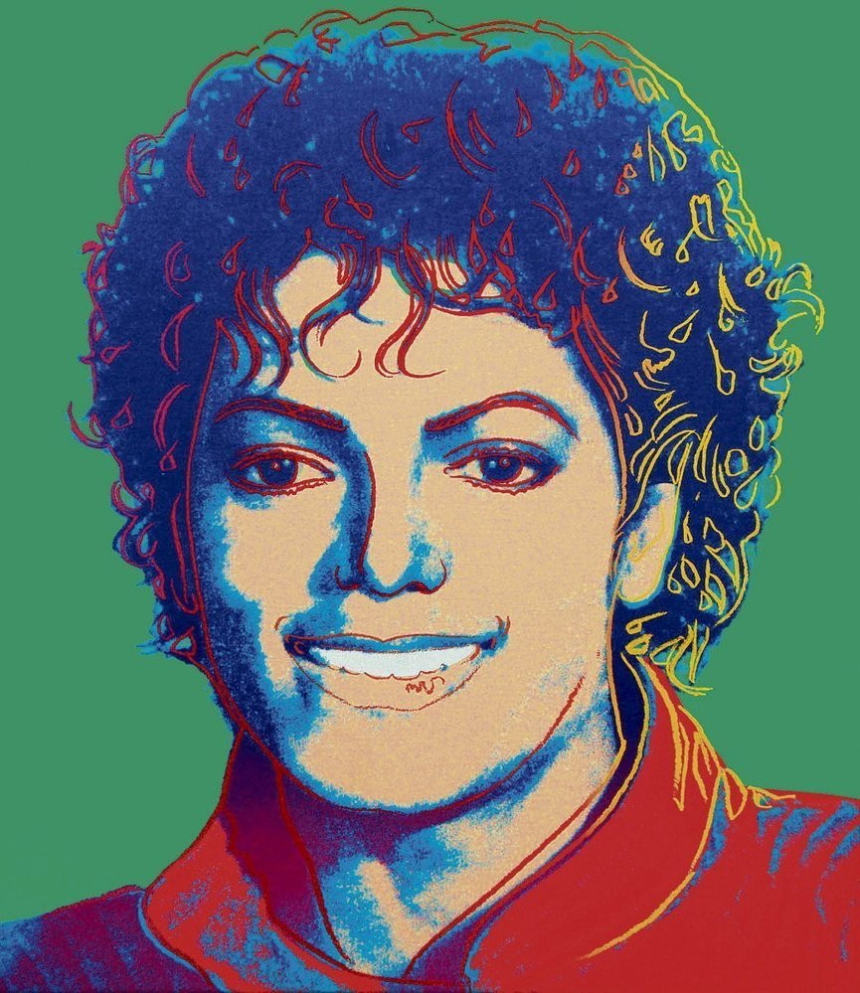
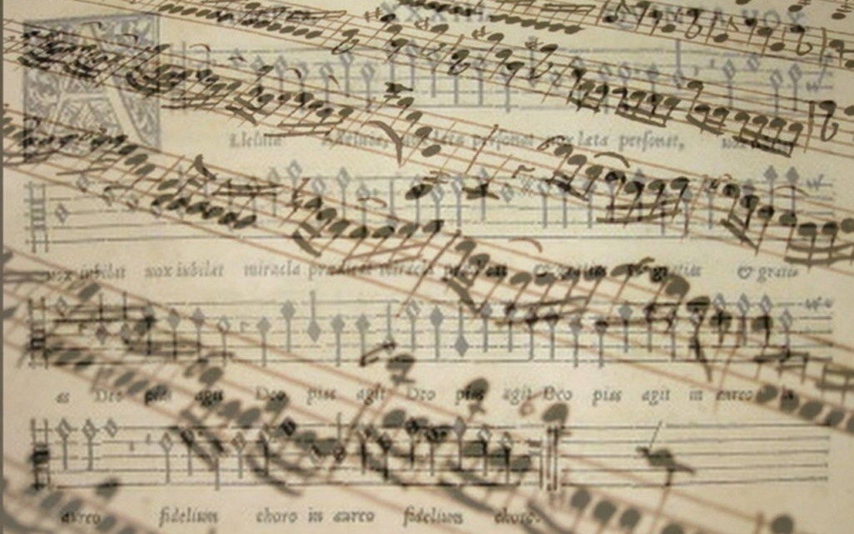
Economy of culture

Slide 2

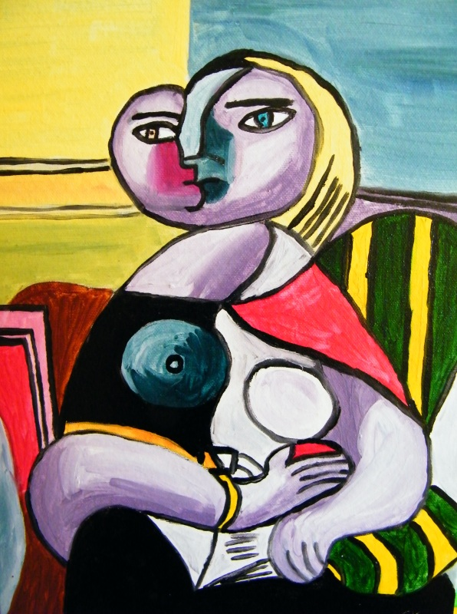

1.Find definition of culture

Slide 3
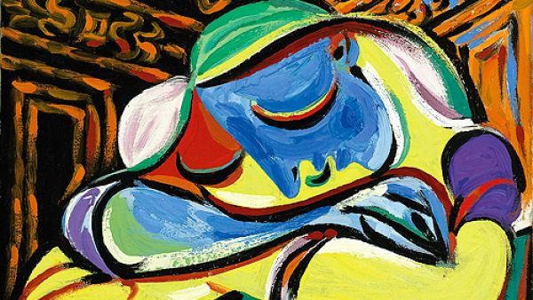

Definition of culture
„the arts and other manifestations of human intellectual achievement regarded collectively“ (Oxford dictionary)
"[Culture] is that complex whole which includes knowledge, beliefs, arts, morals, laws, customs, and any other capabilities and habits acquired by [a human] as a member of society.„ (UNESCO)
An international debate centered in UNESCO (United Nations Educational, Scientific, and Cultural Organization) since 1960s
  Term cultural heritage

Slide 4
2. International cultural differences

Slide 5
Cultural differences
Dress up
Food
Music
Housing
Habits
…..

Slide 6
Roots of cultural differences
Historical
Geographic
Religious
Politicals
…..

Slide 7
3. What is a cultural good and cultural service?

Slide 8
cultural goods and cultural services
Ballet
Opera
Orchestras
Heritage
Museums
Publishing
Cinema
Television
Broadcasting
Music
Visual arts(architecture, design, crafts, etc.)
Festivals
…

Slide 9
How could we sort cultural goods and services?
Cultural heritage (goods and services)
Tangible x Intangible
  Tangible cultural heritage:
    movable cultural heritage (paintings, sculptures, coins, manuscripts)
    immovable cultural heritage (monuments, archaeological sites, and so on)
    underwater cultural heritage (shipwrecks, underwater ruins and cities)
  Intangible cultural heritage: oral traditions, performing arts, rituals
Natural heritage: natural sites with cultural aspects such as cultural landscapes, physical, biological or geological formations
Durable vs. Exist in particular time (castle vs. concert)

Slide 10
4. Financial Self sufficiency of cultural organization

Slide 11
Financial self-sufficiency
Financially self sufficient areas
  Popular culture
Financially dependent areas
  Traditional culture

Slide 12
5.According which economic theory should be culture support by state?

Slide 13
Concept of Market Failure
Market failure
  Information asymmetry
  Non-competitive markets (monopoly, oligopoly)
  Externalities (your production affecting others)
    Culture has positive externalities
  Public goods (culture is one of identification of nations)
    Culture is public heritage

Slide 14
6. What is Baumol's cost disease?

Slide 15
Baumol´s cost disease
Phenomenon described by Bauml and Bowen in the 1960s
Rise of salaries of musicians without productivity changes
Rise of wages in automobile factory X in opera

Slide 16
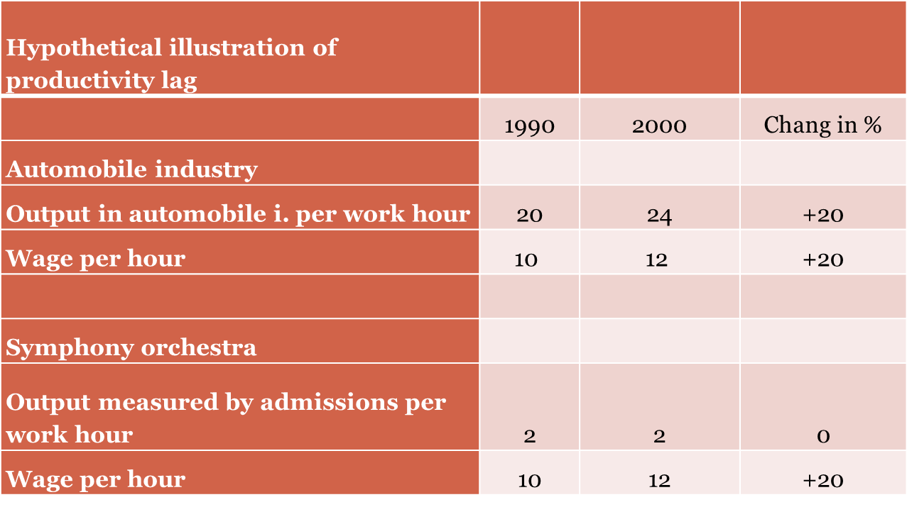
Baumol´s cost disease

Slide 17
Baumol´s cost disease
Weakness of theory:
Modern technology influence the productivity of culture
  Past: composers wrote score by hand
  Now: composers use PC programs to wrote a score
  Past: painters mixed colors by themselves
  Now: painters can buy any color shade
Delivery of cultural products
  More people are able to consume cultural products and services because of modern technologies
    Records
    Pictures of paintings
    Virtual visit of galleries etc.

Slide 18
How could we measure productivity in culture?
It doesn't exist single index for all culture branches
What is used
  Number of (play, paintings, songs, etc.) per month?
    Problem: How to measure quality of product?
  Profit
    Problem: Popular vs. Traditional art
      Film industry vs. Opera->film industry is in general self-sufficient. Opera cannot exist without state support

Slide 19
How could we increase production in culture?
Motivate artist (How?)
  According Baumol´s cost disease increasing of wages doesn't mean increasing of productivity
Have more artist? (what about quality)

Slide 20
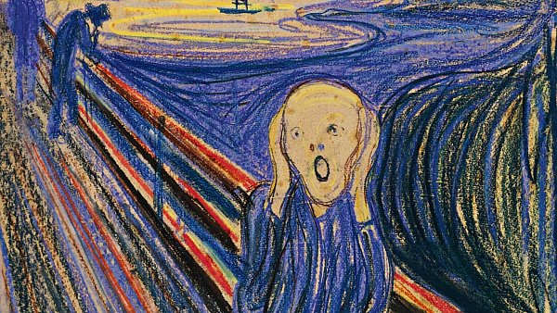
7. International organizations which focused on culture

Slide 21
International organizations which focused on culture
UNESCO – United Nations Educational, Scientific and Cultural Organization
  https://en.unesco.org/
ITI –International Theatre Institution
  https://www.iti-worldwide.org/iti.html
ASEMUS – Asia Europe Museum Network
  http://asemus.museum/

Slide 22
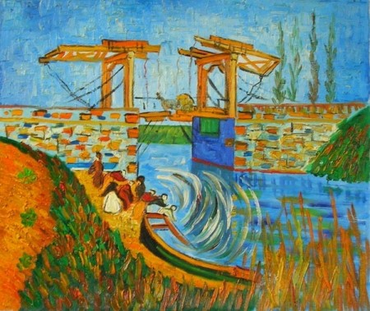
8. What is the EU's role in the culture area?

Slide 23
EU's role in the culture area
Article 167 of Treaty on the functioning of the European union
  „The Union shall contribute to the flowering of the cultures of the Member States, while respecting their national and regional diversity and at the same time bringing the common cultural heritage to the fore.“

Slide 24
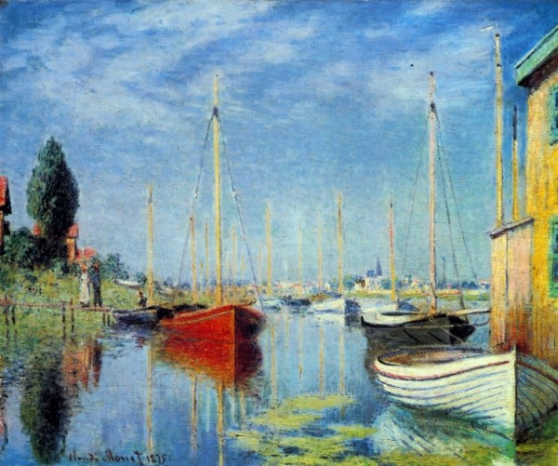
7. Find three examples of European union’s activities, which are connecting with culture

Slide 25
Examples of cultural activities of EU
The European Capitals of Culture initiative is designed to:
  Highlight the richness and diversity of cultures in Europe
  Celebrate the cultural features Europeans share
  Increase European citizens' sense of belonging to a common cultural area
  Foster the contribution of culture to the development of cities

Slide 26
Examples of cultural activities of EU
  Voices of Culture ‒ Structured Dialogue between the European Commission and the cultural sector
    „provides a framework for discussions between EU civil society stakeholders and the European Commission“

Slide 27
Examples of cultural activities of EU
The European Culture Forum
  „The European Culture Forum is a biennial flagship event organized by the European Commission, aimed at raising the profile of European cultural cooperation, uniting the sector's key players, taking stock the European Agenda for Culture's implementation, and sparking debate on EU culture policy and initiatives“

Slide 28
European capitals of Culture 2018
Plovdiv (Bulgaria)
Matera (Italy)

Slide 29
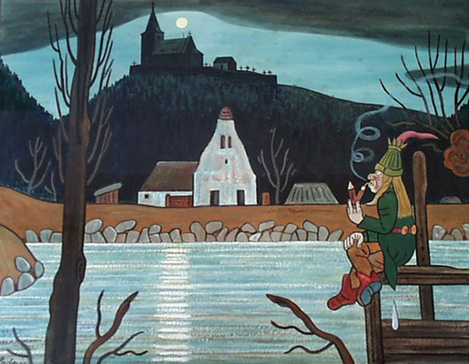
Conclusion

Slide 30
Conclusion
Culture
  „manifestations of human intellectual achievement“
  „product of human creativity“
Roots of cultural difference comes from
  History
  Geography
  Religion
Product of culture is good, service, knowledge or identity
According economic theory has culture positive externality
Productivity in culture is highly limited and in long term condition is constant, but the wages are increasing (according Baumol's cost disease)
Role of EU in field of culture is „ flowering of the cultures of the Member States“

Slide 31
Use full links
  http://www.unesco.org/new/en/social-and-human-sciences/themes/international-migration/glossary/cultural-diversity/
  http://ec.europa.eu/eurostat/statistics-explained/index.php/Quality_of_life_in_Europe_-_facts_and_views_-_leisure_and_social_relations
  http://eur-lex.europa.eu/legal-content/EN/TXT/PDF/?uri=CELEX:12012E/TXT&from=en#page=75&zoom=100&view=FitB
  http://www.lisbon-treaty.org/wcm/the-lisbon-treaty/treaty-on-the-functioning-of-the-european-union-and-comments/part-3-union-policies-and-internal-actions/title-xiii-culture/455-article-167.html
    https://ec.europa.eu/programmes/creative-europe/actions/capitals-culture_en
    http://www.voiceofculture.eu/
    http://ec.europa.eu/culture/forum/index_en.htm

Slide 32
UNESCO monuments in
Czech republic

Slide 33
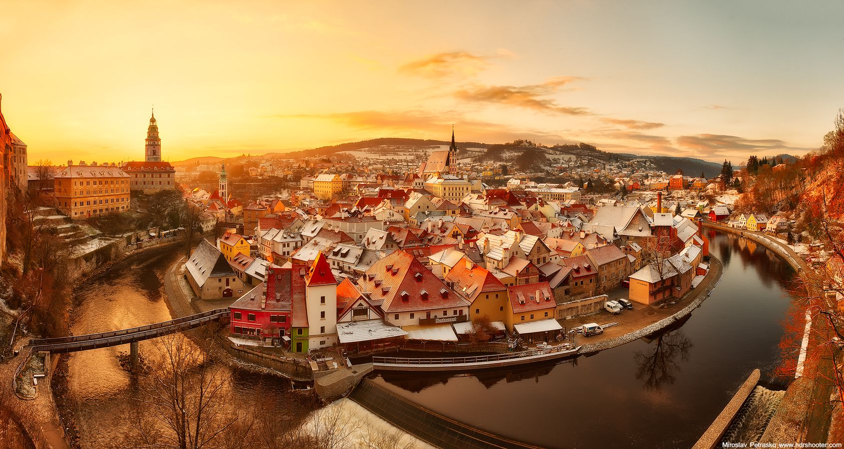

Slide 34
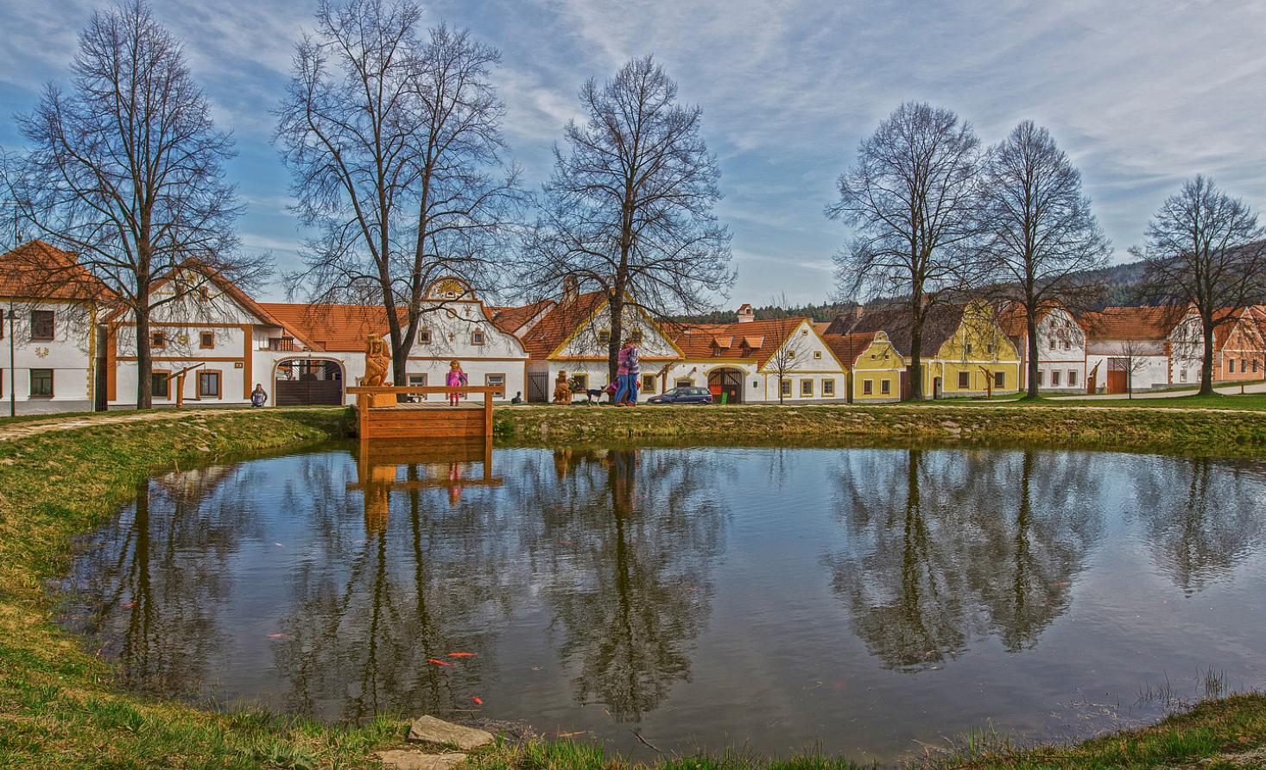

Slide 35
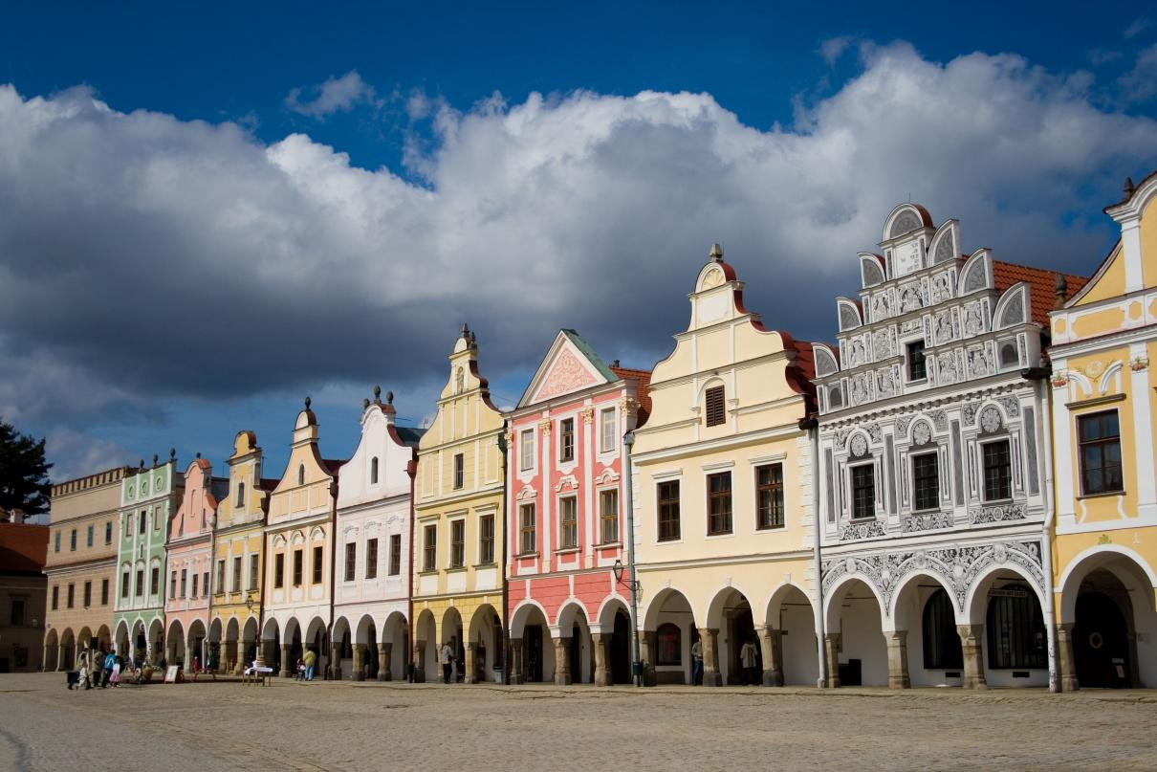

Slide 36
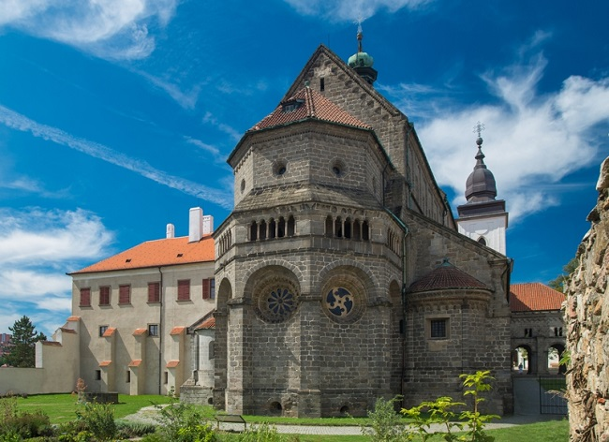

Slide 37
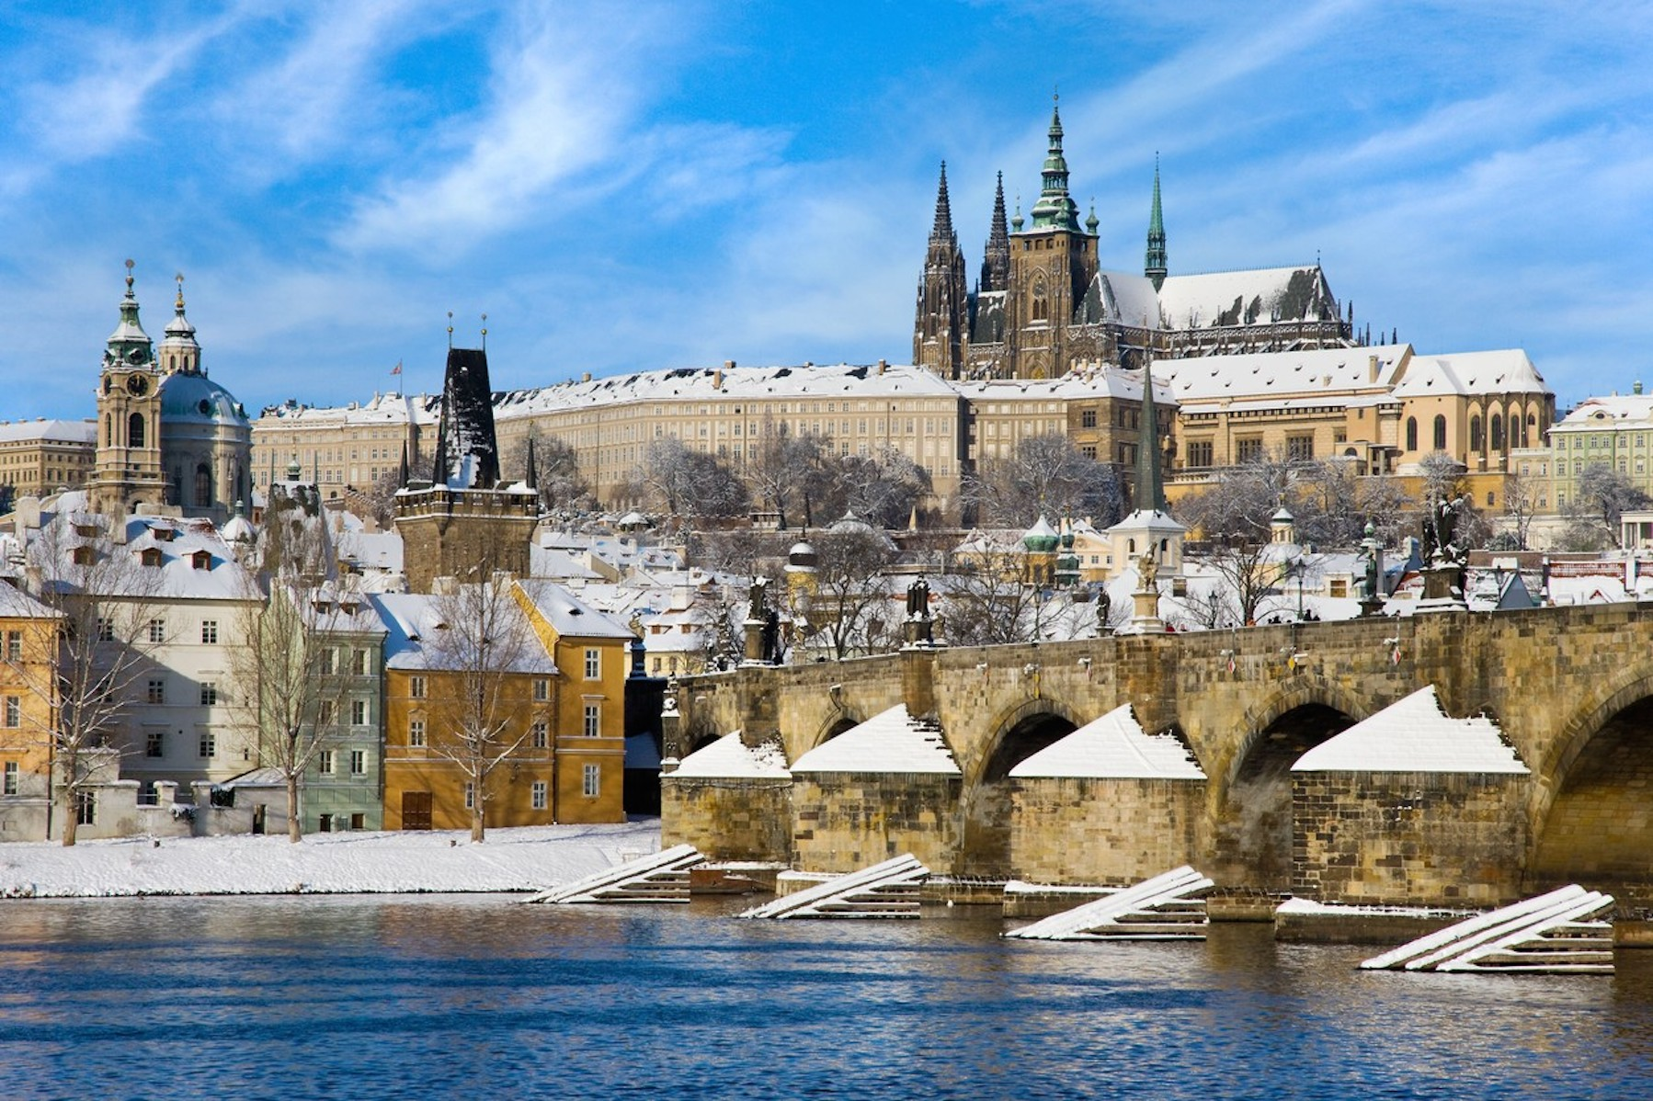

Slide 38
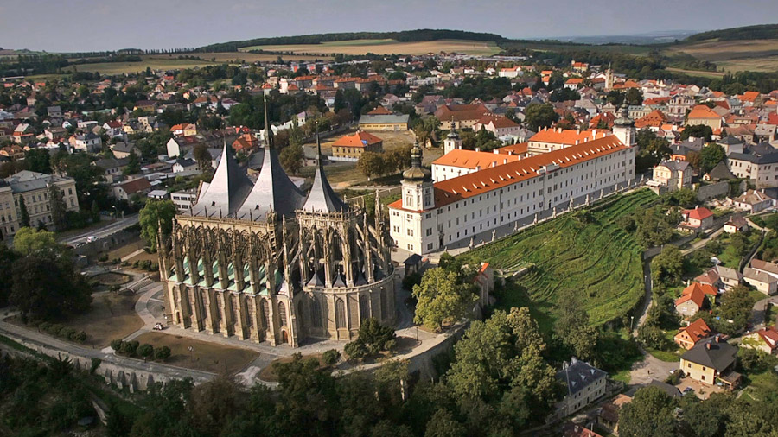

Slide 39
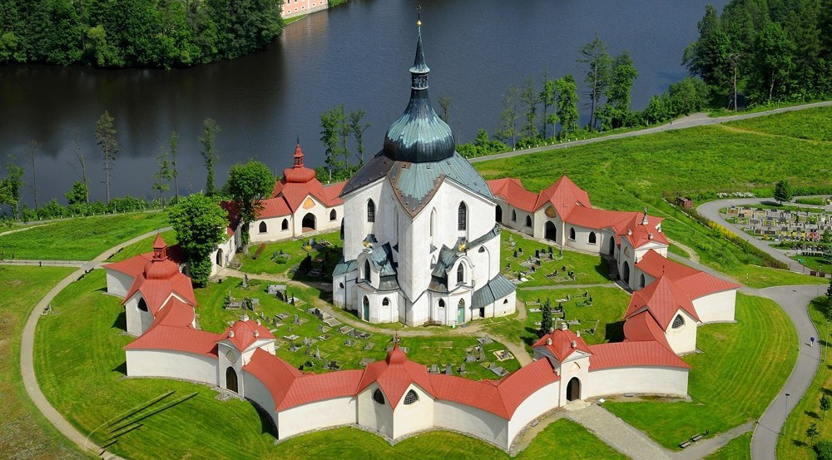

Slide 40
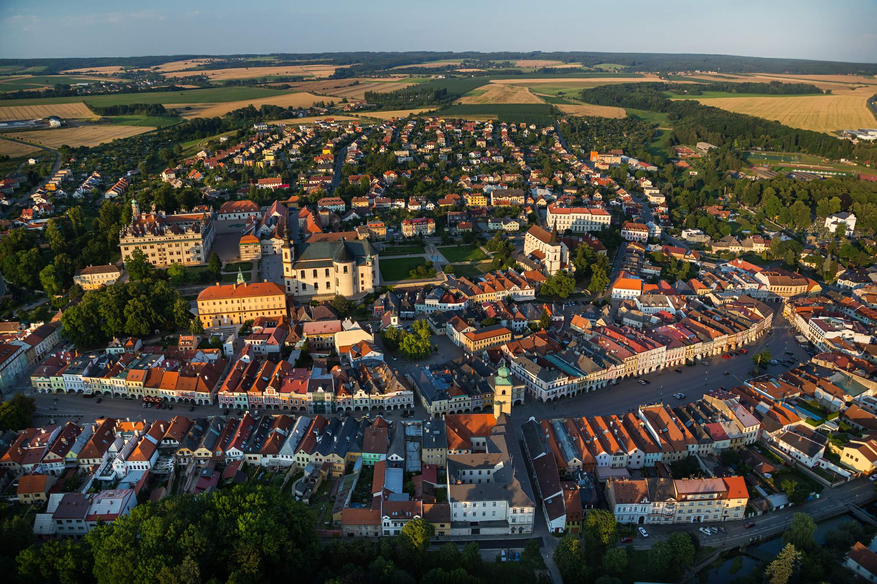

Slide 41
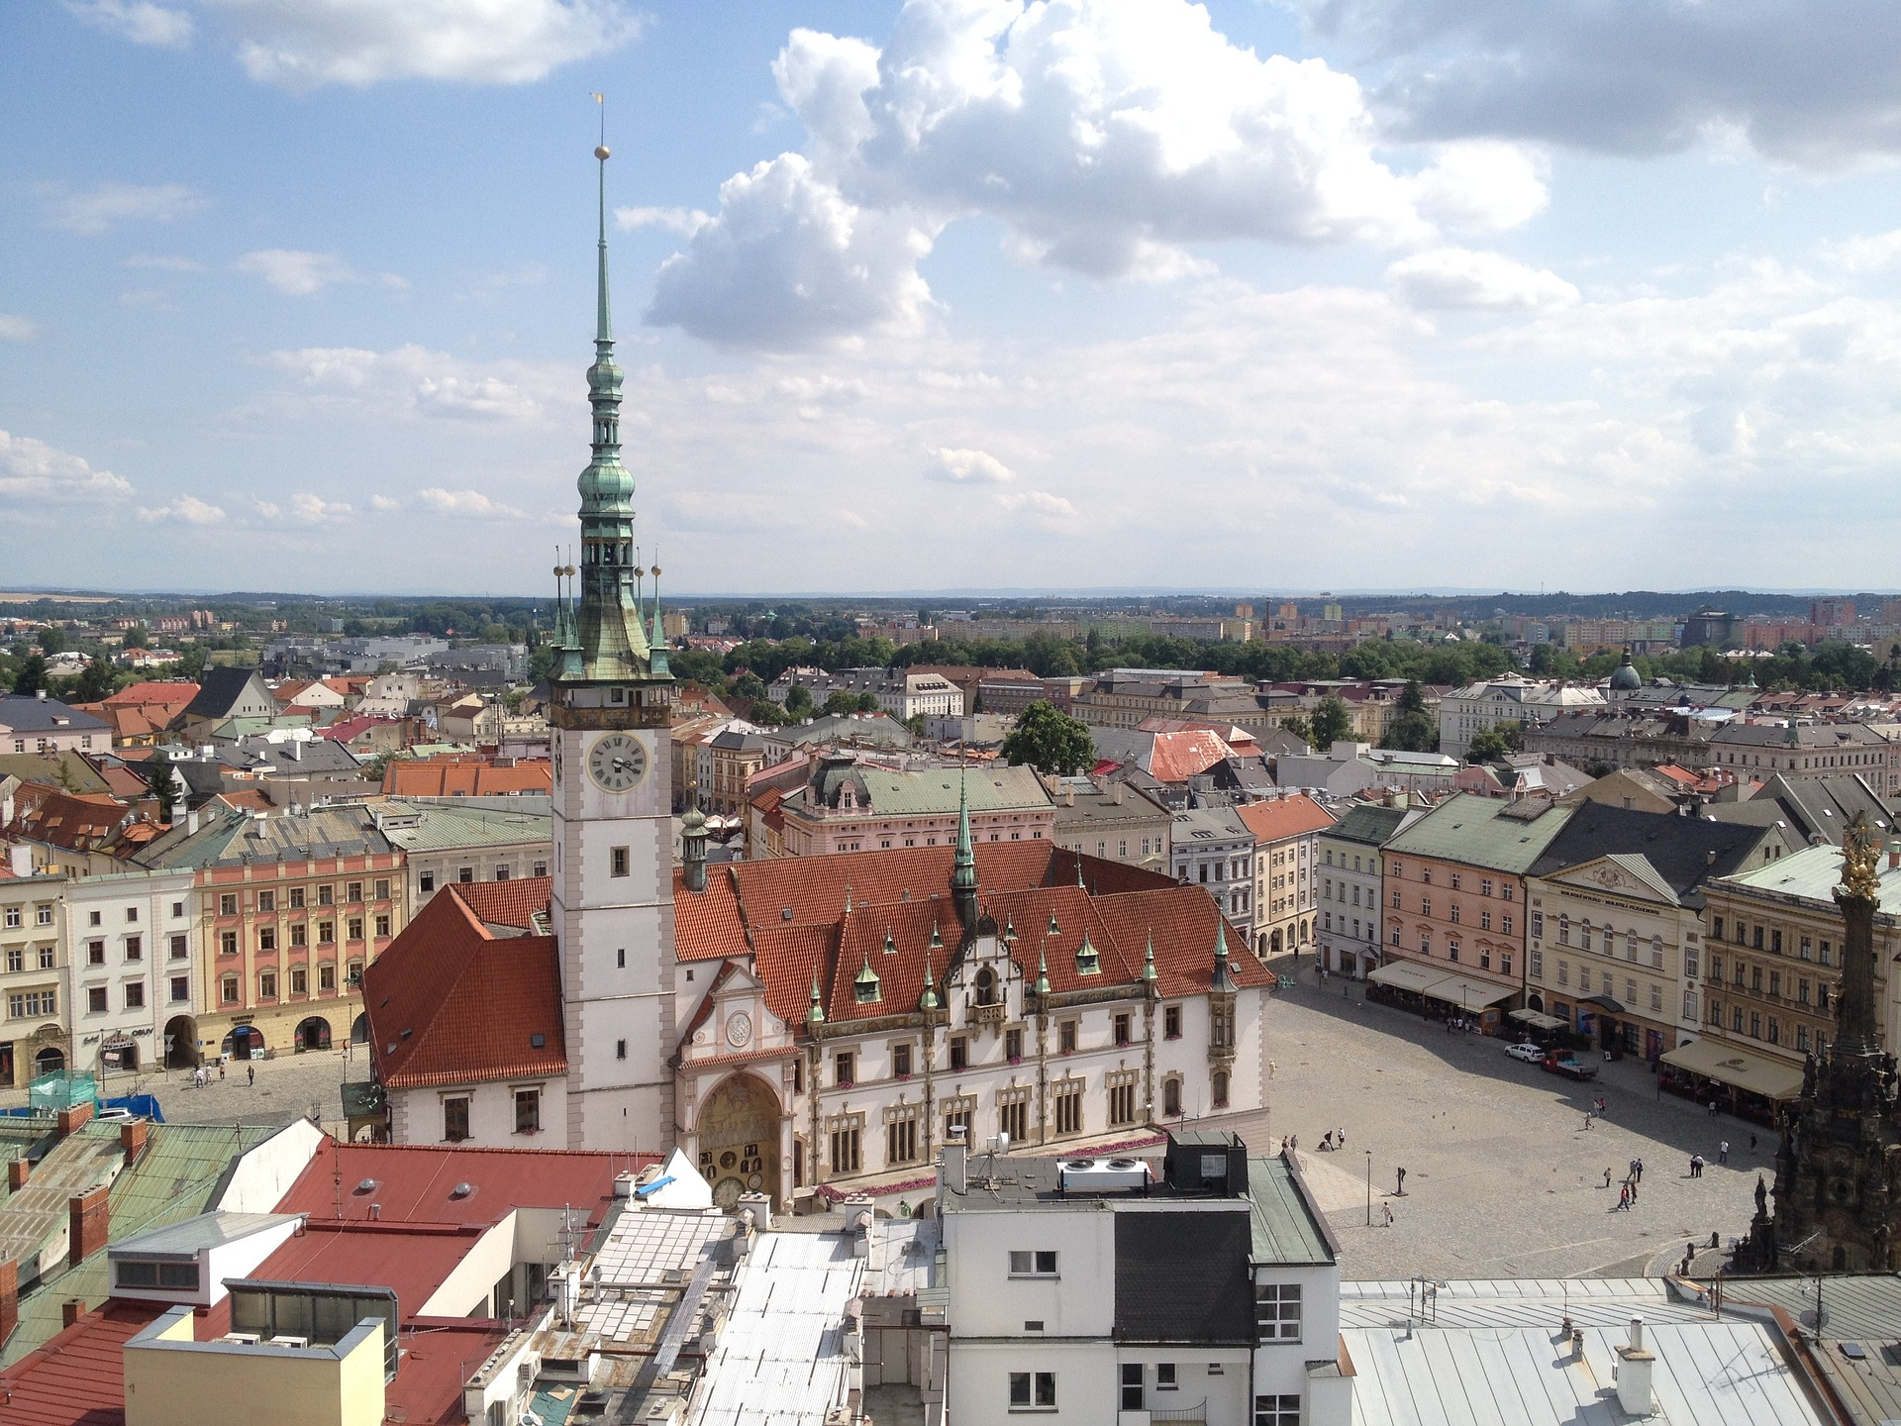

Slide 42
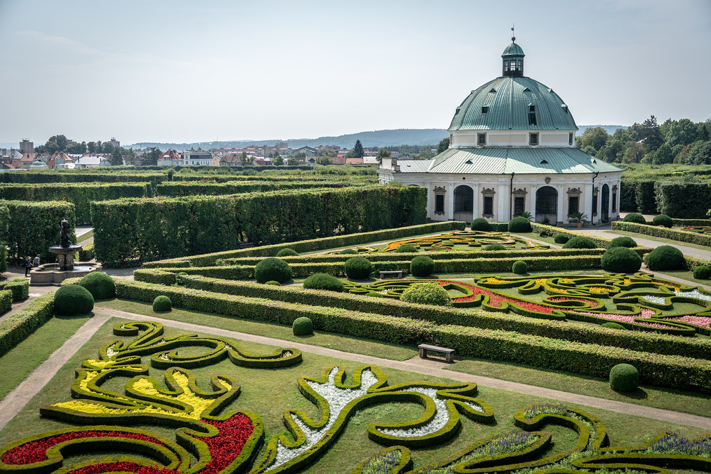

Slide 43
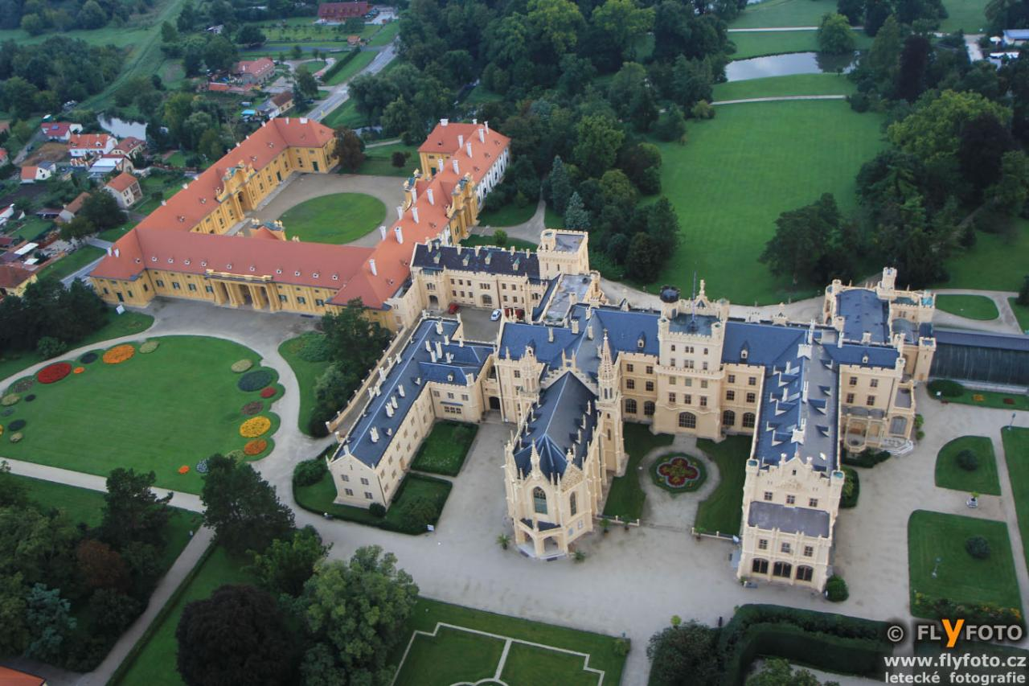

Slide 44
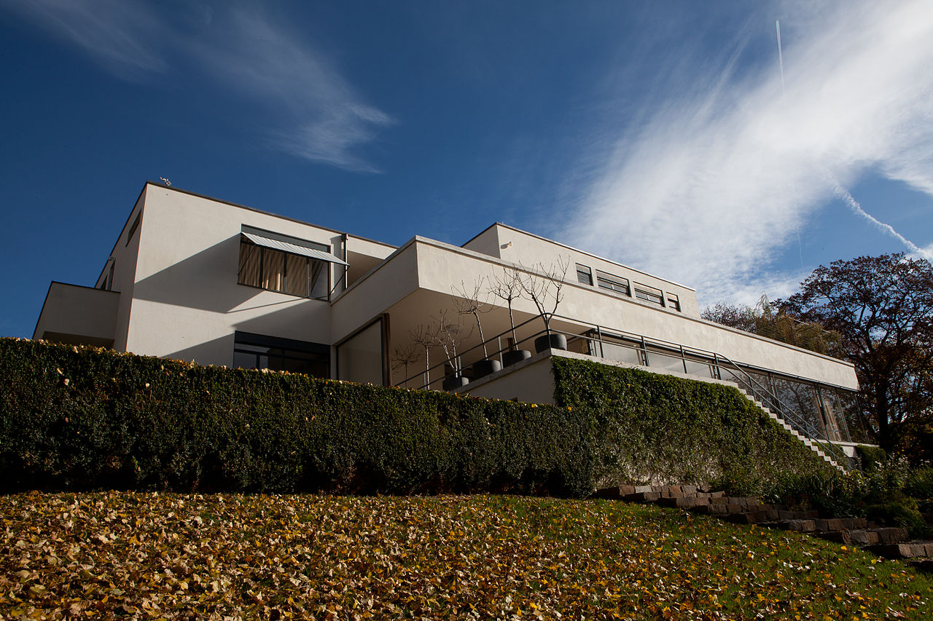

Slide 45
Český Krumlov

Slide 46
Holašovice

Slide 47
Telč

Slide 48
Třebíč

Slide 49
Praha

Slide 50
Kutná Hora

Slide 51
Žďár nad Sázavou

Slide 52
Litomyšl

Slide 53
Olomouc

Slide 54
Kroměříž

Slide 55
Lednice

Slide 56
Brno

