Slide 1

MPH_COSR
Business & Sustainability

Slide 2
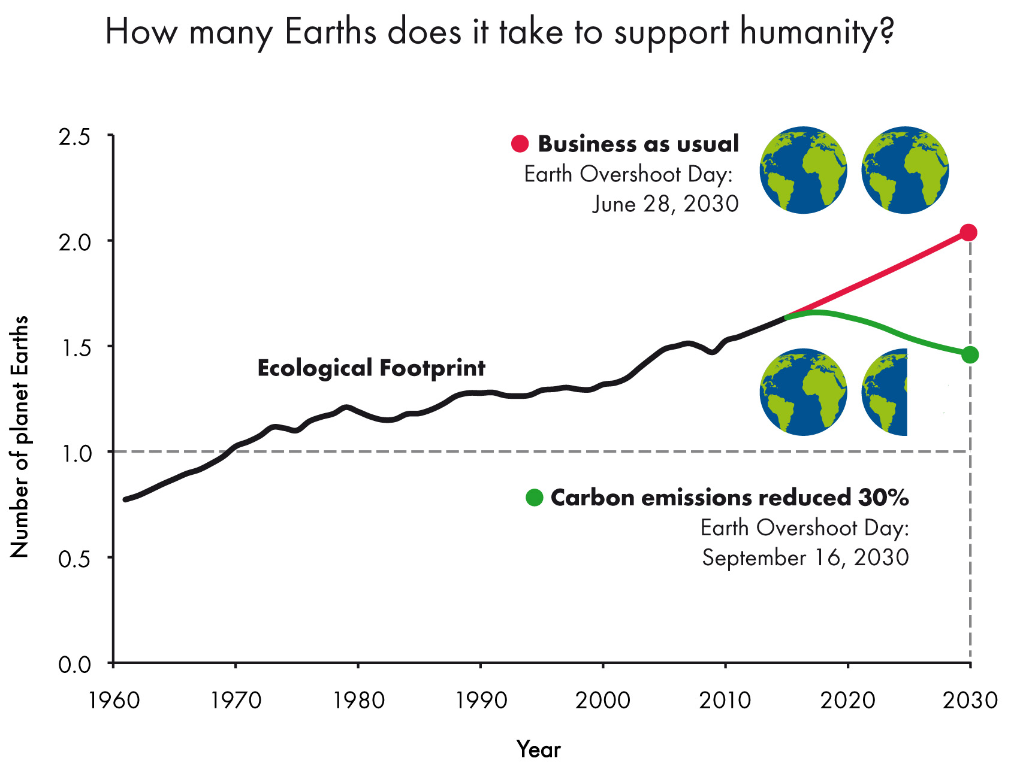
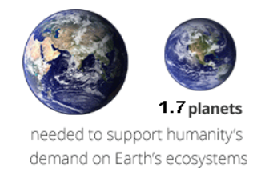
Business & Sustainability
News: Humans have used a year’s worth of Earth’s resources in just seven months
„In 2018 the annual date when people have caused a year’s worth of ecological damage – Earth Overshoot Day –August 1.“

Slide 3
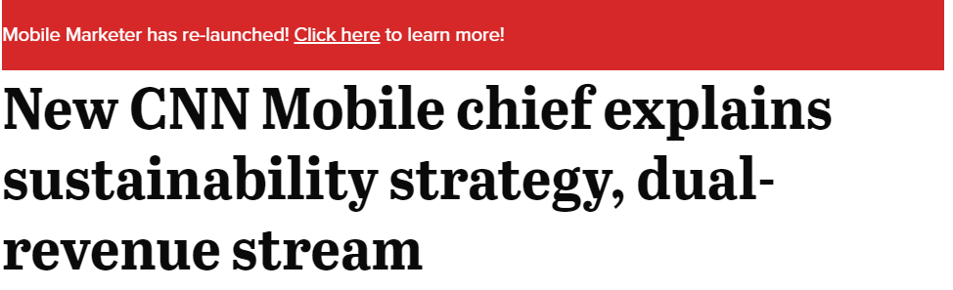




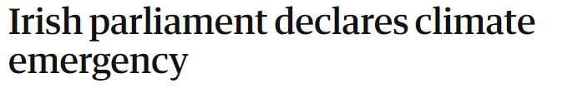




Business & Sustainability

Slide 4



Why companies should care?
DISSCUSSION…
Friedman (1970)
Freeman (1984)

Slide 5
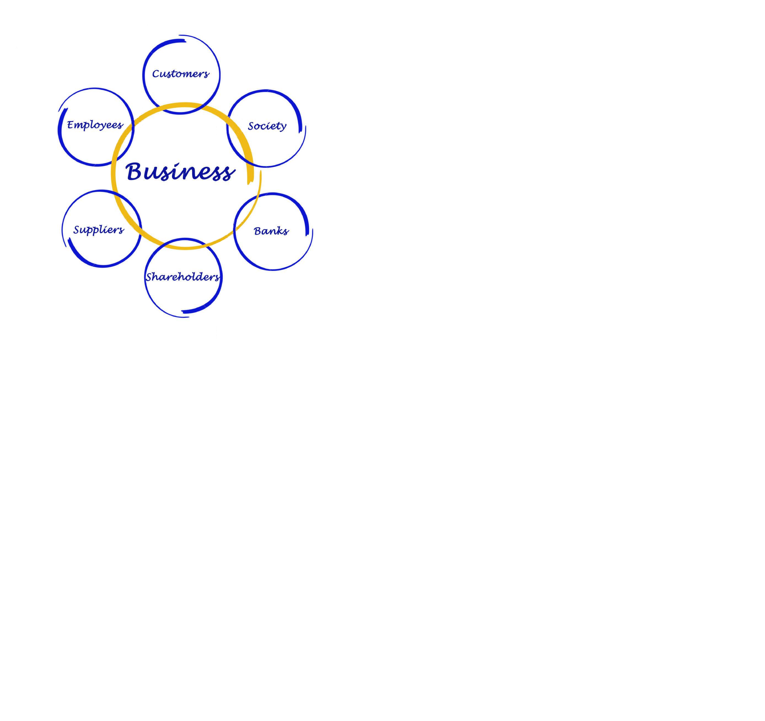
Business & Sustainability
Corporate social responsibiliy “CSR”
… describes a company’s commitment to stakeholders and socially responsible practices.

Slide 6
relationship between CSR and CFP
Managers want to know before adopting CSR principles, whether societally and environmentally good behavior will bring benefits and also lead to good financial results.
CSR
??
CFP
DISSCUSSION…

Slide 7
relationship between CSR and CFP
Improve firms‘ reputation and image
Increase consumer satisfaction
Boost the confidence of employees
Decrease cost of capital
Lower operational cost
Improve firms’ competitiveness
Increase willingness to pay premium prices
Boost employee motivation and reinforcing their confidence
Attract staff with above-average qualifications
Improve stock return
CSR
CFP
POSITIVE

Slide 8
… HOW TO INFORM stakeholders?
CSR REPORTING
represents a tool proving firms’ social behavior outwards.
The reporting about CSR activities provides the necessary information, that might affect the perceptions of stakeholders, reduce the informational gap and thus improve firm’s reputation, which consequently improves corporate financial performance.
Moreover, CSR reports start to be more relevant as investors, customers, employees, regulators, non-government organizations and other stakeholders demand greater transparency.
CSR
CFP
CSR REPORTING

Slide 9
HOWEVER … IT requires financial resources
CFP
??
CSR
DISSCUSSION…

Slide 10
WHY TO INVEST IN csr?
CFP
CSR
Stakeholders’ pressure
  firms have multiple stakeholders who have expectations about firms’ social and environmental performance.
  to invest into them and thus show their legitimacy and commitment to community and their social interest
Managerial motivation
  managers may personally believe that their firm has a moral imperative to invest in CSR activities
  managers may suppose that engaging in CSR activities can improve their reputation
  managers believe in the positive effect of being socially responsible on financial performance
Market environment
  the adoption of CSR activities might be a key factor how to add value to products and directing customers’ attention to important social and environmental issues that go beyond product cost

Slide 11
What about csr reporting?
CFP
CSR
CSR REPORTING
When firms behave proactively and invest in CSR activities, they want to put it publicly and demonstrate it to their stakeholders.
CSR disclosure signals investment that generates positive economic returns and strong future performance is expected
firms can effectively communicate with their stakeholders and influence their perception,
HOWEVER …
composing of CSR reports that have impactful content costs money
firm with better financial results will be able to bear these costs easier

Slide 12

HOWEVER … IT requires financial resources
Performance Feedback Theory
Performance feedback (attainment of firms’ financial goals) is a potential behavioral driver of changes in corporate strategy and thus in socially responsible strategy as well. These changes are caused mainly by the non-satisfactory performance of the firm, which results in shareholders’ pressure on the managers.

Slide 13
non-satisfactory performance
Non-satisfactory performance => firms' financial results are poor
What may happen in this situation?
shareholders may feel the need for closer monitoring firms’ performance and eliminate managers’ attitude in decision-making
managers have a restricted amount of discretionary resources available, which results in cutting cost (such as CSR expenditures)
managers are worried about the potential loss a favor of a various group of stakeholders
Therefore, poor financial performance will consequently result in a decrease in CSR performance.
GOAL

Slide 14
non-satisfactory performance
Non-satisfactory performance => firms' financial results are poor
What may happen in this situation?
firm changes its attitude to disclose CSR information.
firm may attempt to increase their effort to disclosure CSR information and thus counterbalances negative financial results.
by CSR managers may change the perception of the most powerful stakeholders and reduce investors´ uncertainty
Therefore, CSR reports may help to firm hides its poor performance and consequently contribute to reversing its negative future development.
GOAL

Slide 15
satisfactory performance
Satisfactory performance => firm reaches its financial results
What may happen in this situation?
the changes in investment in CSR activities and CSR reporting are not necessary
firm is not under shareholders’ pressure, because they see that the firm is on a good pathway.
managers even get greater trust in their judgment and larger latitude in decision-making and may be motivated to increase their expenditure on CSR activities and to improve their CSR disclosure.
HOWEVER …
thanks to shareholders' myopia some managers will not make an effort to report about their CSR activities. They want to keep away complaints from their shareholders that CSR investments are highly uncertain and thus decrease their future expected profit
GOAL

Slide 16

firms listed on stock exchanges
Socially responsible companies
may attract new investors, who specialized on sustainable businesses or just consider CSR disclosure as a signal of investments that generate positive economic returns and are provided by firms that expect strong future performance.

Slide 17


ESG, SRI …
Environmental, Social and Governance “ESG”
are the criteria that evaluate a company’s practices
used by investors and lenders
sometimes ESG and “sustainability” are used interchangeably, however the latter is more commonly used by companies
Responsible and Impact Investing “SRI”
relates to an actual investment strategy, where one’s focus is on socially responsible companies (this is where CSR and ESG reporting come into play).

Slide 18
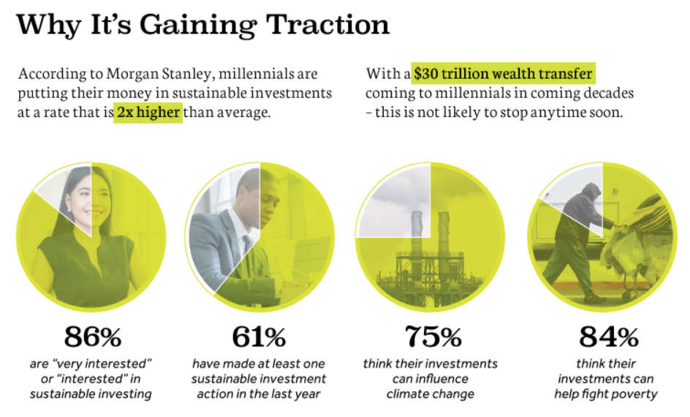
INVESTMENT MARKET
Zdroj: http://www.visualcapitalist.com/millennials-sustainable-investing-mainstream/

Slide 19
relationship between CSR and CFP
88% of the research shows that solid ESG practices result in better operational performance of firms
90% of the studies on the cost of capital show that sound sustainability standards lower the cost of capital of companies
80% of the studies show that stock price performance of companies is positively influenced by good sustainability practices.

Slide 20
THANK YOU FOR YOUR ATTENTION

