Slide 1
Pilot study
ESF: DXH_MET2 Metodologie 2

Slide 2
Recap from DHX_MET1
So far we have discussed mainly the conceptual side of your projects
Research question as a focus and a „handle“
Hypotheses as informed expectations, and clarifications of RQ
Variables as (observable) representations of the concepts in RQ/H and their measures
Designs allowing us to use the measures to create meaningful data to answer RQ

Slide 3
Recap
We have not talked much about
Data analysis
Practical side of the projects
There are numerous details in designs-measures-analyses which are necessary to make it work, or threaten the success of the whole study
It is easier to learn them hands-on trying to understand them

Slide 4
Conceptually, projects are (more or less) in progress…
… it‘s time to prepare a pilot study
Plan for this semester: do a small pilot study for one of your RQ
4 meetings:
Take stock, see what‘s missing; measures, materials, instructions
Finalize procedure/protocol from recruitment to debriefing, decide on participants, check ethics and seek approval
(in the meantime) …. brush up data-analysis skills
Reflect on pilot experience, refine data-analysis plan and power analysis

Slide 5
Focus of DHX_MET2
Projects with people as the primary objects or sources of data

Slide 6
Purpose for a Pilot study
test feasibility of plan
methods work
participants go through the whole procedure without issues
data look as expected
analysis feasibility
do people (participants) function as I imagine them?
identify weak spots - tune the plan
Murphy‘s laws apply

Slide 7
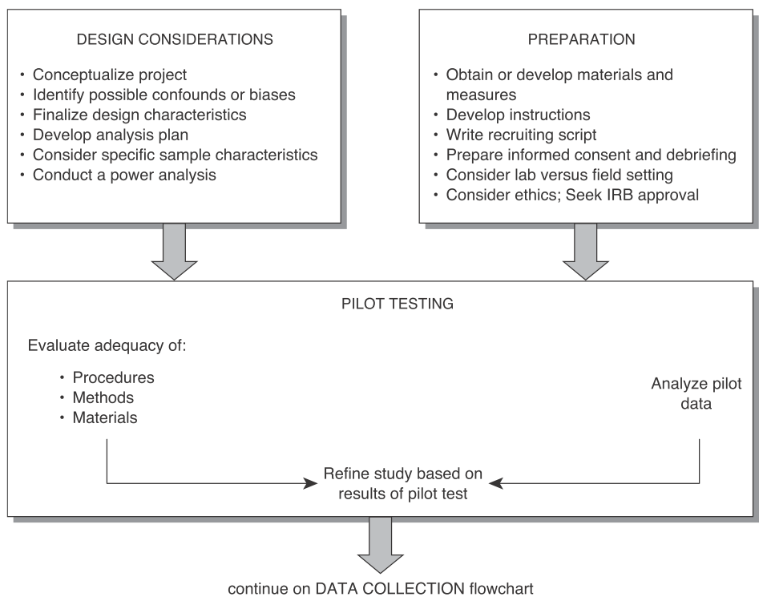
from Leong, Austin (2006)

Slide 8
Choose a RQ/H you want to pilot
in groups of 2 or 3

Slide 9
Take stock

Slide 10
Measures, materials
Full version of your measures + what it measures
If some stimuli materials are used, what exatly are they going to be

Slide 11
Instructions, administration
How exactly are you going to administer the measure to a participant

Slide 12
Gather what you have and show it to a colleague
„I‘m going to measure the participants‘ CHARACTERISTIC(S) i the following way:….“
As a colleague look at it from the perspective of
a participant – how do you react to the measure, the intention to measure..
a colleague – do you believe it will work as expected?
Be sceptical, be critical … of the materials

Slide 13
Possible sources of problems in asking questions. Respondents….
May not understand, may misunderstand
May not know the answer or how to get to answer
May not be motivated to invest energy in getting the best (truest) possible answer
May have trouble fitting their answer to the response scale you offer
May not want to tell you the (known) answer (even though they agreed to participate)
May not even want to know the answer
May have their own agenda with respect to your study
May just wanna have fun

Slide 14
Possible sources of problems in observing behavior (e.g. games)
Opportunities for observation error – vague definitions of categories, high cognitive demands on observer
Missing important situational factors, determinants
Fundamental attribution error
Missing unobservable personal variables
Not optimal scale of behavior – too micro, too macro
…. unless the observed behavior does not represent something else

Slide 15
Homework
Finalize measures, materials, instructions for individual measures
Next, we will combine it with design plans into a protocol for the pilot

