Slide 3
Symptoms of the Bullwhip Effect
Excessive Inventory
Poor Forecasts
Insufficient and/or excessive capacities
Unavailable Products
Long Backlogs
Costs for Expedited
Shipments and Overtime

Slide 5
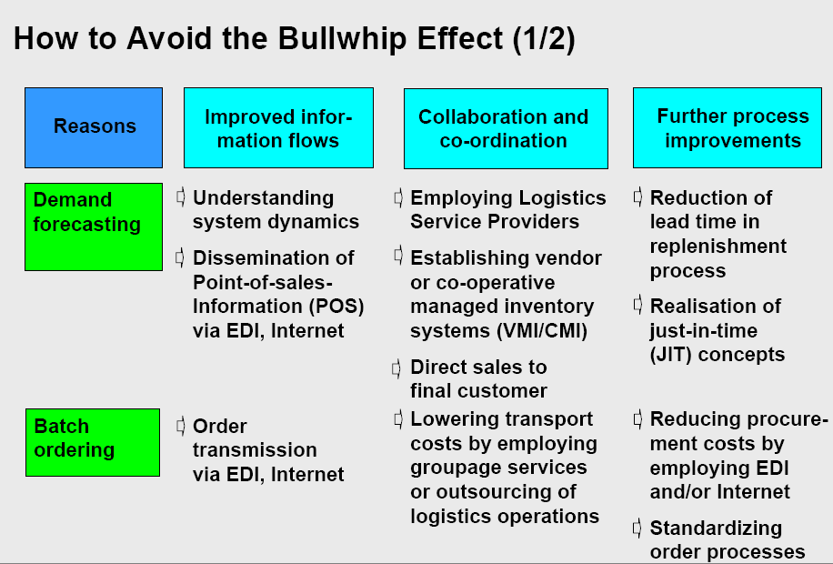

Slide 7
Structure Drives Behavior:
Causes of the Bullwhip Effect
Lack of visibility
Long lead time
Many stages in the supply chain
Lack of pull signals
Order batching
Price discount and promotions
Forward buying
Rationing
Notes:
7

Slide 8
Other Behaviors that Cause the Bullwhip Effect
Over-reaction to backlogs
Neglecting to order to reduce inventory
Hoarding customers
Shortage gaming for customers
Demand forecast inaccuracies
Attempts to meet end-of-month metrics
Notes:
8

Slide 9
Ways to Mitigate the Bullwhip Effect
Reduce lead times
Use/sharing of POS data
Smaller orders
  Work with suppliers on more frequent deliveries of smaller order increments
Use stable pricing, “everyday low prices”
  Levels out customer demand
Allocation based on past sales
Notes:
9

