Slide 1
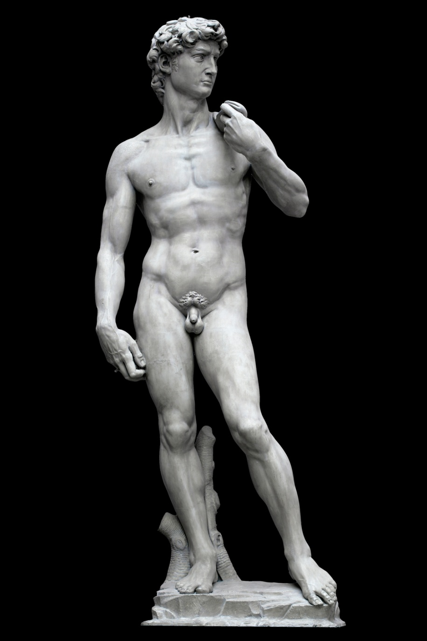
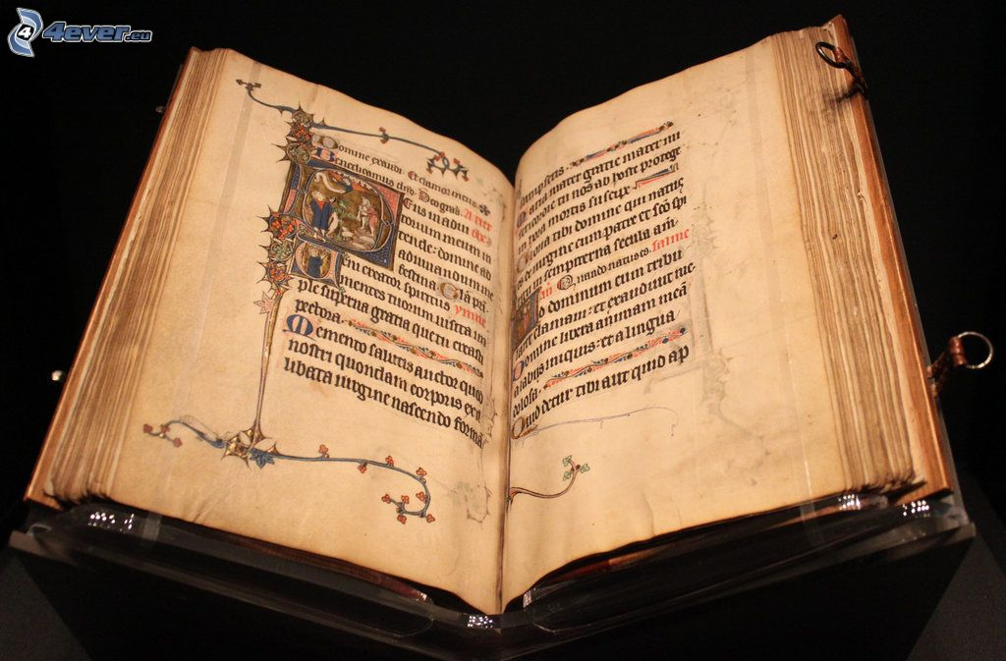
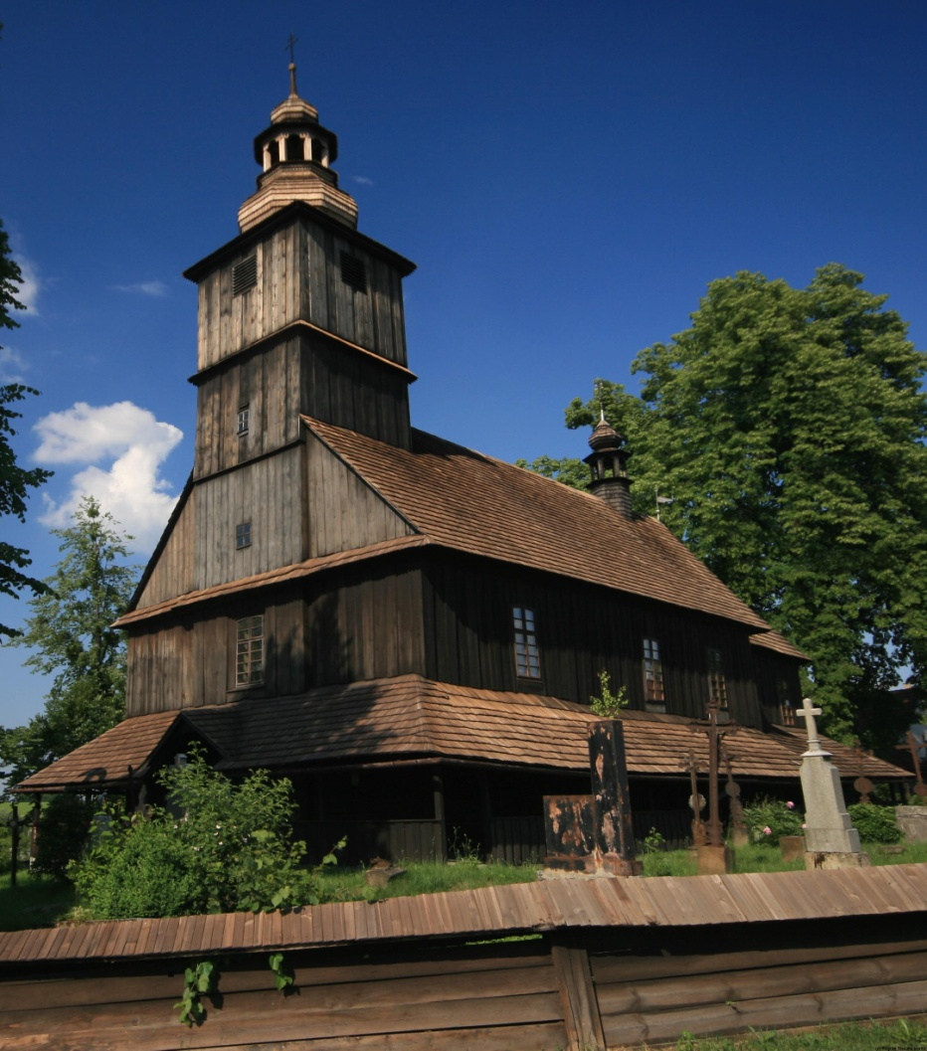
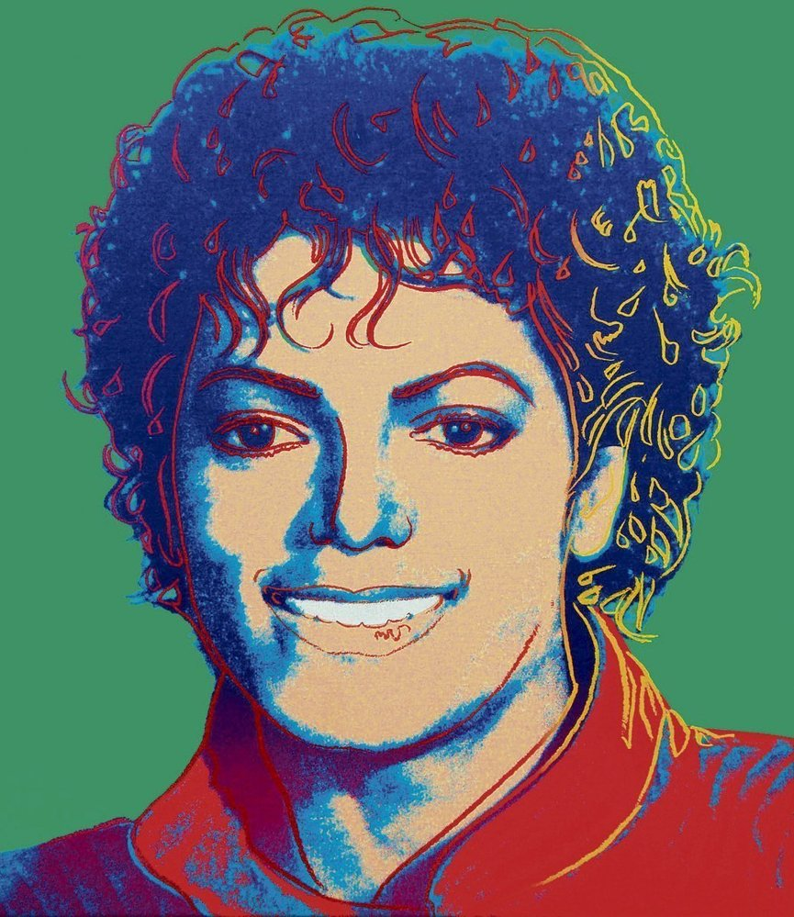
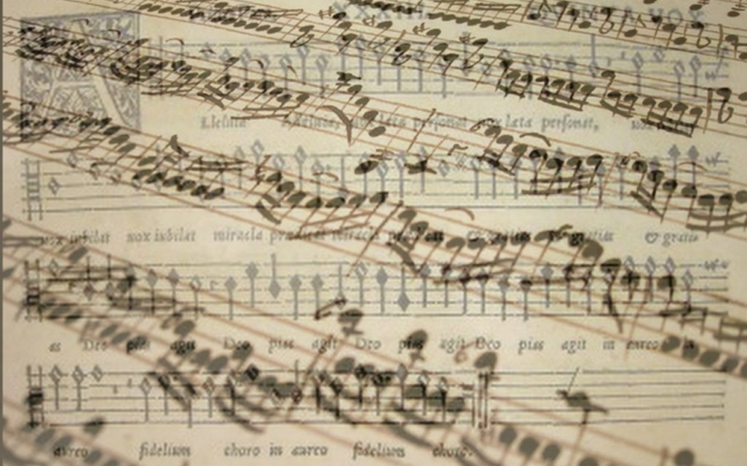
Culture and Mass Media Economy Basic information
Ing. Vojtěch Müllner, Ph.D.

Slide 2
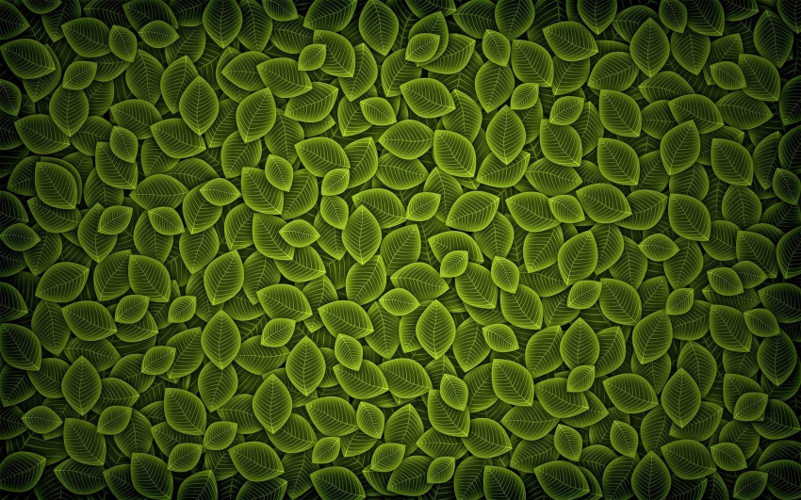
Contacts
Ing. Vojtech Müllner, Ph.D.
Contact:
347683@muni.cz
vojtech.mullner@econ.muni.cz
Office no. 416

Slide 3
Objectives of the course
Introduce economic substance of culture and mass media
Let student think about ways to satisfy cultural needs of people in context of sources
Introduce selected cultural institutions

Slide 4
Study methods
Lecture session
Group work
Individual work
Discussion
Excursions to selected institutions

Slide 5
Schedule
Schedule spring 2022
Date | Place | Topic | Tutor
22nd February | First class-session (class S313) | Introduction to the course-data | Vojtěch Müllner
8th March | Second class-session (class S313) | Economy of Culture | Vojtěch Müllner
22rd March | Third-class session (class S313) | Public Support of Culture | Vojtěch Müllner
5th April | Fourth-class session (class S313) | Mass Media economy | Vojtěch Müllner
19th April | Fifth-class session (class S313) | Investment in culture | Vojtěch Müllner
26th April | Sixth-class session (class S313) | Marketing for Cultural organizations | Vojtěch Müllner
3rd May | Excursion in the center of Brno | Sightseeing tour in the center of Brno | Vojtěch Müllner
4th May | Janacek Theatre | Visit of performance “La bohéme” (written by Giacomo Puccini) | Vojtěch Müllner
17th May | Exam | Final exam | Vojtěch Müllner

Slide 6
Obligatory part of Course
Take part in at least 3 of 5 class session
Take part in sightseeing tour in the center of Brno
Visit performance of opera “La bohéme”
Visit permanent exhibition in Moravian gallery
Write a final exam

Slide 7
Class session
First part
Work in small groups
Group deal with list of questions
Second part
Discussion and presentation of results
Tutors presentation and advanced explanation
Study method
Work with online materials
Necessary to have in group at least one devises with WI-FI

Slide 8
Sightseeing tour in the center of Brno
Tour will be in time of class session
Sightseeing tour will be realize in any weather
Duration of sightseeing tour will be approximately 90 minutes
You will get basic information per email

Slide 9
Visit of the performance “La bohéme”
“La bohéme” is play written by Giacomo Puccini Important information
Date and time: Tuesday 4th May in 19:00
Meeting time and place: 18:40 in front of Janacek Theatre
Dress code: decent clothes or formal clothes
Each student buys ticket by himself (reservation are available on web sites (https://www.ndbrno.cz/en/program/la-boheme-2/)
Don’t forget to buy ticket in time because the OFFER IS LIMITED

Slide 10
Final exam
To set the test must student fulfil obligatory part of course Culture and Mass Media Economy
The final test will be written on 17th May during our class session
The test consists of 20 multiple choice questions (only one question is right). Total time for writing the test is 30 minutes

Slide 11
Final exam (cont.)
Evaluation of the test is as follows:
Points | Percentage | Grade
20-19 | 100 % - 95 % | A
18-17 | 90% - 85 % | B
16-15 | 80% - 75 % | C
14-13 | 70% - 65 % | D
12-11 | 60% - 55 % | E
less than 11 | <55 % | F

Slide 12
Recommended literature
Literature in English:
TOWSE, R., 2019. A Textbook of Cultural Economics. Cambridge university press. ISBN 978-1-108-42168-3.
FUCHS, CH., 2015. Culture and economy in the age of social media. Routledge. ISBN 978-1-138-83929-8.
HALLMANZIK, CH., 2020. Cultural Economics. Agenda Publishing. ISBN 978-1788211628.
Literature in Czech:
SVOBODA, F., ŠKARABELOVÁ, S., 2020. Ekonomiky Kultury. Muni Press. ISBN 978-80-210-9633-2

