Slide 1
Teorie firmy Theory of the firm
Overview of theories in the course
Michal Jirásek

Slide 2
List of theories
Resource-Based View
Main interest: Sustainable competitive advantage (how the firm achieves above-average profits)
Performance Feedback Theory
Main interest: Change making and risk taking (how the firm reacts to performance feedback)
Organizational Ecology
Main interest: Survival and creation of firms (how selection forces of the environment shape firm population)

Slide 3
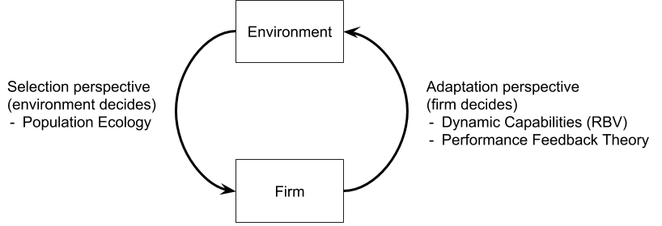
Environment-firm interaction
Who decides on success?
Selection perspective
Environment decides on success/failure by selection processes
The firm is passive
Adaptation perspective
Firm adaptation to the environment decides on success/failure
The firm is active

Slide 4
Theories and their levels
Micro level – interest in firms‘ components (individuals, groups)
Meso level – interest in individual firms
Resource-Based View
Performance Feedback Theory
Macro level – interest in populations of firms
Organizational Ecology

