Slide 1
CHAPTER
15
Unemployment

Slide 2
Look for the answers to these questions:
How is unemployment measured?
What is the “natural rate of unemployment”?
Why are there always some people unemployed?
How is unemployment affected by unions and minimum wage laws?
What is the theory of efficiency wages, and how does it help explain unemployment?

Slide 3
Labor Force Statistics
Produced by Bureau of Labor Statistics (BLS), in the U.S. Dept. of Labor
Based on regular survey of 60,000 households
Based on “adult population” (16 yrs or older)

Slide 4
Labor Force Statistics
BLS divides population into 3 groups:
Employed: paid employees and self-employed
Unemployed: people not working who have looked for work during previous 4 weeks
Not in the labor force: everyone else
Labor force = Employed + Unemployed
The total # of workers

Slide 5
Labor Force Statistics
Unemployment rate (“u-rate”):
% of the labor force that is unemployed
$$\text{u}\text{−}\text{rate} =100×\frac{\text{\# }\text{of} \text{unemployed}}{\text{Labor} \text{force}}$$
Labor-force participation rate
% of the adult population that is in the labor force
$$\text{Labor}\text{−}\text{force} \text{participation} \text{rate} = \text{100}×\frac{\text{Labor} \text{force}}{\text{Adult} \text{population}}$$
Notes:
Many of the following slides abbreviate “unemployment rate” as “u-rate” to reduce slide clutter and to reduce the note-taking burden

Slide 6
Active Learning 1 Calculate labor force statistics
Compute the labor force, u-rate, adult population, and labor force participation rate using this data:
Adult population of the U.S. by group, Feb 2021
# of employed | 150.2 million
# of unemployed | 9.9 million
not in labor force | 100.7 million
Notes:
Data source: Bureau of Labor Statistics, U.S. Department of Labor
http://www.bls.gov, look for latest “Employment Situation Summary”
http://www.bls.gov/news.release/empsit.nr0.htm (Table A-1)

Slide 7
Active Learning 1 Answers
Labor force = employed + unemployed = = 150.2 + 9.9 = 160.1 million
U-rate = 100 x (unemployed)/(labor force) = = 100 x 9.9/160.1 = 6.2%
Population = labor force + not in labor force = 160.1 + 100.7 = 260.8 million
LF partic. Rate = 100 x (labor force)/(population) = 100 x 160.1/260.8 = 61.4%

Slide 8
Labor Force Statistics for Different Groups
The BLS publishes these statistics for demographic groups within the population.
These data reveal widely different labor market experiences for different groups.

Slide 9
Labor Force Statistics for Whites & Blacks, Feb 2021
0
Adults (20 yrs & older)
 | u-rate | LF part. rate
White, male | 5.3% | 69.7%
White, female | 5.2 | 56.3
Black, male | 10.2 | 66.0
Black, female | 8.9 | 59.7
Notes:
9
Within either racial group, males have higher participation rates than females.
Blacks have far higher unemployment rates than whites. This is of great concern to many economists and policymakers.
Source: Bureau of Labor Statistics, U.S. Department of Labor
www.bls.gov, look for latest “employment situation”
http://www.bls.gov/news.release/empsit.nr0.htm (Table A2-)
http://www.bls.gov/news.release/empsit.t02.htm

Slide 10
Labor Force Statistics for Whites & Blacks, Feb 2021
0
Teens (16–19 yrs)
 | u-rate | LF part. rate
White | 13.1% | 38.9%
Black | 19.8 | 28.7
Notes:
10
As one would expect, teens have lower participation rates and higher unemployment rates than adults. What is striking, though, are the racial disparities: the proportion of white teens in the labor force, getting skills and experience that will help them later as adult job market participants, is far higher than the black teen participation rate. And the unemployment rate for black teens is far higher than for white teens.
Source: Bureau of Labor Statistics, U.S. Department of Labor
www.bls.gov, look for latest “employment situation”
http://www.bls.gov/news.release/empsit.nr0.htm (Table A-2)
http://www.bls.gov/news.release/empsit.t02.htm

Slide 11
Labor Force Statistics for Other Groups, Feb 2021
0
All ages
 | u-rate | LF part. rate
Asian | 5.2% | 62.2%
Hispanic | 8.5 | 65.4
Notes:
11
Compared to the national average, unemployment is higher for Hispanics and lower for Asians. The participation rates of these groups are similar to the national average.
Note: Asian is the only demographic group for which seasonally adjusted data were not available. The figures for all other groups are seasonally adjusted. (The seasonal adjustments seem to make relatively little difference in most months.)
Source: Bureau of Labor Statistics, U.S. Department of Labor
www.bls.gov, look for latest “employment situation”
http://www.bls.gov/news.release/empsit.nr0.htm (tables A-2 and A-3)
http://www.bls.gov/news.release/empsit.t02.htm
Asian data remains not seasonally adjusted.

Slide 12
Labor Force Statistics by Education Level, Feb 2021
0
Adults (25 yrs & older)
 | u-rate | LF part. rate
less than h.s. | 10.1% | 45.9%
h.s. diploma | 7.2 | 54.7
some college or assoc degree | 5.9 | 62.7
bachelor’s degree or more | 3.8 | 71.8
Notes:
12
It shouldn’t be surprising that educational attainment is positively related to labor force participation: for most people, the prospect of better jobs is a key reason for investing in education.
Source: Bureau of Labor Statistics, U.S. Department of Labor
www.bls.gov, look for latest “employment situation”
http://www.bls.gov/news.release/empsit.nr0.htm (Table A-4)
http://www.bls.gov/news.release/empsit.t04.htm

Slide 13
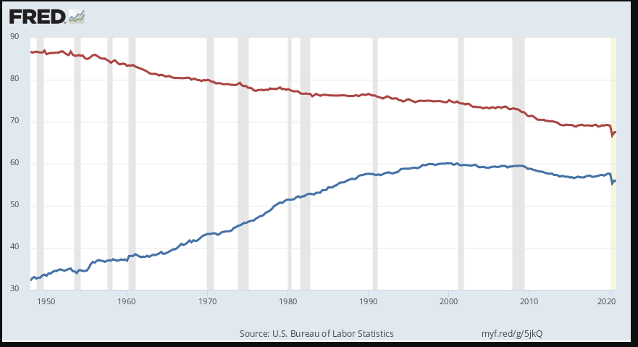
LF Participation Rates by Sex, 1948–2016
male
percent
female
Notes:
The male LF participation rate is males in the labor force as a percentage of all males. Similarly for females.
The vertical axis starts at 30 rather than 0 to make the trends more apparent.
Since 1950, female participation has nearly doubled—from 34% to 56.7%. Male participation has declined from 86% to 68.7%.
Source: US. Bureau of Labor Statistics, Civilian Labor Force Participation Rate: Men [LNS11300001], and Civilian Labor Force Participation Rate: Women [LNS11300002], retrieved from FRED, Federal Reserve Bank of St. Louis; https://fred.stlouisfed.org/series/LNS11300001, https://fred.stlouisfed.org/series/LNS11300002, July 10, 2016.

Slide 14
Active Learning 2 Limitations of the u-rate
In each of the following, what happens to the u-rate? Does the u-rate give an accurate impression of what’s happening in the labor market?
Sue lost her job and begins looking for a new one.
Jon, a steelworker who has been out of work since his mill closed last year, becomes discouraged and gives up looking for work.
Sam, the sole earner in his family of 5, just lost his $80,000 job as a research scientist. Immediately, he takes a part-time job at McDonald’s until he can find another job in his field.

Slide 15
Active Learning 2 Answers
Sue lost her job and begins looking for a new one.
u-rate rises
A rising u-rate gives the impression that the labor market is worsening, and it is.

Slide 16
Active Learning 2 Answers
Jon has been out of work since last year, becomes discouraged, stops looking for work.
Discouraged workers would like to work but have given up looking for jobs
- classified as “not in the labor force” rather than “unemployed”
U-rate falls because Jon is no longer counted as unemployed.
A falling u-rate gives the impression that the labor market is improving, but it is not.

Slide 17
Active Learning 2 Answers
Sam lost his $80,000 job, and takes a part-time job at McDonald’s until he finds a better one.
U-rate unchanged because a person is “employed” whether they work full or part time.
Things are worse, but the u-rate fails to show it.

Slide 18
What Does the U-Rate Really Measure?
The u-rate:
Not a perfect indicator of joblessness or the health of the labor market
It excludes discouraged workers.
It does not distinguish between full-time and part-time work, or people working part time because full-time jobs not available.
Some people misreport their work status
Still a very useful barometer of the labor market & economy.
Notes:
This slide recaps the lessons from the preceding exercise and mentions an additional point from the text: people may misreport their labor market status to the BLS, perhaps because they think it will help them get public assistance. This also makes the unemployment rate a bit less accurate.

Slide 19
The Duration of Unemployment
Most spells of unemployment are short:
Typically 1/3 of the unemployed have been unemployed under 5 weeks, 2/3 have been unemployed under 14 weeks.
Only 20% have been unemployed over 6 months.

Slide 20
The Duration of Unemployment
Yet, most observed unemployment is long term.
The small group of long-term unemployed persons has fairly little turnover, so it accounts for most of the unemployment observed over time.
Knowing these facts helps policymakers design better policies to help the unemployed.

Slide 21
Cyclical Unemployment vs. the Natural Rate
There’s always some unemployment, though the u-rate fluctuates from year to year.
Natural rate of unemployment
Normal rate of unemployment around which the actual unemployment rate fluctuates
Cyclical unemployment
Deviation of unemployment from its natural rate
Associated with business cycles, which we’ll study in later chapters
Notes:
Unemployment is a serious and complicated problem with a variety of causes. To most effectively address such a problem, we need to break it down and look at each cause separately.
We begin by noting that the causes of short-run fluctuations in unemployment are different than the causes of the long-run average unemployment rate, called the “natural rate of unemployment.”
The next slide shows U.S. data on both since 1960.

Slide 22
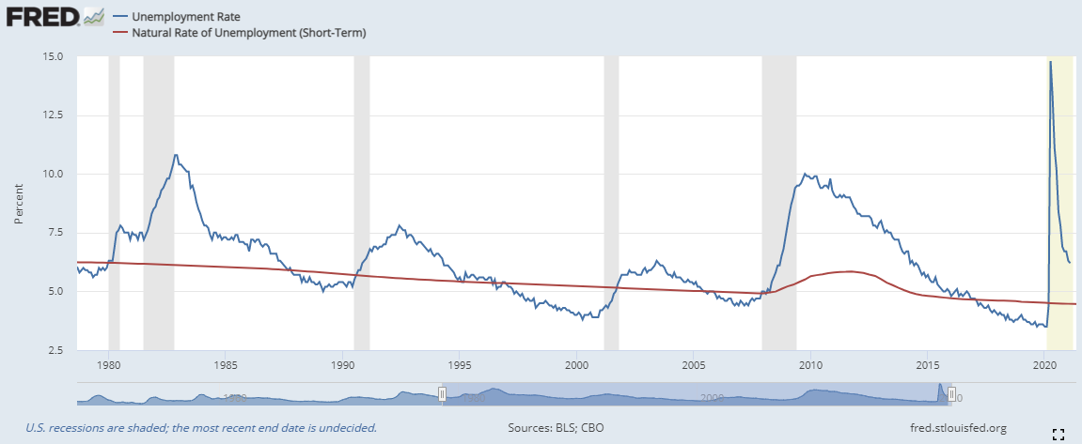
U.S. Unemployment, 1960–2016
Notes:
Cyclical unemployment is the gap between the two lines. In recessions, the actual unemployment rate is higher than the natural rate, and cyclical unemployment is positive. In booms, unemployment is below the natural rate and cyclical unemployment is negative.
Sources: Unemployment rate from FRED, series UNRATE, quarterly (average of monthly rates)
Natural rate of unemployment from CBO, http://www.cbo.gov/Spreadsheets.cfm, scroll down to Table 2-2.
US. Congressional Budget Office, Natural Rate of Unemployment (Short-Term) [NROUST], retrieved from FRED, Federal Reserve Bank of St. Louis; https://fred.stlouisfed.org/series/NROUST, July 10, 2016.
US. Bureau of Labor Statistics, Civilian Unemployment Rate [UNRATE], retrieved from FRED, Federal Reserve Bank of St. Louis; https://fred.stlouisfed.org/series/UNRATE, July 10, 2016.
For the newest data, use the following link: https://fred.stlouisfed.org/graph/fredgraph.png?g=5jml

Slide 23
Explaining the Natural Rate: An Overview
Even when the economy is doing well, there is always some unemployment, including:
Frictional unemployment
Occurs when workers spend time searching for the jobs that best suit their skills and tastes
Short-term for most workers
Structural unemployment
Occurs when there are fewer jobs than workers
Usually longer-term
Notes:
In later chapters, we will study short-run economic fluctuations and learn more about the causes and possible cures of cyclical unemployment. For the rest of this chapter, our job is understanding the various causes of the natural rate of unemployment.

Slide 24
Job Search
Workers have different tastes & skills, and jobs have different requirements.
Job search
Process of matching workers with appropriate jobs
Sectoral shifts
Changes in the composition of demand across industries or regions of the country.
Displace some workers, who must search for new jobs appropriate for their skills & tastes.
Notes:
One reason why economies always experience some unemployment is job search. The economy is always changing, so some frictional unemployment is inevitable.

Slide 25
Public Policy and Job Search
Government employment agencies
Provide information about job vacancies to speed up the matching of workers with jobs.
Public training programs
Aim to equip workers displaced from declining industries with the skills needed in growing industries.
Notes:
Even if some frictional unemployment is inevitable, the precise amount is not. The faster information spreads about job openings and worker availability, the more
rapidly the economy can match workers and firms – public policy may play a role.

Slide 26
Unemployment Insurance
Unemployment insurance (UI):
A government program that partially protects workers’ incomes when they become unemployed
Increases frictional unemployment.
People respond to incentives.
UI benefits end when a worker takes a job, so workers have less incentive to search or take jobs while eligible to receive benefits.

Slide 27
Unemployment Insurance
Benefits of UI:
Reduces uncertainty over incomes
Gives the unemployed more time to search, resulting in better job matches and thus higher productivity

Slide 28
Explaining Structural Unemployment
0
Structural unemployment occurs when there are not enough jobs to go around.
Occurs when wage is kept above equilibrium.
There are three reasons for this…
unemp-loyment
W
S
actual wage
W₁
W_{E}
D
L
Notes:
28
On this graph, W_{E} is the equilibrium wage.
Having seen how frictional unemployment results from the process of matching workers and jobs, let’s now examine how structural unemployment results when
the number of jobs is insufficient for the number of workers.

Slide 29
1. Minimum-Wage Laws
The minimum wage
May exceed the equilibrium wage for the least skilled or experienced workers, causing structural unemployment.
But this group is a small part of the labor force, so the min. wage can’t explain most unemployment.
Notes:
The textbook has a case study entitled “Who earns the minimum wage?” It summarizes a recent study by the Department of Labor detailing minimum wage earners.
These studies find that a 10-percent increase in the minimum wage reduces teenage employment by 1 to 3 percent.

Slide 30
1. Minimum-Wage Laws
Current Population Survey – study by the BLS:
267K earns min. wage ($5.85); 1.5 m earns less
Min wage earners are more likely to be women (1% of men, 3% of women)
Young: ~50% are under 25
More likely to be part-time workers
Leisure and hospit. has highest proportion
Notes:
The textbook has a case study entitled “Who earns the minimum wage?” It summarizes a recent study by the Department of Labor detailing minimum wage earners.
These studies find that a 10-percent increase in the minimum wage reduces teenage employment by 1 to 3 percent.

Slide 31
2. Unions
Union:
Worker association that bargains with employers over wages, benefits, and working conditions
Exert their market power to negotiate higher wages for workers.
The typical union worker earns 20% higher wages and gets more benefits than a nonunion worker for the same type of work.
Notes:
Information about the union wage premium differs. The textbook says that union wages are 10–20% higher. Other sources, such as the AFL-CIO and the New York Times article featured in the “In the News Box,” say the figure is closer to 20%, not including the increased benefits that union workers enjoy. The BLS (stats.bls.gov) reports that, in 2004, median weekly earnings of full-time employed workers were $781 for union members and $612 for non-union members—a difference of 28%.
So the range of estimates seems to be about 10–30%. I picked 20%, a nice round number in the middle of this range, to put on this slide in the 3rd bullet point.

Slide 32
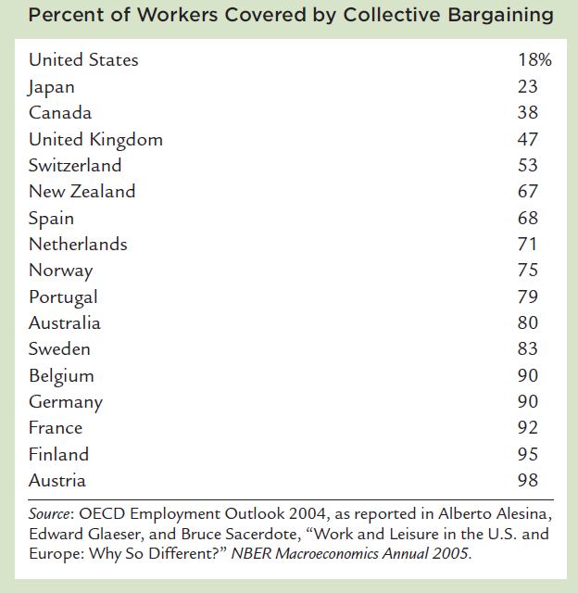
Labor Unions Across the World

Slide 33
Unemployment Rates Across the World

Slide 34
2. Unions
Unions raise the wage above equilibrium:
Quantity of labor demanded falls and unemployment results.
“Insiders” – workers who remain employed, are better off.
“Outsiders” – workers who lose their jobs, are worse off.
Some outsiders go to non-unionized labor markets, which increases labor supply and reduces wages in those markets.
Notes:
The unemployment caused by unions and by the threat of unionization is an
instance of conflict between different groups of workers—insiders and outsiders.

Slide 35
2. Unions
Are unions good or bad? Economists disagree.
Critics:
Unions are cartels.
They raise wages above equilibrium, which causes unemployment and/or depresses wages in non-union labor markets.
Advocates:
Unions counter the market power of large firms, make firms more responsive to workers’ concerns.
Notes:
One possible explanation is that the centralization of wage bargaining and the role of the government
in the bargaining process give more influence to the outsiders, which keeps wages closer to the equilibrium level.

Slide 36
3. Efficiency Wages
The theory of efficiency wages:
Firms voluntarily pay above-equilibrium wages to boost worker productivity.
Different versions of efficiency wage theory suggest different reasons why firms pay high wages.
Notes:
In the case of unions and minimum wage laws, firms that pay above-equilibrium wages do so involuntarily. The theory of efficiency wages, however, suggests that firms may willingly pay extra-high wages in order to increase the productivity of their workers.

Slide 37
Four reasons why firms might pay efficiency wages:
Worker health
In less developed countries, poor nutrition is a common problem.
Paying higher wages allows workers to eat better, makes them healthier, more productive.
Notes:
1. This is clearly not relevant in rich countries like the U.S., where equilibrium wages for nearly all workers are way more than enough to provide for the workers’ nutritional requirements. But rich countries have a fairly small proportion of the world’s population.

Slide 38
Four reasons why firms might pay efficiency wages:
Worker turnover
Hiring & training new workers is costly.
Paying high wages gives workers more incentive to stay, reduces turnover.
Worker quality
Offering higher wages attracts better job applicants, increases quality of the firm’s workforce.
Notes:
2. Besides the costs of placing ads, interviewing candidates, and training new hires, new workers are usually less productive in their first few months on the job—it takes time to learn how to perform their duties efficiently. For all of these reasons, turnover is costly to firms.
3. If firms responded to the surplus of labor by reducing wages, then the most competent applicants may choose not to apply as they may have better opportunities elsewhere.

Slide 39
Four reasons why firms might pay efficiency wages:
Worker effort
Workers can work hard or shirk. Shirkers are fired if caught.
Is being fired a good deterrent?
Depends on how hard it is to find another job.
If market wage is above equilibrium wage, there aren’t enough jobs to go around, so workers have more incentive to work, not shirk.
Notes:
4. In case you’re not familiar with efficiency wage theory, here’s the Cliff Notes version.
In many jobs, each worker can choose how hard he or she works. For simplicity, suppose there are just two choices: working hard, or shirking—neglecting one’s duties and responsibilities at work.
Clearly, the firm suffers when its workers shirk: output and hence revenue & profit are lower. So, the firm fires workers caught shirking. However, monitoring worker effort is costly and imperfect, and workers know there’s a good chance they won’t be caught if they shirk.
Paying workers an above-equilibrium wage gives them an incentive to work hard rather than shirk. If their firm is the only firm paying efficiency wages, then they stand to lose a particularly good job if caught shirking. If all firms are paying efficiency wages, then there will be structural unemployment due to the market wage being above its equilibrium level. In this case, the incentive to work rather than shirk is the prospect of an extended spell of unemployment. This is why Shapiro & Stiglitz titled their 1984 AER article “Equilibrium Unemployment as a Worker Discipline Device.”

Slide 40
Active Learning 3 Applying the concepts
Which of the following would be most likely to reduce frictional unemployment?
A. The government eliminates the minimum wage.
B. The government increases unemployment insurance benefits.
C. A new law bans labor unions.
D. More workers post their resumes at LinkedIn.com, and more employers use LinkedIn.com to find suitable workers to hire.
E. Sectoral shifts become more frequent.

Slide 41
Active Learning 3 Answers
A. The government eliminates the minimum wage.
C. A new law bans labor unions.
These are likely to reduce structural unemployment, not frictional unemployment.
Notes:
The minimum wage and labor unions are two reasons why the actual wage might be above the equilibrium wage, which causes structural unemployment (as Mankiw defines it), not frictional unemployment.

Slide 42
Active Learning 3 Answers
B. The government increases unemployment insurance benefits.
E. Sectoral shifts become more frequent.
These are likely to increase frictional unemployment, not reduce it.

Slide 43
Active Learning 3 Answers
D. More workers post their resumes at LinkedIn.com, and more employers use LinkedIn.com to find suitable workers to hire.
Likely to speed up the process of matching workers & jobs, which would reduce frictional unemployment.

Slide 44
Explaining the Natural Rate of Unemployment: A Summary
The natural rate of unemployment consists of:
Frictional unemployment: it takes time to search for the right jobs
Even if there are enough jobs to go around
Structural unemployment: when wage is above equilibrium, not enough jobs
Min. wages, labor unions, efficiency wages
Later chapters discuss cyclical unemployment, the short-term fluctuations in unemployment associated with business cycles.

Slide 45
Summary
The unemployment rate is the percentage of those who would like to work, who do not have jobs.
Unemployment and labor force participation vary widely across demographic groups.
The natural rate of unemployment is the normal rate of unemployment around which the actual rate fluctuates. Cyclical unemployment is the deviation of unemployment from its natural rate and is connected to short-term economic fluctuations.

Slide 46
Summary
The natural rate includes frictional unemployment and structural unemployment.
Frictional unemployment occurs when workers take time to search for the right jobs.
Structural unemployment occurs when above- equilibrium wages result in a surplus of labor.
Three reasons for above-equilibrium wages include minimum wage laws, unions, and efficiency wages.

