Slide 1
Case Study
Prateek Kalia

Slide 2
What do you understand by case study?

Slide 3
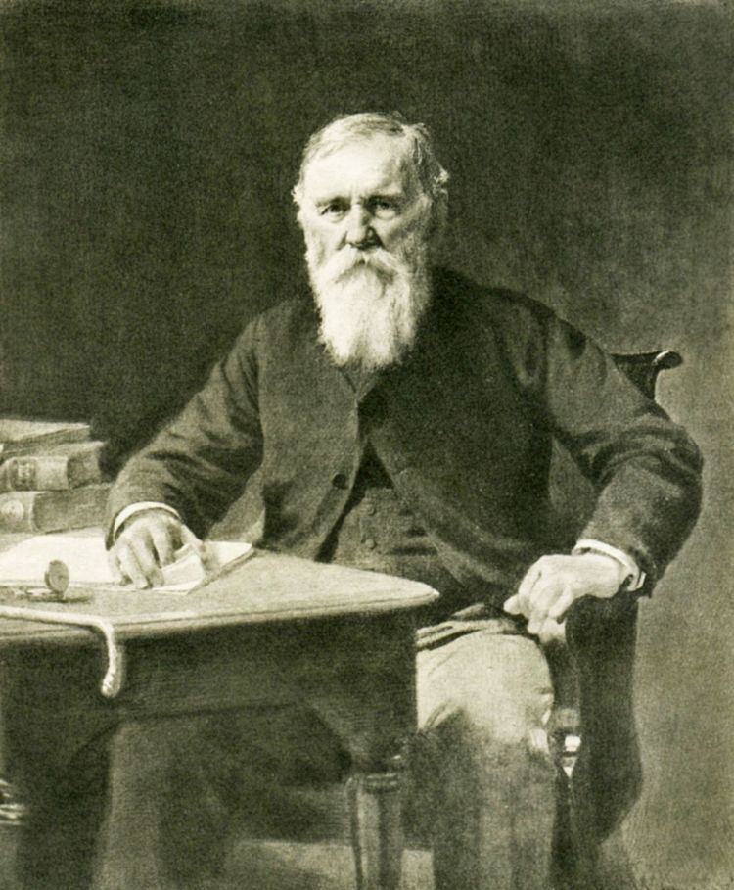
Origin
The case method in legal education was invented by Christopher Columbus Langdell, Dean of Harvard Law School from 1870 to 1895. Langdell conceived of a way to systematize and simplify legal education by focusing on previous case law that furthered principles or doctrines.

Slide 4
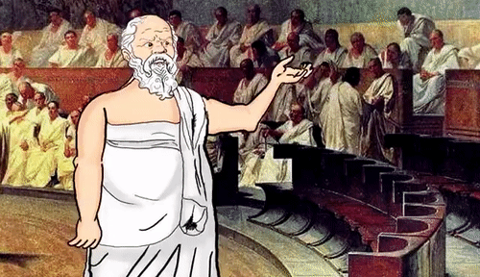
What is case method?
Uses a court decision to exemplify principles of law.
Employs “hub-and-spoke” discussion between professor and student, otherwise known as the Socratic method.
Analyzes the dilemma after it has been resolved.

Slide 5
The Harvard Business School case study approach
Grew out of the Langdellian method.
Real-life examples from the business world to highlight and analyze business principles.
Consist of a short narrative, told from the point of view of a manager or business leader embroiled in a dilemma.
Case studies provide readers with an overview of the main issue; background on the institution, industry, and individuals involved; and the events that led to the problem or decision at hand.

Slide 6
The Harvard Business School case study approach
Cases are based on interviews or public sources; sometimes, case studies are disguised versions of actual events or composites based on the faculty authors’ experience and knowledge of the subject.
Cases are used to illustrate a particular set of learning objectives; as in real life, rarely are there precise answers to the dilemma at hand.

Slide 7
Participants
Are put squarely in the shoes of real people wrestling with real dilemmas.
Argue and defend their advice.
Learn how to approach and solve problems.
Interact with their peers through debate, presentations, and ad hoc role plays.

Slide 8
Lets start…

Slide 9
Reference
The Case Study Teaching Method. (2022). https://casestudies.law.harvard.edu/the-case-study-teaching-method/

