Slide 1
International Management
Formulating Strategy

Slide 2
Opening Profile: Global Companies Take Advantage of Opportunities in South Africa
Acer Africa
Alcatel
General Electric
Unilever

Slide 3
Reasons for Going International
Why companies go international? Write one reason.
Why companies go international? Write one reason.
Why companies go international? Write one reason.
Why companies go international? Write one reason.
Why companies go international? Write one reason.
Why companies go international? Write one reason.

Slide 4


Reasons for Going International
Companies “go international” for different reasons, some reactive (or defensive) and some proactive (or aggressive).
Reactive reasons include
Global competition
Trade barriers
Regulations and restrictions by home country government
Customer demand
Qatar Airways to expand in South Africa

Slide 5


Reasons for Going International
Proactive reasons include:
Economies of Scale
Growth Opportunities
Resource access and Cost savings
Incentives

Slide 6
Key terms
Strategic planning
The process by which a firm’s managers evaluate the future prospects of the firm and decide on appropriate strategies to achieve long-term objectives
Strategy
The basic means by which the firm competes

Slide 7
Strategic Formulation Process
Global strategic planning is more complex than domestic strategic planning
the planning phase
the implementation phase

Slide 8





International Management: Mnaging across borders and cultures, Helen Deresky, p.215
Notes:
Snow White and seven dwarfs
8
© 2010 Pearson Prentice Hall

Slide 9
Mission and Objectives
The following questions must be answered to determine the firm’s basic mission:
What is the firm’s business?
What is the reason for its existence?

Slide 10
Mission and Objectives
Sanyo
Corporate philosophy: to make products and services indispensable for people all over the world, offering a more enjoyable life. Digital technology and core competence generate joy, excitement, and impact, a more comfortable life in harmony with the global environment.
Siemens
Success depends on success of our customers. We provide experience and solutions so they can achieve their objectives fast and effectively. We turn our people´s imagination and best practices in successful technologies and products. This makes us a premium investment for our shareholders. Our ideas, technologies and activities help create a better world.

Slide 11
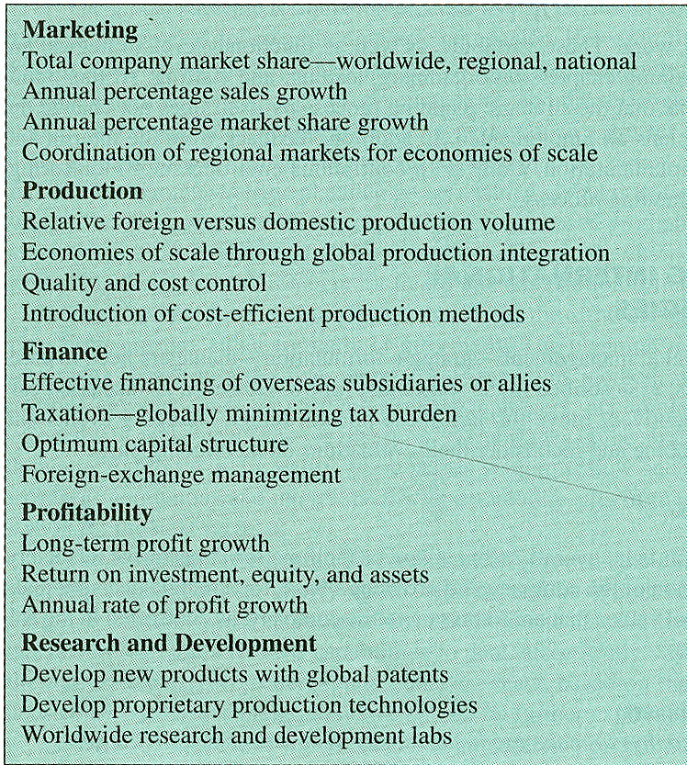
Mission and Objectives
A firm’s GLOBAL OBJECTIVES flow from its mission, usually fall into the areas of marketing, profitability, finance, production, and research and development.

Slide 12
Environmental Assessment
The first major step in weighing international strategic options
Information gathering/ Sources of information (data can be tampered with by government officials – e.g. South Korea – conflicting official figures)
Environmental scanning - process of forecasting relevant trends, competitive actions, and circumstances that will affect operations in geographic areas of potential interest

Slide 13
Environmental Assessment
The most common methods for conducting an environmental scan are as follows:
  Asking experts in the industry to discuss industry trends and to make projections about the future.
  Using historical industry trends to forecast future developments.
  Asking knowledgeable managers to write scenarios describing what they foresee for the industry over the next two to three years.
  Using computers to simulate the industry environment and to generate likely future developments.
Porter´s five forces that determine industry competitiveness:
  buyers
  suppliers
  potential new entrants to the industry
  the availability of substitute goods and services
  rivalry among the competitors.

Slide 14
Internal Analysis
Determines which areas of the firm’s operations represent strengths or weaknesses compared to competitors so that the firm may use that information to its strategic advantage
Identifying resources and competencies, value chain analysis
Identification of key success factors
Technological capability: Microsoft
Distribution channels: Wal-Mart
Promotion capabilities: Disney
Online sales (know how): Tesco

Slide 15
Competitive analysis and generic strategies
Firm´s managers assess the firms capabilities and key success factors compared to those of its competitors
SWOT analysis
CORE COMPETENCIES

Slide 16
Generic strategies
Cost strategy: a strategy that relies on low price through the pursuit of cost reductions
Differentiation strategy: a strategy directed toward creating something that is perceived as being unique
Focus strategy: a strategy that concentrates on a particular buyer group and segments

Slide 17
Global and International Strategy alternatives
Global strategic alternatives - determining the overall approach to the global marketplace a firm wishes to take
Treating the world as an undifferentiated worldwide marketplace
The impetus:
  Regional trading blocks
  Declining tariffs
  Information technology explosion
Local markets are linked together within a region, allowing local responsiveness.
The impetus:
  Unique consumer preferences
  Domestic subsidies
  New production technologies
Lenovo – shift to global strategy (bought IBM divisions), meeting virtually, management meeting rotate around the world
Google – problems with one-size-fits-all-countries strategy in Russia – cultural (language), administrative (censorship), geographic (offices), economic (payment infrastructure) distance
Toyota, Honda, Nissan

Slide 18
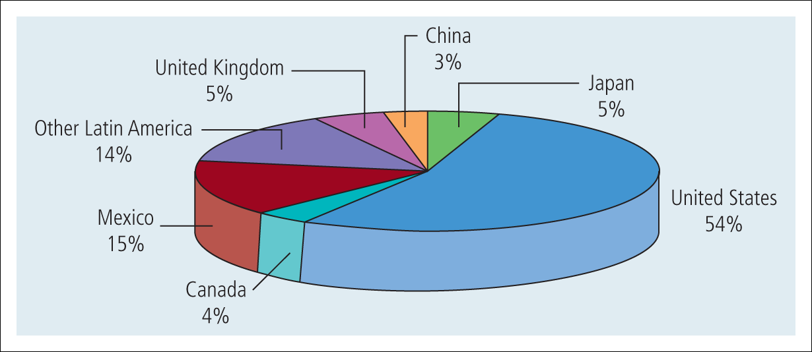
Global and International Strategy alternatives
Wal-Mart’s globalization: regional distribution of stores
Source: Wal Mart Stores, Annual Reports, 2009
BUT!
International expansion does not necessarily mean “global” expansion
Wal-Mart has 94.5% of its sales in North America

Slide 19
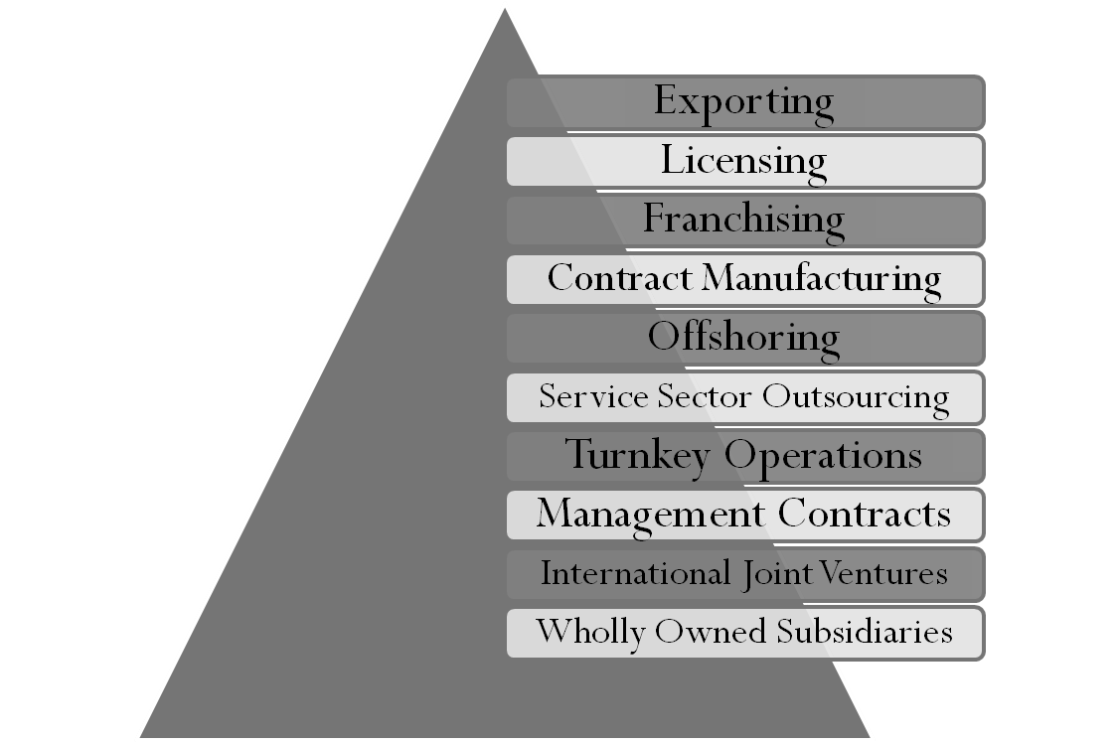
Entry Strategy Alternatives
- determine the specific entry strategy appropriate for each country in which the firm plans to operate

Slide 20
Entry Strategic Alternatives
Exporting
relatively low-risk way to begin international expansion
an export management company may be retained
Licensing
licensing agreements grant rights to a firm in the host country to either produce or sell a product, or both
suitable for the mature phases of the product life cycle
relatively low-risk strategy
it avoids the tariffs and quotas usually imposed on exports
lack of control over the licensee´s activities

Slide 21

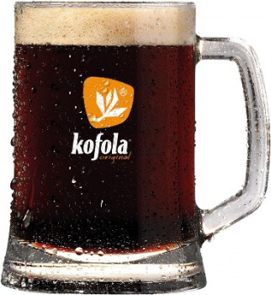

Slide 22
Entry Strategic Alternatives
Franchising
relatively little risk
the franchiser licenses its trademark, products and services and operating principles for an initial fee and ongoing royalties
strategy for small businesses, because outlets require little investment in capital or human resources

Slide 23
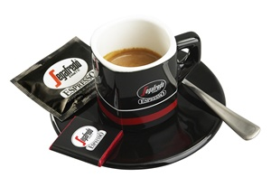
Notes:
Established 1973 Italy

Slide 24
Entry Strategic Alternatives
Contract Manufacturing
common means of utilizing cheaper labor overseas is to contract for production of finished goods or component parts

Slide 25

Notes:
KOH-I-NOOR
Since 1790
2004 factory KOH-I-NOOR Nanjing Stationery CO. Ltd. in Nanjing, China – a part of production has been removed from the Czech republic

Slide 26
Entry Strategic Alternatives
Service-Sector Outsourcing
the process of setting up overseas offices, call centers, and research labs to low-wage countries in order to reduce the cost of white-collar employees.
GE, Accenture, Oracle
“India is the absolute leader in IT sevices offered on the world market”

Slide 27
Entry strategic alternatives
Turnkey Operations
company designs and constructs a facility abroad, trains local personnel, and then turns the key over to local management for a fee
Management Contracts
give the rights to a foreign company to manage the daily operations of a business, but not to make decisions regarding ownership, financing, or strategic and policy changes

Slide 28
Entry strategic alternatives
International Joint Ventures
involves an agreement by two or more companies to produce a product or service jointly
ownership is shared, typically by an MNC and a local partner
rapid entry into new markets by means of an already established partner who has local contacts and familiarity with local operations.
Fully owned subsidiary
total control of operations, full range of risk

Slide 29
Determinants of foreign entry choice
transaction costs theory (TCT) - a firm should internalize its foreign transaction if the costs of internalization are less than those of entering through the market

Slide 30
Determinants of foreign entry choice
the resource-based view (RBV) - Similar to TCT, RBV proposes that a high degree of tacit firm knowledge, being transferred across borders, will lead the market to fail as a knowledge conductor; As the ratio of tacit to generic knowledge increases, the preference for internalization becomes greater than for cooperation

Slide 31
Determinants of foreign entry choice
the eclectic framework (OLI) - Integrating both international trade theory, RBV and TCT, the eclectic framework predicts the choice of entry mode from the following three key determinants: ownership, locational and internalization advantages (Dunning, 1980, 1988).

Slide 32
Do you remember? ☺
Name a reactive reason to go abroad.
Why did many MNEs go to South Africa?
Name a proactive reason to go abroad.
What are the two phases of strategic formulation process?
What are the pros and cons of exporting?

Slide 33
Your task no 1
Visit LandsEnd.com, LandsEnd.de, and LandsEnd.co.jp. Based on an analysis of the three Websites, assess the type of strategy used by Lands End:
Is it a regionalization strategy or a globalization strategy?
Why or Why not?
Has Lands End successfully globalized itself?

Slide 34
Your task no 2
YouTube LLC: Going Global by Acting Local
Do a SWOT analysis of YouTube in India
Assess YouTube’s growth through alliances and partnerships.
Assess the company’s localizing strategy. Do you recommend that YouTube “localize” when entering other countries?
What are the problems YouTube is facing in India?

