Slide 1
LECTURE 3
Introduction to Econometrics
INTRODUCTION TO LINEAR REGRESSION ANALYSIS II
Dali Laxton
March 3, 2023
1 / 36

Slide 2
REVISION: THE PREVIOUS LECTURE
e (Desired) properties of an estimator:
An estimator is unbiased if the mean of its distribution is equal to the value of the parameter it is estimating
An estimator is consistent if it converges to the value of the true parameter as the sample size increases
An estimator is efficient if the variance of its sampling distribution is the smallest possible
2 / 36

Slide 3
REVISION: THE PREVIOUS LECTURE
e We explained the principle of OLS estimator: minimizing the sum of squared differences between the observation and the regression line y_{i} = β₀ + β₁x_{i} + ε_{i}
e We found the formulae for the estimates:
3 / 36

Slide 4
REVISION: THE PREVIOUS LECTURE
e We explained that the stochastic error term must be present in a regression equation because of:
omission of many minor influences (unavailable data)
measurement error
possibly incorrect functional form
stochastic character of unpredictable human behavior
e Remember that all of these factors are included in the error term and may alter its properties
e The properties of the error term determine the properties of the estimates
4 / 36

Slide 5
WARM-UP EXERCISE
e You receive a unique dataset that includes wages of all citizens of Brno as well as their experience (number of years spent working). Obviously, you are very curious about what is the effect of experience on wages.
e You run an OLS regression of monthly wage in CZK on the number of years of experience and obtain the following results:
Interpret the meaning of the coefficient of exper_{i}.
Use the estimates to determine the average wage of a person with 1, 5, 20, and 40 years of experience.
Do the predicted wages seem realistic? Explain your answer.
5 / 36

Slide 6
ON TODAY’S LECTURE
e We will derive estimation formulas for multivariate OLS
e We will list the assumptions about the error term and the explanatory variables that are required in classical regression models
e We will show that under these assumptions, OLS is the best estimator available for regression models
e The rest of the course will mostly deal in one way or another with the question what to do when one of the classical assumptions is not met
e Readings:
Studenmund - chapter 4
Wooldridge - chapters 5, 8, 9, 12
6 / 36

Slide 7
ORDINARY LEAST SQUARES WITH SEVERAL EXPLANATORY VARIABLES
e Usually, there are more than one explanatory variables in regression models
e Multivariate model with k explanatory variables:
y_{i} = β₀ + β₁x_{i1} + β₂x_{i2} + . . . + β_{k}x_{ik} + ε_{i}
e For observations 1, 2, . . . , n, we have:
y₁ = β₀ + β₁x₁₁ + β₂x₁₂ + . . . + β_{k}x_{1k} + ε₁
y₂ = β₀ + β₁x₂₁ + β₂x₂₂ + . . . + β_{k}x_{2k} + ε₂
.
.
. .
y_{n} = β₀ + β₁x_{n1} + β₂x_{n2} + . . . + β_{k}x_{nk} + ε_{n}
7 / 36

Slide 8
MATRIX NOTATION
e We can write in matrix form:
k
k
or in a simplified notation:
Y = Xβ + ε
8 / 36

Slide 9
OLS - DERIVATION UNDER MATRIX NOTATION(OPTIONAL)

Slide 10
MEANING OF REGRESSION COEFFICIENT
e Consider the multivariate model
Q = β₀ + β₁P + β₂P_{s} + β₃Y + ε
^
estimated as Q = 31.50 − 0.73P + 0.11P + 0.23Y
s
Q . . . quantity demanded
Ps . . . price of substitute
Y . . . disposable income
P . . . commodity’s price
e Meaning of β₁ is the impact of a one unit increase in P on the dependent variable Q, holding constant the other included independent variables P_{s} and Y
e When price increases by 1 unit (and price of a substitute good and income remain the same), quantity demanded decreases by 0.73 units
10 / 36

Slide 11
EXERCISE
e Remember the unique dataset that includes wages of all citizens of Brno as well as their experience (number of years spent working).
e Because you realize that wages may not be linearly dependent on experience, you add an additional variable exper²_{i} into your model and you obtain the following results:
wage_{i} = 14450 + 1160 · exper_{i} − 25 · exper²_{i}
What is the overall impact of increasing the number of years of experience by 1 year?
Use the estimates to determine the average wage of a person with 1, 5, 20, and 40 years of experience.
Do the predicted wages seem realistic now? Explain your answer.
^
11 / 36

Slide 12
THE CLASSICAL ASSUMPTIONS
Linearity: the regression model is linear in the parameters (coefficients)
Random sampling: the data is a random sample drawn from the population and each data point follows the population equation
No perfect collinearity: the values of explanatory variables are not all the same and no explanatory variable is a perfect linear function of any other explanatory variable(s)
Zero conditional mean: values of explanatory variables must contain no information about the mean of the unobserved factors - explanatory variables are uncorrelated with the error term
Homoskedasticity: the error term has a constant variance
Normality of the error term: the error term is normally distributed
12 / 36

Slide 13
1. LINEARITY IN PARAMETERS
The regression model is linear in coefficients.
e Linearity in variables is not required
e Example: production function Y = AK^{β1} L^{β2} for which we suppose A = exp^{β0+ε} can be transformed so that
ln Y = β₀ + β₁ ln K + β₂ ln L + ε
and the linearity in coefficients is restored
e Note that it is the linearity in coefficients that allows us to rewrite the general regression model in matrix form
13 / 36

Slide 14
EXERCISE
Which of the following models is/are linear?

Slide 15
EXERCISE
Which of the following models is/are linear?
15 / 36

Slide 16
2. RANDOM SAMPLING
The data is a random sample drawn from the population and each data point follows the population equation.
e Discussion during last class
16 / 36

Slide 17
3. NO PERFECT COLLINEARITY
The values of explanatory variables are not all the same and no explanatory variable is a perfect linear function of any other explanatory variable(s).
e If this condition does not hold, we talk about
(multi)collinearity
e Multicollinearity can be perfect or imperfect
e Perfect multicollinearity: one explanatory variable is an exact linear function of one or more other explanatory variables
In this case, the OLS model is incapable to distinguish one variable from the other
OLS estimation cannot be conducted
Example: we include dummy variables for men and women together with the intercept
17 / 36
Notes:
Mathematically, collinearity causes the determinant of the matrix to be singular (0), therefore, you cannot do inversion beta=x’x^-1x’y

Slide 18
3. NO PERFECT COLLINEARITY
e Imperfect multicollinearity:
There is a linear relationship between the variables, but there is some error in that relationship
Example: we include two variables that proxy for individual health status
e Consequences of multicollinearity:
Estimated coefficients remain unbiased
But the standard errors of estimates are inflated - making the variable insignificant even though they might be significant
e Solution: drop one of the variables
18 / 36

Slide 19
EXERCISE
e Which of the following pairs of independent variables would violate the Assumption of no multicollinearity? (That is, which pairs of variables are perfect linear functions of each other?)
right shoe size and left shoe size (of students in the class)
consumption and disposable income (in the United States over the last 30 years)
X_{i} and 2X_{i}
X_{i} and (X_{i})²
19 / 36

Slide 20
4. BEFORE ZERO CONDITIONAL MEAN
The error term has a zero population mean.
e Notation: E[ε_{i}] = 0 or E[ε] = 0
e Idea: observations are distributed around the regression line, the average of deviations is zero
e On average, we make no ”mistakes”
e This assumption is satisfied as long as there is an intercept
included in the equation
20 / 36
Notes:
Intercept matters because y=beta0+beta1*x+epsilon; E(Y)= beta0+beta1*E(X)+ E(epsilon). And Ey=y-bar, Ex=x-bar => we know that in optimization y-bar=beta0+beta1*x-bar => E(epsilon)=0

Slide 21
4. ZERO CONDITIONAL MEAN
All explanatory variables are uncorrelated with the error term.
e Notation: E[x_{i}ε_{i}] = 0 or E[X^{j}ε] = 0
e If an explanatory variable and the error term were correlated with each other, the OLS estimates would be likely to attribute some of the variation in y to the x when it actually came from the error term
e Example: Impact of skipping classes on exam scores:
Motivated students are less likely to skip classes → negative correlation between skipped and error term
e Leads to biased and inconsistent estimates
e We will solve this problem using IV approach
21 / 36

Slide 22
5. HOMOSKEDASTICITY
The error term has a constant variance - Var(s_{i}|X_{i}) = σ²
e If it is not satisfied, we talk about heteroskedasticity
e It states that each observation of the error is drawn from a distribution with the same variance and thus varies in the same manner around the regression line
e If the error term is heteroskedastic, it is more difficult for OLS to get precise estimates of the coefficients of the explanatory variables
e Technically: the OLS estimate will be consistent, but not efficient
22 / 36

Slide 23
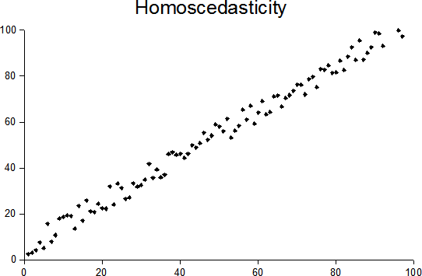
5. HOMOSKEDASTICITY - GRAPHICAL REPRESENTATION
Y
x

Slide 24
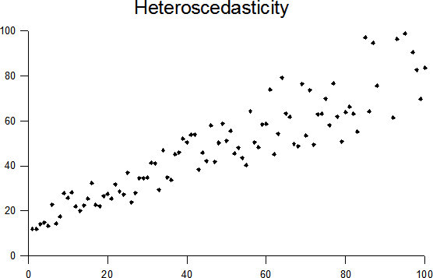
GRAPHICAL REPRESENTATION
Y
x

Slide 25
5. HOMOSKEDASTICITY
e Heteroskedasticity is often present in cross-sectional data
e Example: Analysis of household consumption patterns
Variance of the consumption of certain goods might be greater for higher-income households
These have more discretionary income than do lower-income households
e We will solve this problem using Hull-White robust standard errors
23 / 36

Slide 26
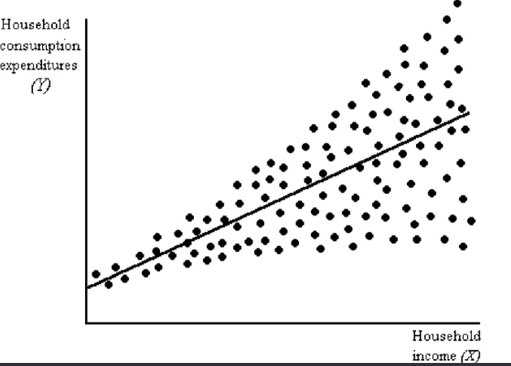
GRAPHICAL REPRESENTATION

Slide 27
6. NORMALITY OF THE ERROR TERM
The error term is normally distributed.
e This is an empirical question
^
e
Normality of the error term is inherited by the estimate β
e Knowing the distribution of the estimate allows us to find its confidence intervals and to test hypotheses about coefficients
26 / 36

Slide 28
PROPERTIES OF THE OLS ESTIMATE
e OLS estimate is defined by the formula
where y = Xβ + ε
e Hence, it is dependent on the random variable ε and thus
is a random variable itself
e The properties of are based on the properties of ε
27 / 36

Slide 29
EXPECTED VALUE OF THE OLS ESTIMATOR
e Under the assumptions 1-4, OLS is unbiased:
e The estimated coefficients may be smaller or larger, depending on the sample
e However, on average, they will be equal to the true parameters
e NOTE: in a given sample, estimates may differ considerably from true values
28 / 36

Slide 30
VARIANCE OF THE OLS ESTIMATOR
Under the assumptions 1-5 , OLS is efficient :
The error variance (σ²): increases the variance of an estimator
The variation in explanatory variable reduces the variance of the estimator
28 / 36

Slide 31
GAUSS-MARKOV THEOREM
Under the assumptions 1 - 5, the OLS estimator of β is the best linear unbiased estimator (BLUE) of the regression coefficients
e NOTE: assumption 6, normality, is not needed for this theorem
e Gauss-Markov Theorem means that:
30 / 36

Slide 32
EXPECTED VALUE OF THE OLS ESTIMATE (OPTIONAL)
31 / 36

Slide 33
VARIANCE OF THE OLS ESTIMATE (OPTIONAL)
32 / 36

Slide 34
NORMALITY OF THE OLS ESTIMATE
33 / 36

Slide 35
CONSISTENCY OF THE OLS ESTIMATE
e When no explanatory variables are correlated with the error term (Assumption 4), OLS estimate is consistent:
e In other words: as the number of observations increases, the estimate converges to the true value of the coefficient
34 / 36

Slide 36
CONSISTENCY OF THE OLS ESTIMATE
^
e
As long as the OLS estimate of β is consistent, the
residuals are consistent estimates of the error term
e If we have consistent estimates of the error term, we can test if it satisfies the classical assumptions
e Moreover, possible deviations from the classical model can be corrected
e As a consequence, the assumption of zero correlation between explanatory variables and the error term
is the most important one to satisfy in regression models
35 / 36

Slide 37
SUMMARY
e We expressed the multivariate OLS model in matrix notation y = Xβ + ε and we found the formula of the estimate:
e We listed the classical assumptions of regression models:
model linear in parameters, random sampling, explanatory variables linearly independent
(normally distributed) error term with zero mean and constant variance
no correlation between error term and explanatory variables
e We showed that if these assumptions hold, OLS estimate is
consistent (if no correlation between X and ε)
unbiased (if no correlation between X and ε)
efficient (if homoskedasticity and no autocorrelation of ε)
normally distributed (if ε normally distributed)
36 / 36

