Slide 1
Binary dependent variables
LECTURE 8
28.04.2023

Slide 2
Lecture Outline
2
The linear probability model
Nonlinear probability models
  Probit
  Logit
Brief introduction of maximum likelihood estimation
Interpretation of coefficients in logit and probit models

Slide 3
Introduction
3
So far the dependent variable (Y ) has been continuous:
  Average hourly earnings
  Birth weight of babies
What if Y is binary?
  Y = get into college, or not; X = parental income.
  Y = person smokes, or not; X = cigarette tax rate, income.
  Y = mortgage application is accepted, or not; X = race, income, house characteristics, marital status ...

Slide 4
The linear probability model
4
Multiple regression model with continuous dependent variable
Yi = β0 + β1X1i + · · · + βk Xki + ui
The coefficient βj can be interpreted as the change in Y associated with a unit change in Xj
We will now discuss the case with a binary dependent variable
We know that the expected value of a binary variable Y is
E [Y ] = 1 · Pr (Y = 1) + 0 · Pr (Y = 0) = Pr (Y = 1)
In the multiple regression model with a binary dependent variable we have
E [Yi |X1i , · · · , Xki ] = Pr (Yi = 1|X1i , · · · , Xki )
It is therefore called the linear probability model.

Slide 5
Mortgage applications
5
Example:
Most individuals who want to buy a house apply for a mortgage at a bank.
Not all mortgage applications are approved.
What determines whether or not a mortgage application is approved or denied?
During this lecture we use a subset of the Boston HMDA data (N = 2380)
  a data set on mortgage applications collected by the Federal Reserve Bank in Boston
Variable
Description
Mean SD
deny pi_ratio black
= 1if mortgage application is denied
0.120 0.325
anticipated monthly loan payments / monthly income 0.331 0.107
= 1if applicant is black, = 0 if applicant is white
0.142 0.350

Slide 6

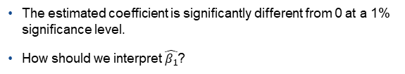
Mortgage applications
6
Does the payment to income ratio affect whether or not a mortgage application is denied?
. regress deny pi_ratio, robust Linear regression | Number of obs = | 2380
 | F( 1, 2378) = | 37.56
 | Prob > F = | 0.0000
 | R-squared = | 0.0397
 | Root MSE = | .31828
deny | Coef. | Robust Std. Err. | t | P>|t| | [95% Conf. Interval]
pi_ratio | .6035349 | .0984826 | 6.13 | 0.000 | .4104144 | .7966555
_cons | -.0799096 | .0319666 | -2.50 | 0.012 | -.1425949 | -.0172243
The estimated OLS coefficient on the payment to income ratio equals $\hat{β_{1}}=0.6$
The estimated coefficient is significantly different from 0 at a 1% significance level.
How should we interpret $\hat{β_{1}}$?

Slide 7

The linear probability model
7
The conditional expectation equals the probability that Yi = 1 conditional on X1i , · · · , Xki :
E [Yi |X1i , · · · , Xki ] = Pr (Yi = 1|X1i , · · · , Xki ) = β0 + β1X1i + · · · βk Xki
The population coefficient βj equals the change in the probability that
Yi = 1 associated with a unit change in Xj .
∂Pr (Yi = 1|X1i , · · · , Xki ) _{= βj}
∂Xj
In the mortgage application example:
$\hat{β_{1}}=0.6$
A change in the payment to income ratio by 1 is estimated to increase the probability that the mortgage application is denied by 0.60.
A change in the payment to income ratio by 0.10 is estimated to increase the probability that the application is denied by 6% (0.10*0.60*100).

Slide 8
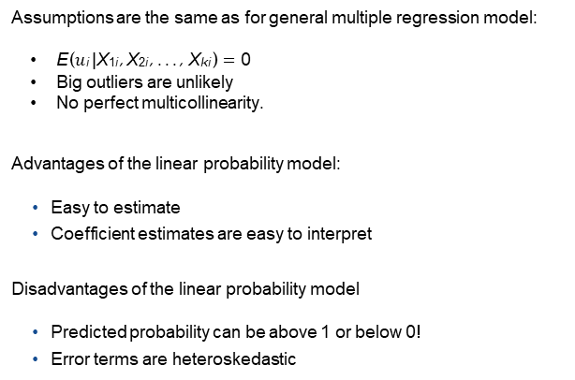
The linear probability model
8
Assumptions are the same as for general multiple regression model:
E ($u$i |X1i , X2i , . . . , Xki ) = 0
Big outliers are unlikely
No perfect multicollinearity.
Advantages of the linear probability model:
Easy to estimate
Coefficient estimates are easy to interpret
Disadvantages of the linear probability model
Predicted probability can be above 1 or below 0!
Error terms are heteroskedastic

Slide 9

The linear probability model: heteroskedasticity
9
Yi = β0 + β1X1i + · · · + βk Xki + ui
The variance of a Bernoulli random variable:
Var (Y ) = Pr (Y = 1) × (1 − Pr (Y = 1))
We can use this to find the conditional variance of the error term
$Var\left(u_{i} | X_{1i},…,X_{ki}\right)=Var(Y_{i}−(β_{0}+β_{1}$ $X_{1i}$ +… ${+β}_{k}$ $X_{ki})| X_{1i},$…, $X_{ki})$
$=Var(Y_{i}|X_{1i},$…, $X_{ki}$)
Solution: Always use heteroskedasticity robust standard errors when estimating a linear probability model!

Slide 10
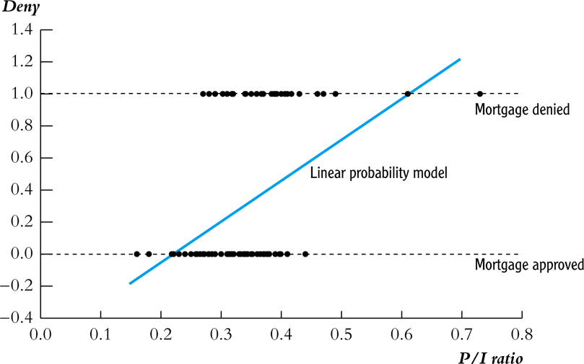
The linear probability model: shortcomings
10
In the linear probability model the predicted probability can be below 0 or above 1!
Example: linear probability model, HMDA data
Mortgage denial v. ratio of debt payments to income (P/I ratio) in a subset of the HMDA data set (n = 127)

Slide 11
Nonlinear probability models
11
Probabilities cannot be less than 0 or greater than 1
To address this problem we will consider nonlinear probability models
Pr (Yi = 1) = G (Z )
with Z = β0 + β1X1i + · · · + βk Xki
and 0 ≤ G (Z ) ≤ 1
We will consider 2 nonlinear functions
Probit
G(Z ) = Φ (Z )
Logit
G (Z ) = ¹
1 + e^{−Z}

Slide 12
Probit
12
Probit regression models the probability that Y = 1
Using the cumulative standard normal distribution function Φ(Z )
evaluated at Z = β0 + β1X1i + · · · + βk Xki
since Φ(z) = Pr (Z ≤ z) we have that the predicted probabilities of the probit model are between 0 and 1
Example
Suppose we have only 1 regressor and Z = −2 + 3X1
We want to know the probability that Y = 1 when X1 = 0.4
z = −2 + 3 · 0.4 = −0.8
Pr (Y = 1) = Pr (Z ≤ −0.8) = Φ(−0.8)

Slide 13
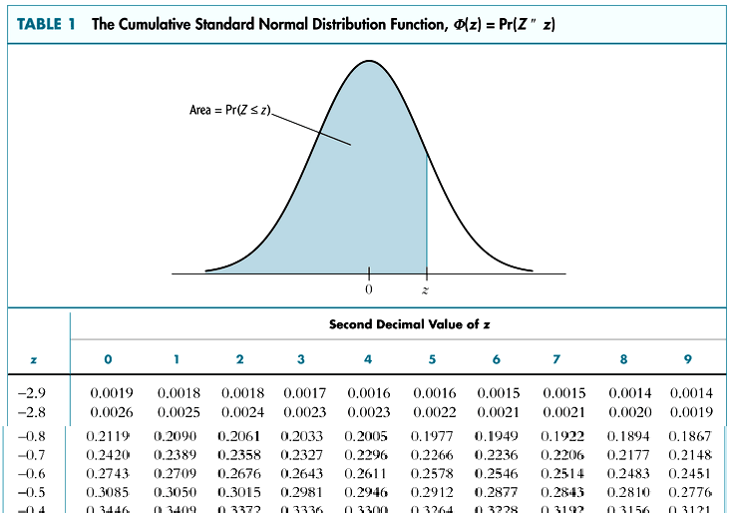
13
Probit
Pr (Y = 1) = Pr (Z ≤ −0.8) = Φ(−0.8) = 0.2119

Slide 14
Logit
14
Logit regression models the probability that Y = 1
Using the cumulative standard logistic distribution function
F (Z ) = ¹
1 + e^{−Z}
evaluated at Z = β0 + β1X1i + · · · + βk Xki
since F (z) = Pr (Z ≤ z) we have that the predicted probabilities of the probit model are between 0 and 1
Example
Suppose we have only 1 regressor and Z = −2 + 3X1
We want to know the probability that Y = 1 when X1 = 0.4
z = −2 + 3 · 0.4 = −0.8
Pr (Y = 1) = Pr (Z ≤ −0.8) = F (−0.8)

Slide 15
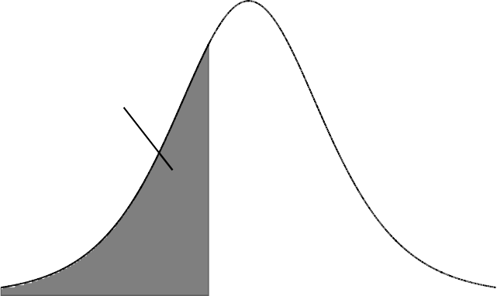
Logit
15
Standard logistic density
.25
.2
Area = Pr(Z <= -0.8)
.15
.1
.05
0
-5
-4
-3
-2
-1
0
1
2
3
4
5
Pr (Y = 1) = Pr (Z ≤ −0.8) =
1
1+e
= 0.31
0.8

Slide 16
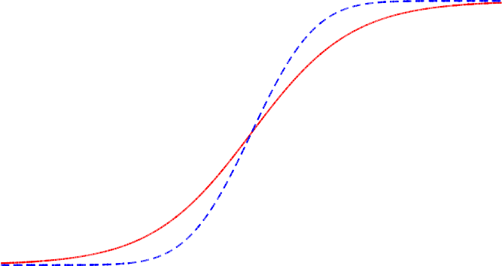
Logit & probit
16
Standard Logistic CDF and Standard Normal CDF
1
.9
.8
.7
.6
.5
.4
.3
.2
.1
0
-5
-4
-3
-2
-1
0
1
2
3
4
5
logistic normal

Slide 17
How to estimate logit and probit models
17
In previous lectures we discussed regression models that are nonlinear in the independent variables
  these models can be estimated by OLS
Logit and Probit models are nonlinear in the coefficients β0, β1, · · · , βk
  these models can’t be estimated by OLS
The method used to estimate logit and probit models is Maximum Likelihood Estimation (MLE).
The MLE are the values of (β0, β1, · · · , βk ) that best describe the full distribution of the data.

Slide 18
Maximum likelihood estimation
18
The likelihood function is the joint probability distribution of the data, treated as a function of the unknown coefficients.
The maximum likelihood estimator (MLE) are the values of the coefficients that maximize the likelihood function.
MLE’s are the parameter values “most likely” to have produced the data.
Lets start with a special case: The MLE with no X
We have n i.i.d. observations Y1, . . . , Yn on a binary dependent variable
Y is a Bernoulli random variable
There is only 1 unknown parameter to estimate:
  The probability p that Y = 1,
  which is also the mean of Y

Slide 19
Maximum likelihood estimation (Optional)
19
Step 1: write down the likelihood function, the joint probability distribution of the data
Yi is a Bernoulli random variable we therefore have
Pr (Yi = y ) = Pr (Yi = 1)^{y} · (1 − Pr (Yi = 1))^{1−y} = p^{y} (1 − p)^{1−y}
1
0
Pr (Y = 1) = p (1 − p) = p
i
0 1
Pr (Y = 0) = p (1 − p) = 1 − p
i
Y1, . . . , Yn are i.i.d, the joint probability distribution is therefore the product of the individual distributions

Slide 20
Maximum likelihood estimation (Optional)
20
We have the likelihood function:
Step 2: Maximize the likelihood function w.r.t p
Easier to maximize the logarithm of the likelihood function
Since the logarithm is a strictly increasing function, maximizing the likelihood or the log likelihood will give the same estimator.

Slide 21
Maximum likelihood estimation (Optional)
21
Taking the derivative w.r.t p gives
Setting to zero and rearranging gives
Solving for p gives the MLE

Slide 22
MLE of the probit model (Optional)
22

Slide 23
MLE of the probit model (Optional)
23
Also with obtaining the MLE of the probit model it is easier to take the logarithm of the likelihood function
Step 2: Maximize the log likelihood function
There is no simple formula for the probit MLE, the maximization must be done using numerical algorithm on a computer.

Slide 24
MLE of the logit model (Optional)
24
There is no simple formula for the logit MLE, the maximization must be done using numerical algorithm on a computer.

Slide 25
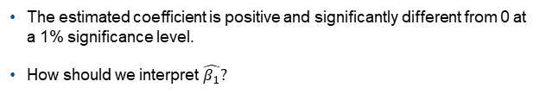

Probit: mortgage applications
25
. probit deny pi_ratio
Iteration 0: log likelihood = Iteration 1: log likelihood = Iteration 2: log likelihood = Iteration 3: log likelihood =
-872.0853
-832.02975
-831.79239
-831.79234
Probit regression
Number of obs = LR chi2( 1) Prob > chi2
Pseudo R2
2380
80.59
0.0000
0.0462
=
=
Log likelihood = -831.79234
=
deny | Coef. | Std. Err. | z | P>|z| | [95% Conf. Interval]
pi_ratio | 2.967907 | .3591054 | 8.26 | 0.000 | 2.264073 | 3.67174
_cons | -2.194159 | .12899 | -17.01 | 0.000 | -2.446974 | -1.941343
The estimated MLE coefficient on the payment to income ratio equals
$$\hat{β_{1}}=2.97$$
The estimated coefficient is positive and significantly different from 0 at a 1% significance level.
How should we interpret $\hat{β_{1}}?$

Slide 26
Probit: mortgage applications
26
The estimate of β1 in the probit model CANNOT be interpreted as the change in the probability that Yi = 1 associated with a unit change in X1!!
In general the effect on Y of a change in X is the expected change in Y
resulting from the change in X
Since Y is binary the expected change in Y is the change in the probability that Y = 1
In the probit model the predicted change the probability that the mortgage application is denied when the payment to income ratio increases from

Slide 27
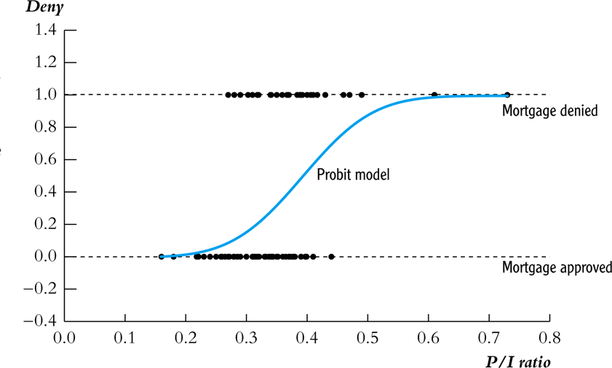
27
Probit: mortgage applications
Predicted values in the probit model:
All predicted probabilities are between 0 and 1!

Slide 28


Logit: mortgage applications
28
. logit deny pi_ratio
Iteration 0: log likelihood = Iteration 1: log likelihood = Iteration 2: log likelihood = Iteration 3: log likelihood = Iteration 4: log likelihood =
-872.0853
-830.96071
-830.09497
-830.09403
-830.09403
Logistic regression
Number of obs = LR chi2( 1) Prob > chi2
Pseudo R2
2380
83.98
0.0000
0.0482
=
=
Log likelihood = -830.09403
=
deny | Coef. | Std. Err. | z | P>|z| | [95% Conf. Interval]
pi_ratio | 5.884498 | .7336006 | 8.02 | 0.000 | 4.446667 | 7.322328
_cons | -4.028432 | .2685763 | -15.00 | 0.000 | -4.554832 | -3.502032
The estimated MLE coefficient on the payment to income ratio equals
$\hat{β_{1}}=$5.88
The estimated coefficient is positive and significantly different from 0 at a 1% significance level.
How should we interpret $\hat{β_{1}}$?

Slide 29
Logit: mortgage applications
29
Also in the Logit model:
The estimate of β1 CANNOT be interpreted as the change in the probability that Yi = 1 associated with a unit change in X1!!
In the logit model the predicted change the probability that the mortgage application is denied when the payment to income ratio increases from

Slide 30
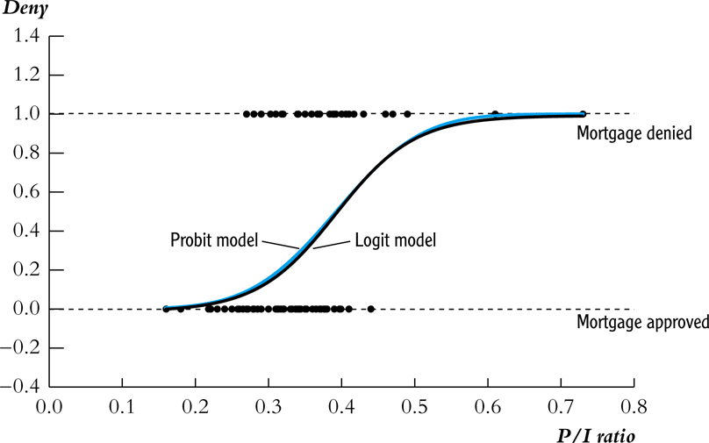
Logit: mortgage applications
30
The predicted probabilities from the probit and logit models are very close in these HMDA regressions:

Slide 31
Probit & Logit with multiple regressors
31
We can easily extend the Logit and Probit regression models, by including additional regressors
Suppose we want to know whether white and black applications are treated differentially
Is there a significant difference in the probability of denial between black and white applicants conditional on the payment to income ratio?
To answer this question we need to include two regressors
  P/I ratio
  Black

Slide 32
Probit with multiple regressors
32
Probit regression
Number of obs = LR chi2( 2) Prob > chi2
Pseudo R2
2380
149.90
0.0000
0.0859
=
=
Log likelihood = -797.13604
=
deny | Coef. | Std. Err. | z | P>|z| | [95% Conf. Interval]
black | .7081579 | .0834327 | 8.49 | 0.000 | .5446328 | .8716831
pi_ratio | 2.741637 | .3595888 | 7.62 | 0.000 | 2.036856 | 3.446418
_cons | -2.258738 | .129882 | -17.39 | 0.000 | -2.513302 | -2.004174
To say something about the size of the impact of race we need to specify a value for the payment to income ratio
Predicted denial probability for a white application with a P/I-ratio of 0.3 is
Φ(−2.26 + 0.71 · 0 + 2.74 · 0.3) = 0.0749
Predicted denial probability for a black application with a P/I-ratio of 0.3 is
Φ(−2.26 + 0.71 · 1 + 2.74 · 0.3) = 0.2327
Difference is 15.8%

Slide 33
Logit with multiple regressors
33
Logistic regression
Number of obs = LR chi2( 2) Prob > chi2
Pseudo R2
2380
152.78
0.0000
0.0876
=
=
Log likelihood = -795.69521
=
deny | Coef. | Std. Err. | z | P>|z| | [95% Conf. Interval]
black | 1.272782 | .1461983 | 8.71 | 0.000 | .9862385 | 1.559325
pi_ratio | 5.370362 | .7283192 | 7.37 | 0.000 | 3.942883 | 6.797841
_cons | -4.125558 | .2684161 | -15.37 | 0.000 | -4.651644 | -3.599472
To say something about the size of the impact of race we need to specify a value for the payment to income ratio
Predicted denial probability for a white application with a P/I-ratio of 0.3
is
_{1/1 + e}−(−4.13+5.37·0.30) _{= 0.075}
Predicted denial probability for a black application with a P/I-ratio of 0.3
is
_{1/1 + e}−(−4.13+5.37·0.30+1.27) _{= 0.224}
Difference is 14.8%

Slide 34
LPM, Probit & Logit
34
Table 1: Mortgage denial regression using the Boston HMDA Data
Dependent variable: deny = 1 if mortgage application is denied, = 0 if accepted
regression model | LPM | Probit | Logit
black | 0.177*** (0.025) | 0.71*** (0.083) | 1.27*** (0.15)
P/I ratio | 0.559*** (0.089) | 2.74*** (0.44) | 5.37*** (0.96)
constant | -0.091*** (0.029) | -2.26*** (0.16) | -4.13*** (0.35)
difference Pr(deny =1) between black and white applicant when P/I ratio=0.3 | 17.7% | 15.8% | 14.8%

Slide 35
Threats to internal and external validity
35
Both for the Linear Probability as for the Probit & Logit models we have to consider threats to
Internal validity
  Is there omitted variable bias?
  Is the functional form correct?
    Probit model: is assumption of a Normal distribution correct?
    Logit model: is assumption of a Logistic distribution correct?
  Is there measurement error?
  Is there sample selection bias?
  is there a problem of simultaneous causality?
External validity
  These data are from Boston in 1990-91.
  Do you think the results also apply today, where you live?

Slide 36
Distance to college & probability of obtaining a college degree
36
Linear regression | Number of obs = | 3796
 | F( 1, 3794) = | 15.77
 | Prob > F = | 0.0001
 | R-squared = | 0.0036
 | Root MSE = | .44302
college | Coef. | Robust Std. Err. | t | P>|t| | [95% Conf. Interval]
dist | -.012471 | .0031403 | -3.97 | 0.000 | -.0186278 | -.0063142
_cons | .2910057 | .0093045 | 31.28 | 0.000 | .2727633 | .3092481
Probit regression
Number of obs = LR chi2( 1) Prob > chi2
Pseudo R2
3796
14.48
0.0001
0.0033
=
=
Log likelihood = -2204.8977
=
college | Coef. | Std. Err. | z | P>|z| | [95% Conf. Interval]
dist | -.0407873 | .0109263 | -3.73 | 0.000 | -.0622025 | -.0193721
_cons | -.5464198 | .028192 | -19.38 | 0.000 | -.6016752 | -.4911645
Logistic regression
Number of obs = LR chi2( 1) Prob > chi2
Pseudo R2
3796
14.68
0.0001
0.0033
=
=
Log likelihood = -2204.8006
=
college | Coef. | Std. Err. | z | P>|z| | [95% Conf. Interval]
dist | -.0709896 | .0193593 | -3.67 | 0.000 | -.1089332 | -.033046
_cons | -.8801555 | .0476434 | -18.47 | 0.000 | -.9735349 | -.786776

Slide 37
Distance to college & probability of obtaining a college degree
37
.35
.3
.25
.2
.15
.1
.05
0
0 5 10 15
Distance to college ( x 10 miles)
Pr( college degree=1| distance)
Linear Probability Probit Logit
The 3 different models produce very similar results.

Slide 38
Summary
38
If Yi is binary, then E (Yi |Xi ) = Pr (Yi = 1|Xi )
Three models:
linear probability model (linear multiple regression)
probit (cumulative standard normal distribution)
logit (cumulative standard logistic distribution)
LPM, probit, logit all produce predicted probabilities
Effect of ∆X is a change in conditional probability that Y = 1
For logit and probit, this depends on the initial X
Probit and logit are estimated via maximum likelihood
  Coefficients are normally distributed for large n
  Large-n hypothesis testing, conf. intervals is as usual

