Slide 1
HRM in perspective seminar
Petr Smutný

Slide 2
Agenda for today
What is HRM and why is it important?
Perspective 1: STRATEGIC
Perspective 2: ORGANIZATIONAL
Perspective 2: CULTURAL and BEHAVIORAL
HRM for beter PERFORMANCE
Q & A

Slide 3
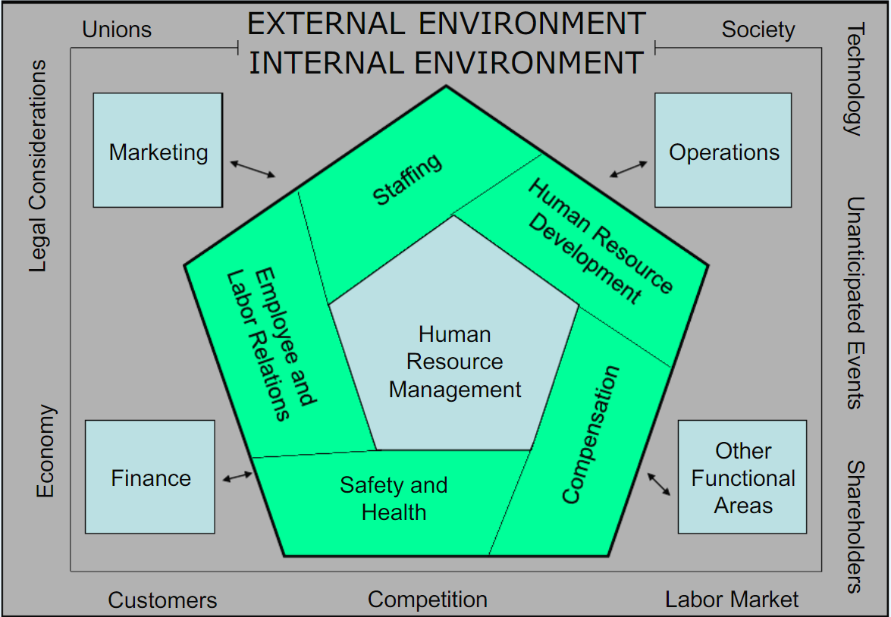
What is HRM and why is it important?
… everything associated with employment relations in an organization.
Why have people/employees become (arguably) the most important asset of a company?

Slide 4
Perspective 1: STRATEGIC
There are two competing perspecitves of SHRM
best practice (univeralistic) approach
best fit (contingency) approach
Some people argue that „best fit“ model is better than „best practice“ model.
What dose the concept of „best fit“ mean?
Are there any potential problems with the concept of „best fit“? If so, what are they?

Slide 5
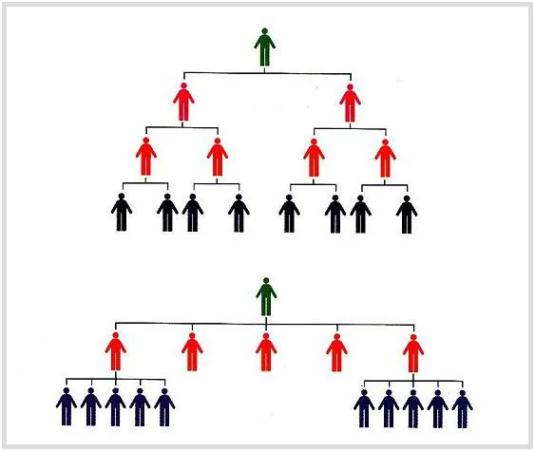
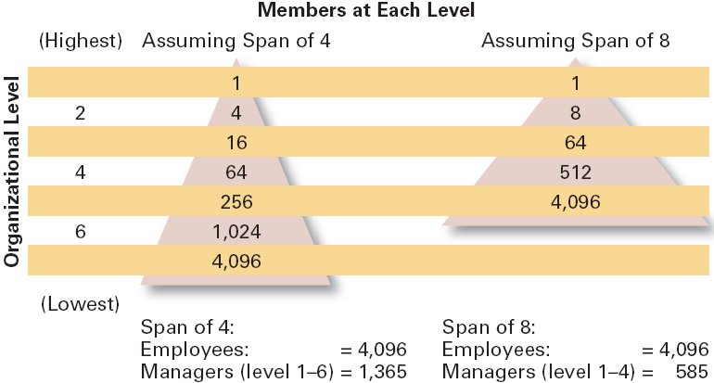
Perspective 2: ORGANIZATIONAL (1/2)
Span of Control
= the number of employees (who can be effectively and efficiently) directly supervised by a manager.
What is the current trend in org. design: towards tall (narrow span of control) or flat (wide span of control) organizational structures?

Slide 6
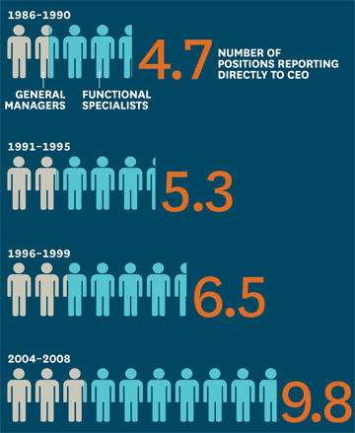
Perspective 2: ORGANIZATIONAL (2/2)
The trend is towards flatter organizations (wider span of control).
How does this influence human resource management in companies?

Slide 7
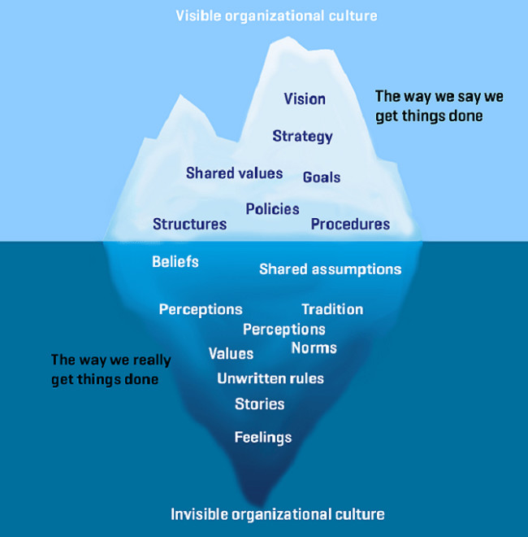
Perspective 3: CULTURAL and BEHAVIORAL
Organizational culture influences how people, teams and organisations behave.
Some people suggest that the most effective organizations have the stronges cultures.
What do we mean by the „strength“ of org. culture?
What factors affect it?
What possible problems are there with a strong org. culture?
What are the implications for HRM?

Slide 8
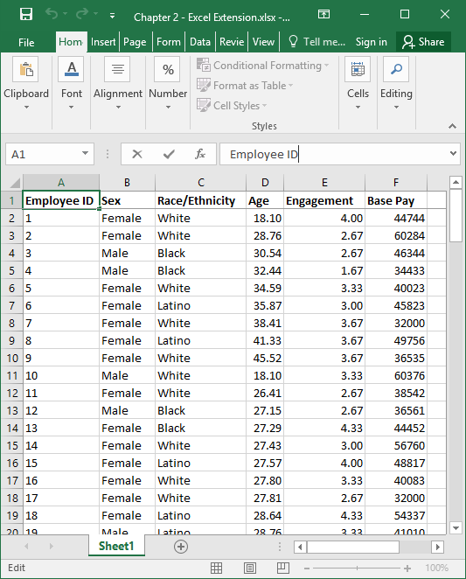
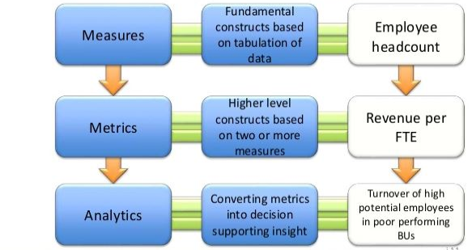
HRM for better PERFORMANCE (1/2)
Progress and performance need to be measured. That allows for evidence-based decisions.
That requires data to be collected in a regular and systematic ways.
Data-driven analyses can support decision making and strategy formulation.

Slide 9
HRM for better PERFORMANCE (2/2)
With the sample data structure on the left:
Which measures can you construct?
Which metrics can you derive?
How can the metrics be used:
  for analysis to facilitate decision making and/or strategy formulation processes?
  to demonstrate HRM performance?

Slide 10
Q & A

Slide 11
THANK YOU

