Slide 1
D9 - Cellulographics©: A novel smartphone user classification metrics
Prateek Kalia

Slide 2
Copyright
This concept is based on Copyright No. L-68022/2017 (Copyright Division, Department of Industrial Policy & Promotion, Ministry of Commerce and Industry, India).

Slide 3
Publication
Kalia, P., Dwivedi, Y. K., & Acevedo-Duque, Á. (2022). Cellulographics©: A novel smartphone user classification metrics. Journal of Innovation & Knowledge, 7(2), 100179. https://doi.org/https://doi.org/10.1016/j.jik.2022.100179

Slide 4
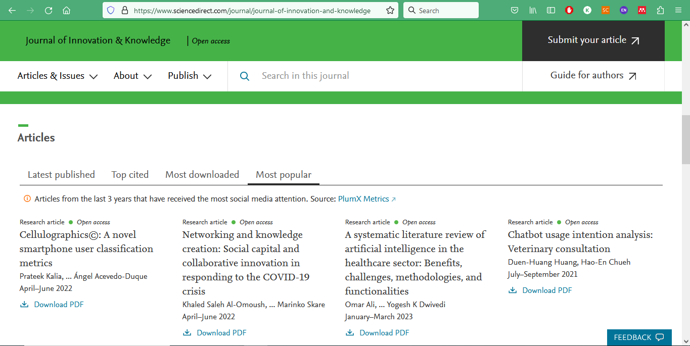
Trending as a most popular article since its publication in JIK (WOS Q1, IF=18.1)

Slide 5
In news
https://www.econ.muni.cz/en/news/cellulographics-is-a-great-new-tool-to-measure-smartphone-use

Slide 6
Minute-to-minute program
Basic introduction (10 mins) 9.00-9.10
Theoretical elaboration (60 mins) 9.10-10.10
Instruction for practical task (20 mins) 10.10-10.30
Break (30 mins) 10.30-11.00
Creating conceptual models (60 mins) 11.00-12.00
Presentation of conceptual models (60 mins) 12.00-13.00

Slide 7
When did you meet a person without a smartphone recently?
Let us start with
some statistical
Information related
to smartphones

Slide 9
BRICS
Brazil ✓
Russia ✓
India ✓
China ✓
South Africa χ

Slide 10
Do you notice BRICS here?

Slide 11
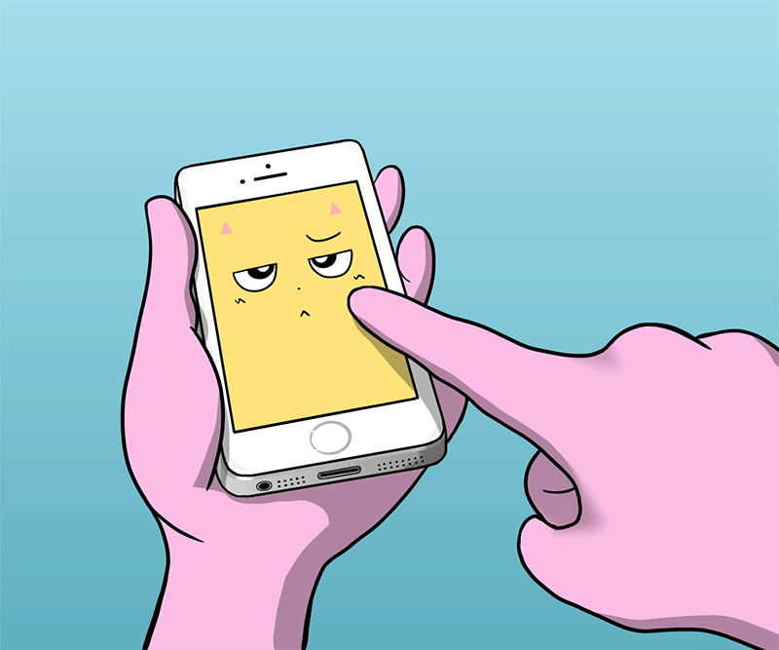
Agenda. Understanding Cellulographics©
Major seminal works on segmentation/classification.
Cellulographics© conceptual model
Creating a research model incorporating cellulographics

Slide 12
Major seminal works on segmentation/classification.
Demographics
John Graunt
Segmentation
Wendell R. Smith
Technographics
Edward Forrest
Cellulographics
Author
1855
1971
2001
1662
Demographics
Achille Guillard
1956
1964
Psychographics
Emanuel H. Demby
1985
Webographics
Joshua Grossnickle
Oliver Raskin
2022
Behavioural
Brand loyalty: Ross M. Cunningham (1956)
Benefit segmentation: Russell I. Haley (1961)
Usage segmentation: Dik Warren Twedt (1964)

Slide 13
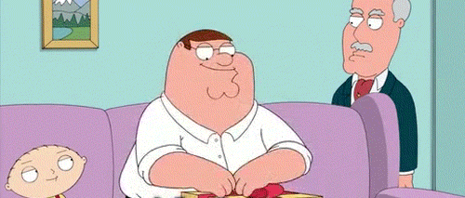
Geographic
Region Pacific, Mountain, West North Central…
City or metro size Under 4,999; 5,000–19,999; 20,000–49,999..
Density Urban, suburban, rural
Climate Northern, southern

Slide 14
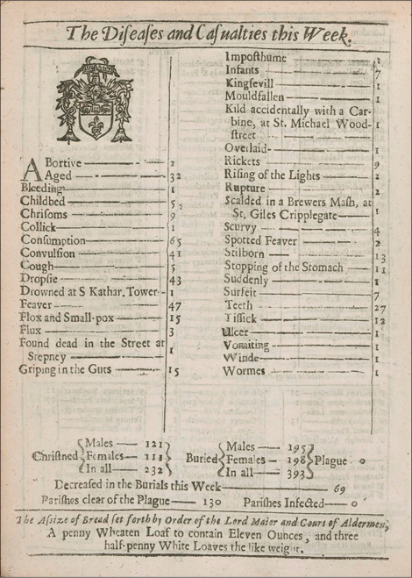
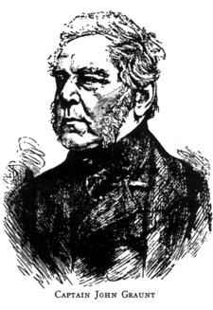
John Graunt (1620-1674): The Father of Demography
Source: Wynder, E. L. (1975). John Graunt 1620–1674 The Father of Demography. Preventive Medicine, 4(1), 85–88.
Natural and Political Observations Upon the Bills of Mortality, 1662

Slide 15
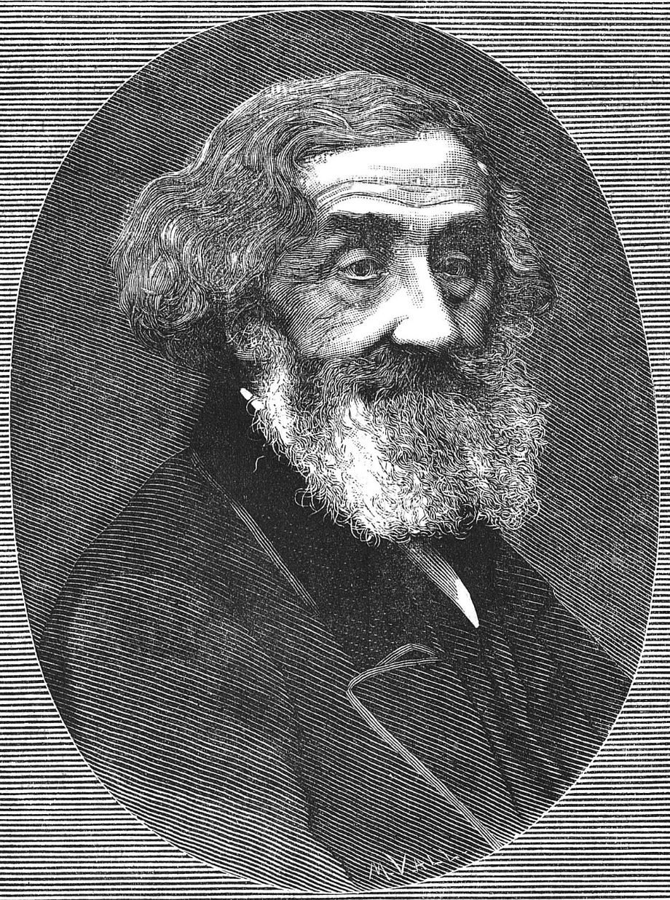
Achille Guillard (1799-1876)
In 1855, a Belgian scholar Achille Guillard defined demography as the natural and social history of human species or the mathematical knowledge of populations, of their general changes, and of their physical, civil, intellectual, and moral condition.

Slide 16
Wendell R. Smith
Smith, W. R. (1956). Product Differentiation and Market Segmentation as Alternative Marketing Strategies. Journal of Marketing, 21(1), 3–8.

Slide 17
Demographic
Age Under 6, 6–11, 12–19, 20–34, 35–49, 50–64, 65
Family Size 1–2, 3–4, 5
Family life cycle Young, single; young, married, no children..
Gender Male, female
Income Under $9,999; $10,000–$14,999; $15,000–$19,999..
Occupation farmers; retired; students; homemakers; unemployed
Education high school graduate; some college; college graduate
Religion Catholic, Protestant, Jewish, Muslim, Hindu, other
Race White, Black,Asian, Hispanic

Slide 18
Demographic (Contd..)
Generation Baby boomers, Generation Xers
Nationality British, French, German, Italian, Japanese
Social class Lower, working, middle, upper

Slide 19
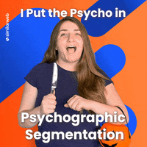
Psychographic
Lifestyle Straights, swingers, longhairs
Personality Compulsive, gregarious, authoritarian, ambitious
Values and attitude
Demby, E. H. (1971). Psychographics: Who, What, Why, When, Where and How. In C. W. King & D. Tigert (Eds.), Attitude Research Reaches New Heights, Proceedings of the Attitude Research Conference.
Arnold Mitchell (February 18, 1918 – July 17, 1985) was a social scientist and consumer futurist who worked for SRI International and created a noted psychographic methodology, Values, Attitudes and Lifestyles (VALS).

Slide 20
Behavioral
Occasions Regular occasion, special occasion
Benefits Quality, service, economy, speed
User status Nonuser, ex-user, potential user, first-time user, regular user
Usage rate Light user, medium user, heavy user
Loyalty status None, medium, strong, absolute
Readiness stage Unaware, aware, informed, interested, desirous, intending to buy
Attitude toward product Enthusiastic, positive, indifferent, negative, hostile

Slide 21
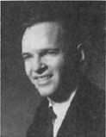
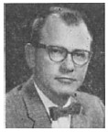
Behavioural
Cunningham, R. M. (1956). Brand loyalty, what, where, how much? Harvard Business Review, 34(1), 116–128.
Haley, R. I. (1968). Benefit Segmentation: A Decision-oriented Research Tool. Journal of Marketing, 32(3), 30–35.
Twedt, D. W. (1964). How Important to Marketing Strategy Is the "Heavy User"? Journal of Marketing, 28(1), 71–72.

Slide 22
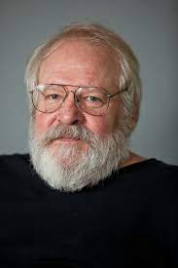
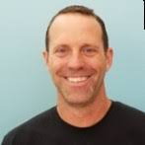
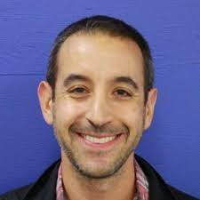
Other segmentations
Webographics: Joshua Grossnickle and Oliver Raskin
Grossnickle, J., & Raskin, O. (2001). Handbook of Online Marketing Research. New York: McGraw-Hill.
Technographics:
Edward Forrest

Slide 23
Cellulographics: The new metrics
The traditional segmentations are getting dated because consumers are migrating to smartphones for their daily online activities. Smartphones are versatile, portable, and 24/7 accessible. Worldwide, smartphone subscription is expected to grow to 7216 million users by 2026 (Statista, 2021), but there is no classification metrics based on smartphone use to date. To fill this gap ‘Cellulographics’ has been proposed and defined as below.

Slide 24
Definition
Cellulographics is a term developed for behavioral classification of smartphone users based on smartphone experience (SE), smartphone use skill (SUS), smartphone internet experience (SIE), smartphone use periods (SUP), smartphone screen time (SST), smartphone use frequency (SUF), smartphone use activities (SUA), and smartphone use location (SUL). These terms are explained below.

Slide 25
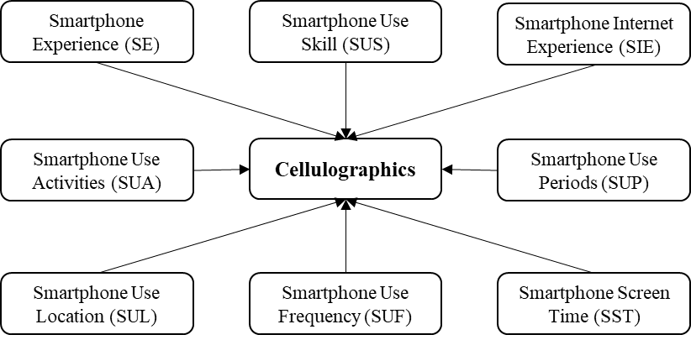
Cellulographics© conceptual model

Slide 26
Smartphone experience (SE)
It is the number of years an individual is using a smartphone. This criterion is important because the length of usage, familiarity, compatibility of the innovation with past experiences, existing values, needs, expertise, background, and prior knowledge can inhibit or motivate technology use.

Slide 27
Smartphone use skill (SUS)
It is an individual’s self-assessment of the ability and proficiency to use the smartphone. Due to differences in culture, social environment, personal characteristics, technological context, etc., information communication and technology (ICT) skills may vary in individuals.

Slide 28
Smartphone internet experience (SIE)
It is an individual’s internet experience through a smartphone. Marketers are trying to provide a seamless mobile internet experience to the users (Asunmaa et al., 2002). Advantages like, mobility, lightweight, long battery life, instant-on capability, high-definition touch screen, and interactivity are leading to higher smartphone dependency and gratifications.

Slide 29
Smartphone use periods (SUP)
It is the time when the user indulges in smartphone use in a day, like morning (6:01 to 12:00), afternoon (12:01 to 18:00), evening (18:01 to 0:00), and night (01:00 to 6:00) (MAEN). Researchers believe that differences may exist in total daily duration, number of uses, and use length at different times of the day.

Slide 30
Smartphone screen time (SST)
It is the time measured in the number of hours or minutes per day, spent by an individual on smartphone use. Researchers believe that screen time is one of the effective methods for determining technology usage.

Slide 31
Smartphone use frequency (SUF)
It is the number of use sessions in a specific time period or the number of times an individual checks his or her smartphone. SUF is also one of the important criteria to access technology usage.

Slide 32
Smartphone use location (SUL)
It is the location from where an individual uses the smartphone or access the internet through it, such as home, office, leisure place, etc. Locational categories (shopping, movie and shows, work and education, recreation and amusement, food and drink, and sports and exercise) proposed by Exler et al. (2016) are quite balanced.

Slide 33
Smartphone use activities (SUA)
A smartphone is a versatile device, it can be used for a variety of work or leisure activities. Elhai et al. (2016) proposed an extensive list that includes 11 activities which are, voice/video calls, email, texting/instant messaging, internet/websites, social networking sites, games, music/podcasts/radio, watching video/tv/movies, taking pictures or videos, maps/navigation and reading books/magazines.

Slide 34
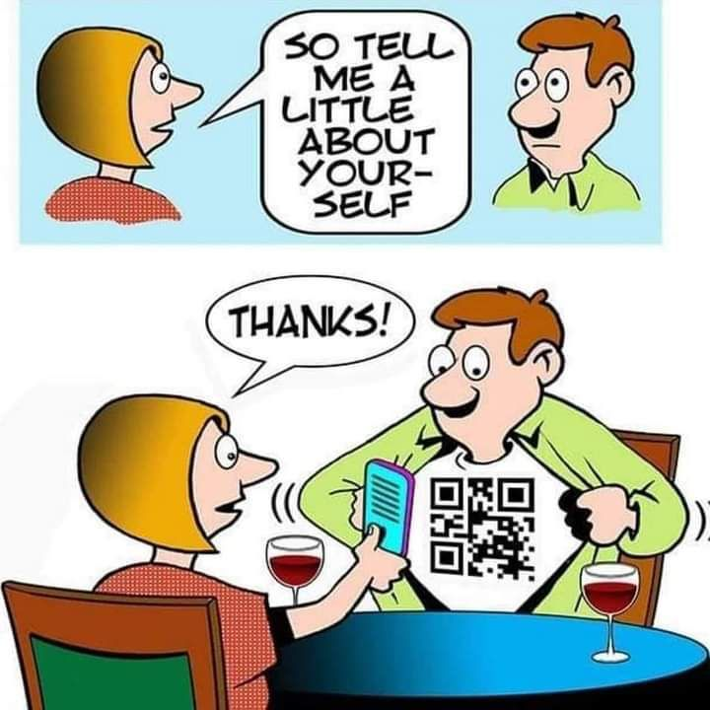
Future
This concept can be applied to any field of study without limitations, where smartphone use is involved. For example, medicine (sleep and health issues due to smartphone use), psychology (smartphone addiction), business management (mobile commerce), computers (human-computer interactions), etc.

Slide 35
Any questions?

Slide 36
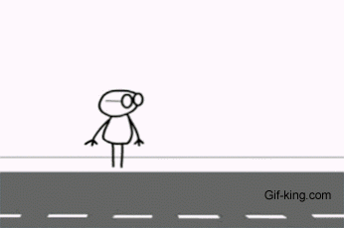
Some real practice now !
Task
To create a research model incorporating cellulographics and your field of interest.
Be original and creative, don’t copy.

