Slide 1
Mechanics of Academic Style

Slide 2
Spelling of plural forms
The plural forms of some words of Latin or Greek origin can be troublesome
Singular:
Appendix
Criterion
Curriculum
Datum
Hypothesis
Phenomenon
Correct: The data indicate
Incorrect: The data indicates
“data base” has become “database,” and “e-mail” has become “email”
Plural:
Appendices
Criteria
Curricula
Data
Hypotheses
Phenomena

Slide 3
Capitalization
Capitalize
The first word in a complete sentence
Names of racial and ethnic groups (“We interviewed 25 Black women”)
Nouns Followed by Numerals or Letters (Figure 2.4, Chapter 5)
Job Titles and Positions when the title precedes a name
“Executive Director of Marketing Carolina Espinoza….”
Do not capitalize
A personal name that begins with a lowercase letter when the name begins a sentence; alternatively, reword the sentence
“… after the test. van de Vijver et al. (2019) concluded …”
Statistical terms (t-test, p-value)
A proper noun that begins with a lowercase (iPad, eBay)

Slide 4
Use of italics
Do not use italics for quotations.
Use italics
  for words in other languages (the first use of a word)
  for titles of works (book titles, journal names, films, poems)
  to provide emphasis
  Ex: The word very is often unnecessarily added to academic writing.
  for scientific and technical terms (names such as Homo sapiens)
  for key terms/phrases
  In the reference list, journal and book titles use italics:
  Borjas, G. J. (1995). The Economic Benefits from Immigration. The Journal of Economic Perspectives, 9(2), 3–22.
https://apastyle.apa.org/style-grammar-guidelines/italics-quotations/italics

Slide 5
Use of Abbreviations
Use abbreviations to save space and avoid repetition
If you use the abbreviation only one or two times, readers may have difficulty remembering what it means (better do not abbreviate).
There is no limit for the use of abbreviations but do not overuse
Text is generally easier to understand when most words are written
Define all abbreviations used in all tables and all figures
  Compare sentences written with and without abbreviations:
  “The advantage of the LH was clear from the RT data,
  which reflected high FP and FN rates for the RH.”
  “The advantage of the left hand was clear from the reaction time data, which reflected high false-positive and false-negative rates for the right hand.”

Slide 6
Latin Abbreviations
Avoid e.g. and i.e., instead use for example and for instance.
Avoid etc. (and so forth)
Avoid vs or v, instead use versus or against
abbreviation “et al.” is a short form of et alia (and others)
It is acceptable when giving in text citations with multiple authors. The full stop should always be included afterwards to acknowledge the abbreviation. It does not need to be italicised as it is in common usage.
Vis-à-vis is from French and its meaning is “face-to-face”
It is used to compare things, or as synonym for “opposite” or “facing.”
Ex: Upgrading immigrant integration policies reduces the gap in unemployment and thus improves immigrants’ labor market position vis-à-vis the natives.

Slide 7
Use Numbers expressed in Numerals
Numbers higher than nine can be written in numerals
Numbers that represent statistics, percentages, ratios, percentiles
Ex: In January 2022, car production fell by 11.4% to 92,657 vehicles.
Time, dates, ages, scores and points on a scale, exact sums of money
Ex: Monday 6 March, 2023, was 2 years old, scored 4 on a 7-point scale,
3 years ago, GDP per capita US$15,027, price increased by $5.
Number after a noun vs. Number before a noun
Ex: Table 2, Column 8, but the second table, the eighth column
Use commas between groups of three digits in most figures of 1,000 or more
Ex: $200,000 but “about two hundred thousand dollars”
Most data can be effectively presented with two decimal digits of accuracy

Slide 8
Use Numbers Expressed in Words
Numbers zero through nine should be written in words
Ordinal numbers less than 10th (e.g., fourth, second)
Exceptions for number usage:
Any number that begins a sentence, title, or heading (or reword the sentence)
Ex: Twelve students improved, and 12 students did not improve.
Common fractions, Ex: Three fourths of the population…
Common phrases, Ex: Seven Wonders of the World, Twelve
It is acceptable to use either numerals or words depending on the context
Ex: a thousand people or 1,000 people
Vague numbers, and less precise large numbers
Ex: half of the population, several thousand, around eight o’clock
Rounded numbers, Ex: four hundred, two thousand, six million.
Notes:
“The year 1066 saw one of the most famous battles in English history.”

Slide 9
Out of 18 students in the group, 12 were women.
One in three engineering students is from China.
Twice as many women as men study business law.
There was a fivefold increase in the price of oil.
The rate of infection halved after 2001.
The unemployment rate doubled after 2008.
A fifth of all employees leave every year.
More than 80 per cent of British students complete their first degree course; in Italy, the figure is just 35 per cent.
The course fees rose from $1,200 to $2,500 in two years.
Since 2008, the number of prisoners has risen by 22 per cent.

Slide 10
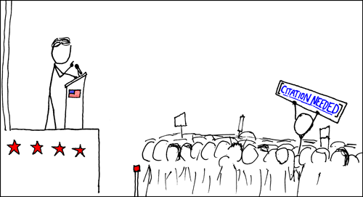
References and Quotations (APA 7th ed.)

Slide 11
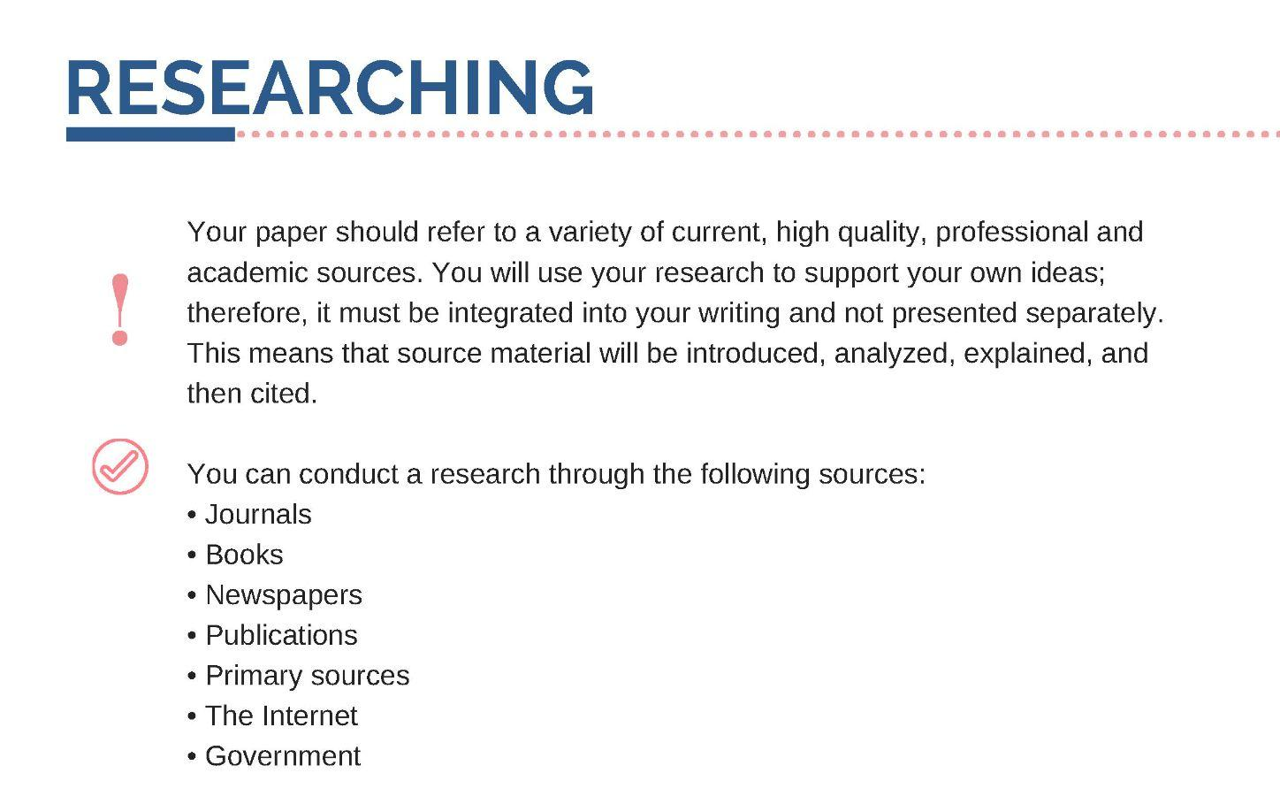

Slide 12
Why use references?
Reasons for providing references and citations:
To show that you have read some works of experts on the subject,
which will give added weight (and quality) to your writing.
To allow readers to find the source, if they wish to examine the topic further
To avoid plagiarism.
Decide if you need to give a reference in the following cases.
No
Yes
Yes
No
Yes
No

Slide 13
Basic principles
Cite only works that you have read
Cite primary sources when possible
All sources that are cited in the text must appear in the references at the end of the paper
Ensure the spelling of author names
Avoid using online sources that cannot be retrieved
If an idea or theory is in a textbook and does not carry a specific citation there, then you probably do not need to cite anyone.
BUT empirical work is nearly always specific and must be cited.
If in doubt – cite it!

Slide 14
In-text citations have two formats: parenthetical and narrative
Friedman (1991) pointed out that inflation is effectively
a kind of taxation.
It could be also said that that inflation is effectively
a kind of taxation (Friedman, 1991).
Friedman (1991) pointed out that ”inflation is the one form of taxation
that can be imposed without legislation” (p. 93).
It could be also said that “inflation is the one form of taxation
that can be imposed without legislation” (Friedman, 1991, p. 93).
References
Friedman, M. (1991). Monetarist Economics. Basil Blackwell.
narrative citation
parenthetical citation
parenthetical citation
with a page number because of a direct quotation

Slide 15
Six Steps to Proper Citation

Slide 16
Use of quotation
When you use the work of others as primary data
When you want to appeal to their authority
When the original is more concise than your summary could be
To avoid any ambiguity or misrepresentation of source material
When the original version is well known
You dispute your source and you want to state her case fairly
The words of the source are especially vivid or significant

Slide 17
Direct quoting from a work
Short quotations appear in double quotation marks
Long quotations (40+ words) appear in the block quotation format
Include the author, year of publication, and page number
Use the abbreviation “p.” (for one page) or “pp.” (for more pages) before listing the page number(s). Use en dash for page ranges.
For example: (Jones, 1998, p. 199) or (Jones, 1998, pp. 199–201)
Do not use italics for quotations.

Slide 18
According to Jones (1998), "students often had difficulty using APA style, especially when it was their first time" (p. 199).
Jones (1998) found "students often had difficulty using
APA style" (p. 199).
She stated, "Students often had difficulty using APA style" (Jones, 1998, p. 199), but she did not offer an explanation as to why.
Mindfulness is defined as "the act of noticing new things, a process that promotes flexible responding to the demands of the environment" (Pagnini et al., 2016, p.91).

Slide 19
Place long quotations (40+ words) in a free-standing block of typewritten lines and omit quotation marks.
Short quotation
Long quotation
Text highlighting

Slide 21
Paraphrasing Sources
Paraphrase as much as possible, rather than quote
  when you are more interested in content, findings or claims
  to summarize or acknowledge another author’s ideas
  when you want to explain difficult material in a way which is easier for your reader to understand
You cannot write a paper out of a series of quotations. You must make your own arguments with your own claims and evidence

Slide 22
Paraphrase citations
Include the author and date in every in-text citation
In parenthetical citations (Author, year) there is a comma between the author and year
In narrative citations Author (year), there is the date in parentheses after the author
For a work with three or more authors include the name of only the first author plus “et al.” in every citation. Ex: (Author et al., year)
All works in the reference list need to be cited in the text
Avoid undercitation = it can lead to plagiarism
Avoid overcitation = for longer paraphrases use one citation when introducing the idea and not repeated the citation
https://apastyle.apa.org/instructional-aids/in-text-citation-checklist.pdf

Slide 23
Basic In-Text Citation Styles
Author | Parenthetical citation | Narrative citation
One author | (Luna, 2020) | Luna (2020)
One author with a quote | (Luna, 2020, p. 37) | Luna (2020) (p. 37)
Two authors | (Salas & D’Agostino, 2020) | Salas and D’Agostino (2020)
Three or more authors | (Martin et al., 2020) | Martin et al. (2020)
Group of authors | (OECD, 2020) | OECD (2020)
In parenthetical citations, use an ampersand (&) between names
(Salas & D’Agostino, 2020)
In narrative citations, spell out the word “and”
Salas and D’Agostino (2020)
Works with the same author and same date
(Judge & Kammeyer-Mueller, 2012a)
(Judge and Kammeyer-Mueller, 2012b)
If multiple authors within a single reference share the same surname
(Chen & Chen, 2019)

Slide 24
Parenthetical citation
Include citation in the sentence = put the period after the closing parenthesis
Many Americans fail to vote (Hobolt et al., 2006).
When citing multiple works in parenthesis, place the citations in alphabetical order, and separate them with semicolons.
… (Hobolt et al., 2006; Westinghouse, 2017).
Multiple sources in narrative citation can appear in any order
Suliman (2018), Gutiérrez (2012), and Medina and Reyes (2019) examined…
Arrange works by the same authors by year of publication
(Carraway et al., 2013, 2014, 2019)
You can cite specific parts of a source
(Armstrong, 2015, pp. 3–17), (Kovačič & Horvat, 2019, Table 1)

Slide 25
For decades, organizational stress researchers have focused on how work in general and job stressors in particular affect workers’ well-being, health, and performance behaviors (Bliese et al. 2017).
Bliese et al. (2017) noted that “mobile devices enabled employees in many jobs to work ‘anywhere, anytime’ and stay electronically tethered to work outside formal working hours” (p. 391).
Reference
Bliese, P. D., Edwards, J. R., & Sonnentag, S. (2017). Stress and well-being at work:
A century of empirical trends reflecting theoretical and societal influences. Journal of
Applied Psychology, 102(3), 389–402. https://doi.org/10.1037/apl0000109

Slide 26
References (Bibliography)
List of references is placed at the end of a work.
Each entry provides the author, date, title, and source of the work.
The reference allows readers to identify and retrieve the source.
Sources are listed in alphabetical order by the author last name.
You should have a reference entry for every source you cite.

Slide 27
Organizing the list of references
Use a citation manager like Zotero or Citace PRO to organize your research and to easily create a bibliography
Always check the reference list for mistakes
Use the most recent 7th APA style

Slide 28
References
Notice differences:
Book with one author
Book with many authors
Book chapter
OECD report
Journal arcticle
Esping-Andersen, G. (1990). The Three Worlds of Welfare Capitalism. Princeton University Press.
Foltýnek, T., Mach, J., Kozmanová, I., Holeček, T., Vorlová, H., Henek Dlabolová, D., Vorel, F., Válová, A., Tesaříková Čermáková, K., & Gojná, Z. (2021). How to Avoid Plagiarism: Student Handbook. Karolinum - Charles University Press.
Giovannetti, G., & Lanati, M. (2016). Migration and Development. A focus on Africa. In Routledge Handbook of Immigration and Refugee Studies. Edited by Anna Triandafyllidou (pp. 236–242). Routledge.
OECD. (1992). The Employment Outlook. OECD.
Stark, O., & Bloom, D. (1985). The New Economics of Labor Migration. The American Economic Review, 75(2), 173–178.
https://apastyle.apa.org/style-grammar-guidelines/references/examples

