Slide 1
Avoiding plagiarism

Slide 2
As a student you are a member of an academic community and therefore you must comply with the code of conduct that applies within that community.

Slide 3
A disciplinary offence includes
any kind of cheating, or unauthorized cooperation during studies
plagiarising someone else’s work
submission of an identical or only slightly adapted paper in order to fulfil various study duties without previous consent
providing one’s own written work to another student
any form of cheating during a written exam
gross or repeated violation of the Faculty’s internal regulations (applies also to the use of university computer network)
intentional destruction of property
aggressive or disturbing behaviour
consumption of alcoholic beverages and use of addictive drugs
failure to pay tuition fees
Student Disciplinary Code: https://is.muni.cz/do/econ/soubory/oddeleni/ozs/10355091/Student_Disciplinary_Code.pdf

Slide 4
Faculty directive 9/2019: Preparation, Submission, Publication and Evaluation of Bachelor’s, Final and Master’s Theses
Plagiarism is understood as unauthorised imitation or adoption of an artistic or scientific work without acknowledging the model or author.
Hiring another person to write a final thesis or buying (borrowing, stealing, etc.) a final thesis is also considered plagiarism (not only) in academia.
Whether or not plagiarism has been committed does not depend on the amount of „non-cited” information; plagiarism may be committed by using a single sentence or even a few words, or an unusual collocation or idiom. Citing only a certain number of borrowed ideas and leaving the others, borrowed from the same source, uncited also constitutes plagiarism.
Plagiarism can also be a violation of copyright law and lead to prosecution.
https://www.econ.muni.cz/en/students/bachelors-and-masters-studies/avoid-plagiarism
Directive: https://is.muni.cz/auth/do/econ/uredni_deska/predpisy_ESF/smernice/smernice_dekana/prehled/2019/smernice_c_9_2019_o_tvorbe_odevzdavani_zverejnovani_a_hodnoceni_bc_zaverecnych_a/SmerniceDekana2019_c.9__EN_FINALNI.docx

Slide 5
Referencing is critical for academic success
The basis for development of academic knowledge is to build upon the results of other academics.
Plagiarism means using another’s work without giving credit.
Obvious cases of plagiarism include:
  Copying or stealing text from online (translation of foreign text)
  Hiring someone to write a paper for you
  Copying whole paragraphs from a book, article, or online source without quotation marks or proper citation
  In academia it is possible to plagiarize from yourself

Slide 6
When you must acknowledge the author
Academic writing = correct use of references.
Quoting (use of quotation marks)
Paraphrasing (express the same with your own words)
Summary (main idea written in your own words)
Synthesizing (reference all authors that informed your writings)
When directly quoting, paraphrasing, summarizing, or synthesizing,
you must acknowledge your sources.
Notes:
You must put others’ words in quotation marks and cite your source(s) and must give citations when using others’ ideas, even if those ideas are paraphrased in your own words.

Slide 7
When you do not need to cite
Writing your own lived experiences, your own observations and insights, your own thoughts, and your own conclusions about a subject
When you are writing up your own results
When you use your own artwork, digital photographs, video, audio, etc.
When you are using "common knowledge“, things like common sense observations, historical events (but not historical documents)
When you are using generally accepted facts (e.g., pollution is bad for the environment) including facts that are accepted within particular research fields.
Material is probably common knowledge if . . .
You find the same information undocumented in at least five other sources
You think it is information that your readers will already know
You think a person could easily find the information with general reference sources

Slide 8
When you need to cite
Words or ideas presented in a book, journal, report, magazine, newspaper, song, TV program, movie, website, computer program, letter, advertisement, or any other medium
Information you gain through interviewing or conversing with another person, face to face, over the phone, or in writing
When you copy the exact words or a unique phrase
When you reprint any figures, pictures, or other visual materials
When you reuse any digital media, including images, audio, video

Slide 9
What is the risk to be discovered?
The risk is high.
Online material is relatively easy to plagiarise.
But it is also easier to find cases of plagiarism.
Current tools can analyze and investigate the authenticity of a text. Think that your thesis may be checked for originality also in the future with better tools.
All universities consider plagiarism a serious academic offense,
and impose serious penalties on students who plagiarize.
Deliberate plagiarism is simply avoided by not cheating.

Slide 10
Consequences of plagiarism
The consequences of plagiarism vary based on the severity of the offense.
Level | Examples | Likely consequence
Mild | Source cited in text but left out of reference list Quotation marks omitted around a quote | Grade penalty or automatic zero
Moderate | Text copied from a source with a few words changed Source paraphrased without citation | Failing grade on course
Severe | Patchwork of different texts submitted as original paper Paper written by someone else (contract cheating or ghostwriting) | Unconditional expulsion from study programme Damage to professional reputation

Slide 11
Excuses of students when caught on plagiarism
“I didn't know it was plagiarism.”
“I did it for the first time.”
“I didn't know how to do the assignment.”
“I have photographic memory.”
“I write miserably.”
“I just helped my friend.”
“We both referred to the same literature sources.”
“I'm too busy.”
Notes:
Start plagiarism prevention by avoiding the following excuses:
1. “I didn’t know it was plagiarism.”
Nice try, but it doesn’t work in higher academic institutions. It might have been alright back in middle school, but now, when you’re in college or university, be ready to deal with new rules. The academic honor code prohibits student dishonesty and “takes care of the rule-breakers,” if a text plagiarism checker finds plagiarism.
2. “I did it for the first time.”
One time is enough. Punishment for plagiarism differs from case to case and from university to university – you can receive a formal notice or suspension for some time. If the case is too serious or repeated, you can even be expelled from your educational establishment.
3. “I didn’t know how to do the assignment.”
It’s easy to say that you were unaware of what you had to do. If your task is done incorrectly, you receive a low grade or some kind of punishment. Sometimes students are assigned tasks they haven’t done before, but assignments come with suggested guidelines or patterns to follow. Ignorance is not an excuse to justify fraud or theft..
4. “I have photographic memory.”
Some violators claim to copy unintentionally as they memorize a text immediately after reading it. It’s quite easy to prove if that’s true or false. You be sure if you use this excuse, teachers would love to test your abilities. You know how this will end up – with suspension or exclusion.
5. “I write miserably.”
You may realize that your work is clearly of low quality – you lack experience, adequate writing skills or organization. Don’t worry because every day presents opportunities to gain experience. Ask your teacher for help in improving your writing skills. The teacher doesn’t expect you to receive only “A” grades.
6. “I just helped my friend.”
Sure, you can help your friend by writing his/her paper. Unfortunately, there is bad news for you both: anyone involved in creating a paper can be considered guilty of plagiarism. Please, don’t forget that plagiarism also covers usage of work written by somebody else.
7. “We both referred to the same literature sources.”
Plagiarism is detected with the help of plagiarism software online. The plagiarism check software shows exactly what was plagiarized – similar wording is highlighted so you can easily trace the source. It doesn’t matter what exactly you copied – a source material or somebody else’s work – it’s still plagiarism.
8. “I’m too busy.”
As a student, sometimes the assignments pile up. You hang out at campus trying to get everything done on time. You think that the only way out in finishing your paper is to plagiarize! Regretfully, it’s a lame excuse.
If you experience difficulties with time management, reconsider your schedule and define your priorities. Also, it’s good to make notes so that important things aren’t forgotten. Create a good weekly working plan. Finally, if you don’t have time, you may talk it over with your educator and postpone the deadline.

Slide 12
The university statement on the use of AI
Pragmatic approach is recommended. Use AI meaningfully in your studies. The active use of AI tools may soon become a norm in our lives.
Do not rely entirely on outputs provided by AI. Be cautious about outputs and verify information you receive through these tools.
Be transparent about the use of AI and openly declare or cite
the use of AI tools at all times.
The unacknowledged use of AI is in principle the same as ghostwriting, which is a form of plagiarism.
User is always responsible for using the AI. Be responsible.

Slide 13
Simple rules for responsible referencing

Slide 14
Rule 1: Include relevant citations
Citations identify where ideas have come from, and consulting the cited works allows readers of your text to study them more closely, as well as to evaluate whether your use of them is appropriate.
Rule 2: Read the publications you cite
Citation is not an administrative task. Read the text to identify whether its content is relevant as support for your claim. You should cite meaningfully. The quality of the sources you include determines the quality of your work.

Slide 15
Rule 3: Cite in accordance with content
Sources that you cite deserve credit for the exact contribution they offer. Cite a single source multiple times throughout your own text, including explanations why. Citations should mention assessments of value, and relevance of whether findings support or oppose your conclusions.
Rule 4: Prioritise the citations you include
Prioritise reviewed (academic journals) over unreviewed sources (reports, blogs). Read and cite quality academic journals.

Slide 16
Refreshing APA citation rules

Slide 17
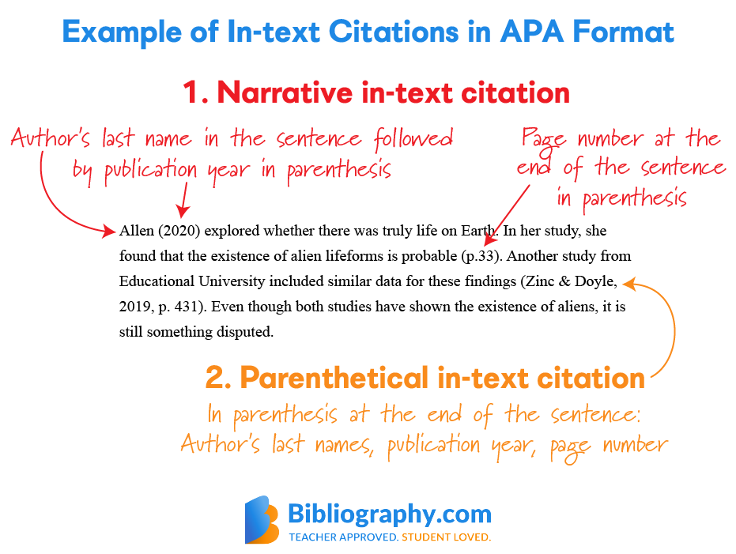

Slide 18
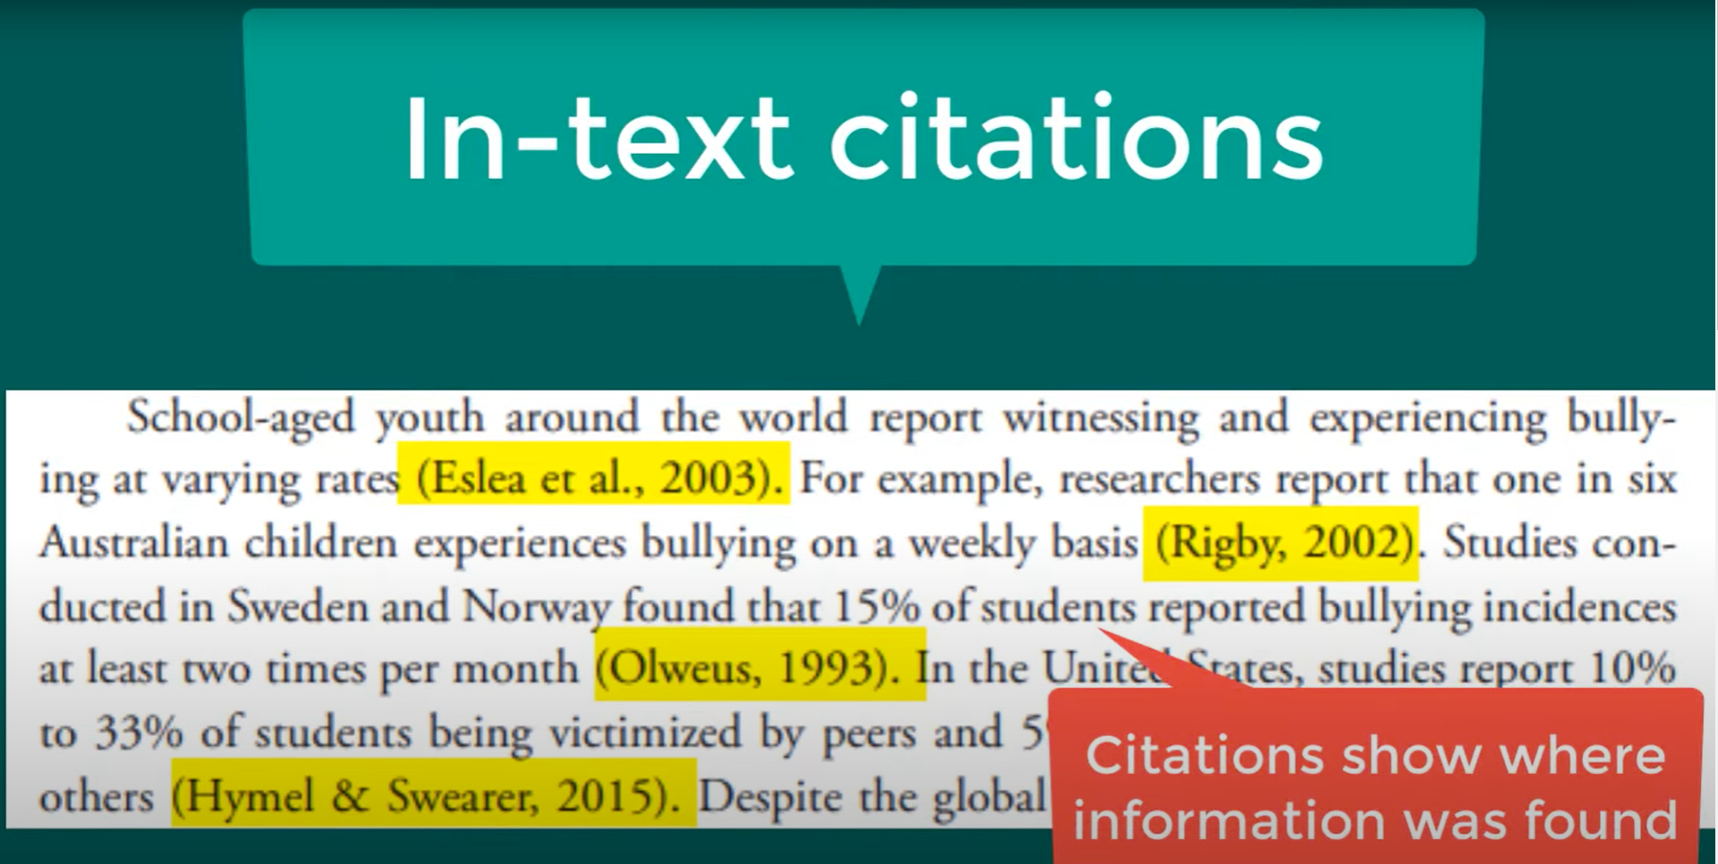
https://www.youtube.com/watch?v=h7XVOf-uIpA

Slide 19
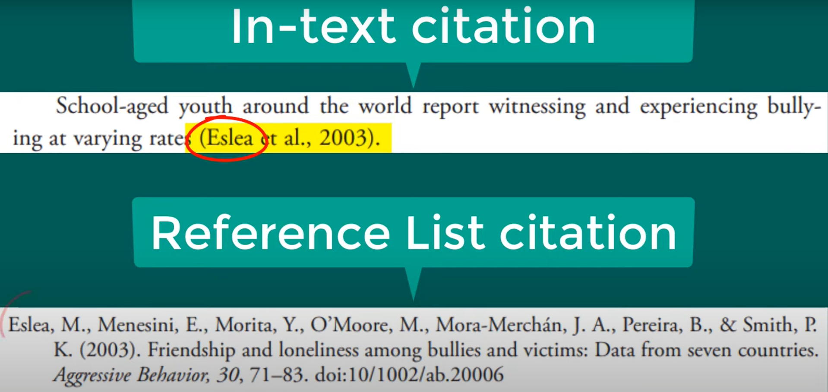
https://www.youtube.com/watch?v=h7XVOf-uIpA

Slide 20
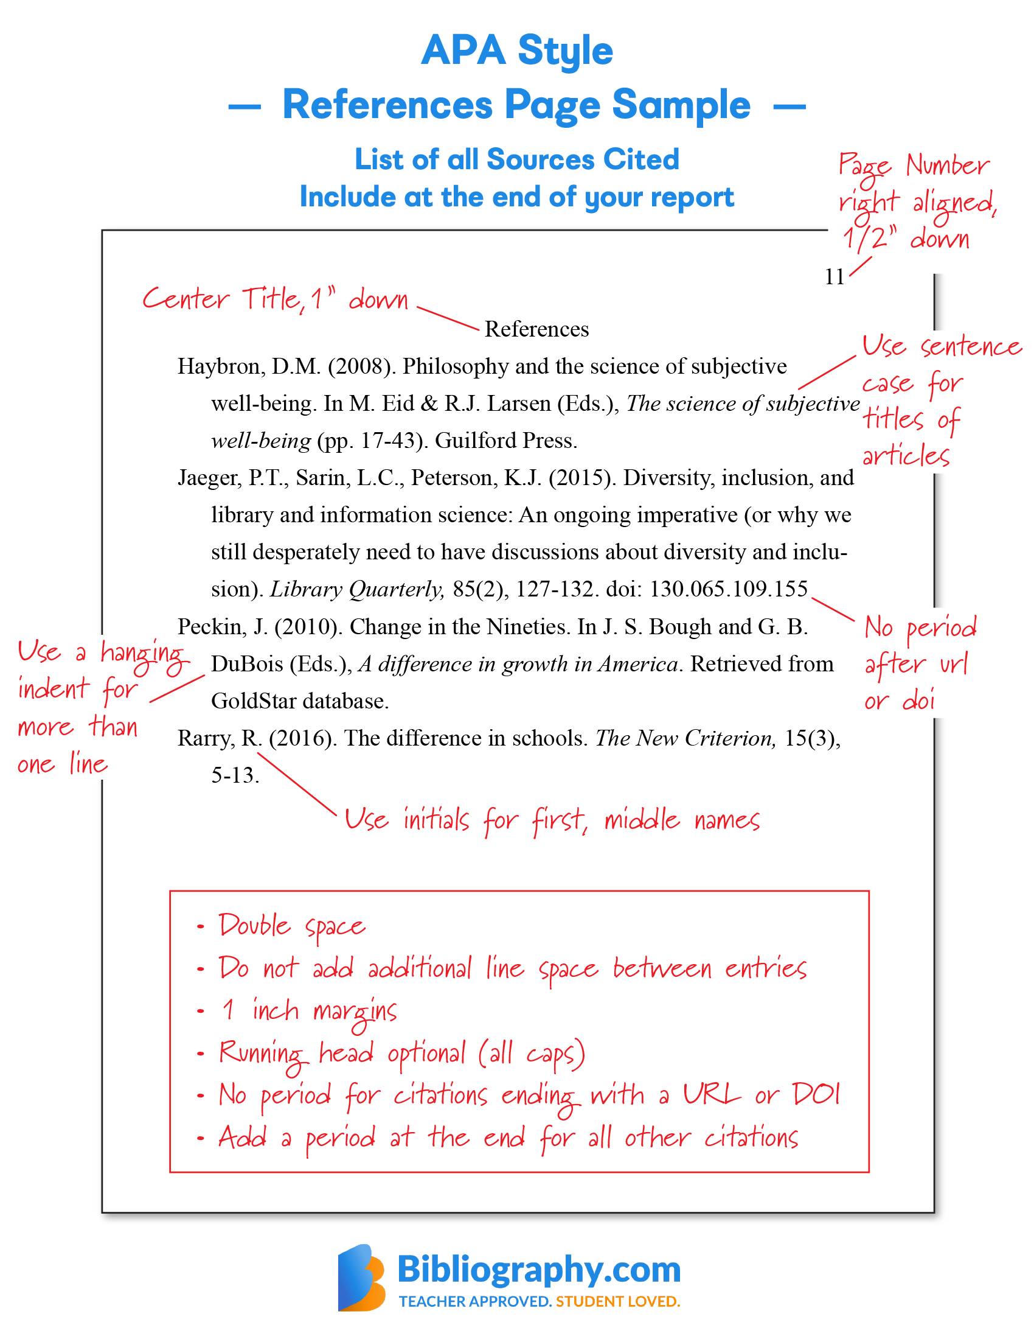
Do not forget to put your references in alphabetical order.

Slide 21
Working with foreign language materials
In the reference list you should provide a translation of the title of the work in the same language as your paper and place it in square brackets after the original title.
Molinari, E., & Labella, A. (2007). Psicologia clinica: Dialoghi e confronti [Clinical psychology: Dialogue and confrontation]. Milan: Springer.
Najm, Y. (1966). Al-qissah fi al-adab Al-Arabi al-hadith [The novel in modern Arabic literature]. Beirut: Dar Al-Thaqafah.

Slide 22
Is this a plagiarism?

Slide 23
The citation rules are simple
If . . . . | Then . . .
The information is common knowledge
The words are your own AND The idea is your own
The words are someone else’s
The words are your own BUT The idea is someone else’s
You do not need a citation
You do not need a citation
Place words in quotation marks
AND
Include a citation
Acknowledge the author of the idea by
referring to him/her in the text
AND
Include a citation

Slide 24
Is this a plagiarism?
A student uses an internet article in researching her paper. She finds several of the ideas in the article useful, and develops them in her own paper. Since she does not quote from the text, she does not cite it in her paper, but she does put the reference in the bibliography.
This is plagiarism. Although the student was correct to cite the article in her bibliography, this is not enough. If she uses the ideas in her paper, she needs to acknowledge the source of those ideas in the paper itself. (e.g., “As Jones (2023) has pointed out, . . . .”)
A student finds a picture on the web that perfectly illustrates a point she wants to make in her paper. She downloads the picture, but does not use the website’s analysis; in addition, she writes her own caption for the picture. Since the analysis and caption are her own, she does not include a citation for the picture.
If the image represents the artistic or intellectual work of another person, it should be cited.
Source: https://discover.trinitydc.edu/policies/plagiarism/

Slide 25
Is this a plagiarism?
A student finds some interesting information on a website that is not under copyright. She downloads several paragraphs and incorporates them into her paper, but does not cite them, because they are in the public domain.
This is plagiarism. It is irrelevant that the material you are using is in the public domain, or that it is not protected by copyright. If it is not your work, you must acknowledge its source.
You find a very interesting quote from Gregor Mendel’s “Experimentation in Plant Hybridization” in a book about Mendel’s life. In your paper, you include the quote, and cite Mendel’s paper as the source.
This is plagiarism. Citing only Mendel’s paper would indicate that you had read the paper itself, whereas you have, in fact, been relying on someone else’s research. The correct way to avoid plagiarism in this instance would be to cite the original source of the quote (Mendel’s “Experiments in Plant Hybridization”) and your source for the quote
(“quoted in . . . .”).
https://apastyle.apa.org/style-grammar-guidelines/citations/secondary-sources

Slide 26
‘Plagiarism constitutes the intentional copying of another author's text and the representation and publication of such a text as one's own original work, careless or inaccurate citation of source literature and/or the omission of required bibliographical information (however unintentional).’

Slide 27
Task 1
Consider the following academic situations and decide if they are plagiarism
 | Situation | Plagiarism? Yes/No
1 | Copying a paragraph, but changing a few words and giving a citation.
2 | Cutting and pasting a short article from a website, with no citation.
3 | Taking two paragraphs from a classmate’s essay, without citation.
4 | Taking a graph from a textbook, giving the source.
5 | Taking a quotation from a source, giving a citation but not using quotation marks.
6 | Using an idea that you think of as general knowledge (e.g. the Great Depression was caused by restrictions on free trade), without citation.
7 | Using a paragraph from an essay you wrote and had marked the previous semester, without citation.
8 | Using the results of your own research (e.g. from a survey), without citation.
9 | Discussing an essay topic with a group of classmates and using some of their ideas in your own work.
10 | Giving a citation for some information but misspelling the author’s name.

Slide 28
Task 1
Consider the following academic situations and decide if they are plagiarism
 | Situation | Plagiarism? Yes/No
1 | Copying a paragraph, but changing a few words and giving a citation. | YES
2 | Cutting and pasting a short article from a website, with no citation. | YES
3 | Taking two paragraphs from a classmate’s essay, without citation. | YES
4 | Taking a graph from a textbook, giving the source. | NO
5 | Taking a quotation from a source, giving a citation but not using quotation marks. | YES
6 | Using an idea that you think of as general knowledge (e.g. the Great Depression was caused by restrictions on free trade), without citation. | NO
7 | Using a paragraph from an essay you wrote and had marked the previous semester, without citation. | YES
8 | Using the results of your own research (e.g. from a survey), without citation. | NO
9 | Discussing an essay topic with a group of classmates and using some of their ideas in your own work. | NO
10 | Giving a citation for some information but misspelling the author’s name. | YES

Slide 29
Which of these do you consider to be unacceptable?
Change some of the words and sentences in a text, but keep the overall structure of the text and the vocabulary the same as in the original text.
Take some short fixed phrases from several different sources and put them together with some of your own words.
Copy a paragraph directly from the source with no changes.
Copy a paragraph making only small changes. For example, replace some words with words with similar meanings.
Copy out an article from a journal or textbook and submit it as a piece of your own coursework.
Notes:
Most people would agree that the only really acceptable one is 8, and, even then, you need a good reason for quoting. None of the others would be acceptable without acknowledgement. 2, 7 and 10 may be acceptable to some lecturers and departments in some cases.

Slide 30
Which of these do you consider to be unacceptable?
Cut and paste a paragraph: use the sentences of the original but put one or two in a different order and leave one or two out.
Paraphrase a paragraph: rewrite the paragraph but change the language, organisation and detail, and give your own examples.
Quote a paragraph by placing it in quotation marks and acknowledge the source.
Rewrite a passage from another writer and present it as your own work.
Take just one word or phrase from a text because it is very well expressed.
Use another author's organisation and way of arguing.
Notes:
: Most people would agree that the only really acceptable one is 8, and, even then, you need a good reason for quoting. None of the others would be acceptable without acknowledgement. 2, 7 and 10 may be acceptable to some lecturers and departments in some cases.

Slide 31
Types of plagiarism
Hamp-Lyons & Courter (1984, pp. 161-166) distinguish between four types of plagiarism:
Outright copying is using exactly the same words as the original author without citation.
Paraphrase plagiarism is changing some of the words and grammar but leaving most of the original text the same.
Patchwork plagiarism is when parts of the original author's words are used and connected together in a different way.
Stealing an apt term is when a short phrase from the original text has been used in the students work, possibly because it is so good.

Slide 32
Indentify the types of plagiarism in the following texts outright copying - paraphrase plagiarism - patchwork plagiarism - stealing an apt term
Original Text | You have to tread quite a fine line between being accused, on the one hand, of not making enough use of the writers you have been reading on the course, and, on the other, of having followed them too slavishly, to the point of plagiarising them. One of your early tasks as a student is to get a feel for how to strike the right balance. (Northedge, 1990, p. 190)
Student's text A | When you are writing you need to be careful to use the information you have read well. At one extreme you may be blamed for not making enough use of the writers you have been reading on the course. While at the other extreme, you may be accused of having followed them too slavishly, to the point of plagiarising them. Early on as a student you need to balance these two extremes.

Slide 33
Indentify the types of plagiarism in the following texts outright copying - paraphrase plagiarism - patchwork plagiarism - stealing an apt term
Original Text | You have to tread quite a fine line between being accused, on the one hand, of not making enough use of the writers you have been reading on the course, and, on the other, of having followed them too slavishly, to the point of plagiarising them. One of your early tasks as a student is to get a feel for how to strike the right balance. (Northedge, 1990, p. 190)
Student's text A | When you are writing you need to be careful to use the information you have read well. At one extreme you may be blamed for not making enough use of the writers you have been reading on the course. While at the other extreme, you may be accused of having followed them too slavishly, to the point of plagiarising them. Early on as a student you need to balance these two extremes.
patchwork plagiarism

Slide 34
Indentify the types of plagiarism in the following texts outright copying - paraphrase plagiarism - patchwork plagiarism - stealing an apt term
Original Text | You have to tread quite a fine line between being accused, on the one hand, of not making enough use of the writers you have been reading on the course, and, on the other, of having followed them too slavishly, to the point of plagiarising them. One of your early tasks as a student is to get a feel for how to strike the right balance. (Northedge, 1990, p. 190)
Student's text B | When you are writing you need to be careful to use the information you have read well. However, there is a difficult area here because, as a student, when you are doing assignments, you need to use what you have read or been taught in your lectures. It is important, however, not to make too much use of this information or you may be accused of having followed them too slavishly. Early on in your life as a student, you need to balance these two extremes.

Slide 35
Indentify the types of plagiarism in the following texts outright copying - paraphrase plagiarism - patchwork plagiarism - stealing an apt term
Original Text | You have to tread quite a fine line between being accused, on the one hand, of not making enough use of the writers you have been reading on the course, and, on the other, of having followed them too slavishly, to the point of plagiarising them. One of your early tasks as a student is to get a feel for how to strike the right balance. (Northedge, 1990, p. 190)
Student's text B | When you are writing you need to be careful to use the information you have read well. However, there is a difficult area here because, as a student, when you are doing assignments, you need to use what you have read or been taught in your lectures. It is important, however, not to make too much use of this information or you may be accused of having followed them too slavishly. Early on in your life as a student, you need to balance these two extremes.
stealing an apt term

Slide 36
Indentify the types of plagiarism in the following texts outright copying - paraphrase plagiarism - patchwork plagiarism - stealing an apt term
Original Text | You have to tread quite a fine line between being accused, on the one hand, of not making enough use of the writers you have been reading on the course, and, on the other, of having followed them too slavishly, to the point of plagiarising them. One of your early tasks as a student is to get a feel for how to strike the right balance. (Northedge, 1990, p. 190)
Student's text C | You have to tread quite a fine line between being accused, on the one hand, of not making enough use of the writers you have been reading on the course, and, on the other, of having followed them too slavishly, to the point of plagiarising them. One of your early tasks as a student is to get a feel for how to strike the right balance.

Slide 37
Indentify the types of plagiarism in the following texts outright copying - paraphrase plagiarism - patchwork plagiarism - stealing an apt term
Original Text | You have to tread quite a fine line between being accused, on the one hand, of not making enough use of the writers you have been reading on the course, and, on the other, of having followed them too slavishly, to the point of plagiarising them. One of your early tasks as a student is to get a feel for how to strike the right balance. (Northedge, 1990, p. 190)
Student's text C | You have to tread quite a fine line between being accused, on the one hand, of not making enough use of the writers you have been reading on the course, and, on the other, of having followed them too slavishly, to the point of plagiarising them. One of your early tasks as a student is to get a feel for how to strike the right balance.
outright copying

Slide 38
Indentify the types of plagiarism in the following texts outright copying - paraphrase plagiarism - patchwork plagiarism - stealing an apt term
Original Text | You have to tread quite a fine line between being accused, on the one hand, of not making enough use of the writers you have been reading on the course, and, on the other, of having followed them too slavishly, to the point of plagiarising them. One of your early tasks as a student is to get a feel for how to strike the right balance. (Northedge, 1990, p. 190)
Student's text D | You must be careful of being blamed for not using the information you have read on your course, and, in contrast, of having used the information too much so that it looks like you have plagiarised. One of your first jobs as a student is to learn how to balance these two extremes

Slide 39
Indentify the types of plagiarism in the following texts outright copying - paraphrase plagiarism - patchwork plagiarism - stealing an apt term
Original Text | You have to tread quite a fine line between being accused, on the one hand, of not making enough use of the writers you have been reading on the course, and, on the other, of having followed them too slavishly, to the point of plagiarising them. One of your early tasks as a student is to get a feel for how to strike the right balance. (Northedge, 1990, p. 190)
Student's text D | You must be careful of being blamed for not using the information you have read on your course, and, in contrast, of having used the information too much so that it looks like you have plagiarised. One of your first jobs as a student is to learn how to balance these two extremes
paraphrase plagiarism

Slide 40
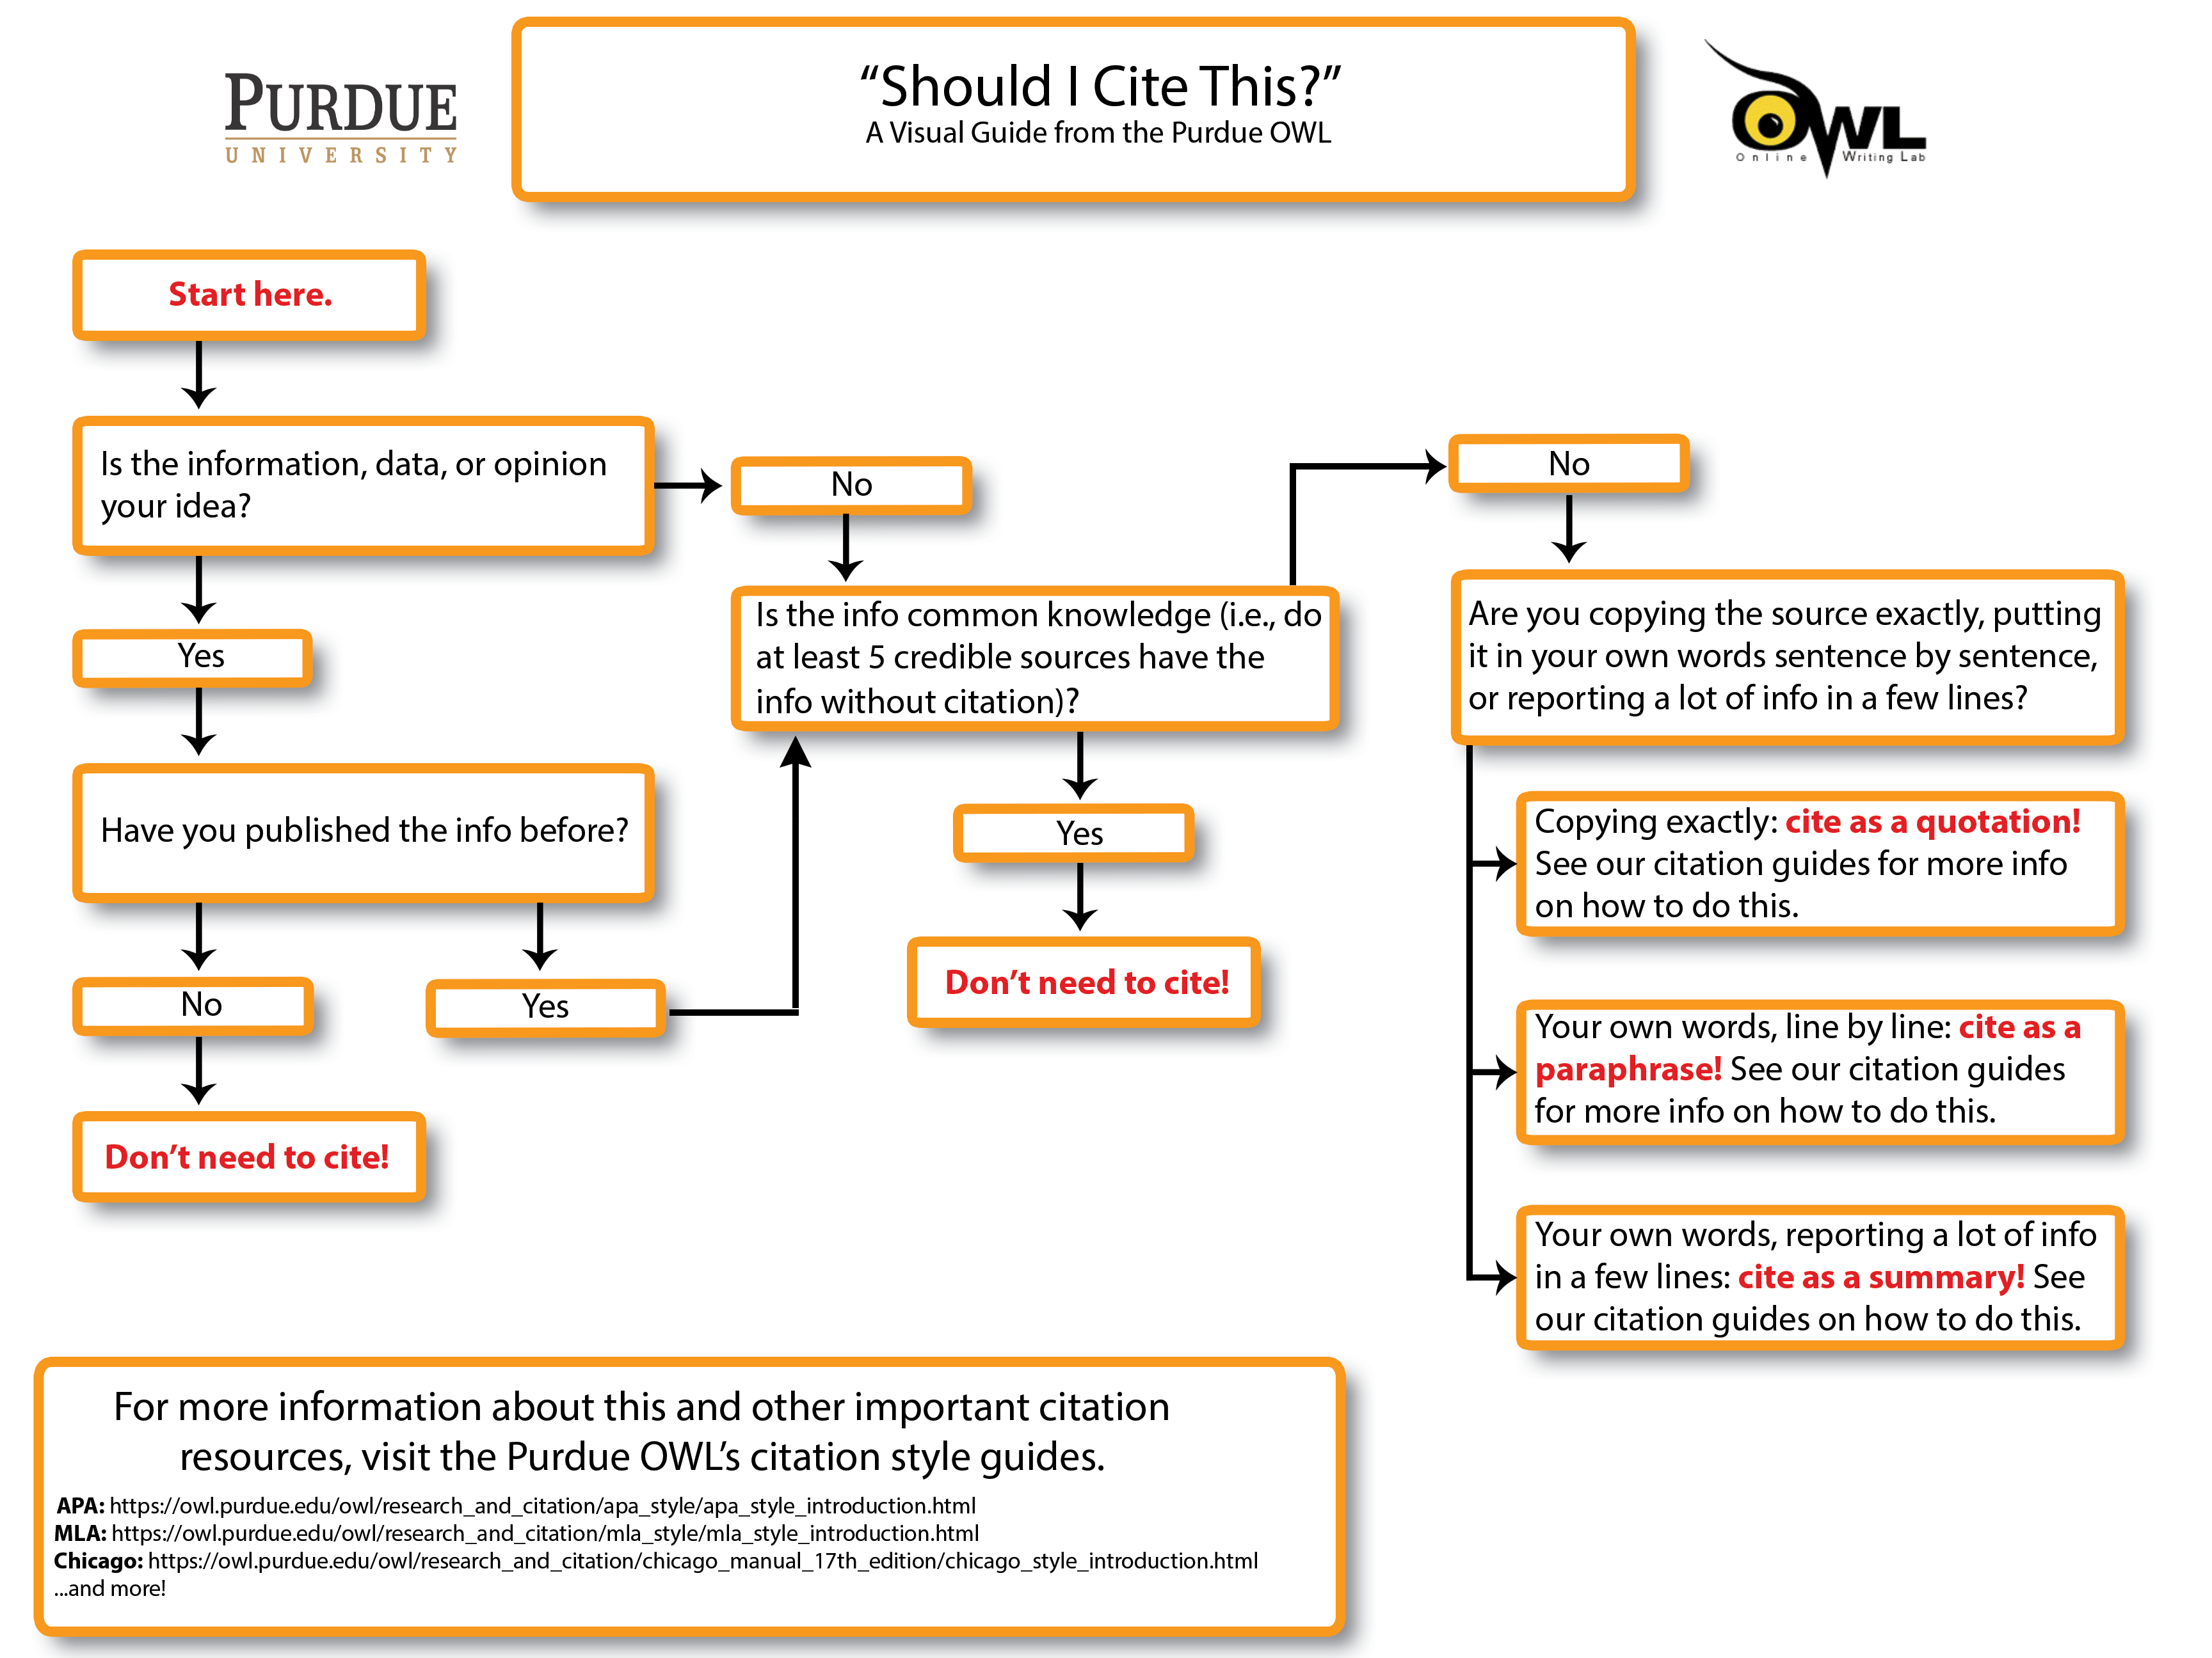

Slide 41
Best practices to avoid plagiarism
Take notes when reading (write notes directly to pdf)
Use a citation manager like Zotero to keep your notes with the source
Use a signal phrase “According to [source],”
Paraphrase or summarize the text without looking at the original source material, and simply rely on your memory
Put quotation marks around any unique words or phrases
Quote no more material than necessary (do not quote full paragraph)
Before finalizing your paper check your notes and sources to make sure that anything coming from an outside source is acknowledged
If you have any questions or concerns about citation ask in advance

Slide 42
GUIDELINES FOR AVOIDING PLAGIARISM
Paraphrasing
Use your own words and style
Use synonyms
Alternate verbs
Change of forms
No citation for common knowledge or universal truth
Citations
Footnotes
References

Slide 43
Plagiarism checker
Plagiarism checker (Searching for Similar Files in IS)
https://is.muni.cz/napoveda/elearning/plagiat?lang=en
Grammarly also has plagiarism checker
https://www.econ.muni.cz/en/news/grammarly-software-for-the-students-of-our-faculty

Slide 44
ACADEMIC WRITING CHECKLIST

Slide 45
I avoid informal terms and contractions.
I avoid second-person pronouns (“you”).
I avoid emotive or exaggerated language.
I avoid redundant words and phrases.
I avoid unnecessary jargon and define terms where needed.
I present information as precisely and accurately as possible.
I use appropriate transitions to show the connections between my ideas.
My text is logically organized using paragraphs.
Each paragraph is focused on a single idea, expressed in a clear topic sentence.
Every part of the text relates to my central thesis or research question.
I support my claims with evidence.
I use the appropriate verb tenses in each section.
I consistently use either UK or US English.
I format numbers consistently.
I cite my sources using a consistent citation style (APA style).

