Slide 1
Summarizing
Annotated Bibliography assignment
Academic writing
Seminar 1

Slide 2
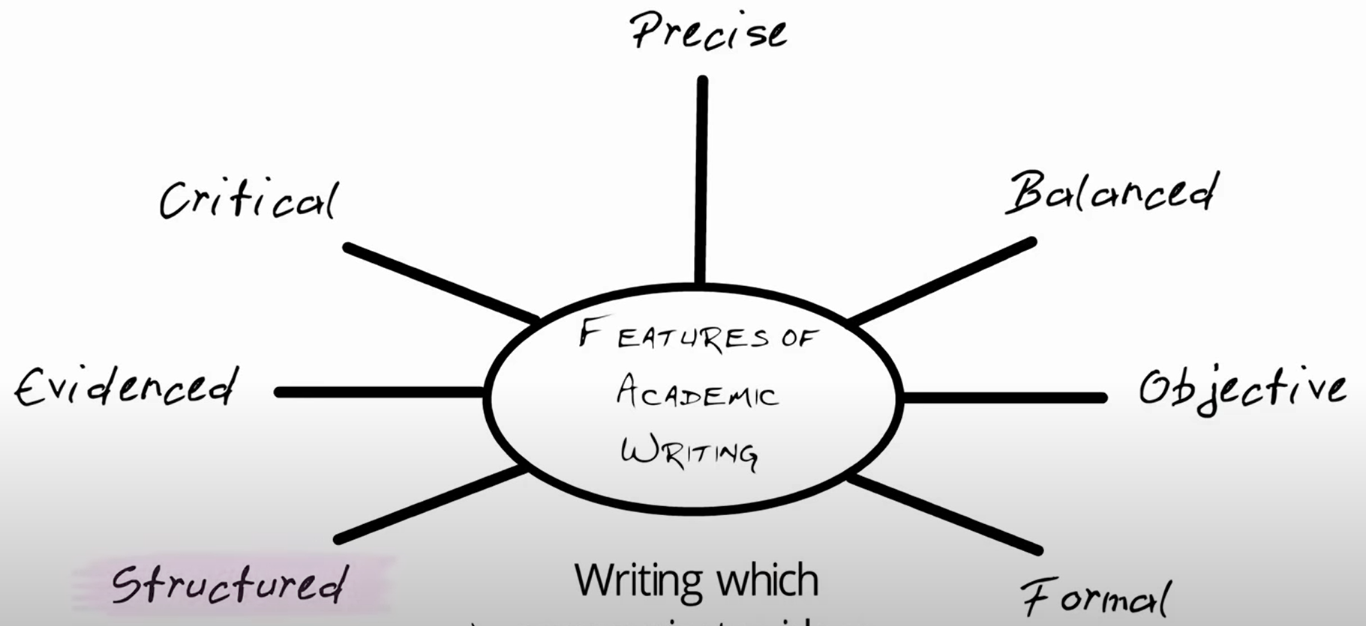
Features of academic writing (refreshing)

Slide 3
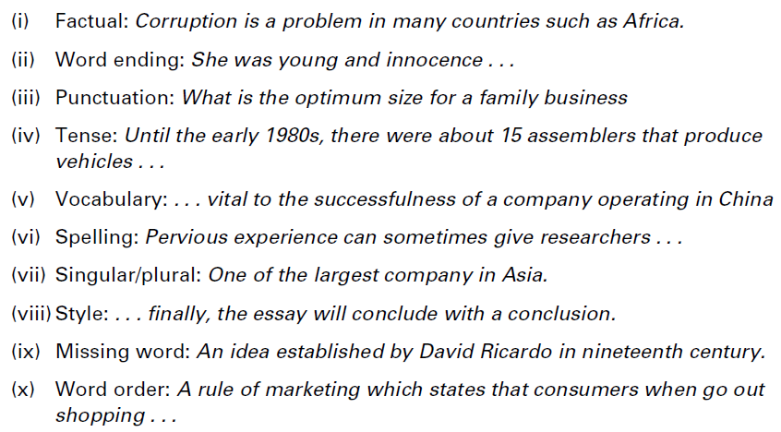
Task 1
Examples of the most common types of error in student writing are shown below. In each case, underline the error and correct it.
Reference book Unit 1.11

Slide 4
(i) Africa is not a country: such as Nigeria
(ii) Innocence is a noun: Young and innocent
(iii) Question mark needed: What is the optimum size for a family business?
(iv) All verbs need to use past tense: that produced
(vi) ‘Successfulness’ is not a word: success
(vi) ‘pervious’ is incorrect: previous
(vii) One of the largest companies in Asia
(viii) Repetition: the essay will conclude with an analysis of
(ix) Time periods need definite article: the nineteenth century
(x) when consumers go out shopping

Slide 5
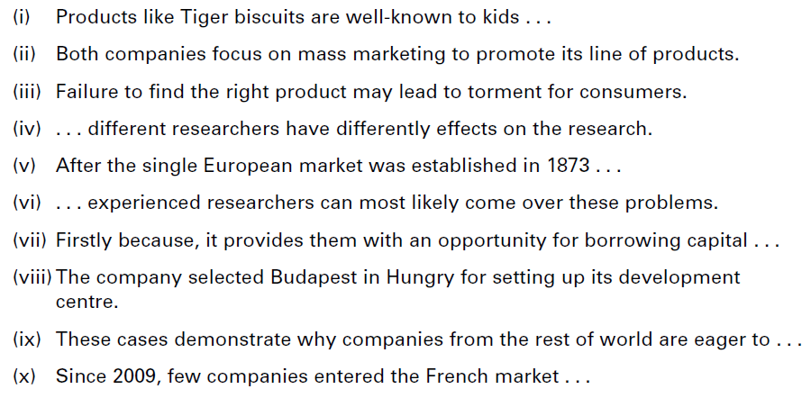
Task 2
The following extracts each contain one type of error. Match each to one of the examples (i-x) above, and correct the error.
Reference book Unit 1.11

Slide 6
(i) Style – use ‘children’
(ii) Singular/plural – their lines
(iii) Vocabulary – torment is too strong, use ‘inconvenience’
(iv) Word ending – different effects
(v) Factual – 1973
(vi) Word order – overcome
(vii) Punctuation – no comma needed
(viii) Spelling – Hungary
(ix) Missing word – the world
(x) Tense: have entered

Slide 7
What can I learn when I prepare annotated bibliography?
Reviewing a paper is a complex skill that takes practice to acquire. Preparing an annotated bibliography is a task which will
1. familiarise you with reading academic literature
2. practice critical thinking by evaluating academic papers.

Slide 8
Task 3
Study the stages of summary writing below, which have been mixed up. Put them in the correct order (1–5).
(a) Write the summary from your notes, reorganising the structure if needed.
(b) Make notes of the key points, paraphrasing where possible.
(c) Read the original text carefully and check any new or difficult vocabulary.
(d) Mark the key points by underlining or highlighting.
(e) Check the summary to ensure it is accurate and nothing important has been changed or lost.
Reference book Unit 1.6

Slide 9
Task 3
(c) Read the original text carefully and check any new or difficult vocabulary.
(d) Mark the key points by underlining or highlighting.
(b) Make notes of the key points, paraphrasing where possible.
(a) Write the summary from your notes, reorganising the structure if needed.
(e) Check the summary to ensure it is accurate and nothing important has been changed or lost.

Slide 10
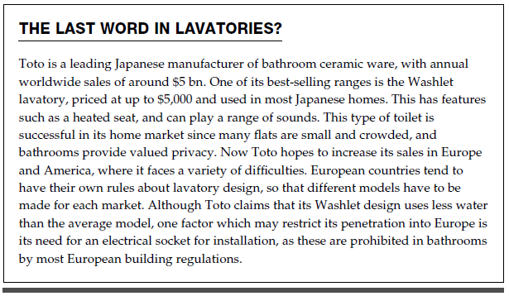
Task 5
Summarise the following text in about 50 words.
Exchange
Reference book Unit 1.6

Slide 11
Task 5
How many questions can you answer YES to?
̶ Have the main ideas been included?
̶ Is all the content relevant?
̶ Is the summary accurate?
̶ Is the summary approx. 50 words?
̶ Is the summary well-organised?
̶ Have they used their own words?
̶ Is it easy to understand?
̶ Have they cited the source?

Slide 12
Model summary
The washlet is an expensive luxury lavatory that is popular in
crowded Japanese homes, with a range of special features. Its
maker, the Toto company, is hoping to expand sales in the West, but
different regulations about toilet design and electrical fittings make
this a challenging goal.

Slide 13
The following information will need to be included in the annotated bibliography:
A complete reference for the paper (including web reference)
Summary – what is it about?
  What is the author’s purpose, aim or research question?
  What is the main argument, finding or conclusion
Evaluation – what do you think about the text?
  Who is it written for? (e.g. the general public, health professionals, academic staff?)
  What do you think are the main strengths?
  Are there any weaknesses or flaws with the research?
Reflection – how might you use it?
  Has the text helped you understand something more in depth?
  How useful is the research?
  How might you refer to it?

Slide 14
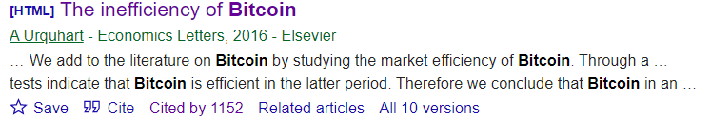
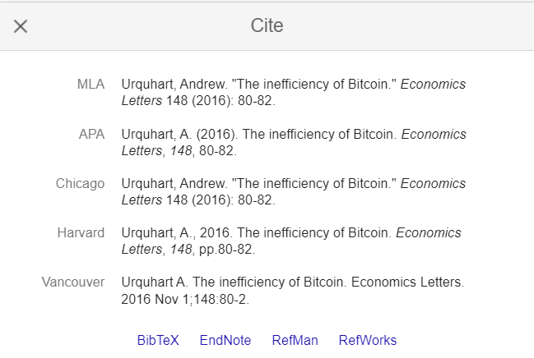


Include a complete paper reference in APA style
Search paper on https://scholar.google.com/

Slide 15
Sample reference + annotation:
Mbanyele, W., Huang, H., Li, Y., Muchenje, L. T., & Wang, F. (2022). Corporate social responsibility and green innovation: Evidence from mandatory CSR disclosure laws. Economics Letters, 212, 110322.
In their article, Mbanyele et al. (2022) examine the impact of Corporate Social Responsibility (CSR) performance on green innovation using CSR disclosure laws from different countries. Overall, the results of the study demonstrate that corporate engagement in CSR activities increases social welfare through the production of sustainable technologies. Furthermore, the results show that the impact of CSR disclosure laws is more significant for companies with weaker corporate governance and for companies that had lower CSR disclosure standards prior to CSR disclosure laws. A strength of this study is that it circumvents problems in measuring CSR activities by using laws on mandatory CSR reporting in different countries. The study is valuable because it provides consistent evidence that the quality and quantity of green patents by companies are increasing in countries that have enforced mandatory CSR disclosure laws. Moreover, the study provides evidence of the positive side of regulatory change, which is important for future research.

Slide 16
Summarizing the argument of a source
An annotation briefly restates the main argument of a source. An annotation of an academic source, for example, typically identifies its thesis (or research question, or hypothesis), its major methods of investigation, and its main conclusions. Keep in mind that identifying the argument of a source is a different task than describing or listing its contents.

Slide 17
The following reading strategies can help you to identify the argument of a source
Identify the author’s thesis (central claim or purpose) or research question. Both the introduction and the conclusion can help you with this task.
Look for repetition of key terms or ideas, especially those occurring in the thesis. Follow them through the text and examine what the author does with them.
Notice whether and how a theory is used to interpret evidence. Identify the method used to investigate the problem/s addressed in the text.
Notice how the text is laid out and organized. What are the main sections? What is emphasized? Why? Accounting for why will help you move beyond listing contents and toward accounting for argument. Look also for paragraphs that summarize the argument.

Slide 18
AB assignment
Your task is to write an annotated bibliography with three annotations related to your thesis research. All the sources should be peer-reviewed research articles on the same topic.
For each source the annotation shall include:
a full reference for the source using APA format (include the author name(s), publication year, article title, journal name, volume and issue number, page range.
a brief summary of main findings written in your own words
critical evaluation of the strengths and the weaknesses of each article
a reflection on the usefulness/relevance of the source (e.g. how it would be useful in writing a paper on the topic, or what you have learned from it about the topic)
Write approximately 150 words for each annotation.
Read page 9-12, 42-47, from the Reference Book

Slide 19
Suggested steps of writing assignment
Narrow the topic of your thesis research. Talk to your thesis supervisor, brainstorm, read lecture notes and recent research papers.
Search for literature. Make a list of keywords and search Google Scholar or MUNI Discovery for a peer-reviewed research article on the topic written in the last five years. I suggest you these two journals:
  Economics Letters journal. Articles are typically less than 3000 words, and this journal covers general topics.
  Journal of Economic Literature. The prestigious economic journal features essays and reviews of the recent economic literature on different topics.
When you have your three research articles, read them and make notes. Use your notes to produce an annotated bibliography with three annotations.
Revise, edit and proofread your work to make sure it meets the requirements above and there are no typos, and obvious referencing or language errors.
Upload your annotated bibliography assignment to the homework folder

