Slide 1
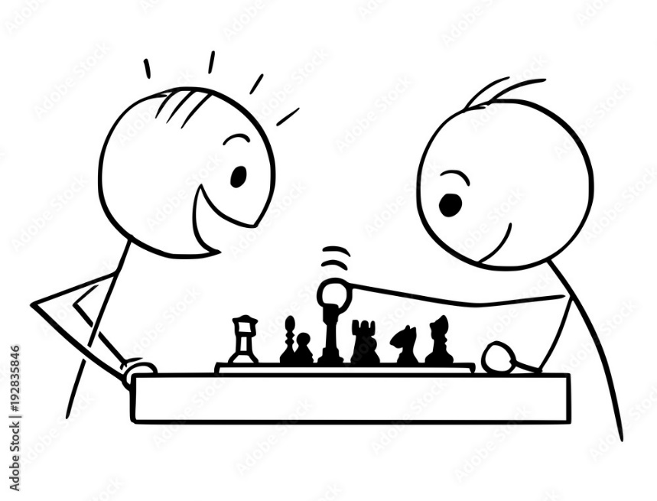
Competitive Strategies
Prateek Kalia, Ph.D.

Slide 2
Agenda
Competitive Strategies adopted by
  Market Leader
  Market Challenger
  Market Follower
  Market Nicher
Product Life-Cycle Marketing Strategies
Marketing in an Economic Downturn

Slide 3

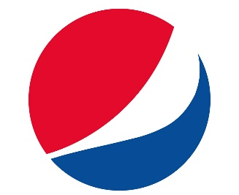


Hypothetical Market Structure
10%
Market
Nichers
20%
Market
Follower
30%
Market
Challenger
40%
Market
Leader

Slide 4

Market Leaders Strategies
Expanding Total Market Demand
Protecting Market Share
Increasing Market Share
PIE

Slide 5
Expanding Total Market Demand
New Customers
  Who might use it but do not (market penetration strategy)
  Who have never used it (new-market segment strategy)
  Who live elsewhere (geographical-expansion strategy)
More Usage
  Increase the amount, level, or frequency of consumption.
  Boost the amount through packaging or product redesign.
  More availability for impulse products such as soft drinks and snacks
  Additional opportunities to use the brand (E.g., Gillette razor cartridges with colored stripes signaling replacement)
New ways to use the brand
  (E.g., Toothpaste as stain remover from piano keys)

Slide 6

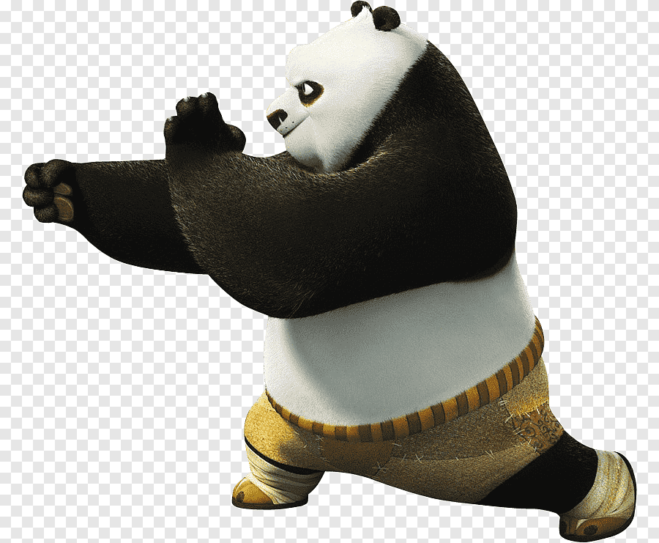
Protecting Market Share
The most constructive response is continuous innovation. The front-runner should lead the industry in developing new products and customer services, distribution effectiveness, and cost cutting.
Proactive Marketing
Defensive Marketing

Slide 7



Proactive Marketing
Responsive
Finds a stated need and fills it.
Anticipative
Looks ahead to needs customers may have in the near future.
Creative
Discovers solutions customers did not ask for but to which they enthusiastically respond.
Hardware → Software

Slide 8
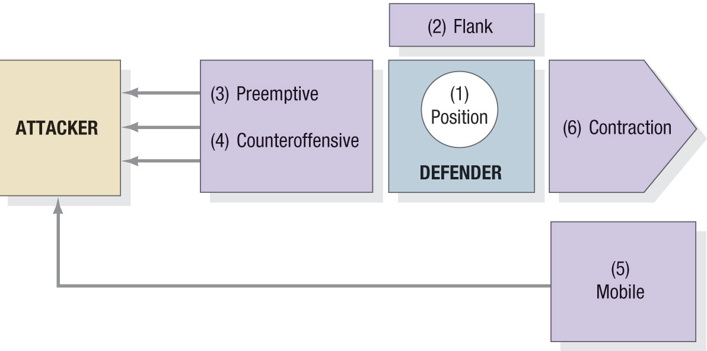
Defensive Marketing

Slide 9
Defensive Marketing
Position Defense.
  Position defense means occupying the most desirable market space in consumers’ minds, making the brand almost impregnable, as Procter & Gamble has done with Tide detergent for cleaning, Crest toothpaste for cavity prevention, and Pampers diapers for dryness.
Flank Defense
  The market leader should erect outposts to protect a weak front or support a possible counterattack. Procter & Gamble brands such as Gain and Cheer laundry detergent and Luvs diapers have played strategic offensive and defensive roles.
Preemptive Defense.
  A more aggressive maneuver is to attack first, perhaps with guerrilla action across the market—hitting one competitor here, another there—and keeping everyone off balance. Another is to achieve broad market envelopment that signals competitors not to attack. E.g., Bank of America, Microsoft (nationwide 18,500 ATMs and 6,100 retail branches)

Slide 10
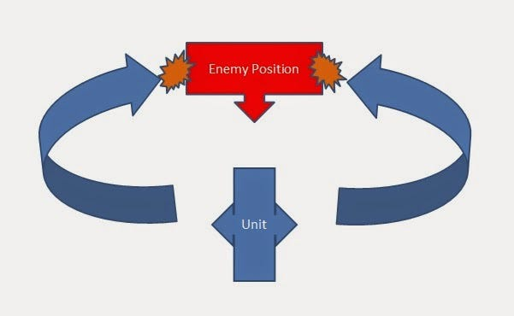
Defensive Marketing Contd..
Counteroffensive Defense
  In a counteroffensive, the market leader can meet the attacker frontally and hit its flank, or launch a pincer movement so it will have to pull back to defend itself. After FedEx watched UPS successfully invade its airborne delivery system, it invested heavily in ground delivery through a series of acquisitions to challenge UPS on its home turf.
  https://www.youtube.com/watch?v=vHVWegNfQl0&ab_channel=JvMNeckar
Mobile Defense
  In mobile defense, the leader stretches its domain over new territories through market broadening and market diversification. Market broadening shifts the company’s focus from the current product to the underlying generic need. Thus, “petroleum” companies such as BP sought to recast themselves as “energy” companies. This change required them to research the oil, coal, nuclear, hydroelectric, and chemical industries.

Slide 11
Defensive Marketing Contd..
Contraction Defense
  Sometimes large companies can no longer defend all their territory. In planned contraction (also called strategic withdrawal), they give up weaker markets and reassign resources to stronger ones. Since 2006, Sara Lee has spun off products that accounted for a large percentage of its revenues—including its strong Hanes hosiery brand and global body care and European detergents businesses—to focus on its core food business.

Slide 12
Increasing Market Share
Economic cost
  Profitability might fall with market share gains after some level. For instance, the costs of legal work, public relations, and lobbying rise with market share.
The danger of pursuing the wrong marketing activities
  Companies that attempt to increase market share by cutting prices more deeply than competitors typically don’t achieve significant gains, because rivals meet the price cuts or offer other values so buyers don’t switch.
The effect of increased market share on actual and perceived quality
  Too many customers can put a strain on the firm’s resources, hurting product value and service delivery.

Slide 13
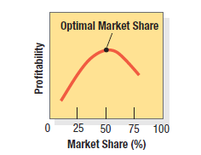
The Concept of Optimal Market Share

Slide 14
Other Competitive Strategies
Market Challengers
Market Followers
Market Nichers

Slide 15
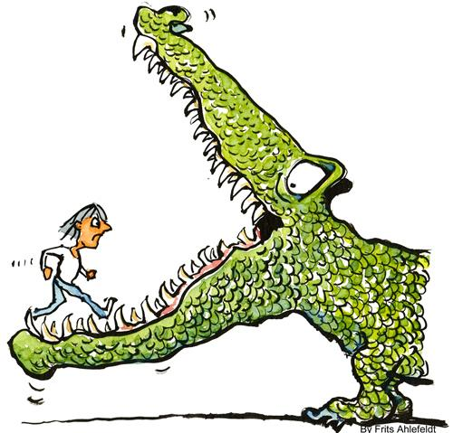
Market-Challenger Strategies

Slide 16
Defining the strategic objective and opponent(s)
Attack the market leader
  This is a high-risk but potentially high-payoff strategy and makes good sense if the leader is not serving the market well. Xerox wrested the copy market from 3M by developing a better copying process.
Attack firms its own size that are not doing the job and are underfinanced.
  These firms have aging products, are charging excessive prices, or are not satisfying customers in other ways.
Attack small local and regional firms.
  Several major banks grew to their present size by gobbling up smaller regional banks, or “guppies.”

Slide 17
Choosing a General Attack Strategy
Frontal Attack
  The attacker matches its opponent’s product, advertising, price, and distribution. The principle of force says the side with the greater resources will win. A modified frontal attack, such as cutting price, can work if the market leader doesn’t retaliate, and if the competitor convinces the market its product is equal to the leader’s.
Flank Attack
  Identifying shifts that are causing gaps to develop, then rushing to fill the gaps. Flanking is particularly attractive to a challenger with fewer resources and can be more likely to succeed than frontal attacks. E.g., Newspapers sell where internet is still weak.
Encirclement Attack
  Attempts to capture a wide slice of territory by launching a grand offensive on several fronts. It makes sense when the challenger commands superior resources. E.g., Microsoft vs Java Software.

Slide 18
Choosing a General Attack Strategies ...
Bypass Attack
  Bypassing the enemy altogether to attack easier markets instead offers three lines of approach: diversifying into unrelated products, diversifying into new geographical markets, and leapfrogging into new technologies. E.g., Pepsi rolled Aquafina, bought Tropicana, Google used technological leapfrogging to overtake Yahoo!
Guerrilla Attacks
  Guerrilla attacks consist of small, intermittent attacks, conventional and unconventional, including selective price cuts, intense promotional blitzes, and occasional legal action, to harass the opponent and eventually secure permanent footholds.

Slide 19
Choosing a Specific Attack Strategy
Any aspect of the marketing program can serve as the basis for attack, such as lower-priced or discounted products, new or improved products and services, a wider variety of offerings, and innovative distribution strategies. A challenger’s success depends on combining several, more specific, strategies to improve its position over time.

Slide 20
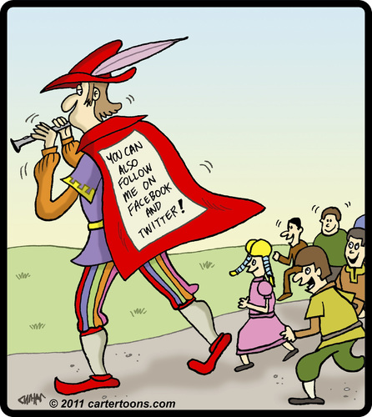
Market-Follower Strategies

Slide 21
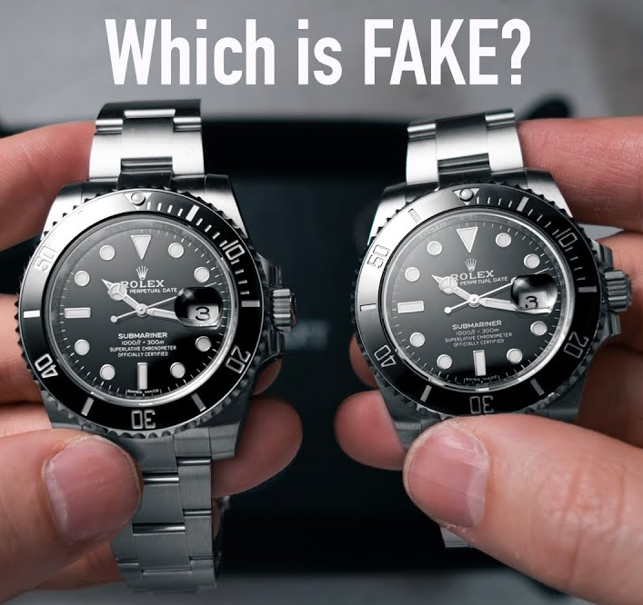
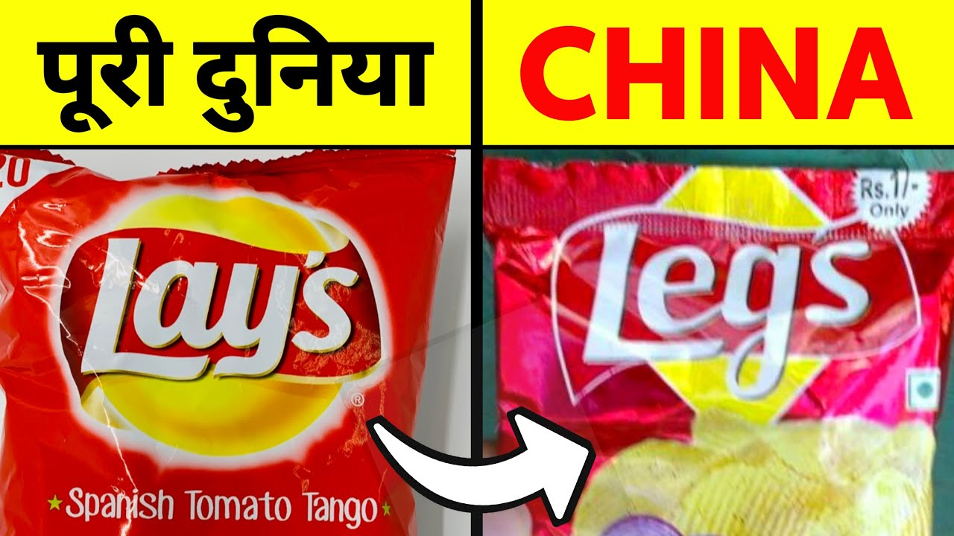
Market-Follower Strategies
Counterfeiter
  Duplicates the leader’s product and packages and sells it on the black market or through disreputable dealers. Music firms, Apple, and Rolex have been plagued by the counterfeiter problem, especially in Asia.
Cloner
  Emulates the leader’s products, name, and packaging, with slight variations. For example, Ralcorp Holdings sells imitations of name-brand cereals in look-alike boxes.

Slide 22
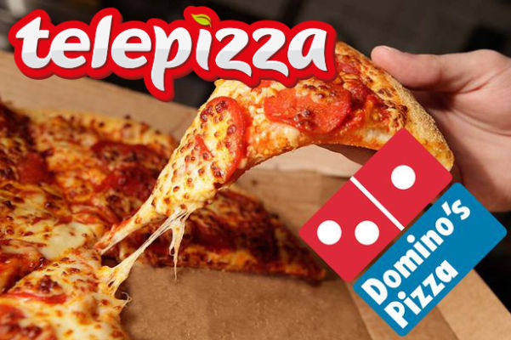
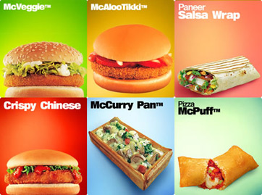
Market-Follower Strategies Contd.
Imitator
  Copies some things from the leader but differentiates on packaging, advertising, pricing, or location. The leader doesn’t mind as long as the imitator doesn’t attack aggressively. Fernandez Pujals grew up in Fort Lauderdale, Florida, and took Domino’s homedelivery idea to Spain, where he borrowed $80,000 to open his first store in Madrid. His Telepizza chain now operates almost 1,050 stores in Europe and Latin America.
Adapter
  The adapter takes the leader’s products and adapts or improves them. The adapter may choose to sell to different markets, but often it grows into a future challenger, as many Japanese firms have done after improving products developed elsewhere.

Slide 23
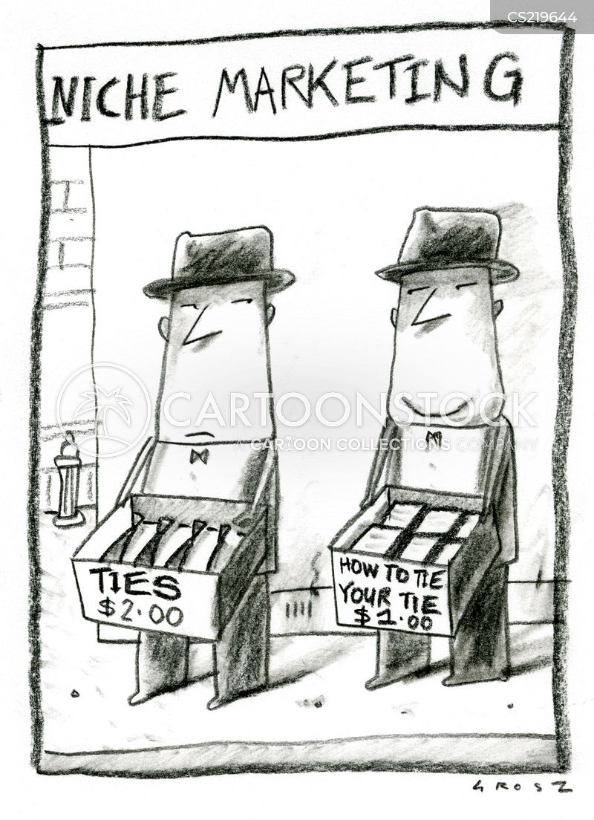
Market-Nicher Strategies
An alternative to being a follower in a large market is to be a leader in a small market, or niche. Smaller firms normally avoid competing with larger firms by targeting small markets of little or no interest to the larger firms. But even large, profitable firms may choose to use niching strategies for some of their business units or companies.

Slide 24
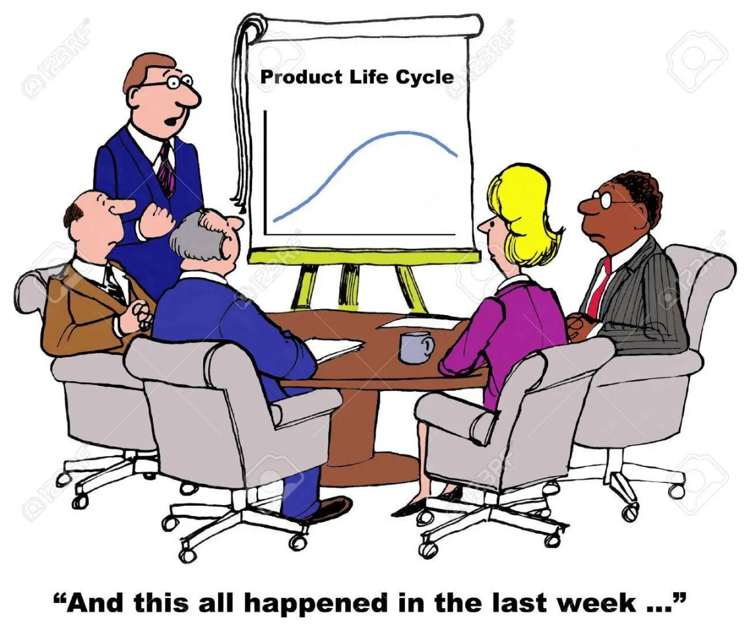
Product Life-Cycle Marketing Strategies

Slide 25
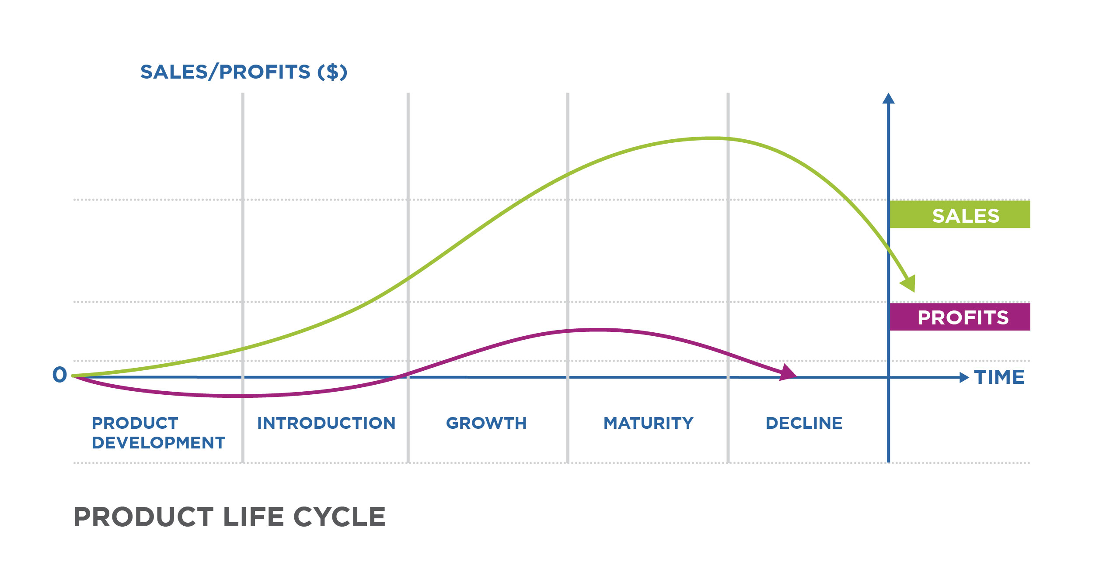
Product Life Cycle

Slide 26
Four assertions of Product Life Cycle
Products have a limited life.
Product sales pass through distinct stages, each posing different challenges, opportunities, and problems to the seller.
Profits rise and fall at different stages of the product life cycle.
Products require different marketing, financial, manufacturing, purchasing, and human resource strategies in each life-cycle stage.

Slide 27
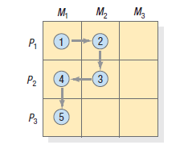
Marketing Strategies: Introduction Stage
Roll out a new product, work out the technical problems, fill dealer pipelines, and gain consumer acceptance, sales growth tends to be slow in the introduction stage. Profits are negative or low, and promotional expenditures are at their highest ratio to sales because of the need to:
(1) Inform potential consumers,
(2) Induce product trial, and
(3) Secure distribution in retail outlets.

Slide 28
Marketing Strategies: Growth Stage
Improve product quality and adds new features and improved styling.
Add new models and flanker products (of different sizes, flavors, and so forth) to protect the main product.
Enter new market segments.
Increase distribution coverage and enter new channels.
Shift from awareness and trial communications to preference and loyalty communications.
Lowers prices to attract the next layer of price-sensitive buyers.

Slide 29
Marketing Strategies: Maturity Stage
Market Modification
  A company might try to expand the market for its mature brand by working with the two factors that make up sales volume: Volume = number of brand users × usage rate per user, but may also be matched by competitors.
Product Modification
  Stimulate sales by improving quality, features, or style. Quality improvement increases functional performance by launching a “new and improved” product. Feature improvement adds size, weight, materials, supplements, and accessories that expand the product’s performance, versatility, safety, or convenience.
Marketing Program Modification
  Stimulate sales by modifying nonproduct elements—price, distribution, and communications in particular.

Slide 30
Marketing Strategies: Decline Stage
Restage or rejuvenate
  a mature product often do so by adding value to it (When exit barriers are high).
Harvesting
  Gradually reducing a product or business’s costs while trying to maintain sales. The first step is to cut R&D costs and plant and equipment investment. The company might also reduce product quality, sales force size, marginal services, and advertising expenditures, ideally without letting customers, competitors, and employees know what is happening.
Divest
  If a company is having a product with strong distribution and residual goodwill, it can probably sell the product to another firm.

Slide 31
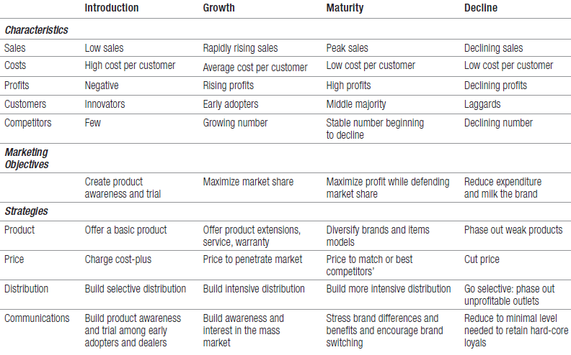
Summary

Slide 32
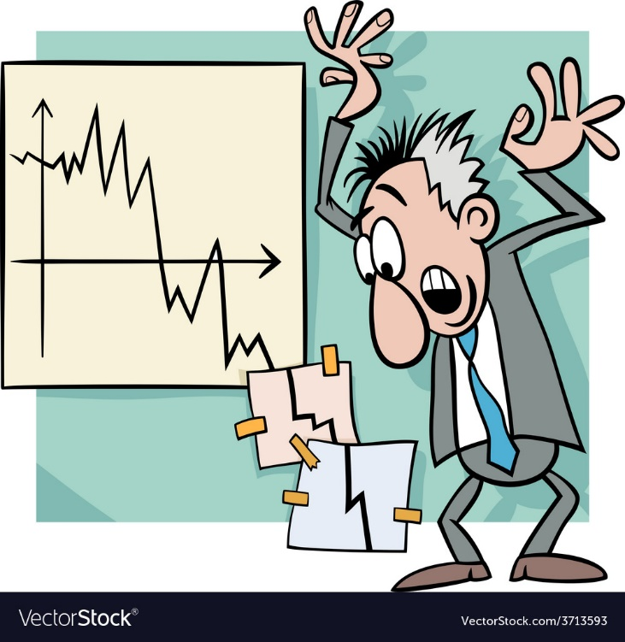
Marketing in an Economic Downturn
Explore the Upside of Increasing Investment
Get Closer to Customers
Review Budget Allocations
Put Forth the Most Compelling Value Proposition
Fine-tune Brand and Product Offerings

Slide 33
Explore the Upside of Increasing Investment
UK supermarket giant Sainsbury launched an advertising and in-store point-of-sale campaign called “Feed Your Family for a Fiver” that played off its corporate slogan, “Try Something New Today,” to encourage shoppers to try new recipes that would feed families for only £5.

Slide 34
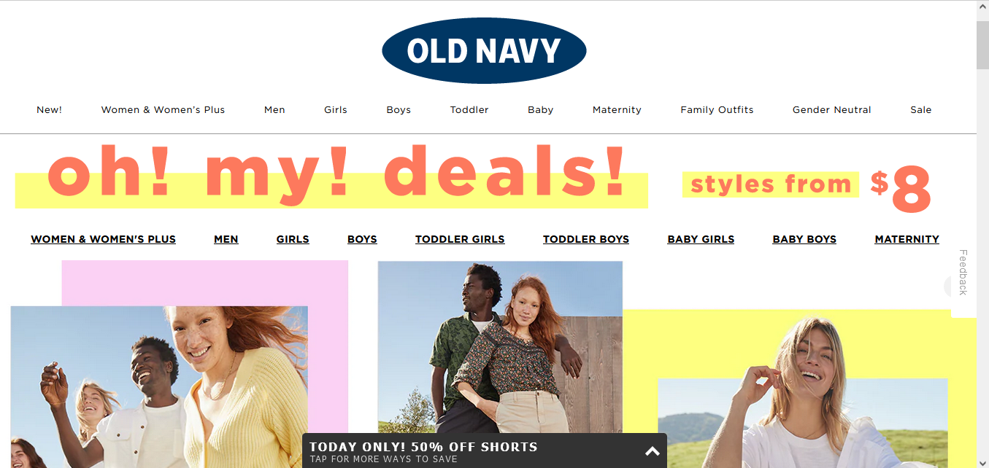
Get Closer to Customers
After unsuccessfully chasing twenty-somethings with trendier clothing, Old Navy refocused its message to target a budget-conscious mom shopping for herself and the family

Slide 35
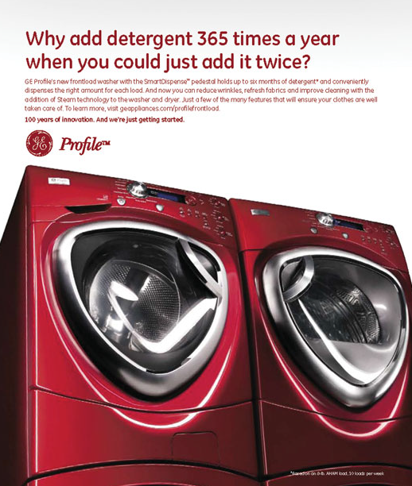
Put Forth the Most Compelling Value Proposition
Marketers should increase—and clearly communicate—the value their brands offer, making sure consumers appreciate all the financial, logistical, and psychological benefits compared with the competition.

Slide 36
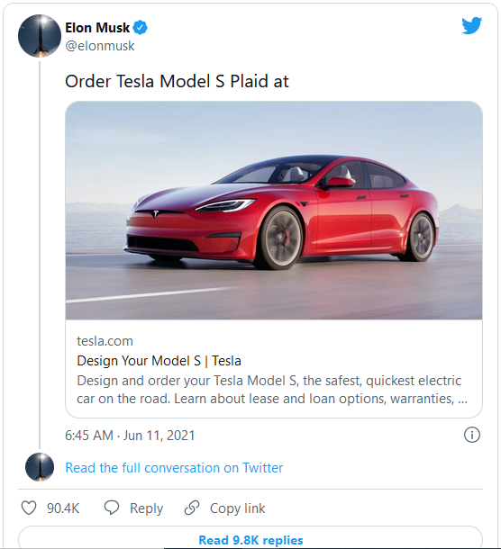
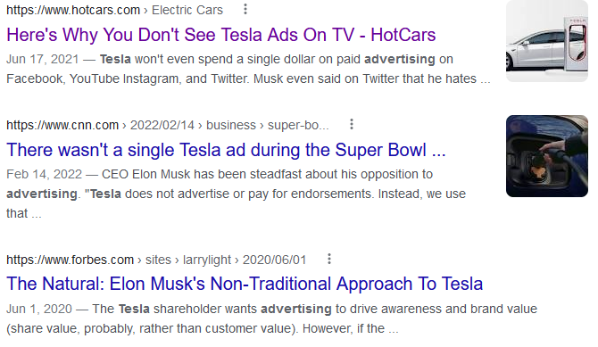
Review Budget Allocations

Slide 37



Fine-tune Brand and Product Offerings
Tier I, Giorgio Armani and Giorgio Armani Privé
  Custom-made couture products that sell for thousands of dollars.
Tier II, Emporio Armani
  Young, modern, more affordable styles—convey technology and ecology.
Tier III, A|X Armani Exchange
  Youthful and street-savvy sold at retail locations in cities and suburban malls.

