Slide 1
MPH_AIMA
International Management

Slide 2

About the course

Slide 3
What do you expect?
What knowledge and skills do you expect after completing this course?

Slide 4
Schedule and topics
16.2. | The global business environment
23.2. | To be confirmed
2.3. | Cross cultural communication,Negotiating across cultures
9.3. | Cross-cultural communication | FNZ
16.3. | Global HR
23.3. | Developing global managers and teams | Zebra Technologies
6.4. | Developing strategy, entry modes, mergers and acquisitions
13.4. | Acquisition | SIKA
20.4. | Organising for global operations
27.4. | Global structure, cross cultural communication, aquisition | Atlas Copco
4.5. | To be confirmed
11.5. | Negotiation/business model abroad | Idea statica/Hartmann-Rico

Slide 5
Literature
Deresky, H. (2017). International management: Managing across borders and cultures : text and cases (Ninth edition, global edition.). Boston: Pearson.
Gooderham, P. N. (2003). International management: Cross-boundary challenges. Malden: Blackwell.
Luthans, F. (2009). International management: Culture, strategy, and behavior (7th ed.). Boston: McGraw-Hill/Irwin.
Phatak, A. V. (2009). International management: Managing in a diverse and dynamic global environment (2nd ed.). Boston: McGraw-Hill/Irwin.
Lecture notes, interactive study materials in IS!!!
Articles! (databases: EBSCO, ProQuest, JSTOR, etc.)

Slide 6
Global environment
International Management
Global Trends and Globalization
Regional Blocks
Open System Model
Political Risk
Economic Risk
Legal Environment
Global Managers

Slide 7
International Management
= ‘The process of developing strategies, designing and operating systems, and working with people around the world to ensure sustained competitive advantage.’
Deresky, H. (2017). International management: Managing across borders and cultures :
text and cases (Ninth edition, global edition.). Boston: Pearson.

Slide 8
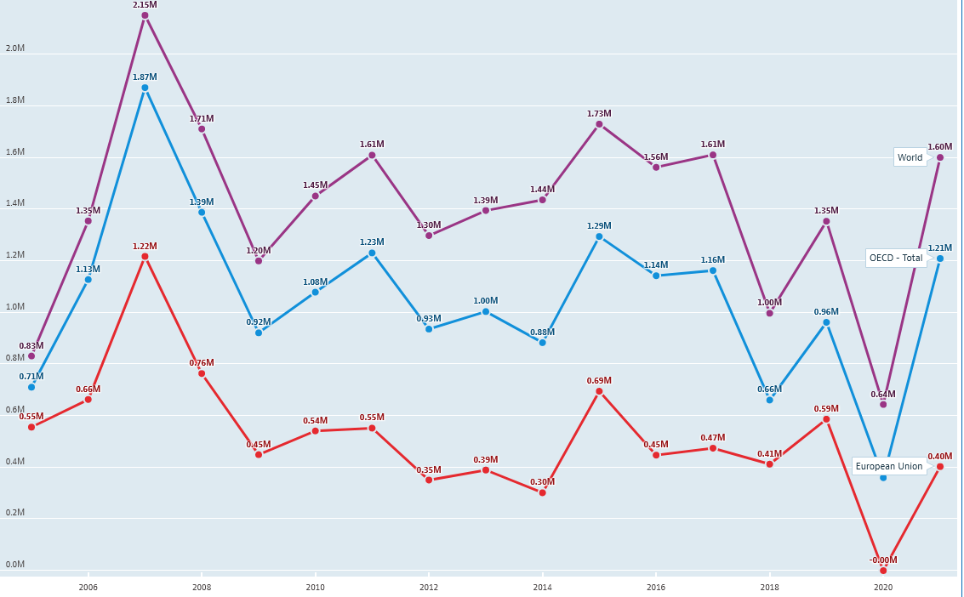
FDI flows Outward
Million US dollars 2006–2021
OECD (2023), "FDI flows" (indicator), https://doi.org/10.1787/99f6e393-en (accessed on 6February 2023).

Slide 9
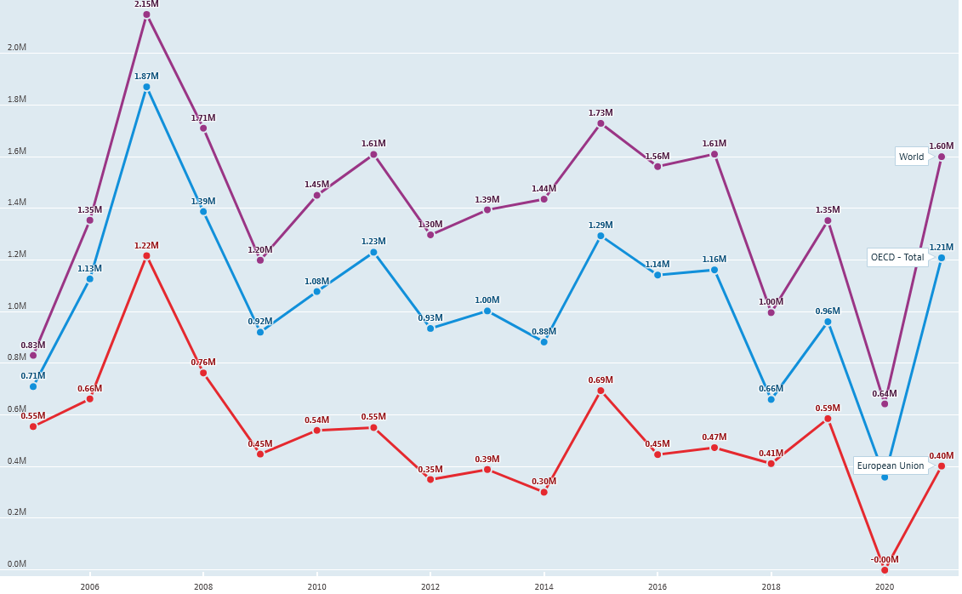
FDI flows Inward
Million US dollars 2005–2021
Source: OECD (2023), "FDI flows" (indicator), https://doi.org/10.1787/99f6e393-en (accessed on 3 February 2023).

Slide 10
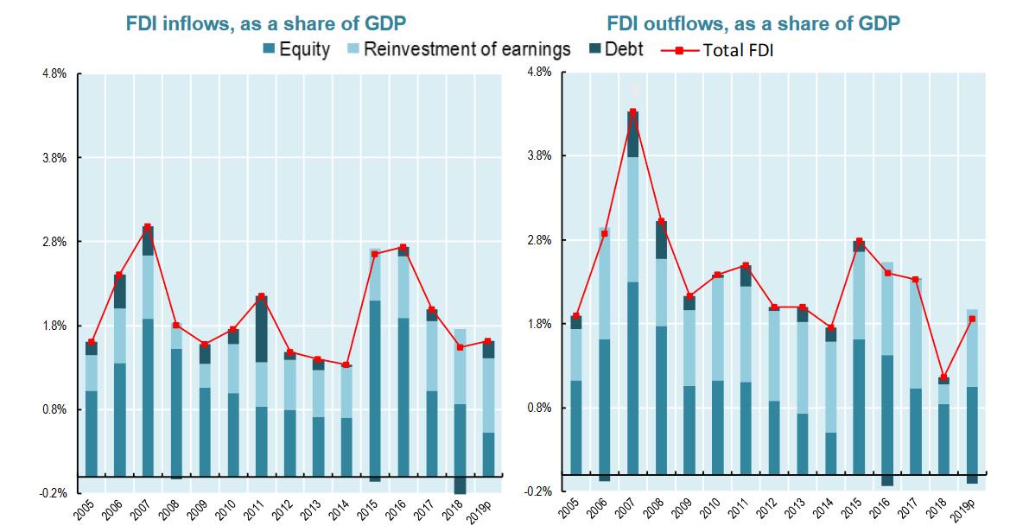

Slide 11
Should it be equal?
by definition, inward and outward FDI worldwide should be equal, but in practice, there are statistical discrepancies between inward and outward FDI.

Slide 12
Impact of the COVID 19/war on FDI flows
FDI flows are expected to decline sharply
Reinvested earning drop
The pandemic is having much greater impacts in some sectors than others (accommodation, food service, transportation – not visible in FDI statistics; primary sector, manufacturing – drops in earnings; information and communication – increase)
Further drops in FDI flows are possible in the medium to long term

Slide 13
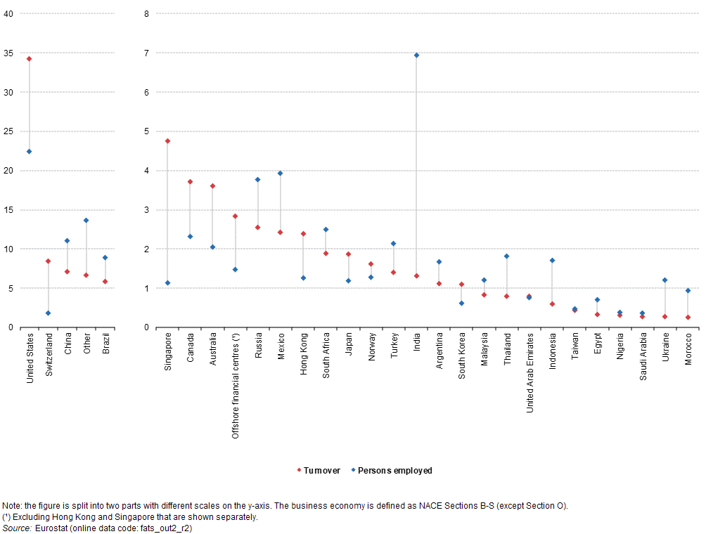
Share of turnover and persons employed in foreign affiliates abroad, business economy, EU-28, 2014 (% of extra-EU total)
Source: https://ec.europa.eu/eurostat/statistics-explained

Slide 14
Global Trends
growing number of middle-class consumers in emerging countries
global supply-chain management
environmental impacts and their solution
virtual marketplaces
global standards
cooperation across cultures
opportunities for SMEs
responsibility of MNCs…

Slide 15
…but…
growing consumption of energy and resources
dependency on other companies, states, and trading blocks
global costs for ‘making change’ and negotiating
dependency on information technologies and infrastructure
backlash against capitalism and rekindling of nationalism
trade wars and increasing protectionism
management across cultures
abusing of weaker systems…

Slide 16
Regional Trading Blocks
USA dominance is probably over
importance of the trading blocks is increasing (NAFTA, EU, ASEAN,…)
world trade takes place mostly within free trade blocks
dominant currencies (euro, yen, dollar, juan)

Slide 17

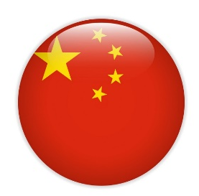

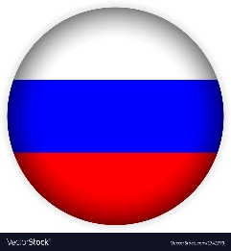

Regional Trading Blocks and Other Regions
  EU (after brexit)
  unified market
  over 447 million citizens
  27 different countries
  euro and 10 other
  national
  currencies
Asia
  China
  India
  ASEAN
  SAARC
  Japan
  Asian Tigers (Hong Kong, Singapore, South Korea, Taiwan)
  political problems
  differentiation within the region
Americas
  NAFTA
  CAFTA
  MERCOSUR
Others
  The Russian Federation
  Middle East
  The African Union
  South Africa
Rest of Europe
Less Developed countries
  Low GDP/GNP
  Large, relatively unskilled workforce
  High international debt

Slide 18
Open System Model
MEGA ENVIRONMENT
HOST-COUNTRY
ENVIRONMENT
Culture
Functions and People
Global Competition
Economic
Global Trends and Forces
OPERATING ENVIRONMENT
Regulations
Skills
Political
Local Competition
Culture
Ethics
Social Responsibility
Technological
Subsidiary–Host Interdependance
MNC–Host-Country Interdependance

Slide 19
Global Managers
What are the most important competencies, skills and knowledge of the excellent manager responsible for international operations?

Slide 20
Political Risk
= ‘any governmental action or politically motivated event, that could
adversely affect the long-run profitability or value of a firm’
Argentina announced plans to nationalize Spanish oil company Repsol YPF and caused international arbitration.
Venezuela took control of cement plants and offices belonging to Mexico, after failing to reach an agreement in nationalization talks.
In Russia Kremlin exploited the finantial crisis to take control of energy companies.
Bolivian president’s move to nationalize the national gas industry followed that in Venezuela.

Slide 21
Political Risk
Political Risk Assessment
consultation with experts
development of internal staff capabilities
cooperation with specialized agencies
Political Risks
expropriation and confiscation
nationalization
terrorism
discriminatory treatment
barriers to repatriation of funds
dishonesty by government officials
…
Dependency / Hedging
input control
market control
position control
staged contribution
insurance
local debt financing
Avoidance / Adaptation
equity sharing
participating management
localization of the operation
development assistance

Slide 22
Economic Risk
Quantitative approach
indexes
indicators
statistics
loss of profitability due to
  abrupt changes in monetary and fiscal policy
  changes in foreign investment policies
  changes in currency exchange rate
connected with the political situation
Qualitative approach
monitoring
induction
experiences
assessments
Combination
Checklist approach

Slide 23
The Legal Environment
local laws and legal systems of those countries in which an international company operates
international law, which governs relationships between sovereign countries (e.g. WTO rules, bilateral/multilateral agreements, CISG,…)
rules inside the free trade areas (e.g. EU law)
CISG – United Nations Convention on Contracts for the International Sale of Goods

Slide 24
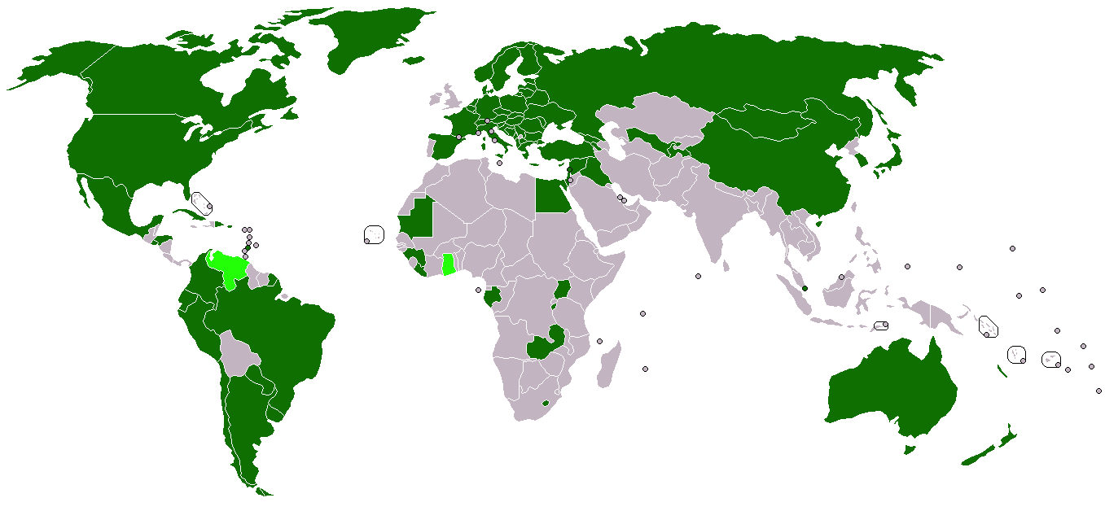
CISG (Vienna Convention)
signed
ratified
Source: https://commons.wikimedia.org/wiki/File:United_Nations_Convention_on_Contracts_for_the_International_Sale_of_Goods.png

Slide 25
Legal Systems
common law
  past court decisions as precedents
  details must be written in the contract to be enforced
civil law
  comprehensive set of laws organized into code
  assumes promises will be enforced without specifying the details
Islamic law
  based on religious beliefs
combination

Slide 26
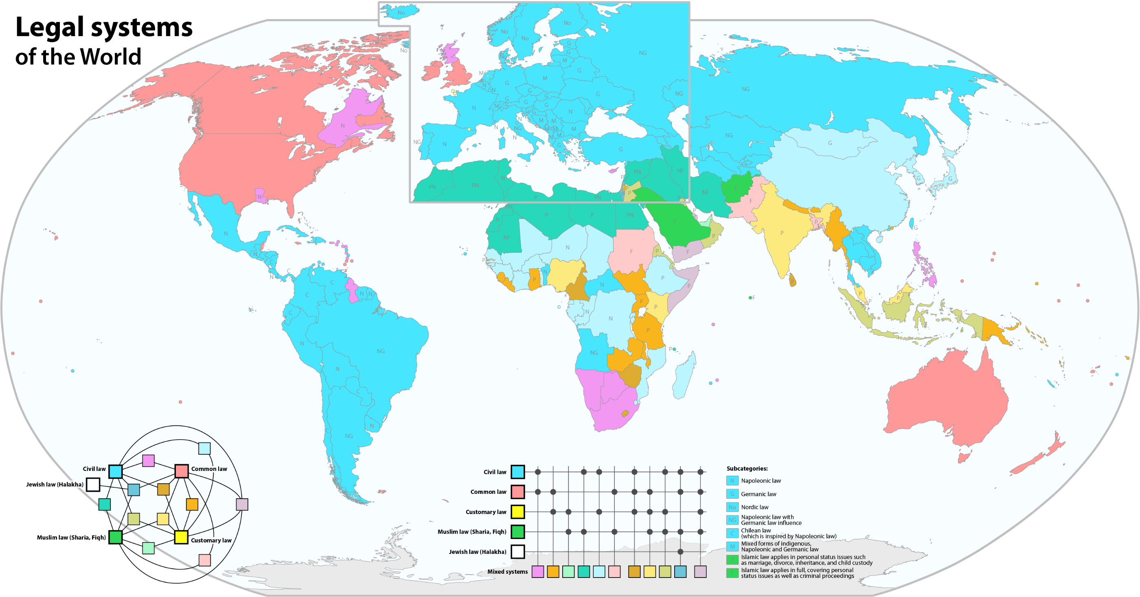
By Maximilian Dörrbecker (Chumwa) - Own work, usingWorld map by Canuckguy and others UNESCO World Heritage map by NNWThe data sources are: University of Ottawa: JuriGlobe – World Legal Systems Research GroupWikipedia: List of national legal systemsEuropean legal systems map by Ain92 and others (which seems to be based on this map by C.Löser and others)World legal systems map by Robinkissac, CC BY-SA 2.5, https://commons.wikimedia.org/w/index.php?curid=40154967

Slide 27
The Technological Environment
Appropriability of technology
  protecting own technology form competitors (patents, trademarks, trade names, copyrights, and trade secrets)
  less developed countries = less protection of technology
The International Convention for the Protection of Industrial Property
  Paris Convention
  administered by WIPO (World Intellectual Property Organization)
risk of inappropriate use of technology
  JV partners, licensees, employees, or stealing by competitors

Slide 28
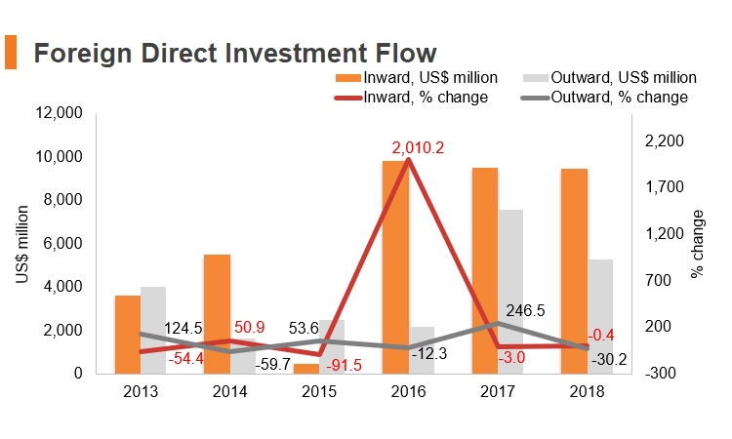
Subsidiary in the Czech Republic?
Why?
Why not?
Source: http://emerging-markets-research.hktdc.com

Slide 29
Questions?
?
?
?
?
?
?
?
?
?
?
?
?
?
?
?
?
?

Slide 30
Thank you for your attention!

