Slide 1

MPH_AIMA
International Management

Slide 2
update
16.2. | The global business environment
23.2. | Cross cultural communication
2.3. | The global business environment | ABB
9.3. | Cross-cultural Communicaton | FNZ
16.3. | Global HR
23.3. | Developing global managers and teams | Zebra Technologies
6.4. | Developing strategy, entry modes, mergers and acquisitions
13.4. | Acquisition | SIKA
20.4. | Organising for global operations
27.4. | Global structure, cross cultural communication, aquisition | Atlas Copco
4.5. | To be confirmed | Idea statica/Hartmann-Rico
11.5. | NO CLASSES

Slide 3
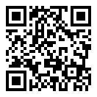
Sli.do
#1611934

Slide 4
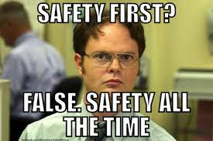
Introduction
Toray
Hyundai

Slide 5
Environmental variables affecting management functions

Slide 6
What is culture
Shared system of values, which as a process leads to automatic solutions of often repeated problems (Schroll-Machl)
A set of learnt behaviour, collection of opinions, customs and traditions shared among group of people... (Mead)
A set of shared attitudes, values, goals, and practices that characterizes an institution, organization or group (Wikipedia)

Slide 7
Culture…
A set of shared values, understandings, assumptions, and goals that are learned from earlier generations, imposed by present members of a society, and passed on to succeeding generations

Slide 8
Organisational culture
Exists within and interacts with societal culture
Varies a great deal from one organization, company, institution, or group to another
Represents those expectations, norms, and goals held in common by members of that group
McDonald’s in Russia

Slide 9
The Effect of Culture on
Organizational Process
U.S. Culture | Alternative | Function Affected
Individual influences future | Life is preordained | Planning, scheduling
The environment is changeable | People adjust to the environment | Morale, productivity
Hark work leads to success | Wisdom and luck are also needed | Motivation, rewards
Employment can be ended | Employment is for a lifetime | Promotions, recruitment

Slide 10
Culture’s Effects on Management
Convergence - the phenomenon of the shifting of individual management styles to become similar to one another
Self-Reference Criterion - the subconscious reference point of one’s own cultural values. Many people in the world understand and relate to others only in terms of their own cultures.
Parochialism - occurs, for example, when a Frenchman expects those from or in another country to automatically fall into patterns of behavior common in France
Ethnocentrism - describes the attitude of those who operate from the assumption that their ways of doing things are best—no matter where or under what conditions they are applied

Slide 11
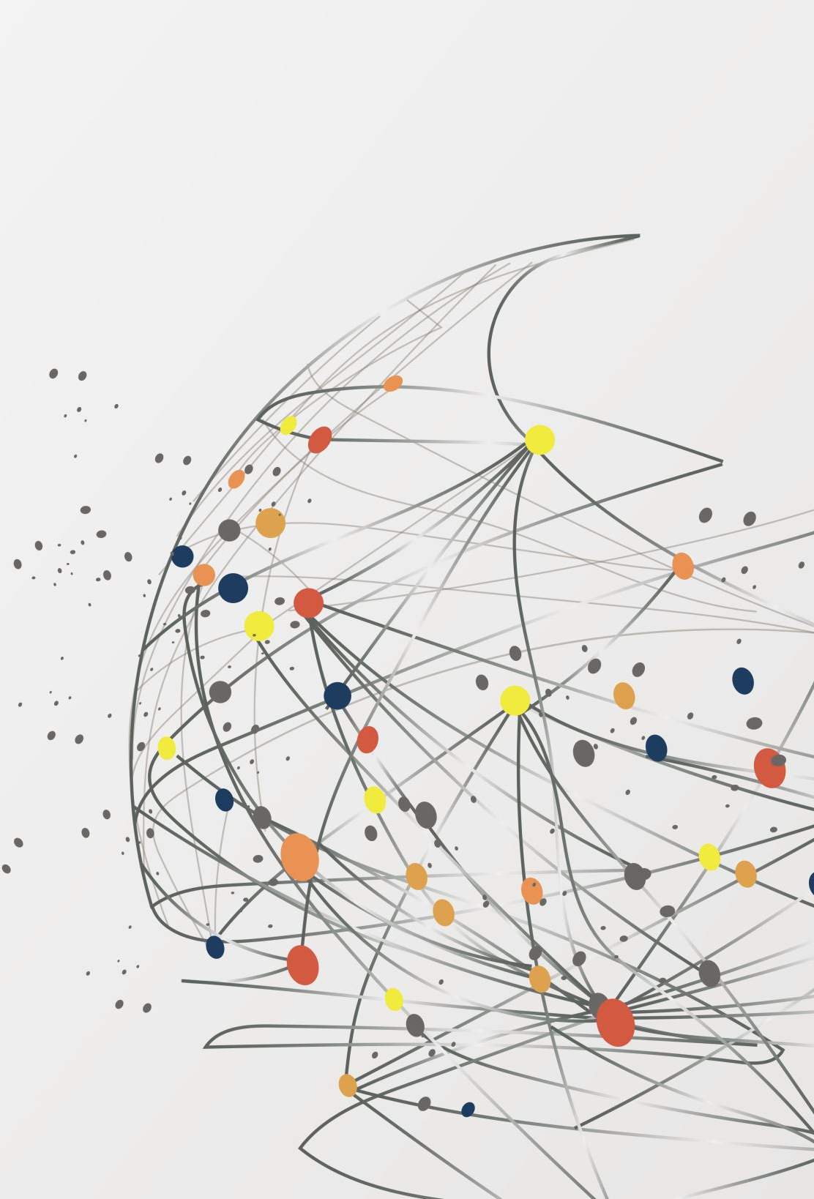
Hofstede’s Value Dimensions
Power Distance
The level of acceptance by a society of the unequal distribution of power in institutions
Uncertainty Avoidance
The extent to which people in a society feel threatened by ambiguous situations
Individualism
The tendency of people to look after themselves and their immediate families only and to neglect the needs of society
Collectivism
The desire for tight social frameworks, emotional dependence on belonging to “the organization,” and a strong belief in group decisions
Long term orientation
Indulgence

Slide 12
Hofstede’s Value Dimensions
Power Distance
The level of acceptance by a society of the unequal distribution of power in institutions
Uncertainty Avoidance
The extent to which people in a society feel threatened by ambiguous situations
Individualism
The tendency of people to look after themselves and their immediate families only and to neglect the needs of society
Collectivism
The desire for tight social frameworks, emotional dependence on belonging to “the organization,” and a strong belief in group decisions
Long term orientation
Indulgence

Slide 13
Hofstede’s Value Dimensions
https://www.hofstede-insights.com/fi/product/compare-countries/
TASK: Compare cultures of you and your neighbor; deduce managerial impacts (motivation, negotiation, behaviour, productivity, flexibility, etc.)

Slide 14
Hall’s Cultural dimensions
Communication context
Proximity
Time
Trompenaars’ Cultural dimensions
Cultural differences come from:
Attitude to time (1 dimension)
Attitude to the environment (1)
Attitude to other people (5)

Slide 15
Problems with application
One dimension contains more aspects
Point of view
Judgements

Slide 16
Expat management
Case reading Kelly´s assignment in Japan

Slide 17
Communication across cultures

Slide 18
Why to concern?
Outsourcing to India – case
Delegation of work - France

Slide 19
Cultural Noise in the
Communication Process
Behavior | Attribution
American: “How long will it take to finish this report?” | American: I asked him to participate. Greek: He is the boss. Why doesn’t he tell me?
Greek: “I don’t know, How long should it take?” | American: He refuses to take responsibility. Greek: I asked for an order.

Slide 20
Cultural Variables in Communication
Three major parts in human face to face communication:
55% of impact is determined by body language—postures, gestures, and eye contact,
38% by the tone of voice, and
7% by the content or the words used in the communication process.

Slide 21
Nonverbal communication
“A picture is worth a thousand words.”
Subtle messages account for between 65 to 93 percent of interpreted communication.
Minor variations in body language, speech rhythms, and punctuality often cause mistrust and misperception of the situation among cross-cultural parties.

Slide 22
The Media for Nonverbal Communication
Kinesic behavior - communication through body movements
Proxemics - the influence of proximity and space on communication—both personal space and office space or layout
  High-contact cultures: prefer to stand close and to experience a “close” sensory involvement
  Low-contact cultures: have a “distant” style of body language
Paralanguage - how something is said rather than the content
Object language/material culture - the way we communicate through material artifacts (e.g. presents!)

Slide 23
Context

Slide 24
Management Focus: Oriental Poker Face
“Oriental poker face” and “idiotic Asian smile”
American mask of confidence

Slide 25
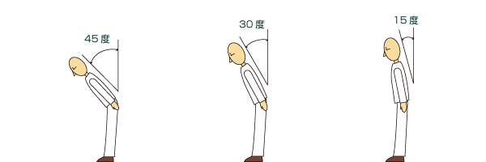
Management focus - Bows in Japan

Slide 26
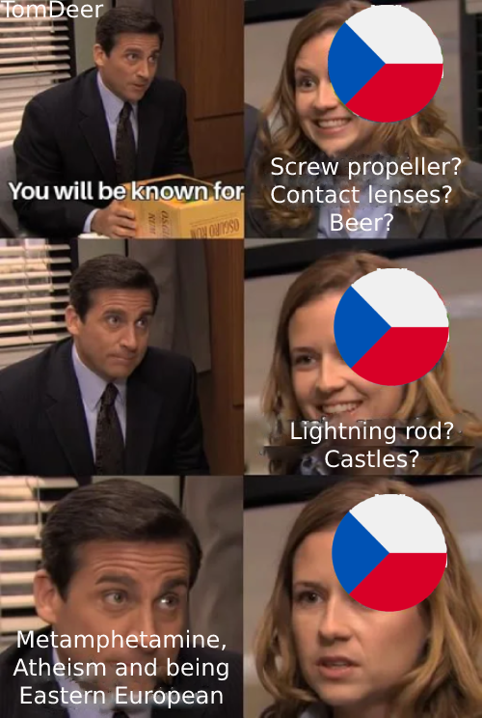
Czech cultural standards
Relationships orientation (prefer relationships to material aspect)
Underestimating structures (love for improvisation)
Simultaneity (parallel work)
Control aims people not rules
Diffusion culture
High communication context
Avoiding conflicts
Variable self-confidence

Slide 27
Recommendations
Develop cultural sensitivity
  Anticipate the meaning the receiver will get.
Careful encoding
  Use words, pictures, and gestures.
  Avoid slang, idioms, regional sayings.
Selective Transmission
  Build relationships, face-to-face if possible.
Careful decoding of feedback
  Get feedback from multiple parties.
  Improve listening and observation skills.
Follow-up actions

Slide 28
Staffing approach

Slide 29
Questions?
?
?
?
?
?
?
?
?
?
?
?
?
?
?
?
?
?

Slide 30
Thank you for your attention!

