Slide 1
Organizational Structure of MNEs and Control Systems
International Management

Slide 2
Lecture Learning Goals
Understand the importance of appropriate organizational structures to effective strategy implementation
Become familiar with the types of organizational designs suitable for the level and scope of internationalization of the firm
Be able to recognize why and when organizational restructuring is needed

Slide 3

Opening Profile 1: Samsung
Samsung SH700
In 1993, they launched the original SH700 model, an “ultra-light” mobile phone that was definitely a step in the right direction for lighter and more convenient to carry mobile phones in the future

Slide 4
Opening Profile 1: Samsung
Badly hit by the global economic downturn in 2009
Implemented a radical reorganization
Consolidating business operations into two operating divisions
Replaced the heads of five of its eight overseas operations

Slide 5

Opening Profile 2: ACO
ACO – building drainage and many more
Changing structure from decentralised towards higher centralisation
Trend in MNEs?

Slide 6
Opening Profile 3: Alcoa
Created smaller units
Linked geographically dispersed, but similar businesses (e.g., Brazil and Australia)

Slide 7
Organizational Change and Design
Needed When:
Clashes among divisions, subsidiaries, or individuals over territories or customers
Duplication of administrative or personnel services, sales offices, account executives
Growth (mergers, aquisitions, etc.)
An increase in overseas customer service complaints
A shift in operational scope (new customers, new project, etc.)
Conflict between overseas and domestic staff
Centralization leads to excessive and, thus, misused or misunderstood data
Unclear reporting relationships
Other?

Slide 8
Organizational Structure
Must evolve to accommodate internationalization
Should be contingency based
Must “fit” with strategy

Slide 9
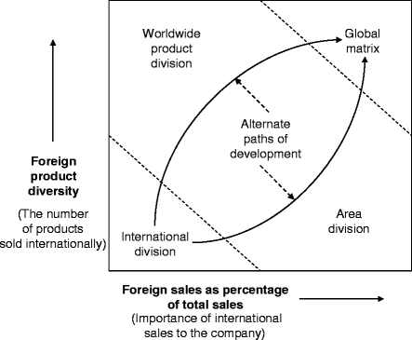
Stopford-Wells model

Slide 10
Basic structures of MNE
Domestic structure +
  export department
  foreign subsidiary
  international division
Integrated global structures
Global functional structure
Global area structure
Global product structure

Slide 11
Domestic Structure Plus Export Dpt/Foreign Subsidiary/Int Division

Slide 12
Domestic Structure Plus Export Dpt/Foreign Subsidiary/Int Division
Organized along functional, product, or geographic lines

Slide 13
Global Functional Structure
Designed on the basis of the company’s functions
Allows for functional specialization and economies of scale
Usually single product companies
Used at the beginning of interntionalisation
No P&L for each product (impact on motivation)
Needs collaborative cultures

Slide 14
Global Product (Divisional) Structure

Slide 15
Global Product (Divisional) Structure
P&L statement for every division
Needs competitive cultures
Used by Microsoft – changed to functional
Heinz, previously using geographical structure, changed to global product structure

Slide 16
Global Geographic (Area) Structure

Slide 17
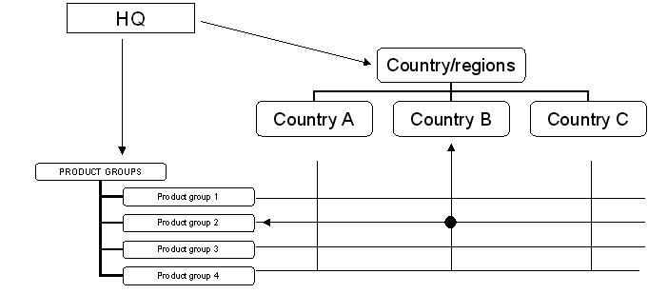
Matrix structure

Slide 18
Stopford-Wells model

Slide 19
Different approaches
One of the other approaches is that of organisational strategy
Bartlett-Ghoshall

Slide 20
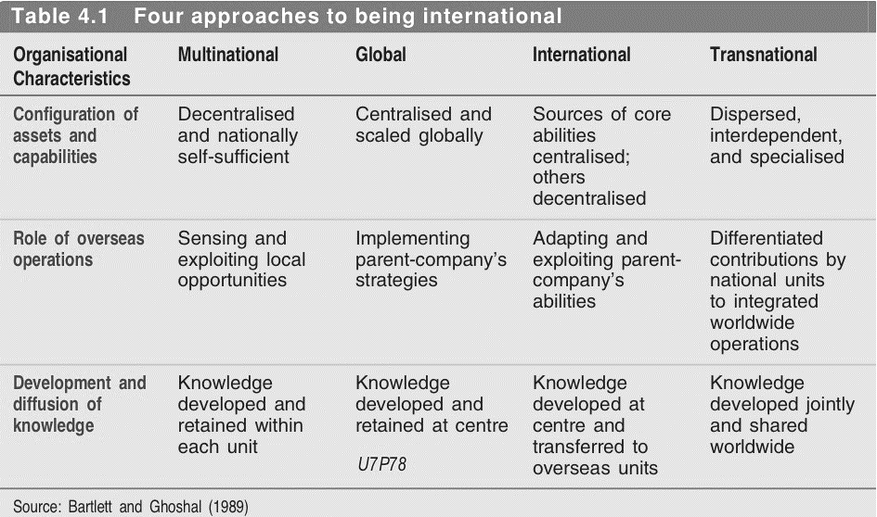
Bartlett-Ghoshall

Slide 21
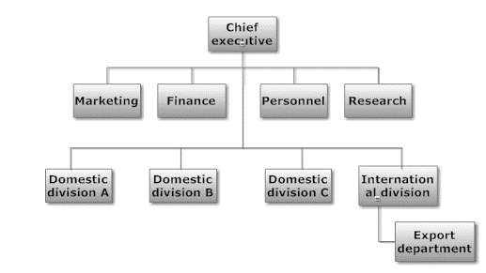
International

Slide 22
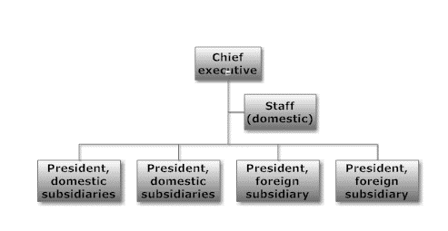
Multinational

Slide 23
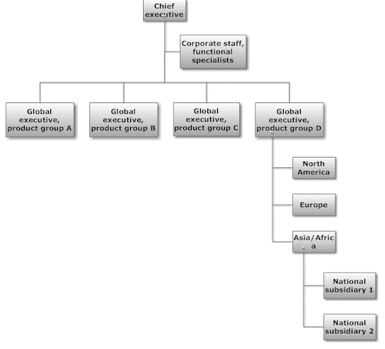
Global

Slide 24
Transnational
Attempts to combine:
The capabilities and resources of a MNC
The economies of scale of a global corporation
The local responsiveness of a domestic company
The ability to transfer technology efficiently typically of the international structure

Slide 25
Organising challenges
Integration vs. differentiation
Globalisation vs. localisation
Centralisation vs. autonomy

Slide 26
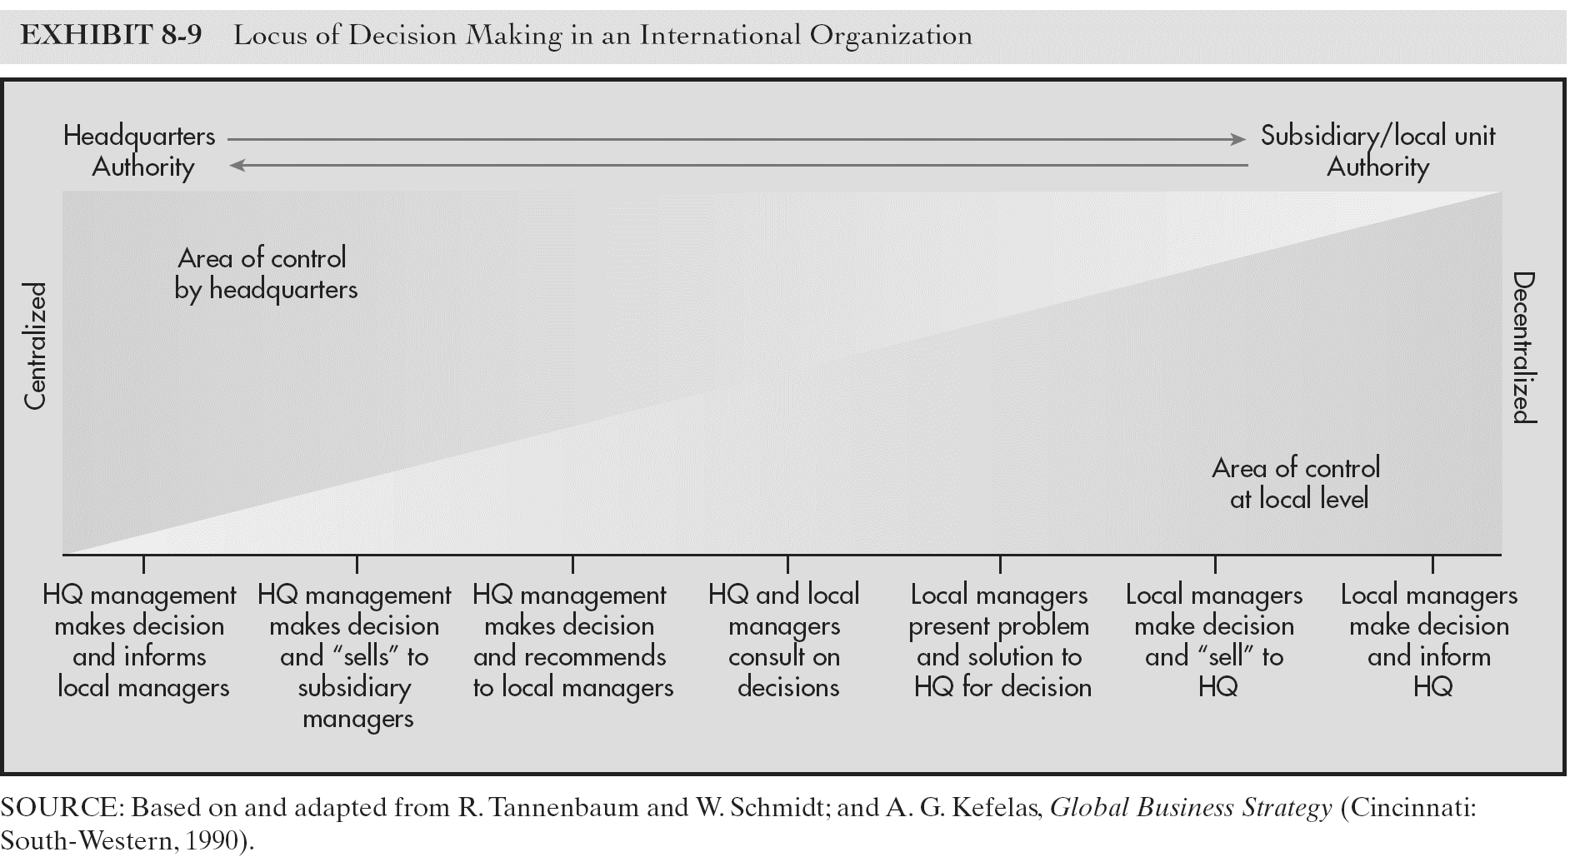
Centralisation vs. autonomy

Slide 27
Globalisation vs. localisation

Slide 28
Control Systems for Global Operations
Direct Coordinating Mechanism
Indirect Coordinating Mechanism
McDonald’s in Moscow
  Problem: quality control
  Solution: built processing plant in Moscow and provided managerial training
Other options: visits by head-office personnel and regular meetings
Examples: sales quotas, budgets, and financial tools and reports
Three financial statements
  One for accounting standards in host country
  One for the standards in the home country
  One for consolidation

Slide 29
Thank you for attention!

