Slide 1

Logistics behind laser printers: the case of Lexmark
The focus of the lecture is to introduce Lexmark’s forward and reverse logistic flows and share a quick overview regarding our business. Lexmark is recognized as a global leader in the imaging and document services market. Our customers are located all over the world with devices deployed in over 170 countries. In fact, Lexmark has managed print service engagements in over 28,000 cities and 200k locations. In total, we have over 6.5M devices operating in the field of which over 1M are managed directly through our single global system. We also have a broad network of over 6,500 partners to reach markets and customers not covered by our direct sales force. Come and join our lecture to find out more about how our processes can be incorporated into the DiCiM project funded by the European Union
“We believe in what we do”
Presenters
Noemi Keszler – Manager, EMEA After Sales Supply Chain
Gyorgy Szemeredi – GBS WW Strategic PMO

Slide 2
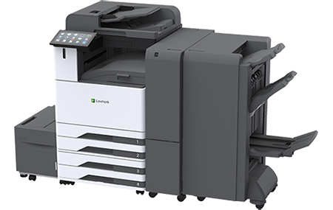
Organization info
Manufacturer of laser printers and imaging products
Founded in 1991
HQ in Lexington, USA
Customers in more than 170 countries
Recognition: Global leader in innovative imaging & IoT

Slide 3
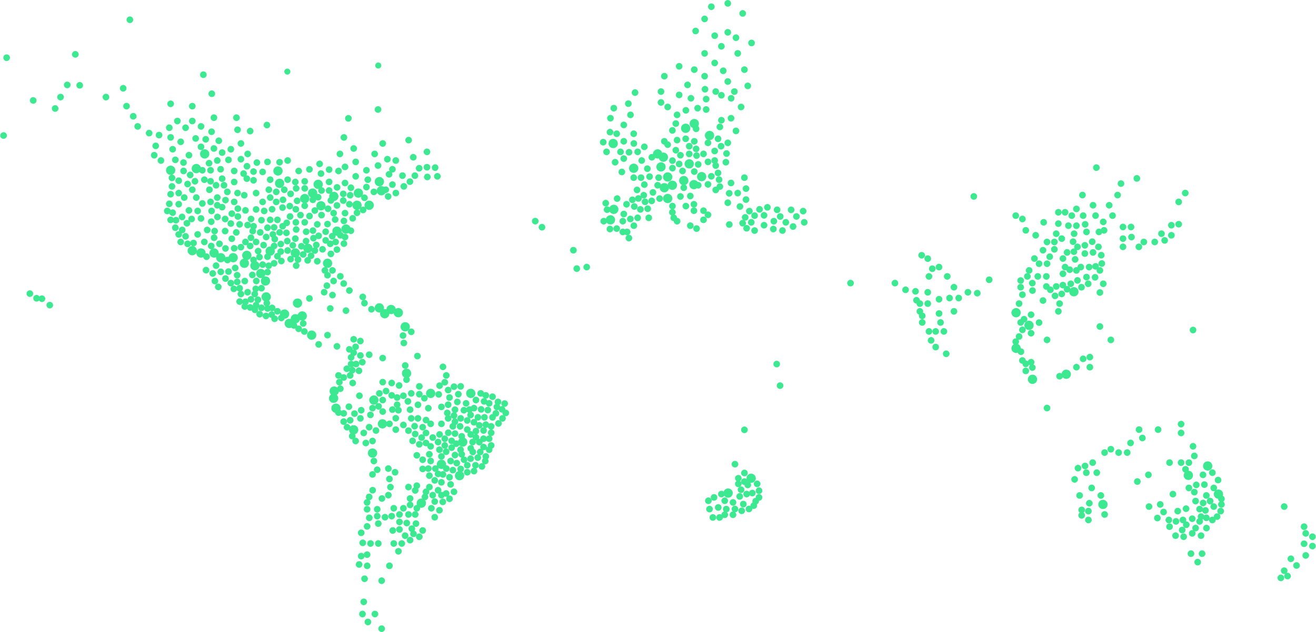
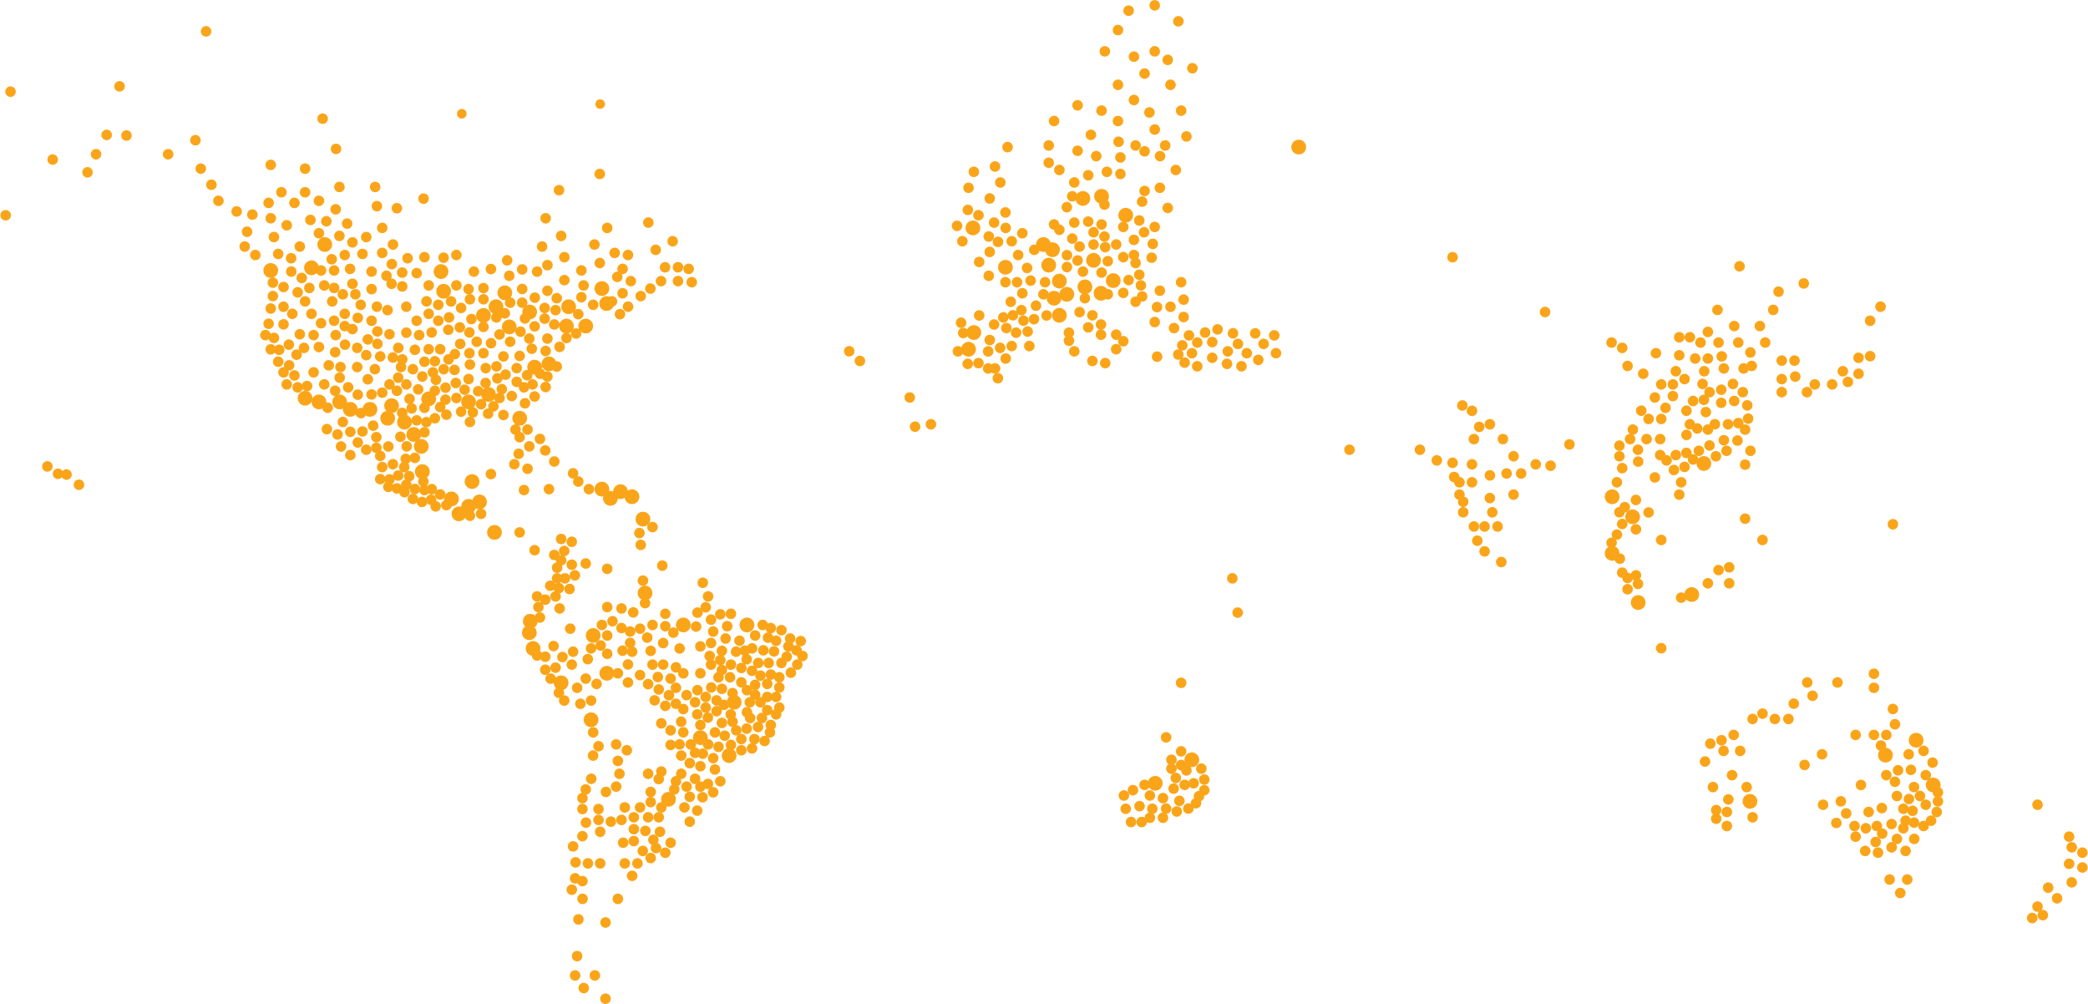
Our global reach
devices
deployed
devices
under contract
locations
7M+
170+
countries
1.2M+
230K+
6,500+
channel
partners
Notes:
We have more than 7 million printers and devices deployed with customers in more than 170 countries around the world.
Of those devices, more than 1.2 million are under contract through Lexmark Managed Print Services engagements. Using the Lexmark Global IoT System, a single worldwide software system, we manage printers and multifunction devices in more than 230,000 locations in 34,000 cities.
We also reach markets and customers not covered by our direct sales force through our broad network of more than 6,500 partner companies.
[NOTE: Information here was accurate as of January 2023.]

Slide 4
A global leader
Regional headquarters
Geneva, Switzerland
Global headquarters
Lexington, Kentucky, USA
Regional headquarters
Singapore
Primary
development centers
Manufacturing
facilities
Shared
services centers
Support
centers
Major field sales
presence
Notes:
Let’s pull back and talk about Lexmark as a company, our people, and the values we embrace.
Lexmark is a global business with our headquarters in Lexington, Kentucky — at the same site where we started.
We also have regional headquarters in Geneva, Switzerland, and Singapore.
[INCLUDE FOCUS ON GEOGRAPHIES RELEVANT TO YOUR AUDIENCE]
Our primary development locations are Lexington; Cebu, Philippines; and Kolkata, India.
We manufacture our products across the world using a combination of contract manufacturing partners and our own facilities in Boulder, Colorado, and Juarez, Mexico.
To support our operations, we have shared services centers in Cebu, Philippines; and Budapest, Hungary.
We have support centers around the world, including: Bogota, Colombia; Sao Paulo, Brazil; Rabat, Morocco; Sofia, Bulgaria; Lisbon, Portugal; Cebu and Manila, Philippines; and Dalian, China.
Finally, we have a large field sales organization, with a presence around the world including in major metropolitan areas such as: New York, Chicago, Washington, D.C., and Los Angeles, U.S.A.; Toronto, Canada; Mexico City; Frankfurt, Germany; Paris, France; London, England; Sydney, Australia; Geneva, Switzerland; Sao Paulo, Brazil; and Beijing, China.

Slide 5
Our employees
8,000
45
countries
employees
Notes:
Lexmark’s greatest strength is our work force: 8,000 exceptionally skilled employees in 45 countries around the world. When customers partner with Lexmark, they are also partnering with the unique wealth of knowledge and experience of our people. That’s one of the things that makes Lexmark the trusted and enduring company it always has been.
OPTIONAL: Competitive salaries, truly flexible work/life balance, cross-departmental experience and global business reach opportunities and our award-winning office culture means we attract the best and the brightest employees.
[NOTE: Information here was accurate as of January 2023.]

Slide 6

Our portfolio
Cloud
services
Managed print
services
Applied
technology
IoT
solutions
Imaging
hardware
Notes:
At our core, we are an imaging company, delivering …
Long-life devices with features that make it easy to create, adapt and share printed content;
Cloud services, designed to help customers reduce infrastructure, simplify device management, and provide solutions that enhance productivity;
and managed print services enabled with the Internet of Things (IoT) and cloud technology and data analytics that provide as-a-service printing for organizations of all sizes.
<CLICK>
These proven foundational elements of our business also provide a springboard to offer new value to new customers, with …
Applied technology that leverages our expansive intellectual property in new and interesting ways – from automotive to health and beauty tools;
and Optra IoT Solutions, a growing portfolio rooted in our decades of technology development and operational expertise. Our offerings — Optra Edge and Optra IoT Platform — drive out cost, improve efficiency and help customers tap into new revenue streams.

Slide 7
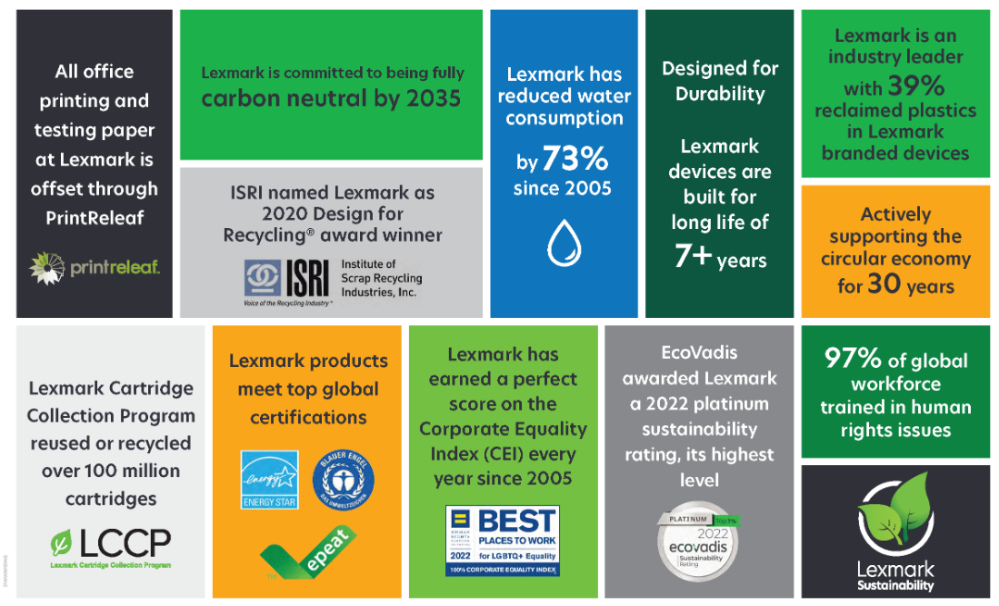
Lexmark CSR Report
Lexmark CSR Report

Slide 8

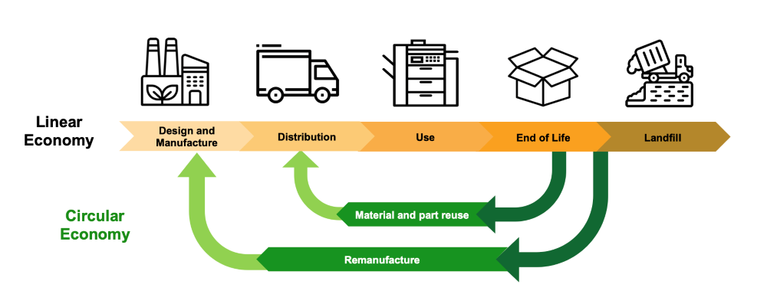
Circular Economy
“To support customer choice, technological innovation and the circular economy by cartridge reuse, we propose that OEMs of imaging devices provide a solution that enables the operation of remanufactured cartridges in their devices (whether remanufactured by the OEM or others) using the OEM’s original circuitry while maintaining key device functionality.”

Slide 9
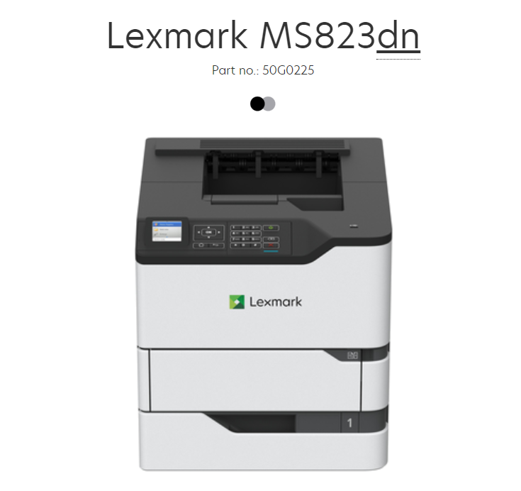
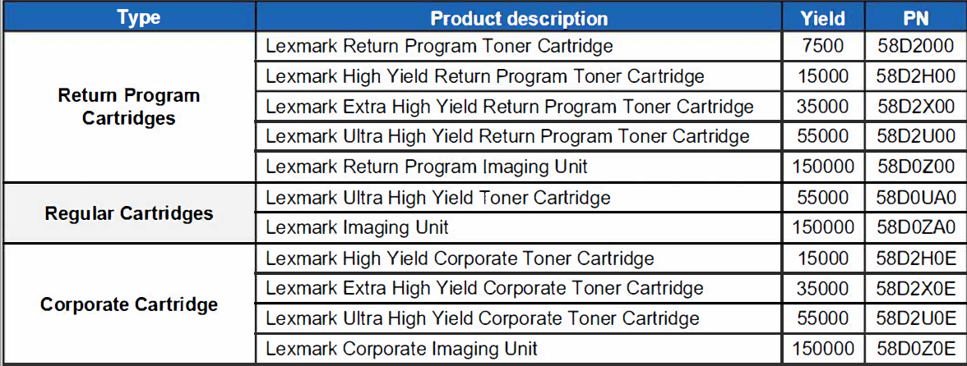
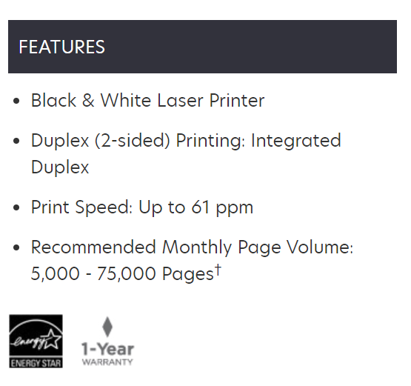
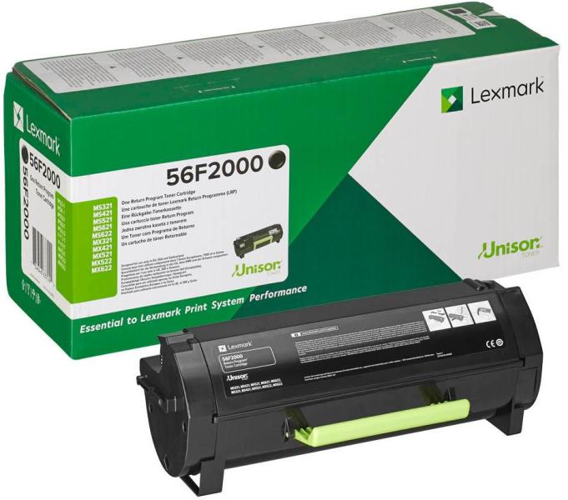
Printer & cartridge selection for DiCiM / MS823dn
Weblink - Lexmark MS823dn

Slide 10
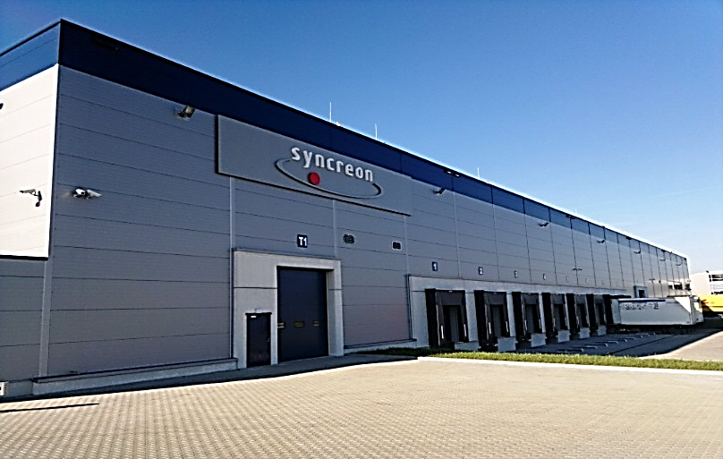
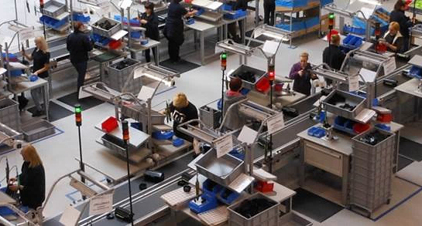
After Sales Supply Chain

Slide 11
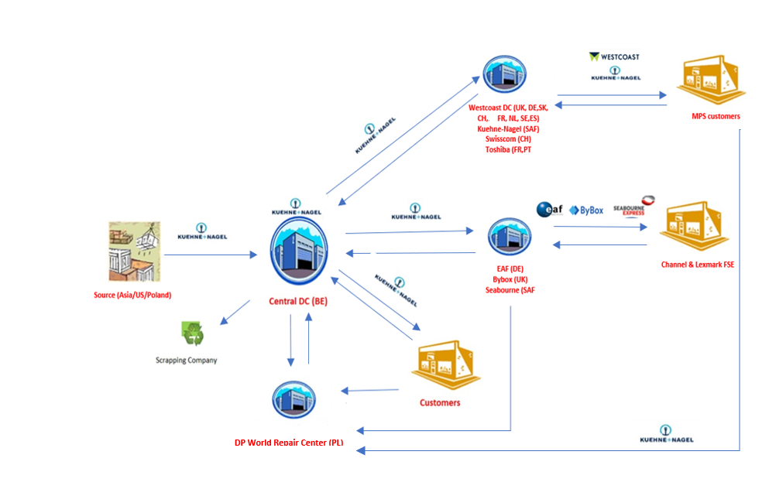
EMEA distribution flow
SCOPE:
Spare Parts logistics partners
MPS Supplies logistics partners
Repair, Dismantling, Remanufacturing
LCCP & LECP (Lexmark cartridge and equipment collection program)

Slide 12





Circular Economy at Lexmark
Warehouse
Distribution
Customer
End Of Life
Ship new printer
To customer
Ship remanufactured
Printer to customer
Evergreen
Remanufacture or dismantle
Remanufactured printer
repaired/cleaned part
LECP
Collect used printers
+
Parts Returns
DP World Poland
Remanufacturing:
Competitive offer & fleet extension
CO2 emisson reduction
New EU regulations
Parts repair:
Flexibility: Reducing leadtime, avoiding airshipment, Backorders
Circular economy
LECP:
Source for Reman and Parts repair
Support fleet changes, reducing cost
Proper handling of GDPR sensitive parts
Reuse and recycle

Slide 13
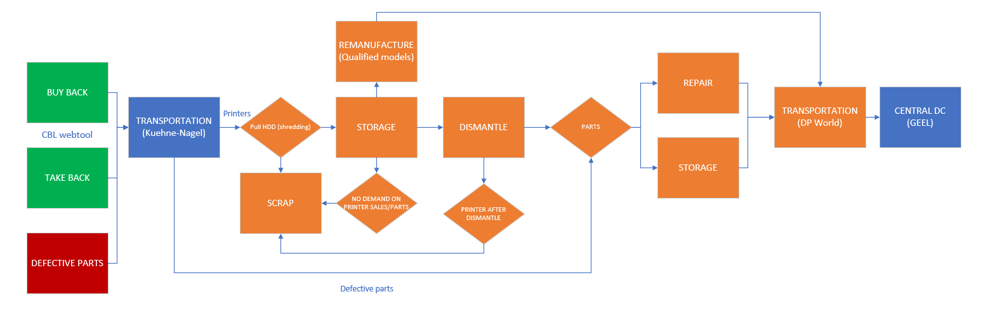
Repair, Dismantling & Remanufacturing process

Slide 14
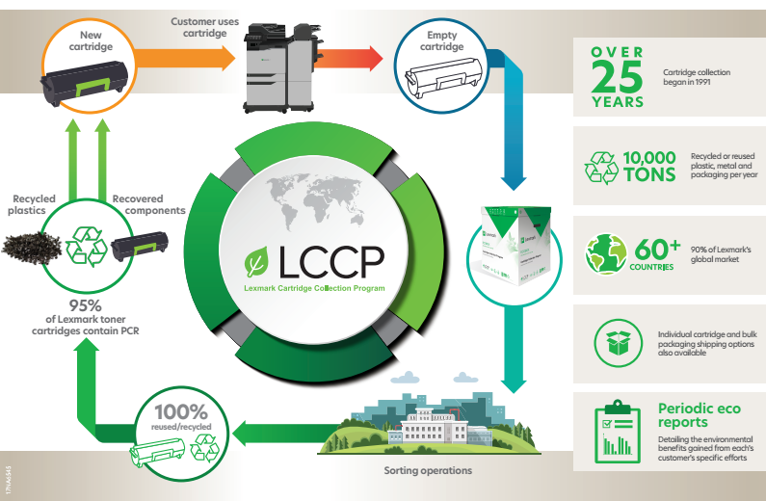
Lexmark Cartridge Collection Program
Lexmark Cartridge Collection Program and the Circular Economy
Lexmark Cartridge Collection Program
30
Lexmark Cartridge Collection Program (LCCP)
Free, easy cartridge recycling since 1991
Customers return more than 1 out of 3 toner cartridges, far exceeding industry averages
Zero landfill / zero waste policy ensures all empty cartridges returned are reused or recycled
Available in 60+ countries

Slide 15

Thank you for your attention!

Slide 17

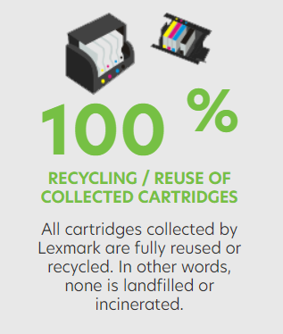


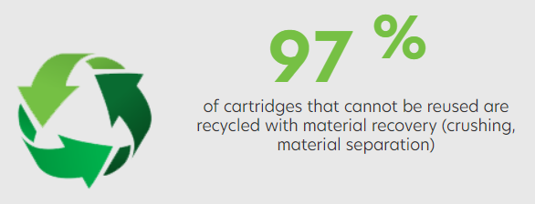
Interesting facts - EMEA

