Slide 1


MPH_SOMA Operations Management
Service Complaints
Feybi Ariani Goni, M.IT., Ph.D.
Assistant Professor
Mail Room 538, Lipová 507/41a, 602 00 Brno
E-mail Feybi.Ariani.Goni@econ.muni.cz
Tel +420 778790553

Slide 2
Learning Goals
To understand the significance of service complaints
Identify different types of service complaints
To understand complaint management concept

Slide 3

Overview of Service Complaints concept
Complaint Management concept

Slide 4
What is Service Complaints?
Expressions of dissatisfaction from customers regarding their experiences with a product or service.
It is about customer needs, expectations, and preferences.
Emphasize that service complaints are not merely negative occurrences but opportunities for growth and improvement.
Encourage a proactive approach to service complaint management for long-term business success.

Slide 5
Types of Service Complaints:
Product-related complaints
Process-related complaints
Personnel-related complaints
Policy-related complaints
Communication-related complaints
Value-related complaints

Slide 6
Overview of Service Complaints concept
Complaint Management concept

Slide 7
Complaint Management
Encompasses the planning, execution, and controlling of all measures taken by a firm in connection with the complaints it receives.
The goal is to increase a firm’s profitability and competitiveness by restoring customer satisfaction, by minimizing the negative effects of customer dissatisfaction on the firm.

Slide 8
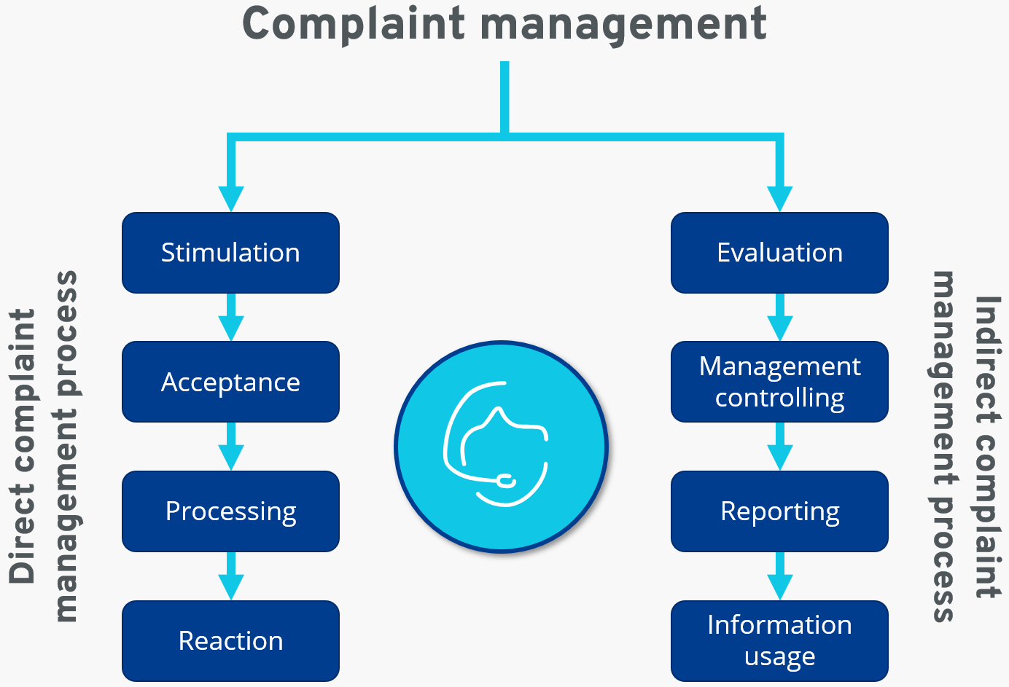
Complaint Management process
Stauss and Seidel (2004)

Slide 9
The actions that customers may take in response to service failures
Take some form of public action (e.g., complaint the firm or a third party or even take legal action).
Take some form of private action (e.g., switch to another provider and/or spread negative word of mouth).
Take no action.

Slide 10
Why customers complain?
Customers typically complain about any combination of the following four reasons: compensation, venting their anger, helping to improve the service, and sparing other customers from experiencing the same problems.
Most dissatisfied customers do not complain as they may not know where to complain, they think it requires too much effort and is unpleasant, and they perceive the payoffs of their effort as uncertain.
The people who are most likely to complain tend to be better educated, have higher incomes, are more socially involved, and have more knowledge about the product.
Customers are most likely to complain at the point-of-service provision (face to face and over the phone). Only a small proportion of complaints is made via other channels such as e-mail, social media, websites, or letters.

Slide 11
Service Recovery
The service recovery paradox describes the phenomenon where customers who experience an excellent service recovery after a failure feel even more satisfied than customers who had no problem in the first place.
However, it is important to note that this paradox does not always apply. It is best to get the service right the first time rather than provide expensive service recovery.

Slide 12
Service Recovery
Effective service recovery systems should:
Make it easy for customers to give feedback (e.g., provide hotline numbers, e-mail addresses, and social media channels on all communications materials) and encourage them to provide feedback.
Enable effective service recovery by making it (1) proactive, (2) pre-planned, (3) trained, and (4) empowered.
Establish appropriate compensation levels. Compensation should be higher if (1) a firm is known for service excellence, (2) the service failure is serious, and (3) the customer is important to the firm.

Slide 13
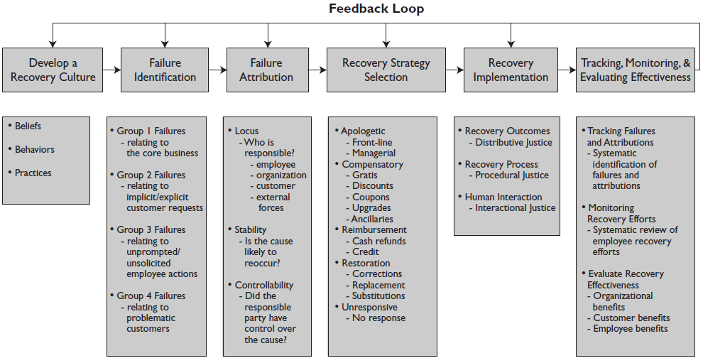
Service Recovery Management
Stauss and Seidel (2004)

Slide 14
References:
Wirtz, J., 2012. Essentials of services marketing. 3rd Edition. FT press.
Stauss, B., Seidel, W., 2010. Complaint management. In Introduction to Service Engineering. Salvendy, G., Karwowski, W. (Ed.). John Wiley & Sons, Inc.
Wirtz, J., 2018. Designing complaint handling and service recovery strategies (Vol. 11). World Scientific.

Slide 15
Activity 1- Individual discussion
Think about the last time you experienced a less-than satisfactory service experience. Did you complain? Why? If you did not complain, explain why not.
When was the last time you were truly satisfied with an organization’s response to your complaint? Describe in detail what happened and what made you satisfied.

Slide 16
Activity 1- Group discussion
Type of service complaints:
Product-related complaints
Process-related complaints
Personnel-related complaints
Policy-related complaints
Communication-related complaints
Value-related complaints
Task: You are the complaint management team. Design real-world scenarios corresponding to each type of complaint. Identify what the complaint is about, and then design the resolution strategies. You may use visuals such as diagrams or icons to illustrate it.

