Slide 1
Service quality

Slide 2
Learning outcomes
Quality concept and service quality
Determinants, attributes, elements of service quality – link to the previous lecture
Customer expectations
Gap model
Servqual
CIT and sequential incident technique
Walk-through audit….link to the lecture focused on service design
Costs of service quality
Service control
Service recovery
ISO 20000-1:2018

Slide 3
Quality concept
“although we cannot define quality, we know what quality is” (Pirsig, 1987)
“quality is fitness for use, the extent to which the product successfully serves the purpose of the user during usage” (Juran, 1974)
“quality is zero defects - doing it right the first time”, Parasuraman, Zeithaml and Berry, 1985)
“quality is exceeding what customers expect from the service”, Zeithaml, Parasuraman and Berry, 1990)

Slide 4
Quality in practice
Conformance quality
  producing the product/service according to specification every time, with no correction required
Quality-in-use
  customer judgements about quality received and resultant level of customer satisfaction
Technological quality
  superior performance features of product/service derived from advanced new technologies

Slide 5
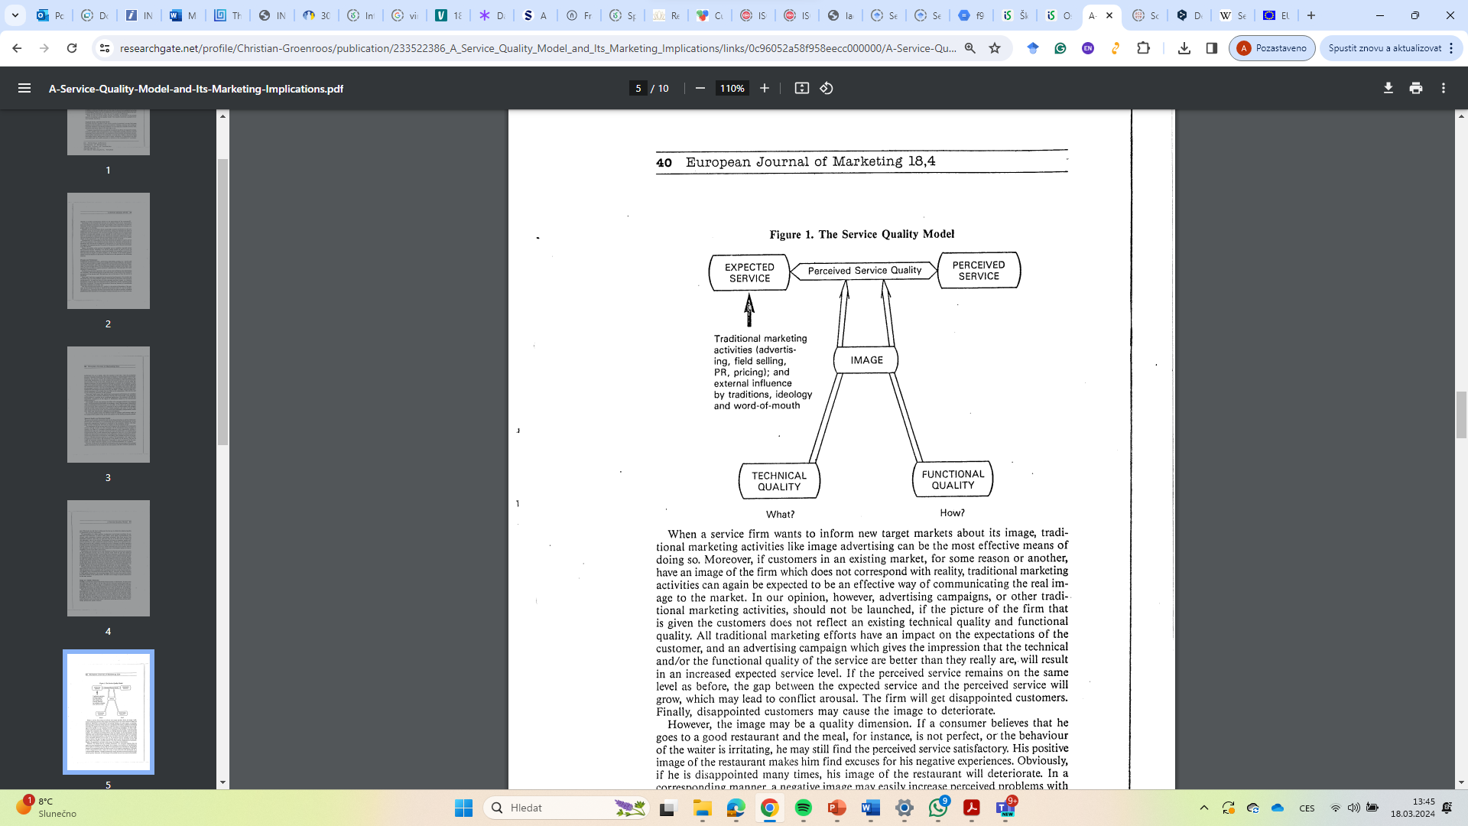
Service quality
Nordic school – what and how dimensions – what is created and delivered and how it is delivered – „a play“ between the dimensions
Grönroos, C. (1984). A service quality model and its marketing implications. European Journal of marketing, 18(4), 36-44.

Slide 6
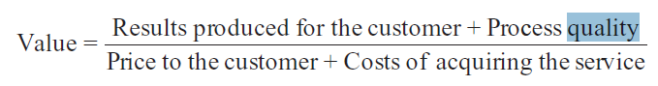
Service quality
service quality as "the discrepancy between customers' expectations and perceptions" (Parasuraman, Zeithaml, & Berry, 1994, p. 111)
perceptions of quality as a function of "prior expectations of what will and what should transpire. . . and the actual delivered service" (p. 7) Boulding et al. (1993)
perceptions of quality are only a function of perceived product performance (Cronin and Taylor, 1994)
Service quality = a comparative function between consumer expectations and actual service performance (Parasuraman et al., 1985).
customer satisfaction literature = "Disconfirmation Paradigm„
service quality literature = "Gap Model“
(Service) quality- very subjective
Quality and value (benefits and sacrifices) - Value may be conceptualized as arising from both quality and price or from what one gets and what one gives.
Value increases as quality increases and as „price“ decreases. VALUE IS A PREFERENCE
Customer satisfaction = a function of the discrepancy between a consumer's prior expectations and his or her perception regarding the purchase
the word “satisfaction” is derived from the Latin satis (enough) and facere (to do or make). A related word is [p. 4 ↓ ] “satiation,” which loosely means “enough” or “enough to excess.” These terms illustrate the point that satisfaction implies a filling or fulfillment. Thus, consumer satisfaction can be viewed as the consumer‘s fulfillment response.
quality is one of the service dimensions factored into the consumer's satisfaction judgment. Subsequent to this effect, satisfaction may reinforce quality perceptions, but only indirectly

Slide 7
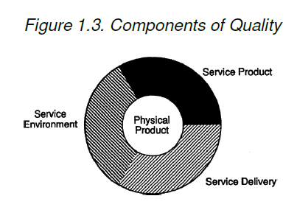
Components of service quality
Rust, R. T., & Oliver, R. L. (Eds.). (1993). Service quality: New directions in theory and practice. Sage Publications.

Slide 8
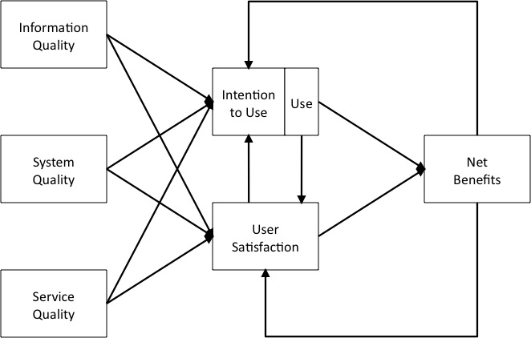
QoS in Information Systems
For those who like reading: Gorla, N., Somers, T. M., & Wong, B. (2010). Organizational impact of system quality, information quality, and service quality. The journal of strategic information systems, 19(3), 207-228.
Data quality
Delone and Mclean, Information Systems Success Theory

Slide 9
Determinants, elements, attributes of service quality
access, appearance/aesthetics, availability, cleanliness/tidiness, comfort, communication, competence, courtesy, friendliness, reliability, responsiveness and security
---------- tangibles, reliability, responsiveness, assurance and empathy
access, communication, competence, courtesy, credibility, reliability, responsiveness, security, understanding and tangibles
+ attentiveness/helpfulness, care, commitment, functionality, integrity
professionalism and skills; attitudes and behaviour;
accessibility and flexibility; reliability and trustworthiness; recovery; reputation and credibility.
care and concern, spontaneity, problem solving and recovery
“firm” - time (including availability, waiting time and responsiveness), fault freeness (including physical items, information and advice) and flexibility (ability to recover from mistakes, to customize the service or add additional services and
“soft” - style (attitude of staff, accessibility of staff and ambience), steering (the degree to which customers feel in control of their own destiny) and safety (trust, security and confidentiality)

Slide 10
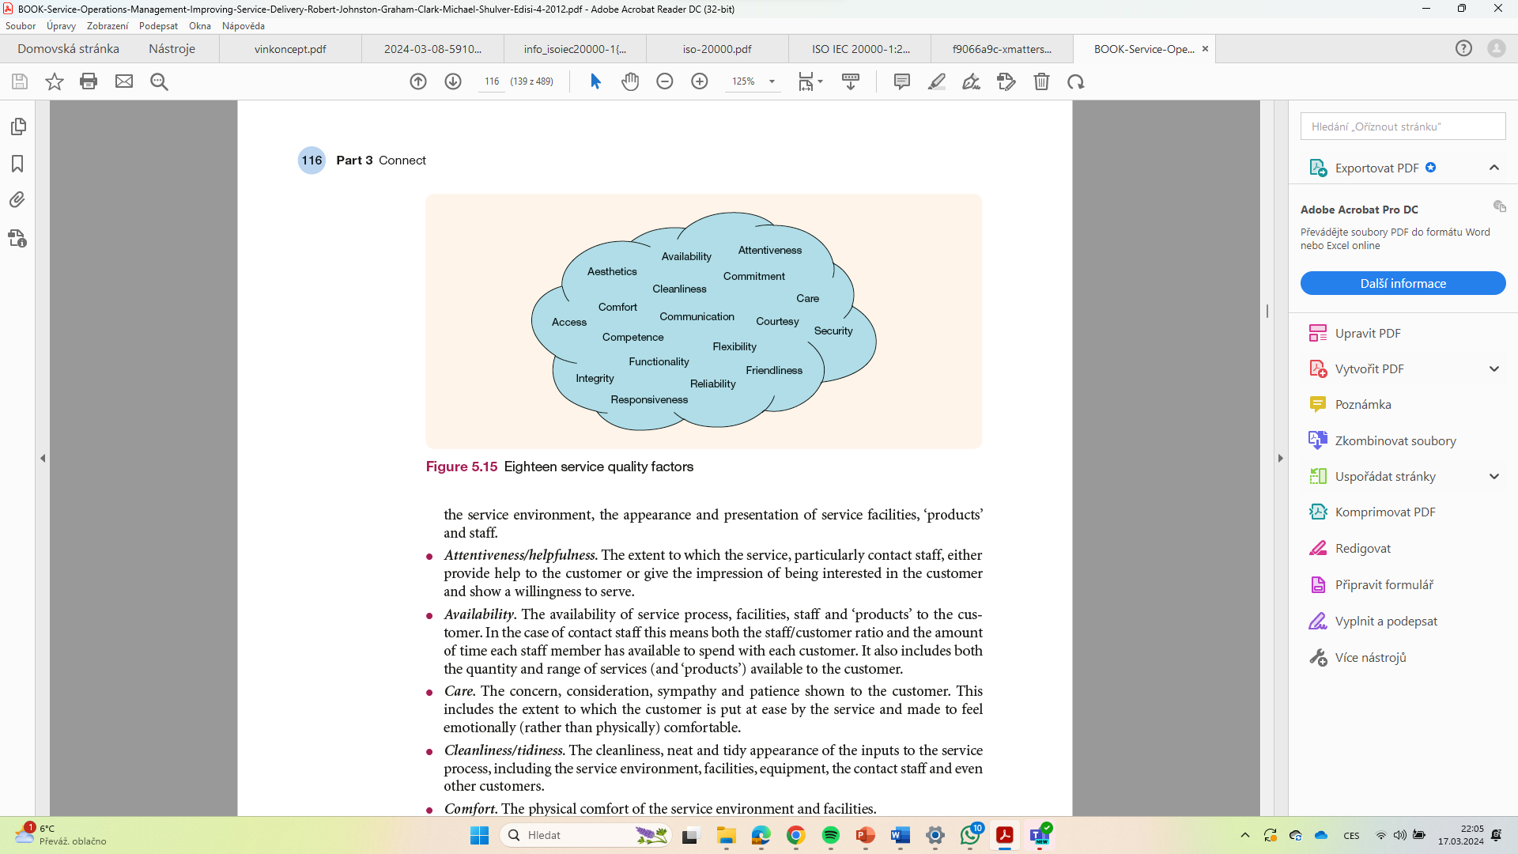
● Access . The physical approachability of the service location, including the ease of finding one’s way around the service process or route through the process.
● Aesthetics . The extent to which the components of the service and their experience of it aremagreeable or pleasing to the customer, including both the appearance and the ambience of the service environment, the appearance and presentation of service facilities, ‘products’ and staff.
● Attentiveness/helpfulness . The extent to which the service, particularly contact staff, eithermprovide help to the customer or give the impression of being interested in the customermand show a willingness to serve.
● Availability . The availability of service process, facilities, staff and ‘products’ to the customer. In the case of contact staff this means both the staff/customer ratio and the amount of time each staff member has available to spend with each customer. It also includes both the quantity and range of services (and ‘products’) available to the customer.
● Care . The concern, consideration, sympathy and patience shown to the customer. This includes the extent to which the customer is put at ease by the service and made to feel emotionally (rather than physically) comfortable.
● Cleanliness/tidiness . The cleanliness, neat and tidy appearance of the inputs to the service process, including the service environment, facilities, equipment, the contact staff and even other customers.
● Comfort . The physical comfort of the service environment and facilities.
Johnston, R., & Clark, G. (2005). Service operations management: improving service delivery. Pearson Education.

Slide 11
● Commitment . The staff ’s apparent commitment to their work, including the pride and satisfaction they apparently take in their job, their diligence and thoroughness.
● Communication . The ability of service staff to communicate with customers in a way they will understand. This includes the clarity, completeness and accuracy of both verbal and written information communicated to the customer and the ability to listen to and understand the customer.
● Competence . The skill, expertise and professionalism with which the service is executed. This includes the carrying out of correct procedures, correct execution of customer instructions, the degree of ‘product’ or service knowledge exhibited by contact staff, the provision of good, sound advice and the general ability to do a good job.
● Courtesy . The politeness, respect and propriety shown by the service, usually contact staff, in dealing with customers and their property. This includes the ability of staff to be unobtrusive and uninterfering when appropriate.
● Flexibility . A willingness on the part of the service worker to amend or alter the nature of the service to meet the needs of the customer.
● Friendliness . The warmth and personal approachability (rather than physical approachability) of the service, particularly of contact staff, including a cheerful attitude and the ability to make the customer feel welcome.
● Functionality . The serviceability and fitness for purpose of service.
● Integrity . The honesty, justice, fairness and trustworthiness with which customers are treated by the service organisation.
● Reliability . The reliability and consistency of performance of the service and its staff. This includes punctual service delivery and the ability to keep to agreements made with the customer.
● Responsiveness . The speed and timeliness of service delivery. This includes the speed of throughput and the ability of the service to respond promptly to customer service requests, with minimal waiting and queuing time.
● Security . The personal safety of customers and their possessions while participating in or benefiting from the service process. This includes the maintenance of confidentiality.
Johnston, R., & Clark, G. (2005). Service operations management: improving service delivery. Pearson Education.

Slide 12
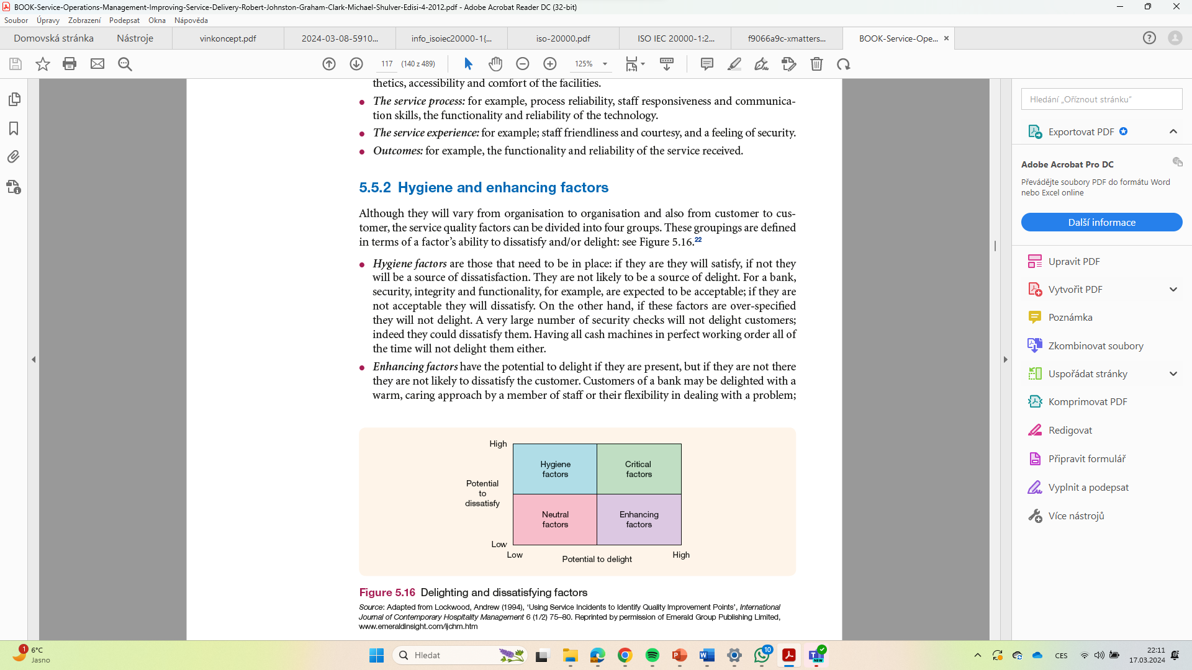
Hygiene and enhancing factors
however, these things are not necessarily expected so, if they are not provided, their absence may not lead to dissatisfaction.
● Critical factors have the potential to both delight and dissatisfy. Responsiveness, communication and competence of bank staff and systems must be at least acceptable so as not to dissatisfy the customer, but if more than acceptable they have the potential to delight.
● Neutral factors have little effect on satisfaction. The comfort or aesthetics of a banking hall
may play no part in customers’ satisfaction or dissatisfaction
Johnston, R., & Clark, G. (2005). Service operations management: improving service delivery. Pearson Education.

Slide 13
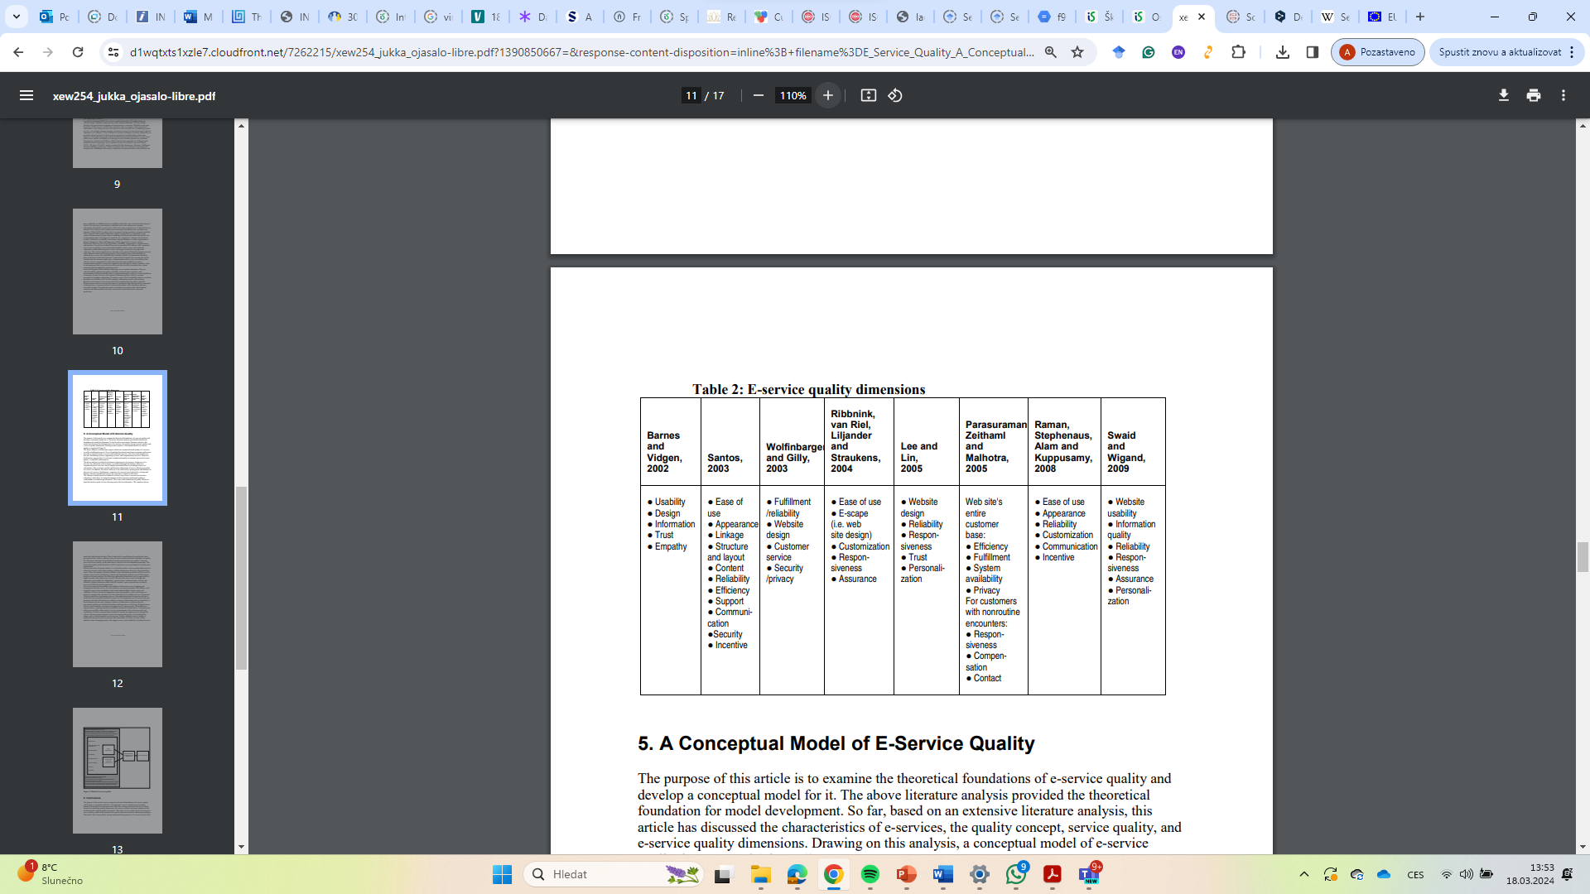
E-service quality dimensions
Ojasalo, J. (2010). E-service quality: a conceptual model. International journal of Arts and Sciences, 3(7), 127-143.

Slide 14
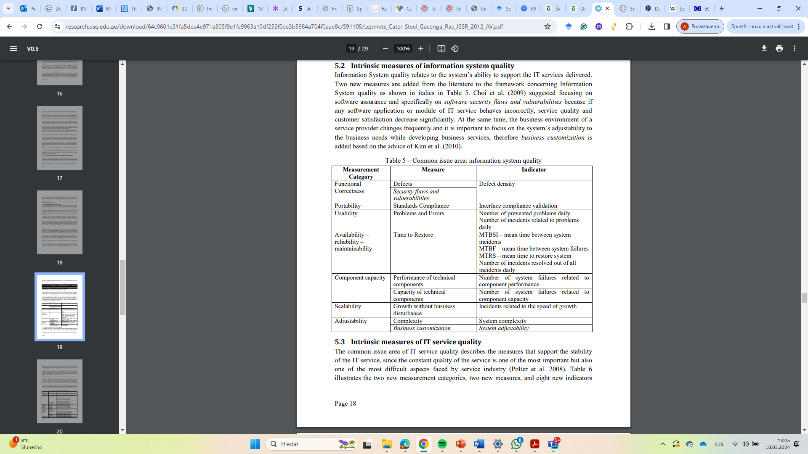
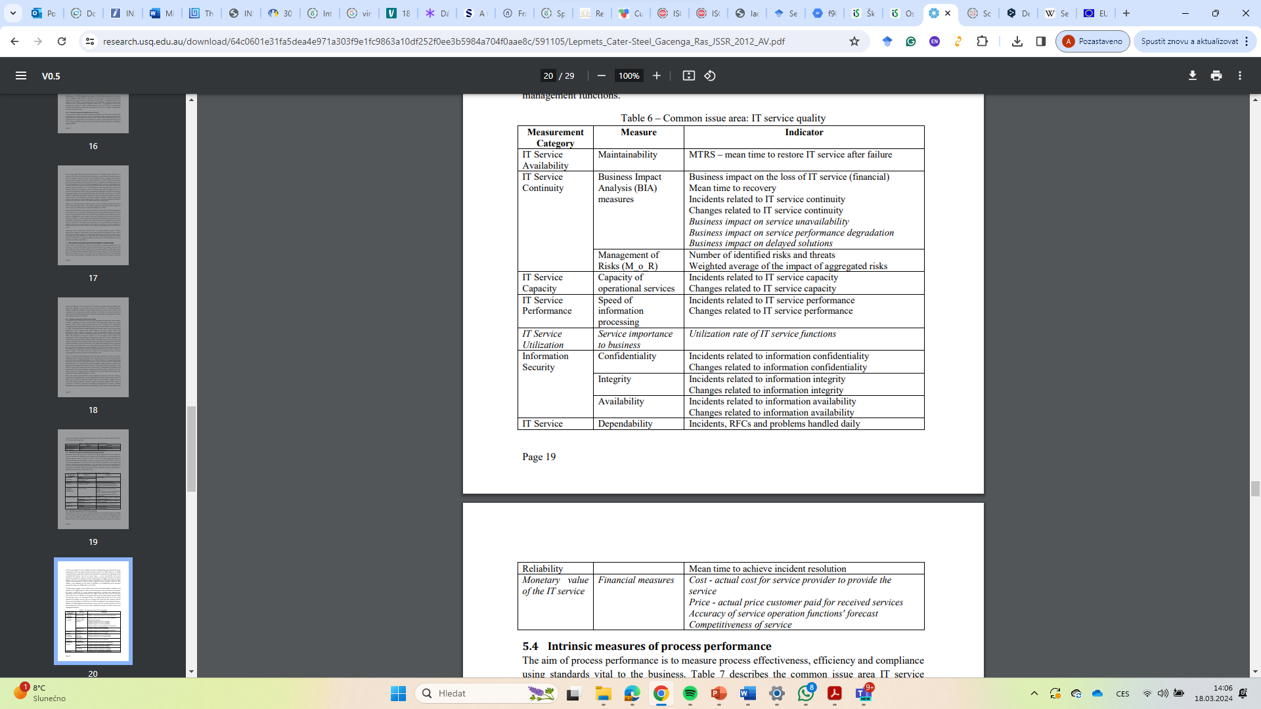
Lepmets, M., Cater-Steel, A., Gacenga, F., & Ras, E. (2012). Extending the IT service quality measurement framework through a systematic literature review. Journal of Service Science Research, 4, 7-47.

Slide 15
Perceived Service Quality
Word of
mouth
Personal
needs
Past
experience
Service Quality
Dimensions
Reliability
Responsiveness
Assurance
Empathy
Tangibles
Expected
service
Service Quality Assessment
1. Expectations exceeded
ES<PS (Quality surprise)
2. Expectations met
ES~PS (Satisfactory quality)
3. Expectations not met
ES>PS (Unacceptable quality)
Perceived
service

Slide 16
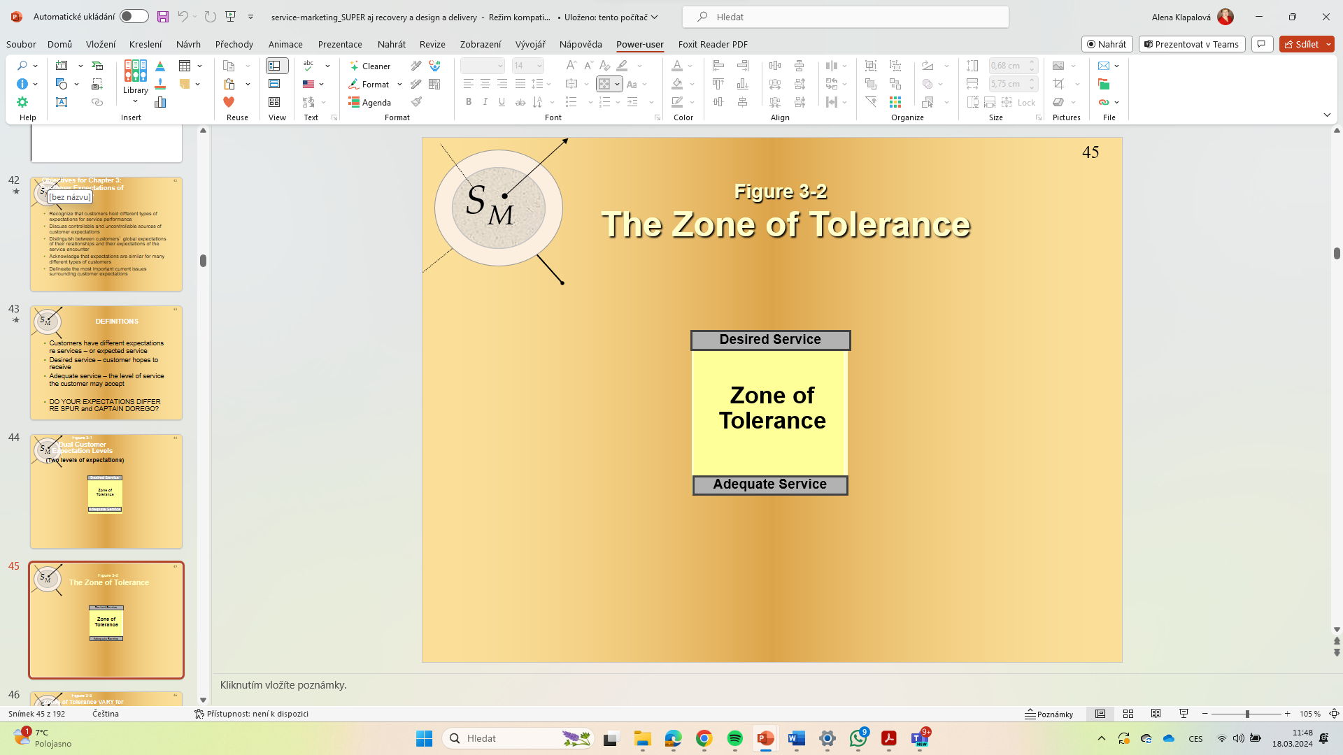
Customer Expectations of Service
Customers hold individual and different types of expectations for service performance – very often not able to define (esp. B2C + intangibility)
desires, wishes, needs, experience, standards
? What are controllable and uncontrollable sources of customer expectations
Necessity to distinguish between customers’ global expectations of their relationships and their expectations of the service encounter
Acknowledge that expectations are similar for many different types of customers
Delineate the most important current issues surrounding customer expectations
Zeithaml, V. A., Berry, L. L., & Parasuraman, A. (1993). The nature and determinants of customer expectations of service. Journal of the academy of Marketing Science, 21, 1-12.

Slide 17
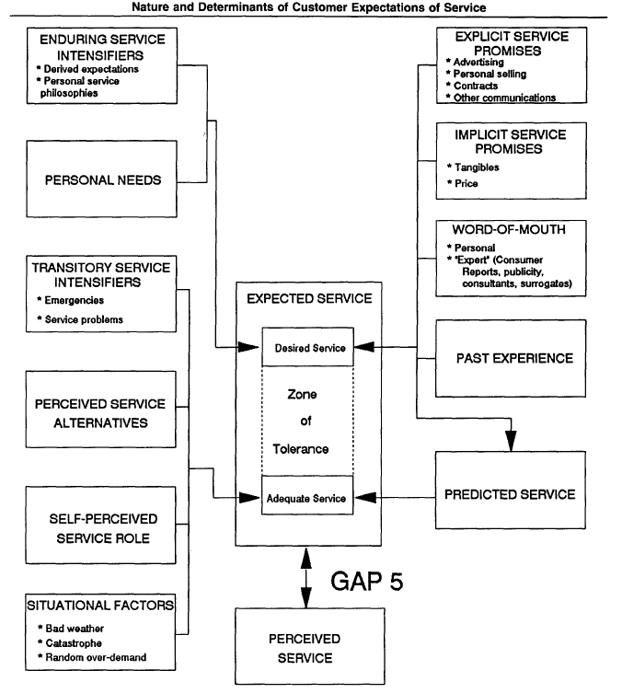
Enduring service intensifiers are individual, stable factors that lead the customer to a heightened sensitivity to service. One of those factors is derived service expectations, where the customer's expectations are driven by another party.
personal service philosophy -the customer's underlying generic attitude about the meaning of service and the proper conduct of service providers.
Transitory service intensifiers are temporary, usually
short-term, individual factors that lead the customer to a
heightened sensitivity to service
self-perceived service role - customers' perceptions of the degree to which they themselves influence the level of service they receive.
Zeithaml, V. A., Berry, L. L., & Parasuraman, A. (1993). The nature and determinants of customer expectations of service. Journal of the academy of Marketing Science, 21, 1-12.

Slide 18
Desired Service
Level
of
Expectation
Zone of
Tolerance
Desired
Service
Desired Service
Zone
of
Tolerance
Adequate Service
Adequate
Service
Adequate Service
Most Important Factors
Least Important Factors
Zeithaml, V. A., Berry, L. L., & Parasuraman, A. (1993). The nature and determinants of customer expectations of service. Journal of the academy of Marketing Science, 21, 1-12.

Slide 19
Factors that influence adequate service
Transitory Service
Intensifiers
Desired
Service
Perceived Service
Alternatives
Zone
of
Tolerance
Self-Perceived
Service Role
Adequate
Service
Situational
Factors
Zeithaml, V. A., Berry, L. L., & Parasuraman, A. (1993). The nature and determinants of customer expectations of service. Journal of the academy of Marketing Science, 21, 1-12.

Slide 20
Service Quality Gap Model

Slide 21
Gaps in Service Quality
Gap1: Market research gap
  Management may not understand how customers formulate their expectations from past experience, advertising, communication with friends
    Improve market research
    Foster better communication between employees and its frontline employees
    Reduce the number of levels of management that distance the customer
Gap 2: Design gap
  Management unable to formulate target level of service to meet customer expectations and translate them to specifications
    Setting goals and standardizing service delivery tasks can close the gap
Gap 3: Conformance gap
  Actual delivery of service cannot meet the specifications set by management
    Lack of teamwork
    Poor employee selection
    Inadequate training
    Inappropriate job design

Slide 22
Continued….
Gap 4: Communication gap
  Discrepancy between service delivery and external communication
    Exaggerated promises in advertising
    Lack of information provided to contact personnel to give customers
Gap 5: Customer expectations and perceptions gap
  Customer satisfaction depends on minimizing the four gaps that are associated with service delivery
  Companies try to measure the gap between expected service and perceived service through the use of surveys (ex. Fig. 6.2)
  SERVQUAL – measures the five dimensions (table 6.1)

Slide 23
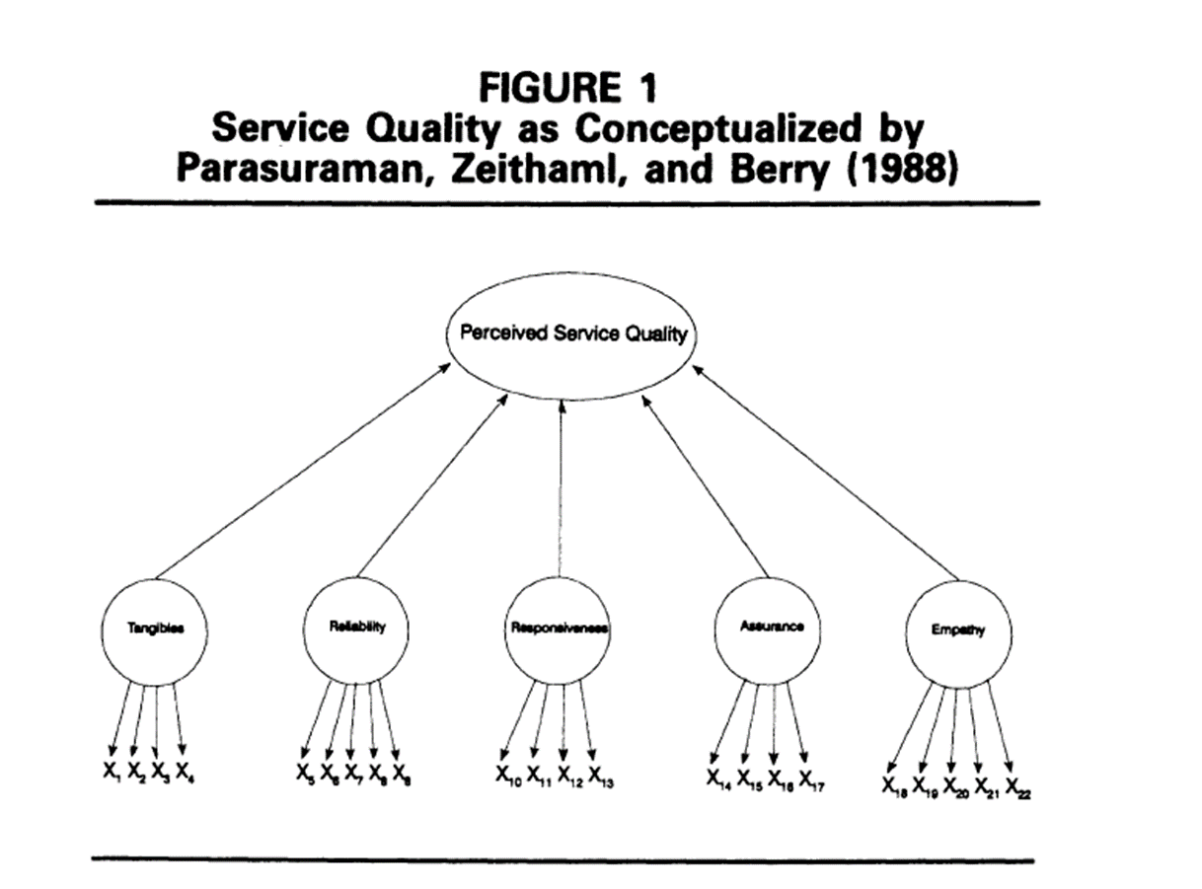
Continued…..
Gap 5: Customer expectations and perceptions gap
  Customer satisfaction depends on minimizing the four gaps that are associated with service delivery
  Companies try to measure the gap between expected service and perceived service through the use of surveys
  SERVQUAL – measures the five dimensions of service quality – a pair-wise questionnaire

Slide 24
SERVQUAL Attributes
RELIABILITY
EMPATHY
Providing service as promised
Dependability in handling customers’ service problems
Performing services right the first time
Providing services at the promised time
Maintaining error-free records
Giving customers individual attention
Employees who deal with customers in a caring fashion
Having the customer’s best interest at heart
Employees who understand the needs of their customers
Convenient business hours
RESPONSIVENESS
Keeping customers informed as to when services will be performed
Prompt service to customers
Willingness to help customers
Readiness to respond to customers’ requests
TANGIBLES
Modern equipment
Visually appealing facilities
Employees who have a neat, professional appearance
Visually appealing materials associated with the service
ASSURANCE
Employees who instill confidence in customers
Making customers feel safe in their transactions
Employees who are consistently courteous
Employees who have the knowledge to answer customer questions
4-24

Slide 25
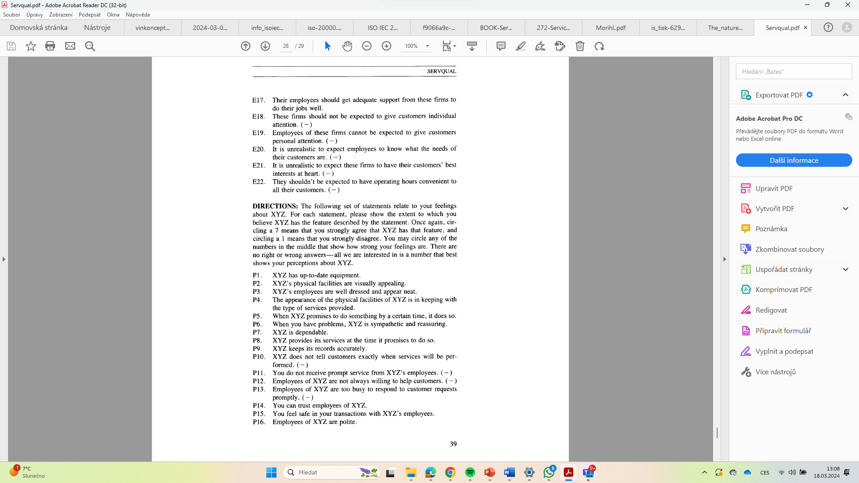
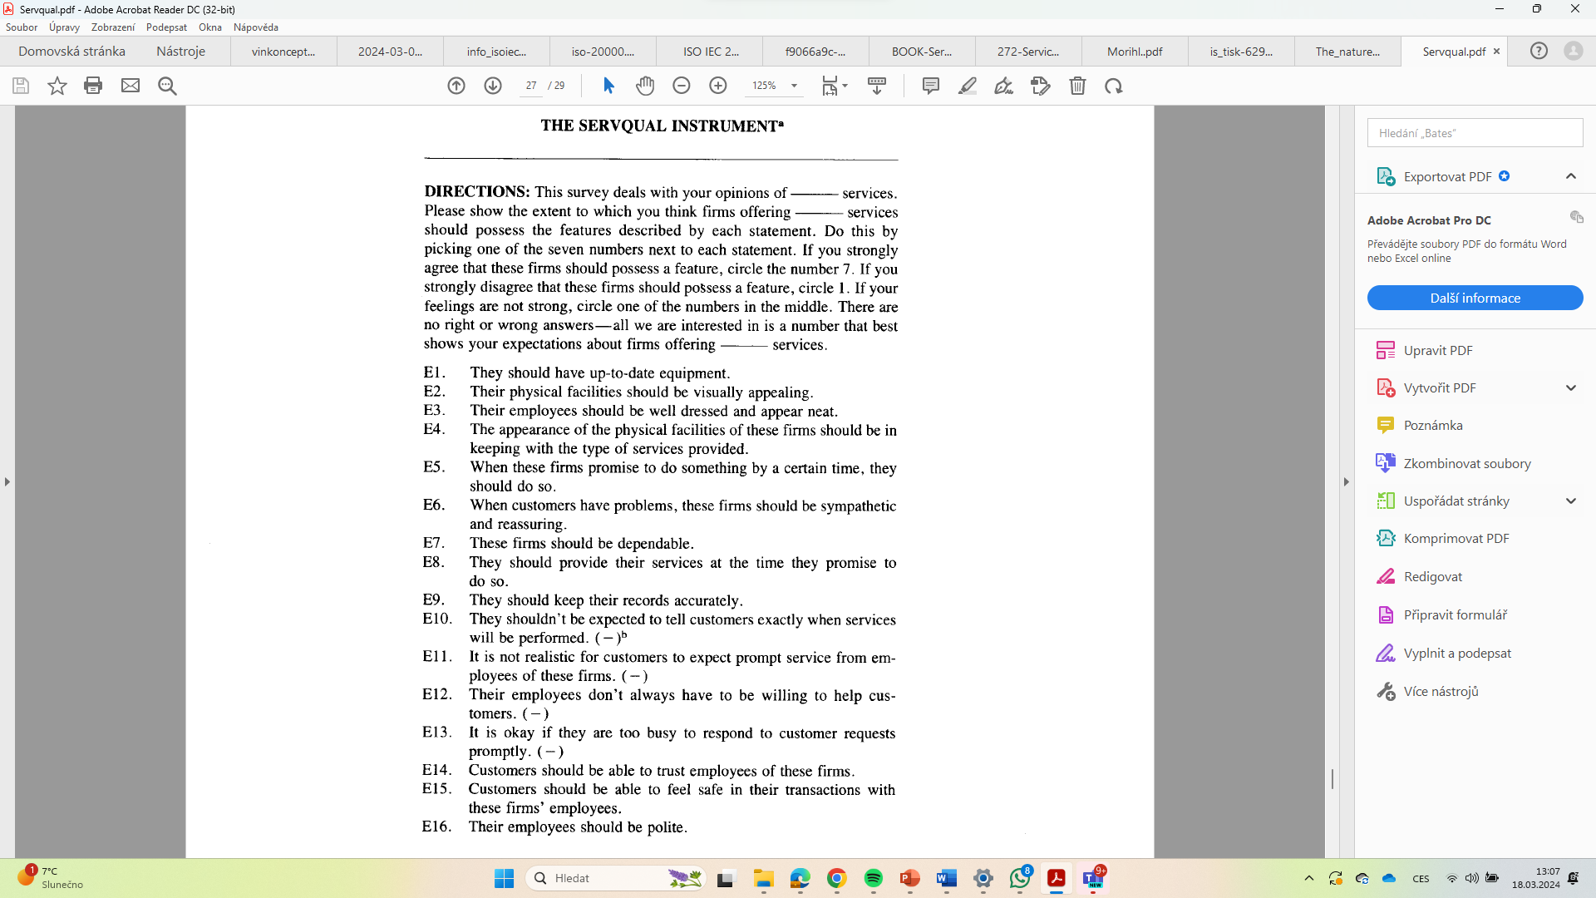
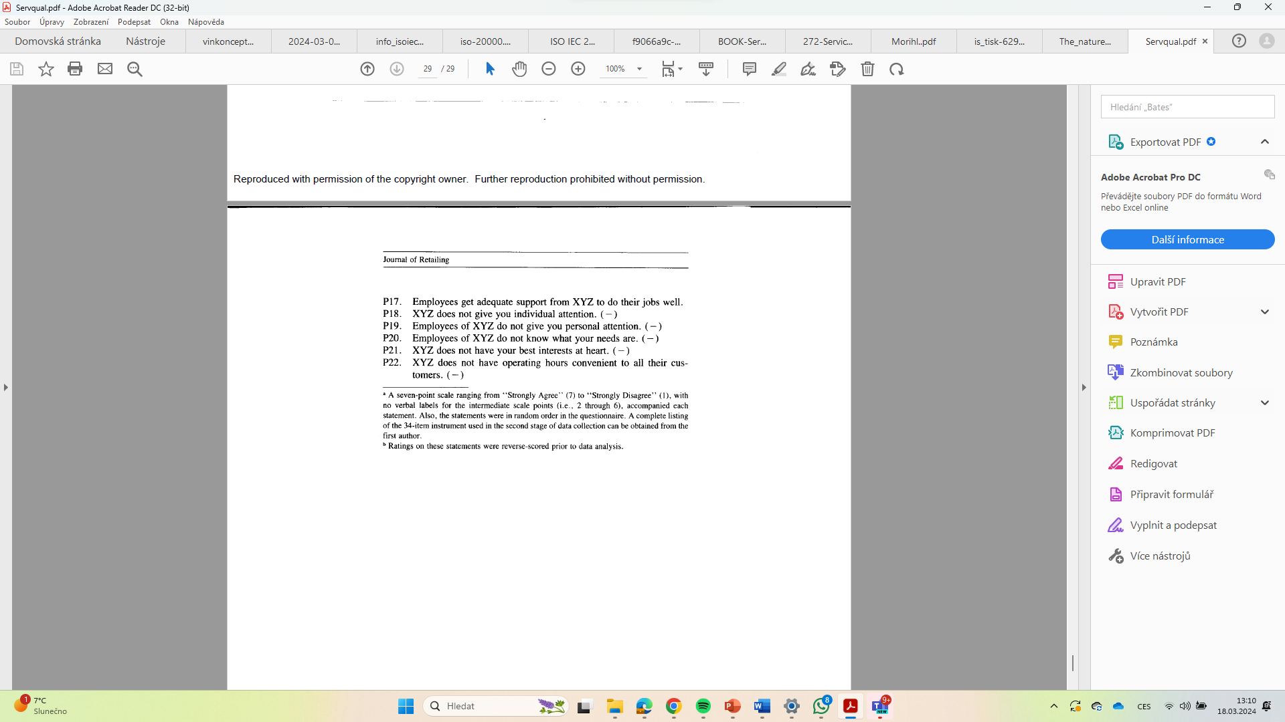
Servqual
Parasuraman, A., Zeithaml, V. A., & Berry, L. L. (1988). Servqual: A multiple-item scale for measuring consumer perc. Journal of retailing, 64(1), 12.

Slide 26
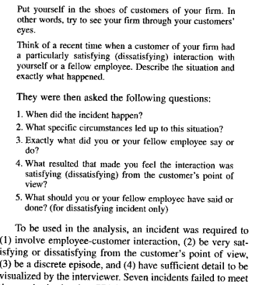
Critical incidents technique - CIT
CI = interaction incidents, which the customer perceives or remembers as unusually positive or negative when asked about them. Customers recall them and tell them as stories
finding the most frequent service- quality dimensions or determinants
personal interviews, focus group interviews, direct or participatory observation, ….digital technologies..(but not human side – machien failures, product failures)
traditional content analysis
THE BEST APPROACH: ask both – customer and employee – quantitative research (different incidents, solutions, perceptions– or for the specific one service also qualitative (different views, evaluations, perspectives)
The critical incident technique produces information on service quality experiences that guide consumer behaviour. Several studies prove that customers remember these reported cases as being particularly satisfying or annoying for a long time, often for years, and that they strongly determine the customer’s evaluation of service quality
EXAMPLE – EMPLOYEE: Bitner, M. J., Booms, B. H., & Mohr, L. A. (1994). Critical service encounters: The employee's viewpoint. Journal of marketing, 58(4), 95-106.
BUT!!!! there are different aspects concerning time, memory and judgement processes that influence customers’ perceptions of criticality
Edvardsson, B., & Roos, I. (2001). Critical incident techniques: Towards a framework for analysing the criticality of critical incidents. International Journal of Service Industry Management, 12(3), 251-268.

Slide 27
Limitations of CIT
Critical incidents record only exceptional customer encounters. They represent from the customer’s point of view an extensive under- or overfulfilment of their expectations. Of course, it is important from the service provider’s perspective to obtain this information about minimum requirements and value-adding qualities. But the everyday perception of quality is normally not as dramatic as that reflected in the collection of critical incidents. Therefore, customers often find it rather difficult to name a critical incident in a survey focusing on one specific (e.g. the last) service encounter. At the same time, there are experiences of which customers are aware and which accordingly influence their cognition and behaviour but which they do not rate as exceptionally positive or negative, and these experiences remain unconsidered. These incidents can be characterized as “usual” or “ordinary” incidents (Stauss, 1995). They are “the little things that customers may find satisfying or dissatisfying during a service encounter but do not report in unaided responses as critical incidents” (Botschen et al., 1993, p. 10).
(2) In CIT surveys all experiences reported are normally included regardless of how serious these incidents are considered by the customer. Thus, it remains unclear from which point customers start to view an incident as a “critical” incident.
(3) As well as most other methods for measuring perceived service quality, the critical incident technique does not take the process character of service consumption into account. This applies to both the collection of incidents and to their categorization. Customers are not asked to report critical incidents related to fractions of the process. The evaluation normally follows according to quality dimensions or problem categories and not according to phases of the process or contact points.
Bernd Stauss Bernhard Weinlich, (1997),"Process-oriented measurement of service quality", European Journal of Marketing, Vol. 31 Iss 1 pp. 33 - 55

Slide 28
Sequential incident technique
visualized customer process (customer path diagram). Both positive and negative incidents can be collected.
A slightly different approach – named sequence-oriented problem identification (SOPI) asks for negative incidents only.
The application of this method consists of two essential steps:
  the determination of the customer path and
  the collecting of incidents in interviews.
The basis of every process-oriented quality measurement is the investigation of the customer process.
This basic procedure can be varied slightly to gain additional insights. It is particularly useful to ask the respondents after each incident reported to specify the degree of incident importance. This provides the opportunity for specific analyses about incidents perceived as usual/not very important and critical/important. Also, this information on the frequency of negative incidents and the degree of perceived annoyance provided allows the additional application of the frequency relevance analysis of problems (FRAP).
Usually, the FRAP is applied in an aided version. This means that a list of customer problems is created on the basis of interviews with customers or by analysing customer complaints. In a separate survey customers are asked about the occurrence and the perceived importance of the listed problems.
Customer path:
  Service blueprinting
  Service mapping
Discrete episode
Bernd Stauss Bernhard Weinlich, (1997),"Process-oriented measurement of service quality", European Journal of Marketing, Vol. 31 Iss 1 pp. 33 - 55

Slide 29
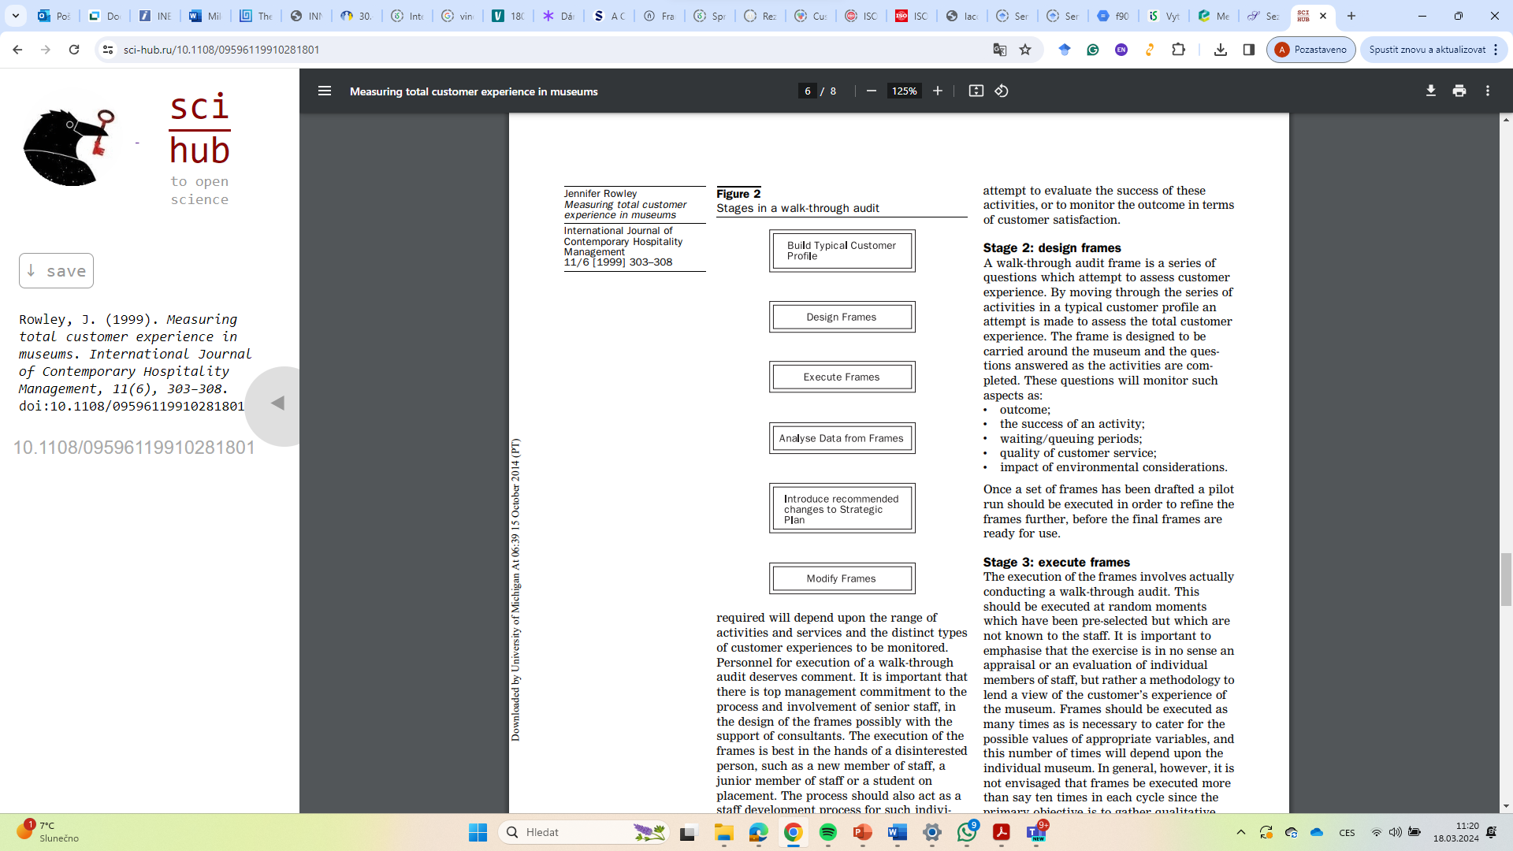
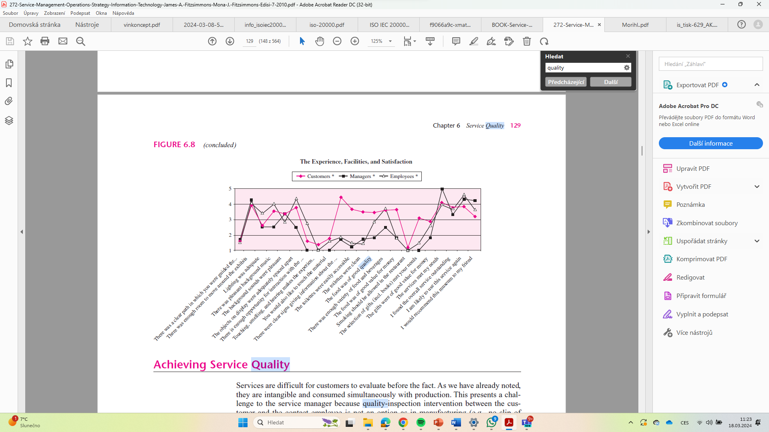
Walk-Through-Audit
Impressions about service quality are determined by both the outcome and the process (because customers are a part of service delivery)
Walk through audit is a customer-focused survey to find the areas for improvement
  Entire customer experience is traced from beginning to end, and a flow chart of customer interaction with service system is made
  Customer is asked for his/her impressions on each of these interactions
  Managers and employees also „walk-through“
Customers can provide a new perspective to service – they can notice things easily as they are new in the system
Service managers and employees can get de-sensitize to their surroundings and also may not notice marginal decreases in service levels.
Rowley, J. (1999). Measuring total customer experience in museums.
International journal of contemporary Hospitality management, 11(6), 303-308.

Slide 30
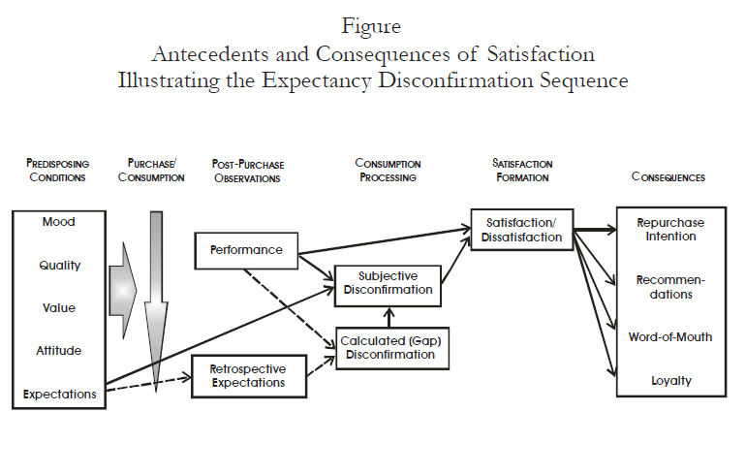
Quality and…………satisfaction …and …consequencies
Oliver, R. L. (2006). Customer satisfaction research. The handbook of marketing research: Uses, misuses, and future advances, 1, 569-587.

Slide 31
Cost of Quality
Products can be returned or exchanged if faulty; but what recourse does customer have to faulty services?
  Legal recourse, claims, complaints, word-of mouth
Prevention cost
  Costs associated with activities that keep failure from happening and minimize detection cost
Detection cost
  Costs incurred to ascertain the condition of a service to determine whether it conforms to safety standards
Internal failure
  Costs incurred to correct nonconforming work prior to delivery to the customer
External failure
  Costs incurred to correct nonconforming work after delivery to customer or to correct work that did not satisfy a customer’s special needs
$1 in invested in prevention = $100 in detection = $10,000 in failure cost (Juran)
Bordoloi, S., Fitzsimmons, J. A., & Fitzsimmons, M. J. (2019). Service management: operations, strategy, information technology. McGraw-Hill.

Slide 32
Costs of Service Quality
Bordoloi, S., Fitzsimmons, J. A., & Fitzsimmons, M. J. (2019). Service management: operations, strategy, information technology. McGraw-Hill.

Slide 33
Service Process Control
The control of service quality can be viewed as a feedback control system – where output is compared with a standard.
The deviation from the standard is communicated back to the input, and adjustments are made to the process to keep the output within the defined range.
Difficult to implement an effective control cycle for service due to the intangible nature of service, which makes direct measurement difficult – so we proxy or surrogate measures.
Simultaneous nature of production and consumption – prevents any direct intervention in the service process to observe conformance to requirements.
  Consequently, we ask customers to express their impression of service quality after the consumption – by which time we are too late to avoid service failure.
  Instead, we try to focus on delivery process by employing SPC
  In the digital life - easier
Bordoloi, S., Fitzsimmons, J. A., & Fitzsimmons, M. J. (2019). Service management: operations, strategy, information technology. McGraw-Hill.

Slide 34
Service Recovery
Disasters can be turned into satisifed and loyal customers by proper and rapid service recovery
Frontline workers, therefore, need to be properly trained and given the discretion to make things right.
Approaches to service recovery
  Case-by-case addresses each customer’s complaint individually but could lead to perception of unfairness.
  Systematic response uses a protocol to handle complaints but needs prior identification of critical failure points and continuous updating.
  Early intervention attempts to fix problem before the customer is affected.
  Substitute service allows rival firm to provide service but could lead to loss of customer.
Bordoloi, S., Fitzsimmons, J. A., & Fitzsimmons, M. J. (2019). Service management: operations, strategy, information technology. McGraw-Hill.

Slide 35
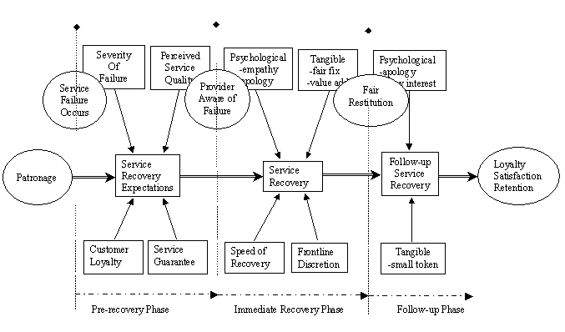
Service recovery framework
Bordoloi, S., Fitzsimmons, J. A., & Fitzsimmons, M. J. (2019). Service management: operations, strategy, information technology. McGraw-Hill.

Slide 36
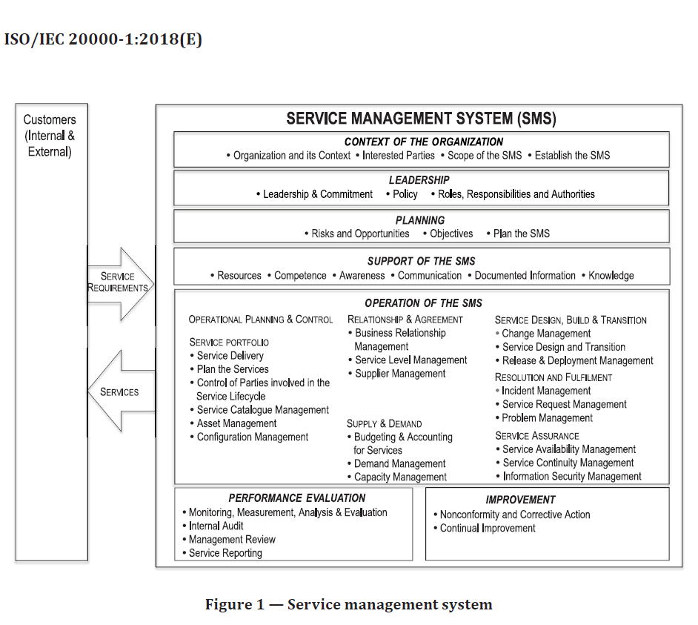
ISO/IEC 20000-1 :2018
Information technology — Service management —
Part 1:Service management system requirements
specify requirements for establishing, implementing, maintaining and continually improving a service management system (SMS). An SMS supports the management of the service lifecycle, including the planning, design, transition, delivery and improvement of services, which meet agreed requirements and deliver value for customers, users and the organization delivering the services.
ISO/IEC 20000-2 provides guidance on the application of service management systems including examples of how to meet the requirements specified in this document. ISO/IEC 20000-10 provides information on all of the parts of the ISO/IEC 20000 series, benefits, misperceptions and other related standards. ISO/IEC 20000-10 lists the terms and definitions

