Slide 1
Labour Market and Employment Policy
Spring 2024
Labour market characteristics
Week 1
Martin GUZI
martin.guzi@econ.muni.cz
Notes:
http://www.youtube.com/watch?v=O5yVcXg2XfE

Slide 2
Everyone wants a good job
Jobs boost productivity and growth
Jobs are linked to a decline in poverty
Jobs create social cohesion
Job gives people dignity
Job contributes to personal well-being
Job provides income to live
Notes:
Jobs are the most important determinant of
living standards. For most people, work is the
main source of income, especially in the poorest
countries. Many families escape or fall into poverty
Because family members get or lose a job.
Earnings from work increase with economic
development, and the benefits associated with
jobs improve as well. The relationship is not
mechanical, but growth is clearly good for jobs

Slide 3
Which of the following affects a person's decision to work?
A. The price of consumption goods relative to the wage.
B. The person's income from non-labor sources.
C. How much the person enjoys working.
D. The amount of fringe benefits offered to the person.
E. All of the above affect a person's decision to work.

Slide 4
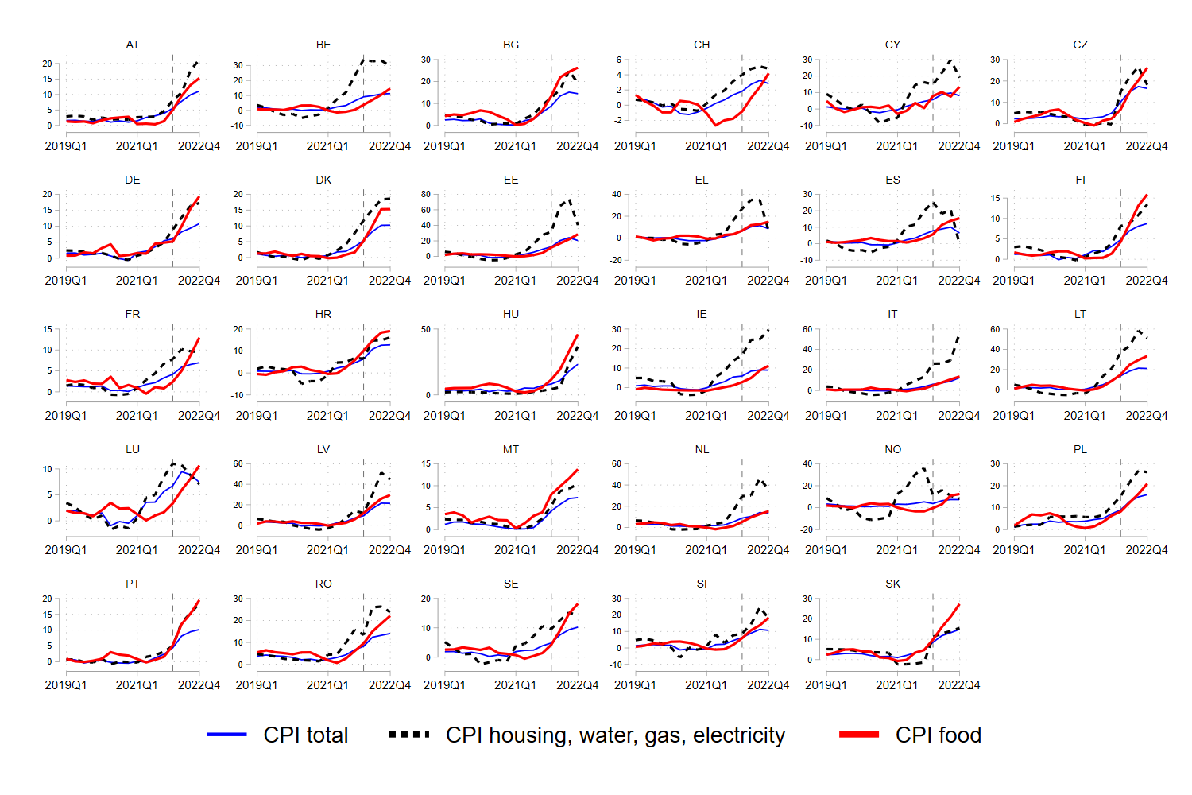
Price hikes (Eurostat CPI data)

Slide 5
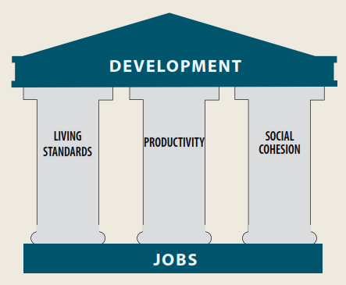
Source: World Development report 2013
Notes:
Jobs are more than just the earnings and benefits
they provide. They are also the output they generate,
and part of who we are and how we interact
with others in society. Through these outcomes
jobs can boost living standards, raise productivity,
and foster social cohesion.

Slide 6
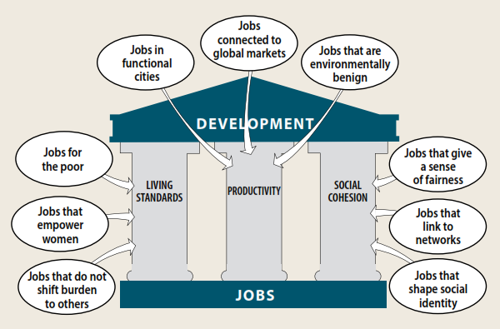

Slide 7
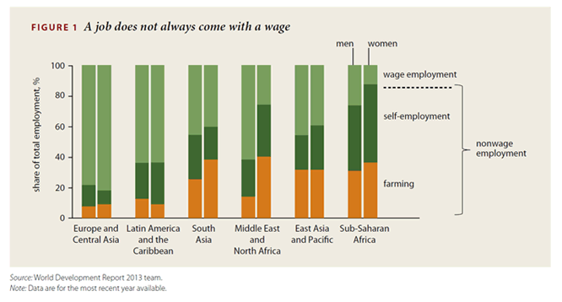
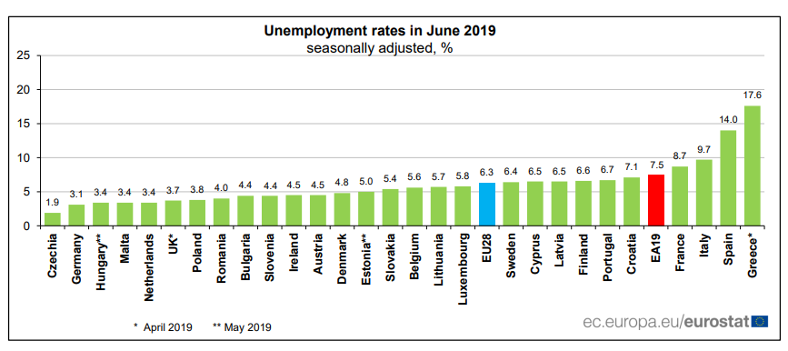
Wage employment is not a standard everywhere

Slide 8

3 signs that something is a motivator in your work:
You look forward to doing it
You feel energized while doing it
When you talk about it later, you light up
Notes:
https://www.youtube.com/watch?v=u6XAPnuFjJc

Slide 9


What motivates us at work? More than money
Seeing the fruits of our labor may make us more productive
The meaningfulness of our work, by others’ acknowledgement
Knowing that our work helps others may increase our unconscious motivation
We are purpose maximizers more than profit maximizers
Eliminating motivation seems to be incredibly easy
Are holidays a good way to motivate workers?
Watch video at 9:50
https://www.ted.com/talks/dan_ariely_what_makes_us_feel_good_about_our_work

Slide 10
Would you prefer a fixed vacation policy or one where you decide how much time you should take off?
9% of companies around the world offer unlimited paid annual leave
The benefits to the employer include less bureaucracy to track vacations, no need to pay out unused vacation; encourages a culture of self-governance (a shift in the responsibility to employee)
Unlimited vacation is the employer version of “All You Can Eat” buffets, where for every one person who can eat their body weight equivalent of food, many others will not.
The reality of today’s workplace coupled with human nature make this arrangement more beneficial to the employer than the employee.

Slide 11
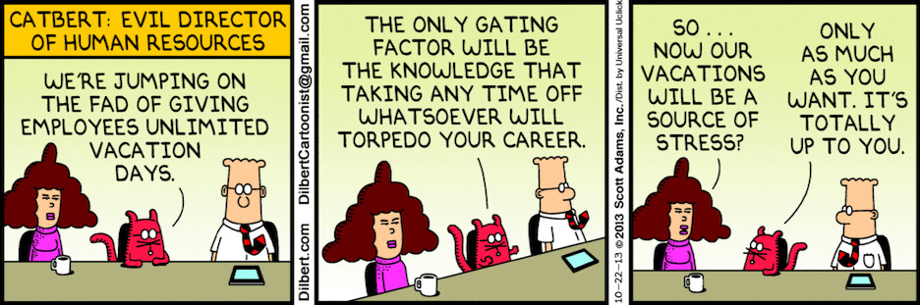

Slide 12
Quick review of labour market terminology
Working age population
Employed
Unemployed
Economically active population
Inactive (Out of labour force)
Workforce or labour force
Long-term unemployed
Registered unemployment
Vacancy

Slide 13
Employment

Slide 14
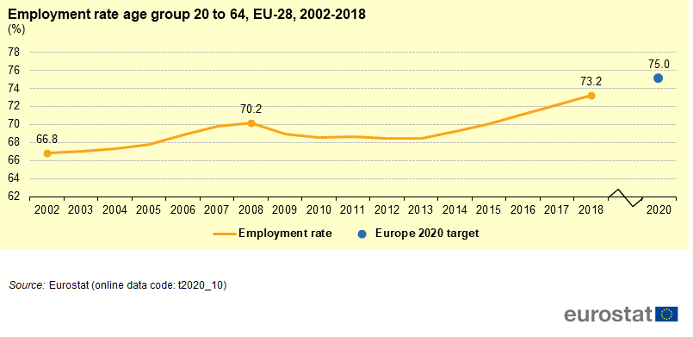
In 2018 the overall employment rate in the EU reached 73.2 %. If the employment rate keeps increasing at the pace recorded since 2013, the Europe 2020 target would be within reached.
In 2020 the employment rate in the EU stood at 72.4 % for persons aged 20-64, dropping for the first time since 2013 due to the impact of COVID-19 measures on the labour market.

Slide 15
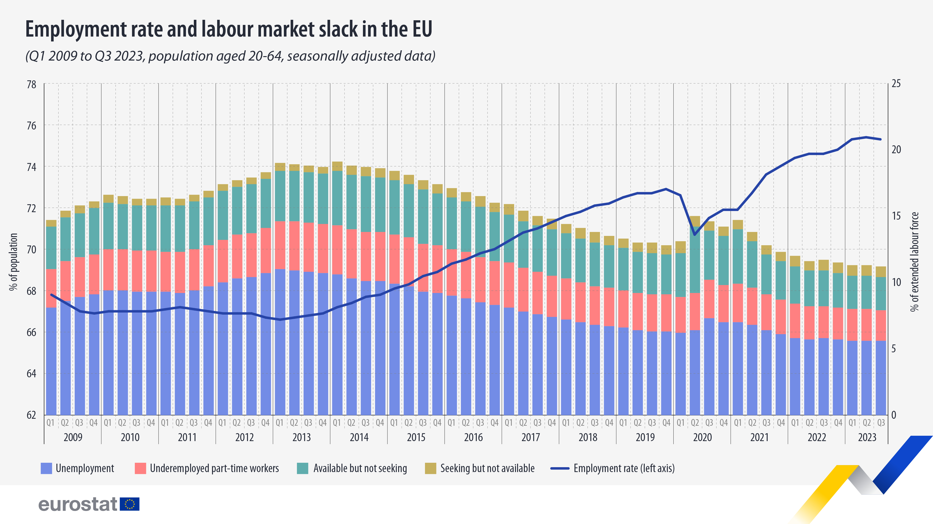

Slide 16
Demographic development in the EEE significantly impacts the size of workforce
Before 2030, it is only in Hungary and Romania that the inflow of 20-year-olds is projected to outnumber the outflow of 64-year-olds.

Slide 17
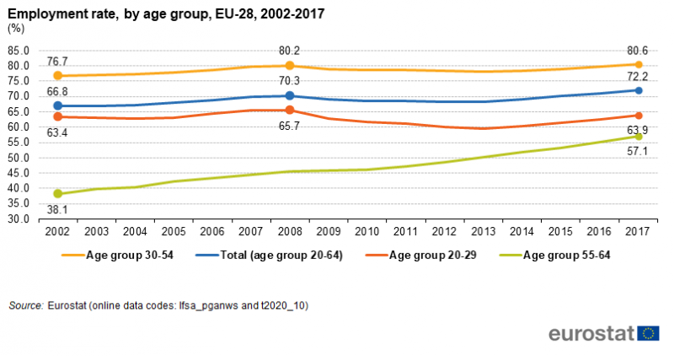

Slide 18
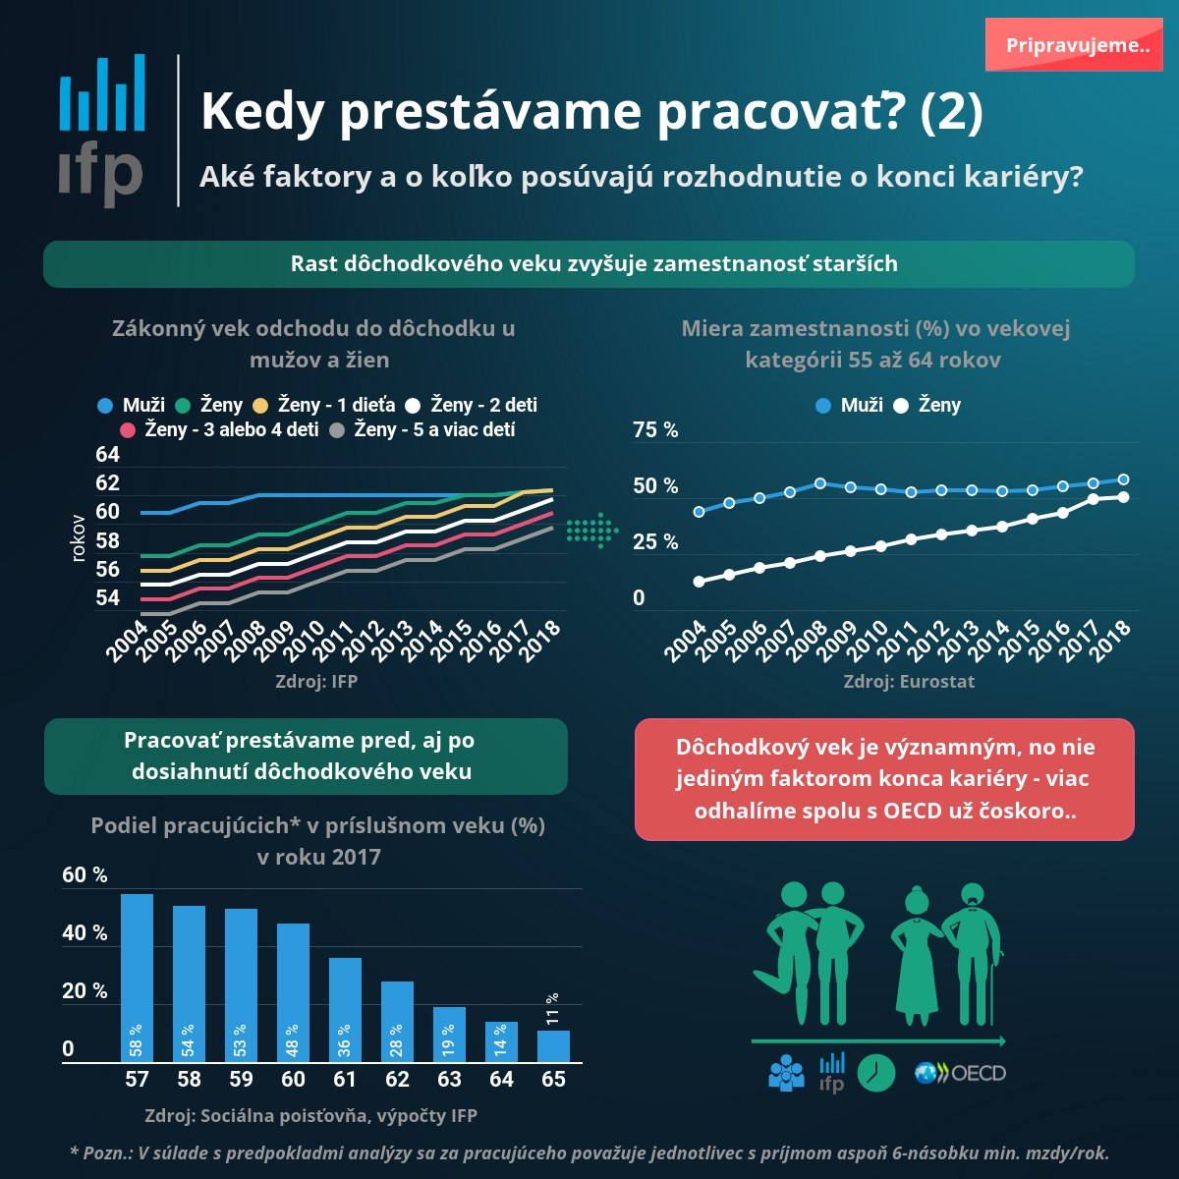

Slide 19
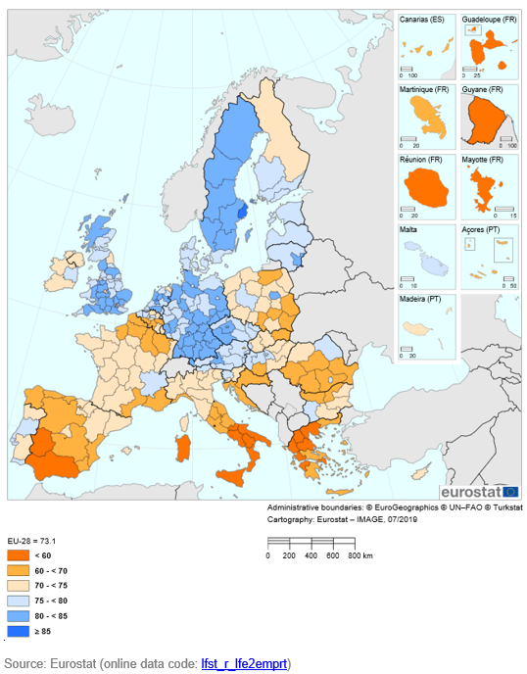

Employment rate age group 20 to 64, by NUTS 2 regions, 2017
(% of population aged 20 to 64)

Slide 20
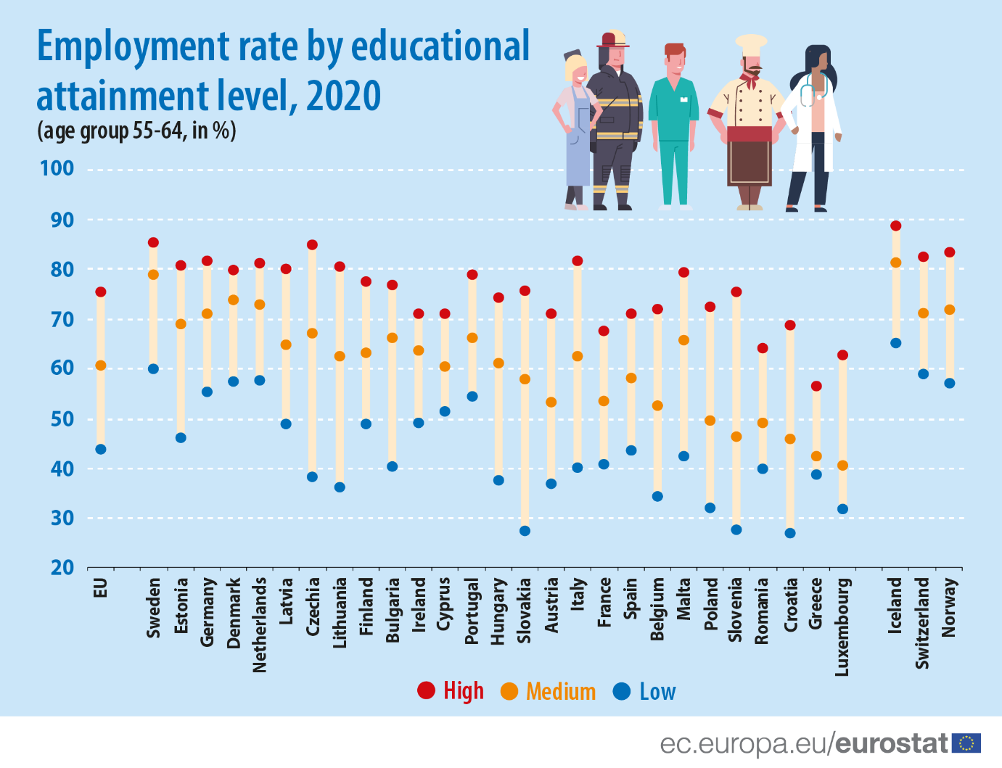

Slide 21
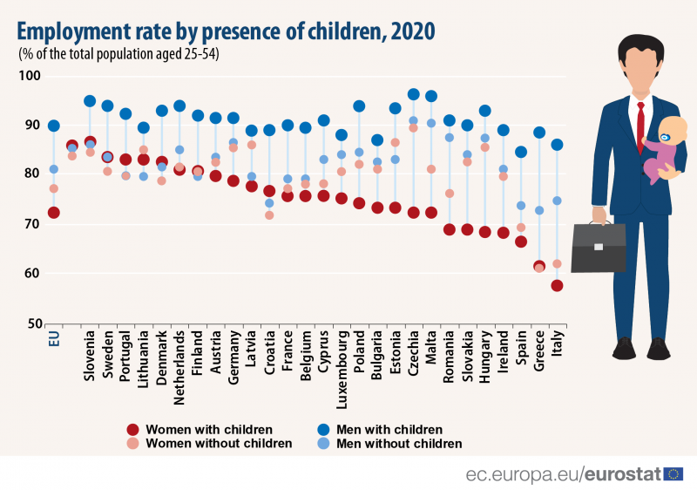

Slide 22
The gender gap in employment opens at childbearing age the most in Czechia, Hungary, Poland and Slovakia. Later, around the age of 50, the gender gap in employment almost closes in Bulgaria, Croatia, Czechia, Hungary, Poland, Slovakia and Slovenia.
In addition, in Czechia and Slovakia, the maternal employment rate of tertiary educated women is among the lowest in the OECD (OECD, 2019).
In comparison, a drop in female employment at childbearing age is
much lower in Austria and Germany.
When skilled labour is in short supply, taking advantage of female labour may provide a considerable boost to the economy.
What family policies are needed?

Slide 23
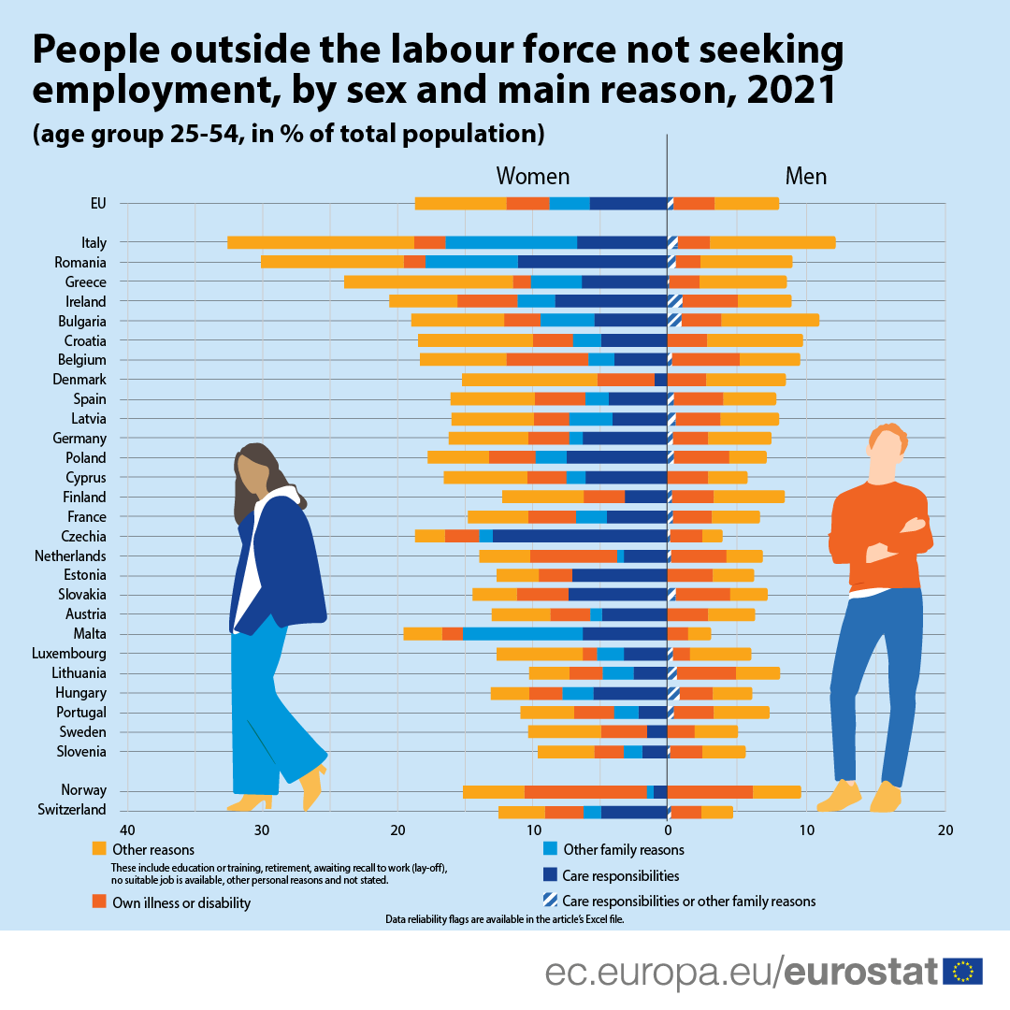

Slide 24
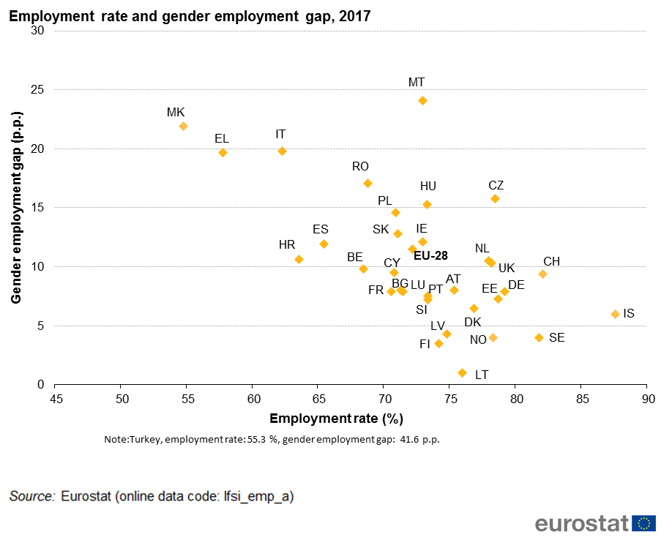

Slide 25
Unemployment

Slide 26
Total Unemployment, Dec 2019
Youth (aged 15-24) unemployment, Dec 2019
Source: Eurostat
https://ec.europa.eu/eurostat/statistics-explained/index.php?title=Employment_statistics

Slide 27
Unemployment statistics might underestimate the total unmet demand for employment, also called the ‘labour market slack’, which includes unemployed, discouraged, and underemployed workers.
Discouraged workers (e.g., persons seeking work but not immediately available, or persons available but not seeking work) are close to unemployment but are not included in unemployment statistics.
Underemployment includes involuntary part-time workers who wish to work more hours.

Slide 31
Labour shortage

Slide 32
Labour market tightness is defined as the ratio of vacancies per unemployment.
Since 2015 the number of posted vacancies has been sharply increasing in all countries.

Slide 33
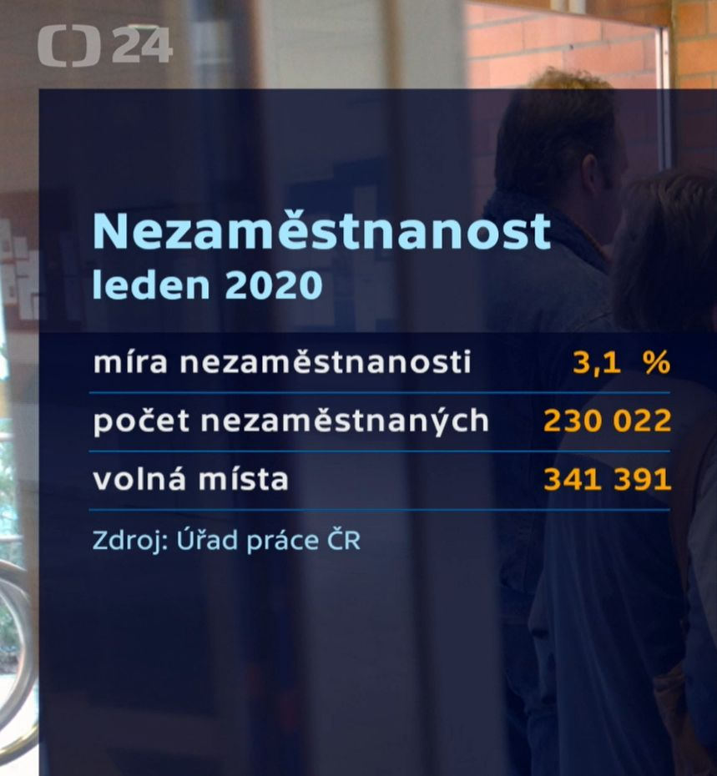
Job applicants and posted vacancies (in thousand)
In August 2019, employment offices in the Czech Republic posted more than 350,000 vacancies, which is the highest figure in the country’s history. The shortage of workers is even higher because many companies in search of more qualified employees do not approach employment offices. Czech Chamber of Commerce estimates the economy currently lacks around half a million people.
Source : Czech Statistical Office

Slide 34
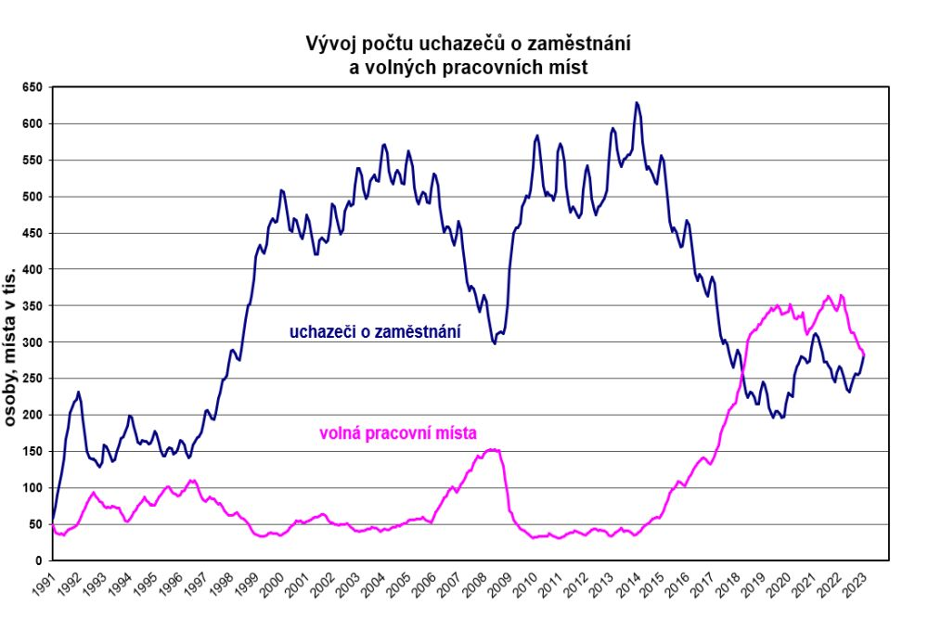
Job applicants and posted vacancies (in thousand)
Job applicants
Persons in thousand
posted vacancies

Slide 35
Demographic development in the Central Europe has a significant impact on the size of workforce.
The outflow of workers over the age of 64 exceeds the number of 20-year-olds entering the labour market
Before 2030, it is only in Hungary and Romania that the inflow of 20-year-olds is projected to outnumber the outflow of 64-year-olds.
The population is younger relative to the EU average but population ageing in some EEE is faster than in the EU.

Slide 36
Q: What strategies companies apply to deal with labour shortage?

Slide 37
Is immigration a solution to labour shortages?

Slide 38
The effect of Covid pandemic

Slide 40
Number of newly posted vacancies per month in Slovakia, 2019-2021
as an indicator of economic recovery
Source: istp.sk

