Slide 1

Highly skilled migration
Lucie Macková

Slide 2

Who are highly skilled migrants?
Other terms like expats, intra-company transferees…
‘Global race for talent’
No universal definition but often those with tertiary education
Different types of visa categories
Some countries define skilled migrants by:
  Salary
  Talent/merit
  Points (Siegel, 2022)

Slide 3
Highly skilled migration
The issue of brain drain (Bhagwati, 1976), brain gain (Lucas, 2005) and talent circulation (Saxenian, 2006)
Moving away from education (Kuvik, 2012) and description according to occupation
The CZ-ISCO classification (2019) includes 3 categories of employment at a highly qualified level:
  senior management
  researchers
  technical, health and teaching staff

Slide 4
Definitions
Highly-qualified or highly-educated migrants
Not a universal definition
  the level of education, rather than the salary scale is the appropriate measure (Smith and Favell 2006; Triandafyllidou and Gropas 2014)
  Students are a special category, considered highly-skilled in some cases, yet not in others (She and Wotherspoon 2013; Raghuram 2013)
  “expatriates,” “lifestyle migrants” (Benson and O’Reilly 2009), “cosmopolitans” (Brimm 2010), “Eurostars” (Favell 2011), “elite migrants” (Beaverstock 2005) or “knowledge migrants” (e.g. Ackers 2005)

Slide 5
Highly skilled migration
Highly skilled workers generally welcomed by destination countries
Still face deficits in terms of rights and hurdles in their transition to a long-term status (Triandafyllidou, 2022)
Less attention to the local experiences of skilled migrants (Van Riemsdijk, 2014)
Research on skilled women in STEM professions in Germany (Grigoleit-Richter, 2017)
  though privileged compared with other immigrant women, face barriers in the highly gender-segregated German technology industry
Migration and settling-in processes of highly skilled professionals and their families in Germany and the UK (Föbker and Imani, 2017)
  the role of language, the establishment of new social networks and labour market participation

Slide 6
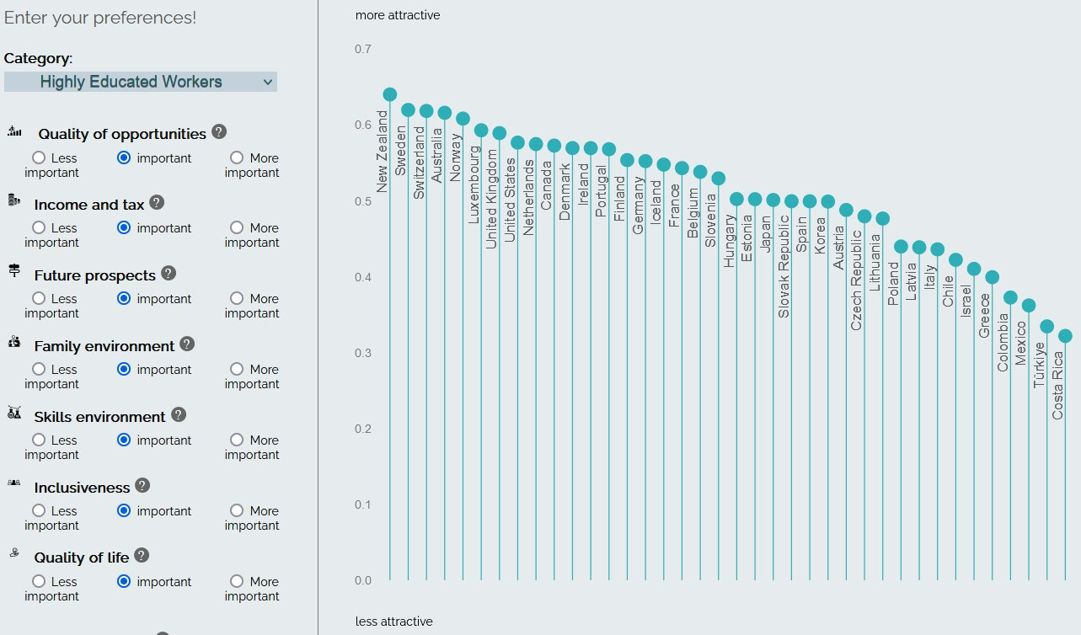
OECD talent attractiveness

Slide 7
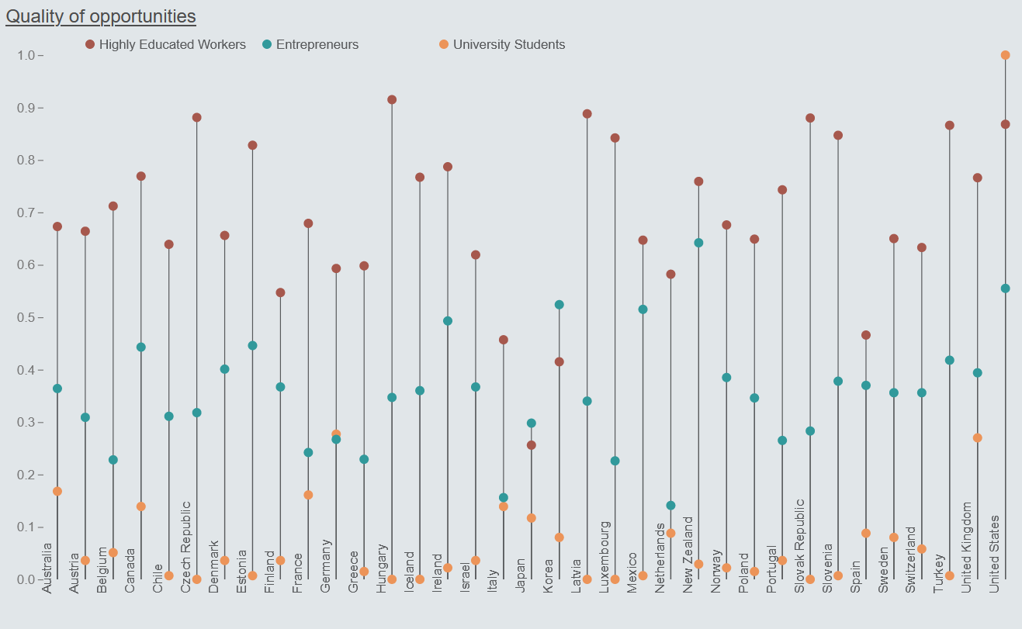
Zdroj: Tuccio, M. (2019), "Measuring and assessing talent attractiveness in OECD countries", OECD Social, Employment and Migration Working Papers, No. 229, OECD Publishing, Paris, https://doi.org/10.1787/b4e677ca-en.
Notes:
Quality of opportunities: Unemployment rate of the foreign-born with education ISCED 7-8; Over-qualification rate of the foreign-born with education ISCED 7-8; Share of the ISCED 7-8 educated foreign-born with temporary contracts; Share of foreign-born part-time workers with education ISCED 7-8.
OECD Talent Attractiveness: How does your country compare in each dimension?
Quality of opportunities, income and tax, future prospects, family environment, skills environment, inclusiveness, quality of life

Slide 8
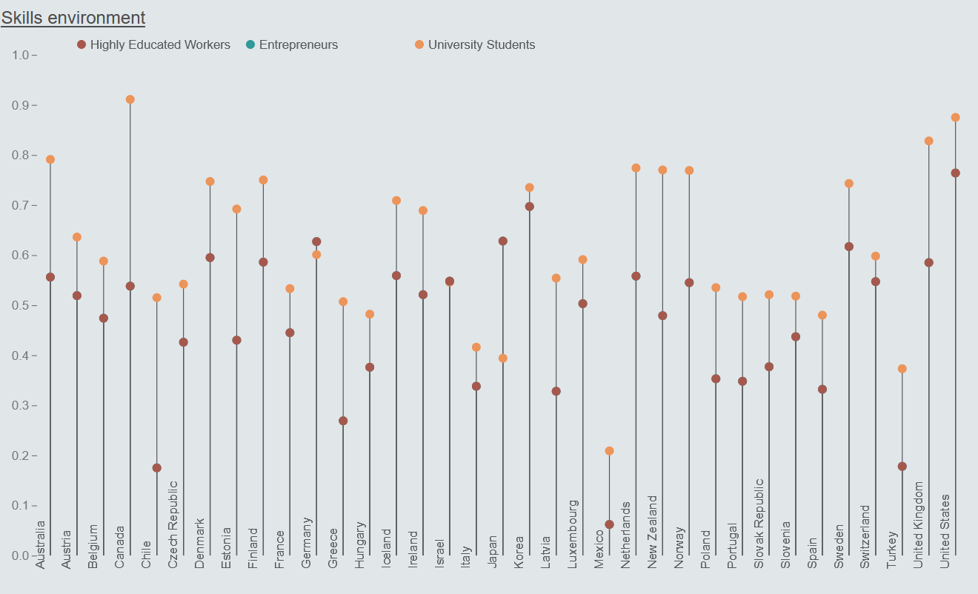
Zdroj: Tuccio, M. (2019), "Measuring and assessing talent attractiveness in OECD countries", OECD Social, Employment and Migration Working Papers, No. 229, OECD Publishing, Paris, https://doi.org/10.1787/b4e677ca-en.
Notes:
Skills environment: Internet access; English proficiency; Gross domestic spending on R&D; Patents.

Slide 9
“Migration can be a powerful force for prosperity and development. When it is managed properly, it provides benefits for all people — in origin and destination societies.”
(World Development Report, World Bank, 2023)

Slide 10
Impact of skilled migration in the countries of destination
Innovation = new idea, device or method
It can be a catalyst for growth and development
Steady increase of highly educated persons among total migration flows
Circulation of scientists, researchers etc.
Migration can help domestic innovative companies in overcoming labour shortages, diffusion of knowledge (or experience)
  Higher rate of patents among migrants in the US

Slide 11
Mette Foged and Giovanni Peri (2013)
Study on Immigration to Denmark
Less skilled domestic workers moved into more complex occupations thanks to immigration
Immigration raised the wages of the low-skilled domestic population
No higher probability of unemployment was found for low-skilled Danes

Slide 12
Christian Dustmann and Tommaso Frattini (2014) The Fiscal Effects of Immigration to the UK
2000-2011: immigrants from EU countries contributed more than £20 billion to the UK budget
Their human capital (education) was calculated at £6.8 billion.
Those who arrived since 2000 were 43% less likely than Brits to be on welfare
Migrants from EU-15 countries: handed over 64% more than they received in benefits
Migrants from new member countries: contributed 12% more

Slide 13
OECD study (2014)
The impact of migrants who have arrived in OECD countries over the last 50 years is almost zero
Only rarely it exceeded the threshold of 0.5% of GDP (positively or negatively)
Luxembourg and Switzerland - 2% positive contribution
In most countries (except those with a higher proportion of older migrants), migrants contribute more in taxes than they receive in benefits

Slide 14
Mayda et al. (2022) The fiscal impact of immigration in the United States: Evidence at the local level
An increase in the population share of immigrants of a U.S. county does not significantly affect, on average, local public revenues and expenditures
Heterogeneity in terms of the impact of immigrants with different skill levels
Inflows of high-skilled immigrants improve the fiscal health of local governments - by increasing county-level revenues and expenditures - while the arrival of low-skilled immigrants has the opposite impact
Transfers to the county from the federal government (only) partially offset the local fiscal impact of immigration

Slide 15
Patricia Cortés (2023) Immigration, household production, and native women's labor market outcomes
- There are more than 12 million foreign domestic workers in the world
- They represent 7.7% of all migrant workers and 17.2% of all female migrant workers
- 70% Filipino migrant women migrate as domestic workers, 88% in Indonesia and 80% in Sri Lanka
- Low-skilled immigrants provide services that are close substitutes for household production and enable high-skilled native women to participate more actively in the labour market
- Migrant domestic workers have large positive effects on the labour supply of highly educated women’s labor supply and on the gender pay gap for high-powered occupations

Slide 16
Highly skilled migrants and integration
Literature on specific patterns of integration among highly-skilled migrants (Nohl et al. 2014; Duchêne-Lacroix and Koukoutsaki-Monnier 2016; Ryan and Mulholland 2014; Raghuram 2013; Piekut 2013; Fechter and Walsh 2010; Fechter 2007)
Migration vs. mobility
Skills often not recognised (spouses, refugees)
Integration support in the host countries focuses on low-skilled immigration and the highly-skilled are often left to their own devices to create a life on their own (Buzdugan and Halli 2009; She and Wotherspoon 2013)

Slide 17
Integration paradox
Various studies point to the fact that immigrants who have a better access to mainstream society report more discrimination
Especially if they possess characteristics that distinguish them from the mainstream society and live in countries with a more open socio-political context of reception
  higher education,
  length of residence,
  language skills,
  news media consumption,
  increased social exposure to mainstream members (Schaeffer and Kas, 2023)

Slide 18
Low skilled migration
People working in jobs that do not require formal qualification
People without qualifications
People working in low-wage positions
Semi-skilled workers (waiters, taxi drivers)
Issue of the recognition of qualifications
Employment-skills mismatch

Slide 19
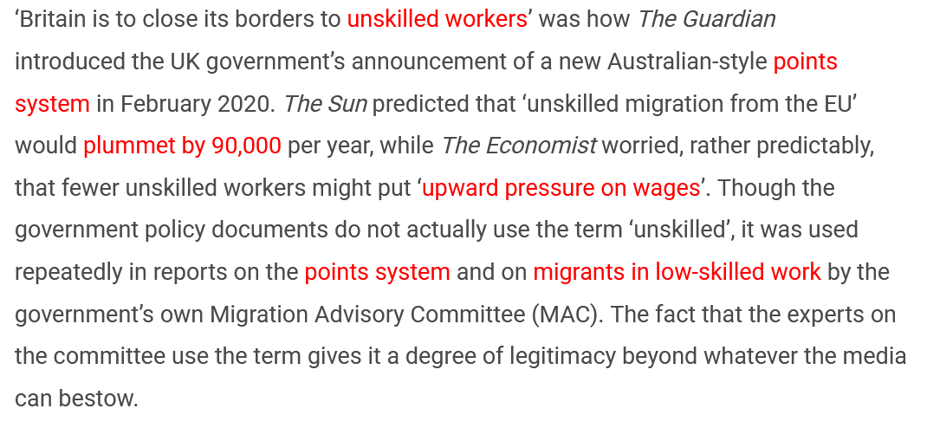
Unskilled migration?
Patrick McGovern (2020). Who are you calling unskilled? https://blogs.lse.ac.uk/brexit/2020/03/06/long-read-who-are-you-calling-unskilled/

Slide 20
Deskilling (brain waste)
Work does not match the worker's qualifications
Complexity of recognition of qualifications – formal education and previous work experience
Also: underemployment (Jong and Madamba, 2001), downward occupational mobility (Bauer and Zimmermann, 1999), degrading of skills (Grandea, 2008), over-qualification (Chen et al., 2010), over-education (Chiswick and Miller, 2009), job mismatch (Pecoraro, 2011) and skill erosion (Galgóczi et al., 2009)
Valenta and Drbohlav (2018) describe the mismatch between the qualifications that skilled migrants have and the jobs they hold on the labour market in the Czech Republic

Slide 21
Impact of skilled migration in the countries of origin
Remittances as a source of income to invest in technologies
Social remittances = the transfer of knowledge, values and norms can lead to changing institutions
Return migration – facilitating knowledge transfer and international cooperation
Transnational networks and specific policies on diaspora engagement
BUT it can also hinder the ability to innovate (brain drain)

Slide 22
Brain drain
Brain drain (or human capital flight) is a phrase denoting the one-way migration of highly educated and qualified people
In contrast to outflow, brain gain has mainly positive effects, both for the country in question and for the person in question
Brain circulation – temporary migration, migrants return after some time with new knowledge or skills
Triple-win situation

Slide 23
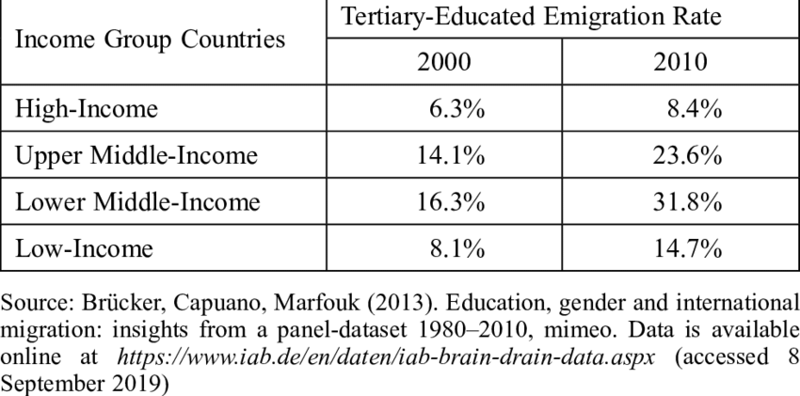
Skilled migration according to income level

Slide 24
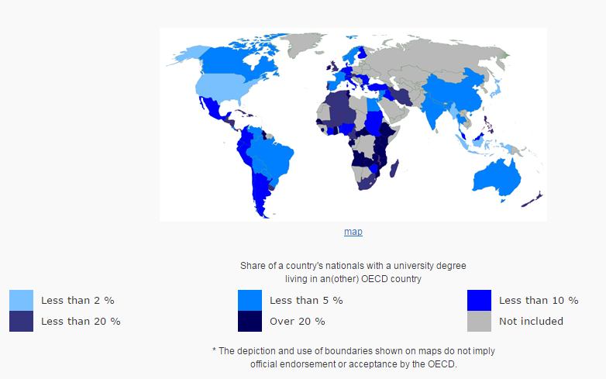

Slide 25
Reverse brain drain
A form of brain drain where human capital leaves a more developed country for a less developed country
Skilled workforce can further their education, gain work experience and then return to capitalize on that experience
Some countries have active policies that support this form of (return) migration, e.g. China
“Sea turtles,” or haigui in Chinese, is slang for people who are born in mainland China, spend a few years abroad studying or working, and return home as high-skilled talent. (Sun, 2013)

Slide 26
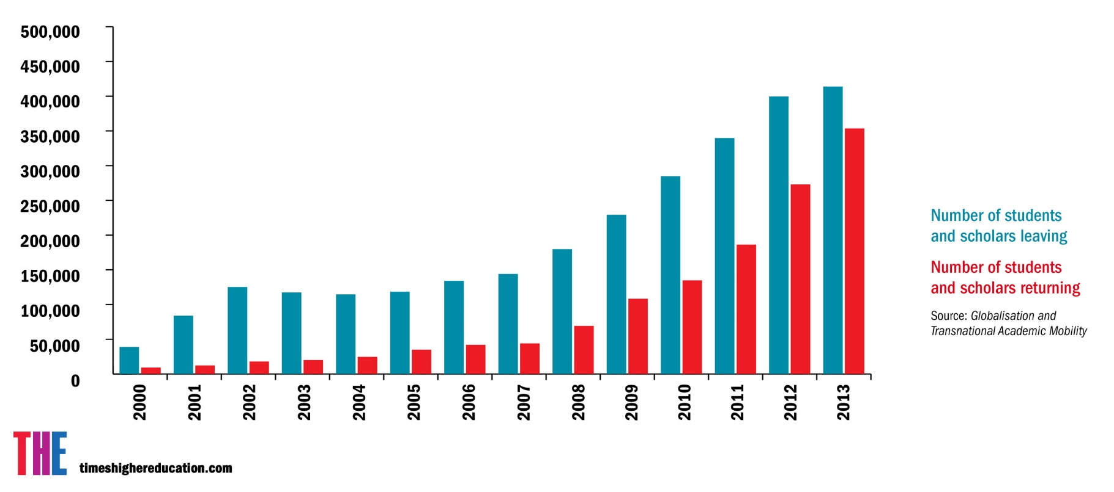
China and brain drain

Slide 27
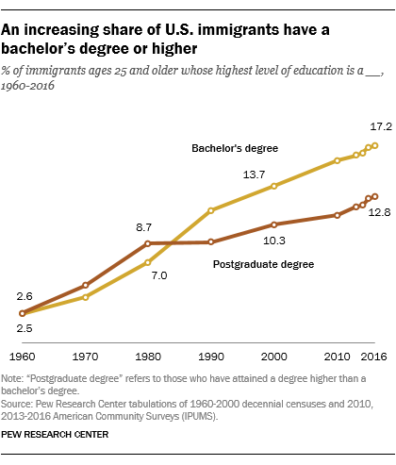
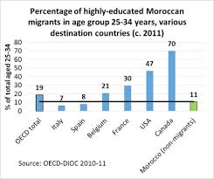
Morocco and USA - examples

Slide 28
USA
“Give us your best, your brightest, your most energetic and talented” instead of “give us your poor, huddled masses” (Moore 1993)
Silicon Valley: 30% of new companies between 1995-98 were founded by Indian and Chinese immigrants
US National Research Council (1988): „a large fraction of the technological output of the United States is dependent upon foreign talent and such dependency is growing“
1 out of 3 engineers in the USA is an immigrant
The US competetiveness also thanks to the ability to attract and retain talented workers from foreign countries
More Russian Nobel prize winners live in the USA than in Russia

Slide 29
Immigrant enterpreneurship
A small corner shop or transnational company…
In Los Angeles: Koreans are 3x more likely to be entrepreneurs than other population
Miami: businesses owned by the Cubans
  1967: 919
  1976: 8 000
  1990: 28 000
An average business employing 2-4 workers
The effect can be positive as well as negative (long work hours, neglecting the legislation…)

Slide 30
USA – selected companies founded by foreigners
Company Founder Country of Origin Employees
Intel Andy Grove Hungary 86,300
Sun Bechtolsheim/Khosla Germany/India 34,900
Yahoo Jerry Yang Taiwan 13,600
Google Sergey Brin Russia 20,222
eBay Pierre Omidyar France 16,200

Slide 31
USA visa types
H1-B visa
To work in a specialty field
Post-secondary education of at least 4 year
H1-B1 (for Chilean and Singaporean nationals)
0-1 visa for individuals with extraordinary ability and achievements in different fields (‘Einstein visa’)
L – intra-company transferees (managerial or executive capacity or specialized knowledge)

Slide 32
Canada and Australia
Expression of Interest (EoI) system, point-based system
To address labour shortages, especially in healthcare, manufacturing, engineering, and trade
In September 2022, Australia adjusted its planning levels upwards by 30 per cent, leading to a total of 142,400 visas for skilled labour in the upcoming year.
In November 2022, Canada announced new plans to expand its highly skilled workforce by making over 300,000 visas available to highly skilled migrants through its federal Express Entry Programme between 2023 and 2025.
Source: ICMPD, 2023

Slide 33
The Blue Card Directive
Annual gross salary at least 1.5 times average national salary
Contract for at least one year
In 2021, first residence permits issued for employment-related reasons hit a record high of 1.3 million, with only 24,500 Blue Cards issued across the EU for highly skilled workers.
The reforms introduce simplified procedures, lower requirements, and more favourable conditions, including better use of intra-EU mobility benefits

Slide 34
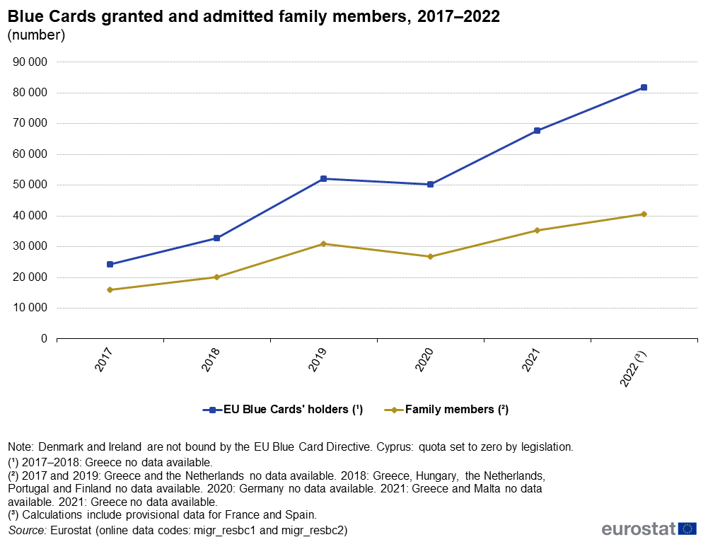

Slide 35
Blue Card
Germany issued 63 200 EU Blue Cards in 2022
  77 % of all EU Blue Cards issued (Eurostat, 2023)
In 2022, the majority of EU Blue Cards issued in the EU were issued in four countries:
  Germany (63 242, 77.3 % of the total),
  Poland (4 831, 6.0 %),
  Lithuania (3 924 or 4.8 %),
  France (3 876, 4.7 %)

Slide 36
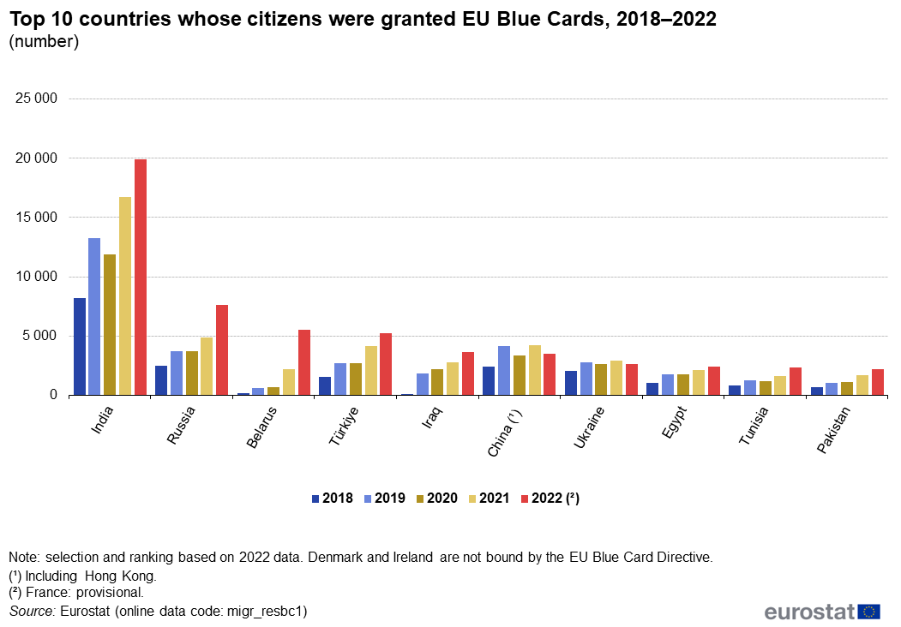

Slide 37
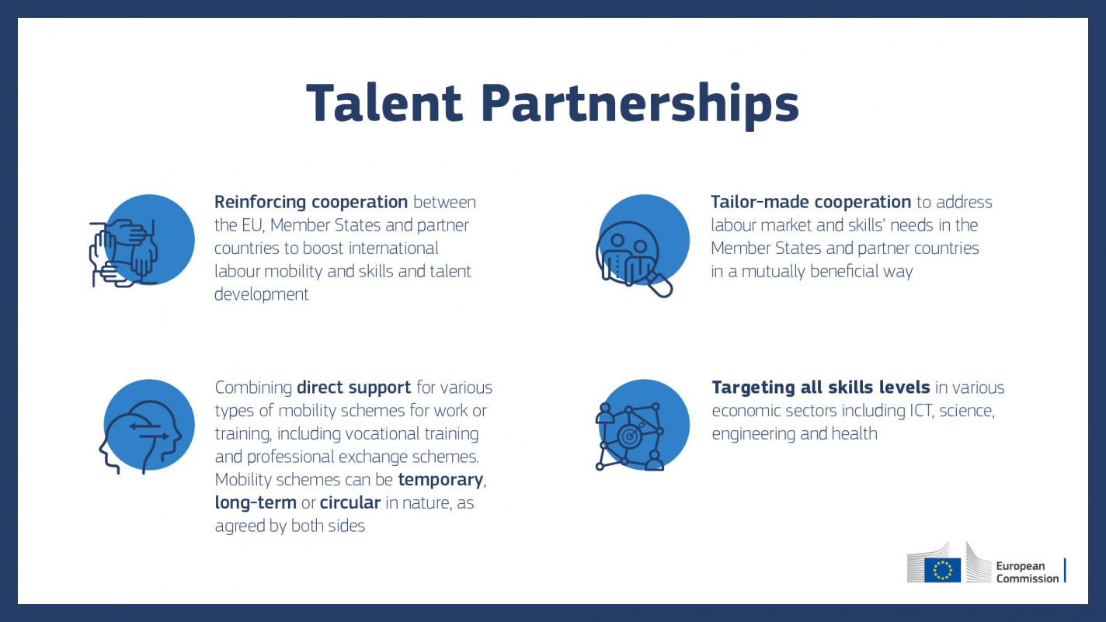
EU talent partnerships

Slide 38
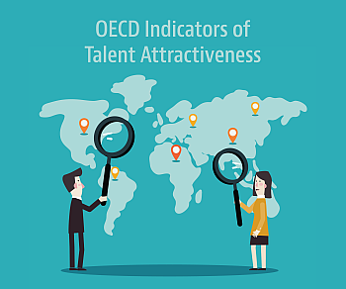
Czech Republic
Czech Republic as a country of immigration
More than 800 thousand employed foreigners in 2021
Approximately 124 thousand immigrants worked in jobs requiring a high level of skills as of 2020, and the numbers of highly skilled migrants have tripled over the past decade (CZSO, 2021)
Quality of opportunities for highly skilled workers (OECD, 2023)

Slide 39
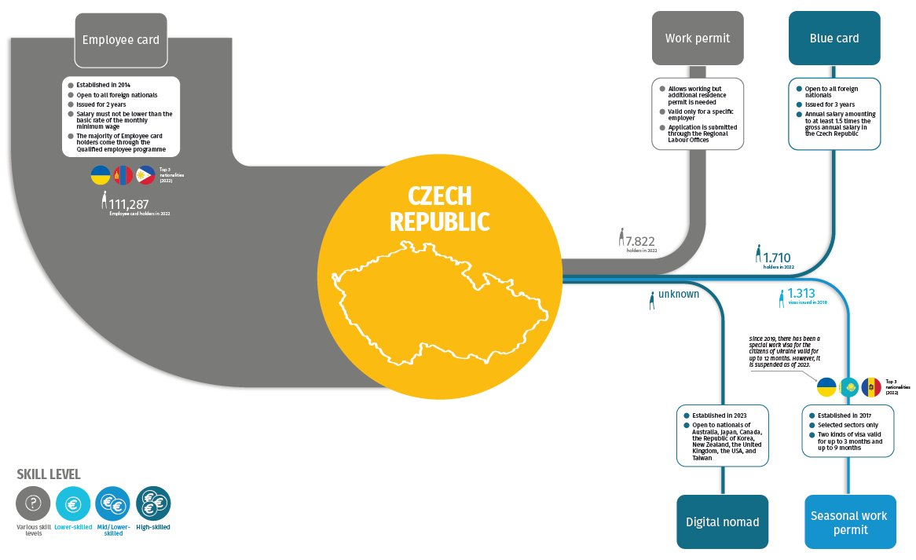

Slide 40
Return migration
“the movement of a person returning to his or her country of origin or habitual residence usually after spending at least one year in another country” (IOM, 2011)
Voluntary vs. Forced return
Criticism that the link between return migration and development is often taken for granted and not critically interrogated (van Houte and Davids 2008)
The impact of return migration depends on the magnitude of the flows and selection of participants (Radu and Straubhaar 2012)

Slide 41
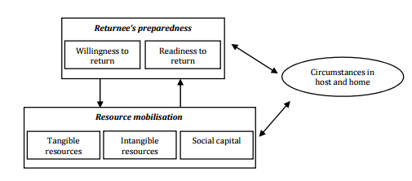
Cassarino (2004)

Slide 42
What can be the benefits of return migration?
Remittances (investment and social remittances/innovations)
Occupational choices or returnee entrepreneurship (Wahba and Zenou 2012; Dustmann and Kirchkamp 2002).
Brain-circulation (Docquier and Rapoport 2011; Saxenian 2006) or increase in the human capital/productive skills (Adams 2006; Adams and Page 2005; De Coulon and Piracha 2005)
Dependent on skill level? (Klagge and Klein-Hitpaß 2010)
In the Netherlands, highly skilled migrants are in a better position to contribute to the development in their countries of origin, by the way of economic and social remittances (Sturge, Bilgili, and Siegel 2016)

Slide 43
Returnee entrepreneurship
Work experience abroad is the most significant predictor of entrepreneurial activity among return migrants.
Other factors included savings, reasons for return as well as frequency of home visits (Black and Castaldo, 2009).
Qin and Estrin (2015) found that peer influence shapes the likelihood of returnee entrepreneurship.

Slide 44
TOKTEN Programme
Transfer of knowledge through expatriate nationals
Created in 1977 by UNDP
Operated in 50 countries and recruited 5 000 experts
Connects migrant professionals to specific programmes in their countries of origin
  Advantage: knowledge about the local circumstances
Some volunteers end up returning to home country permanently

Slide 45

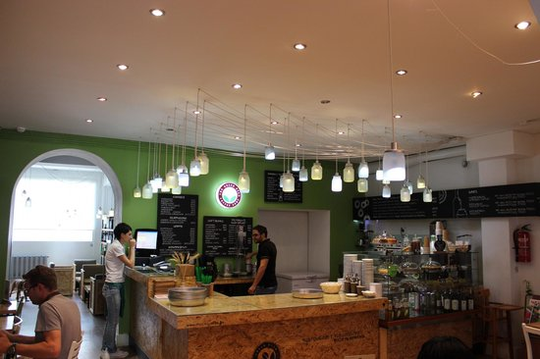
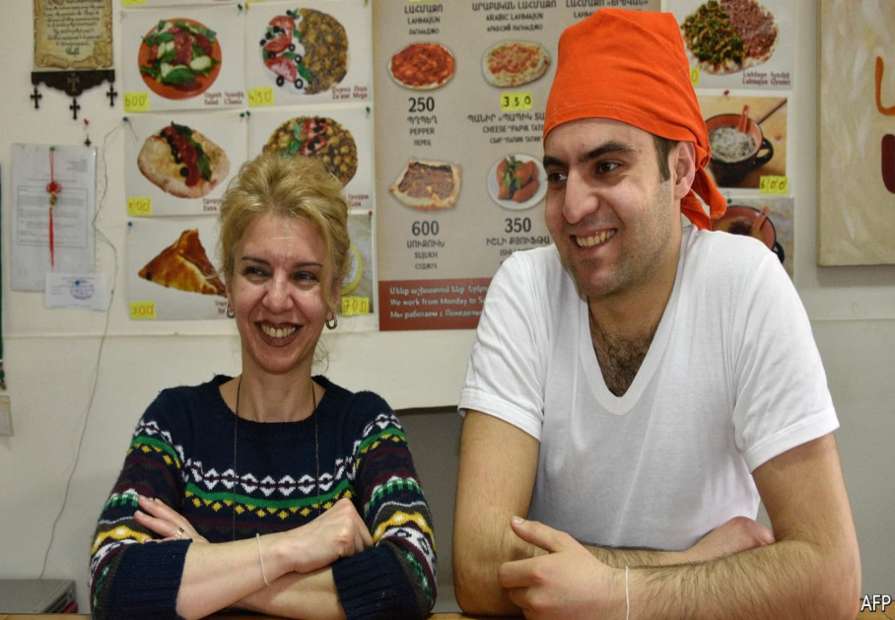
Returnee entrepreneurship

