Slide 1
Labour Market and Employment Policy
Spring 2024
Work careers of
university graduates
Week 6
Martin GUZI
martin.guzi@econ.muni.cz

Slide 2
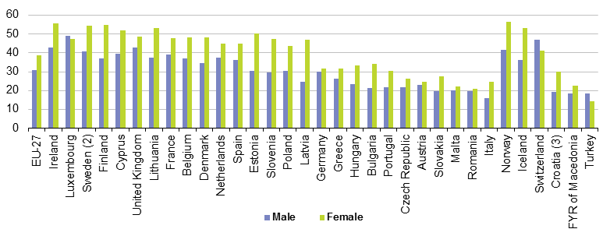
Proportion of the population aged 30 to 34 having a tertiary education, 2011
Young women are increasingly better educated than young men.
Boys are also more likely than girls to drop out from secondary education.
Notes:
Source: Eurostat

Slide 3
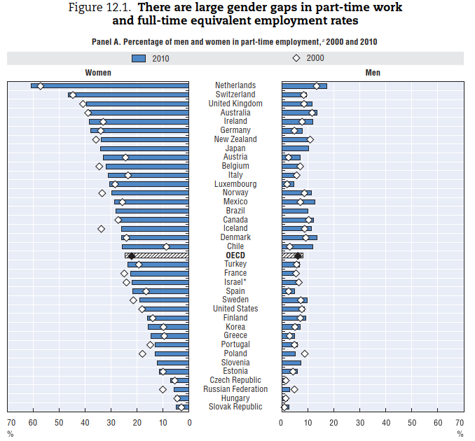
Working part-time on a long-term basis tends to have a negative effect on women’s career opportunities as it limits their abilities to develop
leadership skills and take on jobs with high levels of responsibility.
Part-time employment refers to persons who usually work less than 30 hours per week in their main job.
Source: OECD Employment Database 2012.

Slide 4
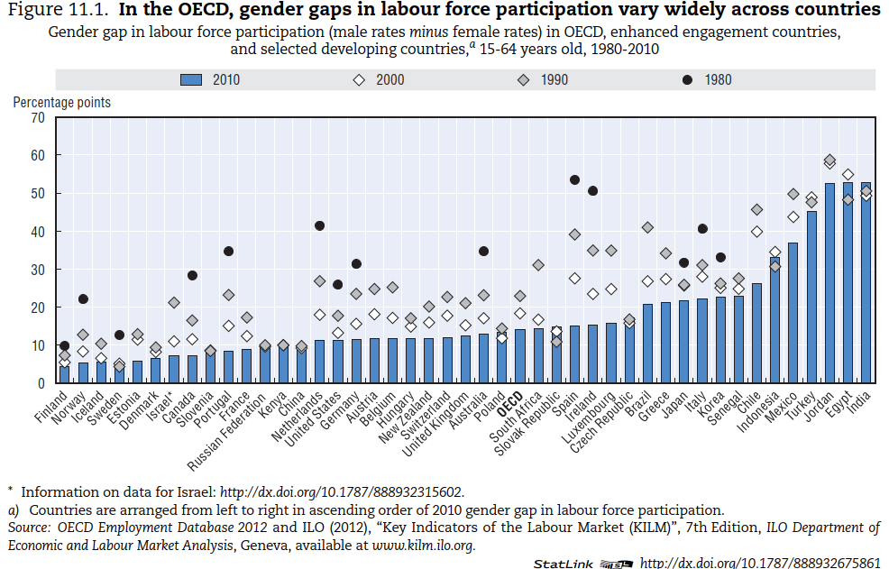

Slide 5
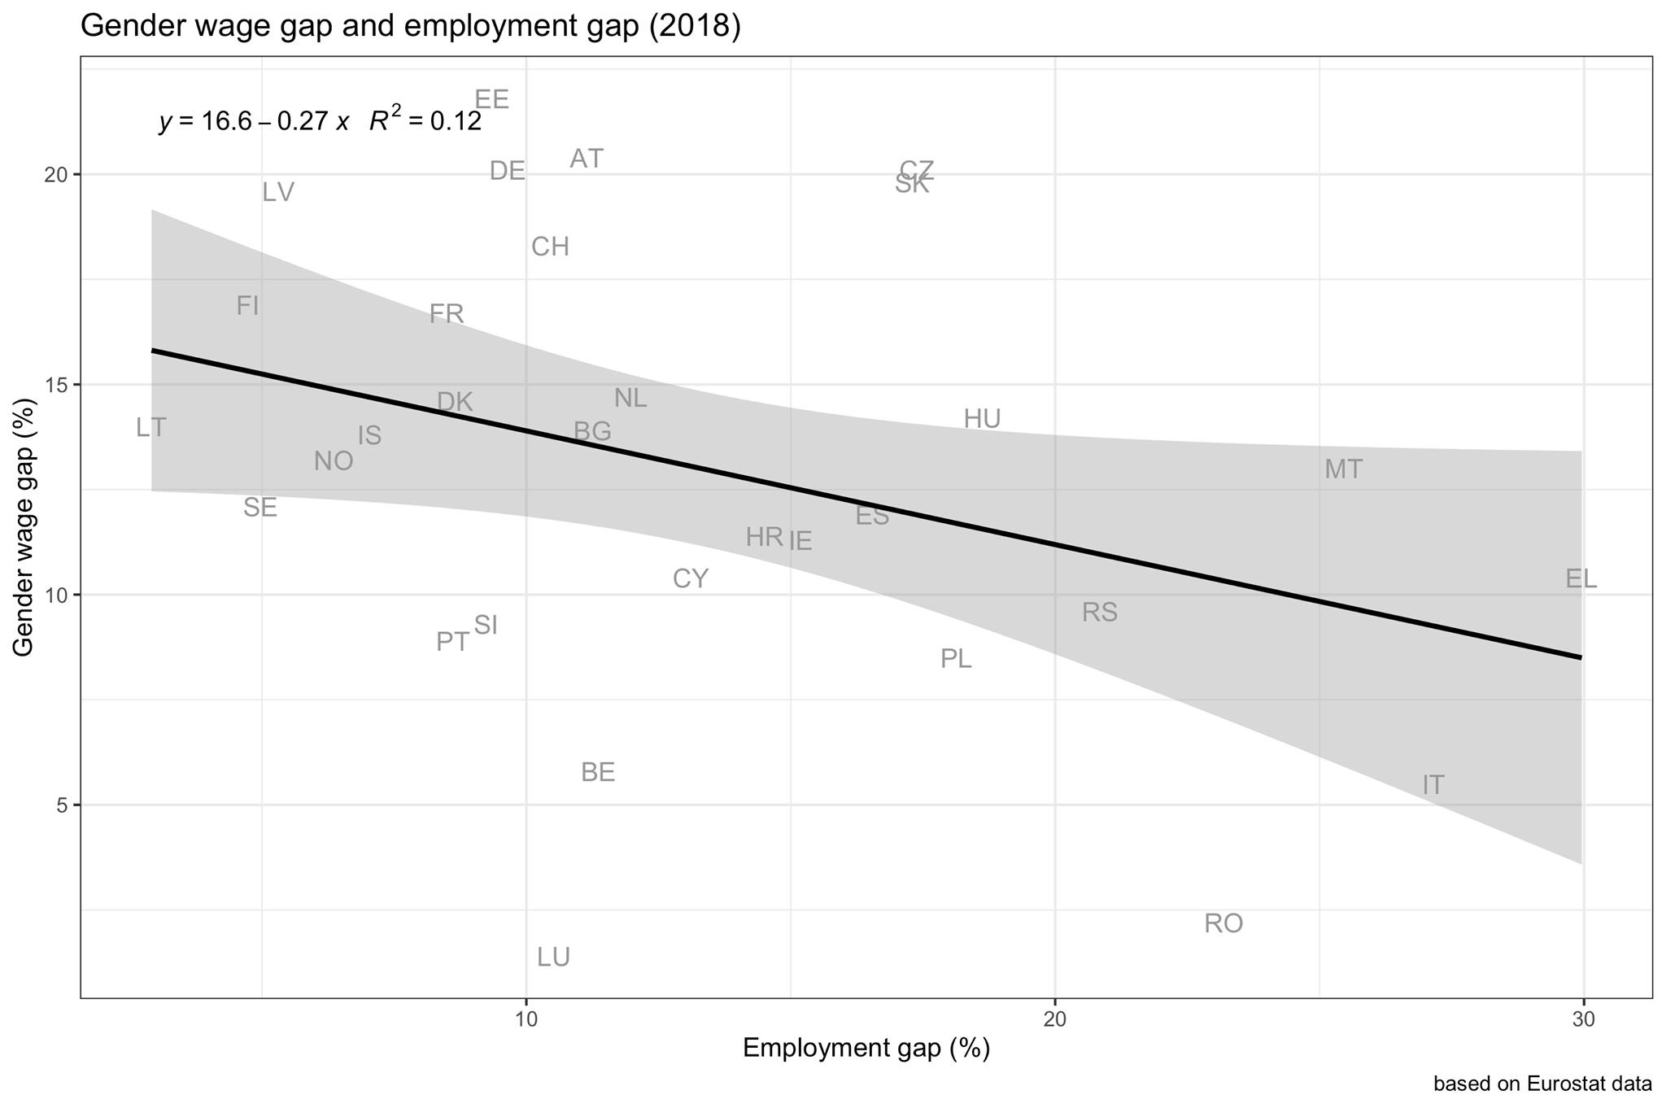
The employment and wage gaps between men and women are related.
There is an inverse relationship between wage and employment gender gaps.
For example 48% of women participate in the labour market in Italy in comparison to 70% in Germany. The employment gender gap is larger in Italy and the gender wage gap is lower in Italy relative to Germany.
One explanation is that women who choose to be employed have the highest earning potential and the higher selectivity in employment contributes to low wage gap in Italy.
The other explanation is the flexibility of labour contracts. In Germany, for example, 48% of working women use part-time jobs, while it is 31% in Italy and only 5.7% in Czechia.

Slide 6
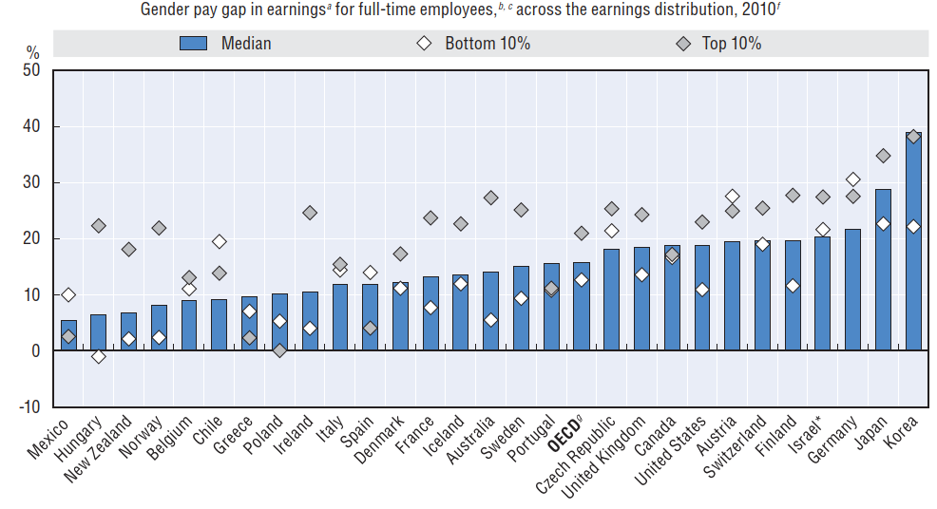
The pay gap is higher for incomes at the top of the earnings distribution
The wage gap is defined as the difference between male and female wages divided by male wages
(at the first decile, median and ninth decile of the earnings distribution).
OECD Database on Earnings Distribution

Slide 7
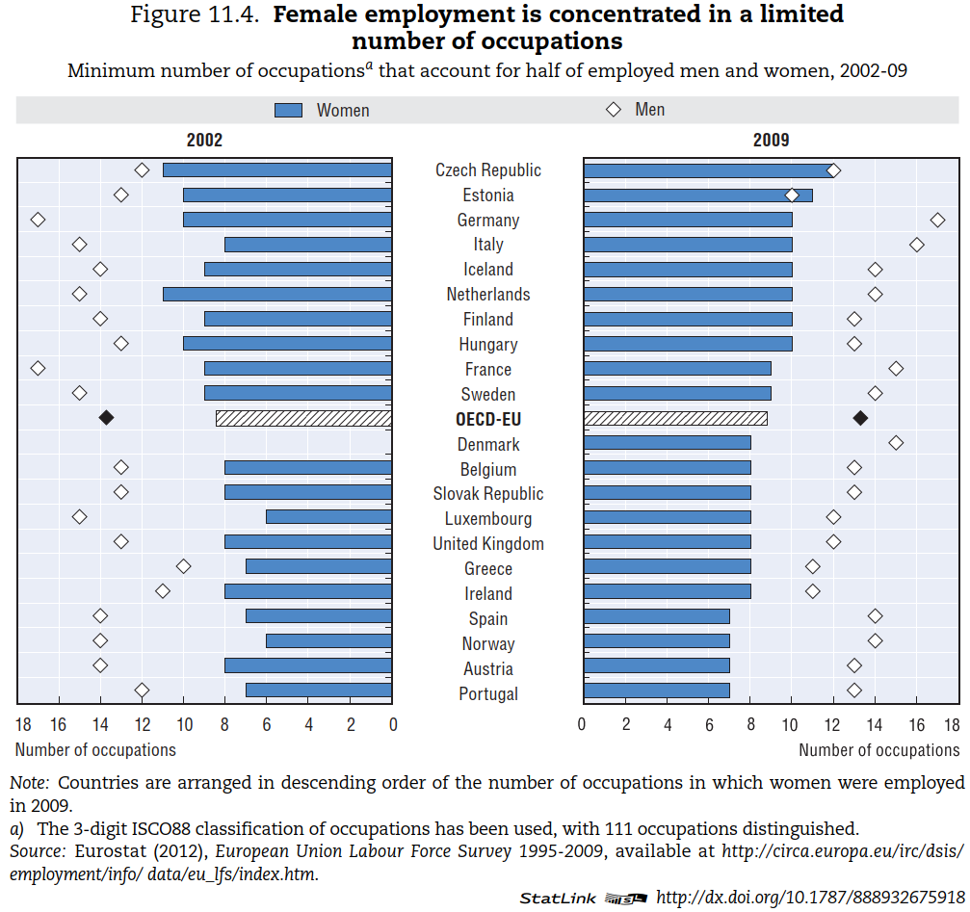

Slide 8
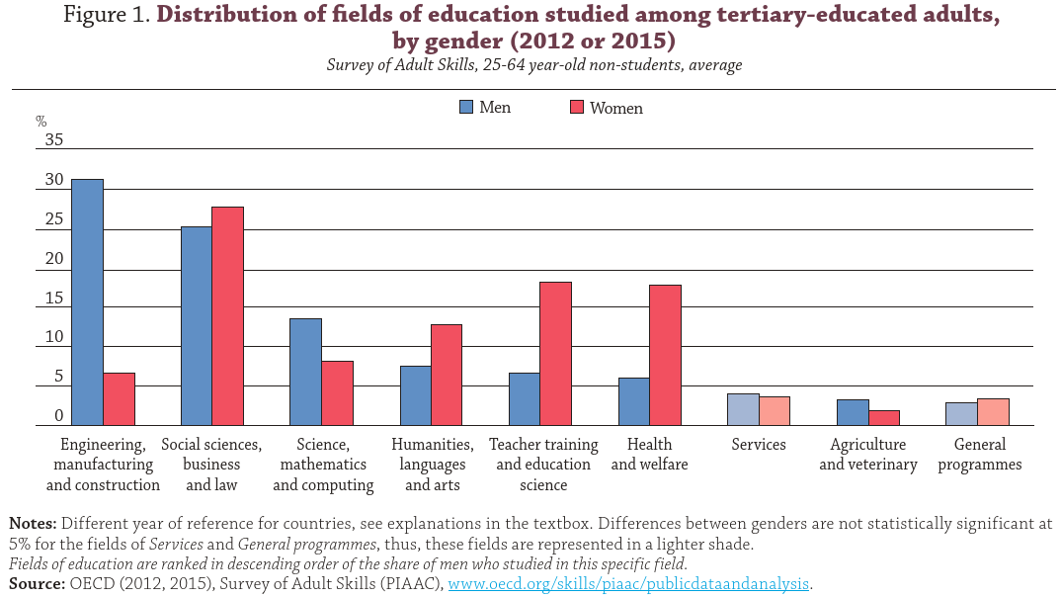
Education fields with a larger share of women are typically associated with lower employment rates and lower earnings. However, even within the same field of education, employment rates and earnings are generally higher for men than for women. Gender stereotypes at school (young age).
Notes:
Countries and fields of education covered in the Survey of Adult Skills
The data source for this publication is the Survey of Adult Skills. This survey was not specifically designed to analyse the tertiary-
educated population, so the sample size for specific fields of education can be small and should therefore be interpreted with
caution.
The national and subnational entities included in this analysis are Australia, Austria, Canada, the Czech Republic, Denmark,
Estonia, England (United Kingdom), Finland, Flanders (Belgium), France, Germany, Ireland, Italy, Japan, Korea, the Netherlands,
Northern Ireland (United Kingdom), Norway, Poland, the Russian Federation, the Slovak Republic, Spain, Sweden,
the United States, for 2012, and Chile, Greece, Israel, Lithuania, New Zealand, Singapore, Slovenia and Turkey, for 2015.

Slide 9
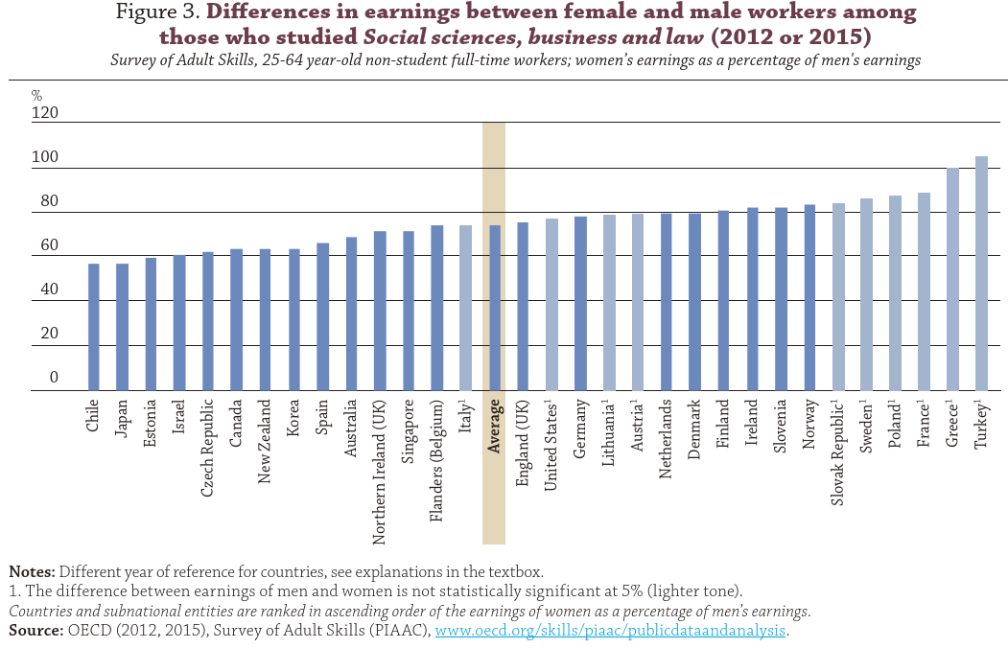
Social sciences, business and law, which was studied by a relatively large share of both women and men in OECD countries and is associated with relatively high earnings, women earn only about 75% as much as men.

Slide 10
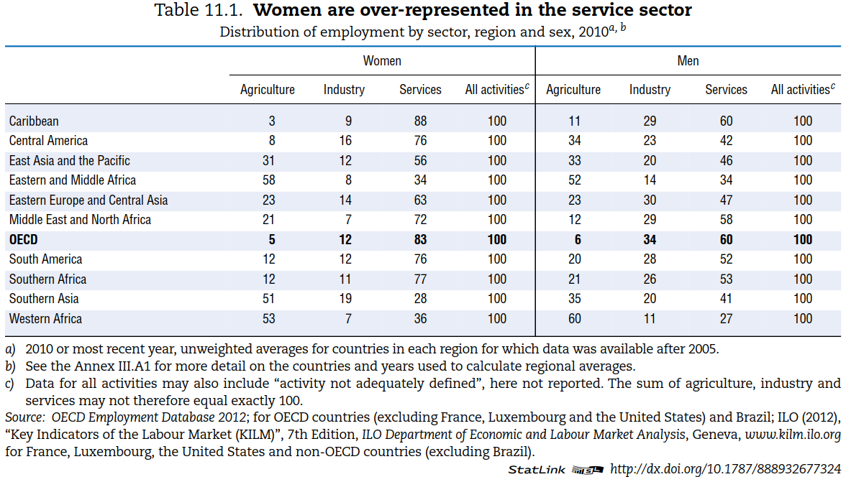

Slide 11

Gender equality in employment
Women work fewer hours and have lower participation in the labor market
Women are over-represented in contractual employment, lower job categories, and part-time work.
High concentration of males or females in certain occupations and sectors (Gender-stereotyped profiles of occupations)

Slide 12
Key policy messages
Collect and share data (promote pay transparency)
Combat all forms of pay discrimination
Address other barriers to gender equality (e.g. cultural)
Set targets for women in senior management positions in the public service
Get girls more interested in science and boys in reading
Ensure that work pays to both parents (via tax and benefit systems)
Promote support for female-owned enterprises in high-tech sectors.

Slide 13
Case study: Portugal
Ana Rute Cardoso and Louis-Philippe Morin, 2018, Can Economic Pressure Overcome Social Norms? The Case of Female Labor Force Participation

Slide 14
Portugal: Institutional setting, 1926-1974
• Constitution 1933, equality of all citizens before the law, with the exception “in the case of the woman, the differences that result from her nature and the good of the family" (art. 5)
• 1956, compulsory schooling: 4 yrs for boys and 3 yrs for girls;
Diploma of 4 yrs required to access jobs in public admin, manufacturing, the services, get a driver’s license, or participate in official sports competitions
• Right to vote: different requirements on males and females
• Employment contract, passport: husband’s consent required
• Divorce and contraception outlawed
• Gender norms were pervasive: women’s participation should be restricted to the household

Slide 15
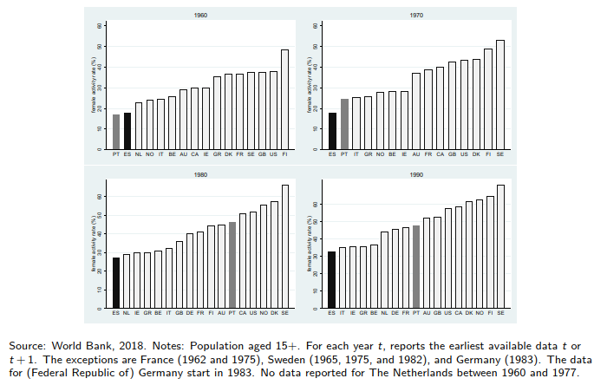
Trends in female participation in the labor market
Widespread rise in female labor force participation
The puzzle of Portugal

Slide 16
Portuguese Colonial War
War in Africa, 1961-74: Angola, Mozambique, Guinea-Bissau
Major drain of human resources: males drafted for 2-4 years, starting the year they turned 21
  [A]round one per cent of the country’s population was called up to fight. By way of comparison: had the Americans called up the same proportion for the war in Vietnam, they would have had to have recruited and deployed 2.5 million troops instead of the 500,000 that were actually mobilized
  (Pinto 2011)
Major drain of financial resources: military expenses reached 63% of Central Govt budget in 1968
Poverty and war, combined motivation to emigrate

Slide 17
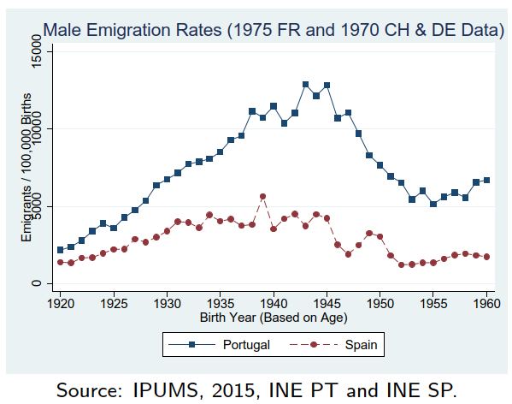
Male Emigration Rates, Spain vs Portugal
Emigration: 1.5 million left Portugal during 1960s and first half of 1970s, out of initial 9 million inhabitants
Spain also 1.5 million emigrants, but out of initial 30 million
By 1969, France absorbed 72% of Portuguese emigrants; Germany, Switzerland and France absorbed the majority of Spanish ones
Major drain of human resources from Portugal: as much as 8%-12% of male cohorts born in 1940s

Slide 18
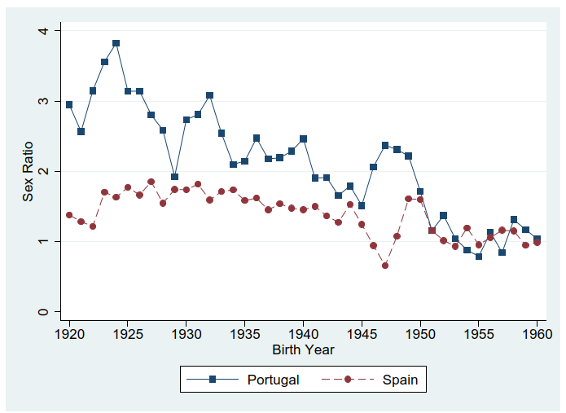
Sex ratio among Portuguese and Spanish emigrants at destination countries (late 1960s)
The Spanish emigration rate was not only remarkably lower than the Portuguese,
it was also much more gender balanced
Men left first, women followed later)
Scarcity of male human resources in economy
Until 1968, large gender imbalance in
emigration
From 1969 to 1974, large magnitude of
outflow
Note: The sex ratio for each cohort is the number of Portuguese (Spanish) males per female observed in the Census in France 1968 and in Germany and Switzerland 1970.

Slide 19
Occupational upgrading in Portugal
1960 Census: classify occupations as "male" or "female"
1980 Census: major occupational upgrading, as women increasingly represented in the following “male" occupations: legislators, senior officials, managers; plant and machine operators and assemblers; skilled agricultural workers;
declining female representation in "elementary occupations“
reduction of gender segregation across occupations
reduction of gender pay gap by 7-8 p.p.

Slide 20
Work careers of university graduates
The importance of education in the society
Earnings advantages from education
Why starting your career during a strong economy is better?
Why finding a matching job is important?

Slide 21
History of university education
First European universities established in Bologna (1088), Paris (1150), Oxford (1167), Cambridge (1209), Salamanca (1218), Montpellier, Padua, Naples, Toulouse, Prague (1348), Heidelberg, Louvain (1425).
Participation in university at that time was at 1.75% (almost all clerics)
In 2021 more than 40% of 25 to 34 year olds in OECD countries have a tertiary-level education.
Notes:
Source: compayre (1893), years adapted from Ritzen 2010

Slide 22
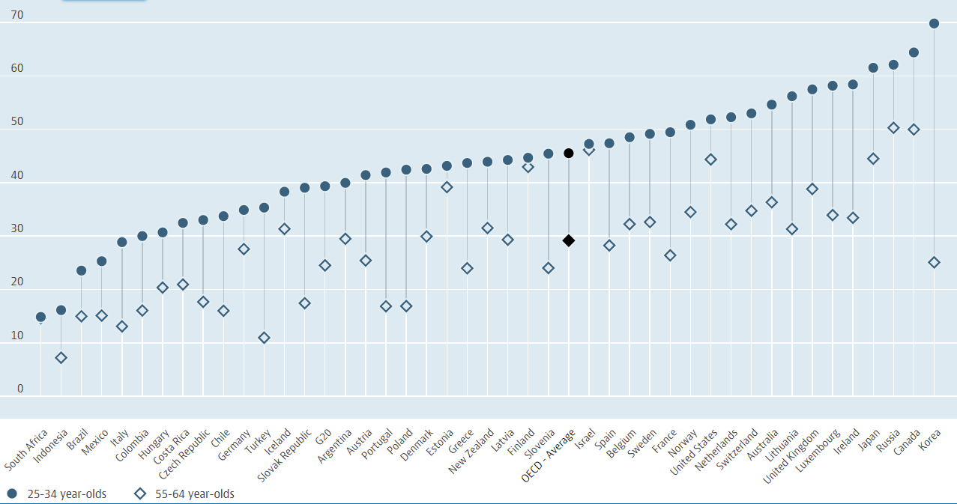
Population with tertiary education, 2021
25-34 year-olds / 55-64 year-olds, % in same age group
https://data.oecd.org/eduatt/population-with-tertiary-education.htm

Slide 23
In OECD countries, almost half of young is tertiary educated but differences between countries are large.

Slide 24
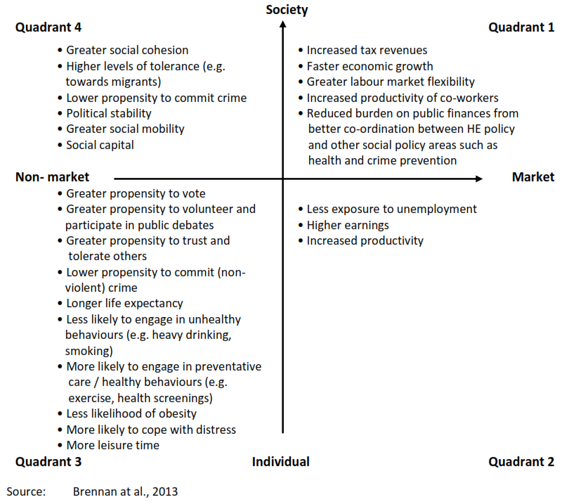
What are the benefits of higher education for individuals and society ?
Notes:
Going to university provides individuals with the opportunity to:
• Gain in-depth knowledge of a particular subject and engage in learning for its own sake.
• Develop vocational knowledge and skills which enable entry to a particular job or profession (e.g. teaching, medicine).
• Increase lifetime earnings compared with non-graduates.
• Make friends, meet future life partners and develop social networks.

Slide 25
What are the benefits of higher education for individuals and society ?
Notes:
Going to university provides individuals with the opportunity to:
• Gain in-depth knowledge of a particular subject and engage in learning for its own sake.
• Develop vocational knowledge and skills which enable entry to a particular job or profession (e.g. teaching, medicine).
• Increase lifetime earnings compared with non-graduates.
• Make friends, meet future life partners and develop social networks.

Slide 26
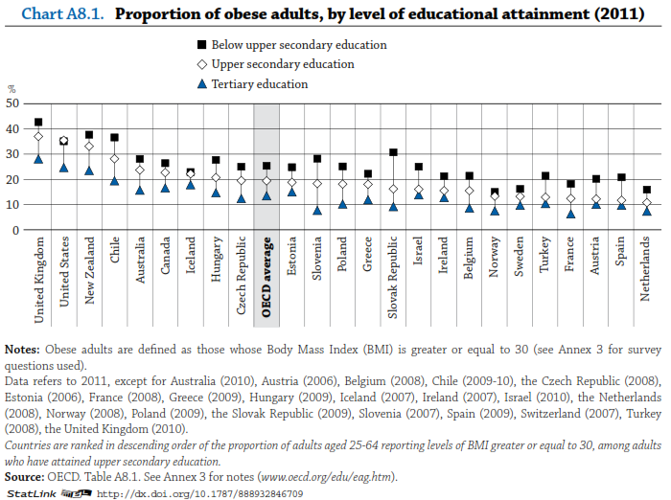

Slide 27
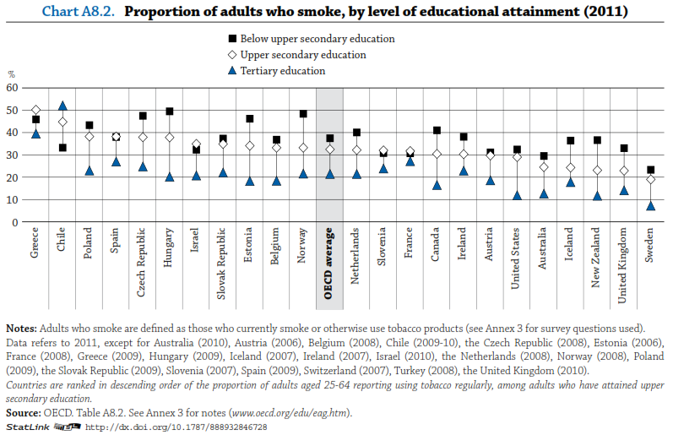

Slide 28
On average across OECD countries, 25-64 year-olds with a tertiary degree earn on average 54% more for full-time employment than those with upper secondary attainment.
Premia differs by type of tertiary education (20% for a short-cycle tertiary degree, 43% for bachelor’s degree and 90% master’s or doctoral degree).
Which countries have the largest premium for education?

Slide 32
Choice of field of studies and expected earnings
The earnings advantage for tertiary-educated adults also varies
by their field of study.
The fields of study with the highest earnings (80% premium) are engineering, manufacturing and construction, and ICT. Fields of study with the lowest earnings (20%) are arts/humanities, and education.
Are students’ preferences in field of study related to relative earnings?
Other factors are more important: limited admission of students in some fields of study, lack of information on expected earnings in different fields, and students’ personal interests and motivation.

Slide 33
Relationship between the share of tertiary new entrants and relative earnings, by field of study (2017)

Slide 34
For younger workers, less favorable outcomes early in their careers, may negatively impact future labor market success
Business cycle
  Think why youths graduating in a recession incur permanent career losses.
Employment mismatch
  Think why the supply of and demand for graduates might not match in a labor market.

Slide 35
Evidence from literature
Individuals who enter the labor market in a recession, when the unemployment rate increases by 3-4 points, earn 6-16% less than their graduates who start career during a strong economy
In a recession it takes longer to find a job and hourly wages are lower
Despite these losses, university graduates perform much better than individuals without a university degree.
Graduating in a recession also has the effect of delaying marriage and having kids for men. This finding does not hold for women.

Slide 36
How to improve your chances of finding a great job after university?
It may help to enhance your CV and make it more attractive to employer
Include any volunteering activities (gold for your CV) or student mobility
Signal other skills
Correct all spelling mistakes in your CV

Slide 37
Spelling mistakes in your resume can cost you a job interview
sent 1335 CVs of three fictitious job candidates. These three candidates differed in the number of spelling errors in their CV: zero, two, or five.
the probability of a job interview was 65.6% for those who made no spelling mistakes, compared to 58.1% for those with two spelling errors and 46.6% for those with five spelling errors.
the effect of two spelling mistakes was equally damaging as the positive effect derived from volunteering work
applicants for low-skilled occupations are penalized more heavily for making many spelling mistakes
spelling errors as a signal of lower interpersonal skills
i) hardworking, (ii) organized, (iii) thorough, (iv) responsible, and (v) systematic
https://www.universal-sci.com/article/effect-of-spelling-mistakes-on-chances-for-job-interview
Source: IZA DP No. 14614: Costly Mistakes: Why and When Spelling Errors in Resumes Jeopardise Interview Chances by Philippe Sterkens, Ralf Caers, Marijke De Couck, Michael Geamanu, Victor Van Driessche, Stijn Baert

