Slide 1
Reforms Reducing
Income Inequality and Poverty
Martin GUZI
martin.guzi@econ.muni.cz

Slide 2
What to learn
Study materials
https://ourworldindata.org/income-inequality
Learn and practice to construct Lorenz Curve and to calculate Gini index
http://shlegeris.com/gini
Understand principles of participation income
https://onlinelibrary.wiley.com/doi/abs/10.1111/j.1467-923X.1996.tb01568.x
(pdf uploaded to study material folder – 3 pages)

Slide 3
Income Inequality gets media attention
Inequality: The rich and the rest
Income inequality: Rich and poor, growing apart
Financial inequality: Are the rich making you poor?
Globalisation and the rise of inequality
Poverty wages in the land of plenty
Income Gap Grows Wider (and Faster)
Richest 8 boast same wealth as half the world (2017)
In April 2014 Pope Francis tweeted:
“Inequality is the root of social evil".
Notes:
http://www.theguardian.com/business/2014/mar/17/oxfam-report-scale-britain-growing-financial-inequality

Slide 4
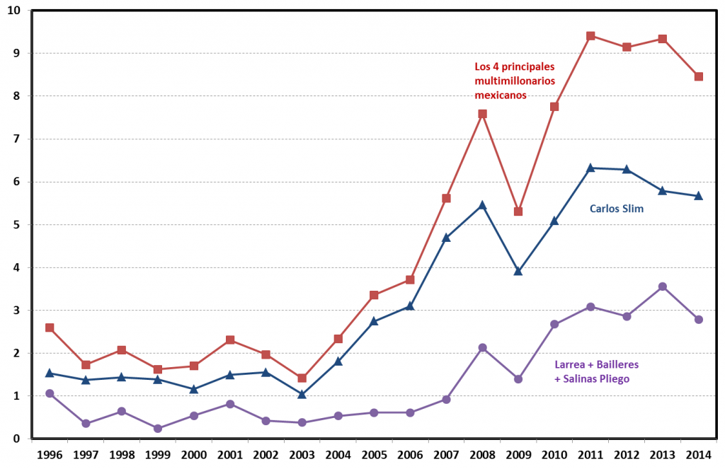
Inequality Income and Poverty in Mexico
Figure 1: Wealth of the Four Main Mexican Multimillionaires as a Percentage of GDP
https://blogs.lse.ac.uk/government/2017/03/24/inequality-in-mexico-and-how-to-address-it/

Slide 5
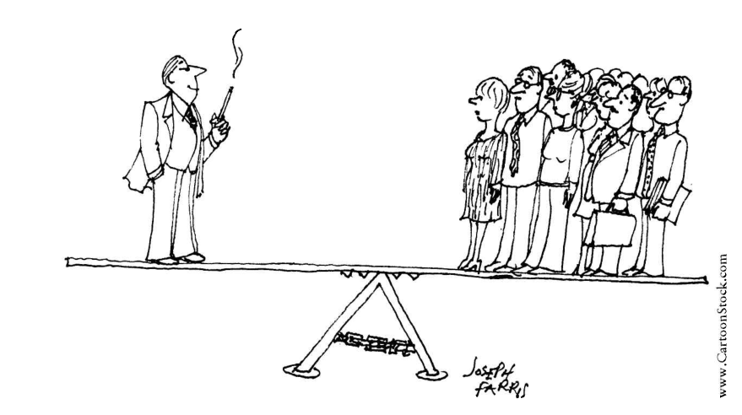
Income inequality in rich countries

Slide 6
Top 1% income share
The share of income earned by top 1 percent (super rich) is a good fit of overall inequality in the country
In Germany top 1% earns more than 150,000 EUR
In 2014-15 UK top 1% earns more than £150,000
(top 5% earns more than £70,000)
In 2017 Canada top 1% threshold is 236,000 CAN
In the US the annual income of $700,000 (2023) $422,000 (2015) opens the door the top 1% club ($389,000 in 2011). The average income earned by top 1% is $1,3 million that is 26 times higher than average income $50,000 of bottom 99%.
Notes:
UK:
https://www.theguardian.com/money/2017/apr/19/how-much-earn-rich-70000-labour
https://www.gov
Canada:
https://www150.statcan.gc.ca/t1/tbl1/en/tv.action?pid=1110005501
US 2015 wage data
https://www.epi.org/multimedia/unequal-states-of-america/
https://www.epi.org/publication/the-new-gilded-age-income-inequality-in-the-u-s-by-state-metropolitan-area-and-county/

Slide 7
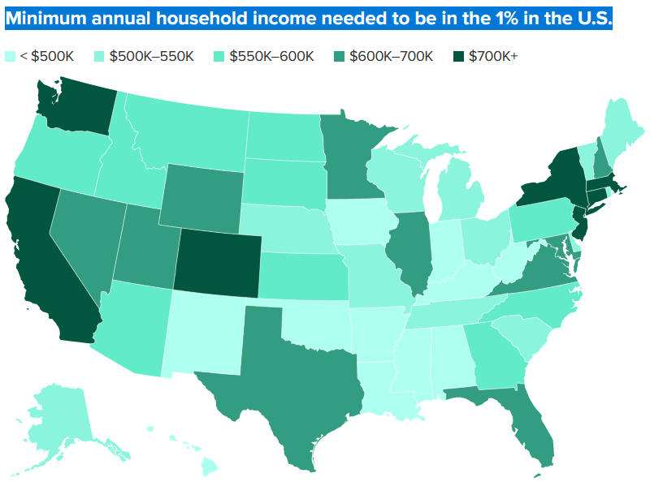
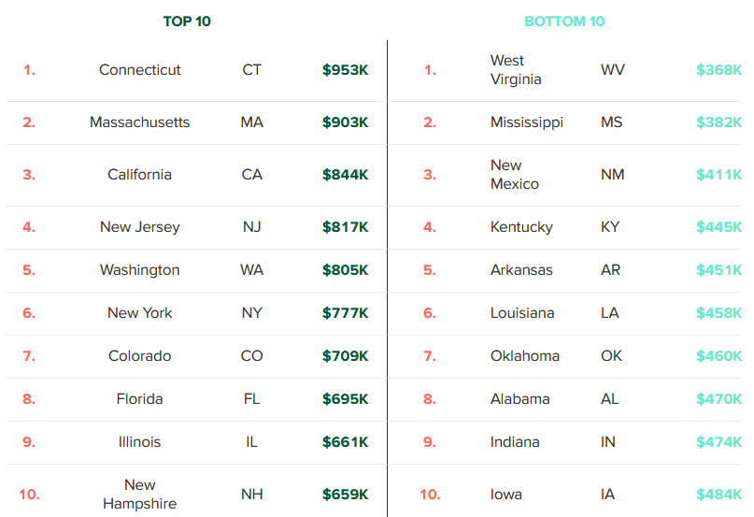
https://www.cnbc.com/2023/09/30/how-much-money-you-need-to-make-to-be-in-the-top-1-percent-in-every-state.html

Slide 8
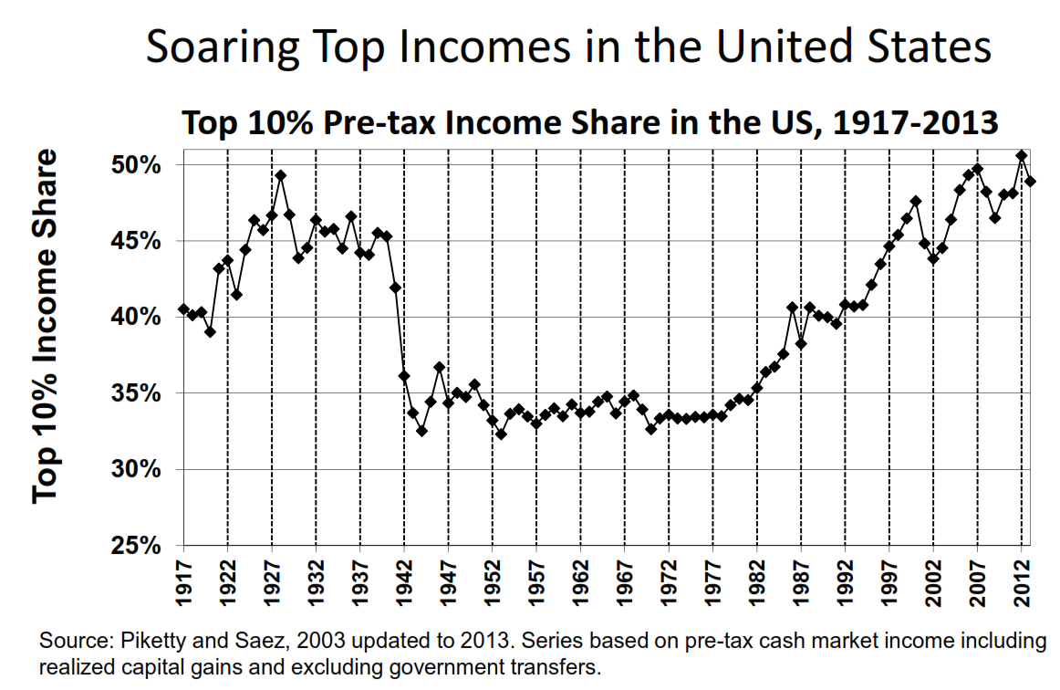

Slide 9
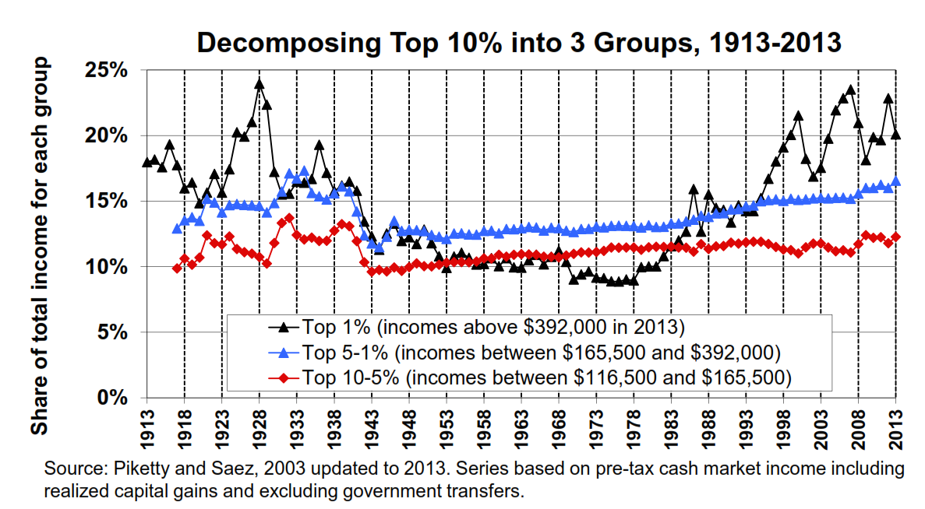
Top income inequality is measured as the share of total income that goes to the income earners at the very top of the distribution. Usually the top 1%.
Historical top income inequality estimates are reconstructed from income tax records, and for many countries these estimates give us insights into the evolution of inequality over more than 100 years.

Slide 10
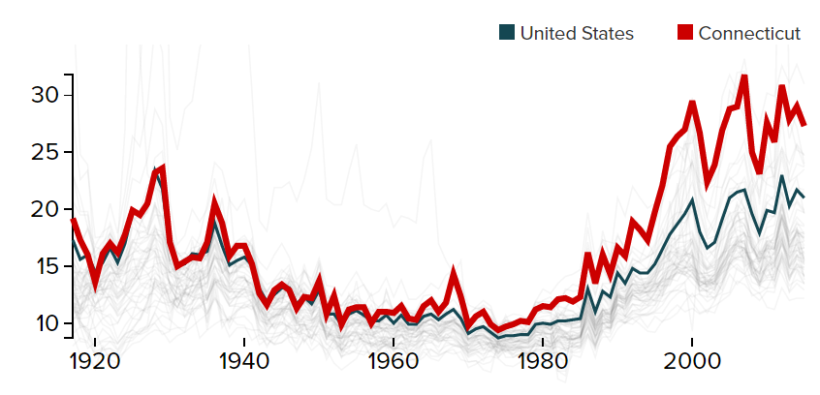
Share of income captured by the top 1% varies between states in the U.S.
To be in the top 1 percent nationally in 2015, a family needed an income of $421,926. The highest thresholds were in Connecticut ($700,800), New Jersey ($588,575), New York ($550,174), and California ($514,694). In New Mexico, you need $255,429. Overall in the U.S., the top 1 percent took home 22.03 percent of all income in 2015.
https://www.epi.org/multimedia/unequal-states-of-america/
Notes:
https://www.epi.org/multimedia/unequal-states-of-america/

Slide 11
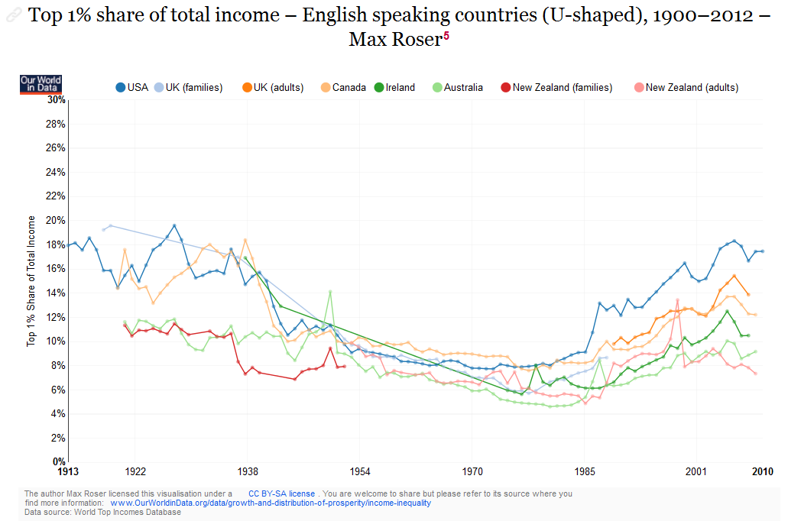

Slide 12
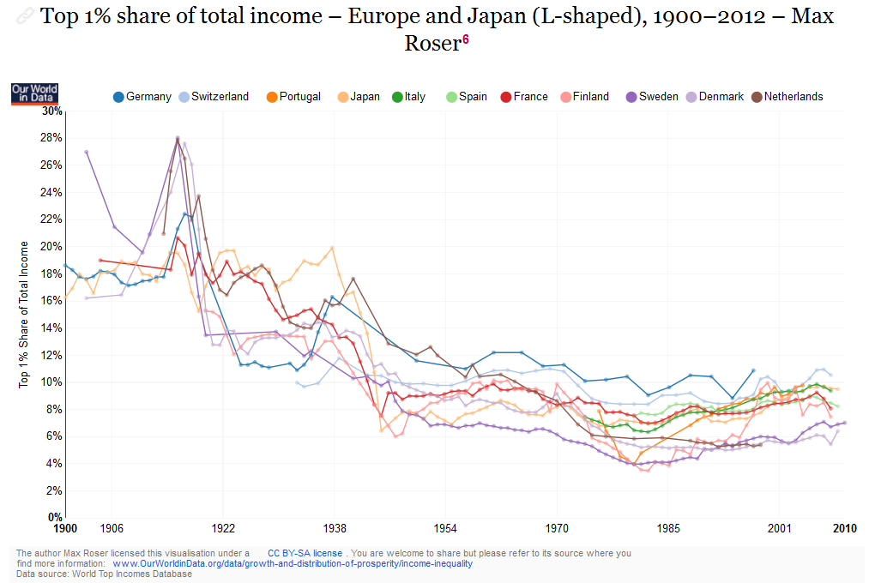

Slide 13
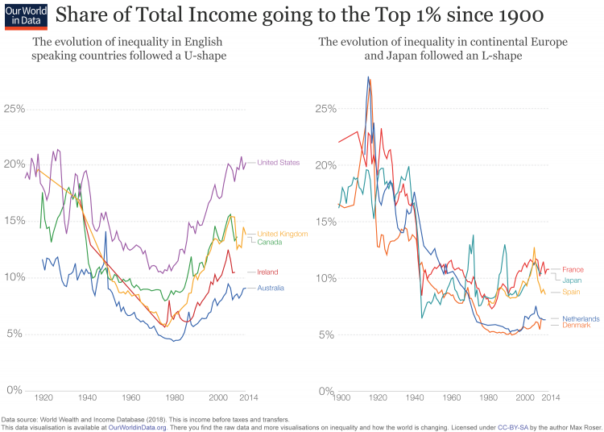

Slide 14
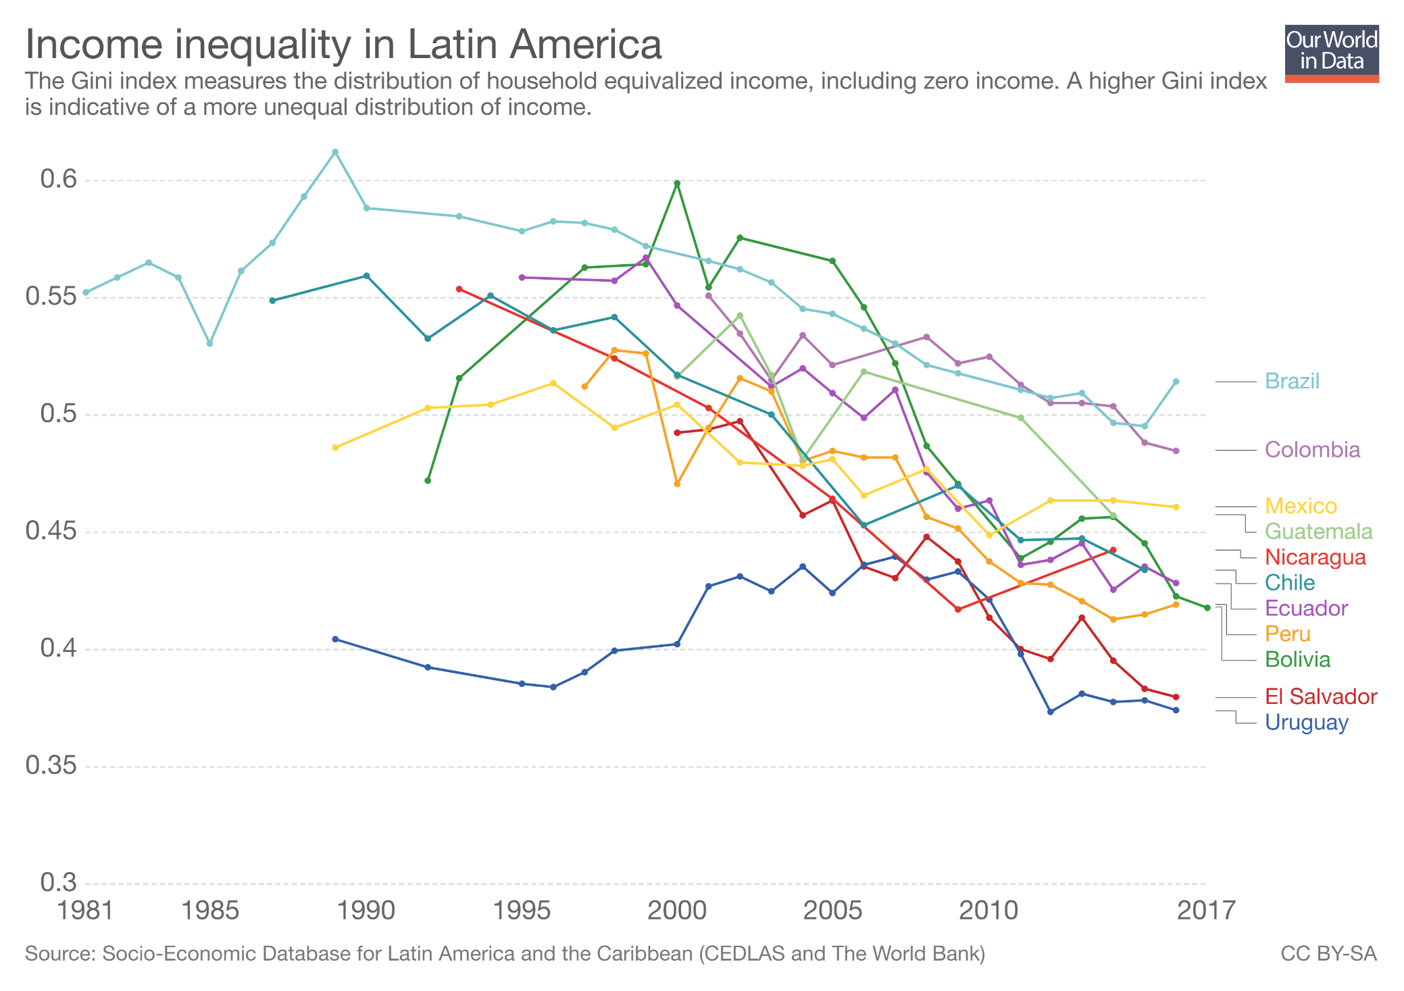
Lopez-Calva and Lustig (2010) suggest that the main factors contributing to declining inequality in Latin countries are
a decrease in the earnings gap between skilled and low-skilled workers and
an increase in government transfers to the poor.

Slide 15
Summary
Income inequality has been rising over the last decades, but magnitudes are very different between countries.
A universal trend of increasing inequality is determined by global market forces and technological progress. Political forces on the national level are important for how incomes are distributed. The different inequality trends within countries suggests that the institutional and political frameworks are important in shaping inequality of incomes.

Slide 16
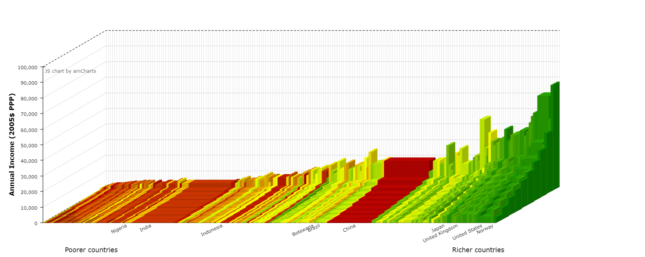
Do you choose option 1 or option 2?
1. You can choose the decile you are to be born in,
but not the country.
2. You can choose the country you are born and live in, but not the decile.
https://jackblun.github.io/Globalinc/html/fig_2014.html
Notes:
The most important determinant of your income is the country.

Slide 17
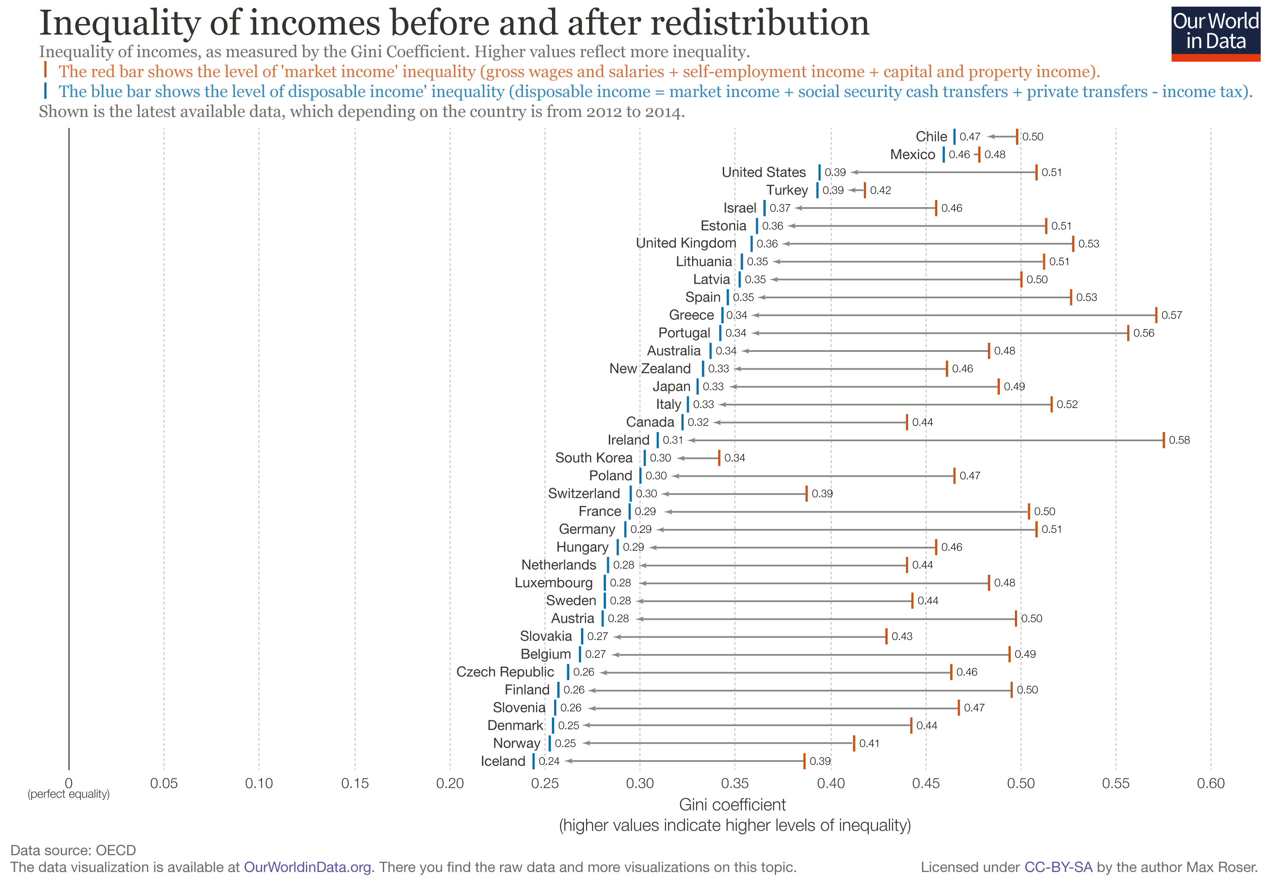
Redistribution through tax and welfare contributions is high in Germany (top 10 richest taxpayers contribute about 50 percent of income tax).

Slide 18
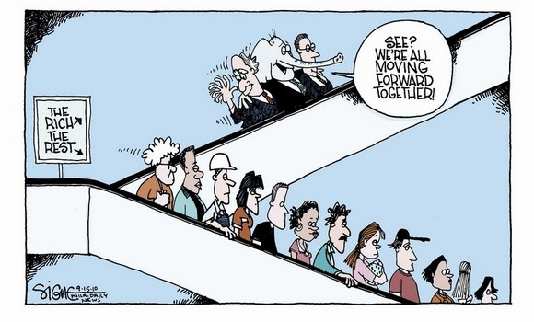

Slide 19
The many ways to measure income inequality
Share of income (top 10%, 1%, .1%, .01%)
Gini index
  The range of the Gini index is between 0 and 1 (0% and 100%), where 0 indicates perfect equality and 1 (100%) indicates maximum inequality.
20:20 Ratio (or decile ratio can be used)
  Compares how much richer the top 20% of populations are to the bottom 20% (SE=4,UK=7,US=8)
Palma ratio (the ratio of the income share of the top 10% to that of the bottom 40%).
Other: the Robin Hood index, the Atkinson index and Theil index.
https://data.oecd.org/inequality/income-inequality.htm

Slide 20
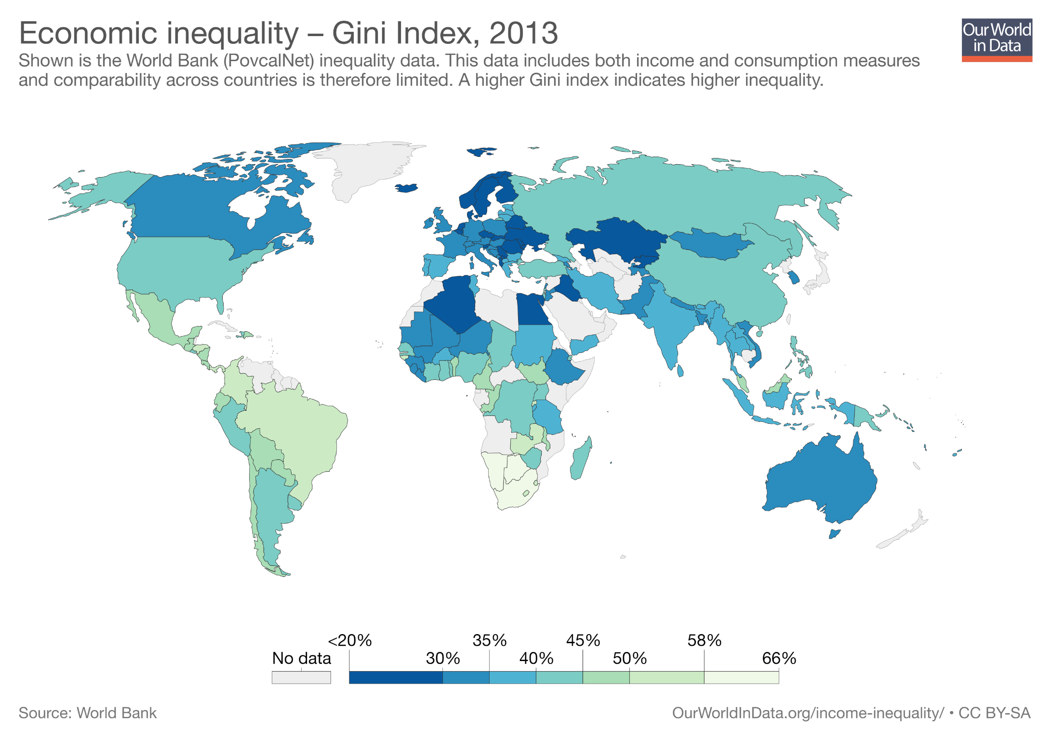


Slide 21
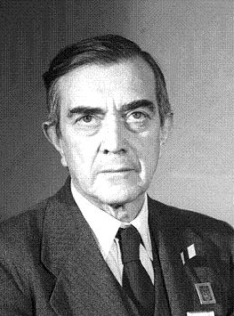
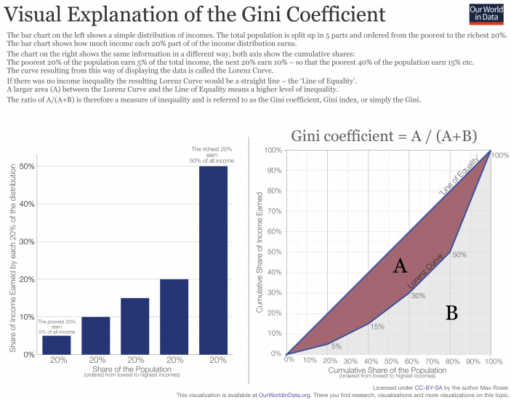
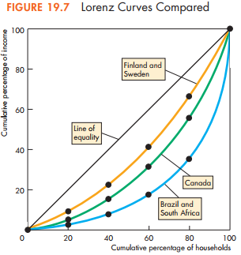
Corrado Gini died in Rome on 13 March 1965, he could not have known that 50 years on, the UN would still use his name in their annual rankings of nations. Gini developed his coefficient in 1912, building on the work of American economist Max Lorenz.
Gini Calculator:
http://shlegeris.com/gini
The more curved, the more unequal
Notes:
https://www.bbc.com/news/blogs-magazine-monitor-31847943
But the Gini coefficient also has limitations. For one, it takes all the data from the Lorenz curve and converts it to a single number. Two different income distributions can have the same Gini coefficient, and a lot of information is lost in the conversion to a graph. Cowell asks, "Why not just look at the Lorenz curve?"

Slide 22
Compare Gini of two economies
In the first economy half of the households have no income, and the other half share income equally.
In the second economy there is a complete income equality, except for one wealthy household that has half the total income.

Slide 23
Discuss how Gini is affected by
Size of country (large vs small)
Population demography
Child benefits (fixed amount) given to every family with children

Slide 24
Limitations of the Gini index
Income concept matters
A Gini based on individual incomes is different to a Gini based on household incomes.
Gini depends on reliable income data
Shadow economies and informal economic activity are not included (developing countries).
Gini is sensitive to outliers—a few very wealthy or poor individuals can change the statistic significantly, even in a large sample.
Gini index is a relative measure (absolute income does not matter)
Demographics matters (pensioners push Gini up)
Very different income distributions can result in identical Gini (use Lorenz curve)

Slide 25
The 20:20 or 20/20 ratio compares how much richer is the top 20% of a population to the bottom 20% of the given population. In Czechia the richest 20% only earn 4 times the poorest 20%.
20:20 ratio (countries ordered by Gini)
Notes:
http://www.oecd.org/social/income-distribution-database.htm
Income distribution data refer to the total population and are based on equivalised household disposable income, i.e. disposable income adjusted for household size. The Gini coefficient takes values between 0 (where every person has the same income), and 1 (where all income goes to one person). The S80/S20 income share ratio refers to the ratio of average income of the top 20% to the average income of the bottom 20% of the income distribution. The poverty threshold is 50% of median disposable income in each country. The income-based poverty rates exclude lump-sum payments which are frequent in the retirement schemes of some countries (e.g. Australia, Switzerland). Working poor are those with income below the poverty line, living in households with a working age head and at least one worker.

Slide 26
How much richer are the richest 20% than the poorest 20%?
Source: Wilkinson & Pickett, The Spirit Level (2009)
www.equalitytrust.org.uk

Slide 27
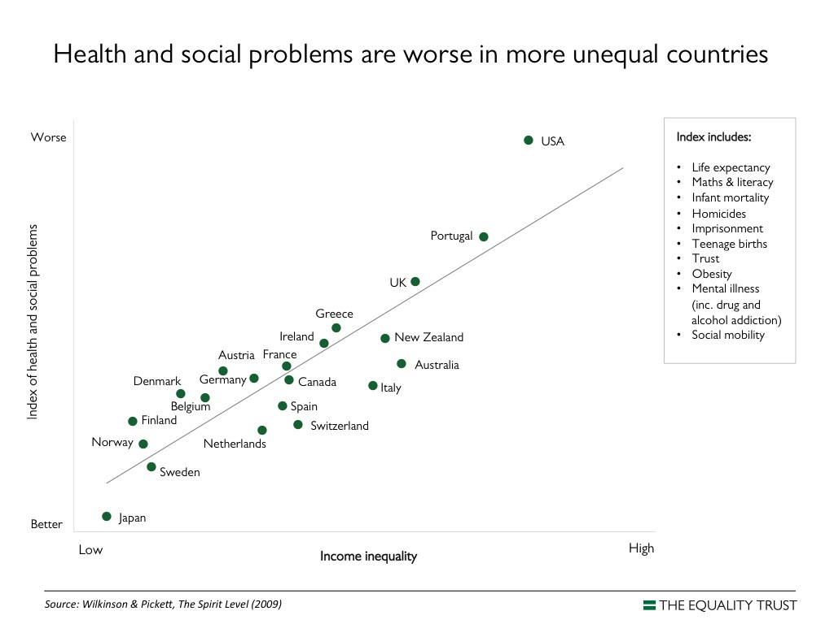

Slide 28
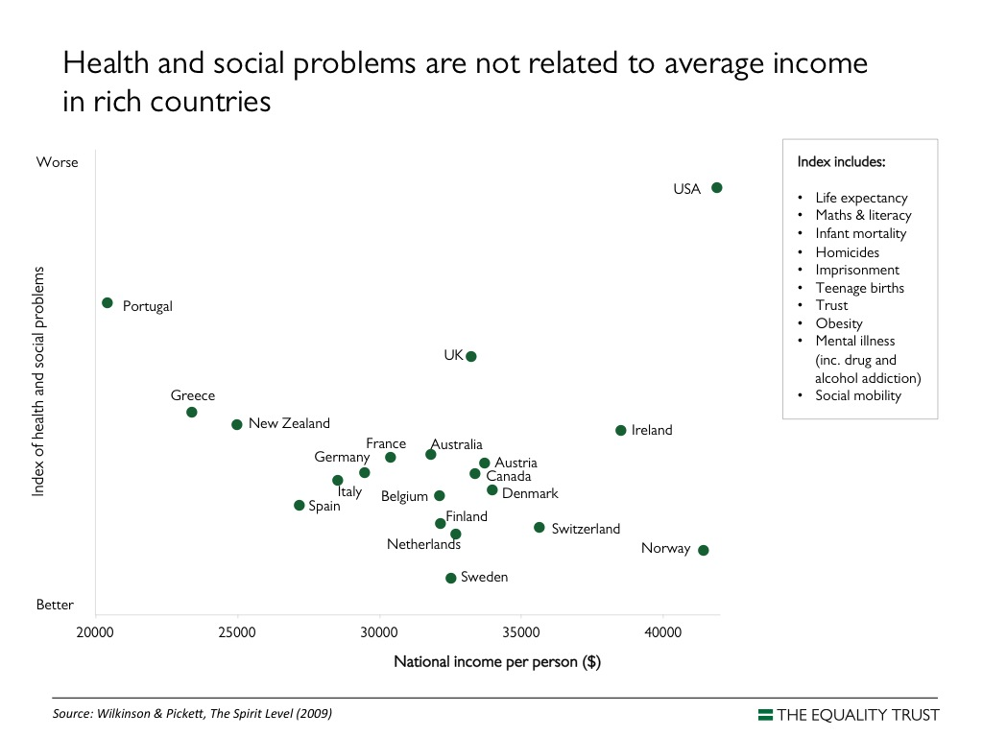

Slide 29
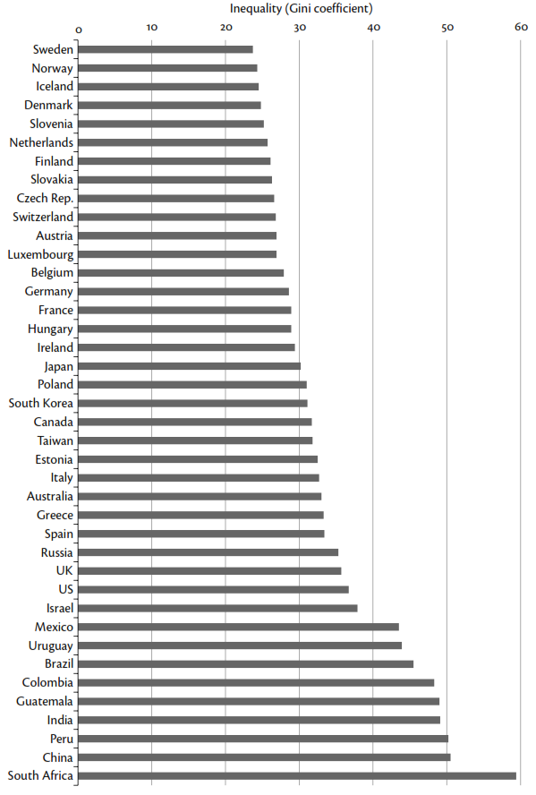
Inequality in selected countries, 2010
Based on equalized household disposable income (after taxes and transfers).
Notes:
Inequality in selected countries, 2010
Based on equalized household disposable income (after taxes and transfes).

Slide 30
Three key measures of economic inequality:
  1. Inequality of income
  (based on individual earnings data)
  2. Inequality of consumption
  (based on individual expenses data)
  3. Inequality of wealth
  Q1: Which inequality is the most difficult to calculate because of data availability?
  Q2: Which inequality is likely to be the highest/lowest (when calculated with data covering the same population)?

Slide 31
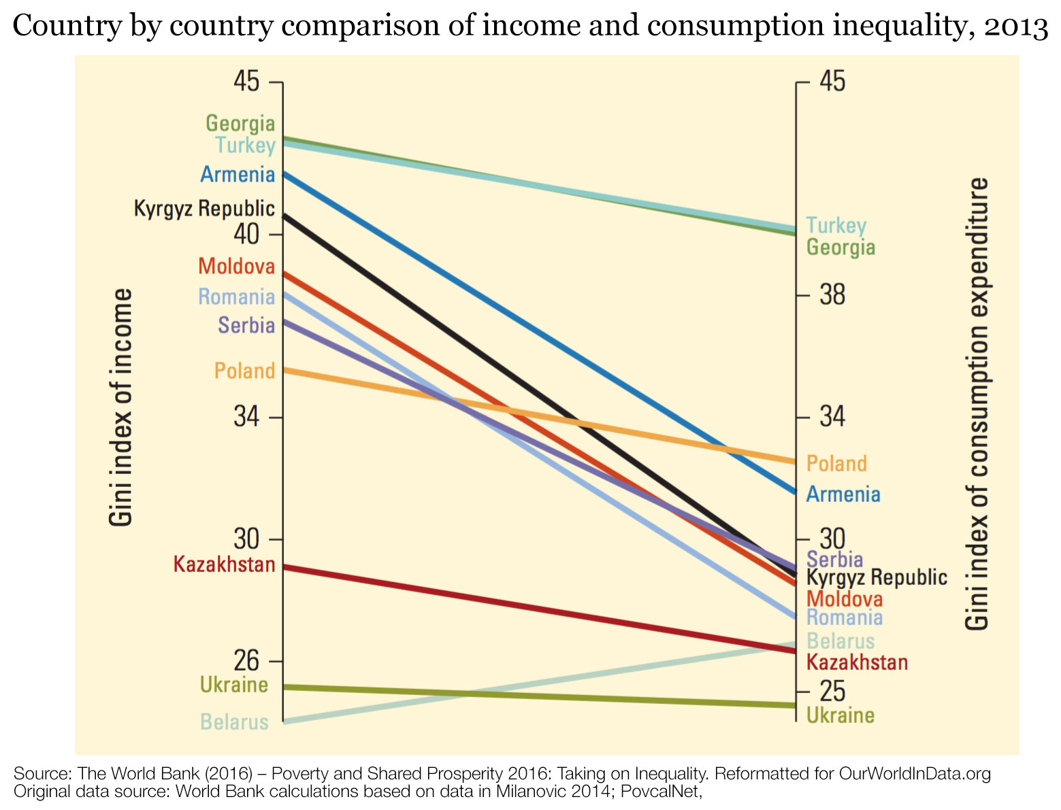
How does income inequality differ from consumption inequality?
Notes:
https://ourworldindata.org/income-inequality/#how-does-income-inequality-differ-from-consumption-inequality
As can be seen, consumption inequality in almost all countries is lower than income inequality. This is intuitive, since consumption can be smoothed over time, for example, by saving earned income. In principle, saving and borrowing allows agrarian societies to have consumption levels that are less volatile – and less reliant on seasonal variation – than incomes.⁸
Saving and borrowing is usually harder at low income levels; so consumption and income measures of inequality tend to be closer for poor populations. But as opportunities for saving and borrowing increase, important differences emerge. The following visualization shows that in middle-income countries differences are indeed substantial.

Slide 32
Income inequality isn’t going to go away, and
it probably will get worse. Only policies that directly address the problem — in particular, progressive taxation — can help us change course.
Thomas Piketty

Slide 33
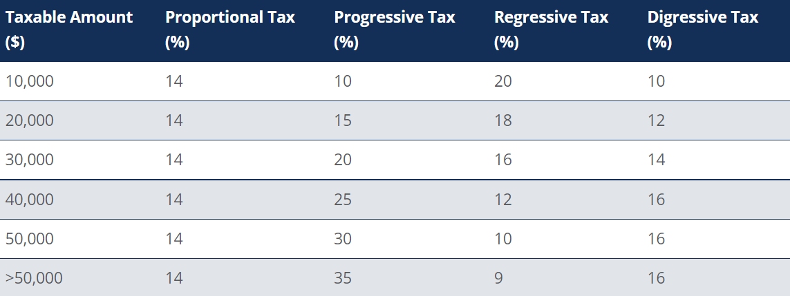
Progressive vs Regressive Tax System

Slide 34
Progressive vs Regressive Tax System
Take an example of a person earning $70,000 per annum, then his/her tax liability under the progressive tax system is as follows:
The first $10,000 at 10% = $1,000
The second $10,000 at 15% = $1,500
The third $10,000 at 20% = $2,000
The forth $10,000 at 25% = $2,500
The fifth $10,000 at 30% = $3,000
The excess of $20,000 at 35% = $7,000
The total tax liability will be $(1,000+1,500+2,000+2,500+3,000+7,000) = $17,000
The total tax liability is $17,000 on a taxable income of $70,000. This implies that the average tax rate will be $(17,000/70,000) = 24.3%. From the calculations, it is evident that the average tax rate of 24.3% is less than the marginal rate of 35%.

Slide 35
Progressive taxation
Additional tax revenue helps government to finance redistribution
Top marginal rate of taxation, corresponds to the tax rate that applies to the last dollar of income earned by the rich.
Personal income taxes should be made more progressive, with a maximum rate of 65 percent (suggested by Sir Tony Atkinson).

Slide 36
Last year my federal tax bill — the income tax I paid, as well as payroll taxes paid by me and on my behalf — was $6,938,744. That sounds like a lot of money. But what I paid was only 17.4 percent of my taxable income — and that’s actually a lower percentage than was paid by any of the other 20 people in our office. Their tax burdens ranged from 33 percent to 41 percent and averaged 36 percent.
Warren E. Buffett, 2011
https://www.nytimes.com/2011/08/15/opinion/stop-coddling-the-super-rich.html

Slide 37

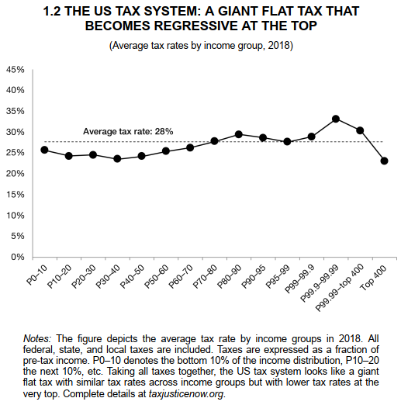
New Book by Saez and Zucman provides the most comprehensive estimates of income in the US:
In 2018 the average annual income of Americans was $75,000 (before tax and transfers)
Working class (bottom 50%, 122m) earns $18,500
Middle class (next 40%, 100m) earns $75,000
Upper middle class (9%, 22m) earns $220,000
Rich class (1 %, 2.4m) earns $1.5m
The average income tax is 28%
Working class pays 25% income tax
Middle class pays bit more
Upper middle class pays at around 28%
Rich pay at around 30%
400 richest Americans pay 23%.
https://taxjusticenow.org/#/

Slide 38
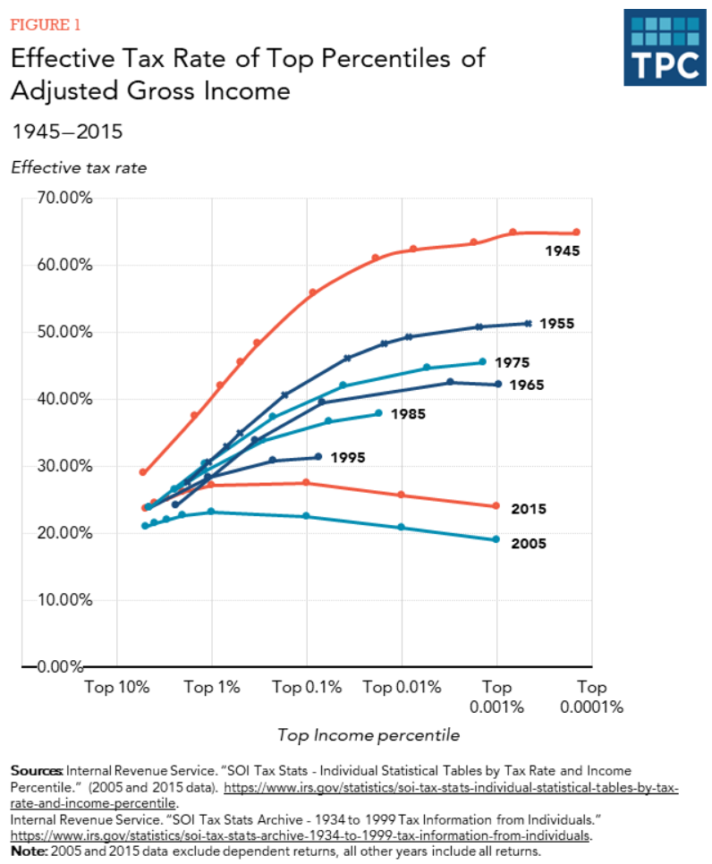

Slide 39
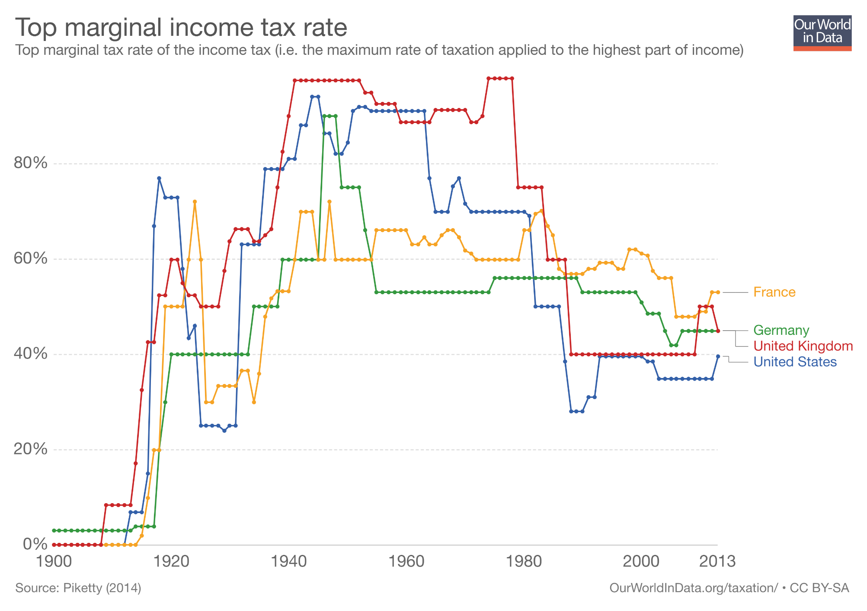

Slide 40
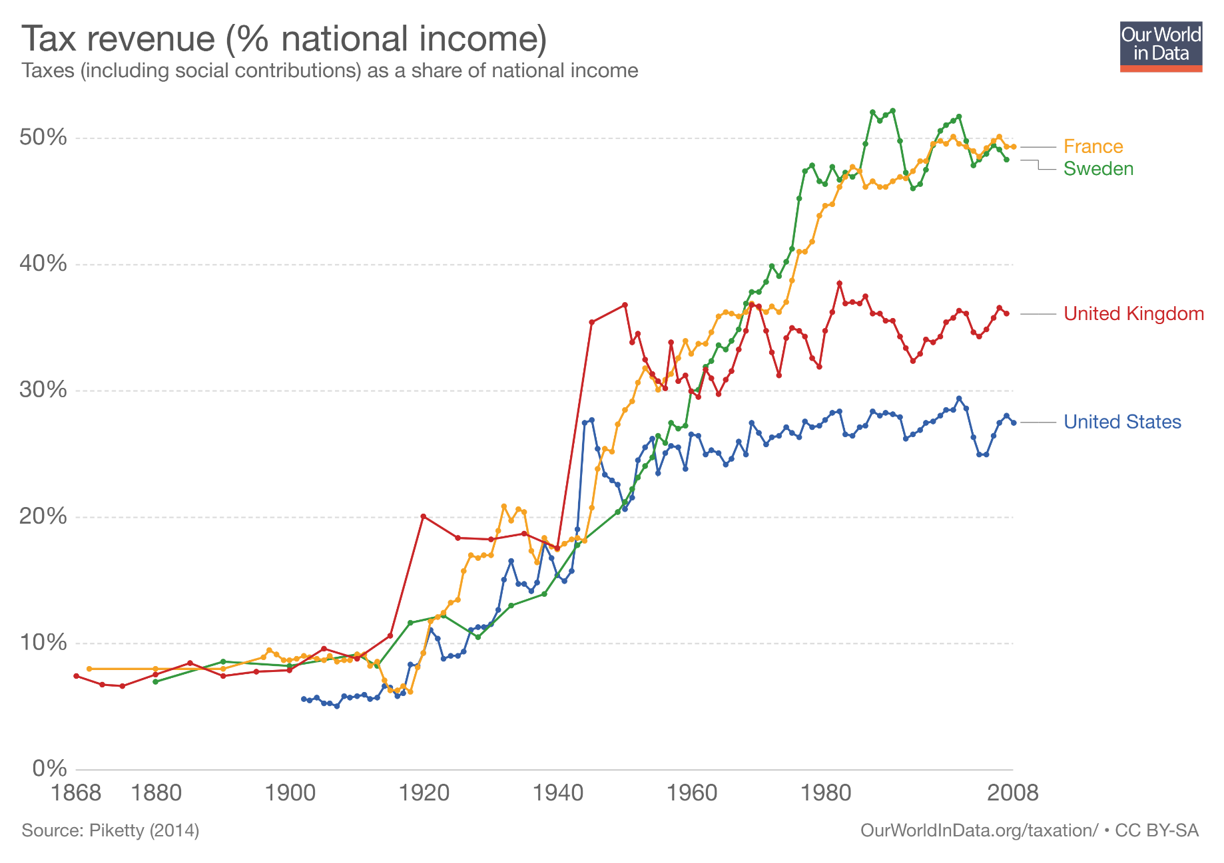
Until 1920 tax revenues were low across all these countries. Less than 10% of national income was collected through taxation (enough to maintain order and enforcing property rights).
After the WWI, taxation started growing considerably. In the period 1920-1980 taxation as a share of national income increased drastically, more than doubling across all these countries.

Slide 41
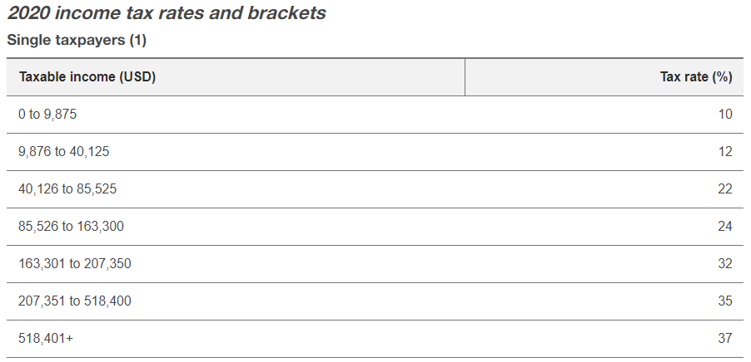
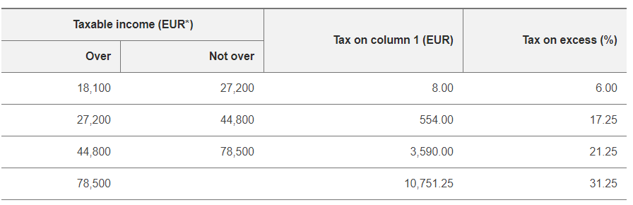
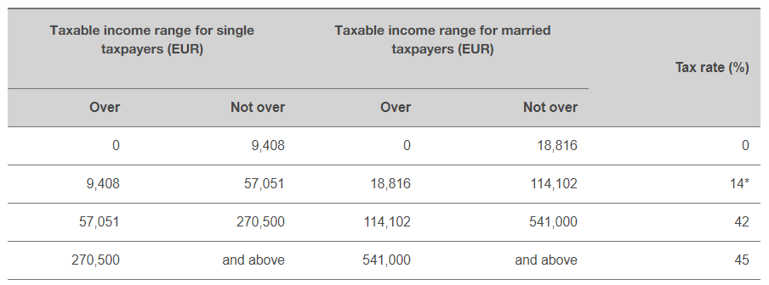
Personal income tax rates
United States
A
B
C
Q1: Which country has the least progresive tax system?
Q2: The highest marginal tax rate?
Finland
Germany

Slide 42
Cap on executive pay
The principle to govern the spread of pay between top and bottom
Swiss executive pay referendum, 2013
  Proposal to limit executive pay to 12 times that of the lowest paid (companies listed on the stock market)
  Voters rejected the proposal with a majority of 67.9% (with 46% turnout)

Slide 43

Book by Tony Atkinson (2015) presents concrete proposals aimed at reducing income inequality
  Progressive income tax
  Increase in minimum wage
  Universal Child Benefit
  Participation Income

Slide 44
Progressive income taxation
Additional tax revenue helps government to finance redistribution
Initial rate of 25%, intermediate rates of 35-55%, and a top rate of 65%.
Low-incomes tax only 20%

Slide 45
Participation Income
Universal (unconditional) basic income is big
Participation income is paid conditional on social contribution.
Paid to adults meeting a participation condition, that includes formal work, but also unpaid work such as caring for a child or an adult, seeking job training, doing voluntary work and include those unable to work.
Proposed by Tony Atkinson already in 1990s
https://onlinelibrary.wiley.com/doi/abs/10.1111/j.1467-923X.1996.tb01568.x

Slide 46
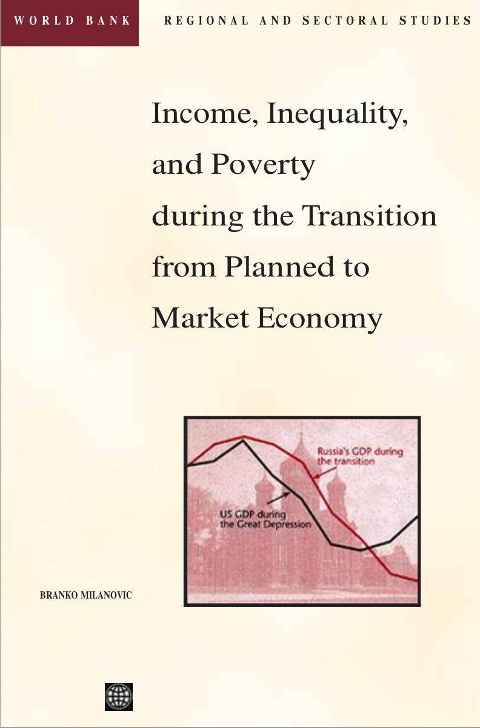
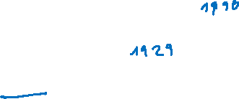

Slide 47
Situation in the communist countries before the fall of Iron Curtain
The defining characteristic of socialist countries was state ownership of the means of production.
On average, 90 percent of the labor force was employed by the state and most income was paid by the state.
All land was typically owned by state (Russia).
In some countries private agriculture was allowed (Poland, Yugoslavia, Bulgaria and Hungary).

Slide 48
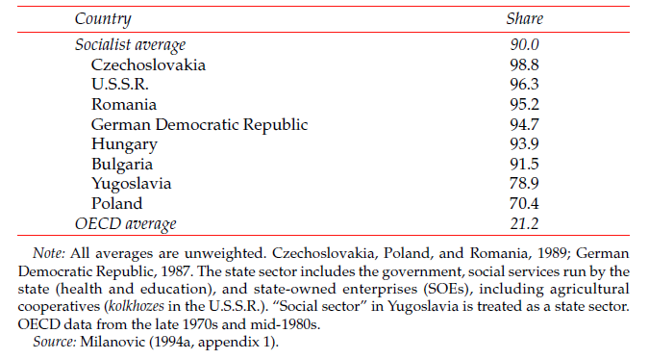
State employment as a proportion of the labor force in 1988 [%]

Slide 49
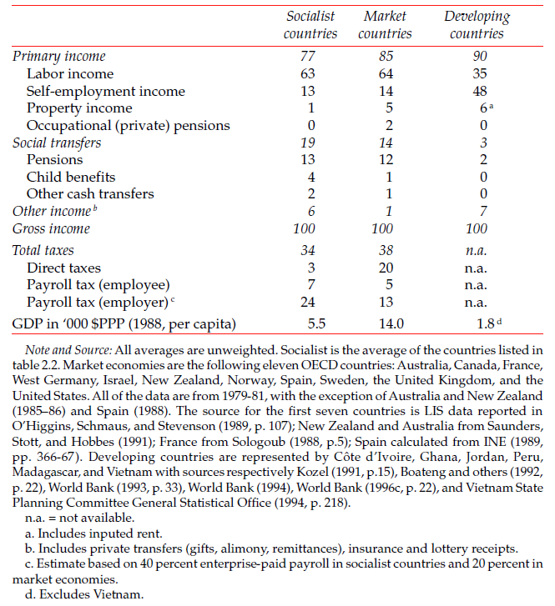
Composition of Gross Income in Socialist,
Market, and Developing Countries, 1980s

Slide 50
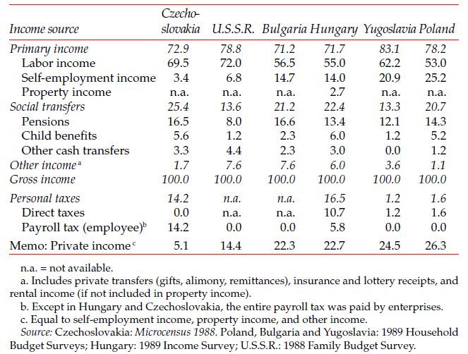
Composition of income, 1988
(gross income=100)
Notes:
the composition of household income in socialist countries
before the transition. Countries are arranged, from left to right, in the order of
the increasing importance of private sources in total gross income.1 At one
end of the spectrum is Czechoslovakia, where an almost total “socialization”
of agriculture and severe restrictions on non-agricultural private business
meant that only a small fraction (5 percent) of total income was not received
through state mediation. In the Soviet Union, approximately 14.4 percent of
gross income was derived from private sources. In Bulgaria, Hungary, Yugoslavia,
and Poland, the private income share was greater than 20 percent.
Labor income—virtually all of it derived from the state—ranged from 53
percent of total gross income (in Poland) to 72 percent (in the U.S.S.R.). Social
transfers ranged between 13 percent (Yugoslavia and the U.S.S.R.) and 25
percent (Czechoslovakia) of gross income.

Slide 51
Communist economies
Absence of property incomes
Small gaps between average pay of non-manual and manual workers
Low direct taxes (proportional or flat tax)
But total tax burden was high
Greater importance of income redistribution
High family allowances relative to wages
The Gini coefficient was in the range of 23-26 like in the very egalitarian Nordic countries

Slide 52
Centrally planned economy
Production dictated by Plan from above rather than in response to consumer demand
Total price control
In 1980s many countries experienced shortages of almost everything
Top party members and state officials got a privilege access to goods and lower prices.
Loyalty to the regime was a price for privilege.

Slide 53
The Armenian capital of Yerevan, had an ample supply of accordions but local people complained that they had gone for weeks without ordinary kitchen spoons or tea samovars.
(Hedrick Smith, 1976)
Leningrad can be overstocked with cross-country skis and yet go several months without soap for washing dishes.
(Hedrick Smith, 1976)
In Hungary, milk was packed in plastic bags and thus could not be sold the next day and had to be destroyed.
Because bread was overproduced in Hungary animals were fed on bread, not only on household plots (Shane 1994)
The accepted norm is that the Soviet woman daily spends two hours in line, seven days a week. (Hedrick Smith 1976)
Indeed, the crop failure was so serious that Russia was forced to buy wheat from the United States” (Hammond 1966)
People had to wait in lines and pay bribes to shopkeepers to obtain products that were common in the marked-based economies of the West.
A basic rule of thumb was: “If you see something for sale that you want, buy it, because tomorrow there probably won’t be any” (Hammond 1966)
Another common saying was, “If you see something for sale that you do not need, buy it anyway. You can trade it with others for what you need.”

Slide 54
Transformation process
Drop in GDP (by 33% and more)
Many local currencies have depreciated
High inflation & unemployment
State ownership replaced by private
Increasing share of informal economy
Political instability (7 countries in war, 8 mil refugees)
Rapidly increasing income inequalities

Slide 55
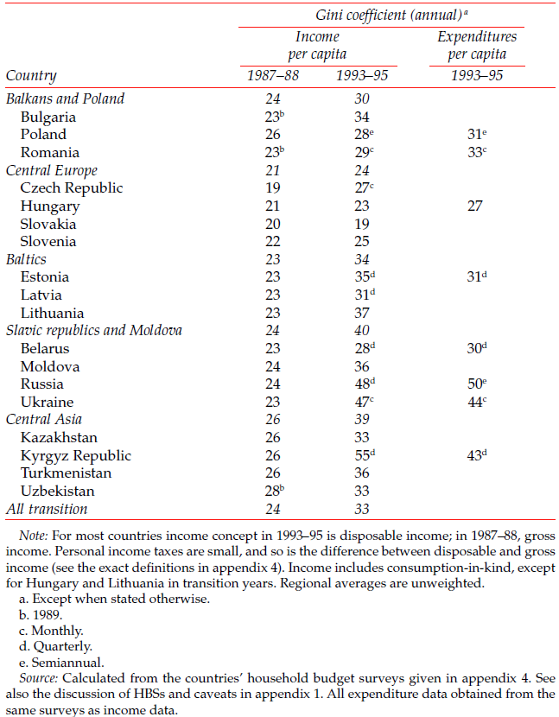
Inequality rises during the transition

Slide 56
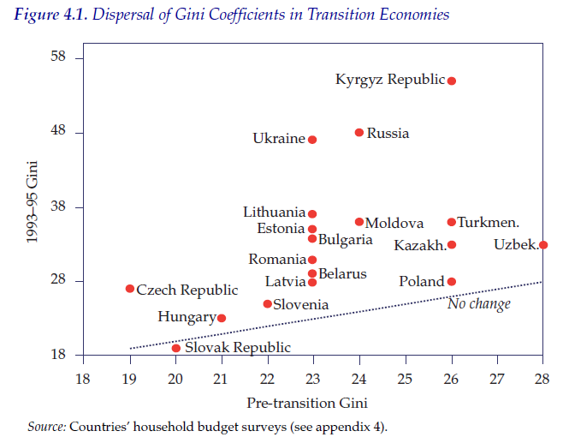

Slide 57
What is true about Gini coefficient?
The calculation of Gini coefficient does not consider the size of the economy
Gini coefficients can be used to measure the poverty across the world
The poorer countries have always higher Gini than rich societies
Gini stands for General Index of National Inequality

