Slide 1


Future labour force in ageing European societies: the role of human capital and migration
Michaela Potančoková, Ph.D.
Senior Research Scholar, Multidimensional Demographic Modelling group,
Population and Just Societies program @ IIASA
External lecturer in Global demography program, University of Vienna

Slide 2
Objective
Demographic shifts in Europe will affect future population sizes and labor supply, fear of negative consequences of population decline
Population composition changes -> educational expansion, longevity, working lives
Immigration often presented as a tool to (partly) mitigate the expected future labour force decline
How demographic multidimensional population projection methods are being used to explore future changes in populations, labour force (labour supply) and dependency

Slide 3
What is population ageing and why is it considered a challenge?

Slide 4
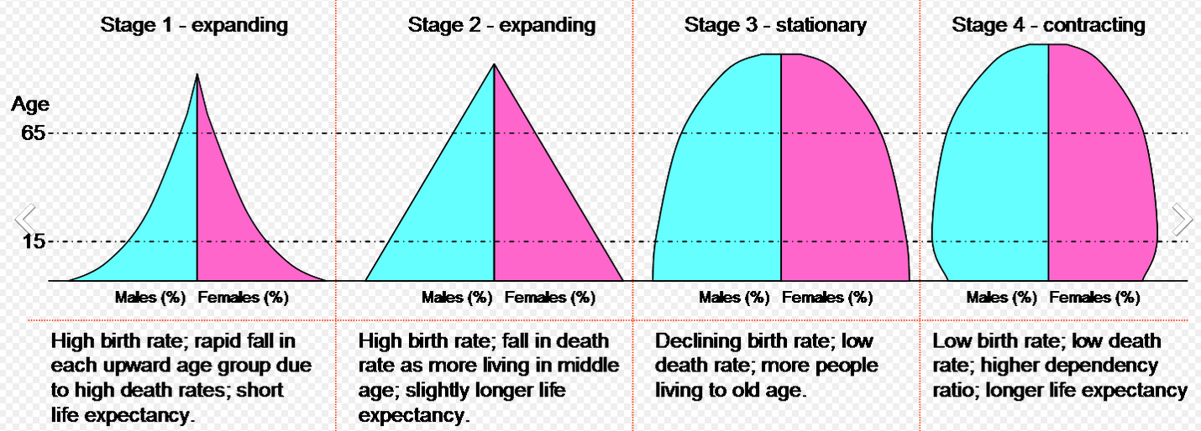
Population ageing
Demographic transition
Notes:
shift in distribution of a country's population towards older ages

Slide 5
Demographic transition & population ageing
Declining birth rates and longevity boost population in productive ages, a window of opportunity to harness benefits of expanding working age population and declining dependency-> demographic dividend (stage 3)
Stage 4: Increase in the elderly due to ageing from the top (increased longevity due to declines in mortality) and from the bottom of the pyramid (low, below-replacement level birth rates)

Slide 6
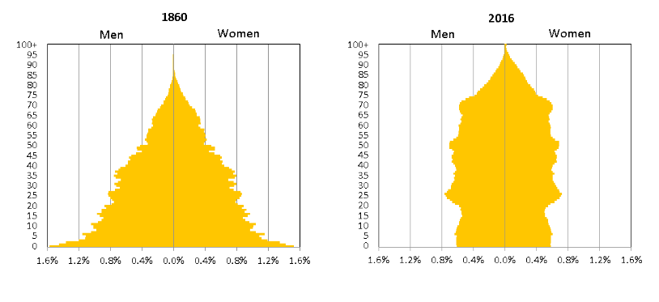
Population ageing in age pyramid
Source: Statistics Sweden

Slide 7
Demographic transition & population ageing
Declining population and working-age population in European countries and other industrialised countries
Increasing share of elderly and dependency
  posing challenges to the social security systems and the welfare state
  Posing challenges to public finances through increased health care expenditures
  deemed detrimental to prosperity, economic growth, productivity
In common narrative increasing age dependency is something to be mitigated

Slide 8

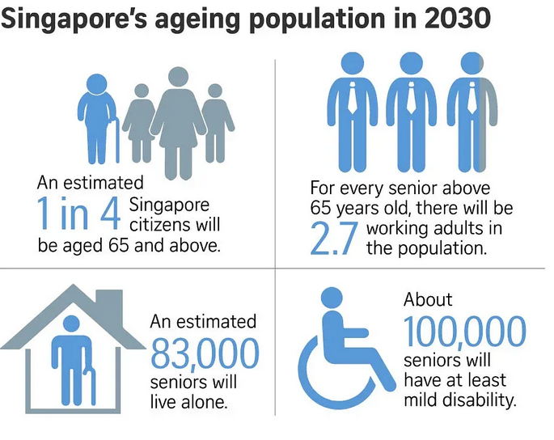

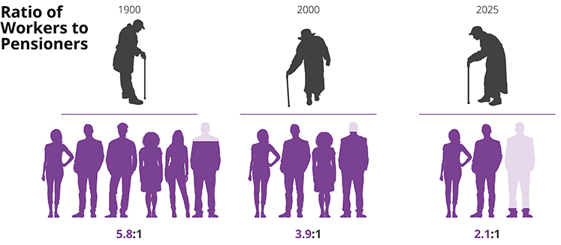
https://economictranscript.wordpress.com/2017/06/22/ageing-population-of-japan/

Slide 9
Demographic shifts in industrialised countries
Longevity -> longer lives (more survival to higher age)
Low birth rates
Population ageing – increase in number and share of older population
-> Smaller populations and labour force
Increasing human capital – educational expansion, health
-> Qualitatively different populations in the past and future
-> implications for labour force size, population structures (beyond age), labour force participation rates

Slide 10
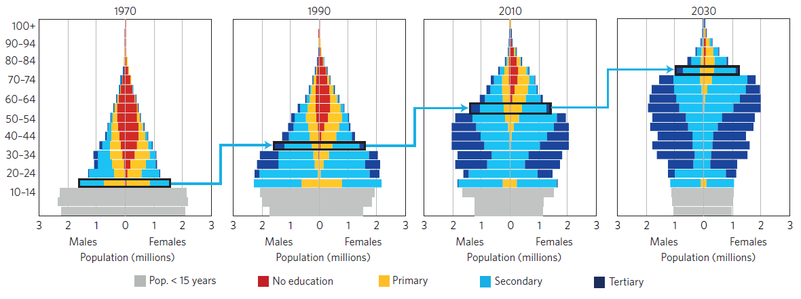
Demographic Metabolism:
Change of populations structures through generational replacement cohort turnover -> older generations replaced by better educated younger generations
Source: Lutz, et al (2018), http://dataexplorer.wittgensteincentre.org/wcde-v3/

Slide 11
Commonly used measures of population ageing
Share of population at age 65+
Age dependency ratio (ADR)
  ADR^{t} = Pop^{t} 0-14 + Pop^{t} 65+ / Pop 15-64
  OADR = Pop^{t} 65+ / Pop 15-64
  YADR = Pop^{t} 0-14 + Pop^{t} 65+ / Pop 15-64
  Different age limits can be used as cut offs – age 19, age 60
  Working age population (age 15-64) is not actual labour force, but potential labour force if everyone at that age was active at the labour market -> includes workers and non-workers
  Deficiencies / limitations of ADR:
    does not capture qualitative changes in working age population
    assumes that everyone at working age participates equally and is equally productive and everyone age 65+ assumed to be inactive and unproductive

Slide 12
Alternative dependency ratios
Prospective Age dependency ratio (Scherbov and Sanderson)
  POADR^{t} = Pop^{t} Pop^{t} with less than 15 remaining years of life / Pop 15-64
  Captures increases in longevity – 65 year olds 50 years ago different to those now and to people in the same age 50 years from now
  Improved cognitive skills, health -> potential for longer working lives
Labour force dependency ratio
  LFDR = inactive (non-workers)/ active at the labour market (workers)
  Takes into account that not everyone in working age equally participates in the LF and that not everyone age 65+ is inactive
Productivity-weighted dependency ratio
  Adds a weighting factor that approximates differences in productivity by through education-specific wage differentials
  Takes into account that not everyone is equally productive

Slide 13
Do you think all EU countries will see rapidly shrinking labour force?

Slide 14
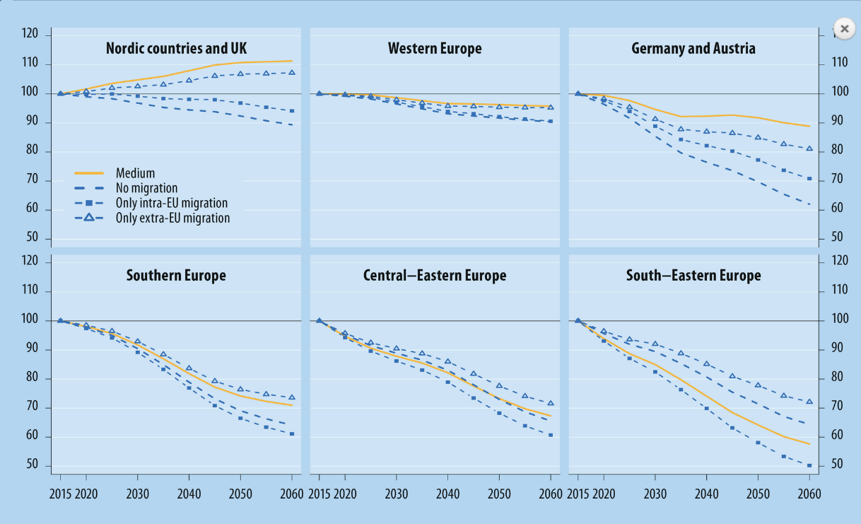
Projected change in working age population (20-64)
Relative change in working age population (2015= 100)
Source: Potancokova et al (2021)
Potancokova et al. (2021): short explanation in European demographic data sheet 2022 @ www.populationeurope.org

Slide 15
Multidimensional population projections
Population projection widely used to inform policy options -> need to go beyond standard population projections by age and sex and to capture population heterogeneity
A useful tool to simulate future scenarios for better informed evidence-based policies to address demographic challenges and assess their consequences of population ageing in broader perspective
WiC Global human capital projections: Education stands out as differentiating factor of demographic behaviours
http://dataexplorer.wittgensteincentre.org/wcde-v3/
Extensions to demographic modeling of labour supply
Numerous scenarios and simulations show that reversing or even slowing down population ageing is not a viable policy option
Extension to migration scenarios (CEPAM, QuantMig) and ongoing work on modelling skills (Liknk4Skills)

Slide 16
Demographic modelling of labour supply
Option 1: Multistate cohort-component population projection by age, sex, educational attainment and labour force participation
Option 2: Dynamic microsimulation population projection model with multiple status variables and stochastically modelled transition rates
What we take into account in modelling?
Mortality differentials by education -> higher edu associated with longevity (and better heath)
Fertility differentials by education -> higher edu associated with higher childlessness and lower fertility (for women)
Emigration rates by age and immigration volumes as during 2010-2016
Fixed educational composition of immigrants
Educational expansion modelled using cohort trends in past educational attainment
Differences in labour force participation by age, gender and education

Slide 17
What do we know about gaps in labour force participation?
Depends on age -> lower before age 25 and after age 60
Depends on gender -> different age patterns due to parental leave
Depends on educational attainment -> lower for those with lowest qualifications and highest for highly-educated
Educational attainment is closely associated with LFP and employment
Notes:
Labour force participation of immigrants is lower than of EU-born
Inequality between men and women among native-born and immigrant women

Slide 18
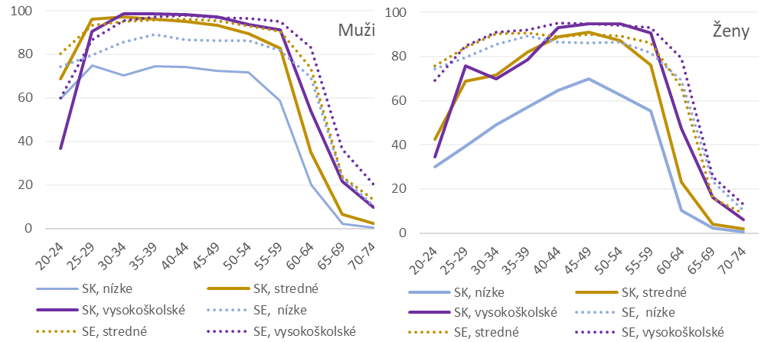
LFPR by age, gender and education, men and women
Slovakia 2014-2019, LFS

Slide 19
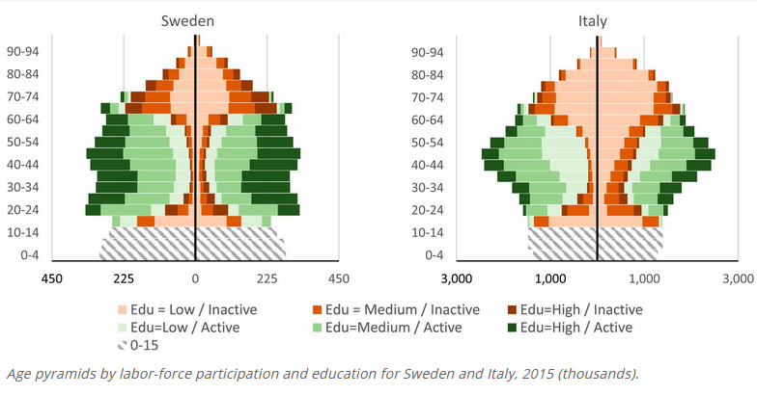
Differences in labour force activity across EU countries
Highest LFPRs
Lowest LFPRs
Source: Marois, Belanger and Lutz (2020)Population aging, migration, and productivity in Europe. PNAS 117(14) https://doi.org/10.1073/pnas.1918988117

Slide 20
Differences in labour force activity across EU countries
Highest LFPRs
Lowest LFPRs
Source: Marois, Belanger and Lutz (2020)Population aging, migration, and productivity in Europe. PNAS 117(14) https://doi.org/10.1073/pnas.1918988117

Slide 21
When we consider educational expansion, higher female labour force participation and longer working lives what are the implications for future labour force sizes?
Constant scenario: fixed LFPR by age, sex, education
Equalisation scenario: women reach the same LFPR as men at equivalent age and education
Swedish scenario: by 2040 men and women in all EU countries will reach labour force participation as in Sweden

Slide 22
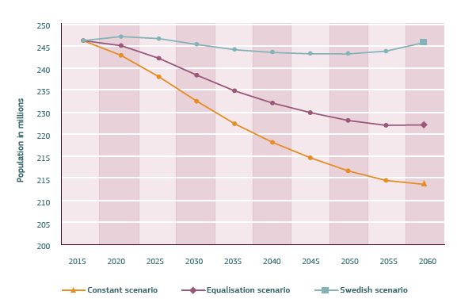
When we consider educational expansion, higher female labour force participation and longer working lives can stabilize labour force size in the EU28
Constant scenario: fixed LFPR by age, sex, education
Equalisation scenario: women reach the same LFPR as men at equivalent age and education
Swedish scenario: by 2040 men and women in all EU countries will reach labour force participation as in Sweden

Slide 23
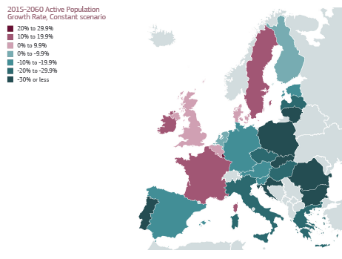
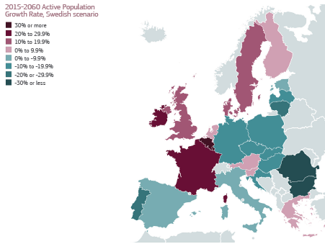

Slide 24
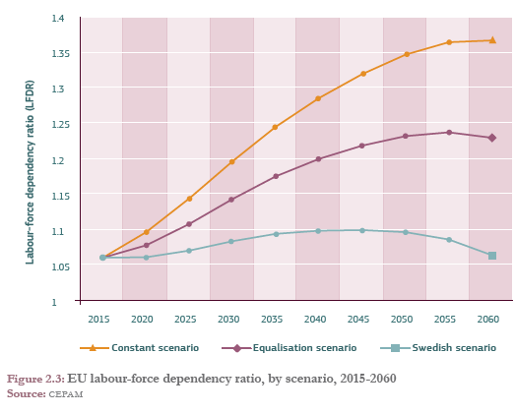
Projected labour force dependency ratio in EU28
(inactive / workers)

Slide 25
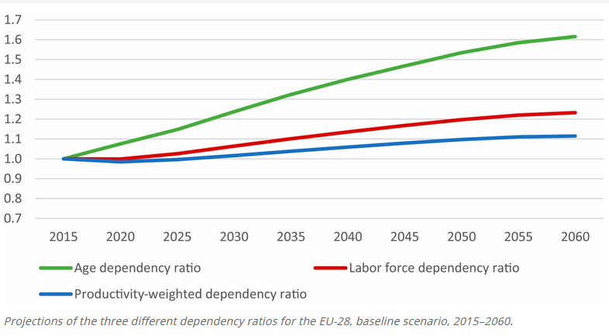


When we consider that productivity is associated with educational attainment, future dependency ratios look less daunting for EU-28
Age dependency ratio (ADR)
Labour force dependency ratio (LFDR)
Productivity-weighted dependency ratio:
estimated productivity weights for Active population are set at 1 for medium education, 1.66 for high education, and 0.62 for low education
Source: Marois, Belanger and Lutz (2020)Population aging, migration, and productivity in Europe. PNAS 117(14) https://doi.org/10.1073/pnas.1918988117

Slide 26
What other feasible ways to address the labour force decline can you think of?

Slide 27
Policy debate
Increase labour force participation of women
Longer working lives: higher retirement age, active aging
Increase birth rates to stabilize and prevent future decline in the labour force
Activate locally available human capital – activation, reskilling, upskilling
Immigration
  Replacement migration – how many immigrants would be needed to stabilize population, working age population, dependency ratios…
  Skilled labour – recognition of foreign degrees, matching demand and supply
  Access to labour market for different types of migrants beased on residence permits
Curb emigration, incentivize return migration

Slide 28
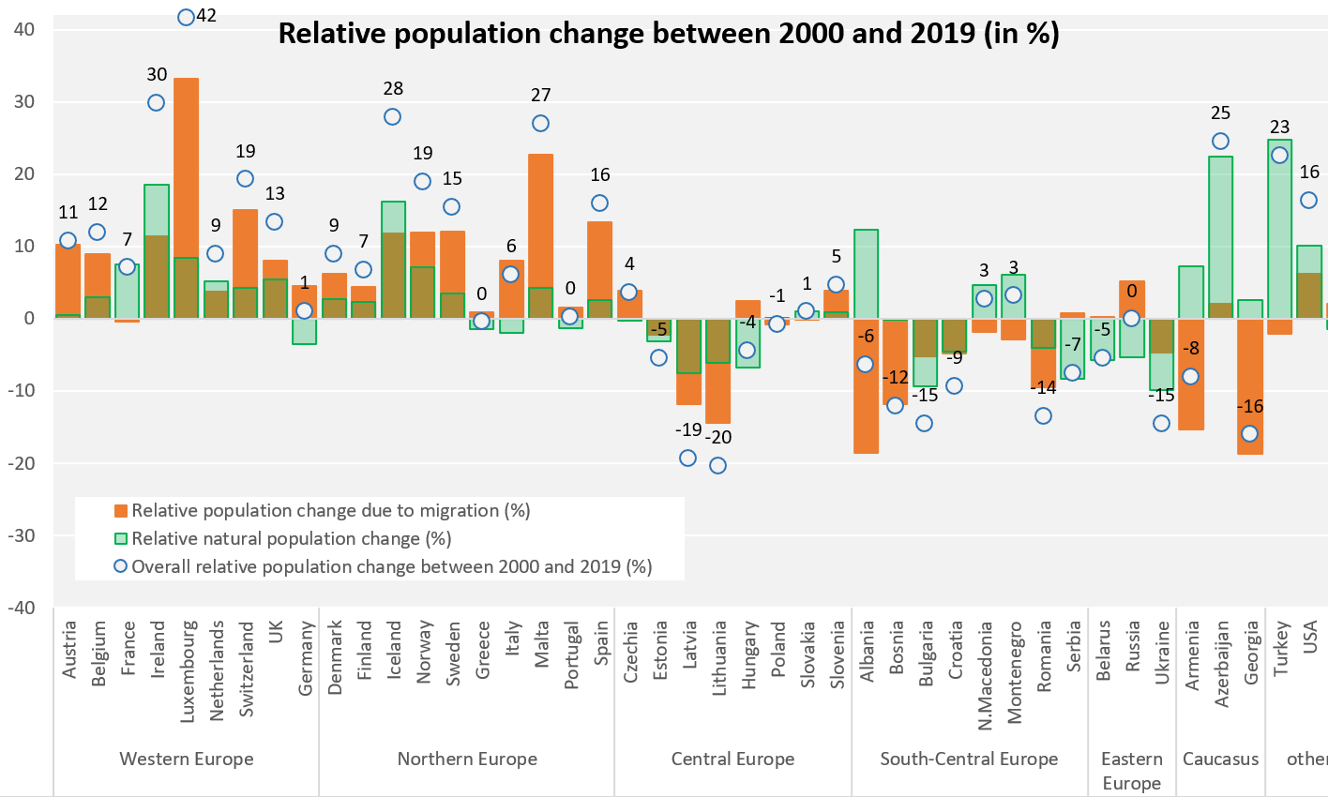
Impact of Migration and Fertility on Population Growth in the UK
European Demographic Data Sheet 2020

Slide 29
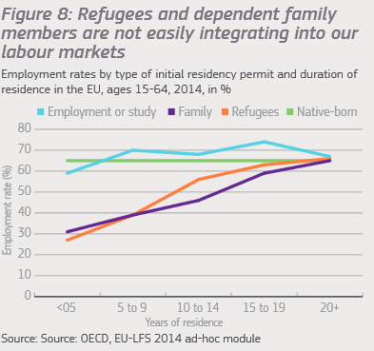
Scenarios of migration impact on future labour force
Immigration often presented as a tool to improve the expected labour force decline
But shift towards rights-based migration policy implies a need to remove barriers for better integration of (some groups of) immigrants into labour market
What would be the long-term impacts of improved or worsened economic integration of immigrants on labour supply and employment?
Source: EPSC (2018)
Notes:
Successful economic integration of immigrants is of high importance as it fosters also their social, linguistic and cultural inclusion and improves the quality of life of migrants, their families and empowers communities. Immigrants' better economic integration is highly needed also against the backdrop of the unavoidable future smaller labour force sizes in the EU overall and in practically all Member States.
we focus on supply of labour driven by structural changes in potential labour force and we do not aim to simulate economic context, labour demand or changes in employment due to economic cycles. Also, there are no feedback effects included and labour force activity and employment depend purely on individual characteristics.

Slide 30
What do we know about gaps in labour force participation of immigrants?
Labour force participation differs between EU-born and (different groups of) immigrants
Notes:
Labour force participation of immigrants is lower than of EU-born
Inequality between men and women among native-born and immigrant women

Slide 31
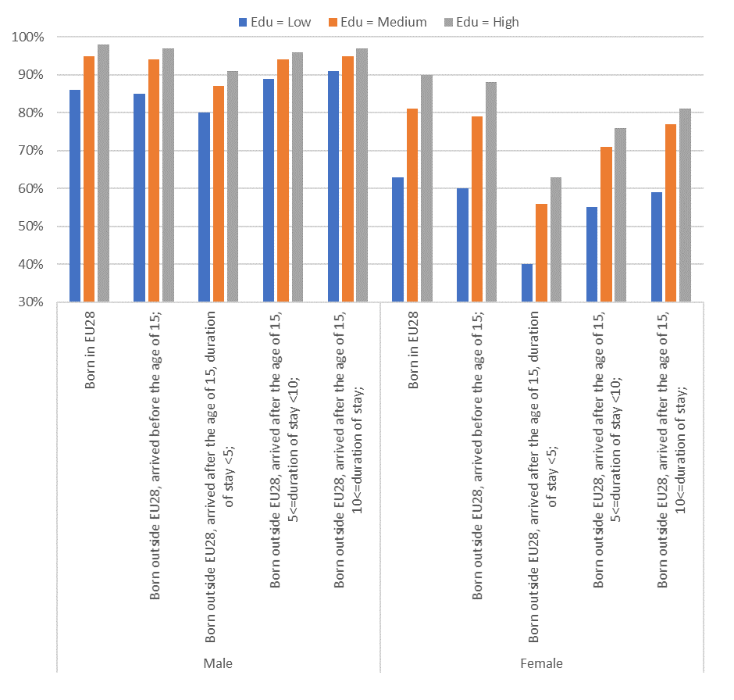
Labour force participation rates at age 35-39, EU28
MEN
WOMEN
Data: EU-LFS 2010-2016
Notes:
What do we know about gaps in labour force participation and employment of immigrants?
I will illustrate this with some descriptive results from EU-LFS analysis

Slide 32
Labour force participation rates at age 35-39, EU28
MEN
WOMEN
Data: EU-LFS 2010-2016
Notes:
Educational attainment is closely associated with LFP and employment

Slide 33
Labour force participation rates at age 35-39, EU28
MEN
WOMEN
Data: EU-LFS 2010-2016
Notes:
For men, labour force participation rate reaches similar levels to natives after 10 years of stay, while it stays way lower for women.
For women, the gap compared to female EU-born is wider and is never completely closed. Among low educated recent immigrants, the participation rates is 23 percentage points lower compared to EU-born women (40% vs. 63%). After 10 years, their participation rates, though improving, are still below the rates of EU-born (59%). For highly educated women born out of the EU the pattern is similar pattern but the gap to the EU-born women is wider after 10 years (81% vs 90%) compared to low-educated women (59% for non-EU-born compared to 63% for EU-born).
The effect of education is smaller for immigrants, especially for women. These lower returns on education could be partly explained by lower quality degrees in source countries, as well as by cultural differences in the definition of gender roles (Inglehart and Norris 2003; Antecol 2000). Reasons for immigration may play a role and one could expect higher labour force participation rates among immigrants coming as students or on economic grounds. In contrast, one can expect lower labour force participation rates, at least in the first years after immigration, among female immigrants arriving on family reunification grounds because in their case migration and family formation are directly interlinked. Studies on fertility outcomes of immigrants show elevated fertility rates in the first year after migration particularly for those arriving for family reunification (Rosero-Bixby et al. 2011; Mussino and Strozza 2012). A decision to have a child shortly after the arrival into the host country can also be linked to poor employment prospects in the destination country (Kulu and Milewski 2007).

Slide 34
What do we know about gaps in labour force participation of immigrants?
Labour force participation differs between EU-born and (different groups of) immigrants
LFP associated with educational attainment for both natives and immigrants
For immigrants increases with duration of stay -> catching up native levels
Immigrants who arrived as children similar outcomes as native-born
Gaps to natives more pronounced for women
Educational attainment matters but the gap never closes for immigrant women even, even after controlling for education
Women face higher unemployment in addition to lower activity rates
Notes:
Labour force participation of immigrants is lower than of EU-born
Inequality between men and women among native-born and immigrant women

Slide 35
Unemployment rates at age 35-39, EU28
Data: EU-LFS 2010-2016
Notes:
First, unemployment rates of immigrants are much higher than those of EU-born, and, second,

Slide 36
Unemployment rates at age 35-39, EU28
Data: EU-LFS 2010-2016
Notes:
unlike in the case of labour force participation rates there is no evidence of improvement with the duration of stay. After 10 years of stay, the unemployment rates of immigrants with medium or high level of education remain more than double the rate of EU-born. This is true for both genders and holds for all levels of education.
unemployment rates are particularly high for male immigrants who arrived during childhood and attained only low level of education. Their unemployment rate is about 7 percentage points higher than natives’ ones with the same level of education (23% vs. 16%). The unemployment rates of female immigrants who arrived during childhood and for male immigrants arrived during childhood and attained medium or high level of education are also higher than those of EU-born but the gap is narrower.
Third, the positive effect of education on employment rate holds for both EU-born immigrants from outside EU, but it is less pronounced for migrants than for EU-born. The unemployment rate for EU-born with a high level of education is about four times lower than the rate of their low-educated counterparts (for both men and women, but at different levels of unemployment). Among immigrants that live in EU since more than 10 years the gradient holds as well but the unemployment rate of highly educated is only about half of the low educated.

Slide 37
Unemployment rates at age 35-39, EU28
Data: EU-LFS 2010-2016
Notes:
Women face higher unemployment in addition to lower activity rates
Labour force participation rates of immigrant women do not reach the level of natives in any of the countries that host larger immigrant populations. Gender inequity in terms of labour force participation appears to be an issue affecting immigrant women more strongly than EU-born women, which supports the double disadvantage theory (Boyd 1984; Ballarino and Paniche
Second,
Large regional variations are, however, observed within the EU. In Denmark, where immigration inflows are dominated by asylum seekers and family reunification immigrants (Liebig 2007), the situation even appears to deteriorate with time for male immigrants, as β8 drops from -1.078 for recent immigrants to -1.692 admitted more than ten years ago. In contrast, Spain emerges as a special case, with no clear differences in LFPRs between male immigrants and native-born population / men.
lla 2017).

Slide 38
Scenarios of economic integration of immigrants from outside the EU28
Scenarios to help assess the long-term impact of better or worsened economic integration of immigrants
Not predictions or plausible scenarios but stylized situations (what-if scenarios) representing a range of policy outcomes
Assumptions on LFPR at fixed demographic and educational trends, and at fixed volume and composition of immigrantion flows

Slide 39
What we take into account in modelling?
Fertility differentials by education, region of birth, migration status and duration of stay in the country
Differences in labour force participation by age, gender, education, region of birth and duration of stay
Differences in migration rates between the native-born, born in the EU+ and born outside the EU+
Immigrants pulled into destinations along established migration corridors

Slide 40
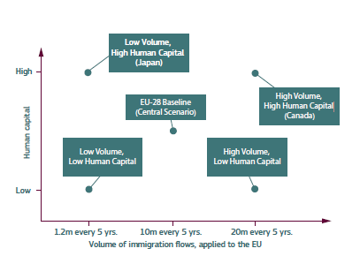
CEPAM scenarios to examine the impact of immigration on future labour force in the EU

Slide 41
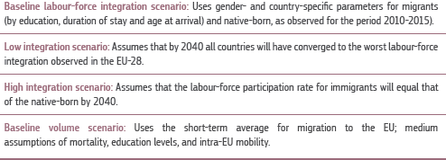
Scenarios to examine the impact of immigration on future labour force in the EU

Slide 42
What-if scenarios of improved or failed integration:
Component | 1-Volume of immigration into EU+UK | 2-Educational composition of immigrants | 3-Integration of immigrants in the labor force | 4-Labor force participation trends for EU-born
i. Baseline | 10M/5 years | Same as recent immigrants | Average of 2010-2016 | Constant entry and exit rates
ii. Baseline/Swedish_LFP | 10M/5 years | Same as recent immigrants | Average of 2010-2016 | Rates reach those of Sweden
iii. Baseline/high integration | 10M/5 years | Same as recent immigrants | Rates reach those of native-born by 2040 | Constant entry and exit rates
iv. Baseline/low integration | 10M/5 years | Same as recent immigrants | Rates reach those of immigrants in Denmark by 2040 | Constant entry and exit rates
v. Canadian | 20M/5 years | Same as recent immigrants in Canada (53% highly educated) | Average of 2010-2015 | Constant entry and exit rates

Slide 43
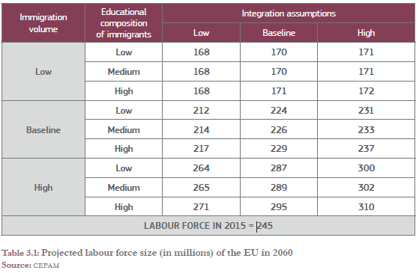
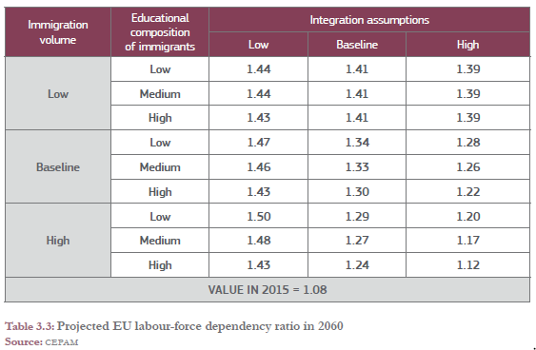
Projected labour force size in EU28
Projected labour force dependency ratio in EU28

Slide 44
Projected labour force by integration scenarios
(constant educational attainment of immigrants as in recent past)
Relative change in projected total labour force,
Austria
Projected labour force dependency ratio,
Austria
(inactive/active)
Labour force by ILO(LFS) definition - includes job seekers
Source: CEPAM projections
44

Slide 45
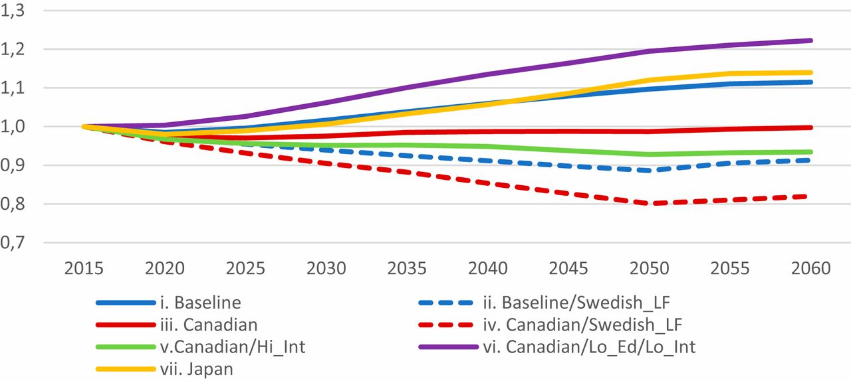
Projection of the productivity-weighted labor-force dependency ratio (inactive / active) for the EU-28 under different scenarios, 2015–2060
Labour force dependency ratio in the EU28 – improved economic integration is paramount under high migration flows
Source: Marois, Bélanger and Lutz (2020) PNAS.

Slide 46
Negative impacts of population ageing on labour supply can be mitigated by changes in migration (education-selective & high integration) AND increased labor force participation
Age pyramids disaggregated by labor force participation and education for the EU-28 in 2015 and 2060 under different scenarios
High & selective migration + high LFP
ADR=1.0
PWLFDR=1.0
ADR=1.6
PWLFDR=1.1
ADR=1.5
PWLFDR=0.8
Source: Marois, Bélanger and Lutz (2020) PNAS.
Notes:
demography is not destiny and policies can make a decisive difference

Slide 47
How would high immigration events impact future demographic trends and labour force?
Volatility and unpredictability of migration
Past political events linked to large migration events to Europe
Uncertainty about future migration quickly increases already in short time horizons (Baker and Bijak 2021)
Much of uncertainty about future migration is irreducible and driver environments are complex (Bijak and Czaika 2020)
How to reflect the uncertainty against the backdrop of the past unexpected large immigration, such as from Syria and Ukraine, in scenarios?
What would be long-term demographic impacts of High migration events emerging from different origins ?
Data source: Statistik Austria

Slide 48
Framework for quantifying rare migration events
We cannot predict but we can simulate what-if scenario
To predict we would need to know/assume: onset, magnitude, duration and origin
Inspiration from contingency planning -> Bijak (2023) pioneers use of selected quantiles from the upper tails of the heavy-tailed probability distributions that approximate volumes of migration for selected frequency of occurrence of a migration event
The method is based on statistical approaches to modelling rare events, including the extreme value theory (Coles 2001)
Rare / extreme events have certain frequency of occurrence and magnitudes
In this presentation: migration corresponding to twice-in-a-century event (0.98 quantiles from Pareto distribution) fitted to harmonised origin-destination-specific migration flows estimates between EU+ countries and 8 world regions (by Aristotelous et al. 2022)
48

Slide 49
High migration events scenarios
What-if scenarios simulated one by one as either short or persistent immigration event from each world region Short event: twice-in a century flows in one single year in 2025-2029 period
Persistent event: increased immigration from High migration event region follows for 10 years, with gradually declining intensity due to family reunifications, migration networks and other reasons (after 10 yeas same flows from that region as in the baseline scenario)
short
}
Twice-in-a-century
(High migration event)
With persistence
from: Other Europe
North Africa
Sub-Saharan Africa
West Asia
South & South-East Asia
East Asia
Latin America
Once-in-a-decade
(Migration event)
short
With persistence
49

Slide 50
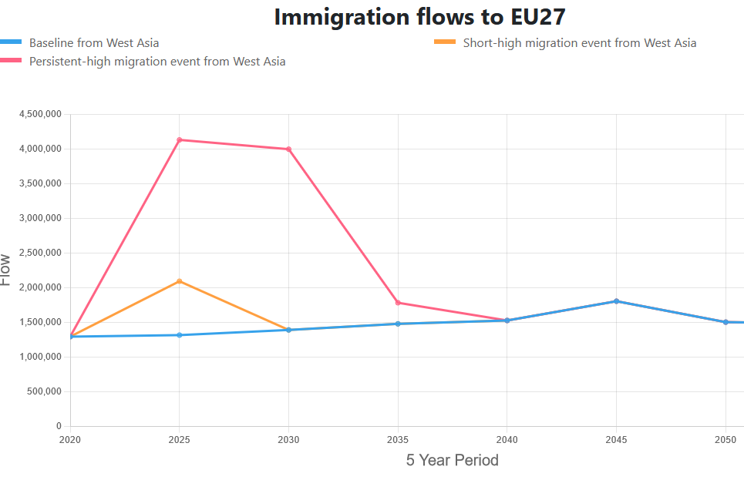
High migration events scenarios
What-if scenarios simulated one by one as either short or persistent immigration event from each world region Short event: twice-in a century flows in one single year in 2025-2029 period
Persistent event: increased immigration from High migration event region follows for 10 years, with gradually declining intensity due to family reunifications, migration networks and other reasons (after 10 yeas same flows from that region as in the baseline scenario)
short
Twice-in-a-century
(High migration event)
With persistence
X 7 regions of birth outside EU+
= total 28 scenarios
Other Europe
North Africa
Sub-Saharan Africa
West Asia
South & South-East Asia
East Asia
Latin America
50

Slide 51
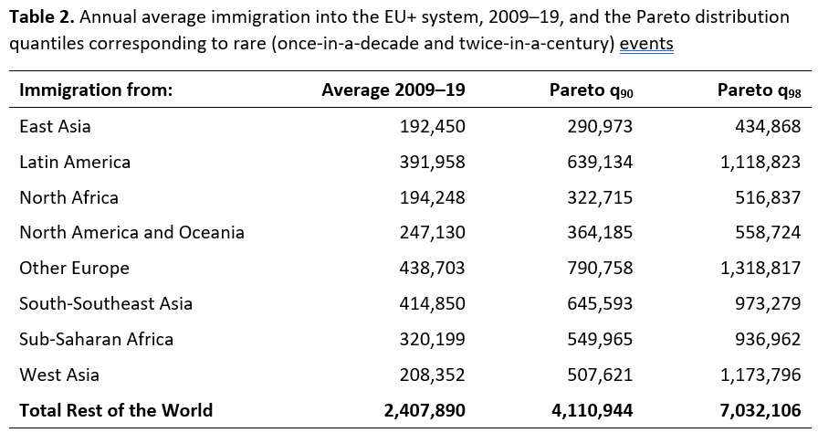
Rare migration events of immigration into EU+ from 8 world regions
Source: Bijak 2023, Deliverable 9.4
51

Slide 52
Results from twice-in-a-century immigration events
Scenarios simulating Immigration event from different world regions in 2025-2029
A surplus of immigrants arrives from a specific world region
What would change compared to the baseline?
 | Twice-in-a century migration event with persistence (millions)
 | 2020-2024 | 2025-2029 | 2030-2034 | 2035-39 | 2040-2044
Baseline immigration form the rest of the world | 15.3 | 11.9 | 12.2 | 12.7 | 13.0
+ event from Other Europe | 0 | +2.7 | +2.5 | +0.3 | 0
+ event from Sub-Saharan Africa | 0 | +2.5 | +2.3 | +0.3 | 0
+ event from North Africa | 0 | +1.4 | +1.3 | +0.2 | 0
+ event from West Asia | 0 | +3.2 | +2.9 | +0.3 | 0
+event from South&South-East Asia | 0 | +2.7 | +2.4 | +0.3 | 0
+event from East Asia | 0 | +1.2 | +1.1 | +0.1 | 0
+event from Latin America | 0 | +3.0 | +2.8 | +0.3 | 0

Slide 53
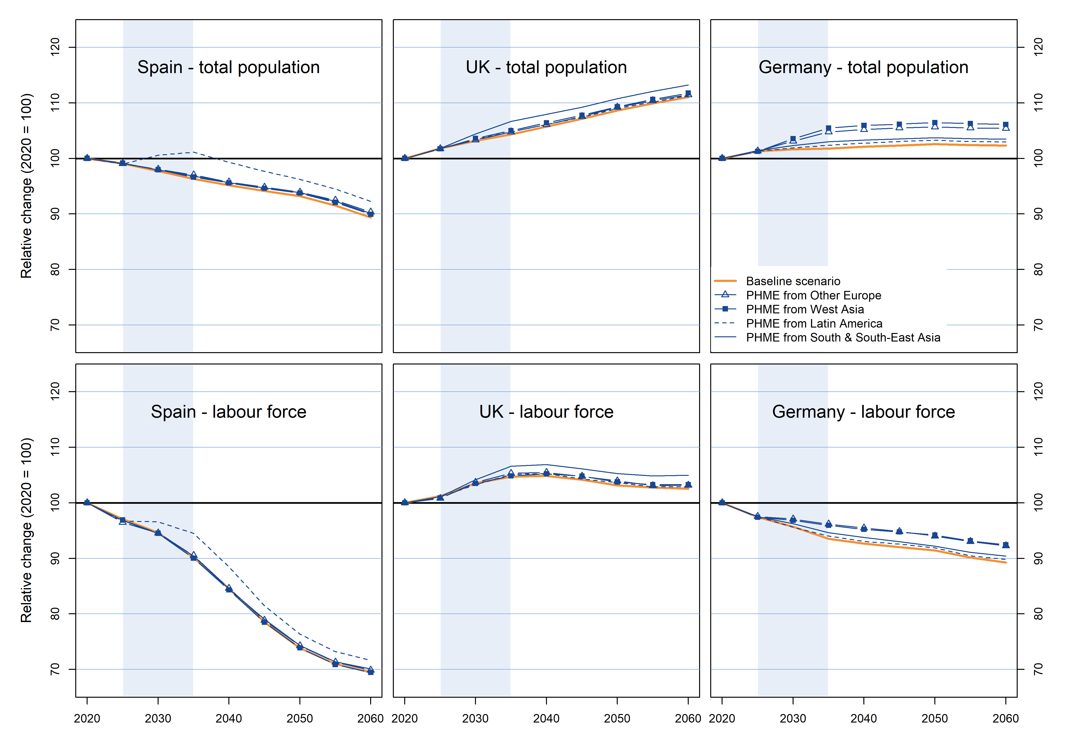
High-migration events projection scenarios key results

Slide 54
Projected total labour force – Twice-in-a-century immigration with persistence

Slide 55
Key messages and recommendations
Most EU countries will experience sizeable labour force declines in future
Positive effect of educational expansion – better educated LF but also better educated elderly -> potential for longer working lifes
Impacts of population ageing not as grim as when only LF size and age dependency considered
Inclusive policies that nurture human capital and remove barriers to labour force participation are feasible policy options that must be considered vis a vis immigration
Increased LF participation of women (and in particular immigrangt women) to LF would boost LF and can stabilize LFDR
Unrealistically sustained immigration would be needed to slow down population ageing and stabilize age dependency ratios -> not a feasible migration policy target
A lot is at stake if immigration is high but LF integration and inequality in educational achievent among migrant’children must be tackled

Slide 56
How to interpret / understand demographic scenarios
Not predictions
Some are forecasts – best guess at most plausible future given the knowledge at the time of creation
What-if scenarios – modify assumptions and provide an outlook given those assumptions
Medium / baseline scenario – business as usual, can be a forecast
Alternative scenarios – usually try to cover scenario space given a rage of possible future developments
Quantitative, narrative-based
Understanding assumptions crucial to their interpretation
Long-term scenarios for better preparedness and assessment of policy options

Slide 57
Limitations
Demographic scenarios based on characteristics approach - > how compositional changes in populations affect the outcome indicator
Abstract from the economic cycle
The association between the characteristic and the outcome can change in the future
Focus on labour supply, not linked to labour demand
How to account or automation, changing nature or work, skills matching

Slide 58
references
Potančoková, M. et al. (2023) Discussion paper:
Potančoková, M. , Stonawski, M.J. & Gailey, N. (2021). Migration and demographic disparities in macro-regions of the European Union, a view to 2060. Demographic Research 45, 1317-1354. 10.4054/DemRes.2021.45.44.
Marois, G. , Bélanger, A. & Lutz, W. (2020). Population aging, migration, and productivity in Europe. Proceedings of the National Academy of Sciences, e201918988. 10.1073/pnas.1918988117.
Marois, G. & Potančoková, M. (2020). Scenarios of labour force participation and employment integration of immigrants in the EU: demographic perspective. Publications Office of the European Union 10.2760/021884.
Lutz, W., Amran, G., Belanger, A., Conte, A., Gailey, N., Ghio, D., Grapsa, E., Jensen, K., Loichinger, E., Marois, G. et al. (2019). Demographic Scenarios for the EU: Migration, population and education. Publications Office of the European Union , Luxembourg. 10.2760/590301.
Marois, G. , Sabourin, P. & Bélanger, A. (2019). How reducing differentials in education and labor force participation could lessen workforce decline in the EU-28. Demographic Research 41, 125-160. 10.4054/DemRes.2019.41.6.
Loichinger, E. & Prskawetz, A. (2017). Changes in economic activity: The role of age and education. Demographic Research 36 1185-1208. 10.4054/DemRes.2017.36.40.
Sanderson, W. & Scherbov, S. (2019). Prospective Longevity: A New Vision of Population Aging. Cambridge, MA: Harvard University Press. ISBN 978-0-06-7497561-3
Lutz, W. & K.C., S. (2011). Global human capital: Integrating education and population. Science 333 (6042), 587-592. 10.1126/science.1206964.

Slide 59
Thank you
potancok@iiasa.ac.at

Slide 60
Microsimulation model dimensions
Events | Age | Sex | Place of residence | Place of birth | Age at immigration | Duration of stay (immigrants) | Language | Religion | Education | Mother’s education | Methods to estimate parameters
Fertility | X |  | X | X | X | X |  |  | X |  | Vital statistics, logit regression
Mortality | X | X | X |  |  |  |  |  | X |  | Vital statistics
Migration between EU MS | X | X | X |  |  |  |  |  |  |  | Population estimates, O/D matrices
Emigration outside EU | X | X | X |  |  |  |  |  |  |  | Population estimates
Language used at home |  |  |  |  | X | X | X |  |  |  | Survival curves
Religion | X | X | X |  |  |  |  | X |  |  | O/D matrices
Educational attainment | X | X | X | X |  |  | X | X |  | X | Ordered logit regression
Labour force participation | X | X | X | X | X | X |  |  | X |  | Logit regression
Employment | X | X | X | X | X | X |  |  | X |  | Logit regression
Notes:
we focus on supply of labour driven by structural changes in potential labour force and we do not aim to simulate economic context, labour demand or changes in employment due to economic cycles. Also, there are no feedback effects included and labour force activity and employment depend purely on individual characteristics.
Population-projection model with 13 dimensions that dynamically projects population of 31 EU and EFTA countries
Simulations at country-level, preliminary results presented for EU28
Simulation starts in 2011, preliminary results presented for 2015-2060
Population consists of individual simulated actors
Life courses are simulated in continuous time and the transitions between the states are determined stochastically
When a change occurs to the characteristic of an individual (age, education, duration of stay, etc.), the module determines probabilistically whether or not event happens through a Monte Carlo experiment
project the population for EU28 member countries in several socioeconomic and ethnocultural dimensions
A person can be economically active between age 15 and 74
When a change occurs to the characteristic of an individual (age, education, duration of stay, etc.), themodule determines probabilistically whether or not he/she participates in the laborforce. The labor force participation status is imputed through a Monte Carlo experimentin which a random number is compared to the probability of being active: a successfultrial means that the simulated individual is active.

Slide 61
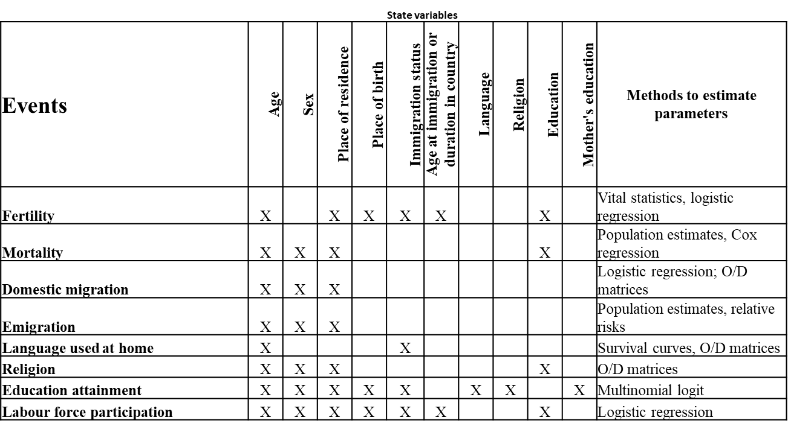
Microsimulation model dimensions
x
Native-born, born in other EU+ country, 8 world regions
(EU+ = EU27, UK & EFTA)
61

Slide 62
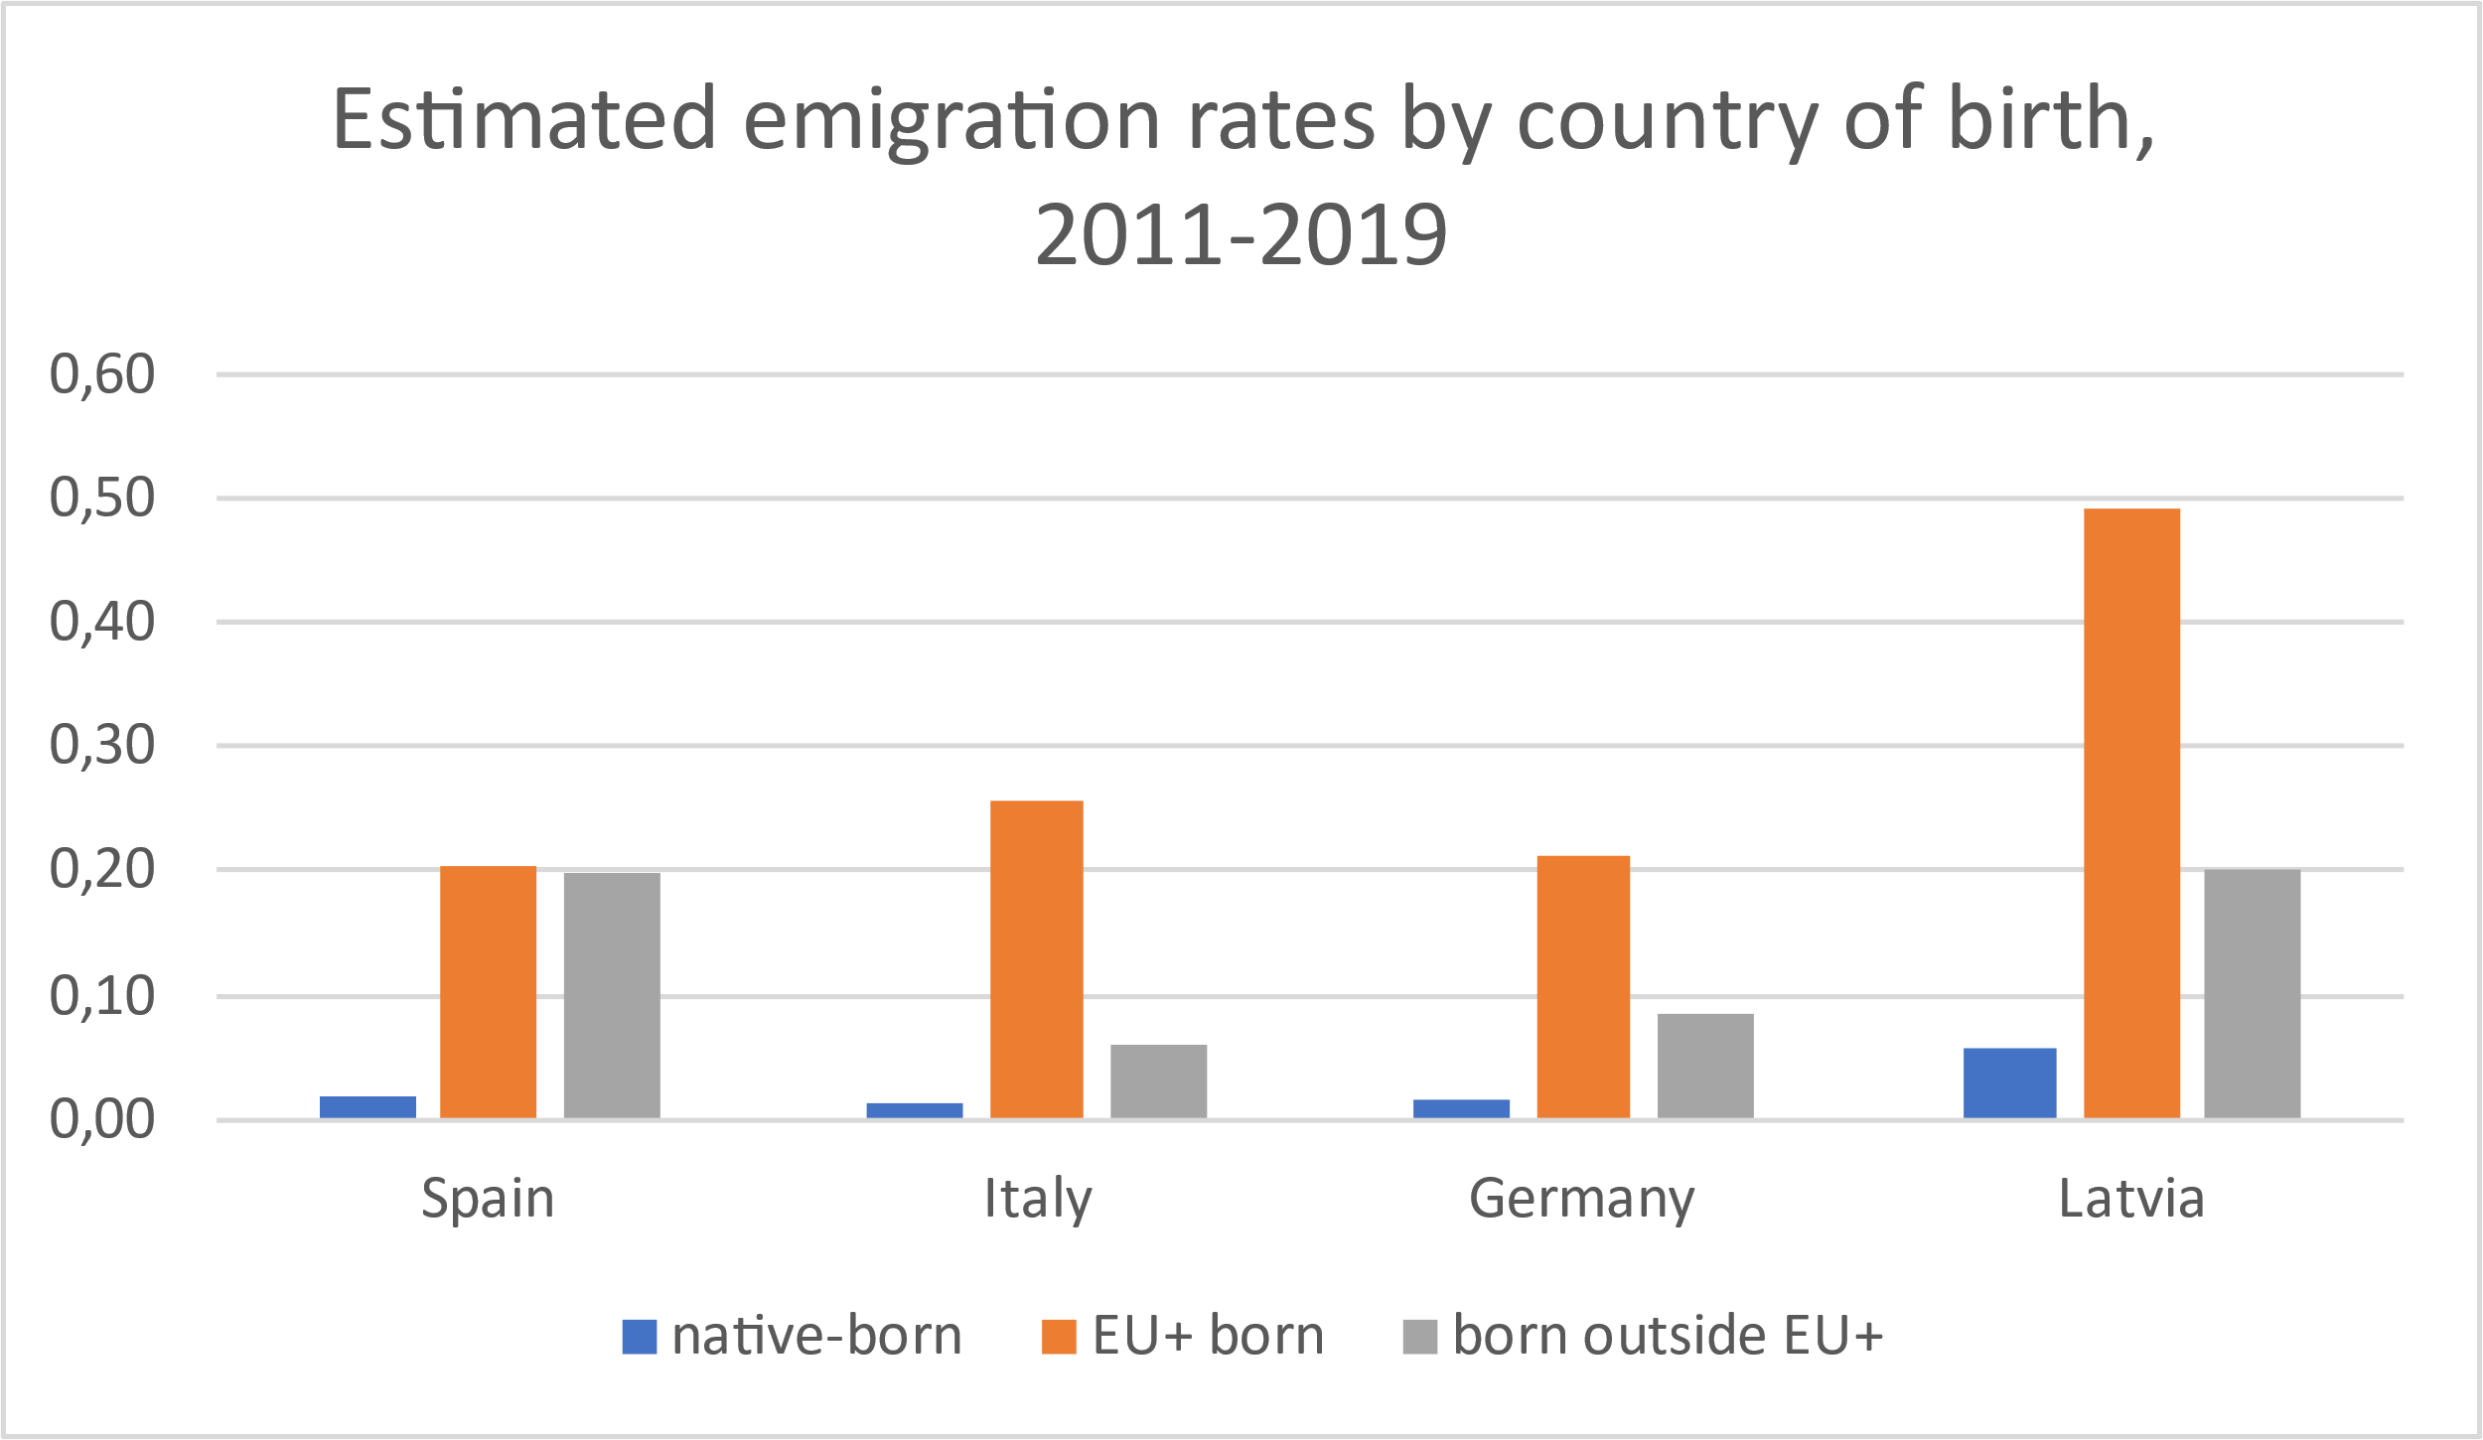
Assumptions on migration in QuantMig-mic
Emigration rates differ by place of birth
Share or emigration to other EU+ country and to the rest of the world differs by place of birth
Intra-EU+ migration: emigration rates of native-born and EU+ born converge to average of EU15 in 2011-2019 -> declining migration rates from Eastern and Southern EU+ and slight increase for migrants from Western EU+
Declining volumes of intra-EU+ migrants also because of ageing -> smaller cohorts of young adults
Immigration from the rest of the world regions to EU+ countries follows scenarios
Destinations follow established migration corridors

Slide 63
Baseline scenario key results

Slide 64
Reducing differentials in education and labor force participation could lessen workforce decline in EU28
A baby of a low educated mother has less chance achieving a university degree, and consequently, to participate in the labor force.
Labor force participation rates are currently lower for women and recent immigrants, who face multiple obstacles.
What if this was not the case?
Source: Marois, Guillaume, Patrick Sabourin, and Alain Bélanger (2019). "How reducing differentials in education and labor force participation could lessen workforce decline in EU28", Demographic Research, 41(6), 125-160.
Notes:
First, here are the outputs of the projection regarding the population size. For the baseline scenario, we expect a decline from about 244M to 220M.
The scenario equality in education, give about the same result in terms of labour force size, although high educated people are more likely to work. The reason is that when we improve education, we improve labour force rates, but we decline fertility levels, so at the end, we have high participation, but smaller cohorts.
Equality for immigrants increases the size by 5M compared to the reference scenario, and finaly, the equality for women increases the size more than 10M, so equality for women is the one having the biggest impact.
Overall when the three types of inequalities are equalized to the higher levels of other groups, the expected decline in the labor force size is reduced by 45%.

Slide 65
Scenario assumptions
Notes:
To analyse the effect of thse divergent integration trajectories the assumptions on LFPR and unemployment are set at fixed demographic and educational trends, holding the demographic trends same for all of them
and at fixed volume and composition of immigrantion flows
1. The baseline scenario presents a business as usual situation, an EU where labour force participation rates and employment rates of both EU-born and foreign-born population stay as they were in the recent past.
2. High integration scenario envisages the best of the worlds – the highest labour force participation and employment rates of immigrants follow the best performing EU countries as described in the parameters section above. This most optimistic scenario can be seen as upper limit, the parameters are explained in the previous section.
3. Low integration scenario follows the worst possible situation and follows the worst labour force participation and employment rates among the EU countries and combines the two into a lower limit scenario. In this scenario, the economic integration of immigrants deteriorates in all EU countries.
4. High employment scenario helps to understand purely the effect of high employment rates of immigrants. The activity (labour force participation) rates remain all EU Member states constant as of the recent years until 2060 but we model a situation of the highest observed employment rates of immigrant in all these countries.

Slide 66
Scenarios of economic integration of immigrants
Baseline integration - no change in the integration of immigrants in labour force and employment compared to what was observed in recent years.
High integration – integration improves and by 2040 immigrants have the same activity and employment rates as their native-born peers.
Low integration -deterioration of the labour force participation and employment rates of immigrants.
High employment - only employment rates improve to those of native-born peers by 2040, activity rates stay the same as observed in the recent years
Notes:
We built the assumptions on future employment using the parameters from the logit regression presented in equation 3.
Our stylized scenarios envision a set of what-if situations
The four scenarios described above thus combine a set of three trajectories (variants) of labour force participation rates (baseline, high and low integration) with three variants of assumed trajectories of employment rates for foreign-born population (baseline, high and low integration) at fixed labour force participation rates and employment rates of EU-born population Scenario and variant are not the same. Scenario is a combination of assumptions on several dimensions of the model. We have prepares several sets of assumptions for some of the dimensions – in this case labour force activity and employment. These sets are termed variants (high, low, baseline).
These assumptions are formulated with respect to future labour force participation and employment rates as well as the differential in these rates between the immigrants vs. EU-born. Therefore, we specify four assumptions on baseline, high, low
1. The baseline scenario presents a business as usual situation, an EU where labour force participation rates and employment rates of both EU-born and foreign-born population stay as they were in the recent past.
2. High integration scenario envisages the best of the worlds – the highest labour force participation and employment rates of immigrants follow the best performing EU countries as described in the parameters section above. This most optimistic scenario can be seen as upper limit, the parameters are explained in the previous section.
3. Low integration scenario follows the worst possible situation and follows the worst labour force participation and employment rates among the EU countries and combines the two into a lower limit scenario. In this scenario, the economic integration of immigrants deteriorates in all EU countries.
4. High employment scenario helps to understand purely the effect of high employment rates of immigrants. The activity (labour force participation) rates remain all EU Member states constant as of the recent years until 2060 but we model a situation of the highest observed employment rates of immigrant in all these countries.
continuation of parameters β₈ and β₉ from equation 2 and β₄ and β₅ of equation 3 throughout the projection
integration variant assumes that parameters for immigrants (β₈ and β₉ from equation 2 and β₄ and β₅ from equation 3) converge to 0 for all countries by 2040. This assumption thus progressively removes the disadvantage of immigrants in the labour force and employment. By 2040, for a same country, age, gender, and level of education immigrants and natives would have the same lab
β₈ and β₉ from equation 2 are assumed to converge by 2040 for all countries to those of Denmark in 2010-2015, which is the country in the EU where those parameters are the lowest (see parameters in table 4 and table 5). For employment, parameters β₄ and β₅ from equation 3 converge to those observed in Sweden, which is the high-immigration country with the biggest gap between immigrants and natives.
our force participation rates and the same unemployment rates.
The four scenarios described above thus combine a set of three trajectories (variants) of labour force participation rates (baseline, high and low integration) with three variants of assumed trajectories of employment rates for foreign-born population (baseline, high and low integration) at fixed labour force participation rates and employment rates of EU-born population Scenario and variant are not the same. Scenario is a combination of assumptions on several dimensions of the model. We have prepares several sets of assumptions for some of the dimensions – in this case labour force activity and employment. These sets are termed variants (high, low, baseline).

Slide 67
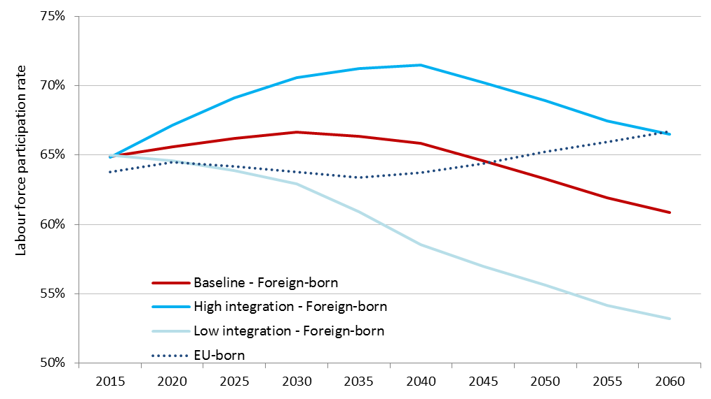
Preliminary results for EU28
Projected labour force participation rates in EU28, population age 15-74
Notes:
The trajectories of labour force activity rates for EU population age 15-74 years
for individual Member States, depending on country-specific participation rates for native-born and foreign-born populations.
Looking at EU average, the labour force participation rates (LFPR) of EU-born population follow in all scenarios the same trajectory and they increase from 64% in 2015 to 67% in 2060. Age-specific age patterns of labour force participation and sizes of older age groups versus younger ones explain the curve seen in Figure 5 (dotted line).
The increasing proportion of the older population (65-74) among the working age population (15-74) drives the light decline of the overall LFPR towards 2035 because this age group has low labour force participation. The increase after 2035 is associated particularly with higher labour force participation of women among the 55-74 and the growth of the highly educated – among the younger but as well among the older age groups – because highly educated men and women have the highest labour force participation rates.
For foreign-born, the high integration variant (used on High integration scenario) represents an increase from 65% in 2015 (thus 1pp higher than the EU-born), peaking at 72% in 2040 followed by a gradual decrease to 66% in 2060. In the baseline variant (used in Baseline and High employment scenarios) LFPR follows a similar trajectory as in the high variant but at a lower activity level: starting at 65% in 2050, peaking at 67% in 2040 and declining to 61% in 2060. In the low integration variant (used in Low integration scenario) the labour force participation rates gradually decline to 53% in 2060. The initial increase in the first years is explained by the boost of young immigrants of prime working age to the existing stock in the EU. Because labour force participation increases with the duration of stay in the country, the inflow of new young immigrants drives the increase in the overall labour force participation rate of the immigrant population in the EU. The ageing of this immigrant stock is driving the declining overall labour force participation rate of foreign-born and this becomes apparent after 2040.

Slide 68
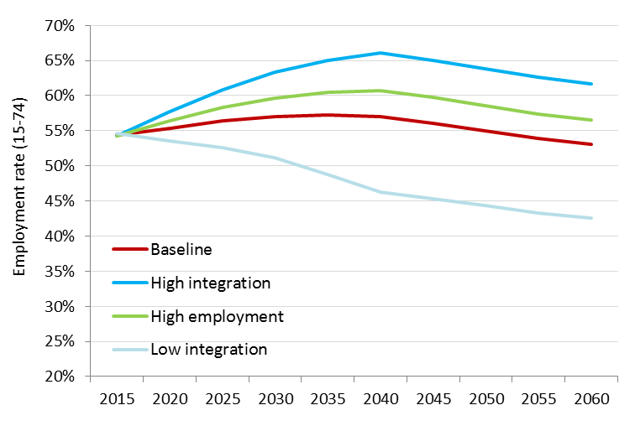
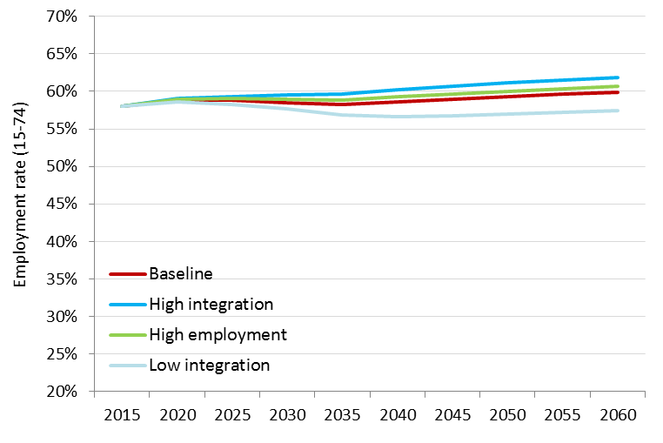
Preliminary results for EU28
Projected employment rates of foreign-born population 15-74
Projected employment rates for total population 15-74
Notes:
The difference between the Baseline and High employment scenarios illustrates the effect of improved employment of immigrants to the level of the EU-born population
The model accounts for structural changes in EU-born and foreign-born populations and is purely labour supply driven. We do not project changes in employment rates within a broader economic context and in relationship to possibly changing demand for labour that may arise due to changing nature of work, digitalization and automation.
. Closing of the gap between immigrants' and EU-born employment rates by 2040 thus increases the overall employment rate compared to the Baseline scenario by 1.17% (0.1pp) in 2040 and by 1.32% (0.8pp) in 2060.
The very optimistic High integration scenario imagines that not only employment gap between the immigrants and EU-born closes by 2040, but that the gap in labour force participation closes as well. In other words, more immigrants would be willing to participate in the labour force and they will face no disadvantage in finding a job compared to their EU-born peers. In such case, the overall employment rate in the EU would be boosted by 2.8% (1.6pp) in 2040, resp. 3.4% (2pp) in 2060, compared to the baseline scenario.

Slide 69
Projected employed population 2015-2060

Slide 70
QuantMig population projections & migration scenarios
Dynamic microsimulation population projection for 31 European countries (EU+) 2020-2060
System modelling of migration between individual EU+ countries
What would be the long-term demographic and labour force implications of unforeseen migration events?
Scenarios of immigration events of different magnitude, duration and from a different world region
Notes:
Successful economic integration of immigrants is of high importance as it fosters also their social, linguistic and cultural inclusion and improves the quality of life of migrants, their families and empowers communities. Immigrants' better economic integration is highly needed also against the backdrop of the unavoidable future smaller labour force sizes in the EU overall and in practically all Member States.
we focus on supply of labour driven by structural changes in potential labour force and we do not aim to simulate economic context, labour demand or changes in employment due to economic cycles. Also, there are no feedback effects included and labour force activity and employment depend purely on individual characteristics.

Slide 71
 | Baseline | Persistent-high immigration event from East Asia | Persistent-high immigration event from Latin America | Persistent-high immigration event from North Africa | Persistent-high immigration event from other Europe | Persistent-high immigration event from South and South-East Asia | Persistent-high immigration event from Sub-Saharan Africa | Persistent-high immigration event from West Asia
Working age population | 80 | 81 | 81 | 81 | 81 | 81 | 81 | 82
Labour force | 86 | 86 | 87 | 87 | 87 | 87 | 87 | 87
Population born outside EU+ | 194 | 197 | 201 | 198 | 201 | 200 | 200 | 203
Labour force born outside EU+ | 172 | 174 | 179 | 175 | 179 | 179 | 179 | 180
 | 2020 | Baseline | Persistent-high immigration event from East Asia | Persistent-high immigration event from Latin America | Persistent-high immigration event from North Africa | Persistent-high immigration event from other Europe | Persistent-high immigration event from South and South-East Asia | Persistent-high immigration event from Sub-Saharan Africa | Persistent-high immigration event from West Asia
% of population born outside EU+ | 8% | 17% | 17% | 17% | 17% | 17% | 17% | 17% | 17%
% of labour force born outside EU+ | 15% | 26% | 26% | 27% | 26% | 27% | 26% | 27% | 27%

