Slide 1
Labour Market and Employment Policy
Spring 2025
Equal playing field -
why do genders differ?
Week 3
Martin GUZI
martin.guzi@econ.muni.cz
Notes:
You may watch this video - the story of African American man. http://www.ted.com/talks/james_a_white_sr_the_little_problem_i_had_renting_a_house

Slide 2
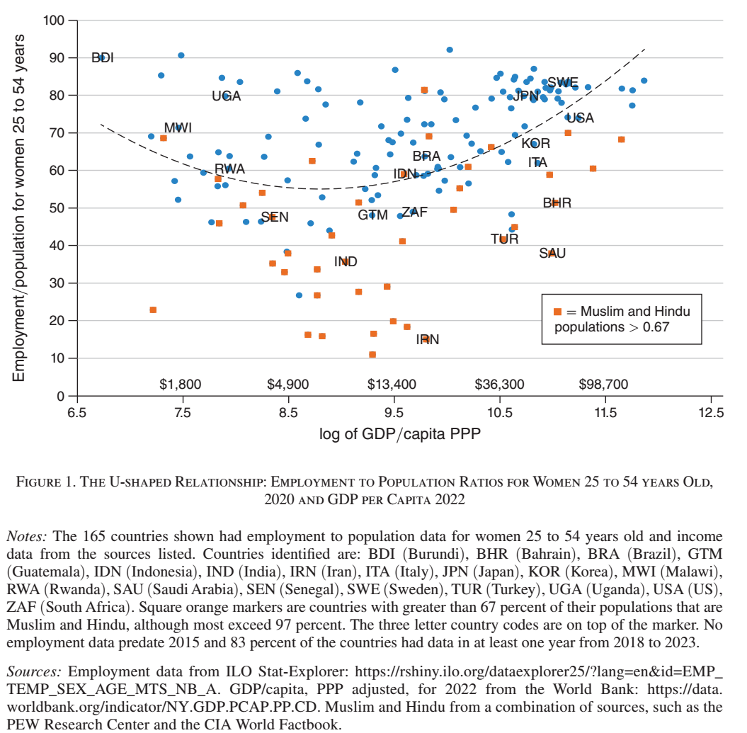
Of the 165 nations almost 60 percent have female employment rates (for those 25 to 54 years old) that exceed 0.70, and 80 percent exceed 0.50.

Slide 3
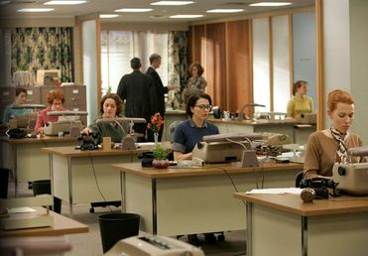
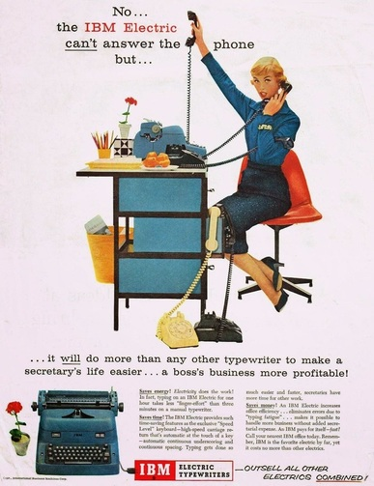
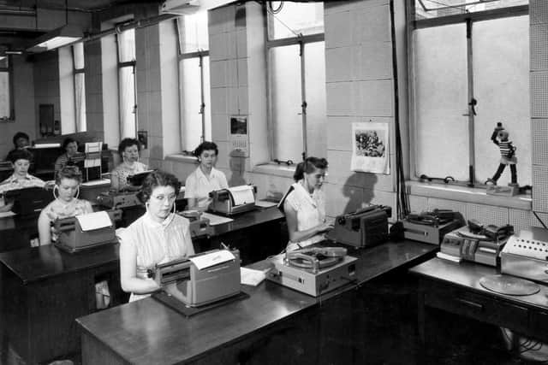

Slide 4
Women are now at the center of the world’s economies.
Women have increased their participation in the labour market
They are rapidly becoming the better-educated, and constitute the majority of college students in all 38 OECD nations.
Women do the vast amount of care-work

Slide 5
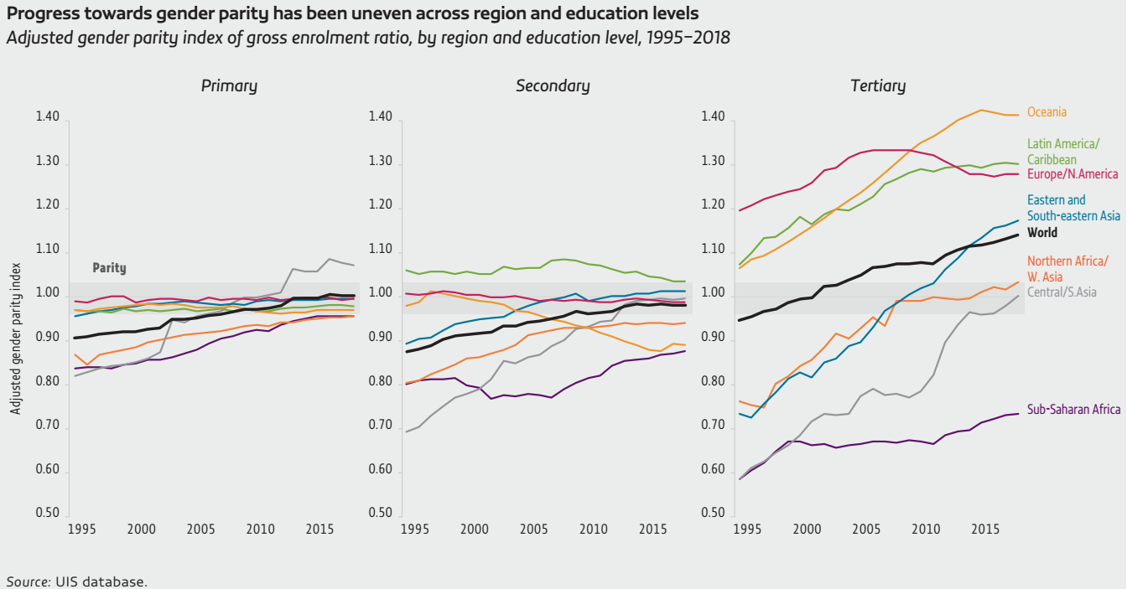
Globally, equal number of girls and boys were enrolled in primary and secondary education in 2018.

Slide 6
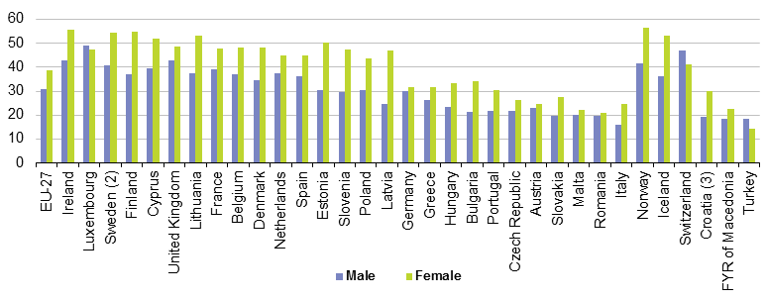
Proportion of the population aged 30 to 34 having a tertiary education, 2011
Young women are increasingly better educated than young men.
Boys are also more likely than girls to drop out from secondary education.
Notes:
Source: Eurostat

Slide 7
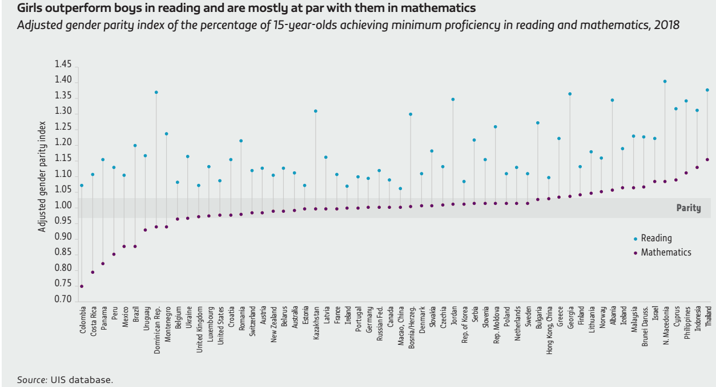
Girls and boys perform equally well in mathematics in more than half of countries. Girls do better in one-quarter of countries, especially in South-eastern Asian countries such as Indonesia, the Philippines and Thailand. Boys maintain a strong advantage in Latin American countries such as Colombia and Costa Rica.

Slide 8
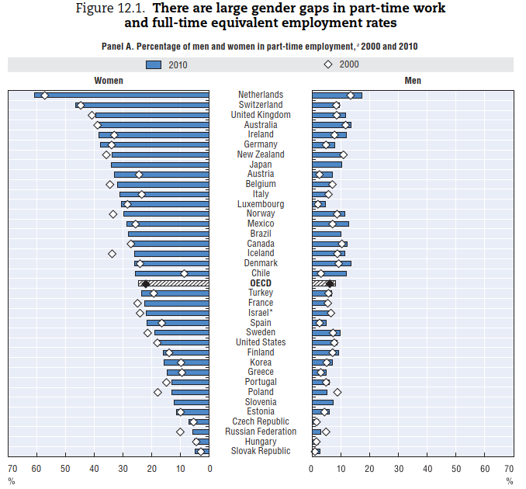
Working part-time on a long-term basis tends to have a negative effect on women’s career opportunities as it limits their abilities to develop
leadership skills and take on jobs with high levels of responsibility.
Part-time employment refers to persons who usually work less than 30 hours per week in their main job.
Source: OECD Employment Database 2012.

Slide 9
The gender gap in employment opens at childbearing age the most in Czechia, Hungary, Poland and Slovakia. Later, around the age of 50, the gender gap in employment almost closes in Bulgaria, Croatia, Czechia, Hungary, Poland, Slovakia and Slovenia.
In addition, in Czechia and Slovakia, the maternal employment rate of tertiary educated women is among the lowest in the OECD (OECD, 2019).
In comparison, a drop in female employment at childbearing age is
much lower in Austria and Germany.
When skilled labour is in short supply, taking advantage of female labour may provide a considerable boost to the economy.
What family policies are needed?

Slide 10
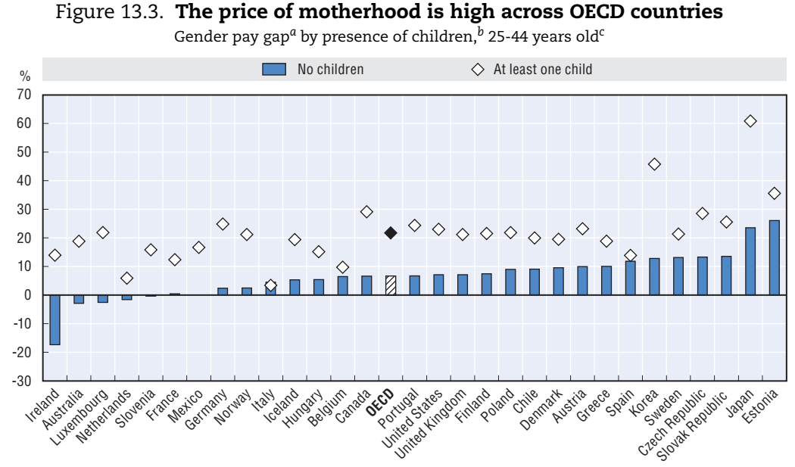
Gender pay gap is defined as the difference between male and female median wages divided by male median wages. Children defined as aged less than 16 years old. Wage gap calculated for men and women aged 25-44 working full-time.

Slide 11
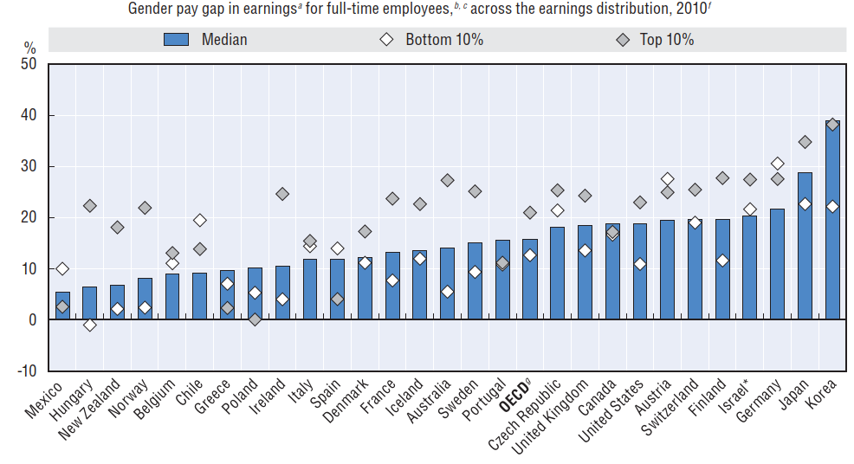
The pay gap is higher for incomes at the top of the earnings distribution
The wage gap is defined as the difference between male and female wages divided by male wages
(at the first decile, median and ninth decile of the earnings distribution).
OECD Database on Earnings Distribution

Slide 12
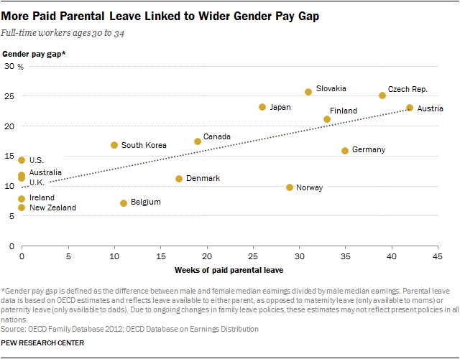
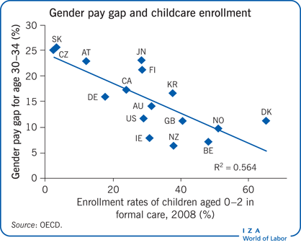
Source: OECD Family database

Slide 13
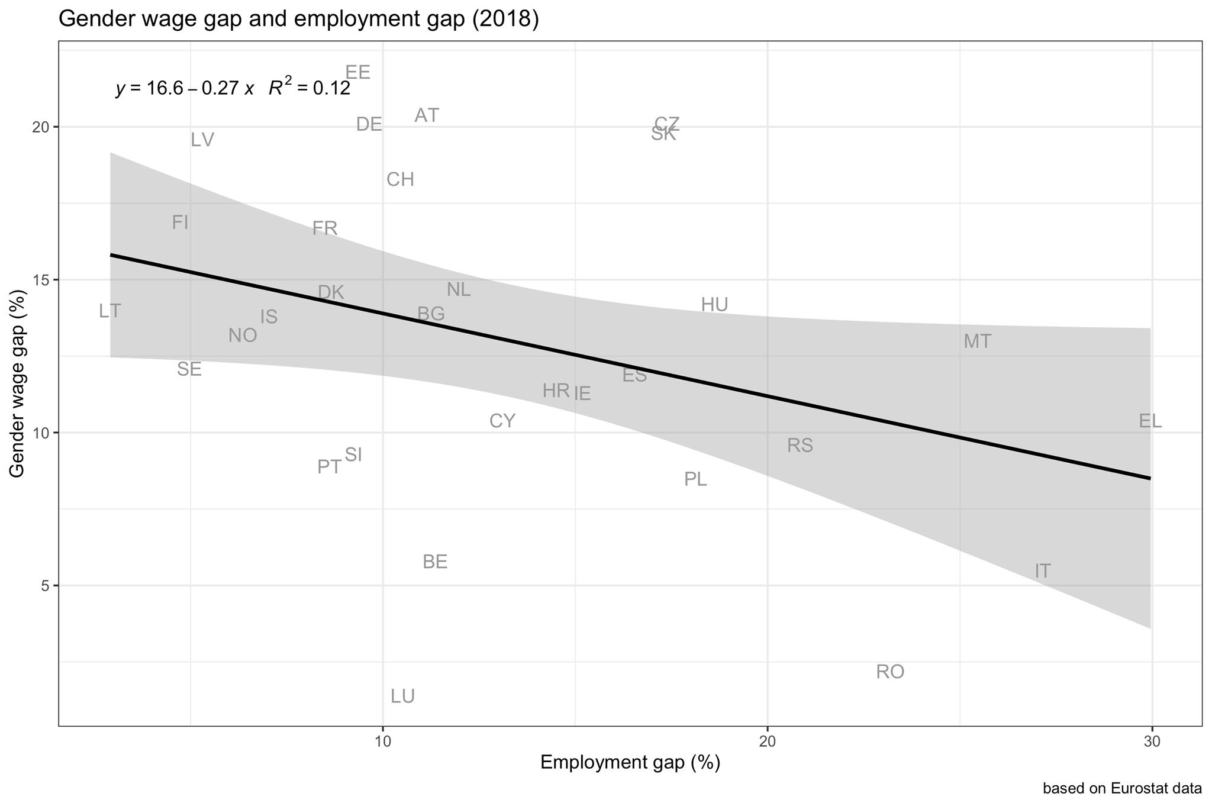
The employment and wage gaps between men and women are related.
There is an inverse relationship between wage and employment gender gaps.
For example 48% of women participate in the labour market in Italy in comparison to 70% in Germany. The employment gender gap is larger in Italy and the gender wage gap is lower in Italy relative to Germany.
One explanation is that women who choose to be employed have the highest earning potential and the higher selectivity in employment contributes to low wage gap in Italy.
The other explanation is the flexibility of labour contracts. In Germany, for example, 48% of working women use part-time jobs, while it is 31% in Italy and only 5.7% in Czechia.

Slide 14
Occupational segregation
Occupational segregation: distribution of workers into various occupations.
Vertical segregation: within occupations
Horizontal segregation: across occupations
Presentation tips: which occupations are female-dominated and which are male-dominated in your country? Are the female-dominated jobs less paid?

Slide 15

Gender equality in employment
Women work fewer hours and have lower participation
Women are over-represented in contractual employment, lower job categories, and part-time work.
High concentration of males or females in certain occupations and sectors (Gender-stereotyped profiles of occupations)

Slide 16
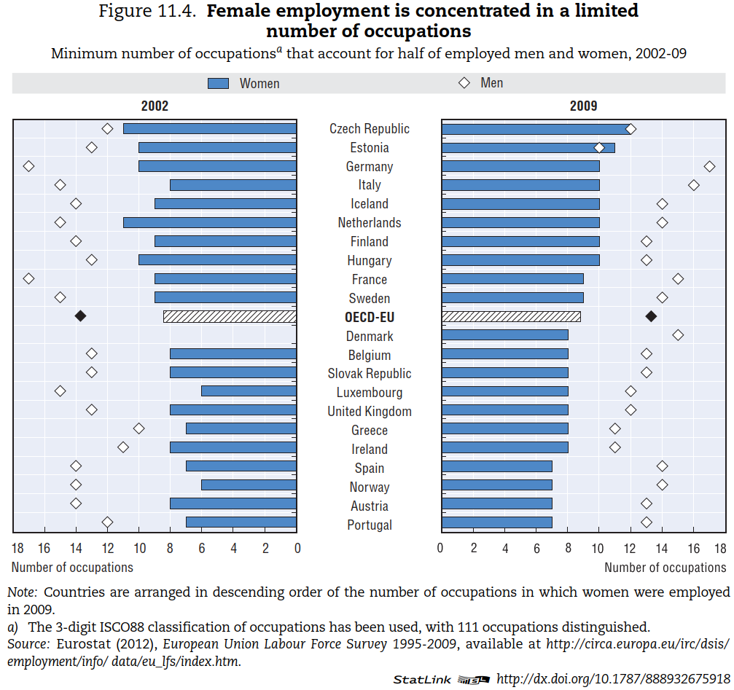

Slide 17
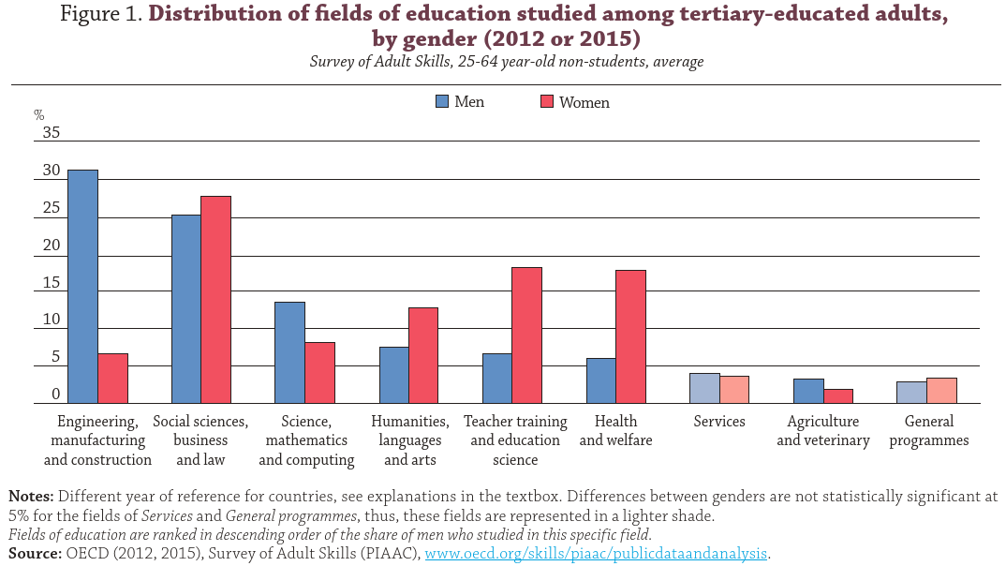
Education fields with a larger share of women are typically associated with lower employment rates and lower earnings. However, even within the same field of education, employment rates and earnings are generally higher for men than for women. Gender stereotypes at school (young age).
Notes:
Countries and fields of education covered in the Survey of Adult Skills
The data source for this publication is the Survey of Adult Skills. This survey was not specifically designed to analyse the tertiary-
educated population, so the sample size for specific fields of education can be small and should therefore be interpreted with
caution.
The national and subnational entities included in this analysis are Australia, Austria, Canada, the Czech Republic, Denmark,
Estonia, England (United Kingdom), Finland, Flanders (Belgium), France, Germany, Ireland, Italy, Japan, Korea, the Netherlands,
Northern Ireland (United Kingdom), Norway, Poland, the Russian Federation, the Slovak Republic, Spain, Sweden,
the United States, for 2012, and Chile, Greece, Israel, Lithuania, New Zealand, Singapore, Slovenia and Turkey, for 2015.

Slide 18
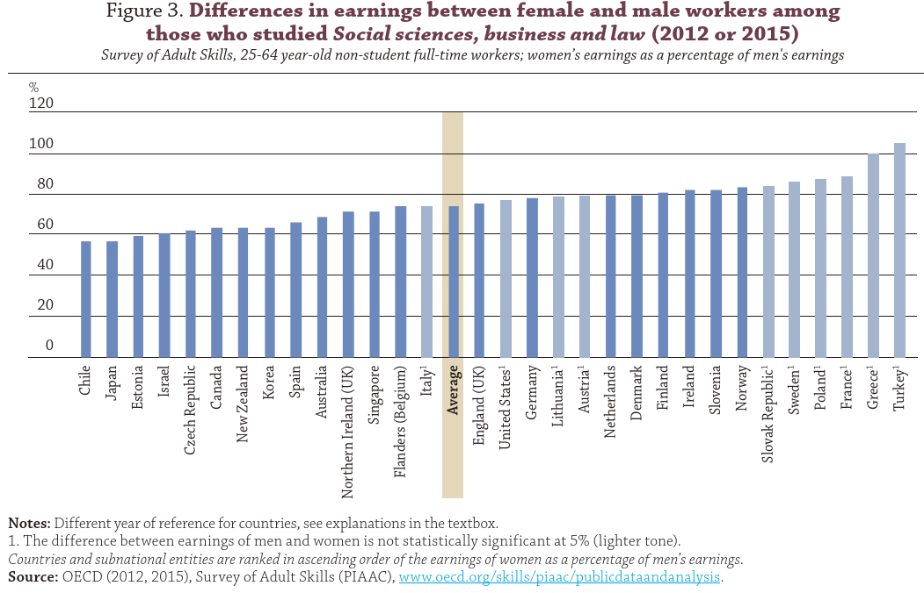
Social sciences, business and law, which was studied by a relatively large share of both women and men in OECD countries and is associated with relatively high earnings, women earn only about 75% as much as men.

Slide 19
Women in top positions
Glass Ceiling: an Invisible Barrier Preventing Women from Reaching the Top
Senior managers often apply gender stereotypes to leadership—women “take care,” men “take charge”.
Women hold under a quarter (24%) of senior roles across the world in 2018 (source: Women in business 2018, Grant Thornton)
The industries most lacking women among hires for leadership roles include manufacturing, energy and mining, software and IT services, finance, real estate, corporate services, and legal.

Slide 20
Key policy messages
Collect and share data (promote pay transparency)
Combat all forms of pay discrimination
Address other barriers to gender equality (e.g. cultural)
Set targets for women in senior management positions in the public service
Get girls more interested in science and boys in reading
Ensure that work pays to both parents (via tax and benefit systems)
Promote support for female-owned enterprises in high-tech sectors.

Slide 21
Consequences of high gender pay gap
Lower economic growth
Higher income inequality
Higher gender inequality in retirement (women pensioners are more likely to be poor)
Gender diversity improves productivity at the workplace
Country’s average degree of happiness increases with greater gender equality (Veenhoven, 2011 and 2012)

Slide 22
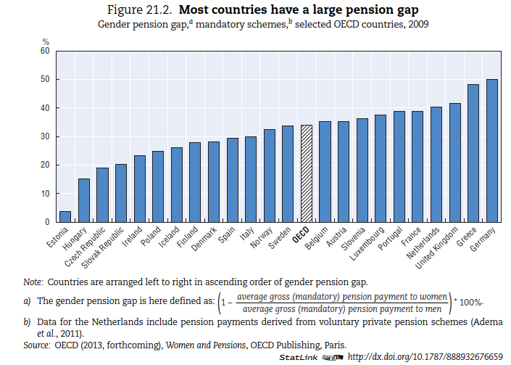
Pension payments are lower than earnings.
Pension payments to individuals aged 65 and over in 2009 were 34% lower, on average, for women than for men.
Women need to live longer on low incomes.

Slide 23
Case study: Portugal
Ana Rute Cardoso and Louis-Philippe Morin, 2018, Can Economic Pressure Overcome Social Norms? The Case of Female Labor Force Participation

Slide 24
Portugal: Institutional setting, 1926-1974
• Constitution 1933, equality of all citizens before the law, with the exception “in the case of the woman, the differences that result from her nature and the good of the family" (art. 5)
• 1956, compulsory schooling: 4 yrs for boys and 3 yrs for girls;
Diploma of 4 yrs required to access jobs in public admin, manufacturing, the services, get a driver’s license, or participate in official sports competitions
• Right to vote: different requirements on males and females
• Employment contract, passport: husband’s consent required
• Divorce and contraception outlawed
• Gender norms were pervasive: women’s participation should be restricted to the household

Slide 25
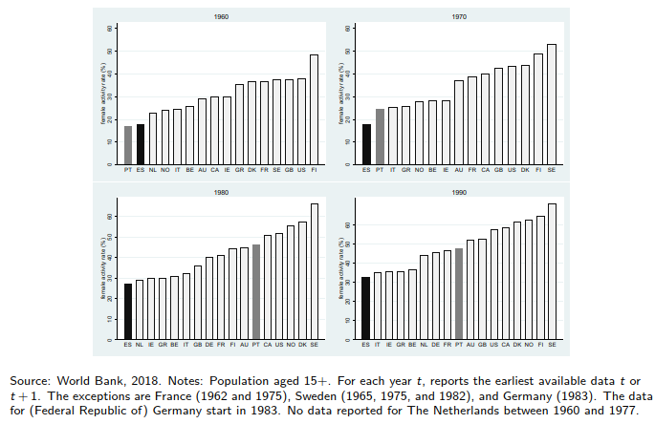
Trends in female participation in the labor market
Widespread rise in female labor force participation
The puzzle of Portugal

Slide 26
Portuguese Colonial War
War in Africa, 1961-74: Angola, Mozambique, Guinea-Bissau
Major drain of human resources: males drafted for 2-4 years, starting the year they turned 21
  [A]round one per cent of the country’s population was called up to fight. By way of comparison: had the Americans called up the same proportion for the war in Vietnam, they would have had to have recruited and deployed 2.5 million troops instead of the 500,000 that were actually mobilized
  (Pinto 2011)
Major drain of financial resources: military expenses reached 63% of Central Govt budget in 1968
Poverty and war, combined motivation to emigrate

Slide 27
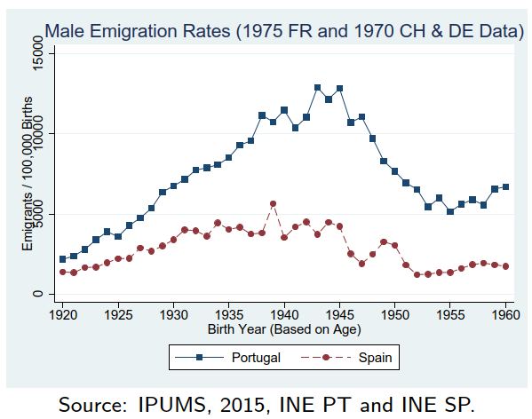
Male Emigration Rates, Spain vs Portugal
Emigration: 1.5 million left Portugal during 1960s and first half of 1970s, out of initial 9 million inhabitants
Spain also 1.5 million emigrants, but out of initial 30 million
By 1969, France absorbed 72% of Portuguese emigrants; Germany, Switzerland and France absorbed the majority of Spanish ones
Major drain of human resources from Portugal: as much as 8%-12% of male cohorts born in 1940s

Slide 28
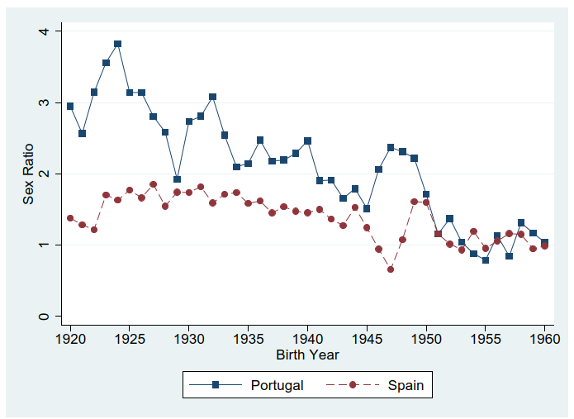
Sex ratio among Portuguese and Spanish immigrants, late 1960s
Large gender imbalance in Portuguese emigration
(Men left first, women followed later)
Scarcity of male human resources in economy
Until 1968, large gender imbalance in
emigration
From 1969 to 1974, large magnitude of
outflow

Slide 29
Occupational upgrading
1960 Census: classify occupations as "male" or "female"
1980 Census: major occupational upgrading, as women increasingly represented in the following “male" occupations: legislators, senior officials, managers; plant and machine operators and assemblers; skilled agricultural workers;
declining female representation in "elementary occupations“
reduction of gender segregation across occupations
reduction of gender pay gap by 7-8 p.p.

Slide 30
What policies can be implemented to address cultural and social factors contributing to gender gaps in the labour market?
Maternity and paternity leave policies
Affirmative action policies (to increase female representation in specific positions)
Flexible work arrangements
All of the above

Slide 31
Which of the following factors contribute to the gender pension gap?
Gender pay gap
Number of children in the family
Men's higher eligibility age for state pensions
All of the above

