Slide 1
Presentation Skills Lecture
Jan Řezáč

Slide 2
What makes a presentation a good presentation?
Inspiring?
Expressive?
Good content?
Enthusiastic?
Clear?
Good feeling?
Notes:
Inspiring? Expresive? Good content? Enthousiastic? Clear? Good feeling?
Get towards aristoteles structure

Slide 3
What makes a presentation an enjoyable presentation for the presenter?
Feeling of accomplishment?
Good immediate feedback?
Ideas for improvement?
Thank-god-it-is-over feeling?
Notes:
Inspiring? Expresive? Good content? Enthousiastic? Clear? Good feeling?
Get towards aristoteles structure

Slide 4
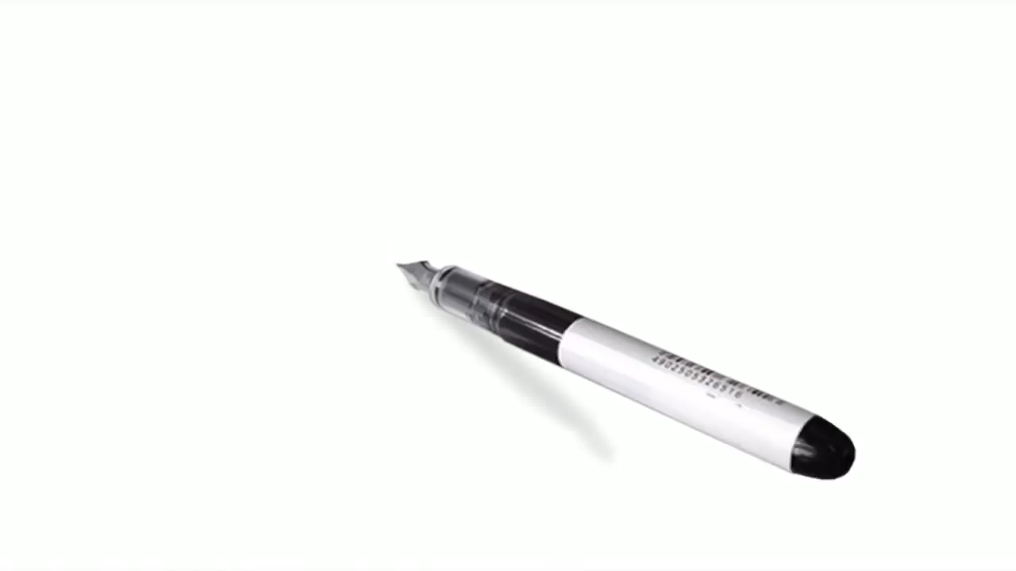
Amy Cuddy - More confidence in 2 minutes

Slide 5

Presentation and storytelling
Think back about the last time you had to present:
How did you feel?
What was your goal?
What would you improve?
Notes:
5
Personal opening
Opening statement: take 30 seconds to think of the last times you had to present something. How was it? how did it go? What would you do better?
Then slide questions
extra questions:
Why

Slide 6
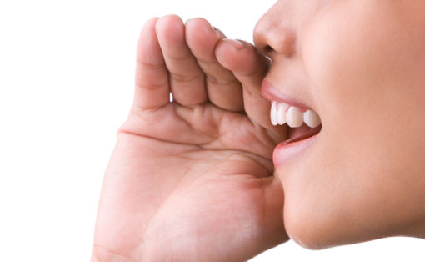
Why presentation skills?
People love stories
Transfering a message
Inspiring an audience
How can we learn it?
Practise
Study
Observe
Get and use feedback
Notes:
6
Why and how
Why presentation skills?
People love story’s
Transfering a message
Inspiring an audience
How can we learn it?
Practise
study
observe
get and use feedback
People love listening to stories. It is the most natural and VERY enjoyable thing.
Remember how you liked stories as a child? That is, how you should speak again.
By telling something, you are GIVING your audience another perspective, and making their world richer.
If you have a passion - you have a story.
(other place, remove?)

Slide 7
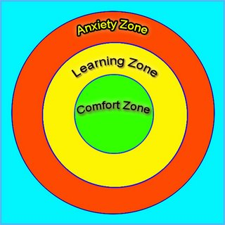
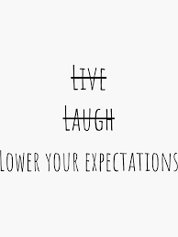


Guidelines for this session
Notes:
A possitive and open environmentwith proactive helps
This is a safe environment so you can focus on learning.
Make it a safe environment for others so they can get out of their confort zone and learn as much as possible
Learning and practice means putting yourself open for feedback and taking it as advice.
Its not about how good you are, its about getting better.

Slide 8
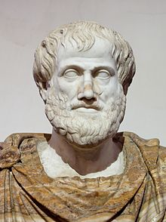
Aristoteles´ Advice
Good speech has three sides:
    Ethos (nonverbal communication)
    Pathos (language techniques you use)
    Logos (facts that you say)
Brilliant presentation embraces all 3 angles.
Notes:
Aristiteles structured it in the following way:
Discussion/example of how important non-verbal, intonation and content are but that they can not miss each other and it depends on the situation.

Slide 9

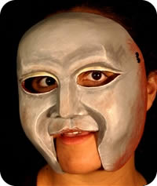
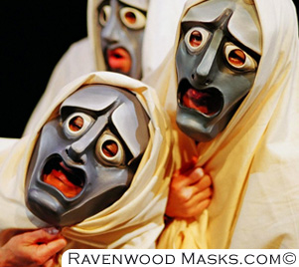
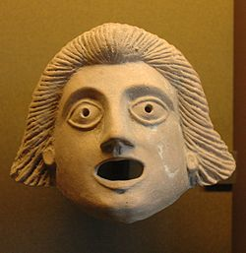
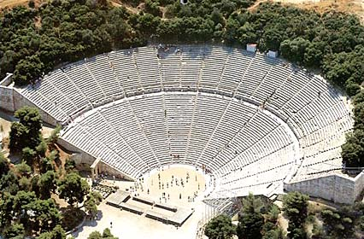
Ethos = The way you come across to the audience
Ethos is the way the speaker shows s/he is a skilled presenter.
Expert, involved, qualified, ethical
Important:
Work on your own style!
Notes:
Greek charakters

Slide 10
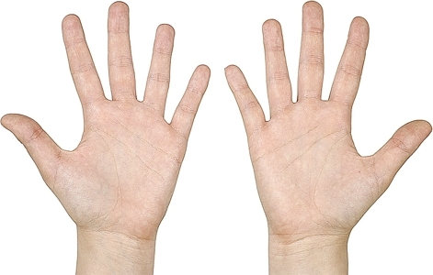
What to do with hands?
It is best if they are relaxed, natural and flexible.
Make them part of your voice.
Things you can do include counting, pointing at things or relating to audience.

Slide 11
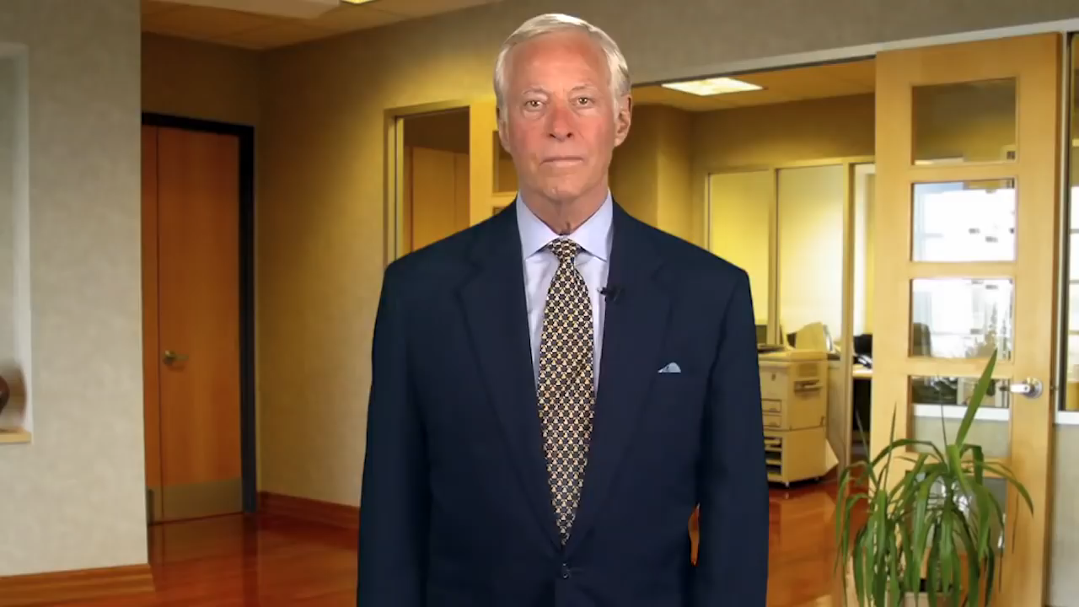
3 Ways to Improve Your Communication Skills

Slide 12

Pathos (language techniques)
Rule of three
Pauses in your speech
Intonation
Metaphor
Analogy

Slide 13
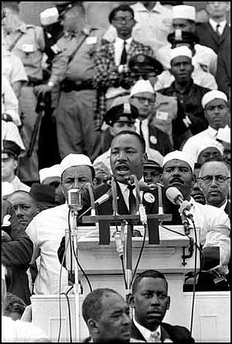
Time for some inspiration...
https://www.youtube.com/watch?v=gevdV4LvipQ; 1:30

Slide 14
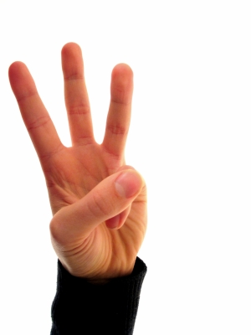
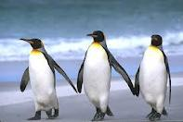
The Rule of Three
Have you noticed how often there are on slides precisely three facts?
It is a good number. Two is too little. Four is too much, and people forget.
Good speakers use it often. It is a hint, not a rule.

Slide 15

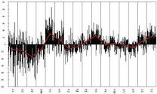
Pauses and intonation
It is ABSOLUTELY NORMAL to have a 3 seconds pause.
You can organise your thoughts, or use the pause to build tension.
For experienced – work on your intonation. use your voice to target keypoints.

Slide 16

Power of repeating
Think about what message/feeling should stick in people’s mind after the session.
Say what you want at the beginning.
Repeat it at the end.
Notes:
16
Add goal like in jans slide

Slide 17
The dictionary defines a "metaphor" as a figure of speech that uses one thing to mean another and makes a comparison between the two. For example, Shakespeare's line, "All the world's a stage," is a metaphor comparing the whole world to a theater stage. Metaphors can be very simple, and they can function as most any part of speech. "The spy shadowed the woman" is a verb metaphor. The spy doesn't literally cast his shadow on the woman, but he follows her so closely and quietly that he resembles her own shadow.
A simile, also called an open comparison, is a form of metaphor that compares two different things to create a new meaning. But a simile always uses "like" or "as" within the phrase and is more explicit than a metaphor. For example, Shakespeare's line could be rewritten as a simile to read: "The world is like a stage." Another simile would be: "The spy was close as a shadow." Both metaphor and simile can be used to enhance writing.
An analogy is a bit more complicated. At the most basic level, an analogy shows similarity between things that might seem different -- much like an extended metaphor or simile. But analogy isn't just a form of speech. It can be a logical argument: if two things are alike in some ways, they are alike in some other ways as well. Analogy is often used to help provide insight by comparing an unknown subject to one that is more familiar. It can also show a relationship between pairs of things. This form of analogy is often used on standardized tests in the form "A is to B as C is to D."

Slide 18
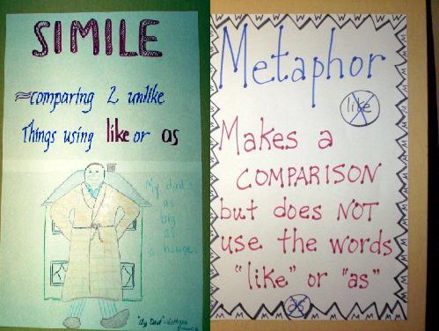

Slide 19
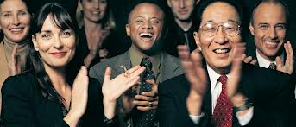
The spice of speech
A metaphore helps many times to describe a concept with different terms.
You can explain an unknown process by making an analogy to a known process.
There are other techniques (simile, allegory, hyperbole). All of these make your speech much more interesting to audience
Notes:
Change text layout, check content metaphor on the internet

Slide 20
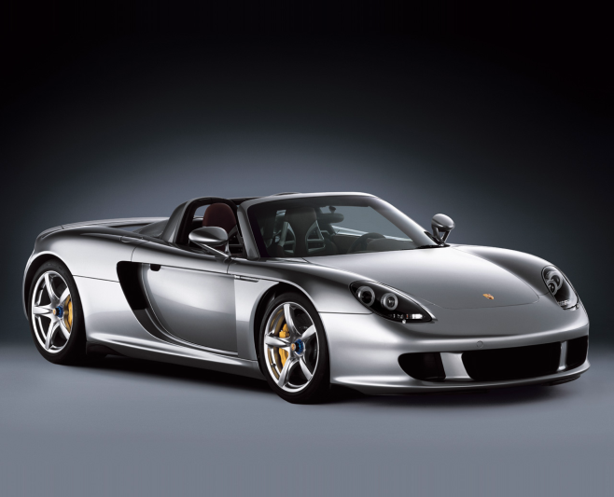
Metaphores - examples
Her hair is blond. – Her hair is the purest gold.
It was very difficult problem. - It was a Gordian knot.
“A Porsche is not a car. It is the best engineered executive toy in the world.“
Notes:
Change text layout, check content metaphor on the internet

Slide 21
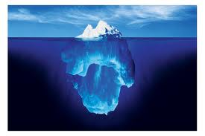
Analogy - definition
Analogy is a cousin to the metaphor.
Metaphor describes just one attribute, that is similar.
If you use the similarity to describe another attributes, it becomes an analogy.
Notes:
Change text layout, check content metaphor on the internet

Slide 22

Analogy - examples
Traffic system in Bangkok and blood distribution in the body can have similar problems.
What is the structure of atoms? Just look at the stars and planets.
Was the bank of justice broken, as Luther said?
Notes:
Change text layout, check content metaphor on the internet

Slide 23

Metaphors and analogy - exercise
Try individually to describe the following with „the spice of speech“.
Go as a tourist into Syria.
Our attachment to the internet
Dentist´s work.
Marriage after 30 years.
Your area of expertise.
Something else.
Notes:
layout

Slide 24
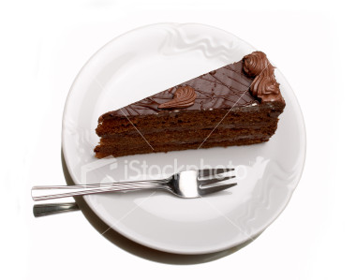
Pathos - Recap
Rule of 3 works. Try it.
Your voice can change with words you say. Do not forget pauses and intonation.
Analogies and metaphores make complex issues look easy like a piece of cake.

Slide 25

Logos (facts)
Usually, you know much more about the situation than your audience.
Difficult part is choosing and simplifying the information you want to say.
Also important is order in which you will present information

Slide 26
Structure of Presentation
All presentations should have an Introduction, a Main Part, and a Conclusion
There are broadly two ways to structure your powerpoint
Academic (Ted talks audience) and Consulting (for executives)

Slide 27
Academic presentation
Introduction: describes current situation, makes people pay attention;
Main part: systematically provides facts, interprets them, suggests a solution;
Conclusion: a summary or a call to action

Slide 28
Consulting presentation
Introduction: Provides the executive summary including a call to action;
Main part: States all reasons leading you to your conclusion at first, than provides detail for those;
Conclusion: presents alternative, possibly credentials

Slide 29

Recap presentation skills
Audience LOVES speakers and speeches. Perfection is unnecessary, passion is the key.
Good posture, gestures and breathing are incredibly helpful.
Metaphore and analogy are sharp and necessary tools for every speech.

Slide 30
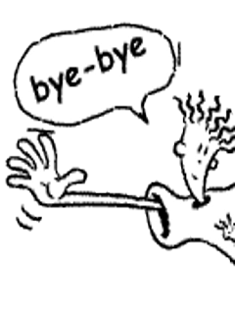
Thank you for your attention

