Slide 1
MPV_COMA Communication and Managerial Skills Training
Non-Verbal Communication and Assertiveness seminar
Jan Řezáč

Slide 2
Recap – How to pass
Attendance
Test at the course end
Presentation:
  Select your presentation topic – done?
  Seminar 3: Short description of your presentation outline at the seminar. If not passed, it is possible to rework
  Seminar 5: Actual presentation. If not passed, it is possible to rework

Slide 3
NONVERBAL COMMUNICATION - WORDLESS SIGNALS
What are some examples of nonverbal communication?
Goal of this seminar: Making subconscious observations explicit

Slide 4
Amy Cuddy: Turning the Power Back On - YouTube

Slide 5
NONVERBAL COMMUNICATION
- WORDLESS SIGNALS
Goal: Making subconscious observations explicit with a precise vocabulary
Distance
Eye contact
Facial expressions
Tone of voice
Gestures
Posture
Physical contact
Motion & Intensity
Dress/dress code

Slide 6
DISTANCE
I. zone – private, 0 - 45 cm
  Intimate communication (partners, parents and children, close friends)
II. zone – personal, 45 - 100 cm
  Greetings, shaking hands, family dinner, friends at
lunch)
III. zone – social, 100 - 360 cm
  Meetings in the store, shop, post office, bank, meetings, offices etc.
IV. zone – public, 360 cm and more
  Lectures, theatre etc.

Slide 7
EVALUATING NONVERBAL SIGNALS – THE RIGHT VOCABULARY
Eye contact
Is eye contact being made? If so, is it overly intense or
just right?
Facial expression
What is their face showing? Is it masklike and unexpressive, or emotionally present and filled with interest?

Slide 8
EVALUATING NONVERBAL SIGNALS – THE RIGHT VOCABULARY
Tone of voice
Does their voice project warmth, confidence, and interest, or is it strained and blocked?
Posture and gesture
Are their bodies relaxed or stiff and immobile? Are
shoulders tense and raised, or slightly sloped?

Slide 9
EVALUATING NONVERBAL SIGNALS – THE RIGHT VOCABULARY
Physical contact
Is there any physical contact? Is it appropriate to the situation? Does it make you feel uncomfortable?
Motion & Intensity
Do they seem flat, cool, and disinterested, or over-the-
top and melodramatic?

Slide 10
EVALUATING NONVERBAL SIGNALS – THE RIGHT VOCABULARY
Timing and pace
Is there an easy flow of information back and forth? Do nonverbal responses come too quickly or too slowly?
Sounds
Do you hear sounds that indicate caring or concern? Any signs of active listening?

Slide 11
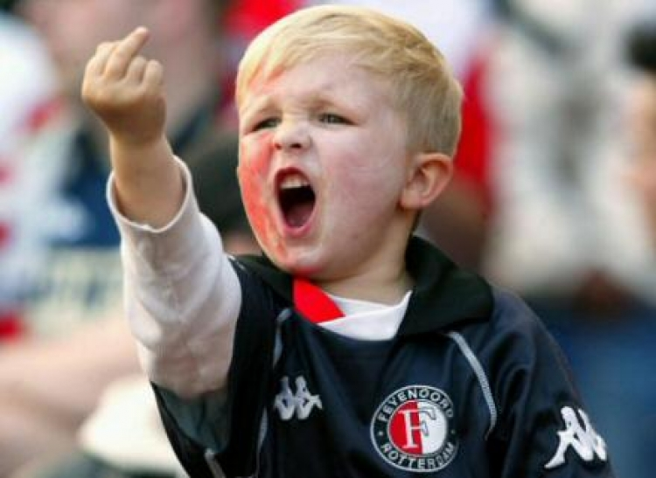
Decribe the non – verbal communication, and then resulting emotions

Slide 12
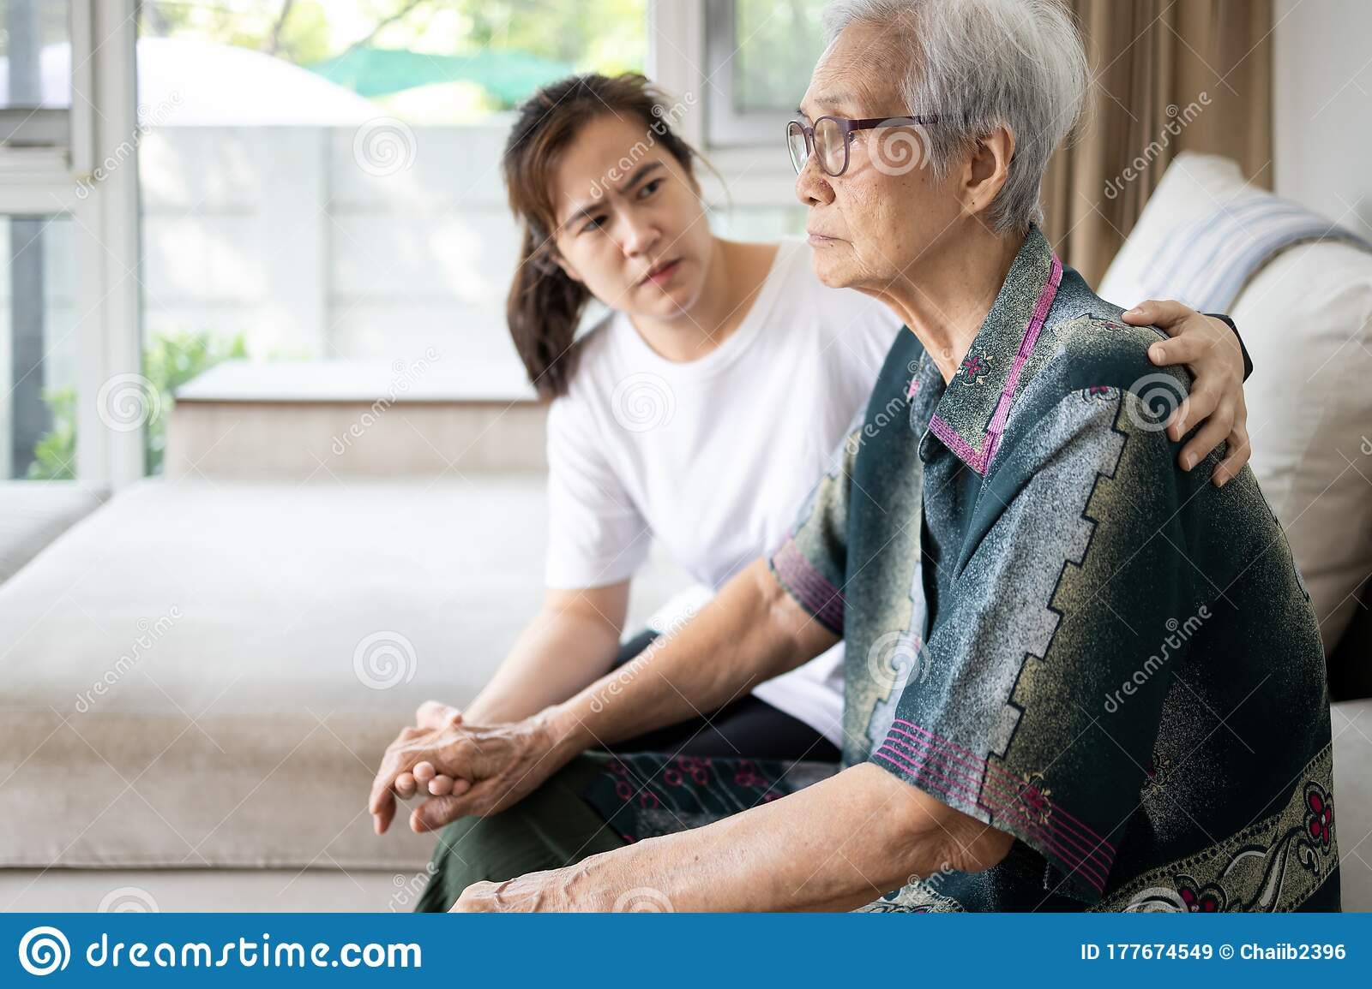
1
2

Slide 13

1
2

Slide 14
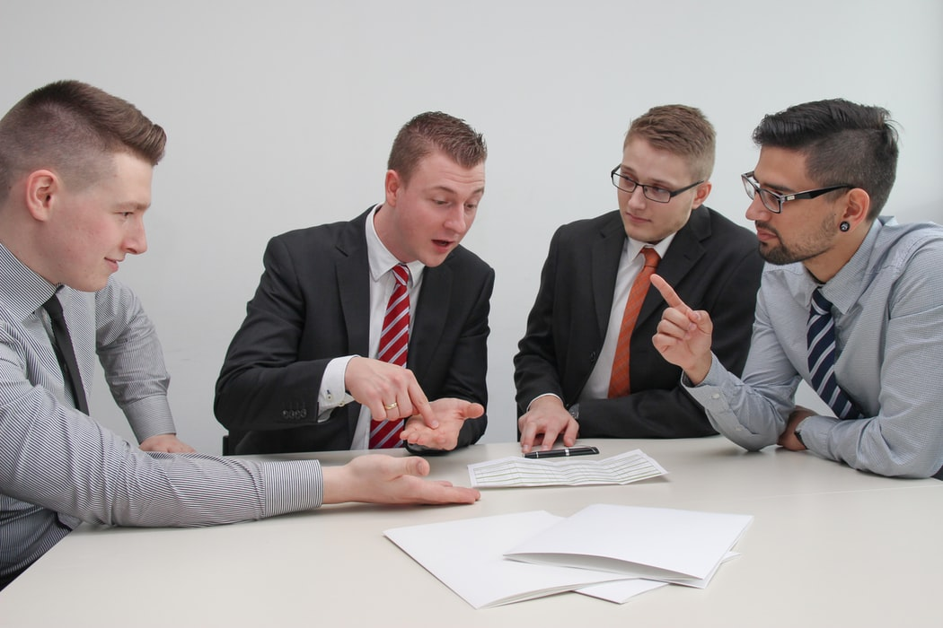
1
2
3
4

Slide 15

1
3
2
4
5
6

Slide 16
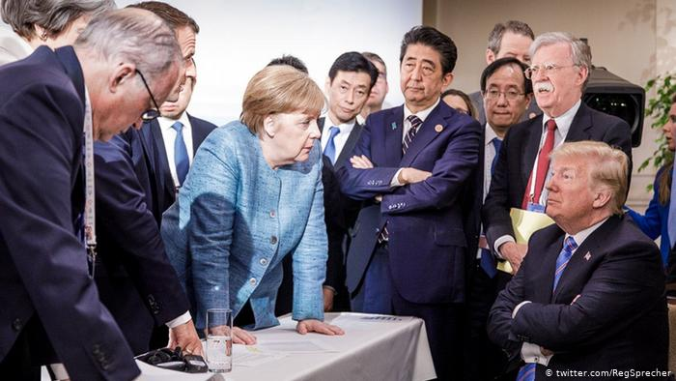
3
4
1
2

Slide 17
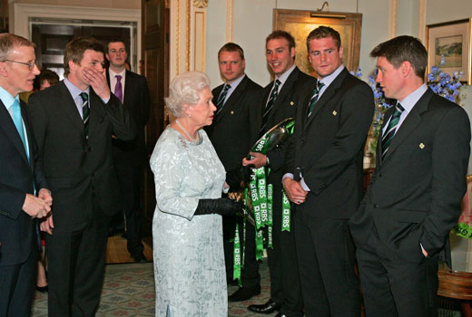
4
7
6
5
3
2
1
Notes:
Situation: meeting the queen and the non-verbal communication going on.
Hands are imporant part of your appearance.
Open hands -> hounesty, truth, loyalthy
Closed or hidden hands -> not caring (onverschillig), closed, not willing to participate

Slide 18
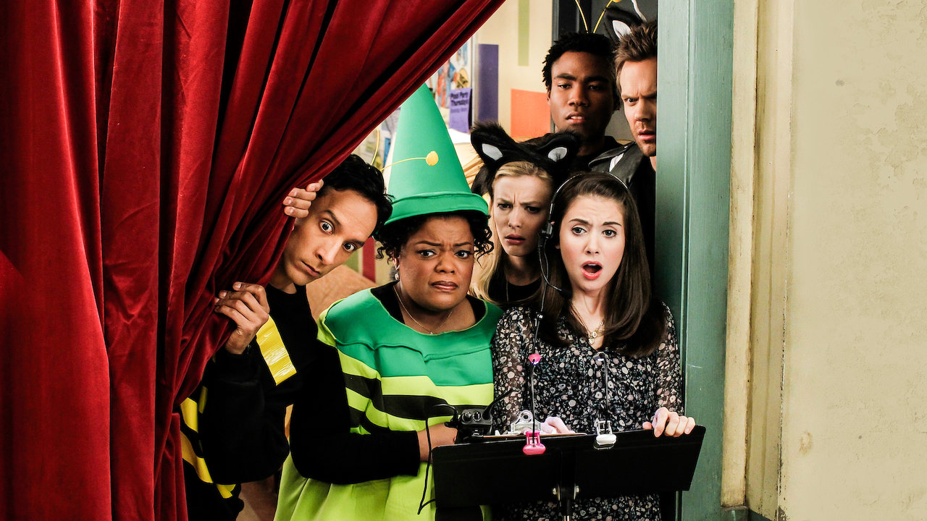
6
5
4
3
2
1

Slide 19
EVALUATING NONVERBAL SIGNALS - Exercise
Make pairs. You will change your partners often. Stand up and find comfortable place for both of you. One person is the teller, other is the listener. Tellers pretend they are presenting (2 min). Suggested topics: Your future work. Last job interview. Experience with successful teamwork.
Tellers make one mistake in their nonverbal communication!
Listeners give overall feedback and try to notice the mistake (1 min).
Change roles, and then change your partner.
You can change subjects, but KEEP IT PROFESSIONAL.

Slide 20
FEEDBACK FOR EFFECTIVE NONVERBAL COMMUNICATION
Observe the reaction of the listener
Pay attention to the level of interest/no interest of the audience
Adjust the content and form to your audience

Slide 21
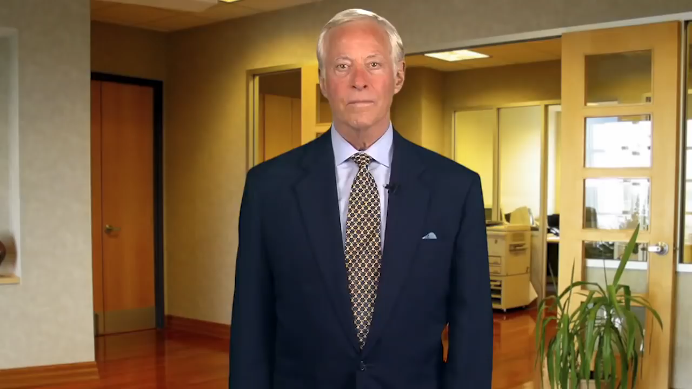
https://www.youtube.com/watch?v=D5hMN_XkPQA
Notes:
Listening actively is the key to successful communication. Here is the summary of this video. 1. Pause : -- Pause for 3 to 5 seconds before interrupting the speaker 2. Question : -- Ask for clarification, never assume that you have fully understood 3. Paraphrasing : -- Paraphrase the speakers words in your words to reflect that you are genuinely listening and understanding

Slide 22
Functions of questions:
questions establish a relationship as they are an indication of interest;
a good choice of questions will control the speech of a talkative or silent communication partner;
by questions we can control the negotiation naturally (topics of conversation are not given by those who answer but those who ask).

Slide 23
TASK -Active listening, Cca 6 minutes in total
Create pairs, in them describe your future job plans
Be a bad speaker. Nervous, stopping, forgetting, jumping from
one topic to another
Your partner uses the mentioned techniques to be a good listener
I thought I heard you say... So, you need to know why I am asking you to share? This is a tough one. We may need to think about it. | Can you tell me more? What else can you remember? What a good idea! You thought of a different way to... | So it is about... Let me make sure that I understand what you mean... What would happen if we...? Have you thought about...? What else could we try?
This is really important to you. You seem worried about this. How proud you must feel! | Are you saying that...? What else can you tell me about...? | I know how hard you have worked to help me understand. Thank you for staying calm while you helped me learn why you were so confused.

Slide 24
Asking questions
Open and close ended questions
  Open-ended questions: "what", "how", "when", "why“
  Open-ended questions are very useful when: you need to gain maximum information, especially about a conversation subject you are not much familiar with; you need to create a good atmosphere and build rapport; you do not know your communication partner and for a successful negotiation you need to learn about their character as much as possible.
  Generally, open-ended questions are mainly suitable at the beginning of a meeting.

Slide 25
Group exercise: Talk, Ask, Observe; in Job Interview
Create groups of 3 people. You will practice job interviews.
One is talking about their area of expertise, hobby, project. Attention is at good nonverbal communication.
Second person asks questions, with the goal of hiring. Important is to keep the conversation going (good listening, open ended questions).
Last person observes BOTH, and gives feedback after cca 4 minutes.
Example start:
„Thank you for giving me an opportunity to interview in your Marketing Agency.“
„Of course. Tell me why do you believe you are a good fit?“
Then change within group.

Slide 26

Group exercise: GET AS MUCH AS YOU CAN!
Please make two papers with VISIBLE X and O markings. Small paper A5 is fine.
You will be in groups of 4
X
O

Slide 27
Group exercise: GET AS MUCH AS YOU CAN!
From now on, do not communicate, including non-verbal communication, unless asked
Instructions for groups of 3 and groups of 4 have a tiny difference in results, but principle is the same
It is OK not to grasp the instructions fully and to not have a plan – confussion and misunderstanding is part of the exercise
You can raise your hand and ask questions individually
OK Question: What is the meaning of the word X?
Not OK Question: Is it best if we do X?

Slide 28
Assertiveness

Slide 29
Energizer!
Two people become „volunteers“ – A and B.
The others can observe, but not comment or hint.
One of you is person B, and looks away. Person A will read the instructions.
Afterwards, person A looks away, and person B reads their instructions.
The exercise starts when lecturer says „start“.

Slide 30

Exercise – The Fist, person A
Person B will make a fist. You MUST get that fist open.
Now look away for B to read their instructions.

Slide 31
Exercise – The Fist, person B
Make a fist. Person A is going to attempt to get you to open your fist.
You must NOT open your fist unless he/she asks you politely and assertively.

Slide 32
Overview
What is assertiveness?
Differences from other types of behaviour.
Practice of assertive communication.
Playing scenarios.
Job interviews (second part of the session)

Slide 33
What is your definition of Assertiveness?

Slide 34
What is your definition of Assertiveness?
Behaving confidently and able to say in a direct way what you want or believe.
Assertiveness means standing up for your personal rights - expressing thoughts, feelings and beliefs in direct, honest and appropriate ways.
Forthright and positive insistence on the recognition of everyone's rights. By being assertive we should always respect the thoughts, feelings and beliefs of other people.

Slide 35
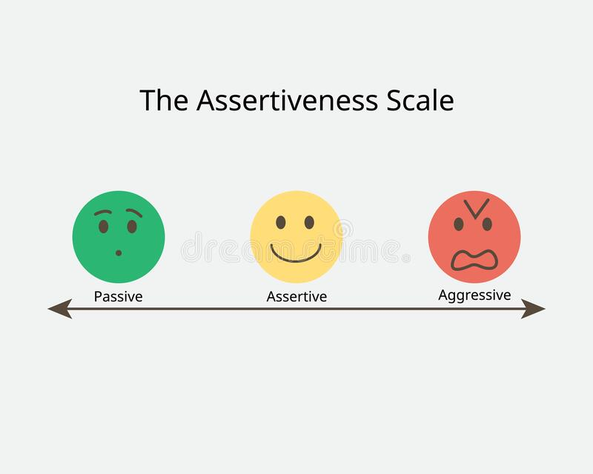
Assertiveness and other modes of behavior

Slide 36
Examples
Aggressive
  “I don’t know how you’ve got the nerve to give me this sort of stuff for signing. It’s full of mistakes.”
Assertive
 “Jane, I’d like you to re-do this document as there are several mistakes in it.”
Non-Assertive / Passive
 “I know it’s probably my fault in not writing very clearly, but is there any chance at all you could find a spare minute to just change one or two small things on this letter for me?”
Or you find an excuse not to say anything at all.

Slide 37
Exercise: Aggressive, Passive or Assertive?
Threats and intimidation
    Aggressive
Never sharing your ideas
    Passive
Accepting compliments comfortably
    Assertive
Manipulating
    Aggressive
Not saying no (when you should)
    Passive
Not saying yes (when you want to)
    Passive

Slide 38
Exercise: Aggressive, Passive or Assertive?
Sarcasm
    Aggressive
Using “I need, I want, I feel” statements to express your needs, wants, feelings, or concerns
    Assertive
Over apologizing
    Passive
Respecting the opinions and needs of others
    Assertive
Withdrawal
    Passive
Blaming
    Aggressive

Slide 39
Exercise: Aggressive, Passive or Assertive?
Believing in own opinion and right to be heard
    Assertive
Easily intimidated by others
    Passive
Violating others’ rights and boundaries in an effort to get what she wants
    Aggressive
Using “I” statements to get the message across
    Assertive
Worrying about others getting angry
    Passive

Slide 40
WHAT DRIVES BEHAVIOUR: Inner dialogues
Inner Dialogues can affect the way we respond, for
example:
Aggressive “If people produce rubbish, I have every right to tell them so”. “She obviously doesn’t care. That’s typical of young people today.” “This reflects badly on me, and I won’t stand for it.”
Assertive “This may be uncomfortable for us both, but we can handle it.” “She has the right to make mistakes, but the responsibility to correct them.” “I want her to know the effect her errors have on other people.”
Non-Assertive “I don’t want to make a scene or upset our working relationship.” “I’m sure these are unintentional errors – I’ll let it go this time.” “I know she’s very busy, so I expect that’s why these mistakes happened.”
Being aware of these Inner Dialogues can help us consider our response and adjust behaviour to be assertive!

Slide 41
Move out of my way!
Create a single line
The second person then has to persuade the person in front to leave the front of the line so they can move up. When the person in front moves, they join the end of the line.
The game is over when the person who started at the back reaches the front.

Slide 42
Exercise!
On the next slides will follow instructions for player A and player B

Slide 43
Player A instructions
Start by pushing the shoulder of the other player, with open palm. Enough to push the shoulder a little, but not to imbalance the other person.
You will then be pushed by the other player. Wait a little, and push the other player again, with the SAME FORCE as you were pushed.

Slide 44
Player B instructions
You will be pushed on your shoulder by the other player.
Wait a little, and push the other player again, with the SAME FORCE as you were pushed.

Slide 45
Assertive techniques
Fogging
Stuck Record
Positive Enquiry
Negative Enquiry

Slide 46
Stuck Record
It involves repeating what you want, time and time again
Without raising the tone of your voice, becoming angry, irritated, or involved in side issues.
You try to save your strenght, by continually repeating a request will ensure the discussion does not become side-tracked
The key is to stay calm, be very clear in what you want, stick to the point and not give up.

Slide 47
Positive Enquiry
For handling positive comments
Especially those with lower self-esteem may feel that the positive comments are not justified.
It is important to react appropriately to positive feedback that you receive.
Positive enquiry is to
  find out more details about the compliment or praise given
  and agree with it.

Slide 48
Negative enquiry
Is used to find out more about critical comments
Good alternative to more aggressive or angry responses to criticism.
You ask for clarification of the things about yourself or your behaviour that might be negative.
It is important to get specific, eliciting information in an unemotional low key manner

Slide 49
Fogging
No arguing back
Minimal, calm response using terms that are placating
But not agreeing to meet demands.
Agree with any truth, even if critical.
The hope is the other person will cease confrontation as the desired effect is not being achieved
When the atmosphere is less heated, it will be possible to discuss the issues more reasonably.
Fogging is so termed because the individual acts like a 'wall of fog' into which arguments are thrown, but not returned. (Other name: Grey Rocking)

Slide 50
Fogging in communication
'The bedroom is a complete mess!'
'You're right - it is messy.'
'It really annoys me when you leave the place in such a state.'
'Yes, I can see you're annoyed. Tidiness isn't one of my strong points.‘
'Not one of your strong points! You'd make a five year old look like the most organised person in the world!'
'I agree I am often not very organised.‘
'It's maddening - can't you see that it annoys people.'
'You're probably right - some people might find it annoying.'
'I don't know if you're ever going to change - it's infuriating!'
'Yes, I can see you are angry about it.'

Slide 51
Final exercise
One person tries assertive behavior, one person opposes, one person gives feedback. Then switch within the group.
You are waiting to see the accountant / IT person. Somebody is getting in front of you, but you believe they should wait in the queue.
At a daily briefing with the team, your manager comes up with an idea, which you yourself had mentioned only 3 days ago. The manager did not mention you. You are annoyed about this, as this is not the first time.
You want to go to the department meeting. Your manager says to you: “As everyone can’t go the meeting, and you were not very helpful last time, would you mind staying and answering the phone.” You want to go.
Your own scenario.
Remember to use the technics mentioned! Fogging, Stuck Record, Positive Enquiry, Negative enquiry. Person giving feedback should point them out if they are not used in the dialogue.

Slide 52
Videos to watch for you
https://www.youtube.com/watch?v=D5hMN_XkP QA
http://www.youtube.com/watch?v=4kyvjEpXuPg
http://www.skillsyouneed.com/present/presentati
on-nerves.html

Slide 53
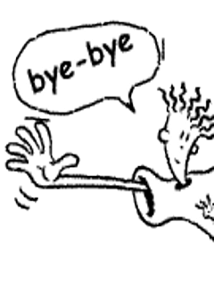
Thank you for your attention

