Slide 1
Financial system of china
Lecturer – Oleg Deev
oleg@mail.muni.cz

Slide 2
Contents
Statistical results of financial reforms in China
Reformation of the banking system
Key challenges for Chinese banking system
Development of financial markets in China
Financial regulations and supervision
Key challenges for Chinese financial markets

Slide 3
Some statistics for discussion
Global financial stock
Global financial stock growth rates
Financial stock as % of GDP
Chinese share of global financial stock
The statistics for years 1993 and 2003 is graphically revealed in McKinsey survey, available at
http://www.mckinsey.com/mgi/publications/gcm/images/cap_markets_map.swf
Was China a major player in a global financial market in 2003?

Slide 4
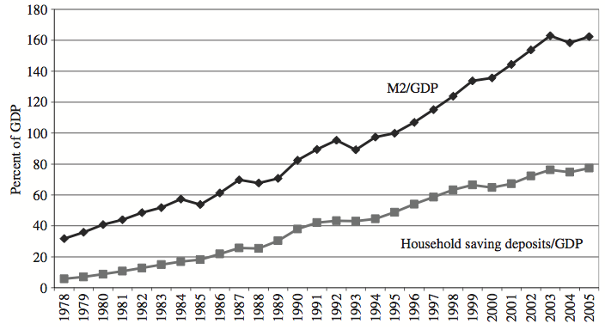
Financial deepening

Slide 5
Banking system before 1978
PBOC
As central bank the People’s Bank of China has an objective of promoting economic growth and price stability.
It focused on monetary policy issues and financial system liquidity.
CBRC
The China Banking Regulatory Commition (CBRC) managed the functions of supervision. It focused on the restructuring of the banking sector
PBOC remains still very influential, it has considerable regulatory power (common overlapping of functions)

Slide 6
Reforming Chinese banking system (1)
Phase One (1978-1994)
1978 - The People's Bank of China (PBC) was designated as a central bank and became independent of the Ministry of Finance resulting in more effective conduct of monetary policy
A two-tier banking system was created in which the PBC emerged as the central bank, while the following banks emerged as the specialized banks
  the Bank of China (BOC)
  the China Construction Bank (CCB)
  the Agricultural Bank of China (ABC)
  the Industrial and Commercial Bank of China (ICBC)

Slide 7
Reforming Chinese banking system (2)
  Other bank and Non-bank financial institutions
Regional banks (partially owned by local governments)
City commercial banks (with business restricted to home city)
Cooperatives banks (Rural Credit Corp., similar to credit unions in the U.S. and Urban Credit Corp.)
Non-bank financial intermediaries (such as the Trust and Investment Corporations ; finance companies, financial leasing companies, auto financing companies)

Slide 8
Reforming Chinese banking system (3)
Phase Two (1994-1998)
Three policy banks were set up to undertake the policy driven financing earlier assigned to specialized banks:
the China Development Bank,
the Agricultural Development Bank of China and
the Export-Import Bank of China

Slide 9
Reforming Chinese banking system (4)
Phase Three (1998-2006)
Reform initiatives (as part of its WTO accession):
  13 cities have been opened for foreign banks to conduct “renminbi” business
  100 eligible foreign banks were permitted to conduct “renminbi” business
  55 of them were allowed to provide “renminbi” services to the Chinese enterprises
  Recapitalization of state banks
      4 asset management companies set up in year 2000 to take over US$1,600 billion of non-performing loans
      US$1108 billion NPLs disposed up to March 2006,
      cash recovery rate 20.8%
      US$45 billion capital injection in 2004 for BOC and CCB
      US$15 billion capital injection in 2005 for ICBC

Slide 10
Reforming Chinese banking system (5)
Phase Four (2006-?)
2006 – removing of all geographic and (most) business restrictions for foreign banks. Foreign Banks allowed to provide 12 categories of services in China. Nevertheless they play rather small role
The permitted equity holding in Chinese financial institutions by a single foreign investor has been raised from 15 to 20%, while the maximum foreign equity holding remains at 25 %
  CCB listed in Hong Kong in 2005, BOC and ICBC in 2006
  Reorganization and recapitalization of China Agricultural Bank and Postal Savings Bank for listing

Slide 11
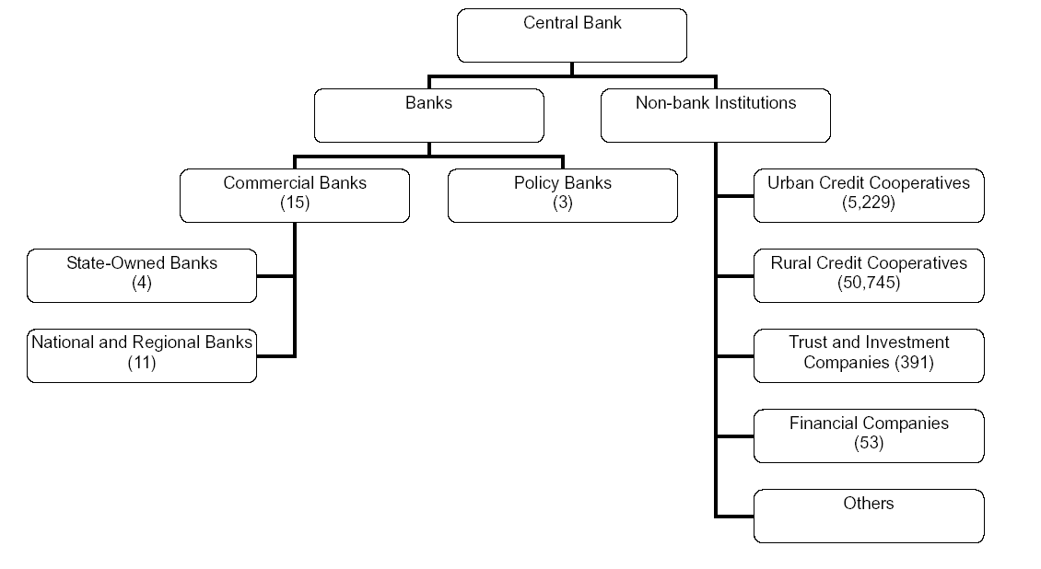
Design of the banking sector

Slide 12
Chinese banking system
China Banking Regulatory Commission
Policy Banks
(3)
Regional
Banks
Joint stock
Commercial banks(10)
Foreign
Banks
(225)
State-Controlled
Commercial
Banks(4)
Postal Saving
Banks
City commercial banks
Co-
operated banks
Non-bank financial
companies
Bank
of
China
Industrial and Commercial
bank of china
China Construction bank
Agricultural bank of china
The assets of the banking sector account for around 95% of the total assets of all financial institutions in China.
62% of the fixed-asset investment in China are funded by banking Sector.
The big four SOE banks are the major players in the Chinese financial market, with their assets accounting for 52.7% of the total bank assets in China.

Slide 13
State dominance in the banking industry (2006)

Slide 14
Banks in China
State-owned banks: ICBC, CCB, BOC, CAB
Joint stock banks: Bank of Communication, China Merchants Bank, Guangdong Development Bank, Minsheng Bank
City banks and credit unions: Bank of Shanghai, Bank of Nanjing, Ningbo Commercial Bank
Foreign banks: HSBC, Citibank, Standard Chartered

Slide 15
Weak bank performance creates vulnerabilities
Key vulnerabilities
Root causes of weak performance
  Renewed NPL build-up
  Sharp reductions in liquidity and profitability, due to concentration of profits, from:
      Foreign bank entry
      Corporate bond market development
      Real estate exposure
  Weak governance and lack of commercial mindset
  Operational weaknesses in lending and risk management
  Decentralized structure with local autonomy

Slide 16
The non-performing loan problem
A residue of casualties of economic reform
The Government’s response a combination of:
  worst loans moved to asset management companies (“bad banks”)
  Capital injections
  Enhancement of recovery rates
  Restrictions of “political” lending

Slide 17
Key challenges for Chinese banking system
Fundamental banking industry reform is far from complete
Ensure large state-owned banks, that have been cleaned up and recapitalized, do not repeat past mistakes
  Upgrade management expertise
  Improve risk management and internal control
  Adopt risk-based pricing
  Implement proper incentive system
Further lower high NLP ratios and address thin capitalization of other underperforming banks
Eliminate influence by central and local governments (introduce real competition)
Further improve regulatory/legal framework (for example, deposit insurance)

Slide 18
Financial markets
  Two domestic stock exchanges:
  Shanghai Stock Exchange Market (SHSE)
  Shengzhen Stock Exchange Market (SZSE)
At the end of 2005, the combined total market capitalization of the SHSE and SZSE ranked 15th among the largest stock exchanges in the world, 2007 – the 5th.
Bond Markets: government bonds, “policy financial bonds”, corporate bond
Private Equity/Venture Capital
  In years 2000-2007 the performance of the stock markets has been volatile
  This is somewhat surprising given the robust performance of the real economy

Slide 19
Chinese capital market
  1540 publicly listed companies on domestic exchanges, 143 on overseas (Feb 2007)
  Equity market capitalization of around US$3 trillion (2007)
      State Shares 33.1%, (non-tradable until 2005)
      Legal person shares 16.7% (non-tradable until 2005)
      Tradable individual shares 50.2%
  Government bond market cap US$ 364 billion
  Corporate bond market cap US$35 billion

Slide 20
Equity market
Great Leap Forward in Equity Market
  An average of US$9 billion raised per year from 1991 to 2006
  In 2007, $50 billion new A-shares were issued, taking the first place in the world (the second place US equity markets raised less than $40 billion in 2007)
  Shanghai Stock index increased by almost 100% in 2007
Private Equity
  Size estimated around 620 billion RMB in 2007, much of it comes from abroad
Enormous Potential
  Great demand in a vibrant economy for private equity
  High risk and cost due to poor legal and financial infrastructure

Slide 21
Chinese stock market reform
Before 2005, state-owned and legal person-owned shares could not be traded on stock exchanges. Large shareholders paid little attention to the prices of tradable shares held by the public
In 2005, the government initiated reforms that made non-tradable shares tradable.
This aligned the interests of large shareholders with that of outside shareholders

Slide 22
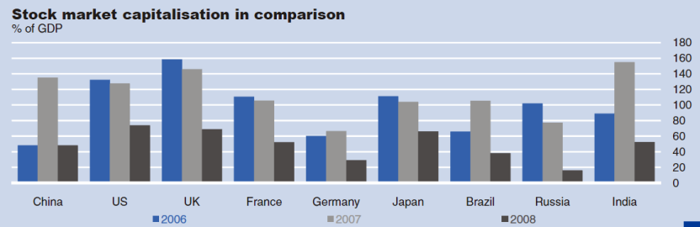
Equity market
Starting in 2006, China’s stock markets witnessed a stellar rise. Average daily trading volume reached USD 26 bn, making it one of the most actively traded markets worldwide.
After the stock market started to correct in October 2007, market capitalization declined to around 50% of nominal GDP as of end-2008. Trading activity also dropped, reaching USD 17 bn on a daily average basis

Slide 23
Shanghai Stock Exchange
Founded in 1891, closed in 1949, reestablished in 1990

Slide 24
Share categories
Non-tradable shares
  Legal person shares
  State-shares
Tradable shares
  A-shares: denominated in RMB
  B-shares: denominated in US$ and HK$
  H-shares: PRC-registered listed in HK$
  Red-chips: Chinese companies registered overseas and listed abroad

Slide 25
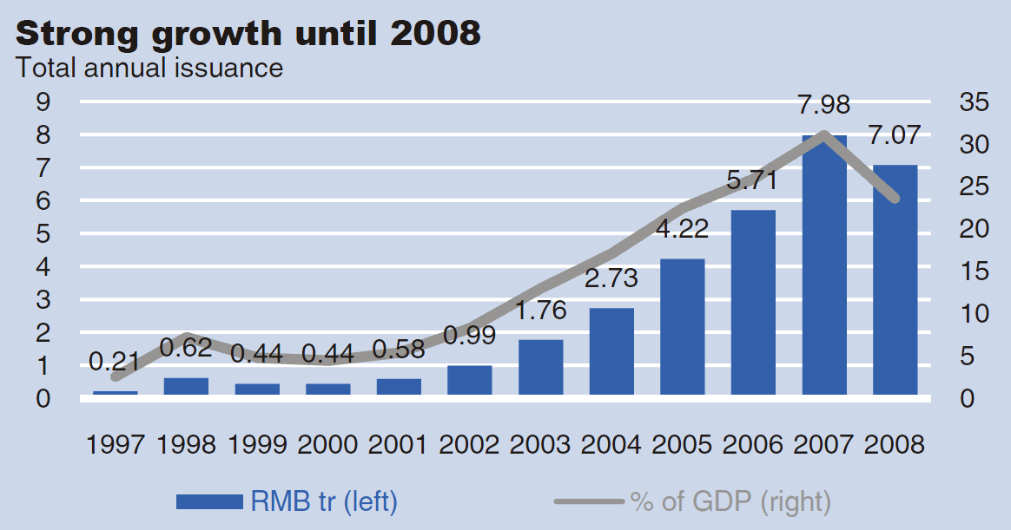
Bond market

Slide 26
Bond market
Although total annual issuance has surged since the early 2000s China’s bond market is still relatively small as a share of nominal GDP (35% in 2007) especially when compared to mature economies
Public sector issuance dominates. People’s Bank of China (PBC) and treasury bonds accounted for almost 80% of total issuance in 2007
Domestic commercial banks are the major players in China’s local bond market, holding close to 60% of the total amount outstanding

Slide 27
Financial regulations (1)
  Entry regulations
    Geographic and business restrictions for foreign banks and insurance companies
    Foreign stake in commercial banks capped at 25%
    Foreign partners can take up to 33% in brokerage firms and fund management companies
    Approval required for branches & offices
    License required for domestic institutions
    Private individuals can only have a minority position

Slide 28
Financial regulations (2)
  Interest rate regulation
    Both lending and deposit benchmark rates are set by the central bank (one year lending rate is now 7.47% and deposit rate is 4.14%)
    Lending rate has no upper limit and the lower bound is 90% of the benchmark rate. the rates for mortgage loan can be 85%.
    Deposit rate has the benchmark rate as the upper limit and is allowed to float downward.
    Interbank rate SHIBOR was introduced on Dec. 1, 2006 and determined by market forces

Slide 29
Financial regulations (3)
  Regulation of international accounts
    Current account deregulated
    Closed Capital/Financial account with a few exceptions
  Managed floating exchange rate regime
    The RMB pegged to USD at RMB 8.27/USD from mid-1990s to 2005
    It is supposed to be pegged to a basket of currencies since July 21, 2005
    The RMB/US$ exchange rate allowed to float no more than 0.5% of the previous day’s closing, 1.5% against other currencies
    No timetable for full convertibility

Slide 30
Financial supervisory bodies
The China Securities Regulatory Commission (CSRC in end of 1992)
The China Insurance Regulatory Commission (CIRC in 1998)
The China Banking Regulatory Commission (CBRC in 2003)
A joint mechanism has been developed among the CBRC, the CSRC and the CIRC for co-operation among themselves

Slide 31
Financial regulatory structure
The State Council
CBRC
CSRC
CIRC
Commercial Banks
Securities Firms
Insurance Companies
Credit Cooperatives
Exchanges
Trust & Investment
Fund Management

Slide 32
Key challenges for Chinese financial markets
Availability of information for investors (information disclosure)
Institutional investors’ involvement in the market development
Problem of insider trading
Monitoring and control of credit rating institutions
Minimization of the financial panic
Encourage small banks to raise capital
Development of the corporate bond market
Government intervention

Slide 33
China’s financial system (1)
Financial institutions
  Policy banks
  Commercial banks
    state-owned
    partially state-owned
    private-owned and foreign
  Non-bank financial institutions
    RCC, UCC, Postal Savings
    TIC, Mutual Funds, Finance companies
Non-standard financial sector
  Informal Financial Institutions

Slide 34
China’s financial system (2)
Financial Markets
  Stock market (SHSE, SZSE, HKSE)
  Bond market
    Government bond
    Corporate bond
  Venture capital / PE
  Real estate
Foreign sector (FDI)

Slide 35
Main characteristics of China’s financial system
China has made steady advances in modernizing its financial system and in mobilizing savings, reflected in the doubling of China’s stock of financial assets relative to GDP over the past ten years
China’s banking sector plays a large role in its financial system
Capital allocation in the system is poor: wholly and partially state-owned companies continue to absorb most of the funding from the financial system, while private enterprise, the engine of China’s growth, receives a disproportionately small share. As a result, China’s investment efficiency is declining
China’s financial system’s remaining problems are intricately linked across its component markets, and will therefore require an integrated approach to reform

Slide 36
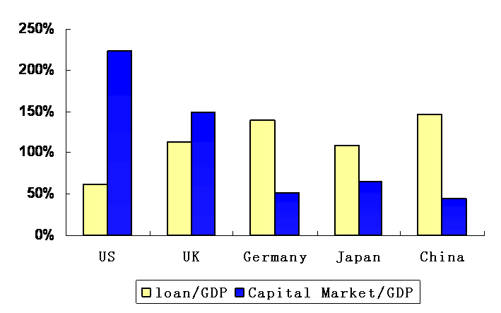
Heavy reliance on bank financing (2006)

Slide 37
Key challenges for financial system
Banks still serve as the primary channel for corporate financing with very limited ability to lay off risks outside the banking system
  Domestic tock market is growing
  Domestic bond market remains underdeveloped
Emerging universal banking trend poses increasing complexity for regulation
  Banks are allowed to set up asset management companies
The biggest issues are probably cultural
  Credit focus, not formula lending allocations
  Creative tensions within banks, and between banks and regulators
  Institutional loyalties

Slide 38
Is China’s financial system sound and safe?
China’s economy is experiencing the fastest growth in the world, and is expected to maintain a relatively high growth in a considerable long period. With further implementation of financial sector reforms and liberalization of the sector, China’s financial sector has the potential to achieve the fastest growth in the global context

