Slide 1
ECONOMIC TRANSITION OF RUSSIA
Lecturer – Oleg Deev
oleg@mail.muni.cz

Slide 2
Contents
Key factors of Russian economic development
Conditions of the transformation
Objectives and goals of the transformation
Transformation procedures
Macroeconomic situation during the transition
Results of transformation
The 1998 financial crisis
Economic growth 1999-2008
Russia during the global financial crisis
Challenges for the future development

Slide 3
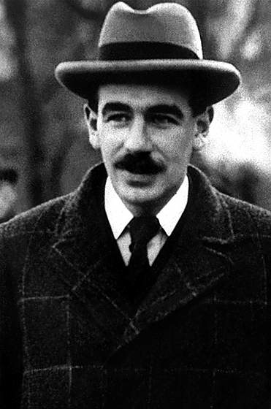
John Maynard Keynes in 1925
“The economic system of Russia has undergone such rapid changes that it is impossible to obtain a precise and accurate account of it… Almost everything one can say about the country is true and false at the same time”

Slide 4
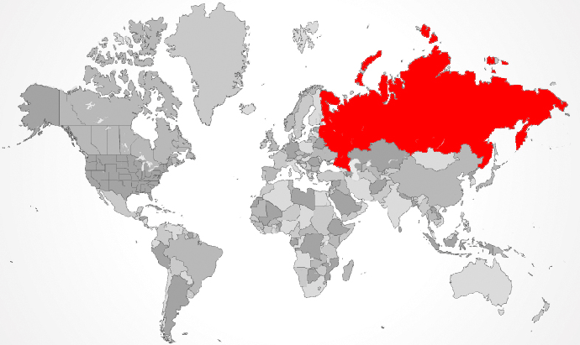
Key factors of Russian economic development
The largest country in the world - 17,075,400 square kilomètres

Slide 5
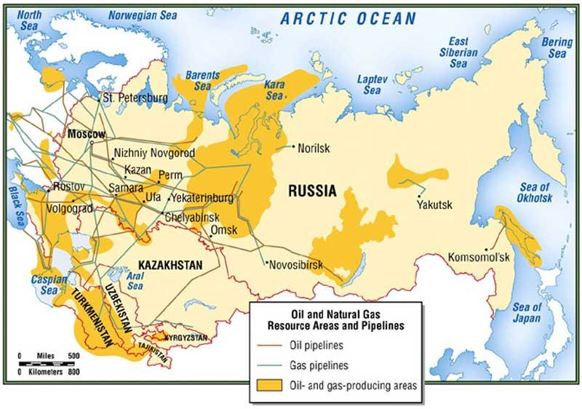
Key factors of Russian economic development
The world’s largest reserves of mineral and energy resources

Slide 6
Key factors of Russian economic development
Conflict between the center and the periphery (diversity of population, nationality and religion)
  160 different ethnic groups and indigenous people
  Religion groups – Russian Orthodox Christianity, Muslim, Buddhism, Catholic, Protestant, Jewish, beliefs (shamanism, pantheism, paganism, etc.)
  Induction into religion takes place primarily along ethnic lines
  Majority of ethnic groups are settled in certain areas
  In modern Russia these ethnic group have a partial sovereignty – 21 republics with its own constitution, president, and parliament within the Russian Federation
  The public finances are generated in the regions, transferred to the center, and only then re-allocated back to the regions

Slide 7
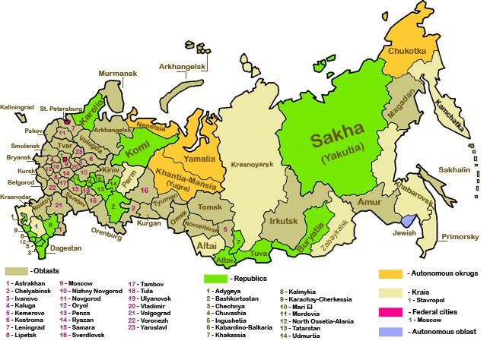
Key factors of Russian economic development
Conflict between the center and the periphery (diversity of population, nationality and religion)

Slide 8
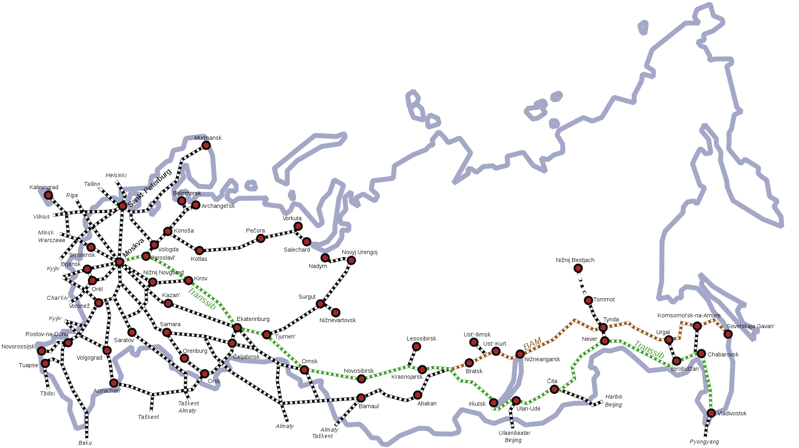
Key factors of Russian economic development
Lack of investment in infrastructure
  One of the world’s longest webs of railways, highways and subways
  the European part is more developed than the Asian part

Slide 9
Key factors of Russian economic development
Vast territory
Natural resources
Conflict between the center and the periphery
Lack of investment in infrastructure
Authoritarian nature of governance to control the territory
Huge expanses on defense and military
The origins of investments are mainly internal

Slide 10
Starting conditions of the transition in late 1980s - social
Low level of social inequality
  as low as in Scandinavian countries
Relatively low level of corruption
Relatively low crime and mortality rates
Immense investments in the human capital
  Free high-quality education in every level
  One of the best education system in the world
  Free health care to all citizens
  Relatively high life expectancy level
  Highly developed pure science and innovation at the theoretical level

Slide 11
Starting conditions of the transition in late 1980s - economic
Centralized bureaucratic allocation replaced market allocation
Economic policy making was strictly hierarchical
Macroeconomic situation – closed economy with the volume of money exceeded the volume of goods;
Microeconomic situation – people demanded other goods than those supplied
No initiative behavior among people and enterprises
Economic distortion of prices
Structural dysfunction of the economy (with prevailing heavy-industries enterprises)
Large budget deficit – more than 6% of GDP
Excessive foreign debt – 30 to 40% of GNP
Falling oil prices
Economic growth – 1 to 3%

Slide 12
USSR economic experiments of systematic changes
1920s – NEP – New Economic Policy
1930s – Industrialization & Collective farming
1950s – Khrushchev’s reforms
1960s – Brezhnev’s reforms
1980s – Gorbachev’s reforms – transition to indicative planning; introduction of some market mechanisms – leased enterprises, family farming, joint ventures with foreign capital
  ended up with political democratization
Reforms did not change the planned nature of the economy

Slide 13
Objectives
Restructuring of the national economy
Macroeconomic stabilization
Goals
Deregulation and promotion of competition
Prices and interest rates liberalization (if to let go the prices, the output might be saved)
Liberal foreign trade police (open market)
Establishment of property rights
Development of the market economy institutions

Slide 14
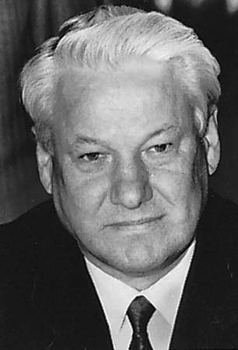
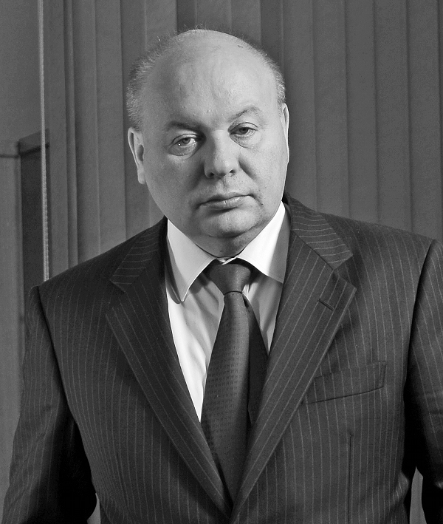
Starting the transition
Boris Yeltsin
Yegor Gaidar

Slide 15
Price liberalization – early 1992

Slide 16
External liberalization - 1992

Slide 17
Privatization – since 1988
Spontaneous privatization (1988-1991)
  control over some industrial assets was acquired by their managers
  this accounted for only several thousand enterprises, a small part of the Soviet industry
Voucher privatization (1992 - 1994)
  each voucher were corresponding to a share in the national wealth
  vouchers were distributed equally among the population, including minors
  vouchers could be exchanged for shares in the enterprises to be privatized
  low price of vouchers $7-10 – less than an average monthly wage
  most shares were acquired by the management of the enterprises

Slide 18
Privatization – since 1988
Loans for shares (1995)
  included most oil, gas and other natural resource-based companies, which were highly profitable ones and were supposed to be sold for cash
  industrial assets were leased through auctions for money lent by commercial banks to the government
  the auctions lacked competition, as they were largely controlled by favored insiders
  scheme that gave rise to the class of Russian business oligarchs, who have concentrated enormous assets
  banks and enterprises involved in the scheme stopped seeing an interest in maintaining high inflation

Slide 19
Macroeconomic instability

Slide 20
Anti-inflation policy – 1992-1998
First half of 1992 (Gaidar). Growth of money supply was restricted; inflation fell to 10% a month in summer 1992; as a consequence, massive non-payments emerged
First half of 1994 (Chernomyrdin). Tightened monetary policy allowed to bring down inflation to 5% a month in summer 1994; again, non-payments increased
mid 1995: exchange rate based stabilization; inflation brought down to 6% a year (July 1998 to July 1997); currency crisis in August 1998, acceleration of inflation

Slide 21
Why high inflation was so persistent?
There was no consensus among major lobbying groups, how to finance reforms, therefore it was impossible to balance the budget
Problems with tax collection: high level of tax evasion in the 1990s. The government was willing, but not able to increase tax revenues
Attempts to tighten monetary policy caused non-payments

Slide 22
What was expected?
GNP growth rates, %

Slide 23
Results (1991-1998)
Free market
Private business – 70% of GDP
Huge fall in output
High inflation
Income redistribution
Privatization – controversial results
  people’s disapproval & emergence of oligarchs
Organized crime and corruption
Capital flight – $20 billion a year
The development of barter economic relations and dollarization
Unemployment and poverty
Deterioration of education system, health care, demographics
Inadequate pension system
Inefficient legal system
Existence of shadow economy

Slide 24
GDP growth rates, %

Slide 25
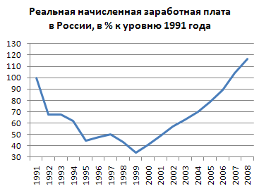
Personal incomes - % of level in 1991

Slide 26
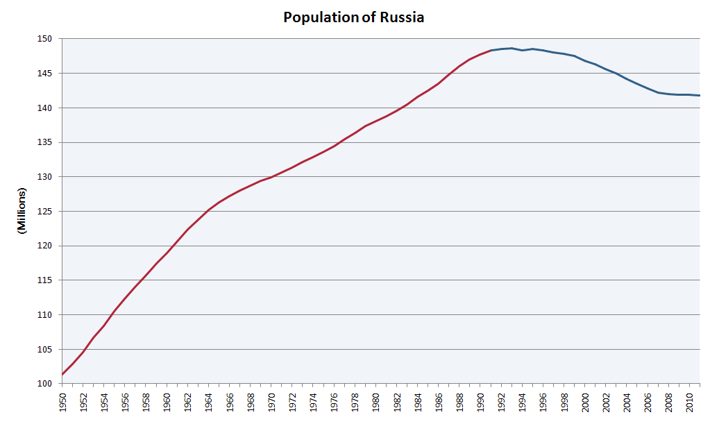
Human development

Slide 27
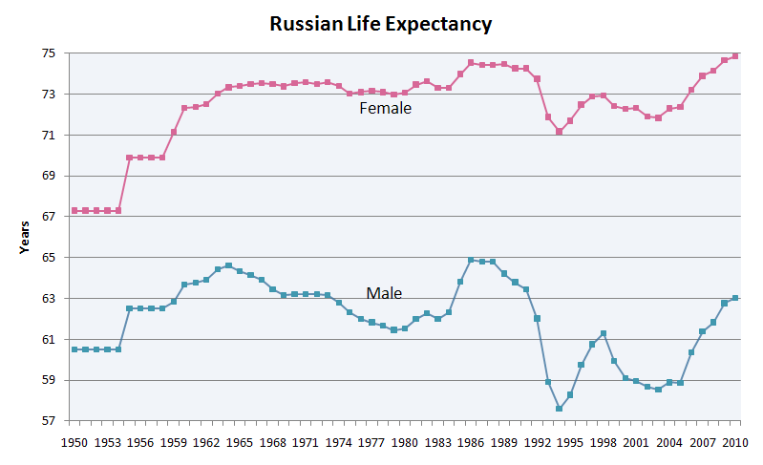
Human development

Slide 28
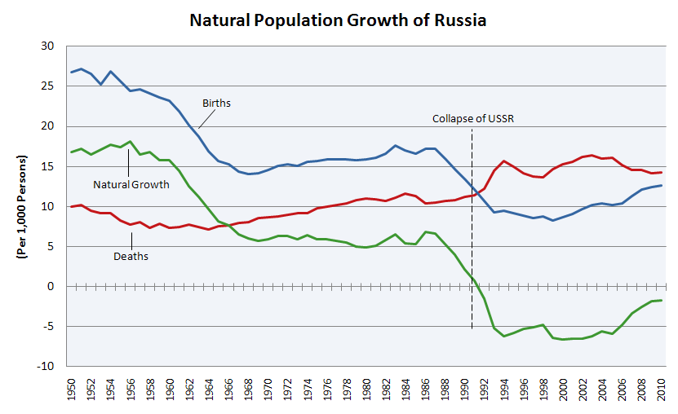
Human development

Slide 29
Russian financial crisis – August 1998

Slide 30
Russian financial crisis – August 1998

Slide 31
Russian financial crisis – August 1998

Slide 32
Russian financial crisis – August 1998
1997 - Inflow of portfolio investment of $46 billion or 10% of GDP
High volatility of exchange rate – ruble/USD (high valuation of ruble)
Extremely high interest rates
1998 – world price for Russia’s oil – 10$ per barrel
The government was not able to refinance it’s debt

Slide 33
Measures – August 1998
Devaluation of the ruble
  At the moment the ruble/dollar trading band was expand from 5.3-7.1 RUR/USD to 6.0-9.5 RUR/USD
  Later the RUR/USD rate was set to move freely within the wider band
Default on domestic debt
  To prevent mass Russian bank default Russia's ruble-denominated debt would be restructured
A moratorium on payment to foreign creditors
  A temporary 90-day moratorium was imposed on the payment of some bank obligations, including certain debts and forward currency contracts

Slide 34
Russia's 1998 financial collapse
In a matter of days the exchange rate lost over 60% of its value
    more than in all most Latin American and Southeast Asian countries (except for Indonesia)
Prices increased by nearly 50% in only 2 months after the crisis
    as compared to less than 6% annual inflation July 1998 to July 1997 before the crisis
Real output fell by about 6% in 1998
    after registering a small increase of 0.6% in 1997 for the first time since 1989, it fell in January - September 1998, i.e. mostly before the August 1998 crisis

Slide 35
Why was the drop so drastic?
Some of the standard explanations
  Bad institutions
  Natural resource dependence
  Bad policies
For a medium income level country, Russia is trade wise open
Financial dependence proved important
  Short-term debt was concentrated and fast growing
  Dependence of financial intermediation on foreign funding
  The dual financial system: households and most companies using domestic markets; some big companies and banks dependent on foreign markets

Slide 36
Measures 1998-1999
Budget reform
  Expenditures and arrears reduction
  Revision of expenditures
Taxation reform
  The creation of efficient taxation system
Changes in banking sector
  The worst half of the banks was closed
  Strengthening the governance of banks
  The payment system improvement

Slide 37
So why the talk of a safe haven?
Politicians were not in the business of doom-saying
Shifting blame to where it belonged: global imbalances
Good grounds why a pure financial crisis might handle Russia softly
  Small financial sector with limeted role in investment finance
  Strong public sector financial position – taxation reform
  Households with no financial wealth, little debt: no wealth effect on consumption
  Labor markets expected to be very flexible

Slide 38
After the crisis
Boom in industry
After devaluation, domestic producers were taking advantage of new export opportunities and made shift from foreign to Russian made goods
Devaluation of the previously overvalued currency restored the previously lost competitiveness
Output was falling in the beginning of 1998, but started to grow in October (unlike in East Asia, where output fell after the currency crises)

Slide 39
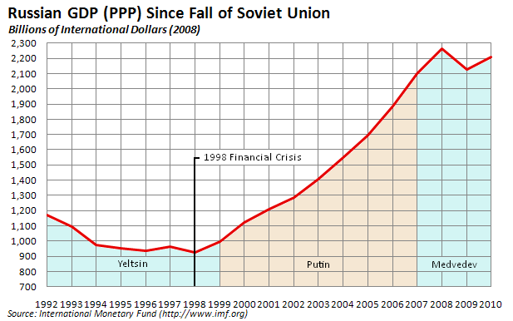
Economic growth – 1999-2008

Slide 40
Output is growing, inflation is under control

Slide 41
Oil price grows, GDP does not accelerate

Slide 42
Russia’s anti-crisis policies – 2008-2009
Basically similar to those in other countries
Package of tax reforms, reducing the tax burden
Emphasis on monotowns, pensions, minimum wages - crisis fighting as a social policy measure
  Since 2005 - emphasis on social policy, with view on demography (national priority programs). In practice - expenditure on health, education and housing are stable as share of budget, increasing in line with total expenditure
  Since 2007 - decisions to increase pensions, minimum wages, public sector salaries were made
Structure of the banking system left no alternative to ”favoring” state-controlled banks as liquidity channels

Slide 43
Challenges for the future
Unpredictable export revenue
  Oil price
  Energy efficiency needed for maintaining export volumes
  Changes in gas markets
Regaining budget surplus
  Re-accumulating reserve funds is a high priority
  Expenditure pressure due to recent hikes, long-term needs
  Revenue problem due to declining share of energy sector in GDP
Exchange rate policy
  Increased flexibility of nominal rate, no pure inflation targeting
  Real exchange rate appreciation pressures as financial inflow resumes
Financial system development
  Rolling back the state
  Need for long-term domestic funding
Pension reform
  Increasing dependency ratio
  Previous failures to depart from pay-as-you-go
Competitiveness of jobs

