Slide 1
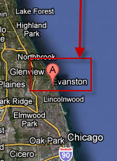
CONWIP
(A pull alternative to kanban principle)
Main resources : Mark Spearman, David Woodruff and Wallace Hopp
Northwestern University,
Evanson, Illinois, USA
Diagrams, modifications, structures and editing (J.Skorkovský,KPH)

Slide 2
Methodologies used for effective production control
Based on PULL principle
  JIT
  kanban
  zero inventory
    kanban (mostly used for repetitive manufacturing)
Based on PUSH principle
  MRP (MRP-II)
Based on both principles (push and pull)
  CONWIP (Constant Work In Progress)
greatly reduced inventory levels
and production lead times

Slide 3
PUSH and PULL
PUSH : production jobs (production orders) are scheduled (MRP nad MRP-II)
  often not feasible plans are generated and problems are often detected too late
  used fixed lead times=LT (see next slide) do not depend on capacity utilization
  Having in mind , that production is random process, LT is very pessimistic
PULL : production jobs (production orders) starts are triggered by completion of another job
Black box
t=start of the job
t+LT=end time of the job (where LT=constant)

Slide 4
Flow time and Lead time
Flow time (known also as a „cycle time“)
Typically random time (highly variable)
time
Job is released
Job is completed
Lead time (constant used for planning )
Controlling parameters
JOB 1
Job scheduling
(MRP-MRP-II)
WIP level
Flow times
FGI level
JOB N
FGI – finished good inventory

Slide 5
Components for Job N needed…
1 (kanban = card)
2
Operation (Job1)
Operation (Job2)
Operation (JobN)
Components for Job N produced and
Supplied (pulled)
UPSTREAM
Authorization
to start Job 2
DOWNSTREAM
1
=kanban
Controlling parameter
Production
The number of cards in the system determines the WIP levels in the plant

Slide 6
JIT
Kanban is not JIT (manufacturing philosophy)
JIT encompasses :
  kanban
  total quality control (TQM) – e.g. scrap loss not tolerated….
  setup time reduction
  worker participation
Advantages of JIT philosophy :
  reduced WIP
  shorter flow times
  lower production costs
  greater customer responsiveness

Slide 7
PUSH and PULL are not mutually exclusive (vzájemně se nevylučují) approaches and other statements…
Push and Pull can be combined !
MRP is considered to be more applicable than kanban
MRP is in almost any discrete part production
Kanban(JIT,pull) – superior results if applicable
Kanban(JIT,pull) – is difficult to use if :
  Jobs with short production runs
  Significant setup times
  Remarkable Scrap losses
  Unpredictable fluctuation in demand

Slide 8
PUSH and PULL and the types of the queuing networks
Push : open queuing network
Pull : closed queuing network
Push : schedule Throughput and measure WIP
T
WIP
PULL : setup WIP and measure Throughput

Slide 9
Advantage of PULL over PUSH
PUSH : WIP and Throughput fluctuations – result in violation of the assumption, that Flow Times (FT) and therefore Lead Times (LT) are constant ! Push is more difficult to manage than Pull
WIP is easier to optimize than Throughput (T)
Little´s low :
Average FT=Average WIP/Average T – meaning that FT cannot be constant but vary with WIP and T
Pull is easy to manage : why ? -> WIP is easier to control than an estimation of the capacities needed to appropriately release work in Push system

Slide 10
CONstant Work In Process = CONWIP
System having benefits of a PULL and can be used in variety of manufacturing environment
CONWIP : generalized form of Kanban
CONWIP relies on signals (electronic, paper
cards, semaphores,…)

Slide 11
CONstant Work In Process = CONWIP
Kanban: card is used to signal production of a specific part
CONWIP : card is assigned to production line and are not part number specific

Slide 12
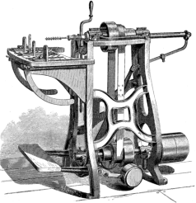
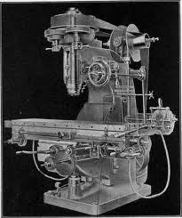
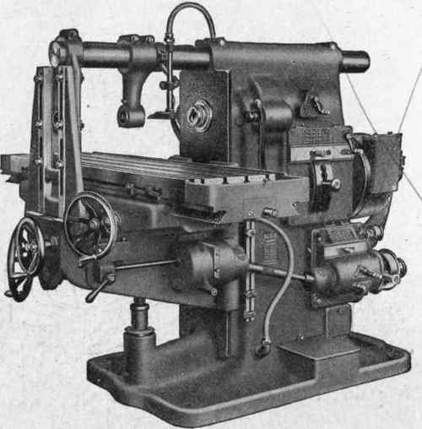
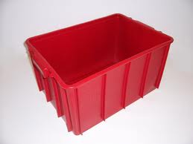
CONWIP
BOM of the final
product (7)
cards
7
4x
6
5
2x
Container C
parts
parts
Container B
Queue (First- In First-Served=FSFS system)
4
3
2
1
2x
2x
3x
3x
Container A
Container A
Container A
Container A
Bag log list
1 : 6 pc
2 : 6 pc
3 : 8 pc
4 : 8 pc
6 : 0 pc
5 : 0 pc
7 : 0 pc
Bag log list
1 : 6 pc
2 : 6 pc
3 : 0 pc
4 : 0 pc
6 : 4 pc
5 : 0 pc
7 : 0 pc
Bag log list
1 : 0 pc
2 : 0 pc
3 : 0 pc
4 : 0 pc
6 : 4 pc
5 : 2 ks
7 : 0 ks
Bag log list
1 : 0 pc
2 : 0 pc
3 : 0 pc
4 : 0 pc
6 : 0 pc
5 : 0 ks
7 : 1 ks
System Entry Time=SET
maintaining of BLL
(bag log list) is
responsibility of
inventory control staff
SET=8:00
SET=10:00
SET=12:00
SET=14:00

Slide 13
CONWIP parameters
The card count (it determines the max WIP level for the line) =m
Production quota (target production quantity/period) =q
Maximum work ahead amount =n (if q+n is produced during a period, the line is stopped until the start of the next period)

Slide 14


CONWIP-air traffic control
Originating airport
Destination airport
(air above airport)
If heavy air traffic, departing planes should be held on the ground
at the originating airport rather than control flying aircrafts
in the air above destination airport as a holding pattern
The results : greater safety and lower fuel consumption

Slide 15
CONWIP-Theory of Constraints
Balance the flow and not the capacity
Operation of the CONWIP line is regulated by the bottleneck resource
If we have sufficient demand, the correct number of the cards will maintain just enough WIP to keep bottleneck busy

Slide 16
Thanks a lot for Your Attention
Skorkovský

