Slide 1
Guidance Store System
Miki Skorkovský
Notes:
This is the presentation template for Navertica a.s. / Navertica SK s.r.o.
A document theme file has also been provided for top-level control of fonts and colours
Several different layouts are packaged within this template.
The standard title and content layouts will load by default. Other layouts are available within your “Slide Layouts” palette.
Charts will all adopt the Navertica colour theme automatically, provided the document theme file has been installed and selected under your “Document Theme” palette.
A sample presentation has also been provided to illustrate the different slide layouts, as well as a small illustration of different chart displays.
Be sure to delete these notes and the colour palette slide before saving your final document.

Slide 2
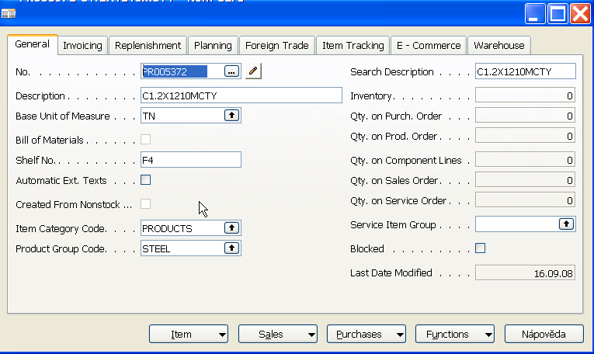
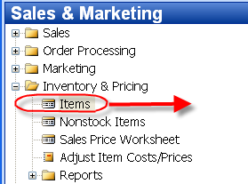
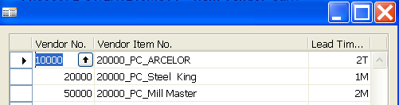
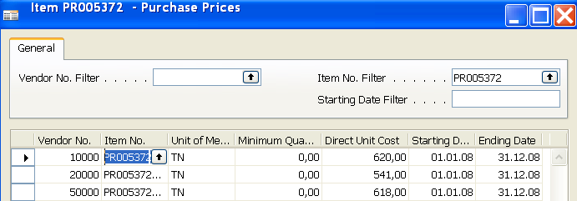
Standard Item Card (Steel)

Slide 3
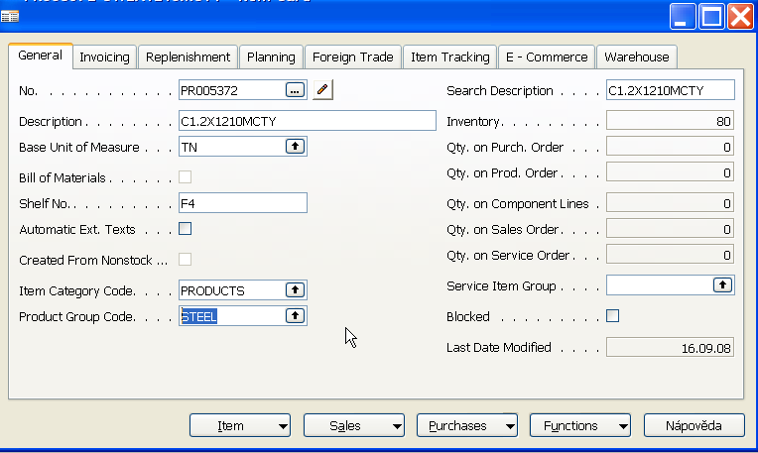
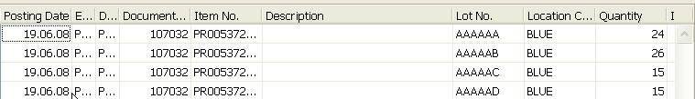
Purchased Products and Item Ledger Entries (Steel)
Quantity on hand

Slide 4
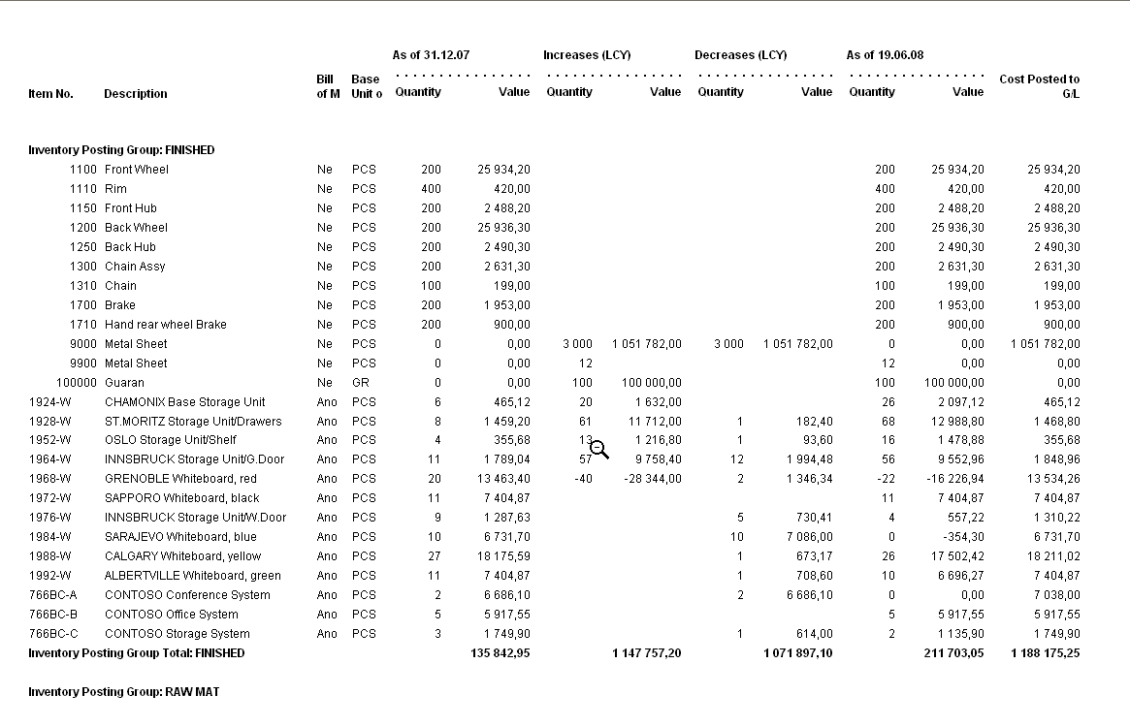
Standard Item Card (Consumables)- Inventory Valuation

Slide 5
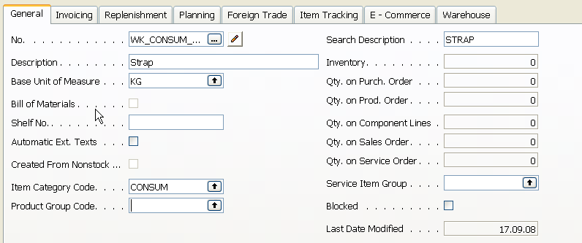
Creation of the new Item Card

Slide 6
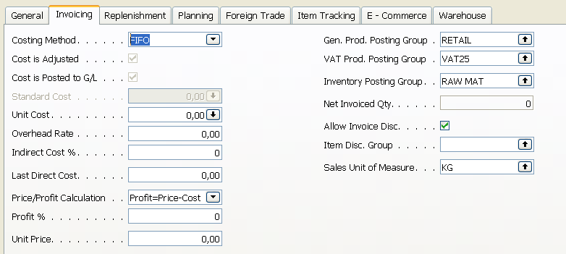
Creation of the new Item Card

Slide 7
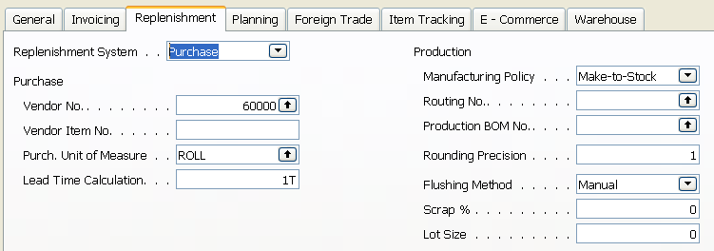
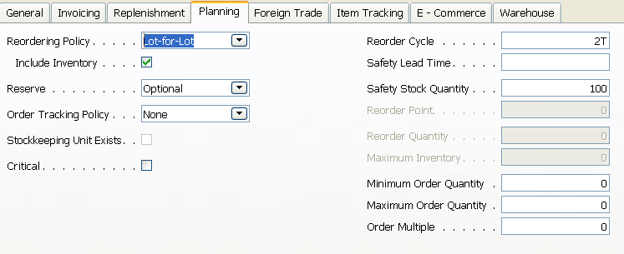
Creation of the new Item Card

Slide 8
Item Card and Entries (Item Ledger and Value Entries)
Item Card
Inventory Value
Availability
Reservation
Location
Order
Tracking

Slide 9
Stock Availability
Reasons for reordering (replenishment)
  Sales Order (CR)
  Production Order
  Transfer Order
  Both of above
Sales
Order
Production
Order
Transfer
Order
Gross
Requirement
Components
Item Card
Availability

Slide 10
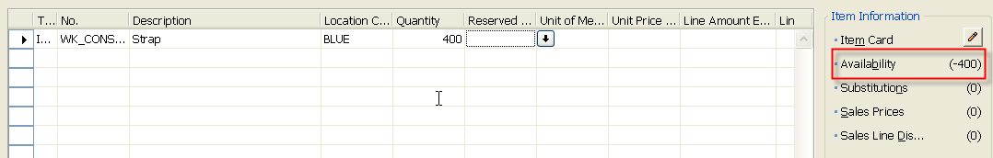
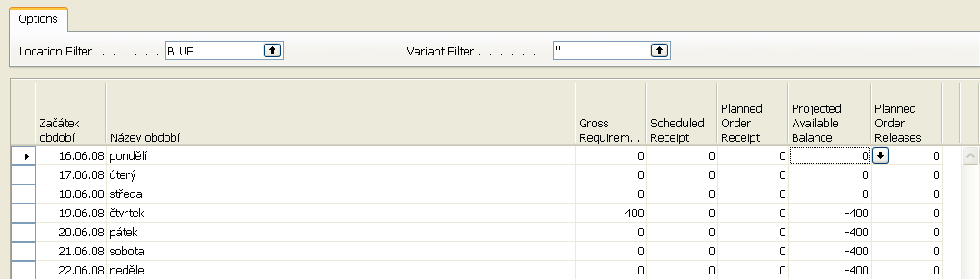
Stock (Item) Availability by Period
Sales Order Header
Sales Line

Slide 11
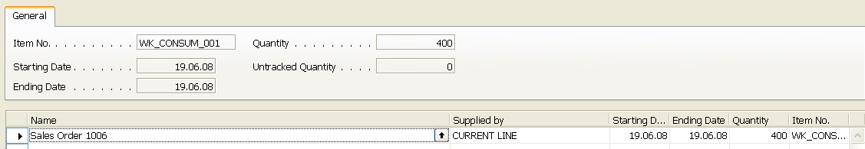
Suggested replenishment using standard Req Work Sheet
Order
Tracking
Sales
Order

Slide 12
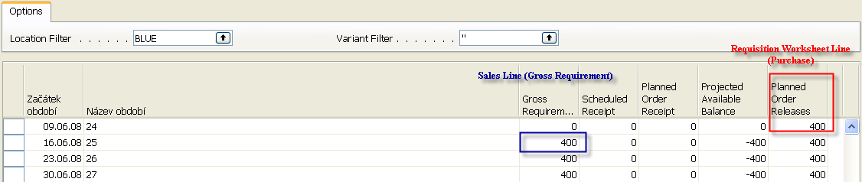
Stock (Item) Availability by Period

Slide 13
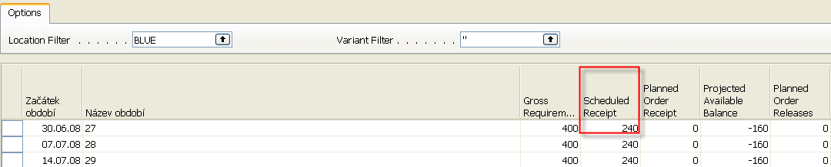
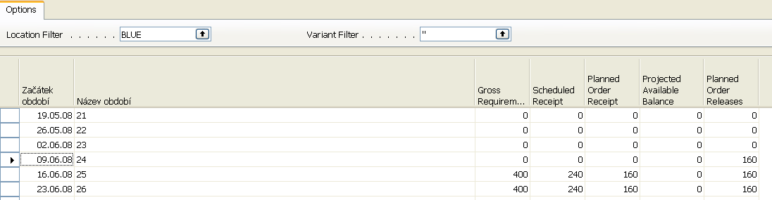
Stock (Item) Availability by Period (after partial Purchase Order is issued)
and after RQWSHT started again

Slide 14
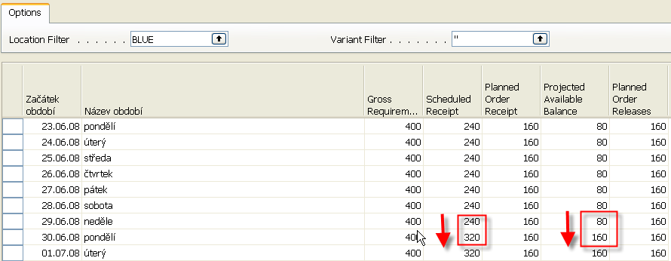
Stock (Item) Availability by Period (after another partial Purchase Order has been booked)
What we have at our disposal at the given point of time. This goes beyond the quantity
on hand and includes such a factors as allocations, meaning quantities,
that have been already put aside or reserved for specific purposes

Slide 15
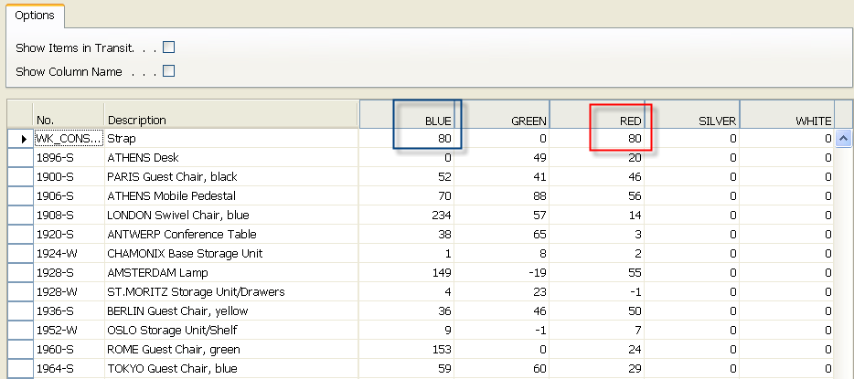
Stock (Item) by Location (after another partial Purchase Order has been booked)

Slide 16
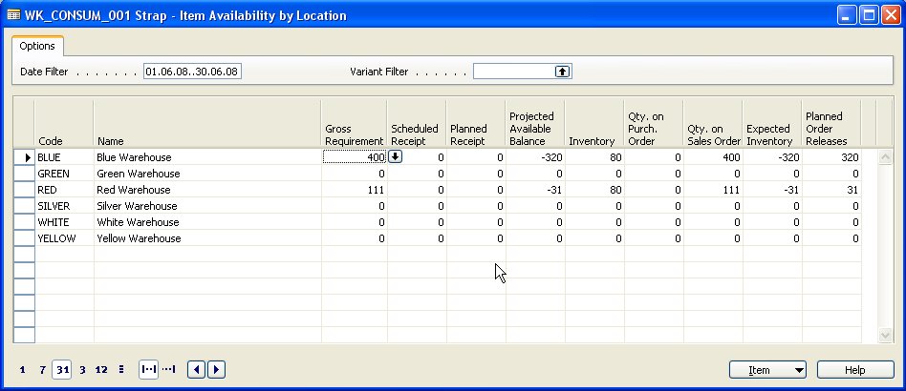
Stock (Item) Availability by Location

Slide 17
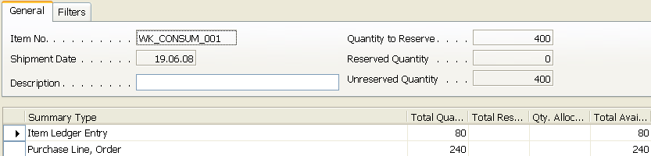
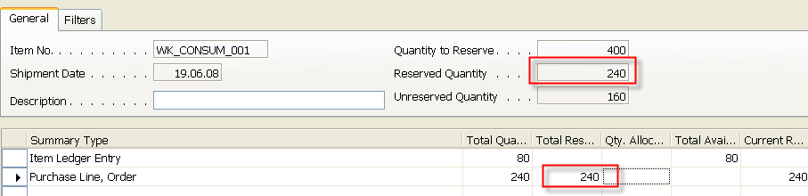
Stock Reservation (from Sales Order Line)
Sales
Order
Reservation form before action is taken
Reservation form after partial action was taken

Slide 18
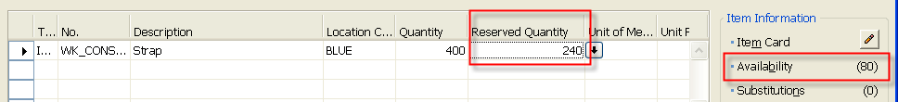
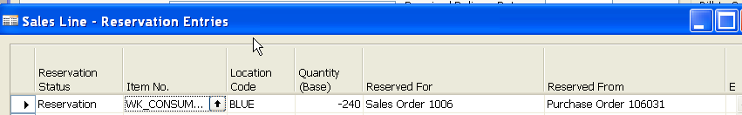
Stock Reservation (from Sales Order Line)
Sales
Order
Item Card
Reservation entries
Purchase
Order 106031
Item Card

Slide 19
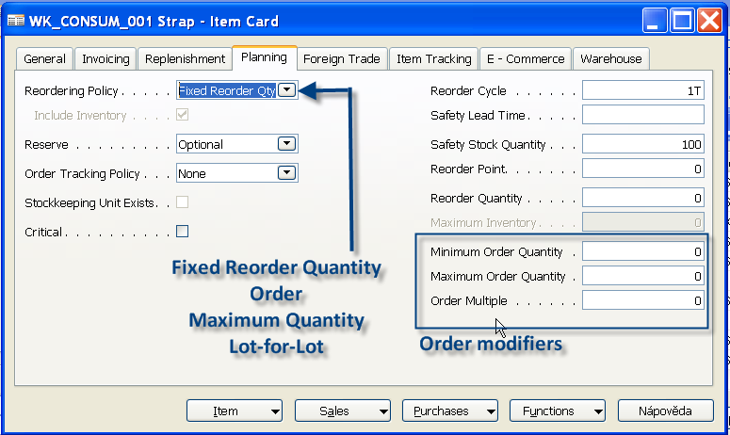
Stock Reordering Policy
Once the program has detected the need for replenishment, it uses reordering policy to calculate the lot size per planning period, which you define in Reorder Cycle Field. Depending of chosen value in Reordering policy field your replenishment rules for calculation is driven by Order Modifiers and other fields on right hand side of the form (Safety Stock, Maximum, Reorder Point,..)

Slide 20
Stock Reordering Policy – Fixed Reorder Quantity
The program uses the quantity specified in Reorder Quantity filed as the standard lot size. Notwithstanding, the program may adjust this quantity to meet additional requirements of the specific inventory level. In this case program disables Maximum Qty field.
In this example we are using 2 Stock Locations (Bays): Red and Blue
Gross Requirement | Reorder Quantity (RQ) | Safety Stock Quantity (SSQ) | Reorder Point (RP) | Projected Available Balance (Stock in Hand) | Calculated Quantity
400 | 400 | 500 | 600 | 80 Blue + 80 Red | 320 Blue + 500 + 400
400 | 400 | 0 | 0 | 80 Blue + 80 Red | 320 Blue + 400
400 | 400 | 500 | 0 | 80 Blue + 80 Red | 320 Blue + 500
IF SSQ<RQ-> 320+400
80 + 320 = 400

Slide 21
Stock Reordering Policy – Maximum Quantity
The program uses the quantity specified in Maximum Quantity to determine the maximum lot size. The program may adjust this quantity to meet additional requirements of the specific inventory level. If this option is selected, than Reorder Quantity field is disabled (it is use only with Fixed Reorder Quantity option.
In this example we are using 2 Stock Locations (Bays): Red and Blue
Gross Requirement | Maximum Quantity (MQ) | Safety Stock Quantity (SSQ) | Reorder Point (RP) | Projected Available Balance (Stock in Hand) | Calculated Quantity
400 | 300 | 300 | 0 | 80 Blue + 80 Red | 320 Blue + 300 + 300
400 | 400 | 0 | 0 | 80 Blue + 80 Red | 320 Blue
400 | 330 | 222 | 0 | 80 Blue + 80 Red | 320 Blue + 552
400 | 330 | 340 | 0 | 80 Blue + 80 Red | 320 Blue + 340
Note that for optimal results, you should set up
this field so that maximum inventory>reorder point>safety stock.

Slide 22

Stock Reordering Policy – Maximum Quantity
Note that depending on the current inventory at the time,
this may result in order proposal quantities that cause
the projected available balance to exceed
the maximum inventory that you define

Slide 23
Stock Reordering Policy – Lot-for-Lot
The program generates an order proposal with a quantity that meets the sum of the requirements that come due within the reorder cycle. If you select this option, the program disables the Reorder Quantity field, which is used exclusively with the Fixed Reorder Qty. option, the Maximum Inventory field, which is used exclusively with the Maximum Qty. option, and the Reorder Point field. Using the reorder point with Lot-for-Lot could result in additional (surplus) replenishment order proposals.
Gross Requirement 19.6.2008 (BLUE) | Gross Requirement 29.6.2008 (RED) | Safety Stock Quantity (SSQ) | Reorder Cycle | Projected Available Balance (Stock in Hand) | Calculated Quantity
400 | 111 | 200 | 1M | 80 Blue + 80 Red | 320 Blue + 200 + 31 Red
In this example we are using
2 Stock Locations (Bays): Red and Blue
Where 111 = 80 + 31 for Red location

Slide 24
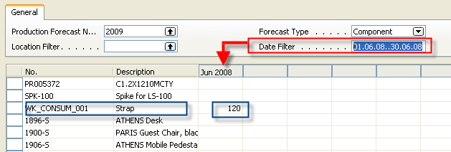
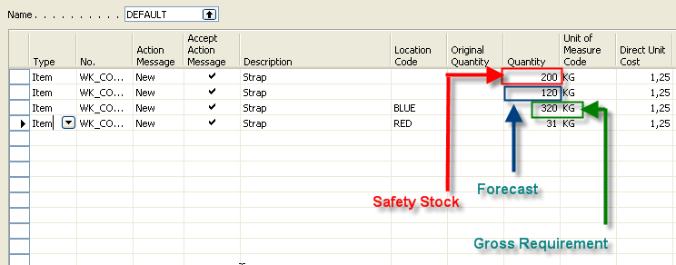
Use of forecast for planning replenishment
Requisition Worksheet

Slide 25
Net Requirement; Gross Requirement- definitions
Some helps refer for calculation : firstly calculate availability and then Net Requirement
Comments : i = period, GR- Gross Requirement, NR= Net Requirement, SS- Safety Stock, PO=Purchase Order, SO – Sales Order
Definition 1 : Stock[ i ] = Expected stock [ i ] = Stock calculated for the last date of the previous period + Quantity of already generated PO – Quantity of already generated SO - SS
Simplified definition : Stock[ i+1 ] = Stock[ i ] + Expected receipt – Expected delivery – SS
GR=NR + Stock[ i+1] , Stock availability
NR = GR - Stock[ i+1] = GR- Stock[ i ] – receipts + deliveries + SSZ

Slide 26
Order Promising I
ATP – based on the inventory reservation system – performing the availability check (calculation of the date of delivery )
CTP – based on WHAT IF scenarios. Earliest date that item will be available
If no items that can be available, no inbound orders- purchase, transfer , return, production – it calculates Earliest date, create Order lines and reserve inventory. May be integrated to the production scheduling, transfer and purchase

Slide 27
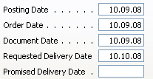

Order Promising II
Part of SO Header
IF RDD exists THAN RDD = PDD
Part of SO Lines
PDD is calculated by Navision
if RDD is not entered
Entered manually
to affect calculation
RDD is entered manually if required by customer
and it affects the calculation

Slide 28
Order Promising III
From Sales Header
(can be changed manually)
Requested Delivery
Date=RDD
Shipment
Date=SD
Planned Shipment
Date= Plan SD
Planned Delivery
Date=Plan DD
Output
Warehouse
Handling Time=OWHT
Shipping
Time=ST
Promised Delivery
Date=PDD
Calculated by Navision
Manually entered
to Navision
Navision verifies, if by hand entered RDD is realistic,taking into account inventory availability (using backward calculation)

Slide 29
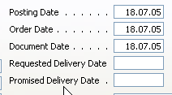
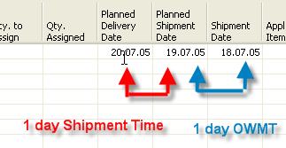
Scenario I
Sales Line
Sales Header – a part of it
REQUESTED Delivery Date not entered
Comment : Outbound Warehouse Handling Time = OWMT

Slide 30
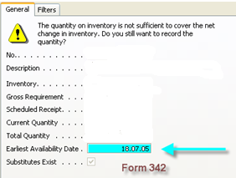
Scenario II-1
On must be carefully setup up :
Check Available period Calculation
and
Check Available Time Bucket
(in Company setting)
Sales Order Header
Sales Order Line
Location Green, PART001 – 30 pc
PART001
TEST
Another possibility to get help in guess
of availability is use of
CTP =Capable-To-Promise
11
30
30
-19

Slide 31
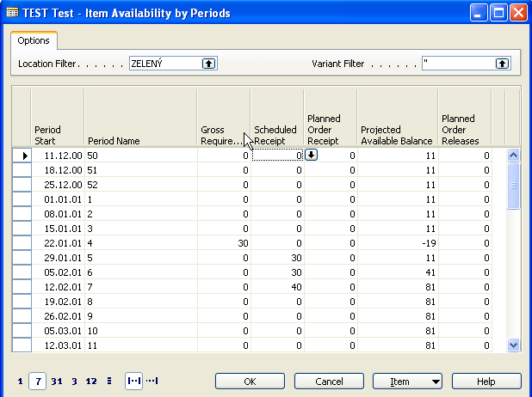
Scenario II-2

Slide 32
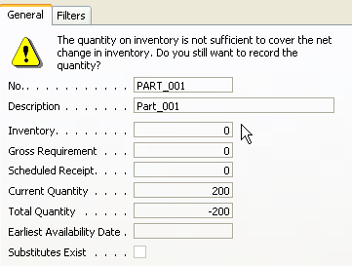
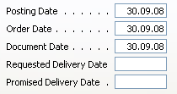

Scenario III-1
Sales Line

Slide 33
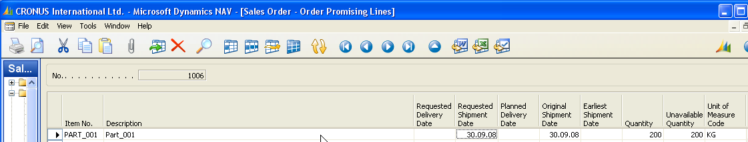
Scenario III-3
Before CTP calculation
After CTP calculation

Slide 34
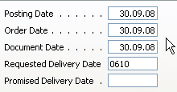
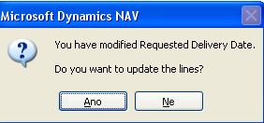



Scenario III-4 – Requested Delivery date entered manually
After CTP calculation
Sales Line when accepted
PART is reserved
Request Worksheet is created is CTP accepted

Slide 35
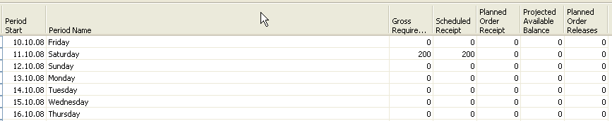
Scenario III-5
Request Worksheet to replenish PROD_001 is created ->Purchase Order is created

Slide 36
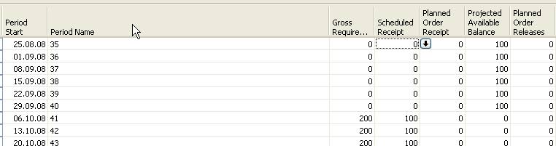


Scenario III-6 – PC purchased and 50 % of production registered
After some stock transfers- bin in standard will be changed and modified to GRID

Slide 37
COLOUR PALETTE
Backgrounds Primary Text Secondary Text
Accent Accent Gradients
Gradient Upper Levels

