Slide 1
Requisition Management- ENG version
Skorkovský, KPH ESF MU 2012

Slide 2
Requisition Management
Overview
Requisition Management Setup
The Requisition Worksheet
Additional Worksheet Features

Slide 3
Requisition summary
The requisition worksheet – the central processing tool – offers the following features:
• Calculates a current and detailed purchase order proposal plan.
• Creates actual purchase orders from order proposal lines.
• Handles stock keeping units that are replenished by transfer and
creates the corresponding transfer orders.
• Automatically handles designated purchase order lines from other
areas of the application.
• Handles manually created purchase order proposal lines.
• Controls the flow of relevant information between concerned
departments.
• Provides a practical overview of the individual processes involved.

Slide 4
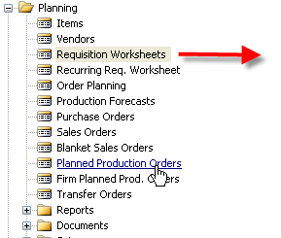

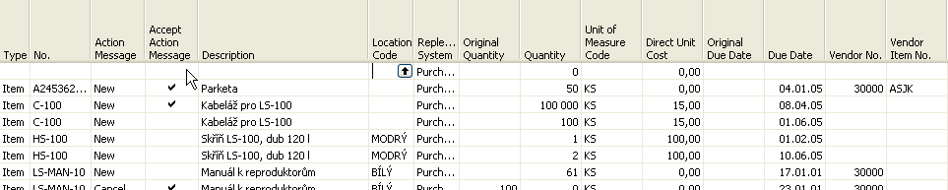
Requisition worksheet
SETUP :
Reorder Point
Safety Stock
Time bucket
+ Lead Time Calculation +

Slide 5
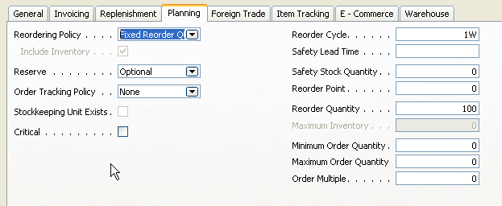
Other important parameters setup : page 115 - 116
Modifiers

Slide 6
Basic setup I – Safety Stock and Reorder Point (part one)
Safety Stock (SS) – : the protection against fluctuation of the demand.
If Inventory Level < SS , it means that it will drop below this level (Safety Stock level), than we will get a suggestion of the quantity equal to the variance (difference) of the current state of Inventory and Safety Stock Level .
Reorder Point - : if the Inventory drops below this level, than when starting batch planning job in requisition worksheet or planning window, which supply you, according to the setup of modifiers, a REPLENISHMENT. You must have realistically setup Lead Time Calculation, Safety Lead Time and Reorder Quantity. If those fields are not setup, you will get a suggestion so, that the replenishment will be just to the level of the reorder point itself. The important modifiers are also Minimum Order Quantity and Maximum Order Quantity - see next slide

Slide 7
Basic equations (1st approximation)
AV=Availability = Inventory + IN –OUT – SS
IN=Planned Receipts + Issued Receipts
OUT=Issued Sales Orders +Requirements from Manufacturing Application
SS= Safety Stock
Net Requirement = Gross Requirement - AV

Slide 8
Basic Setup II – Reorder Point (part two)
In this field, you can enter a quantity of stock that sets the inventory level below which you must replenish the item. You can equate the reorder point quantity to anticipated demand during the replenishment lead time.
The Reorder Point field plays the following role in the planning calculations when the reorder point>projected available balance>safety stock quantity
The program will create an order proposal that is forward scheduled from the date of the requirement that used the deficit in the projected available balance – inventory level
The order proposal quantity will, at the minimum, bring the projected available balance up to the level that is specified by the Reorder Point field.
The final order proposal quantity may be further adjusted due to additional requirements within the Reorder Cycle, the effects of the reordering policy, and the three quantity modifier fields: Minimum Order Quantity, Maximum Order Quantity and Order Multiple.
If you leave the field blank, the program sets the reorder point quantity for the item to zero.
Note that the field is disabled when you select the reordering policy options of Order and Lot-for-Lot.

Slide 9
Basic Setup III – Maximum Inventory
In this field, you can enter a quantity that you want to use as a maximum inventory level. When calculating order proposal quantities, the program will then use maximum inventory minus the actual quantity available at the time of the order. Note that depending on the current inventory at the time, this may result in order proposal quantities that cause the projected available balance to exceed the maximum inventory that you define.
This field is used only with the reordering policy Maximum Qty. It is disabled for all other reordering policy options.
Note that for optimal results, you should set up this field so that maximum inventory > reorder point > safety stock.
Maximum
Actual quantity
Ordered Qty
Reorder Point
Safety Stock

Slide 10
Basic Setup IV – Minimum Order Quantity
In this field, you can specify a minimum allowable quantity for an item order proposal. Once the program has detected the need for replenishment and adjusted the lot size to meet the specified reordering policy, it will increase the quantity, if necessary, to meet the minimum order quantity that you define for the item.
This field is intended to be used with a make-to-stock manufacturing policy

Slide 11
Basic Setup V – Maximum Order Quantity
In this field, you can specify a maximum allowable quantity for an item order proposal.
Once the program has detected the need for replenishment and adjusted the lot size
to meet the specified reordering policy, it will decrease the quantity, if necessary,
to meet the maximum order quantity that you define for the item.
If additional requirements remain, the program will calculate new orders to meet them.
This field is intended to be used with a make-to-stock manufacturing policy.

Slide 12
Action Messages
Change Quantity
Reschedule
Reschedule and Change Quantity
New
Comment 1 : Replenishment methods can be visible in the filed Replenishment policy (for Purchase, Manufacturing or Transfers)
Comment 2 : Drop Shipment Lines- vendor delivers goods directly to the customer – see button Functions – Drop Shipment

Slide 13
Planning Worksheet Lines
Planning Worksheet Lines
This feature is relevant for a large manufacturing company that is likely to have
separate departments that handle production planning and purchasing.
In the manufacturing application area, a production planner uses the planning
worksheet to calculate an item replenishment plan for all items, whether they are
manufactured, purchased, or transferred.
¨
From the planning worksheet, the planner can then select the order proposal lines
for items that are replenished by purchase or transfer and conveniently forward
them to the requisition worksheet by using the Carry Out Action Messages – Plan.
batch job. You can read more about the batch job in the online Help.
This function, although initiated from the manufacturing application area, results
in order proposal lines appearing in the requisition worksheet. From there, the
purchaser can edit, approve, and convert the lines to actual purchase or transfer
order lines by using the Carry Out Action Messages – Requisition Worksheet batch job.

Slide 14
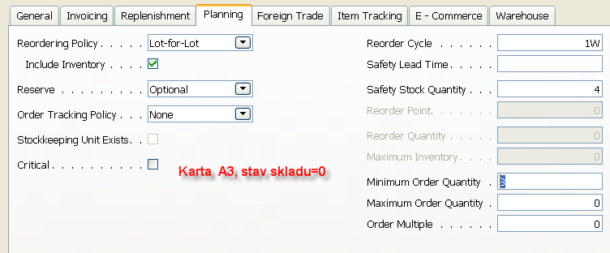
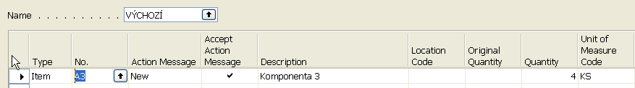
Příklad na používání sešitu požadavků
Po spuštění Sešitu požadavků – Výpočet plánu dostaneme :
=

Slide 15

Příklad na používání sešitu požadavků
Sešit požadavků
Proveď hlášení akce
Nákupní
hlavička
Nákupní řádek
Změníme množství ze 4 ks na 7 ks

Slide 16
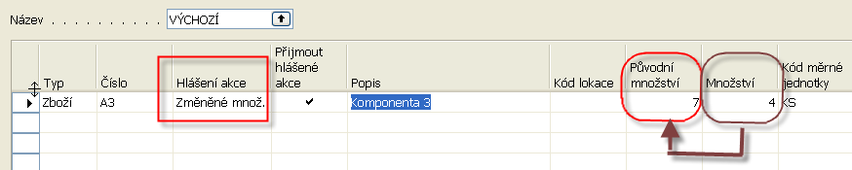
Příklad na používání sešitu požadavků
Sešit požadavků
Vypočítat plán

Slide 17
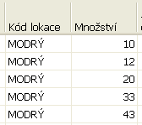
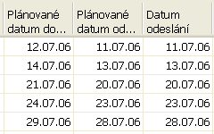
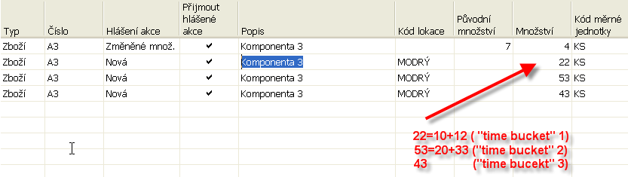
Příklad na používání sešitu požadavků
Naplánujeme prodeje v různých po sobě jdoucích týdnech a to vždy dva prodeje do jednoho týdne (time bucket=1 week) :
a po spuštění Sešitu požadavků dostaneme :

Slide 18
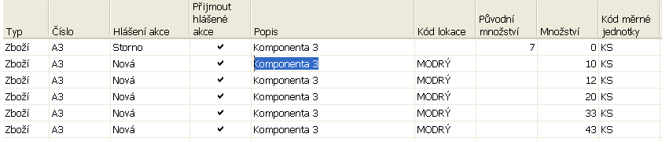
Příklad na používání sešitu požadavků
Změníme na kartě zboží Způsob přiobjednání z Dávky-pro- dávku na Zakázka a po spuštění plánování v sešitu požadavků dostaneme :
Což znamená, že pro každou PO je navržený nový řádek (Bucketless approach)

