Slide 1
Innovation or R&D
Xavier Sala-i-Martin
Columbia University
June 2011

Slide 2
Innovation
NEW WAY TO SATISFY A (perhaps new) DEMAND (sometimes, a demand that customers don’t even know they have)!
Is this achieved through R&D?
Should ONLY developed countries worry about innovation?

Slide 3
Which brings me to…
PIZZA!!!

Slide 4
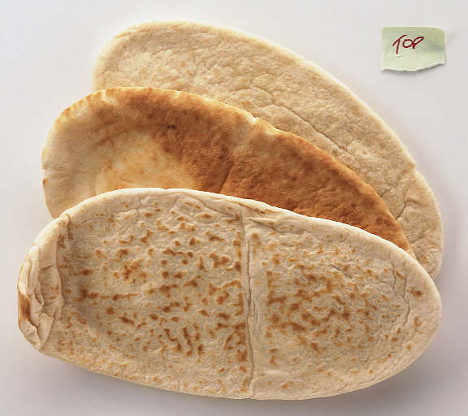
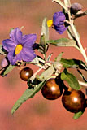

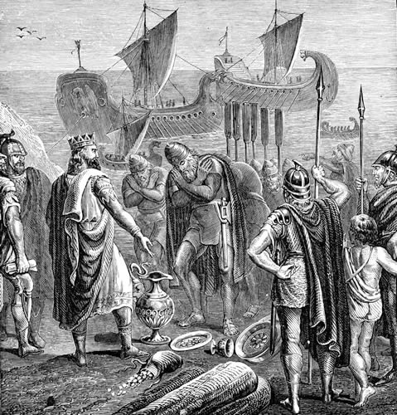
History of Pizza: From Phoenicians to Tomatoes
Arameic word
for bred:
PITTA
Belladona o
Uvas del Diablo
Notes:
Romans or fenicians: stuff on top of bread
Tomato arrives in XVIth century. Since people are afraid of tomatoes (it was believed by many Europeans to be poisonous (as are some other fruits of the nightshade family – Belladona o Uvas del Diablo), only the poor use it.

Slide 5
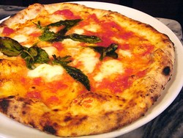
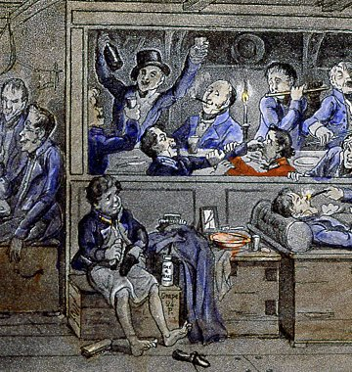
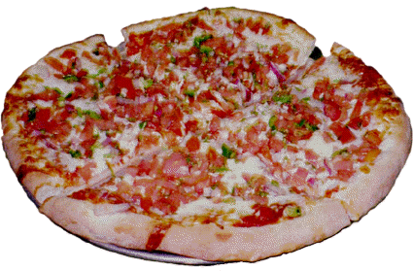
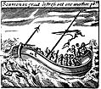
Early Pizza: From Marinara to Napolitana
1st Pizzeria in the World:
Antica Pizzeria Port d’Alba in Naples
Notes:
However, by the late 18th century it was common for the poor of the area around Naples to add tomato to their yeast-based flat bread and so the pizza was born.
The Marinara is the oldest and has a topping of tomato, oregano, garlic, extra virgin olive oil, and basil (Alhabaca).
It was named “Marinara” not, as many believe, because it has seafood on it (it hasn't) but because it was the food the fishermen ate when they returned home from fishing trips in the Bay of Naples.
The world’s first true pizzeria, Antica Pizzeria Port’Alba, opened in Naples in 1830 and still serves pizza from the same premises today.
Alexandre Dumas explains that people in Naples ate pizza with tomato, cheese, anchovies and olives.
Pizza Napolitana is born

Slide 6
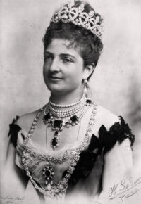
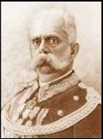
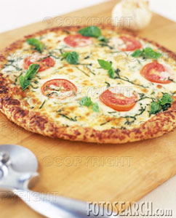

Pizza Margarita
Raffaele Esposito
Notes:
The Margherita introduced cheese to the pizza and is attributed to baker Raffaele Esposito. Esposito worked at the pizzeria "Pietro... e basta così" (literally "Peter... and that's enough“).
In 1889, for the visit of King Umberto I and Queen Margherita of Savoy he baked a pizza evoking the colors of the Italian flag – green (basil leaves -Albahaca), white (mozzarella), and red (tomatoes).
This combination was named Pizza Margherita in her honor
The Port D’Alba people say that Margherita is NOT a true pizza

Slide 7
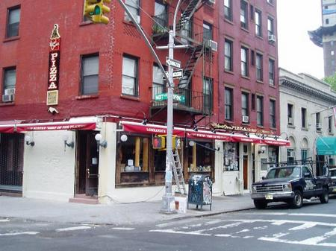
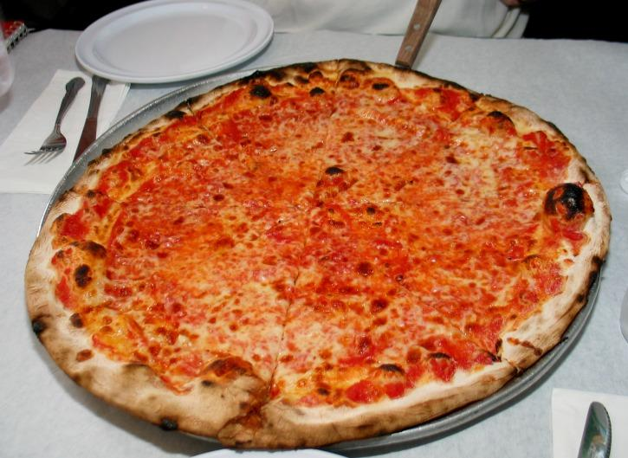
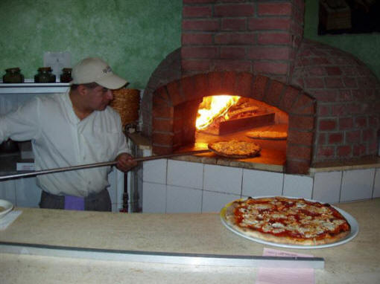
New York Pizza
Lombardi’s employee (Tonono Pero)
and Coal Oven
Notes:
Italian immigrants go to the US.
The first "official" pizzeria in America is founded by Gennaro Lombardi in Little Italy, Manhattan.
Gennaro Lombardi opened a grocery store in 1897.
An employee of his, Antonio Totonno Pero, began making pizza for the store to sell that same year. He uses “coal” rather than “wood”. The pie is softer than the napolitan pie.
New York Pizza is invented.
The success of the “pizza department” of the grocery store is so large that he decides to start the pizzeria in 1905 (casualitat!)
Mostly used in Italian neighborhoods.
Old Italians from Naples say this “soft” New York thing is NOT PIZZA

Slide 8
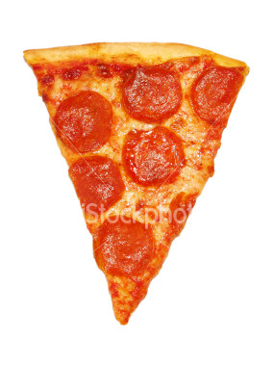
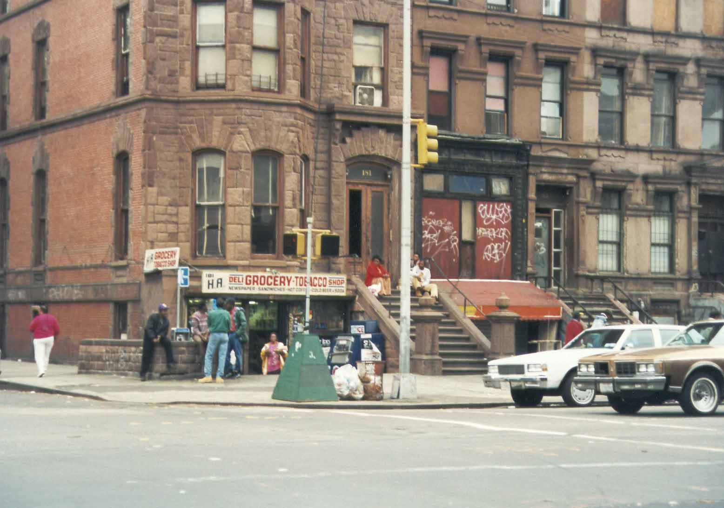
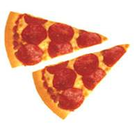
The Pizza Slice: Harlem, NY
Notes:
In Haarlem, they were poor and could not afford the 5cents that an entire pie cost. So started selling pizza by the slice: you say how much money you have and we give you a proportion of the pie.
Great marketing campaign (the person who eats a slize in the street makes the other people go hungry)
Allows the poor to buy pizza
The traditional pizza people from Little Italy (Lombardis’ et al) say this is NOT PIZZA (pizza should be sold with an entire pie).

Slide 9

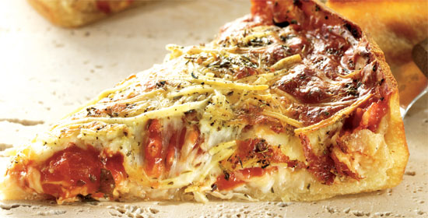
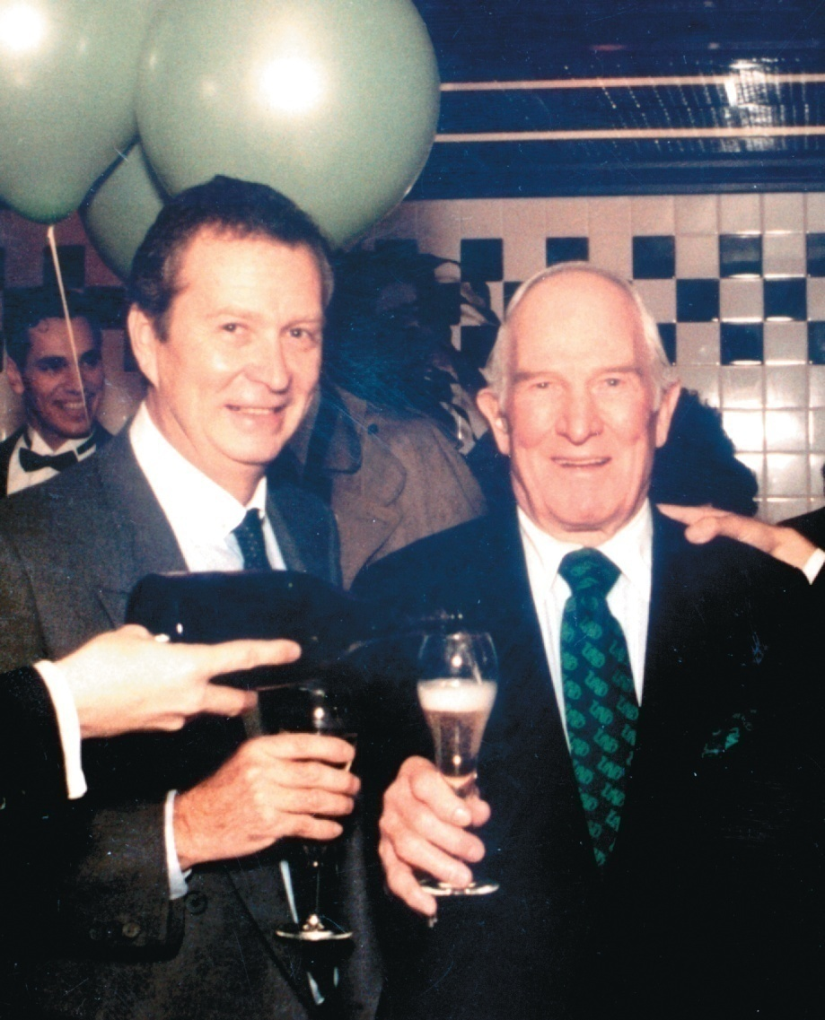
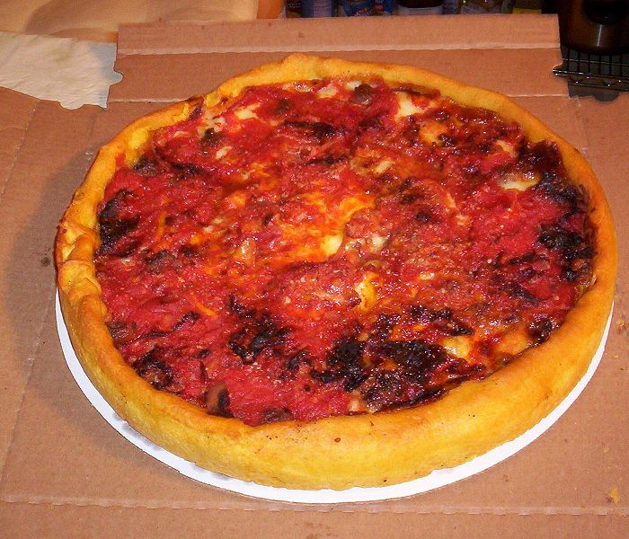
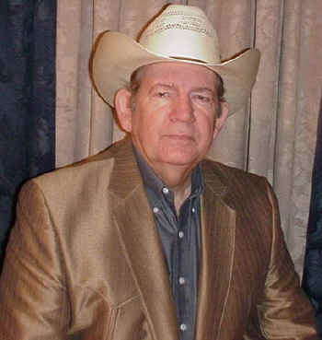
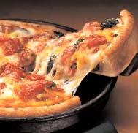
Chicago Pizza
Ric Riccardo and Ike Sewell
Notes:
In 1943 Ric Riccardo and Ike Sewell, a Texan businessman in Chicago set up Pizzeria UNO.
Sewell wants to put lots of BIG things like sausages and so on (he’s texan) in the pizza. He needs a thicker pie.
He invents the “deep dish pizza” or Chicago Pizza.
The traditional pizza people from New York (Lombardis’ et al) say this is not pizza.

Slide 10
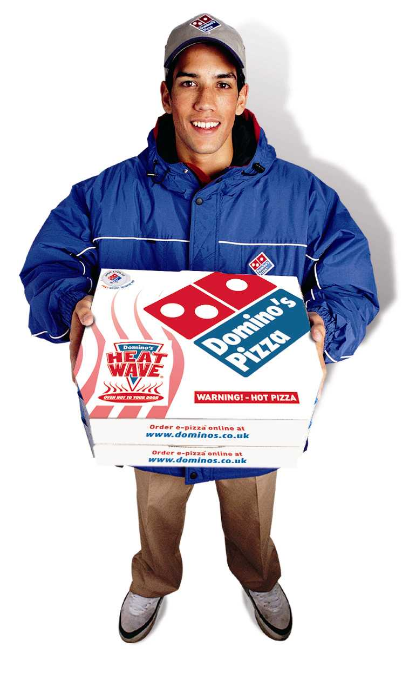
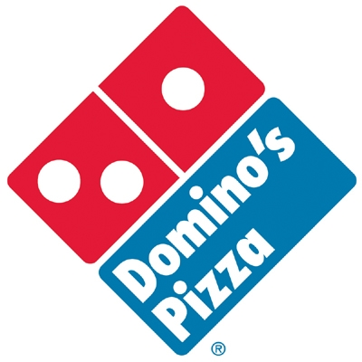
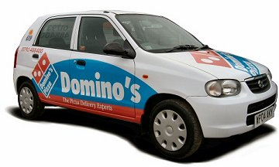
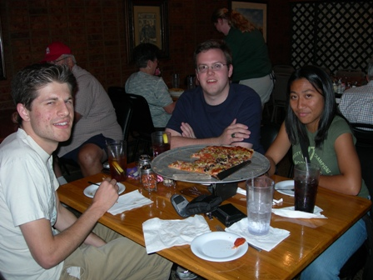
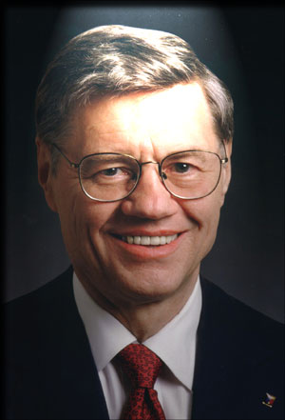
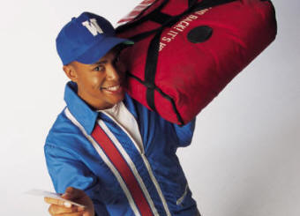
Pizza Delivery: Domino’s
Tom Monaghan
Notes:
Key is “delivery”. To deliver pizza the key is the BOX (previous boxes were flimsy to so the top would fall and get all the cheeses). He used the corrugated box cardboard of top of “tall hats” which was sturdy and had insulating properties. Great success.
Key is speed in production: Monaghan uses a “meat grinder” that he had seen in a food fair to grind cheese 4 times faster
Marketing genius: “pizza in 30 minutes or it is free”. It is an amazing success
As expand the number of stores, key is same quality pizza everywhere: For this you need
conveyer heat (not coal or wood) which is a uniform way to send heat,
the same ingredients
and a central place where the dough is produced
Although the cardboard was partly insulating, 15 minutes in the car wouold get t he pizza cold. He needed the pizzas to remain hot.
R&D: A woman who worked at a steel company invented the Insulated bag and sold bags to Dominos. These bags are generally vinyl, with cotton insulation. They generally keep a hot pizza hot for about 15 minutes. They are both very light, and very cheap,
R&D: Domino’s own R&D in search of a heated bag. They come up with the “HeatWave," a portable electrical bag system that uses patented magnetic induction technology to keep the pizza hot during delivery.
Italians, New Yorkers, and Chicagoans now say this fast produced thing is NOT PIZZA.

Slide 11
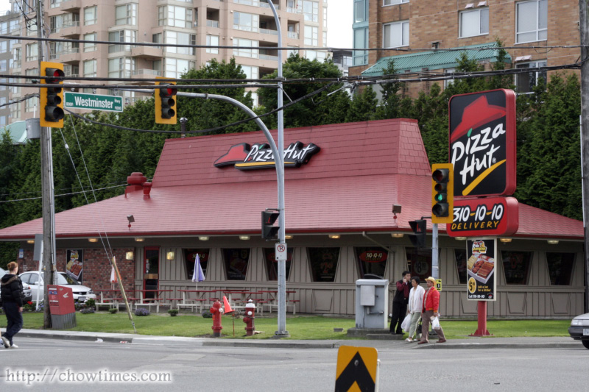
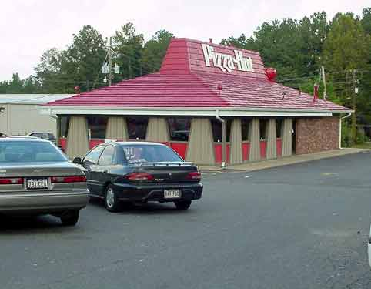
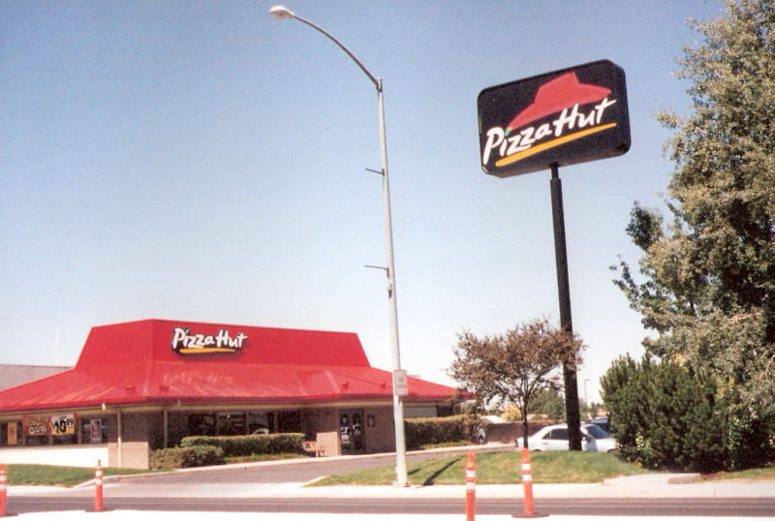
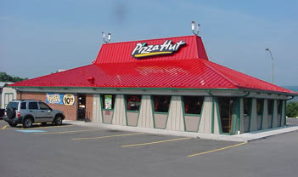
Pizza Hut: McDonald’s in Pizza
Notes:
Explain the Success of Ray Kroc and McDonalds in hamburger world
Pizza people want to replicate the success of McDonalds in pizza
PIZZA HUT was born: same quality, same efficiency, even same look (a hut) to be recognized

Slide 12
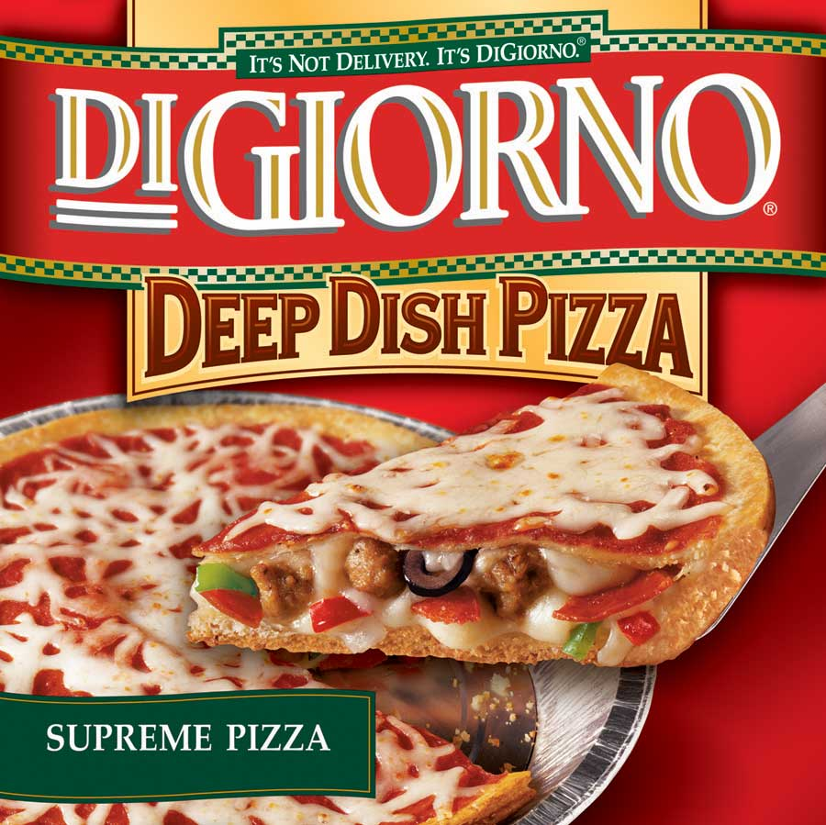
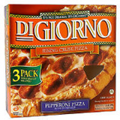
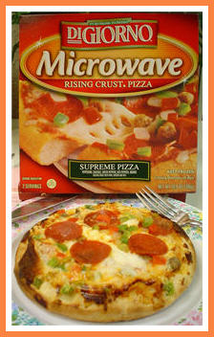
DiGiorno Frozen Pizza: Di Giorno Rising Crust Technology
Notes:
Next step is to take the pizza home: frozen pizza that can be produced at home.
Technical problem is that the moist in the dough gets frozen into water. And when you warm it back, it soggies the dough and the ingredients.
Di Giorno: they find a particular kind of though that, if partly baked, can expand and finish up baking at home (“DiGiorno Rising Crust technology“).
Automated process: machines that can produce millions of pizzas by the minute.
Italians, NYC, Chicago, Domino’s, and Pizza Hut say this is NOT PIZZA

Slide 13
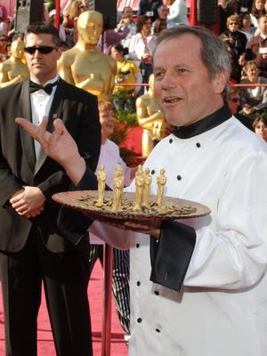

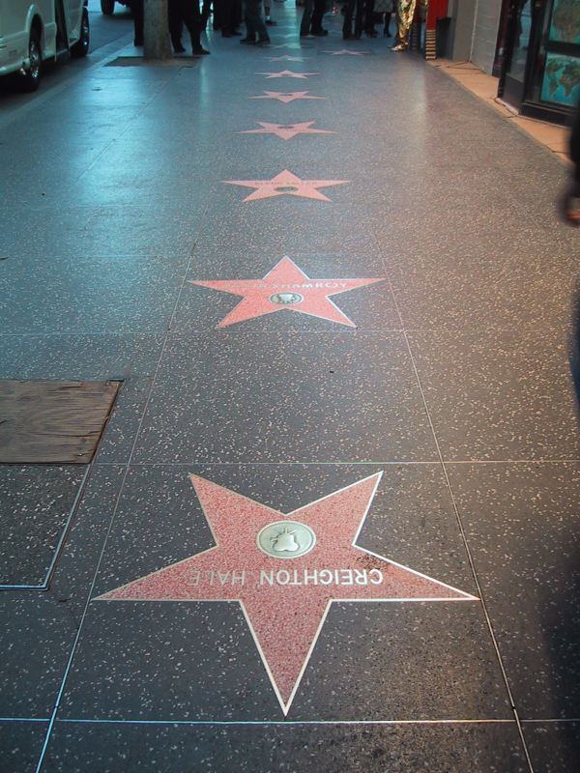
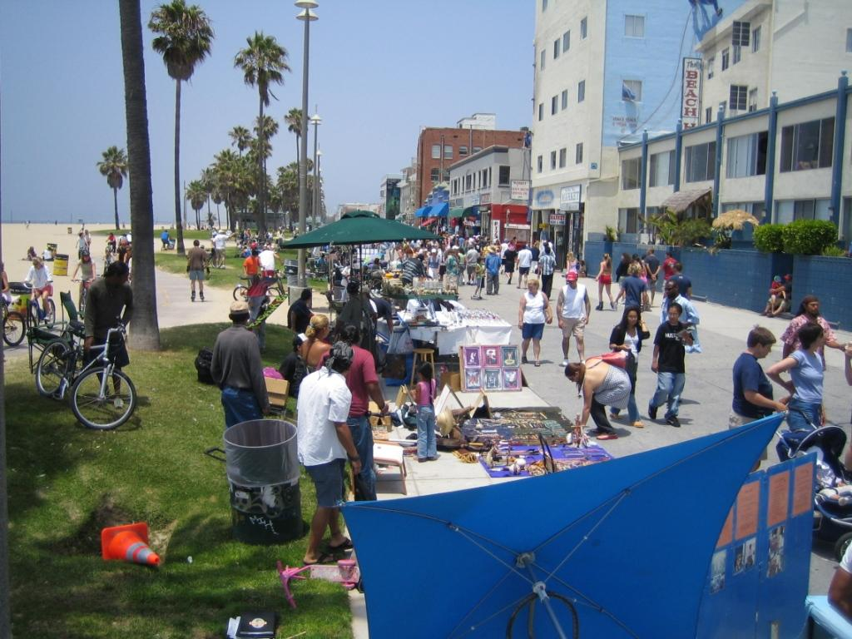
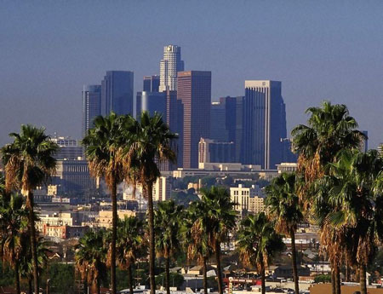
Gourmet or California-style pizza

Slide 14
Lessons from History of Pizza for Innovation
IT IS NEEDED IN EVERY SECTOR
SMALL STEPS
MOST IDEAS ARE NOT R&D:
  Chance/Employees (Tonono Pero at Lombardi’s)
  But when R&D is needed, it is DRIVEN BY NEEDS, NOT BY TAX INCENTIVES!!
Innovation is done by individuals (workers) or SMALL BUSINESSES
Some times “copying what works elsewhere” is a way to succeed (Pizza Hut)
But some times, in order to succeed you need to innovate by adapting to your own specific circumstances
  to the tastes of your customers –Chicago
  to the environment –there is lot of cheap coal in NYC
  to the income of your customers –slices in Haarlem
  to the desires of customers –fast delivery in college

Slide 15
Where do Business Ideas Come From?
Amar Bhidé ( “Origin and Evolution of New Businesses”)
  500 growth businesses in USA
Results
    71% of enterprises “saw” an idea while working for someone else: WORKERS!
    21% found an idea “by chance”
    Only 8% through formal R&D...
      But usually “PULLED” by a firm (not pushed by the government)
Notes:
71% of enterprises “saw” an idea while working for someone else: WORKERS!
Ray Krock of McDonalds
Chad Hurley, Steve Chen, and Jawed Karim of Youtube
21% found an idea “by chance”
Mark Zuckeberg of Facebook
Nokia
Bill and Paul
Only 8% through formal R&D...

Slide 16
Innovation “Policy”
WHAT IS NOT:
  It is NOT R&D subsidies (you would not target the right people or the right sector)
  It is NOT industrial policies or PLANS directed by clever bureaucrats
  It is NOT the promotion of “CLUSTERS” and “Technology Parks”
    everyone wants to be Silicon Valley 2!!!. Latest one is Skolkovo in Russia, which is meant to fail.
What IS:
  Creation of an environment conducive to
    (A) creation of ideas and
    (B) implementation into real products, services and processes

Slide 17
Innovation “Policy” (2): A Business-Friendly Environment
IDEAS HAVE TO BE IMPLEMENTED
  Infrastructures:
    Physical and virtual (technological adoption!)
    Not enough to have infrastructures, they have to be run efficiently!
  Institutional Quality
    Trust in law and order
    Tax system that works and is efficient
    Policy Certainty (opposite of Policy Reversals):
    Crime
    Private Corporations Scandals (Enron, Maddof, Banking, …)
  Regulation “barriers” :
    Bureaucracy (World Bank Rankings of Doing Business)
    Competition in Goods Market:
      DANGER OF PROTECTIONISM (Post-Recession Neo-Nationalism: E-on, France Suez, Danone, ...).

Slide 18
Innovation “Policy” (2, Cont.): A Business-Friendly Environment
Competition in Labor Markets
    Legal.
      Spain (worst-hit country in Europe as far as unemployment is concerned)
    Mental (regional mobility)
    Meritocracy (Football again)
    Female Discrimination (Did Affirmative Action work?)
Financial Markets
  Need to finance entrepreneurs and innovators (not so much real estate): capital risk
  Careful with demonization of banking system after the current financial crisis: no ideas can be implemented without banks
Firms need to set up mechanisms to LISTEN and SCREEN their WORKERS’ IDEAS

Slide 19
Innovation “Policy” Part 1:
Creation of Ideas=Education
The world is changing and the education system is not!
World is moving so fast that, FOR THE FIRST TIME IN HISTORY:
  Kids know more than parents and teachers
  Kids already live in the new world:
    Newspapers? Books?
    Wearing watches?
  Reading (Remember “Don Quijote”), TV, Playstation, and ARES
Notes:
Kids already live in the new world:
Newspapers? Books?: mention that neither books nor news papers have hiperlinks so the current generation correctly thinks they are old fashioned
Wearing watches? : single-function devices that are not understood by children today (useless if you cannot download apps, games, etc)

Slide 20
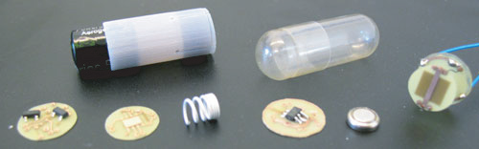

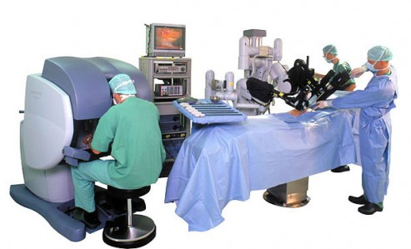
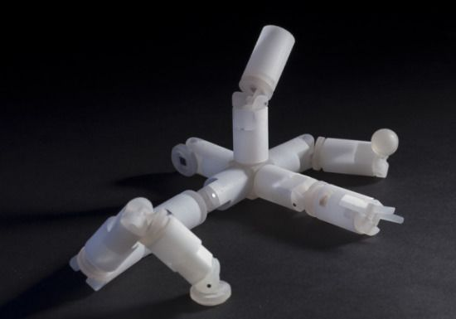
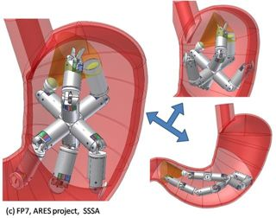
ARES: (Assembling Reconfigurable Endoluminal Surgical System)
Notes:
Ares: Assembling Reconfigurable Endoluminal Surgical System

Slide 21
Education: Change HOW we teach
Are we sure we still want to divide classes by age?
Are we sure we use the best available tools to teach?
Are we sure we can speak our student’s language?
Are we sure we teach the “right” things?
  Are we teaching the right math? Statistics or Calculus?
  Are we teaching “critical thinking”?
  Are we teaching “creativity”
  Are we teaching to solve real problems?
  Are we teaching to learn from mistakes?
  Are we teaching to “not give up”?
  Are we teaching to ask for help?
  Are we teaching to be entrepreneur?
  Are we teaching to lead or to obey?
Notes:
Manufacturing is moving away from Henry Ford (and MacDonald’s) into indivudualized products (Dell computers, Nike shoes, BMW cars, …)
Education is not! Linear education. Teacher (and parents) define success: lawyer from Harvard Law

Slide 22
Education outside school
Parents:
  Weekly allowance?
  Reading or story telling?
  Public Speaking
  Save/invest=teach risk
  Sell toys

Slide 23
THE END

