Slide 1
Week Three: Fundraising

Slide 2

Fundraising Facts and Figures
Projections for the Future
The Fundraising Cycle
Creating a Fundraising Plan
Developing a Case Statement

Slide 3


Your slice of the fundraising pie
How many 501 c 3 organizations are vying for the fundraising dollars in the U.S.?
U.S.: over 1.5M in 2011
Czech Republic: over 75,000 in 2006

Slide 4
Facts about Philanthropy in the U.S.:
The U.S. has the largest system of organized private philanthropy in the world.
  If nonprofits in the U.S. were a single industry, they would rank as the nation’s largest industry, accounting for just under 10% of the workforce and about 5% of the gross domestic product.
  As of 2011, the IRS recognized more than 1.5 million tax exempt organizations.
  Source: United States Internal Revenue Service, 2012

Slide 5
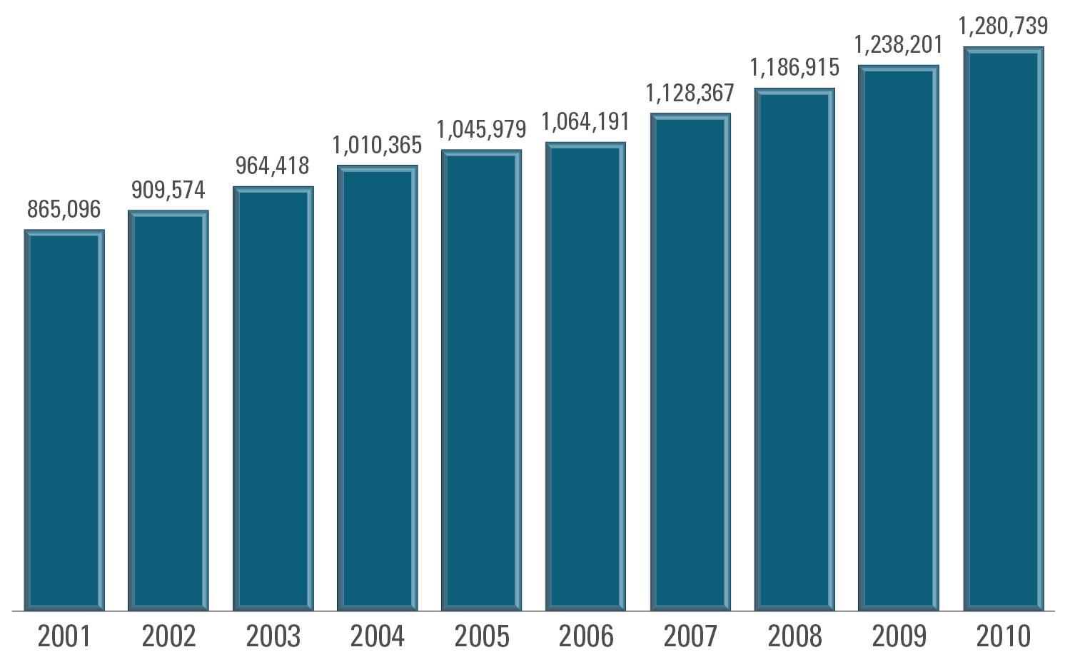
U.S.: The number of 501(c)(3) organizations 2001–2010

Slide 6
Facts about Philanthropy in the Czech Republic:
Thirteen legal forms of non-profit organizations in the Czech Republic
  Foundations, Funds, Public Benefit Companies, Association of Owners of Dwelling Units (3), Public Universities, Political Parties, Associations (1), Organizational Branch of Associations (2), Church Organizations, Professional Organizations or Chambers, Chambers (other than professional), Association of Legal Persons, Hunting Communities
In 2006, there were 75,224 entities registered as non-profits (some, however, with limited fiscal activity would not be included in this number)
Source: CZSO, NPI Satellite Account 2006

Slide 7
Global Philanthropy
Foundation growth in global giving outstripped domestic giving over last two decades; now 24% of $ given
Background:
  Foundation assets increased four-fold since 1990
  Foundation giving increased more than five-fold over same period
  Number of foundations more than doubled over same period; new foundations more likely to give internationally

Slide 8
Global Philanthropy (cont)
Health received the largest share of foundation funding with intended beneficiaries outside the US (43% in 2006, 39% in 2008)
Gates gave almost all the global health funding

Slide 9
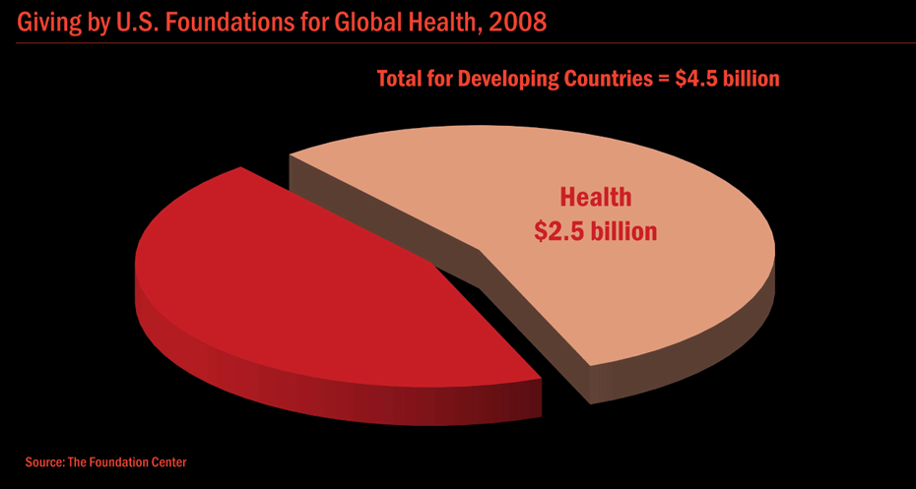

Slide 10
Global Philanthropy Modes
Grants
Loans
Time/effort (volunteering)
Notes:
Again no good data

Slide 11
Broader Global Philanthropy
Foundation giving only a small part of global giving
Other donors include:
  Individuals
  NGOs
  Religious organizations – by far the largest generally; globally too?
  Corporations

Slide 12
International Giving Comparison
(lists countries by the amount of money they give as a percentage of their gross national income)
Sweden – 1.12%
Norway – 1.06%
Luxembourg – 1.04%
Denmark – 0.88%
Netherlands – 0.82%
Belgium – 0.55%
Finland – 0.54%
Ireland – 0.54%
United Kingdom – 0.52%
France- 0.47%
Spain – 0.46%
Switzerland – 0.45%
Germany – 0.35%
Canada – 0.30%
Austria – 0.30%
Australia – 0.29%
New Zealand – 0.28%
Portugal – 0.23%
United States – 0.21%
Greece – 0.19%
Japan – 0.18%
Italy – 0.16%
South Korea – 0.10%
Source: Organization for Economic Cooperation and Development, 2009

Slide 13
International Giving Comparison
(lists countries by the amount of money they give in absolute terms)
United States – $28.67 billion
France – $12.43 billion
Germany – $11.98 billion
United Kingdom – $11.50 billion
Japan – $9.48 billion
Spain – $6.57 billion
Netherlands – $6.43 billion
Sweden – $4.55 billion
Norway – $4.09 billion
Canada – $4.01 billion
Italy – $3.31 billion
Denmark – $2.81 billion
Australia – $2.76 billion
Belgium – $2.60 billion
Switzerland – $2.31 billion
Finland – $1.29 billion
Austria – $1.15 billion
Ireland – $1.00 billion
South Korea – $0.82 billion
Greece – $0.61 billion
Portugal – $0.51 billion
Luxembourg – $0.40 billion
New Zealand – $0.31 billion
Source: Organization for Economic Cooperation and Development, 2009

Slide 14
International Giving Comparison
( Humanitarian donation in absolute terms from non-DAC countries)
Saudi Arabia – 51.8 million
United Arab Emirates – 35.3 million
Kuwait – 34.2 million
Russia – 32.5 million
India – 14.6 million
South Korea – 13.2 million
Qatar – 12.9 million
Turkey – 4.8 million
Czech Republic – 4.3 million
Hong Kong – 4.0 million
Other countries – 16.5 million
Source: Global Humanitarian Assistance, July, 2010

Slide 15
Giving in the Czech Republic
Facts and Figures

Slide 16
Civil Society in the
Czech Republic
47% of citizens made a material or financial donation to a CSO in 2004. (Four percent increase since 2000)
47% of Czechs are a member of at least one CSO
Almost 60% of citizens take part in civic and social activities (work brigades, assistance to older citizens, organization of cultural and sporting events in their communities)
32% of Czechs did voluntary work in 2003
CSO types with largest memberships: sports organizations, trade unions, beekeepers and similar organizations, voluntary fire brigades
Source: An Assessment of Czech Civil society in 2004: after fifteen years of development by Tereza Vajdova

Slide 17
2009 Czech Giving Data
Source: Czech NPI Satellite Account 2005–2009

Slide 18
Giving in the Czech Republic
Corporations: http://www.youtube.com/watch?v=9jV-b2Fgex4

Slide 19
Giving in the U.S.
Facts and Figures

Slide 20
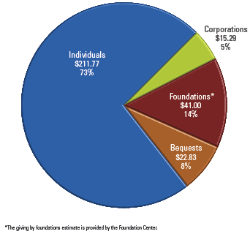
U.S. 2010 charitable giving
Total = $290.89 billion

Slide 21
Sources of Contributions, 2010
Total giving = $290.89 billion.
Increase of 3.8 percent (2.1 percent adjusted for inflation).
Individuals remain the single most important source.
Individuals + charitable bequests = 81 percent of total
Foundation grantmaking = 14 percent of the total.
  About three-fifths of independent foundation giving is from family foundations.
Individual + Bequest + Family Foundations = 87 percent.
Corporate giving is an estimated 5 percent of the total.

Slide 22
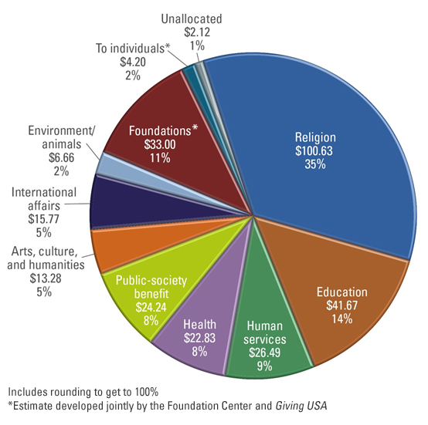
U.S. Types of recipients of contributions, 2010 Total = $290.89 billion

Slide 23
Changes in giving by source
Current $
Total up 3.8 percent in 2010.
Increase attributable to modest economic recovery.
Individual giving up by 2.7 percent from 2009.
Charitable bequests rose an estimated 18.8 percent in 2010 after a very large decrease (38.7 percent) in 2009.
Foundation grantmaking decreased an estimated 0.2 percent in 2010.
Corporate giving increased an estimated 10.6 percent in 2010, attributable to large in-kind contributions and increased corporate profitability.
  Includes grantmaking by corporate foundations.

Slide 24
Changes in giving by recipient organization
Current $
Estimated giving in current dollars held steady or increased modestly in all subsectors except international affairs, which saw a large increase, and environment/animals, which saw a slight decrease.
Giving USA estimates growth in giving by:
  International affairs 15.3 percent
  Public/society benefit 6.2 percent
  Arts, culture, and humanities 5.7 percent
  Education 5.2 percent
  Giving to foundations 1.9 percent
  Health 1.3 percent

Slide 25

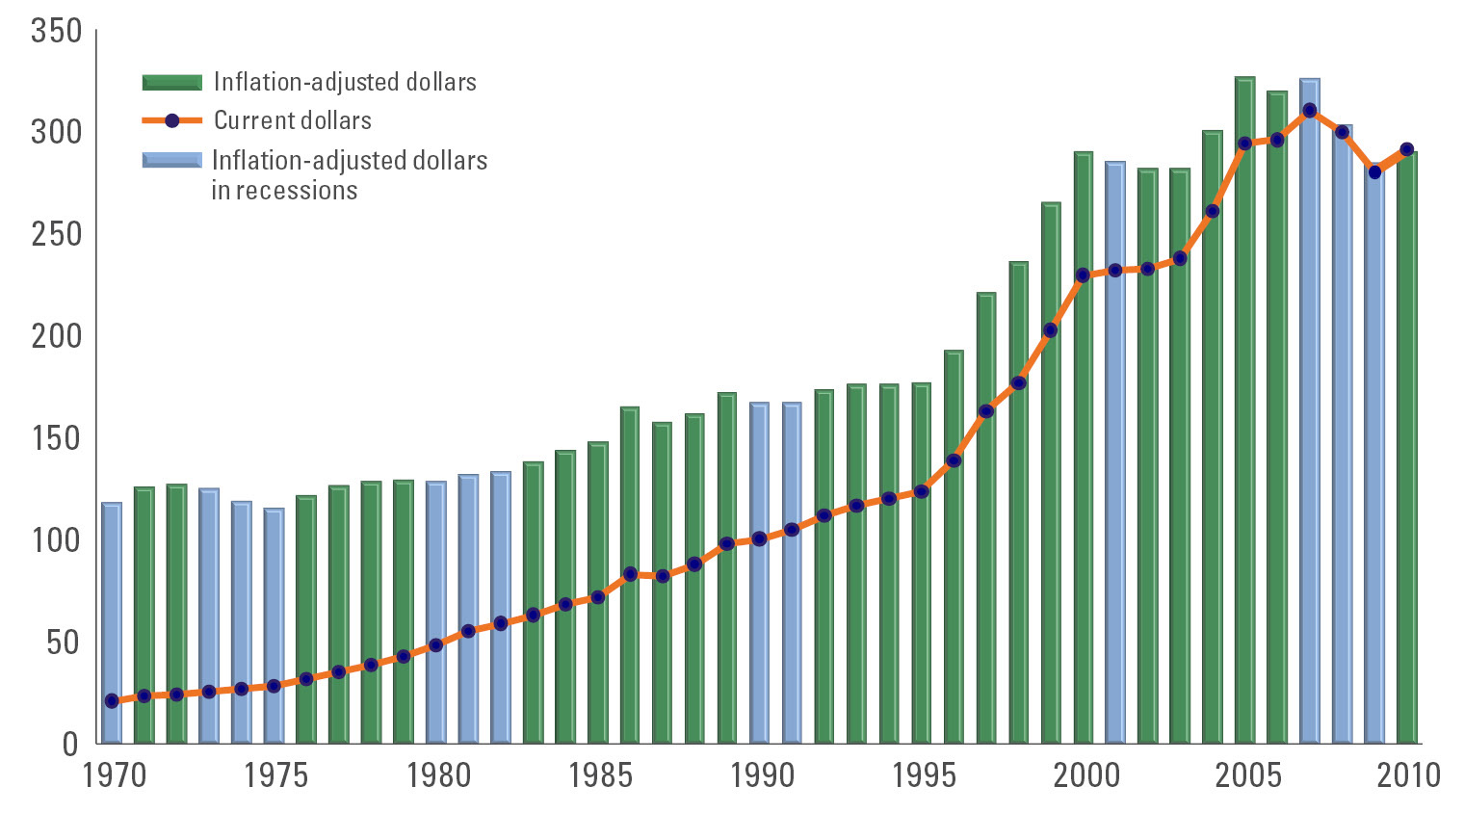
Total giving, 1970–2010

Slide 26
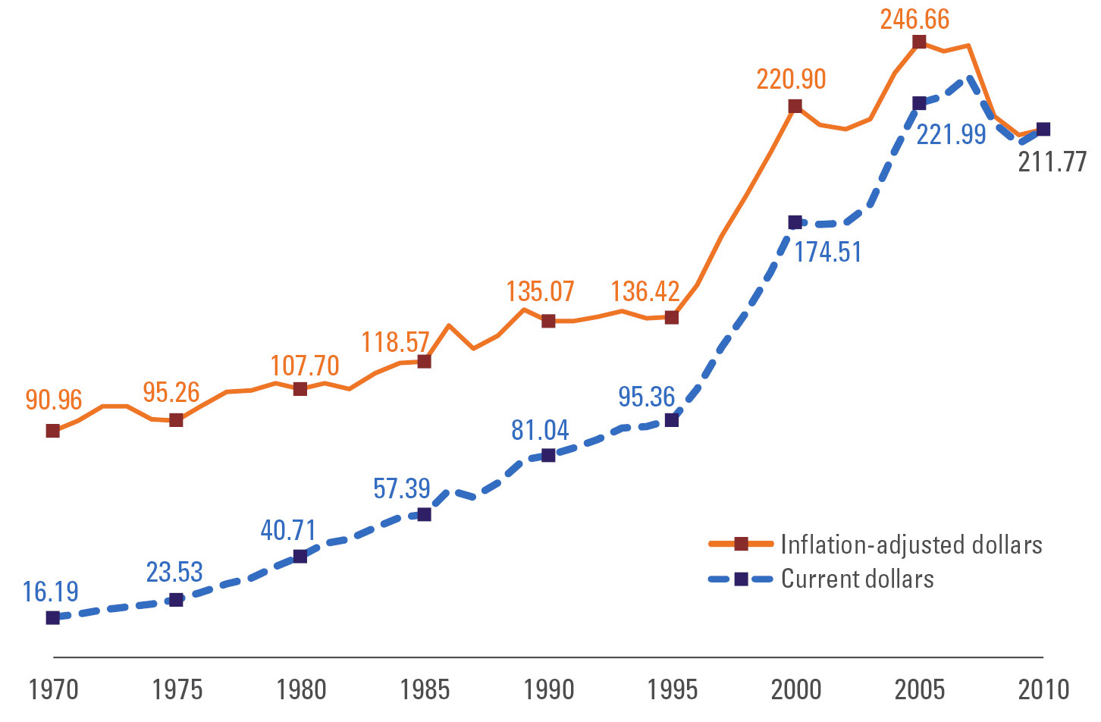
Giving by individuals, 1970–2010

Slide 27
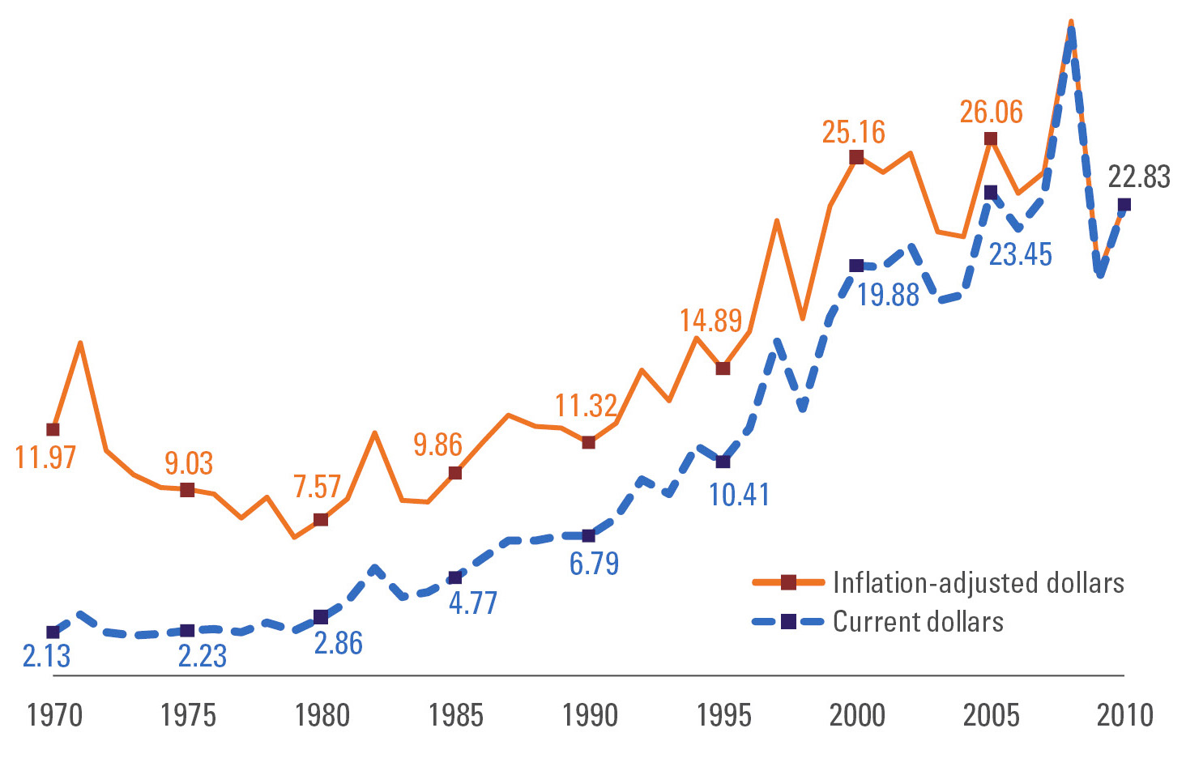
Giving by bequest, 1970–2010

Slide 28
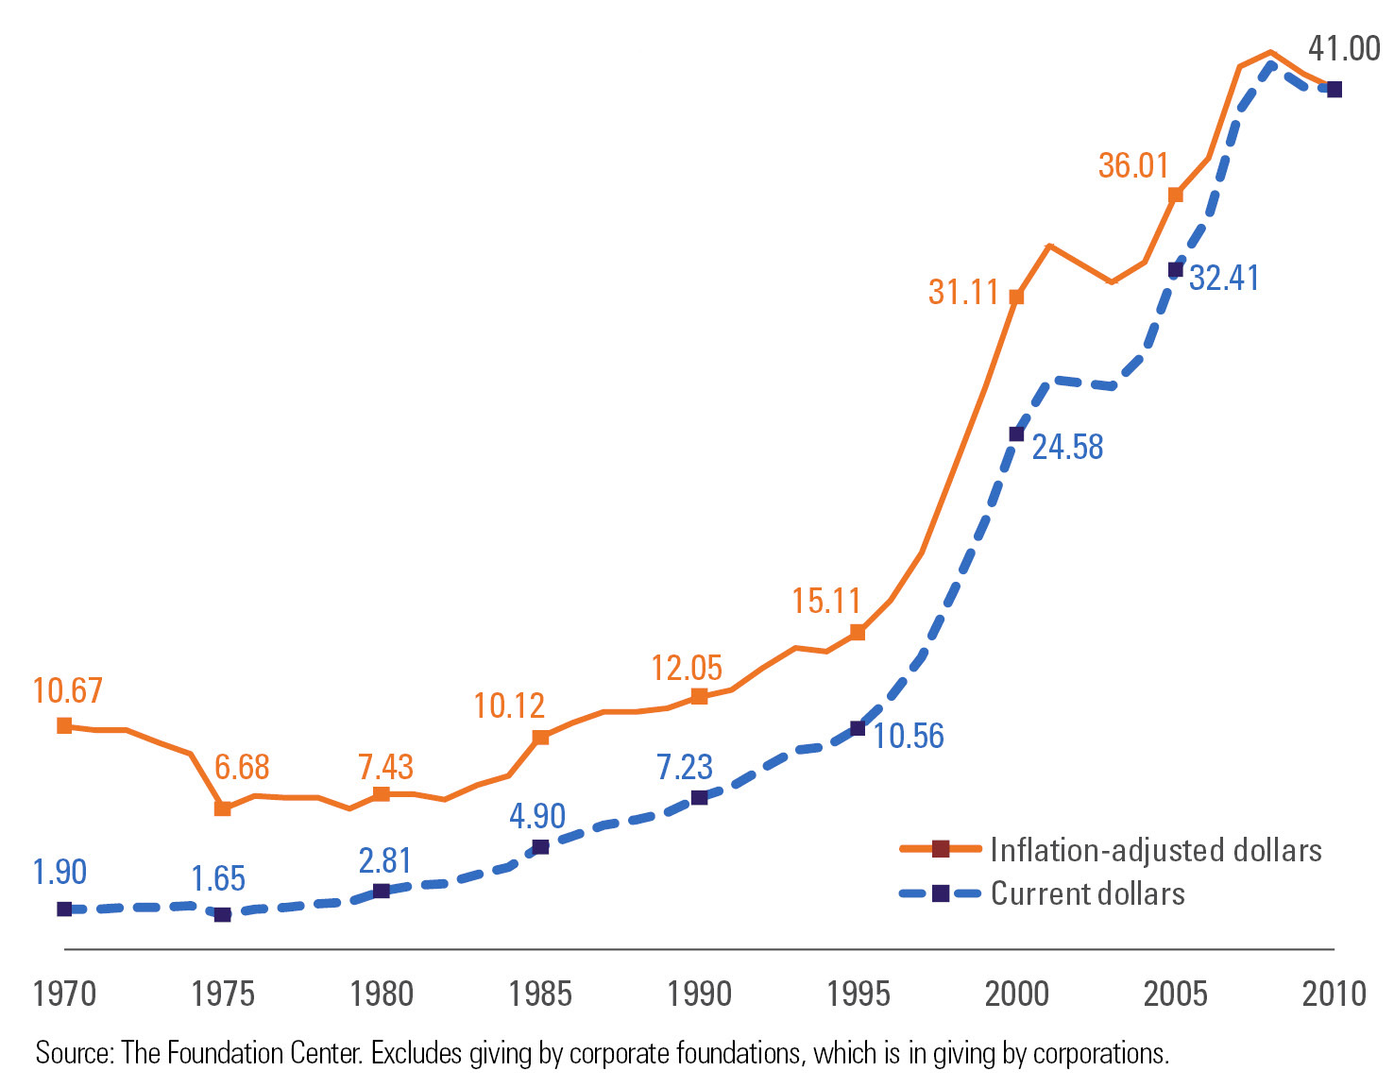
Giving by foundations, 1970–2010
Data: The Foundation Center

Slide 29
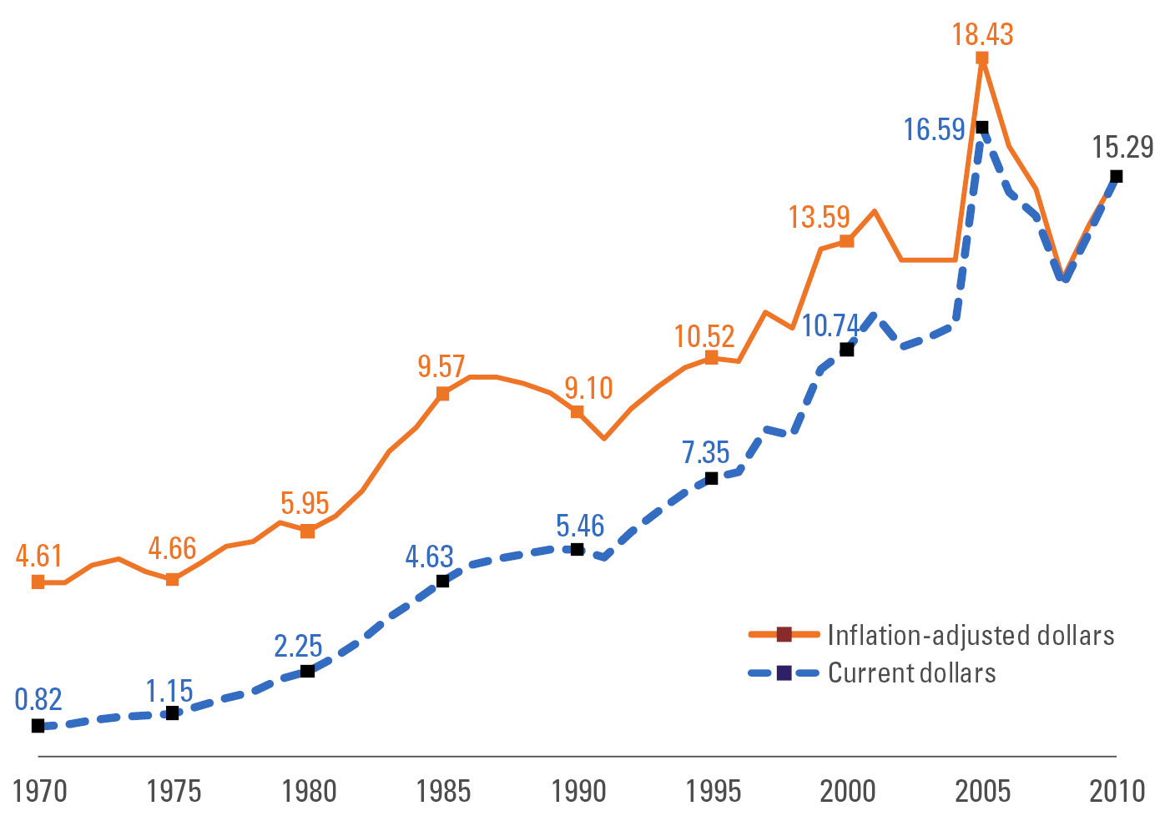
Giving by corporations, 1970–2010

Slide 30
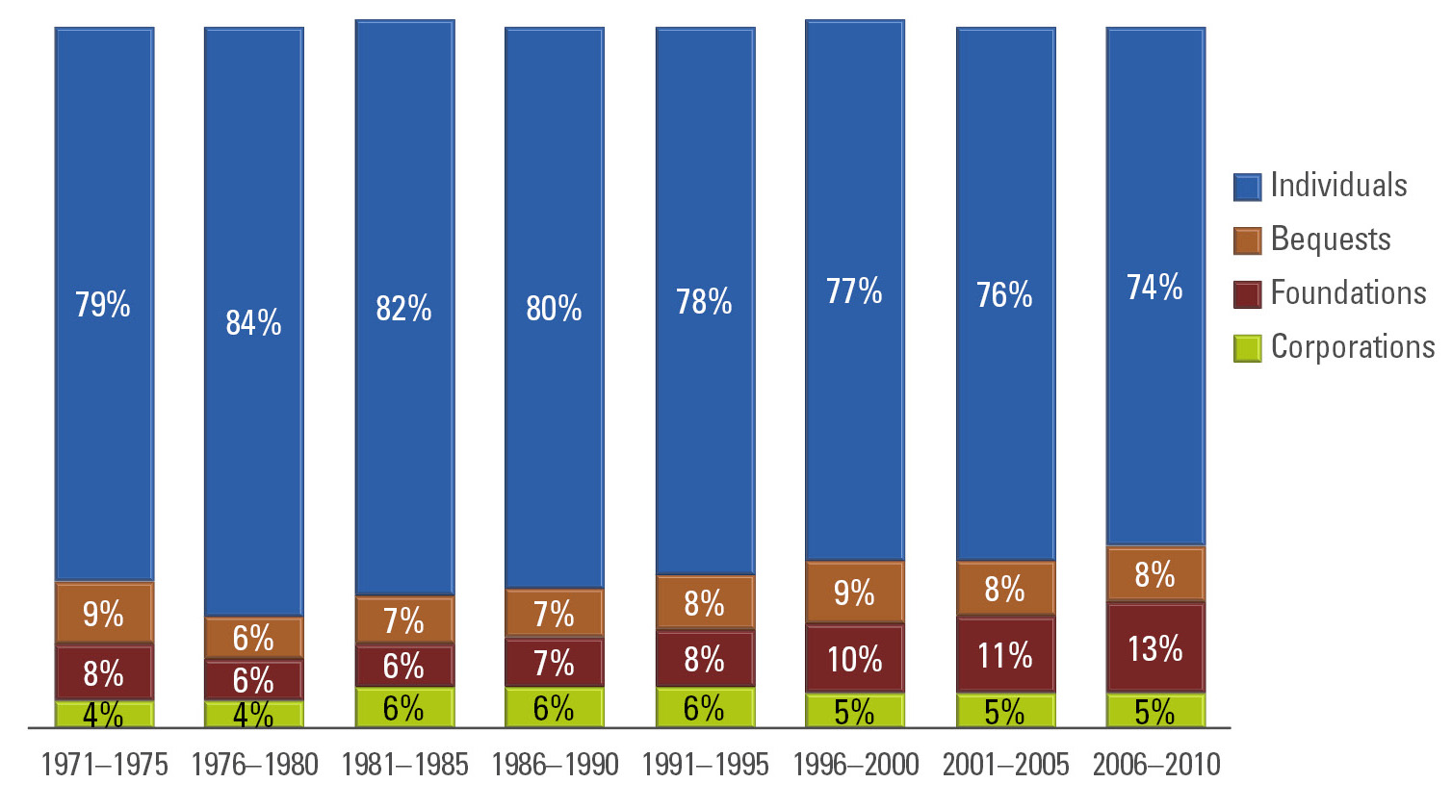
Giving by source: Percentage of the total by five-year spans, 1971–2010

Slide 31
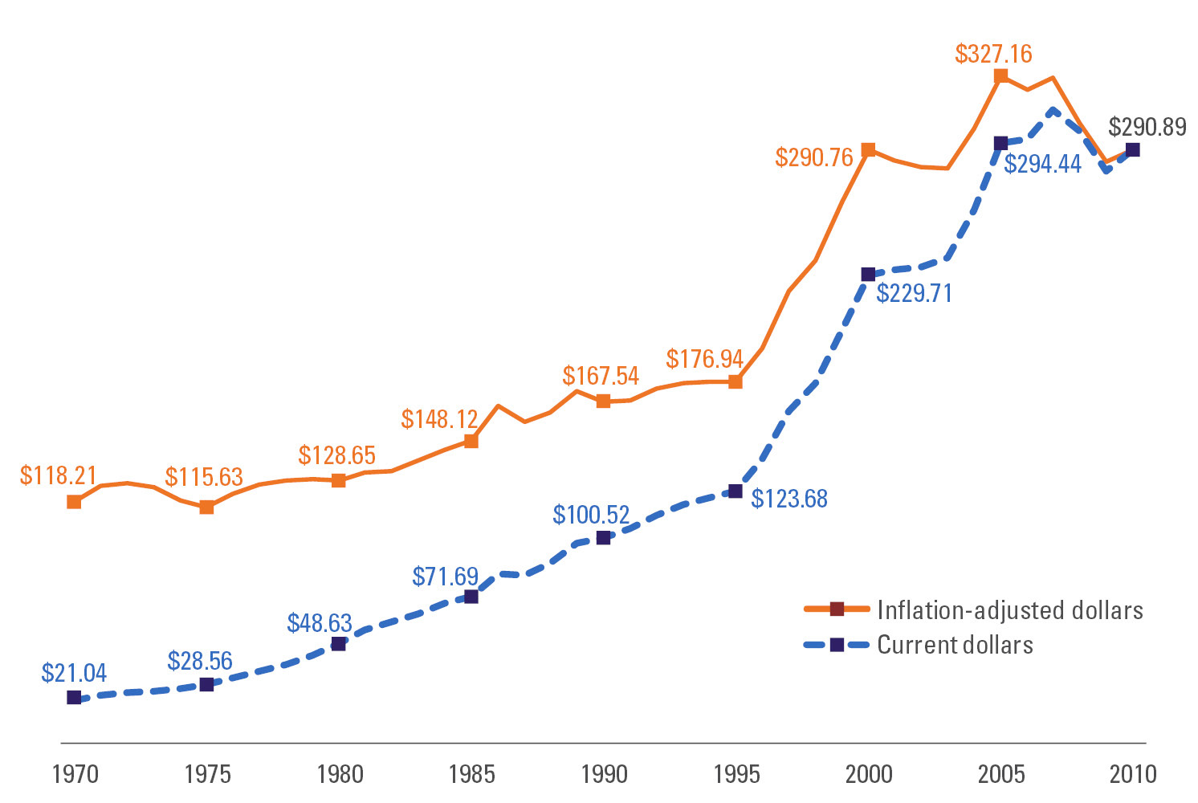
Total giving and trends for total giving:
1970–2010

Slide 32
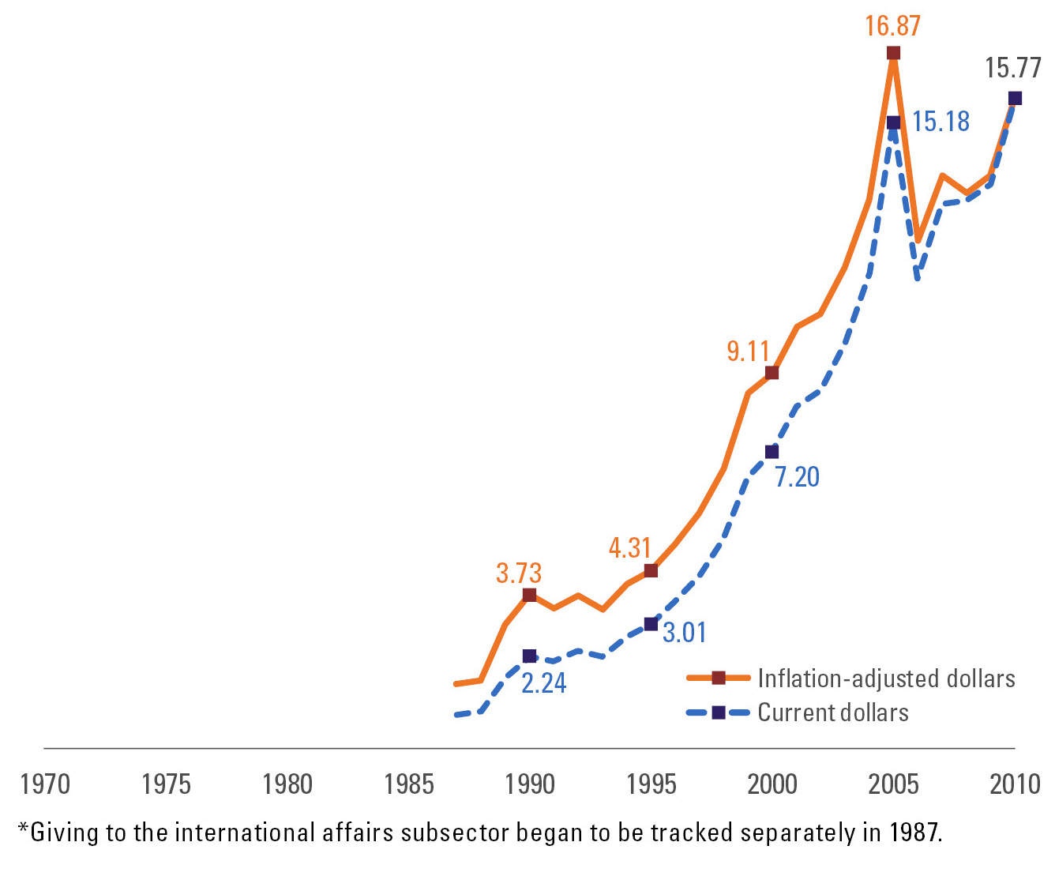
Giving to international affairs, 1970–2010

Slide 33
Wealth Transfer
As our wealth increases, the percentage contributed rises markedly.
  97% of families with a net worth in excess of $1 million give to charitable organizations annually and 99% of families with a net worth in excess of $5 million give annually
  93% of the affluent would increase giving if they found additional causes they felt passionately for
  66% would give more if they were better informed about giving options and the effectiveness of their contributions
  85% would be anxious to receive guidance from their advisor on philanthropy
Notes:
₃₃

Slide 34
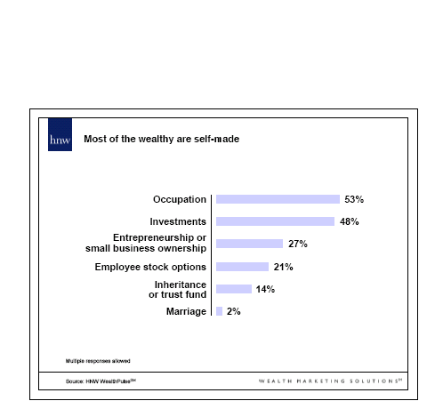
Wealth Source
Notes:
₃₄

Slide 35
Projections for the Future
Globalization of giving
  Problems and solutions will be less bound by geo-political borders
Transfer of Wealth
  Despite economic downturns, next generation will inherit unprecedented sums for giving
Diversification of Giving Streams
  Organizations will strive for diversified revenue streams to stabilize funding
Shifts in Recipient Organizations
  Moves away from traditional recipients (religion) toward new solutions (international relief, environment)

Slide 36
How do you get your slice of the fundraising pie?
The fundraising cycle
The fundraising plan

Slide 37
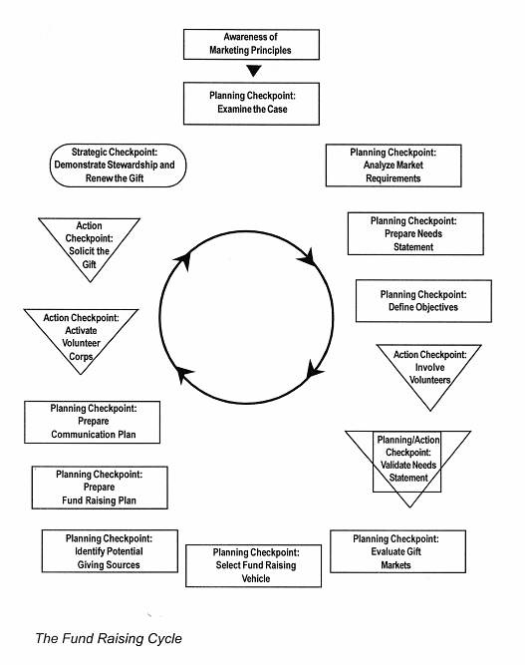
The Fundraising Cycle

Slide 38
The Fundraising Planning Model
Understanding the big picture
Identifying plan inputs
  Build the case: case statement
  Identifying the key donors/prospects
  Selecting effective fundraising activities
Putting the plan together
Implementing the plan
Monitoring plan results and refining plan

Slide 39
CREATE A WRITTEN FUNDRAISING PLAN
Set a goal (based on your budget)
For each income strategy, note the following details:
  Tasks required to complete the strategy
  Due date for each task
  Who is in charge of each task
  How much the strategy will cost and how much it will raise

Slide 40
FUNDRAISING PLAN (cont’d)
Plot out your plans for raising money from individuals
Decide on numbers of donors and match them to strategies
Put the plan onto a timeline and fill out the tasks

Slide 41
FUNDRAISING PLAN (cont’d)
INDIVIDUAL FUNDRAISING GOALS:
  60% from major donors
  20% from habitual donors responding to retention strategies
  20% from first- or second-time donors giving through acquisition strategies

Slide 42
Description of Case Statement
A message to a particular audience, designed to:
  Establish an organization’s needs and merits
  Articulate benefits to the contributor to stimulate monetary response
Case statement should:
  Be brief/direct
  Demonstrate success
  Be targeted to the motivations of each specific market
  Describe how contributor’s investment will solve specific problem
  Be compelling

Slide 44
Case Statement Data
Organization’s mission
History and track record
Goals, strategies and specific objectives
Organization resources
Accountability
Problems to be addressed
Trends affecting problem
Future organization plans

