Slide 1
Week Nine: Fundraising

Slide 2

Grant Writing
Test Review

Slide 3
What is a Grant?
Bounty, contribution, gift, or subsidy (in cash or kind) bestowed by a government or other organization (called the grantor) for specified purposes to an eligible recipient (called the grantee). Grants are usually conditional upon certain qualifications as to the use, maintenance of specified standards, or a proportional contribution by the grantee or other grantor(s).
Read more: http://www.businessdictionary.com

Slide 4
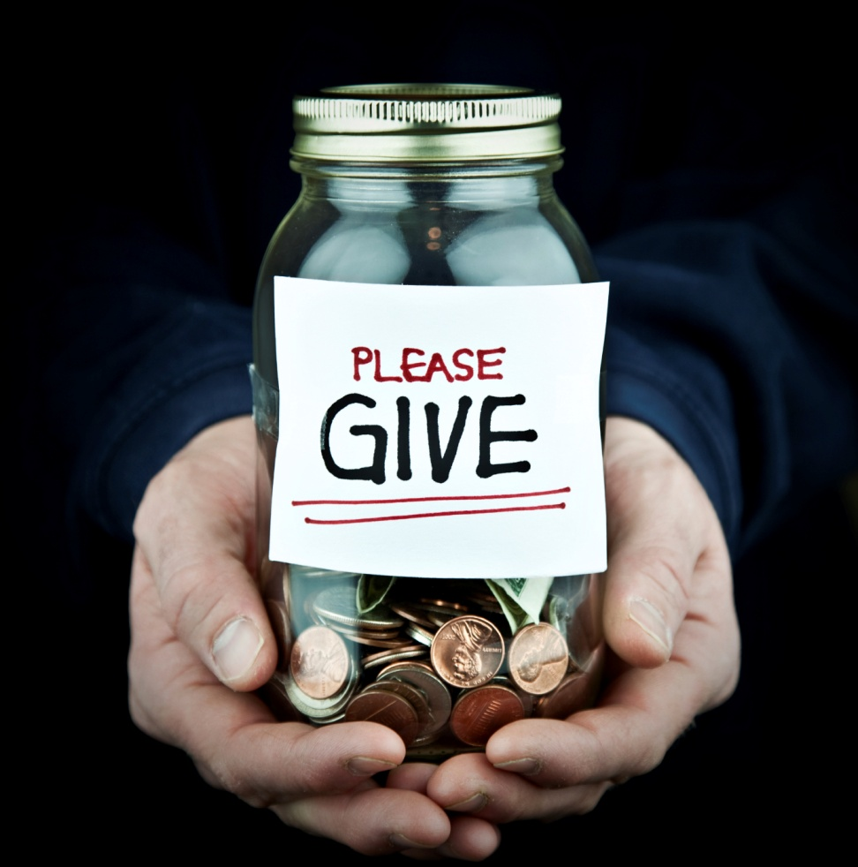
Who gives grants?
http://www.ceetrust.org/grants-database/in-country-grants/czech-republic.html
http://www.ceetrust.org/grants-database/cross-border-initiative.html

Slide 5
The Grantwriting Process
Step One: Setting Funding Priorities
Step Two: Drafting the Basic Proposal
Step Three: Packaging the Proposal
Step Four: Researching Potential Funders
Step Five: Contacting and Cultivating Potential Funders
Step Six: Responding to the Result
Notes:
In class, we discuss the grantwriting as being a process – much more than the actual composing of a grant at the computer and the mailing it off to potential funders. In fact, the Foundation Center discusses grantwriting as being comprised of six equally important steps. Some of these the other panel member have already discussed or will be discussing. I’d like to focus my attention on the first three of these steps – setting the funding priorities, drafting of the basic proposal and the packaging of the proposal in a way that will achieve results.
No less important is the process of researching potential funders and finding the right fit between your project and the mission/objectives of a potential funder. Contacting and cultivating the potential funder through e-mail, telephone, visits, presentations and the like. And then, responding to the result of the grant request – whether it be positive and you are concerned with meeting the terms and budget of the grant contract – or negative and you are obtaining feedback to improve your submission the next time around.

Slide 6
Step One: Setting Funding Priorities
Notes:
But the first step is really setting funding priorities.
It’s interesting because invariably when I teach this class, many if not most students come in with an organization they want to write a grant for and right away they want to start researching funders that support the kind of organization they are – and they really have given little thought to what are their funding priorities within their overall organization.

Slide 7
Approach to grant seeking
Set funding priorities
Identify the need within your community that your organization wants to meet and that is in line with the organization’s mission.
  Research grant funders that have an interest in funding that need.
Notes:
There are in fact two approaches that organizations can take to seeking a grant.
Rule number one in my book is that you don’t start an effective grant search by asking who is out there that might give money to my organization.
To do so leads your organization down a path of programming that follows the money rather than programming that meets an identified community need. The end result for the former approach is that organization suffers from some mission drift as a result of grant awards that are ill-targeted to real needs.

Slide 8
Prepare a needs statement
Who will be helped?
Why do they need your help?
What are the consequences of not providing help? Is need acute?
What outside support can you provide that this is indeed a problem?
What are the benefits of providing help? Is there hope for improvement?
Notes:
So, the first step is really an inventory of the most pressing community needs that the organization wants to address and a prioritization of those needs based on the acuity and urgency of the need, the level of funding needed and the ability of the organization to adequately address the need.
As a result of prioritizing those needs, the organization then is in a position to prepare the needs statement.
In my mind, the needs statement is the most important grant element that an organization must prepare. So, it’s worth the extra time and effort to get this component right.
In the needs statement, an organization is answering the following questions.

Slide 9
Step Two: Draft the Proposal
Notes:
Once a comprehensive and compelling needs statement is prepared, the organization can set about drafting the other elements of the proposal.

Slide 10
Proposal components
Organizational Statement
Project Description
  Fundable Idea
  Goals/objectives
  Methods
  Budget
  Sustainability
Notes:
The other proposal components that are typical of most grants are the organizational statement and the project description.
The project description includes a simple, direct statement of the project idea, the goals and objectives that the project strives to achieve, the methods the project will use to get there,
The budget in as little or as much detail as prescribed by the grantor and a sustainability section.

Slide 11
Boilerplate materials
Standard information required in most grants that does not need to be customized for any particular grant
  General description of the organization
  Organizational mission
  Organizational history
  Leadership/organizational chart
  Clientele served
  Qualifications of project team members (bios)
Notes:
Quite often I have organizations that say to me, “We hired a consultant to prepare a standard grant for us and then we cut and paste and send it out to all the various funders that we think might fund it.”
There is some merit and some drawbacks to this approach.
There are, in fact, some materials that tend to be pretty standard in most grants – boilerplate materials should be prepared that pertain to your organizational statement.
So prepare a good general description of the organization, its mission, history, leadership/governance, clientele served and the qualifications of key leaders and project team members.
Do a good job in drafting these materials as they can be fairly standard from grant to grant.

Slide 12
Target your writing
Different projects, different audiences, different voices
  Writing for lay leaders, managers and program staff
  Knowing your audience: interests, biases, history, knowledge, linkage
Notes:
But beyond that, be mindful that grants involve targeted writing – no two grants are likely to be the same because you are dealing with different projects or fundable ideas, different audiences (different types of foundations and level of professionalism and type of reviewer)
As a consequence you will be using different voices or approaches in your writing content and style for each grant.
It is imperative that you know your grantor audience – what are their interests, biases, history, knowledge and linkage – in fundraising terms, we talk continually about capacity, interest and linkage – and these are equally important in the grantseeking world. You’ve got to appeal to your audience on that basis.

Slide 13
Organizational statement
Briefly describe:
  Organizational history
  Organizational mission
  Clientele/need served
  Resources: staff, board, volunteers, knowledge base, etc.
  Programs offered
  Unique capacity to successfully address the problem
Notes:
As we’ve said, the organizational statement will address the organizational history, mission, clientele you’ve served, your resources to be applied to the project, the programs and services you currently offer. The most important thing you are trying to convey with the organizational statement is the unique capacity your organization has to successfully address the problem. You are establishing your credibility and your credentials to tackle what you’ve already described as a tough problem.

Slide 14
What is a fundable idea?
Most ideas are fundable – but not by all funders
Match between funder and idea is the key
More fundable:
  New/innovative approaches
  Addresses acute and recognized need
  Results will be apparent
  Direct client benefit
  Minimizes administrative support
  Not duplicative of other programs
  Can serve as a model for future efforts
Notes:
So, the first step is to provide a clear statement of your idea.
What makes for a fundable idea – in other words, one that funders are likely to get behind and support.
In truth, most ideas are probably fundable by somebody…..its a matter of finding the correct match behind the potential funder and the idea.
But research has shown that the more fundable ideas tend to have the following attributes (not necessarily all of them, but one or more of them).

Slide 15
Sample project description:
Meals on Wheels Consortium

Slide 16
Developing goals and objectives
Give a clear picture of the anticipated results
Outline the outcomes of the plan
Goal: broad-based statement of ultimate result of change
  The homebound elderly in Main County will live with dignity and independence in their own homes.
Notes:
Having stated the idea, your next step is to outline what you hope to achieve. This involves drafting goals and objectives.
Very important – funders are interested in results and the outcomes of their support.
In grant-seeking terms, we make an important distinction between goals and objectives.
Goals are the broad-based statement of the ultimate result of change.
So if we were offering a caregiving support program for seniors in our community -- a goal with our program might be:

Slide 17
Developing goals and objectives
Objective: measurable, time-specific result that the organization expects to accomplish
  There will be a five percent decrease in the number of frail older adults going into convalescent homes during the first year of the social services referral program. (Outcome objective).
  There will be an increase in social services referrals and follow-up for 75 percent of the individuals served by the Meals Consortium during 2010-2011. (Process objective).
Notes:
Objectives, on the other hand, are the measurable, time-specific results that the organization expects to accomplish.
Goals are generally very limited in a grant project – you may have only one or two. But objectives are more numerous and specific.
Outcome objectives are more impactful and important than process objectives – outcome objectives point to the type of long-range impact that will result from the program. Process objectives tend to be the activities or tasks that you will achieve in working toward the outcome.

Slide 18
Tips for writing goals and objectives
Goals and objectives tie to needs statement.
Activities/methods distinct from objectives.
Objectives are feasible and targeted.
Objectives are action oriented: to reduce, to increase, to decrease, to expand…..
Objectives and change are measurable.
At least one outcome objective included.
Notes:
What are some things to keep in mind in writing good goals and objectives.

Slide 19
The methods
Describes the specific activities to achieve the objectives
  The How – What will occur from time project begins until it is completed?
  The When – When and in what order will tasks occur?
  The Why – Why will the planned work lead to outcomes you anticipate?
Notes:
So within the project description, we clearly stated our idea, our goals and objectives and now we will describe the methods we will use to get to our objectives.
Here, we are essentially answering the how, when and why.
Timelines are sometimes good tools to use to chronologically display how you will go about the grant work.

Slide 20
Steps in budget preparation
Review project description.
Estimate agency’s ongoing expenses to be charged to projects as well as new costs (i.e. salaries for personnel not yet hired).
Obtain relevant costs from person in agency responsible for keeping the books.
Notes:
Grantors are also looking for a feasible, sufficiently detailed budget for your project. Most grant budgets tend to be fairly straightforward line item budgets as opposed to program or performance based budgeting classification. Depending on the funding source, you may be asked either for a very detailed budget or for a general outline of income and expenses. Usually government funding sources require considerable detail and provide instructions and budget forms that you will use. Foundations and corporations typically require less detail, but they still rely on your budget to help them evaluate the merit of your proposal.
If a funder’s guidelines specify a format for the proposal budget, be sure to follow those guideslines.
How do you go about preparing the budget. Well it isn’t a terribly complicated process. First, you review the project description and identify all the personnel and non-ppersonnnel cost items related to project implementation and operation. You will likely have to go to the financial person in the agency to obtain relevant costs – in other words, if the project call for the hiring of an additional social worker, go to your financial person to get an idea of standard salary and fringe benefits associated with hiring of this position.
In addition to the new costs associated with the project (i.e. the hiring of new personnel), you will also want to consider what portion of the agency’s ongoing expenses should be charged to the project – so if you’ve decided to start a new children’s grief program in your hospice- you may be hiring a new social worker, but you will also want to consider what percentage of your existing social services director’s time should be allocated to the supervision of this new children’s grief program. Also, consider such things as space and equipment uses, etc.
If your project has revenue sources associated with it – whether it be in-kind contributions, or fees for service – be sure to account for these in your budget display of revenues.

Slide 21
What about overhead?
Most expense budgets include “overhead”
Rationale: project should bear a portion of the administrative costs of the host organization.
Formulas used for allocating overhead costs.
  Based on size of total project budget as percentage of total organizational budget or of total salary line.
Funders have policies regarding overhead.
Notes:
Might also be labeled as indirect costs, administrative costs or just other.
Government agencies generally have an established percentage that they will allow for overhead costs. Corporate funders or foundation funders may not. Unless specifically prohibited by the grant application from doing so, you should include a percentage for overhead expense. Most foundations will allow administrative costs of at least 10-15%.

Slide 22
Budget narrative
Used to explain any unusual line items; may not always be needed.
Structure:
  Notes to the budget: footnote-style numbers on line-items with corresponding explanations
  Straight text
Answer any outstanding questions posed by funder
Notes:
A budget narrative may not always be needed. But if you have unusual line items (unusual in the sense of the type of item or the level of expense), use a budget narrative to explain it.
There are two options for the budget narrative. The funder may specify which they want. Notes to budget or straight text.
The point of this is to answer any questions that the funder might have in just looking at the budget table. Be mindful of red flags! Administrative expense in general, travel, consultants, training, etc. all tend to be areas that get padded in budget preparation and grantors are on the look out for that.

Slide 23
Sustainability component
Future funding to sustain your project.
Funders don’t want your organization’s project to fail once initial grant is over.
Sources for future funding:
  Continuation grants
  Annual campaigns
  Fees for service
  Sales of items or activities
Notes:
Even though funders do not always ask for this section, it is important to include some information on sources of money for the project’s future.
A one-line sentence explaining that future funding will be sought is not enough information for funders.
More specific you are, more confidence you will inspire in funders that project will continue after they go away.

Slide 24
Sustainability component
Future funding to sustain your project.
Funders don’t want your organization’s project to fail once initial grant is over.
Sources for future funding:
  Continuation grants
  Annual campaigns
  Fees for service
  Sales of items or activities
Notes:
Even though funders do not always ask for this section, it is important to include some information on sources of money for the project’s future.
A one-line sentence explaining that future funding will be sought is not enough information for funders.
More specific you are, more confidence you will inspire in funders that project will continue after they go away.

Slide 25
Evaluation
Process that determines the effectiveness and efficiency of the project (quantitative or qualitative)
Evaluations answer these questions:
  Did the project do what was expected?
  Were objectives met?
  Was there an impact made on the need?
  How was the project perceived by the target group?
  What was learned and what adjustments should be made?
Notes:
An evaluation is a process that determines the effectiveness and efficiency of the project. Decisions made during this process help an organization plan for the project’s future and reassure funders that their financial commitment is being well spent.
How a program or project will be evaluated must be determined prior to implementation. Bear in mind that funders expect to know the ways an organization defines and measures the success of a project.
If you do this section well, your evaluation methods can strengthen the proposal in the eyes of the reviewers. The evaluation methods also serve as early warning devices to determine what is going well and what is not. Essentially, the evaluation methods should be focused on answering these questions relative to your project:
Many grantors are specific in the type of approach that want you to take to your evaluation.
How can you conduct evaluations? You can use qualitative or quantitative methods.
Qualitative – rooted in direct contact with the people involved in a program and consist of three kinds of data collection: interviews (group or individual), direct or field observation, and review of documents. Qualitative methods are most appropriate when your questions involve: understanding feels or opinions about a program among participants, staff or community members.
Quantitative methods – most appropriate when your questions involve understanding the quantities of frequency of particular aspects of a program (i.e. number of dropouts), determining cause and effect relationships, comparing two different methods seeking to achieve the same outcomes or establishing numerical baselines. Quantitative methods translate experience into units that can be counted, compared, measured and manipulated statistically. Use of descriptive statistics – averages, means, percentages, etc.) and inferential statistics – linear regressions, chi-square, etc.
Both methods have value. You want the right fit between the methods you choose, the questions you want answered and information needs of those asking the question.

Slide 26
Step Three: Package the Proposal
Notes:
Once a comprehensive and compelling needs statement is prepared, the organization can set about drafting the other elements of the proposal.

Slide 27
Executive summary components
Clear, one-page abstract of the proposal
Elements:
  Identification of the applicant
  Specific purpose of grant
  Qualifications to carry out purpose (the project)
  Anticipated end result
  Amount of money requested
  Total project budget
Notes:
The executive summary should essentially contain these elements and be no longer than one page in length.
Don’t bury your request. First paragraph.

Slide 28
Cover letter
Make a specific request ($)
Indicate why you are applying to the grantor – why this problem and why them?
Mention prior discussions of the proposal
Describe contents of proposal package
BRIEFLY explain the project
Offer to set up a meeting to provide additional information
Notes:
In general, your cover letter should contain the following:
Who should the cover letter be addressed to: The contact person listed in research materials on the funder (may be CEO of foundation, may be program director, may be board president, refer to RFP).
Who should letter be signed by: Generally by both the executive director of the nonprofit and the president of the board of directors.

Slide 29
Adhere to their guidelines!!!!

Slide 30
Step Four: Research Potential Funders
Notes:
Once a comprehensive and compelling needs statement is prepared, the organization can set about drafting the other elements of the proposal.

Slide 31
U.S. Prospect Research Sources
Online sites: Type in search phrases, such as public charities or private foundations.
  Grants.gov
  Foundation Center
  National Endowment for the Humanities
  National Endowment for the Arts
  From the Heart Productions
  Jeannette Rankin Foundation
  The Puffin Foundation
  The Haven Foundation
Public Library
Academic Databases

Slide 32
Step Five: Contact and Cultivate Potential Funders
Notes:
Once a comprehensive and compelling needs statement is prepared, the organization can set about drafting the other elements of the proposal.

Slide 33

Contacting a Potential Funder
Pick up the phone……
Send an e-mail…….
Send a letter…..
To the program director at the foundation

Slide 34
Step Six: Respond to the Result
Notes:
Once a comprehensive and compelling needs statement is prepared, the organization can set about drafting the other elements of the proposal.

Slide 35
Handling rejection
Large % of all grants are not funded on first submission
Learn why grant was not funded – go beyond the rejection letter
Identify ways could be strengthened in future
Determine if funder would be open to future submissions
Notes:
It’s important to keep in mind that a large percentage of all grants are not funded on the first submission. So rejection should be expected….but don’t stop with just accepting the rejection letter.
You need to learn why the grant was not funded. If the rejection letter doesn’t give you specifics – ask for a copy of the rating sheets on your grant. This is acceptable practice and you can learn a lot from this. In general, there are three reasons that a grant won’t get funded: They don't have enough funds to accept every request (and there are higher need priorities), the request falls outside of the funder's giving interests.
the applicant didn't follow application guidelines.
Identify ways that your grant can be strengthened in the future.
And determine if the funder would be open to future submissions (provided the need is in line with their funding priorities).

Slide 36

Celebration
Thank the donor
Pat yourself on the back
Thank and acknowledge all who have had a part
Build the relationships
Submit timely reports
Notes:
You have just heard the good news that your proposal has been successful. The donor is happy with your proposal. It was clearly a job well done. Congratulations! Is this the end of the process?
No. In fact, it is the beginning. From now on you need to work at building up a strong relationship with this donor so that, when the time comes, you have a good chance of having other successful proposals and of forming an ongoing relationship with the donor that is beneficial to both parties.
Here are some of the things you need to do to build a strong relationship with a new donor:
Thank the donor for the favorable response. By approving your proposal, the donor has shown that your work is valued. You need to respond in a way that shows that you value the donor’s commitment and support. Keep the donor up-to-date on what is going on in the project and/or the organization.
This means sending regular reports and information that may be of use or interest to the donor. If you have done your homework properly, you should be able to personalize this process of keeping the donor up-to-date. For example: “As we know you are involved in supporting similar work in other developing countries, we thought you would be interested in this case study on our AIDS orphans project.”
Invite donors to your events – even if you think they may not be able to come.
Meet the reporting requirements of the donor. This means providing the right information (narrative and financial), in the right format, at the right time. As soon as you sign a contract with a donor, diarise when reports are due. Make a note in your diary for a month before the reports are due so that you have them ready on time.
Set mechanisms in place for collecting the information that will be required. You need a monitoring and evaluation system (See the toolkit on Monitoring and Evaluation). Keep the documentation that is required. Be available for meetings with representatives of the donor. Be ready to answer questions, organize field trips, and/or explain details. Wherever possible, get donor representatives into the field where they can meet the people whom the donor contribution is actually helping. Keep communication open at all times.
Make sure that you know what the donor is hoping to get from the relationship, and then provide it. If you have done your homework well, you will know what the donor is interested in. You can also ask: “What can we do or provide that will help you in your work?” It may be information, it may be participation in conferences, it may just be the sharing of experiences. In this way, the donor/project relationship becomes a real partnership.REMEMBER THAT, BY SERVICING YOUR DONORS, YOU CREATE THE POTENTIAL
FOR LONG-TERM RELATIONSHIPS.

Slide 37
Review
The Grantwriting Process
  Step One: Setting Funding Priorities
  Step Two: Drafting the Basic Proposal
  Step Three: Packaging the Proposal
  Step Four: Researching Potential Funders
  Step Five: Contacting and Cultivating Potential Funders
  Step Six: Responding to the Result

Slide 38
Test Review

