Slide 1
Inflation and price development
Ing. Tomáš Paleta, Ph.D., ESF MU

Slide 2
Centraly planned economy
Problem: economic balance was achieved by central plan
  Amount of production
  Prices
Characteristics of CPE
  Low economic performance
  Ineffective explotation of resources
  High energy consumption
  Equalization of earnings (not motivating but reduction on poverty)

Slide 3
Factors of price developement
Banking sector
  Relation of government and CB
  Monetary policy
Price liberalization
Tax developement

Slide 4
Banking sector in Czechoslovakia
massive nationalization + liquidation of two-tier banking sector after the communist coup 1948,
liquidation of the central bank (Czechoslovak National Bank) – creation of the monobank (SBČS – Czechoslovak State Bank),
SBČS was owned by the state, executing orders in the monetary area from the political centre,
SBČS had branches in all larger communities, performing bank service,
SBČS controlled vassal commercial banks according to the central plan.
Notes:
The situation in socialist Czechoslovakia can be characterized from the standpoint of financial economy as a typical monobank system. Two-tier banking system, established in 1926 by setting up the central bank – the Czechoslovak National Bank, functioned including the disruption during the World War II up to the year 1948. The communist coup launched a wave of massive nationalization, which did not spare the banking sector, and the liquidation of political freedom was followed by the liquidation of economic freedom. In 1950 the Czechoslovak National Bank went into liquidation and along with it also two-tier banking sector. In the following 40 years Czechoslovakia implemented a rigid model of one-tier banking system – the monobank (see Diagram 4). The main component of the system was the all-embracing central bank – Státní banka Československá (SBČS – Czechoslovak State Bank), owned by the state, executing orders in the monetary area from the political centre. It had branches in all towns and larger communities, and practically controlled vassal commercial banks. SBCS branches performed banking functions in relation to firms[1], which consisted especially in distribution of credits according to the central plan and in providing money services in paying out wages.
[1] It should be noted that all firms were ether owned by the state or they assumed a form of cooperatives related to the central plan.

Slide 5
Major tasks and issues, which had to be solved:
to create and implement a standard money market,
to conceive a functioning standard banking system, based on non-state commercial banks and an autonomous central bank,
to define the degree of the central bank’s independence,
to outline the main strategy of monetary policy and its objective (within the condition of the unstable economic environment: price liberalization, liberalizing foreign trade, flows of foreign capital).
Notes:
At the outset of economic transformation the government and parliament faced major tasks and issues, which had to be solved. As far as the monetary policy was concerned, it was necessary to create and implement a standard money market, which had not existed for decades. The task required to conceive a functioning standard banking system, based on non-state commercial banks and an autonomous central bank. Position of the newly established central bank with respect to the government had to be specified, i.e. it was necessary to define the degree of the bank’s independence. Then the central bank had to outline the main strategy and monetary policy objective and stick to it in the unstable economic environment characterized by price liberalization and by liberalizing foreign trade and flows of foreign capital.

Slide 6
Function and position of a central bank in the economy
Central bank fulfils irreplaceable functions in modern market economy particularly in two major areas:
monetary policy
banking system regulation and supervision.
Importance and contents of each function depends on the degree and strength with which the government affects economic processes.
Notes:
As the previous chapter indicated, a central bank fulfils irreplaceable functions in modern market economy particularly in two major areas:
• monetary policy,
• banking system regulation and supervision.
Importance and contents of individual functions depend on the degree of state interventionism, i.e. the degree and strength with which the government affects economic processes.

Slide 7
Functions of central bank
Contents and importance of central-bank´s functions differ according to the type of economic policy + level of economic liberalism:
→ during the transformation the functions were gradually changing.
Notes:
Contents and importance of individual central bank functions differ according to the type of economic policy, level of economic liberalism – it means that during the transformation process the central bank’s position was not rigid while its position and functions were gradually changing. As stated in the previous chapter, the first step of transformation in monetary area was the establishment of the central bank; further measures altered and developed its position and functions. The central bank performs six principal functions:

Slide 8
Relationship between the central bank and the government
→ central bank’s autonomy = the degree of decision-making independence from political pressures.
government seeks the easiest way to finance state-budget deficit
the easiest way is to use inexhaustible credit capacity of the central bank
money supply grows with each credit provided to the government - the inflation increases as well
If the central bank is closely dependent on the government, the danger of inflation is quite high.
Notes:
The relationship between the central bank and the government is seen from the viewpoint of central bank’s autonomy, i.e. the degree of decision-making independence from political pressures. As mentioned above, a high degree of central bank’s independence proved vital for achieving stable non-inflationary environment in the economy. It is not sufficient to declare independence; it is necessary to set up such a system of rules and provisions, which would effectively prevent the central bank from accommodating any undesirable fiscal development. Since central bank’s independence has a character of a symbolic guarantee, while its practice deeply intervenes in the economy, it is quite important to determine unambiguous criteria for evaluating the degree of this independence. It is also vital for its retroactive accountability for monetary policy, since this accountability is indivisible. The degree of independence then appears as a criterion of accountability: a highly independent central bank is fully responsible for the quality of currency, while a bank having a low degree of independence delegates the responsibility for currency stability to the institution, which it reports to, i.e. which it is dependent on. Central bank‘s independence can be viewed either from the economic point of view or from the political one.

Slide 9
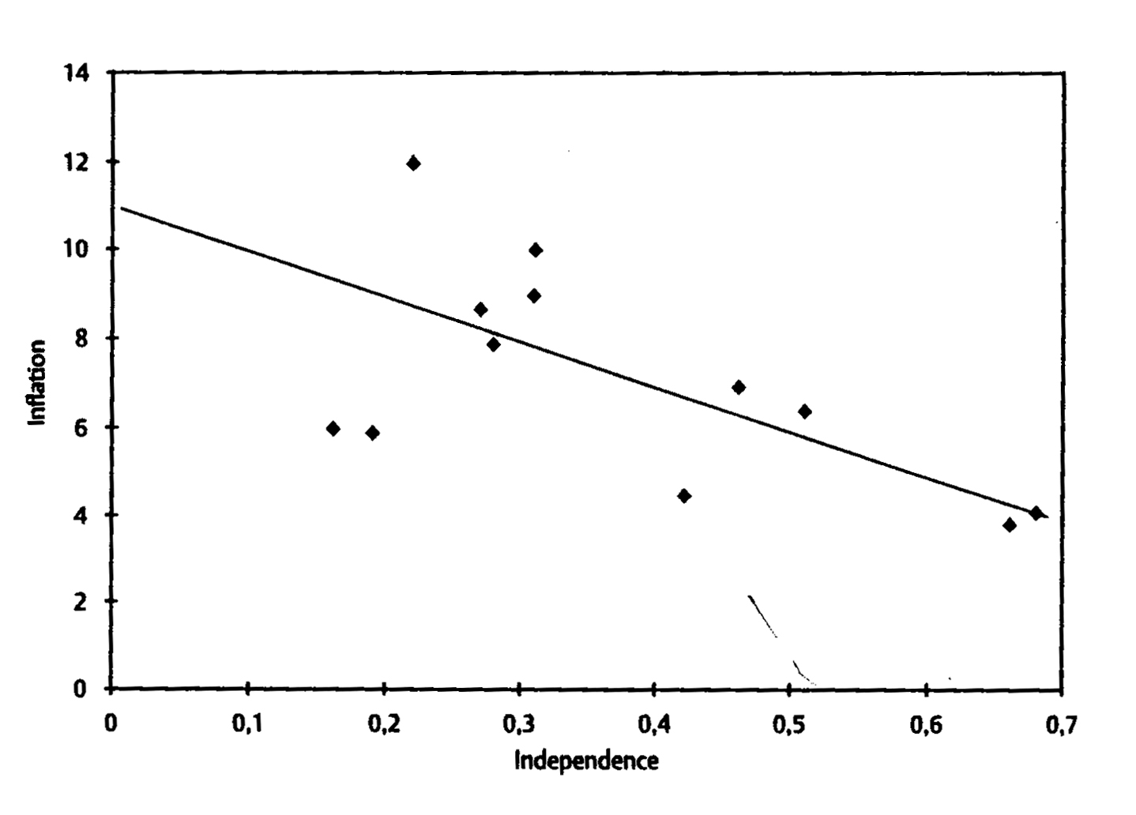
Long-term comparisons imply that there is a correlation between the central bank’s independence and the inflation.

Slide 10
Development of functions and position of the Czech central bank
Mutual coordination of monetary and fiscal policies depend on two basic things :
the level of central bank’s independence
concept of macroeconomic tasks
During the transition, both these things were developing ⇒ the functions and position of the central bank were changing.
Notes:
4.1 Economic equilibrium and monetary and fiscal policy
It is not allowable for economic policy to be left uncoordinated. It means it is not possible for monetary and fiscal policies to head for different targets or to head for a common target in a principally different and incompatible manner. Monetary policy should be determined with a view to the intentions in fiscal policy and vice versa the fiscal policy should allow for the fact that a given measure will provoke a corresponding response of monetary policy. At the same time, however, the primary aim of modern economy must be price stability. Uncoordinated implementation of each policy will probably make the situation worse. It will lead to overloading one policy and to replacing one imbalance by another. In better case the imbalance will be successfully eliminated, but at higher social costs than in case of a coordinated course of action. In connection with the process of economic transformation, Isard emphasizes this fact, when he states “In the absence of a well-defined and credible timetable for phasing out restrictions, the process of economic transformation and growth may be seriously weakened or undermined^{[1]}”. Problems of mutual coordination of monetary and fiscal policies will depend on two basic facts: (i) on a legislatively stipulated relationship between the government and the central bank (i.e. the degree of central bank’s independence) and (ii) on setting macroeconomic targets, i.e. understanding the concept of macroeconomic balance or quantification of imbalance, which is still acceptable. Economic policy will obtain the best results, if monetary and fiscal policy measures (i.e. government’s and central bank’s activities) will be mutually coordinated – not at random, but according to predetermined rules. It is also related to setting and quantification of macroeconomic targets publicly and to efficient public control. It should be noted that macroeconomic equilibrium would be viewed differently in a developed market economy, in a developing country, and in a country passing through economic transformation. The definition of macroeconomic equilibrium, quantification of acceptable imbalance and determination of the scope of economic and political provisions needed for its removal became an apple of contention between the Czech government and the central bank. The situation can be described with a certain amount of simplification by using different stages of transformation process in respect with the position of the Czech central bank and the government (see also Table 14).
[1] [Isard, P. 1991] s. 19

Slide 11
Socialist monobank till 1989
SBČS was completely subordinated to decisions of the government and to interests of the communist political authority
monetary policy was a subject of a central plan
SBČS was absolutely dependent
Notes:
There was no point in talking about the central bank until 1989, because the entire banking system was run by the principle of the monobank. The main pillar of this system – Státní banka československá (SBČS) – fulfilled the functions of the central bank and those of a commercial bank. However, either of these functions was directly linked to the central plan, by means of which the power centre controlled the whole economic life in socialist Czechoslovakia. The activity, which could be called monetary policy, was limited to issuing currency and distributing credits and funds to state firms. It was completely subordinated to decisions of the government and interests of the communist political nomenclature.
The central bank was Státní banka Československá – SBČS, whose relationship to the government can be described as an absolute dependence, for SBČS was a part of centralized economic and political power.

Slide 12
First stage 1990 – 1992
meeting basic macroeconomic objectives had an absolute priority for the government
SBČS´s main function was to be the state’s bank and the bankers’ bank
SBČS was dependent both politically and economically
relationship between the SBČS and the government was relatively obliging, due to a complex economic situation and personal, friendly relations
Notes:
The first stage encompasses the beginning of transformation until the end of 1992. At this stage the central bank (SBČS) was dependent both politically and economically, particularly in the area of setting objectives; generally speaking, this situation can be described as dependence of monetary policy on fiscal policy. It had two reasons: (i) the newly emerging banking system did not operate in a functioning money market and (ii) the principal target was not to maintain price stability, but to alleviate inflationary consequences of price liberalization which was then under way. With regard to situation at the outset of transformation, the given state can be considered appropriate for the primary transition period, when meeting basic macroeconomic objectives had an absolute priority for the government because of political reasons and therefore it was not in any conflict with central bank‘s policy.
Státní banka Československá – SBČS was still in the position of the central bank but was already reformed. The area of commercial banking was shifted to the independent Komerční banka (KB) and Všeobecná úverová banka (VÚB). The SBČS continued functioning only as the central bank. At that time its main function was to be the state’s bank and the bankers’ bank. The banking sector of those years operated in a relatively noncompetitive cooperative environment, when the savings bank (ČSSP) provided other commercial banks (KB, ČSOB, IB, ŽB) necessary funds accumulated in the form of household savings. These banks, in turn, provided commercial loans to both state-owned and private firms. If needed, the SBČS itself provided cheap credits to commercial banks, which were at the interest rate equal to the discount rate. A special type of credits, called redistribution credits, was provided by the SBČS at the interest rate that was even lower than the discount rate. Those credits were to cover bad debts left by state enterprises, which gradually went bankrupt. The SBČS was a formally autonomous central bank, however it depended heavily on the government. The relationship between the SBČS and the government was relatively obliging, due to a complex economic situation and personal, friendly relationships.

Slide 13
Second stage 1993 – up to the present
running banking system, money market, price liberalization, and privatisation ⇒ reform of the central bank
SBČS had to be split due splitting of the republic
new ČNB was established as a modern central bank, totally independent from the government (Bundesbank)
principal target of monetary policy – to maintain a low inflation
Notes:
Establishment of a newly conceived Czech central bank – the Czech National Bank (CNB) – can mark off the second stage. A stabilized banking sector and functioning money market together with advanced price liberalization and privatisation made it possible to complete the reform of the entire banking system – i.e. the reform of the central bank. Break-up of Czechoslovakia contributed to its establishment from the political point of view, because the existing central bank had to be split. The process of dividing liabilities and assets of SBČS was utilized for a complete reform of the institution and ended in establishing a new central bank.

Slide 14
Central bank’s instruments and objectives
5.1 Monetary policy objectives
Principal macroeconomic objectives:
economic growth
employment
low inflation
equilibrium in the balance of trade
Monetary policy targets monetary objective – i. e. low inflation.
Notes:
Generally speaking, objectives of monetary policy are identical with principal macroeconomic objectives - economic growth, employment, price level stability (i.e. low inflation rate), equilibrium in the balance of payments and stable exchange rate[1]. Practical monetary policy formulates its basic strategy on the basis of specific targets that are derived from the principal objectives. Monetary policy targets are viewed in a different way according to the central bank’s position in international economy and the relationship of monetary policy to fiscal policy fiscal in individual countries. E.g. the American Federal Reserve System sets its objectives as: high employment, economic growth, price stability, interest rate stability, financial and exchange market stability[2]. The European Central Bank has specified as its principal objective price level stability along with maintaining support to the EU economic policy. In its present neo-conservative concept, the monetary policy does not usually set directly as one of its objectives economic growth or employment but it focuses on the monetary objectives, through which economic growth and hence employment is targeted. Using monetary policy and its instruments and objectives for targeting high employment was typical for Keynesian economic policy in the 60s and 70s of the 20th century. However, exclusion of other than monetary objectives does not relieve monetary policy from the responsibility for the entire economic development.
[1] Exchange rate stability as a target of monetary policy should be viewed differently on introducing of different exchange rate systems - see chapter XXX.
[2] cf. Mishkin, F.S. [1991] s. 344

Slide 15
principle:
direct inflation targeting – based on forecasts and prognoses
monetary targeting - central bank targets quantity of money in circulation
interest rate targeting - central bank targets interest rate levels on the money market
exchange-rate anchor – targeting of the fixed exchange rate
Each strategy requires some particular conditions – not all could be used during the transition.
Notes:
A central bank can pursue its primary objective – price level stability – directly. In that case it is known as direct inflation targeting. Another typical method of monetary policy control is money targeting, in which the central bank targets interest rate levels on the money market or a certain quantity of money in circulation. The central bank estimates, based on experience, economic models and prognoses, that if a certain interest rate or money supply are maintained, then the primary objective (hitting a certain level of inflation) will be fulfilled. In both cases it is important for money market institutions and market mechanism to function properly in the country, otherwise the central bank’s monetary strategy could fail. Another possibility how to ensure the price level stability, is to peg the price of domestic currency to the currency of some other country, whose price level is stable. A central bank implements the peg by announcing the fixed exchange rate (see chapter XXX). Domestic price level is thus anchored to a stable foreign price level (from here the name of the provision “price level nominal anchor“) and the central bank pursues the monetary policy targeted at maintaining the announced fixed rate. This method is especially appropriate for the situations, when the domestic economy experiences a difficult period of uncontrollable inflations or when market mechanisms of the money market do not function. Economic transformation is an example of such a period and a number of transitive countries applied this method of monetary policy targeting.
To reach monetary objectives, the central bank can use a portfolio of instruments. In principle, central bank’s instruments are its institutionalised powers within monetary policy. In a standard two-tier banking system, selected instruments are the ways, by means of which the central bank enters the money market and affects the money supply and demand. The central bank is, on account of its position within the banking system, endowed with extraordinary possibilities of such interventions. Central bank’s instruments can be divided into direct and indirect according to their general effect.

Slide 16
Direct instruments
based on directive, administrative decisions, which commercial banks have to follow by law
not rely on the money market - not require its proper functioning
can become exponents of economic dictatorship
their application is minimized in modern market economies
Direct instruments can be a way of controlling monetary policy in a situation, when the money market does not work – during the economic transition.
Notes:
Direct instruments of the central bank are based on using directive, administrative decisions, which commercial banks have to obey by law. Such instruments are very efficient, involve minimum costs for the central bank, do not rely on the money market and therefore do not require its proper functioning. Simultaneously, using direct instruments means that the basic principles of free enterprise and competition are curbed considerably. As these instruments do not act through the money market, their application can be contra-productive, because they can throw the economy off balance. If the central bank is linked to the political power centre, then direct instruments can become exponents of economic dictatorship. That is why their application is minimized in modern market economies.
On the other hand, direct instruments can be perceived as an appropriate way of controlling monetary policy in a situation, when the money market does not work. A typical situation of this kind is the period of economic transformation. The previous chapters dealt with establishment of a two-tier banking system and emergence and revival of the money market. At the outset of economic transformation the central bank was incorporated into the monetary system, in which commercial banks were anchored as new institutions. The money market based on freedom of choice and competition slowly began to function and was purposefully cultivated especially on the lowest level, i.e. between commercial banks and their clients (firms and households), and step by step among commercial banks. However, the mechanisms of such money market were still limited and imperfect, the market was prone to panics, rational behaviour of agents and their experience were not sufficiently developed, their expectations failed, etc. In this situation the relationship between the central bank and commercial banks was not built on market principles and the only effective way of controlling the money market by the central bank, as an alternative to the previous directive monetary plan, was to implement direct instruments. Implementation of direct instruments in such a period is appropriate and appears to be the only effective method how to control the imperfect money market. Direct instruments can be complemented with indirect instruments until institutional framework for a functioning money market has been developed. Then direct interventions can be phased out. Direct instruments can be divided into several groups.

Slide 17
Prudential rules
principal instrument of banking supervision
short-term, low-interest deposits should not be used to provide long-term, high-interest loans
can be focused on money market regulation: selectively set for different banks, or purposefully changed after some time
result - banks can provide higher or lower volume of credit to their clients, which raise or lower quantity of money in the economy
Notes:
One of the primary functions of the central bank is to supervise the banking sector. A principal instrument of the supervision is setting prudential rules for banks. The rules are based on international records of the Basle Committee on Banking Supervision[1]. The agreements require for commercial banks a binding ratio between their liabilities (accepted deposits) and assets (provided credits) in a certain time structure. In principle, short-term, low-interest deposits should not be used to provide long-term, high-interest loans. Even if this practice is highly profitable, its degree of risk is high. Prudential rules determine the maximum allowable ratio between long-term assets and short-term liabilities. The purpose of the measure is to reach a balance between profitability and degree of risk so that the stability of the entire banking sector may not be jeopardized. The instrument is implemented in this manner in all modern market economies.
Prudential rules can be also used as a direct instrument of monetary policy focused on money market regulation in such a way that the rules are selectively set for different commercial banks, or are purposefully changed after some time. As a result, commercial banks can provide higher or lower volume of credit to their clients, which raise or lower quantity of money in the economy. Thus the central bank can thus reach a change in behaviour on the money market, without entering the market.
[1] for more detail see [Revenda, 2001]

Slide 18
Loan quotas
the hardest directive provision
maximum volume of funds, which a commercial bank can provide to one client
sum of funds over a certain period to all its clients
result - limited free entrepreneurial behavior of banks and strongly affected the money market and the whole economy
Notes:
One of the hardest directive provisions of the central bank is to implement loan quotas. Their principle is that the central bank determines the maximum volume of funds, which a commercial bank can provide to one client or a sum of funds over a certain period to all its clients. The quotas can be the same for all banks or they can be selective. In any case they severely limit free entrepreneurial activities of banks and at the same time strongly affect the situation on the money market and the whole economy in general. Implementation of this instrument differs from the distribution of credits based on the central plan in the monobank by the fact that the central bank allows commercial banks to decide, whom to grant the credit – it dictates only its volume. A comparatively softer provision is so-called relative quota, which means that the central bank determines the maximum allowable volume of credit, which the bank itself is going to grant to a single commercial bank in its function of bankers’ bank.

Slide 19
Limits on interest
direct setting of private credits´ interest rate by the central bank
limited entrepreneurial freedom of both commercial banks, and their clients
result - strong and quick impact on interest rates in the economy
Notes:
Monetary policy management is principally based on reaching a certain required, equilibrium price of money on the money market, i.e. a certain interest rate. The central bank reaches this interest rate indirectly by means of interventions on the money market and by changes of supply and demand for money from commercial banks. The interest rate can be targeted directly without any own activities by ordering commercial banks to grant loans and/or accept deposits at particular interest rates or it sets a margin (band) of the rates or sets their floor or ceiling. Thus the central bank can grossly interfere with entrepreneurial freedom of both commercial banks, and their clients. However, it meets its objective very quickly.

Slide 20
Gentlemen agreements
between the central bank and commercial banks from an urgent request to recommendation
commonly used in modern market economies - fulfilling is not legally binding
together with the other direct instruments form a powerful tool
Notes:
The last category of direct instruments is gentlemen’s agreements between the central bank and commercial banks. The agreements include anything ranging from an urgent request to recommendations, through which the central bank stimulates commercial banks to certain activities or behaviour. The behaviour of the central bank must be strictly distinguished from the behaviour of the leading bank in the monobank system – in that case commercial banks were really centrally controlled under the former legal system. Gentlemen’s agreements are commonly used in modern market economies, but fulfilling the wishes of the central bank is not legally binding. Hardly any commercial bank, however, dares to openly resist expressed wish of the central bank. On the other hand, the central bank should not misuse the informal powers. In the transformation process gentlemen’s agreements were frequently used as an instrument motivating for building up a desirable banking sector structure.

Slide 21
Indirect instruments
based on central bank’s actions on the money market
very well functioning money market is required
using need not be successful and exactly predictable
absolutely consistent with market economy: full sovereignty, free enterprise and free competition of commercial banks are ensured
Within a developed market economy just indirect instruments can and must be used.
Notes:
Central bank’s indirect instruments are the opposite of direct instruments in the sense that their action is directly determined by the existence of a functioning money market. Therefore indirect instruments include behaviour of the central bank with which it enters the money market in its function of bankers’ bank and currency issuer. The central bank tries to change the behaviour of commercial banks on the money market with help of indirect instruments and change the price of money, i.e. interest rate in such a manner that it itself behaves as a subject of the market. Using indirect instruments need not be successful, and it is not exactly predictable if the selected objective will be met. Moreover, the central bank often has to bear the costs incurred in using indirect instruments. But their application is absolutely consistent with market principles; it ensures full sovereignty of commercial banks, free enterprise and free competition. To reach its objectives, the central bank usually uses several instruments at the same time. Implementation of individual instruments also brings some side effects into economy and by a suitable combination of several instruments the central bank can more effectively attain its given objective. Indirect instruments can be divided into several groups.

Slide 22
Discount rate
the principal rate of interest of the central bank
the price of money charged by the central bank to commercial banks on loans
related to the central bank´s functions a bankers’ bank, and a lender of last resort
great signalling importance
Notes:
Discount rate is the principal rate of interest of the central bank and in general it is the price of money charged by the central bank to other commercial banks on loans. It is related to the function of the central bank, which acts as a bankers’ bank and a lender of last resort. A rise in the discount rate curbs the demand of commercial banks for loans from the central bank and vice versa. Reactions of commercial banks to discount rate movements hinge on[1] the dependence of commercial banks on loans from the central bank, on the possibilities to get credit from other commercial banks or foreign agents, and on the possibilities of commercial banks to transfer the rise in discount rate to their clients by increasing the interest rates on provided loans. Changes in the discount rate have a great signalling importance. Banks and economic agents in general are thus informed about the future character of monetary policy (i.e. whether the central bank tightens or softens monetary policy) and they adjust their expectations accordingly. A great influence on a change in expectations has even a mere announcement that the central bank is going to change the discount rate. In modern market economies the discount rate is not the price of current funds provided by the central bank, but the price of a emergency credit, which should ward off liquidity problems of a commercial bank. Commercial banks are obliged to seek additional funds on the inter-bank market at market interest rates. The discount rate is usually the lowest interest rate in economy and all other interest rates move above it and are influenced by it indirectly. The effect of movements of the discount rate is shown in Diagram 15.
[1] [Revenda, 2001]

Slide 23
central bank´s
discount rate
RISE
commercial bank´s credit capacity
DECLINE
money supply in economy
DECLINE
commercial bank´s supply of credits
DECLINE
inflation
DECLINE
economic growth
DECLINE
employment
DECLINE
balance of payments
INFLOW

Slide 24
Lombard rate
the rate of „Lombard credit“
central bank provides credit to commercial banks against collateralised security (i.e. state bonds)
common source of commercial banks´ funds
related to the central bank´s functions a bankers’ bank
Notes:
Lombard credit is provided against collateralised security. In modern market economies it is a common source of funds provided by the central bank to commercial banks. As a collateral are accepted only state securities, i.e. those with zero risk. Lombard credit is provided at a set interest rate, which is specified and announced by the central bank as its Lombard rate. It is usually higher then the market short-term interest rate on the inter-bank market. If the Lombard credit were cheaper than the market one, commercial banks would tend to use funds from Lombard loans for speculation on the financial market and the central bank would be pushed into “Lombard trap”. Lombard credit mainly acts as an issue instrument, complements sources of funds of commercial banks. Effects of change in the Lombard rate on the economy are shown diagrammatically in Diagram 16.

Slide 25
central bank´s
Lombard rate
DECLINE
commercial bank´s credit capacity
RISE
money supply in economy
RISE
commercial bank´s supply of credits
RISE
inflation
RISE
economic growth
RISE
employment
RISE
balance of payments
OUTFLOW

Slide 26
Repo rate
central bank purchases state bonds to commercial banks with the obligation of repurchas at a specific time with the interest - repo rate
central bank provides commercial banks with sufficient liquidity
very efficient and operational for regulating market interest rates
effect of change in the repo rate is similar to that of change in the discount or Lombard rates
Notes:
A specific instrument that is based on a perfectly functioning money market is called repo-operations (repurchase agreements). Their objects are the securities accepted by the central bank (i.e. government bonds), which the central bank purchases with the obligation of the selling commercial bank that they will be repurchased at a specific time with the interest that is given by the announced repo rate. Repo tenders are agreed for standard periods of time and the central bank declares e.g. one-week, two-week etc. repo rate. In this way the central bank provides commercial banks with sufficient liquidity. To decrease the money supply, the central bank uses reverse repo, which means that the seller is the central bank and agrees to buy the securities back at a specified time along with the interest given again by the announced repo rate. Repo became a widely used instrument because of its operativeness and universality both for influencing commercial banks´ liquidity and for regulating market interest rates. The effect of change in the repo rate is similar to that of change in the discount or Lombard rates (see Diagram 15 and 16).

Slide 27
Open market operations
purchasing and selling of state bonds by the central bank on the money market
raise or lower the money supply directly
central bank has to keep the securities in its portfolio
standard financial market + a sufficient volume of adequate securities are requested
Notes:
Open market operations are a term denoting purchasing and selling of state securities by the central bank on the money market. The principle of their function lies in influencing credit capacity of banks. By purchasing state securities, the central bank increases the credit capacity and liquidity of commercial banks (supplies the economy with additional funds). By selling state securities, the central bank lowers the credit capacity and liquidity of commercial banks (withdraws surplus money from the economy). Hence it is the instrument that directly raises or lowers the money supply. Efficiency of open market operations depends on concrete conditions in an economy. The central bank need not have in its portfolio the securities, which the banking sector would be willing to purchase in sufficient volumes. In that case the central bank is obliged to issue its own securities (treasury bills) and by doing so commit itself to provide debt servicing – paying out any accrued interests. A condition for smooth functioning of open market operations is the existence of standard financial markets and of course a sufficient volume of adequate securities. Open market operations are linked with the above problem of financing government deficit by loan from the central bank, if the central bank purchases state securities directly from the government instead from commercial banks. As mentioned earlier, law in most market economies prohibits the direct purchases. The effect of open market operations is schematically indicated in Diagram 17.

Slide 28
central bank´s
open market op.
PURCHASE
commercial bank´s credit capacity
RISE
money supply in economy
RISE
commercial bank´s supply of credits
RISE
inflation
RISE
economic growth
RISE
employment
RISE
balance of payments
INFLOW

Slide 29
Minimum reserves requirement
percentage from clients’ deposits - commercial banks have to keep it at cental bank´s account
management of liquidity in commercial banks with the aim to provide security and functioning of the banking system
long-term stability and a low level in developed market economies
frequent changes during transition + gradual lowering to the level common in market economies
Notes:
The main purpose of minimum reserves requirement is to regulate liquidity in commercial banks with the aim to provide security and functioning of the banking system. Minimum reserves requirement is determined as a percentage from clients’ deposits with commercial banks. Thus they represent compulsorily created receivables of commercial banks with the central bank that are usually interest-free. In the commercial bank’s balance it is one of the items of assets, in the central bank’s balance it belongs among one of the important items of liabilities. The main advantage of minimum reserves requirement is that it acts uniformly and very efficiently on all banks. Their biggest disadvantage lies in the low operativeness: the rate changes of minimum reserves cannot finely tune monetary policy. Therefore, they are adopted especially in unstable periods, when the raised rates ensure stability and liquidity of the banking system. Changes in rates of minimum reserves are thus usually linked with regulation of behaviour of the banking system as a whole rather than with controlling the monetary policy. A long-term stability and a low level of minimum reserves requirement are typical of standard market economies. On the contrary, changes in the minimum reserve requirements are relatively frequent during transformation process and there is a trend towards their gradual lowering to the level common in market economies. Effects of minimum reserves requirement on the economy are schematically shown in Diagram 18.

Slide 30
central bank´s
rate of MRR
RISE
commercial bank´s credit capacity
DECLINE
money supply in economy
DECLINE
commercial bank´s supply of credits
DECLINE
inflation
DECLINE
economic growth
DECLINE
employment
DECLINE
balance of payments
- NON -

Slide 31
Use of monetary policy instruments
Stage of the SBČS 1989 - 1992
no money market + no competition in the banking system = the SBČS used mostly direct instruments:
limits on interest
loan quotas
„re-financing credits“ - non-standard loans to help to big state-owned banks
minimum reserves requirement
Notes:
The use of individual monetary policy instruments matched the possibilities, which the central bank had with regard to its position in the banking system and the economic situation. In summary it can be stated that the SBČS used mostly direct instruments, while the CNB since 1993 indirect ones. The non-existence of the money market and competition in the banking system forced the SBČS to implement limits on interests and credit ceilings. In the first years of economic transformation the SBČS implemented refinancing credits enabled commercial banks a relatively easy access to credit. Refinancing credit for 1 - 3 months was provided in the form of an auction at the market interest rate. Banks that did not succeed in the auction could get refinancing credit for 1 - 7 days at the a priori declared fixed interest rate derived from the discount rate. The amount of this credit, however, could not exceed the double of the commercial bank’s capital. Refinancing credit were non-standard instruments of monetary policy, whose use was enforced by the situation on the money market at the beginning of transformation. Gradually the SBČS and later the CNB adopted the use of standard indirect instruments and refinancing credits were abolished. The CNB was established as a standard central bank and that is why it used standard, indirect instruments. It was made possible by already functioning market environment of the banking system and functioning money market. The CNB resorts to non-standard measures only in its function of banking supervision and regulation, if it intervenes in a concrete case. Repo tender, discount and Lombard rates, open market operations and minimum reserves requirement gradually became principal monetary policy instruments:

Slide 32
Stage of the ČNB from 1993
standard central bank + standard money market = the ČNB used standard, indirect instruments:
repo rate - two-week repo tender is announced daily
discount rate - overnight deposit at the ČNB
Lombard rate - marginal lending facility from the ČNB
open market operations - fine-tuning interventions on money market or foreign exchange market
minimum reserves requirement – a "cushion" ensuring the smooth functioning of the banking system
Notes:
• The main monetary instrument is the two-week repo tender. The two-week repo tender is announced daily and commercial banks may come with bids. Because of the systemic liquidity excess, the repo tenders are for liquidity withdrawal. The two-week limit repo rate, set up by the CNB, is the most important policy rate of the central bank. The supplementary monetary instrument is the three-month repo tender. This is usually announced weekly, and the tenders are for liquidity withdrawal as well.
• The deposit facility is a non-collateralised overnight deposit with the CNB that any Czech bank may place, provided it applies for it not later than 15 minutes before the end of the accounting day at the CNB's clearing centre. The rate used for these deposits is the discount rate. The marginal lending facility is and collateralised overnight repo that any Czech bank may use to borrow from the CNB, provided it applies for it not later than 25 minutes before the end of the accounting day. The rate used for this facility equals the Lombard rate. Because of the nature of the automatic facilities, the discount rate and the Lombard rate create and corridor (setting the floor and ceiling) for the two-week repo rate and hence for the very short-term money market rates.
• The CNB may, at its discretion, initiate several fine-tuning interventions on money market or foreign exchange market buying or selling securities – state bonds. The CNB may from time to time issue its own short-term securities (treasury bills), which may be used as eligible collateral in its own operations or in commercial bank operations.
• Apart from these instruments, the CNB also makes use of and minimum reserves requirement. The role of the minimum reserves requirement as a monetary policy instrument is low at present. However, the funds deposited by banks on non-interest bearing accounts with the CNB to meet the requirement serve as and "cushion" ensuring the smooth functioning of the banking system.
An overview of using various types of monetary instruments in different transformation stages is summarized in table 22.

Slide 33
Price developement
Stormy price development at the begining of inflation
Increasing inflation differential
  1991-2000: inflation in CR nine times higher than in Germany
1991-1993: Price liberalization, currency separation, new tax system
1994-2001: demand growth, deregulation
  1994-1997: inertial inflation
  Since 1998: desinflation process

Slide 34
Monetary policy strategy in Czechoslovakia / Czech Republic
Conception of monetary policy objective
Clear targeting of low inflation was not possible at the beginning of the transition:
money market did not exist
extensive price liberalisation was on process
Objective was changing during the transition according to the needs and possibilities of the economy.
Notes:
The conception of monetary policy objective was changing during the transformation process according to the needs and possibilities given by the shape the national economy was in. As early as in 1989 monetary policy targeting was abandoned, as it was based on the uniform mechanism of the central plan, which was only politically motivated. However, the central bank could not switch to unambiguous targeting of price level stability, due to the state of Czechoslovak economy, its institutional structure and with respect to the state of the banking system. Two reasons existed for it: (i) the money market did not function and so the central bank (SBČS) could not base its monetary policy strategy focused on price stability and above all (ii) price stability could not a priori be maintained, since the process of far-reaching price liberalization was launched at that time. Price liberalization was based on comparing the pressure of supply and demand on the markets and was accompanies by a vast price increase. Although prices of a number of services and goods were still regulated and were freed only gradually, the inflation rate attained the order of tens of percent. The price growth in that situation was a necessary associated phenomenon of the emerging market economy and could not be anyhow eliminated. The aim of monetary policy was not to target a certain inflation rate but simply prevent the one-off price shock from getting out of control to degenerate into the inflationary spiral. In the early years of transformation the central bank’s task was to maximally soften inflationary pressures resulting from price liberalization and gradually stabilize the inflation rate. The proper objective of the SBČS was a fixed exchange rate of Czechoslovak crown anchored in the composite of west-European currencies and the US dollar (for more detail see chapter XXX). The strategy proved successful, the inflation stabilized rather quickly and fell to the level of 10% p.a.

Slide 35
Fixed exchange rate – 1989 - 1996
the monetary policy´s target was not a certain rate of inflation
prevent of price shock at the beginning of the liberalization
exchange rate of the Czechoslovak koruna was fixed - anchored in the composite of west-European currencies and the US dollar
⇒ strategy proved successful, the inflation stabilized rather quickly and fell to the level of 10% p.a.
Notes:
The conception of monetary policy objective was changing during the transformation process according to the needs and possibilities given by the shape the national economy was in. As early as in 1989 monetary policy targeting was abandoned, as it was based on the uniform mechanism of the central plan, which was only politically motivated. However, the central bank could not switch to unambiguous targeting of price level stability, due to the state of Czechoslovak economy, its institutional structure and with respect to the state of the banking system. Two reasons existed for it: (i) the money market did not function and so the central bank (SBČS) could not base its monetary policy strategy focused on price stability and above all (ii) price stability could not a priori be maintained, since the process of far-reaching price liberalization was launched at that time. Price liberalization was based on comparing the pressure of supply and demand on the markets and was accompanies by a vast price increase. Although prices of a number of services and goods were still regulated and were freed only gradually, the inflation rate attained the order of tens of percent. The price growth in that situation was a necessary associated phenomenon of the emerging market economy and could not be anyhow eliminated. The aim of monetary policy was not to target a certain inflation rate but simply prevent the one-off price shock from getting out of control to degenerate into the inflationary spiral. In the early years of transformation the central bank’s task was to maximally soften inflationary pressures resulting from price liberalization and gradually stabilize the inflation rate. The proper objective of the SBČS was a fixed exchange rate of Czechoslovak crown anchored in the composite of west-European currencies and the US dollar (for more detail see chapter XXX). The strategy proved successful, the inflation stabilized rather quickly and fell to the level of 10% p.a.

Slide 36
Controlling the quantity of money – 1993 - 1996
the Act of ČNB changed the objective: “to maintain stability of currency“
external stability related to exchange rate stability
internal stability related to price level stability
⇒ it failed to decrease the inflation rate to the EU average level
⇒ quantity of money wasn’t maintained on the planned level due foreign capital inflows
Notes:
A certain breakthrough in the direction of monetary policy was the establishment of the Czech National Bank in 1993. The objective of CNB’s monetary policy was laid down by the Constitution of the Czech Republic and the Act on the CNB and it was worded as “to maintain currency stability“. Monetary stability had an internal and an external dimension: (i) the internal stability related to price level stability, while (ii) the external stability related to exchange rate stability of the Czech koruna. The CNB’s principal objective in this period was (i) to minimize the inflation rate and (ii) to maintain the fixed exchange rate declared at the beginning of transformation. It executed disinflation policy by controlling the quantity of money in circulation, maintained exchange rate stability by trading on the foreign exchange market. The purpose of this monetary policy strategy was to utilize good experience with the fixed exchange rate as a price level stabilizer. Besides, by means of controlling the quantity of money in circulation, to decrease the inflation rate, which in the mid-90s oscillated permanently round 9 – 10% p.a. Although the CNB tried to meet the set objectives conscientiously and risked an open conflict with the government, it failed to decrease the inflation rate to the target level that equalled average EU inflation. The main reason was that CNB did not succeed in maintaining the quantity of money in circulation on the planned level: the money supply increased every year at a higher rate due foreign capital inflows. That is why the inflation rate continued to be relatively high.

Slide 37
Direct inflation targeting - from 1998
under the pressure of foreign capital outflow the fixed rate was left in May 1997
the concept of nominal anchor had to be abandoned
targeting of quantity of money was not very successful so far
⇒ The ČNB specified short-term and medium-term stages, during which it tried to squeeze the inflation within the set limits.
Notes:
A significant turning point in the conception of monetary policy objective came in 1997 after monetary turbulences, when the CNB, under the pressure of foreign capital outflow, was obliged to abandon the fixed rate of the koruna and went floating (for more detail see chapter XXX). Thus it abandoned the concept of nominal anchor, on which monetary policy had been based since the beginning of transformation. Because targeting of quantity of money was not very successful so far, termination of the fixed rate meant a marked worsening of the central bank’s ability to control inflation. The CNB therefore decided to completely change its monetary policy strategy and switched to direct inflation targeting. It signified that the CNB made an obligation to target a particular explicit inflation rate during a particular concrete time horizon. In practice it implied that the CNB specified short-term and medium-term stages, during which it tried, by means of its indirect instruments, to squeeze the inflation within the set limits. Table 19 indicates direct inflation targets set by this method.

Slide 38
the first targets:
Target month
Target level
Set in
December 1998
5.5% – 6.5%
December 1997
December 1999
4% – 5%
November 1998
December 2000
3.5% – 5.5%
December 1997
December 2001
2% – 4%
April 2000
December 2005
1% – 3%
April 1999

Slide 39
Net inflation
Problem:
in 1998, more than 18% of goods and services had administratively regulated or controlled prices
inflation target was related to net inflation = movement of prices of the goods and services, whose prices were set freely by the free market
the ČNB was not responsible for the inflation caused by a government’s decision to raise some regulated prices
the ČNB was responsible only for the inflation caused by market forces
Notes:
When direct inflation targeting was implemented in 1997, price liberalization had not been finished yet and a number of goods and services had administratively regulated or controlled prices (more than 18% items of the consumer basket). That is why the direct inflation target was not related to headline inflation but only to net inflation. Net inflation represented movement of prices of the goods and services, whose prices were set freely by the free market. Net inflation was calculated by excluding from the consumer basket all the items, whose price was not set by the market – they are shown in Table 20. The purpose of this measure was that the CNB was not made responsible for the inflation caused by a government’s decision to raise some regulated prices, but it was responsible only for the inflation caused by market forces. It was only this inflation that could be influenced by its instruments.

Slide 40
calculation of the net inflation
A. Items with maximum prices
Constant
weight in %
a) set by the Ministry of Finance of the Czech Republic
net rent for rental flats
1,6531
electricity
2,5249
gas
0,9589
medicine and health care output
0,6734
passenger railway transport
0,2081
telecommunication services – telephone
0,7605
b) set by local authorities
municipal public transport
0,7716
parking services
0,0171
taxi services
0,0295

Slide 41
B. Items with prices regulated on and cost-plus basis
water and sewerage
0,9867
heating for households
3,0174
bus transport
0,6899
postal services
0,1163
telegraph
0,0121
propane-butane gas
0,1464
household waste disposal
0,2744
housing-related services for rental flats
0,2495
housing-related services for co-operative flats
0,1131
supplementary educational services (student fares)
0,1785

Slide 42
C. Fees
health insurance
3,4783
mandatory insurance of motor vehicles
0,4099
motor vehicle owner registration
0,0196
radio and TV fees
0,8155
signature authentication
0,0629
divorce application fee
0,0154
dog ownership fee
0,0247
postal order C
0,0354
building permit issuance
0,0808
Total
18,3239

Slide 43
Headline inflation
Starting from 2002, the ČNB switched to direct targeting of headline inflation:
the rate of inflation dropped significantly
progress in price liberalization
the headline inflation has a higher informative value
Notes:
The new strategy of targeting of monetary policy proved successful in the sense that the rate of inflation really dropped significantly. Its negative feature, however, was a considerable inflation rate fluctuation, which is attributed to a still relatively short market history of Czech economy. To overcome these problems, the CNB, starting from 2002, switched to direct headline inflation targeting. It was made possible by further progress in price liberalization. Targeting of headline inflation has a higher informative value and the CNB increased transparency of this system by setting the inflation target in the form of a continuous band, instead of using irregular intervals for declaring the net inflation (see Table and Diagram 21).

Slide 44
Prices in CPE
Deformation of price levels
Domestic prices set directively from centre
Because of low interaciton with then rest of the world – different price development
  Crude oil
Conservative monetary policy
  Low inflation X high inflation in PL and HU

Slide 45
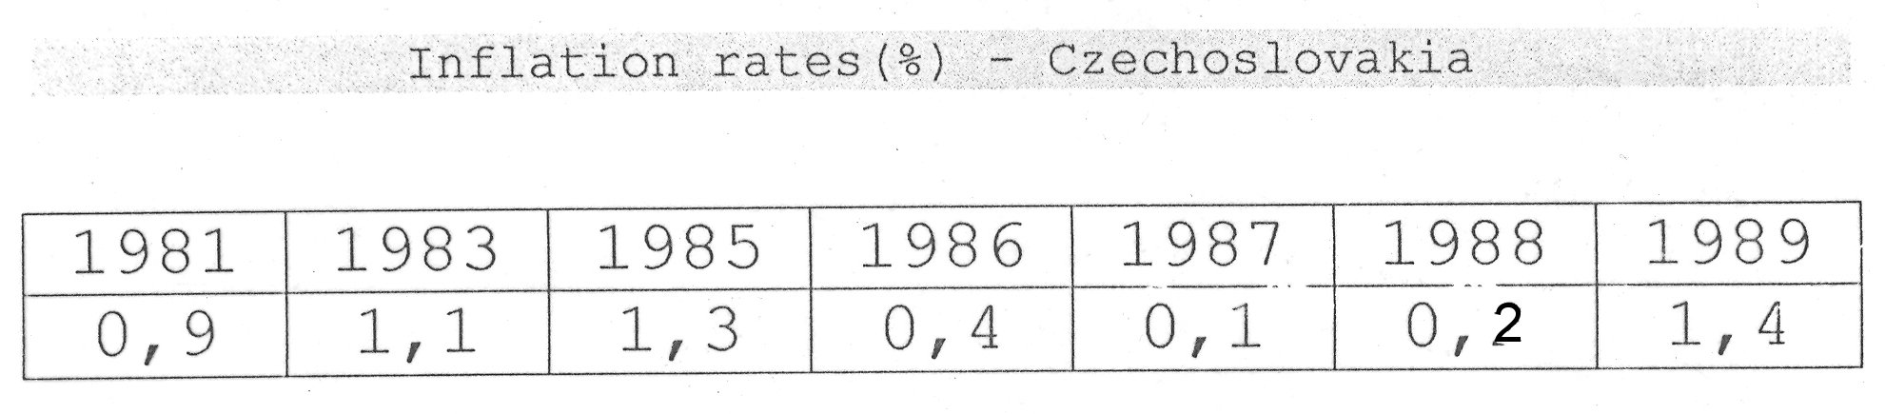
Inflation rates in socialistic Czechoslovakia

Slide 46
Price liberalization
Key element of transition
  Necessary condition for the introduction of the market mechanism
  During CPE prices did not reflect the cost of production nor value to the consumers
Liberalization = change of relative price = improvement in resources allocation
Also redistribution = winners and losers

Slide 47
Price liberalization
Several partial measures during 1990
  Removing the subsidies for food
  Petrol prices
Big one-off liberalization – 1.1.1991
  Result: cca 80% of prices were free
  Some prices administratively set or controled
  Subsidies gradually reduced

Slide 48
Results of liberalization
No more queues in shop
Increased availability of goods
Increased efficiency
Reduction of social wasteful activities
Drop in real wages
  Improvement of competitiveness of firms
  Harmfull mainly for low-income households
  Some privileged classes droped in social status and income
Increasing earning differential

Slide 49
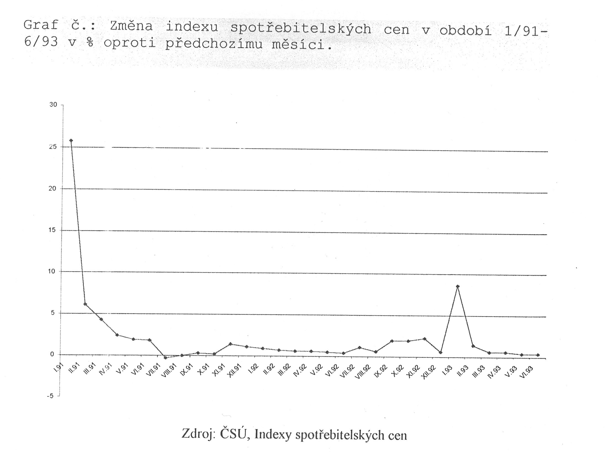
CPI monthly development

Slide 50
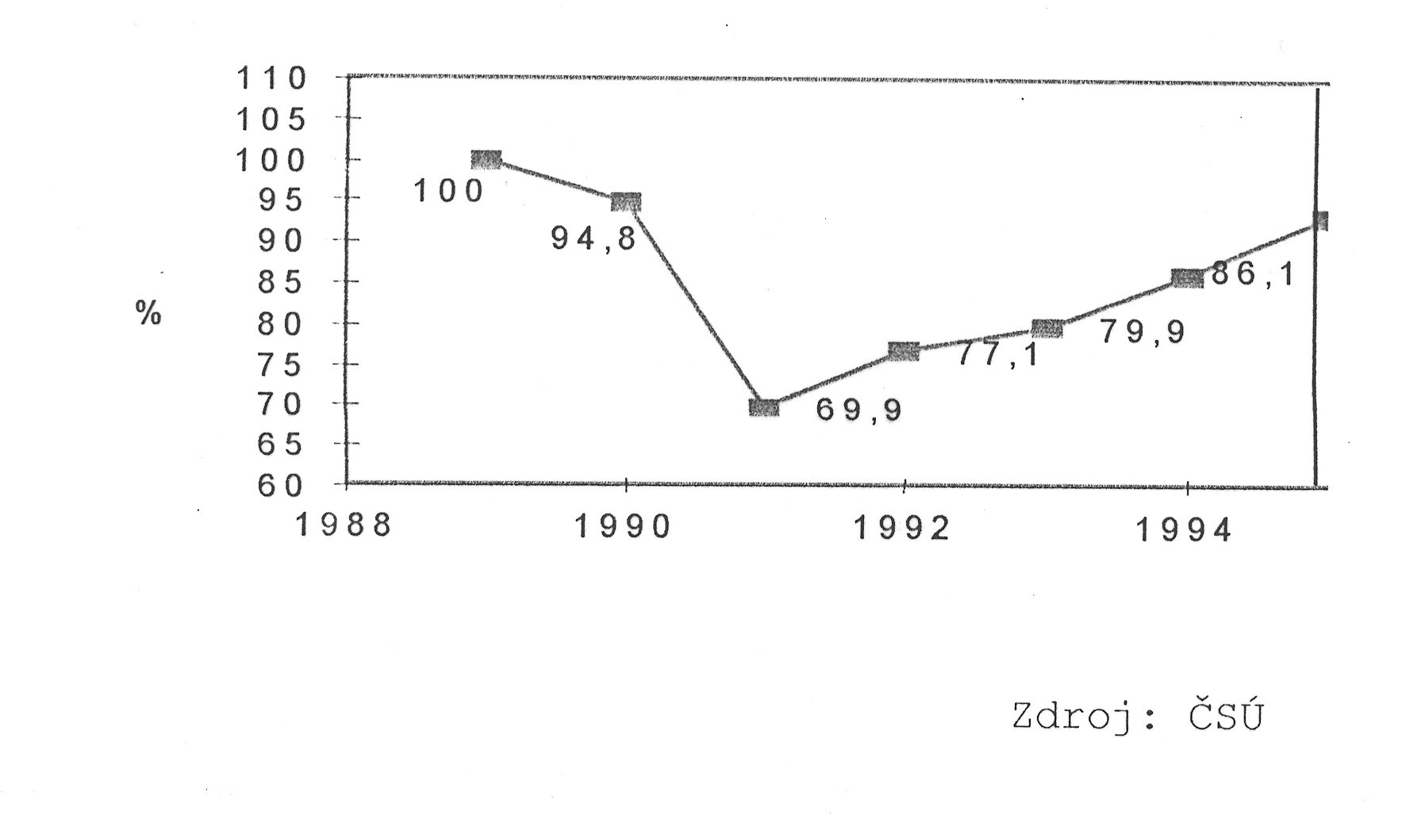
Real wage development 89-94

Slide 51
Inflation 1992-1993
Forced savigs from CPE – increased comsumption – demand growth – price increase
1993 – split of Czechoslovakie
  onother inflation jump
    New tax system
    Introduction of VAT (previously turnover tax)
    Growth of wages supported by growth of productivity = boost of demand
Monetary restriction – aim acceptable inflation and stable ER

Slide 52
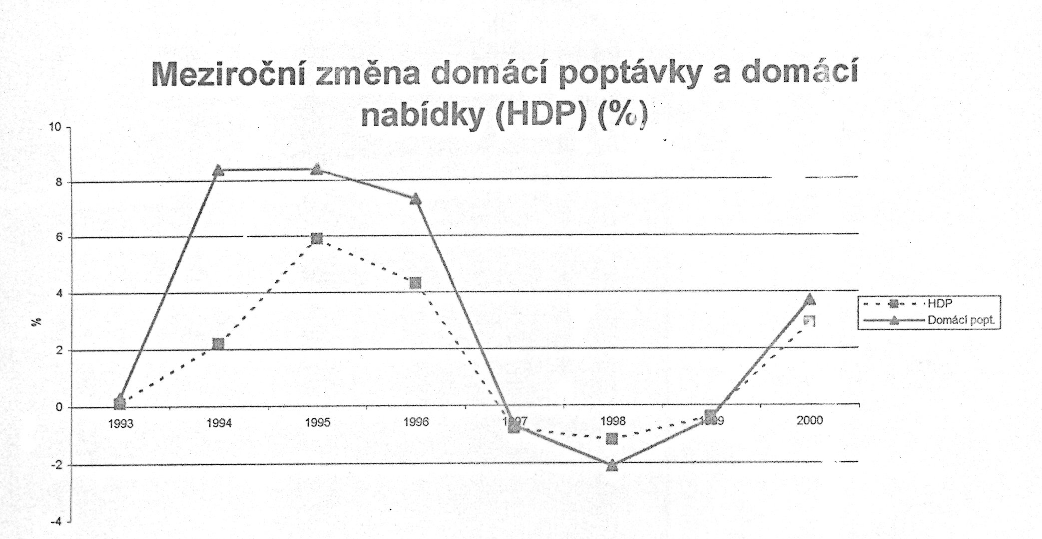
Year-to-year chance of domestic demand and GDP (%)

Slide 53
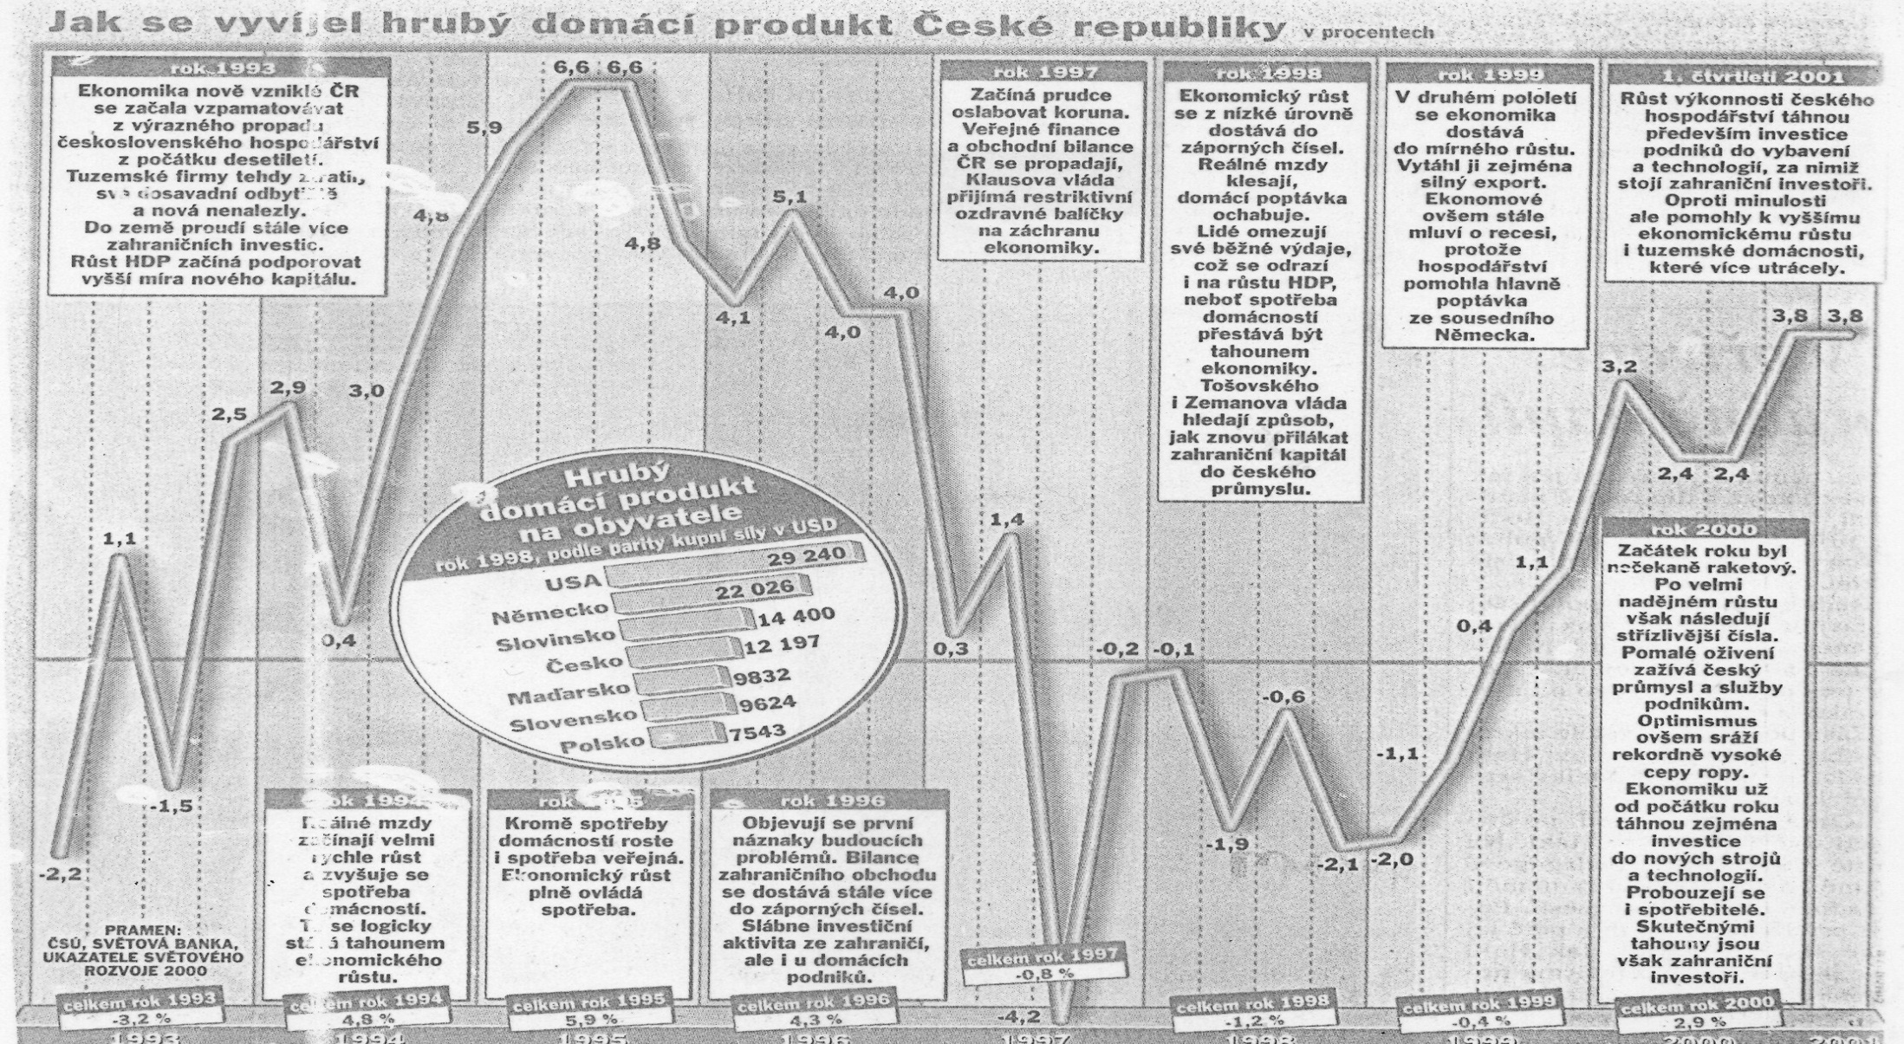
GDP development

Slide 54
Inflation after 1993
Low dymanic of changes
  Inflation still higher then in developed countries (1% per month)
  Inflation differential
Further lowering unsuccessful
  Expectations (collective bargaining)
  Downward price rigidity
  Short-term inflow of foreign capital
    More money in economy – against restrictive MP

Slide 55
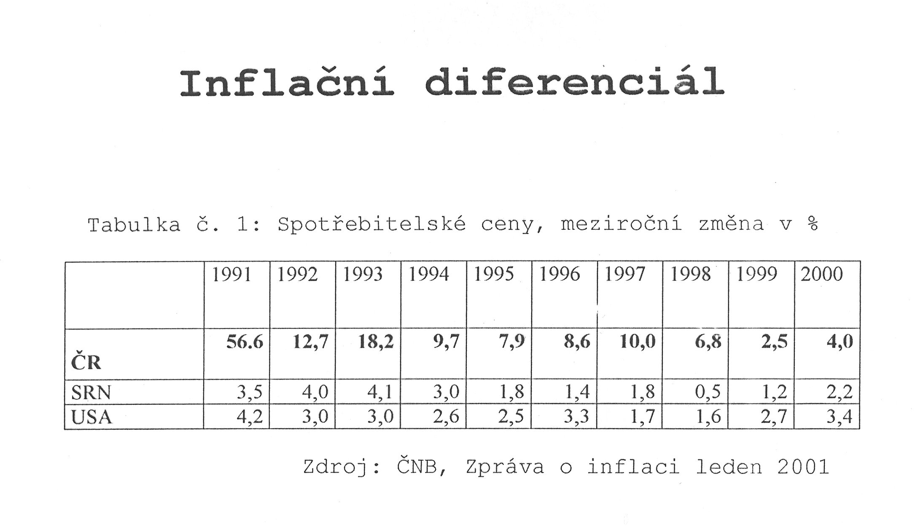
Inflation differential

Slide 56
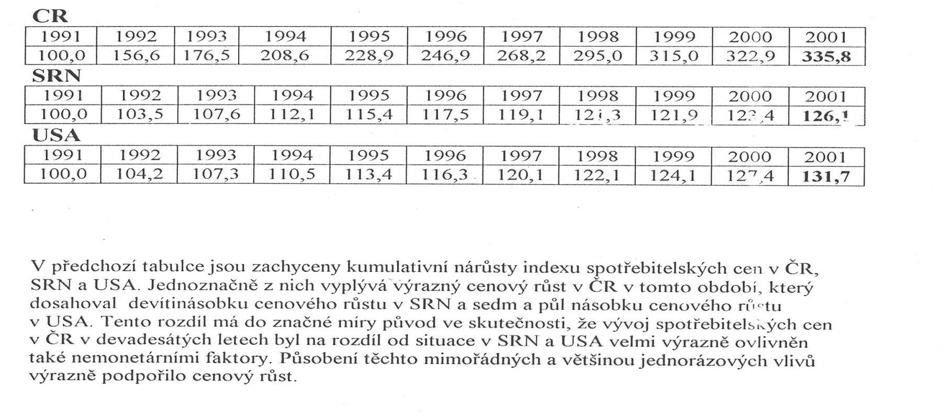
Cumulative incerase of consumer prices

Slide 57
Monetary crisis - 1997
Growth of demand higher than growth of GDP
  Deficit of CA
    Financed by inflow of „hot-money“
    1997: lost confidence in fixed ER
Decrease of inflation in first months
  Econonimc slowdown
  But increase of import prices
  Incerase of energy prices

Slide 58
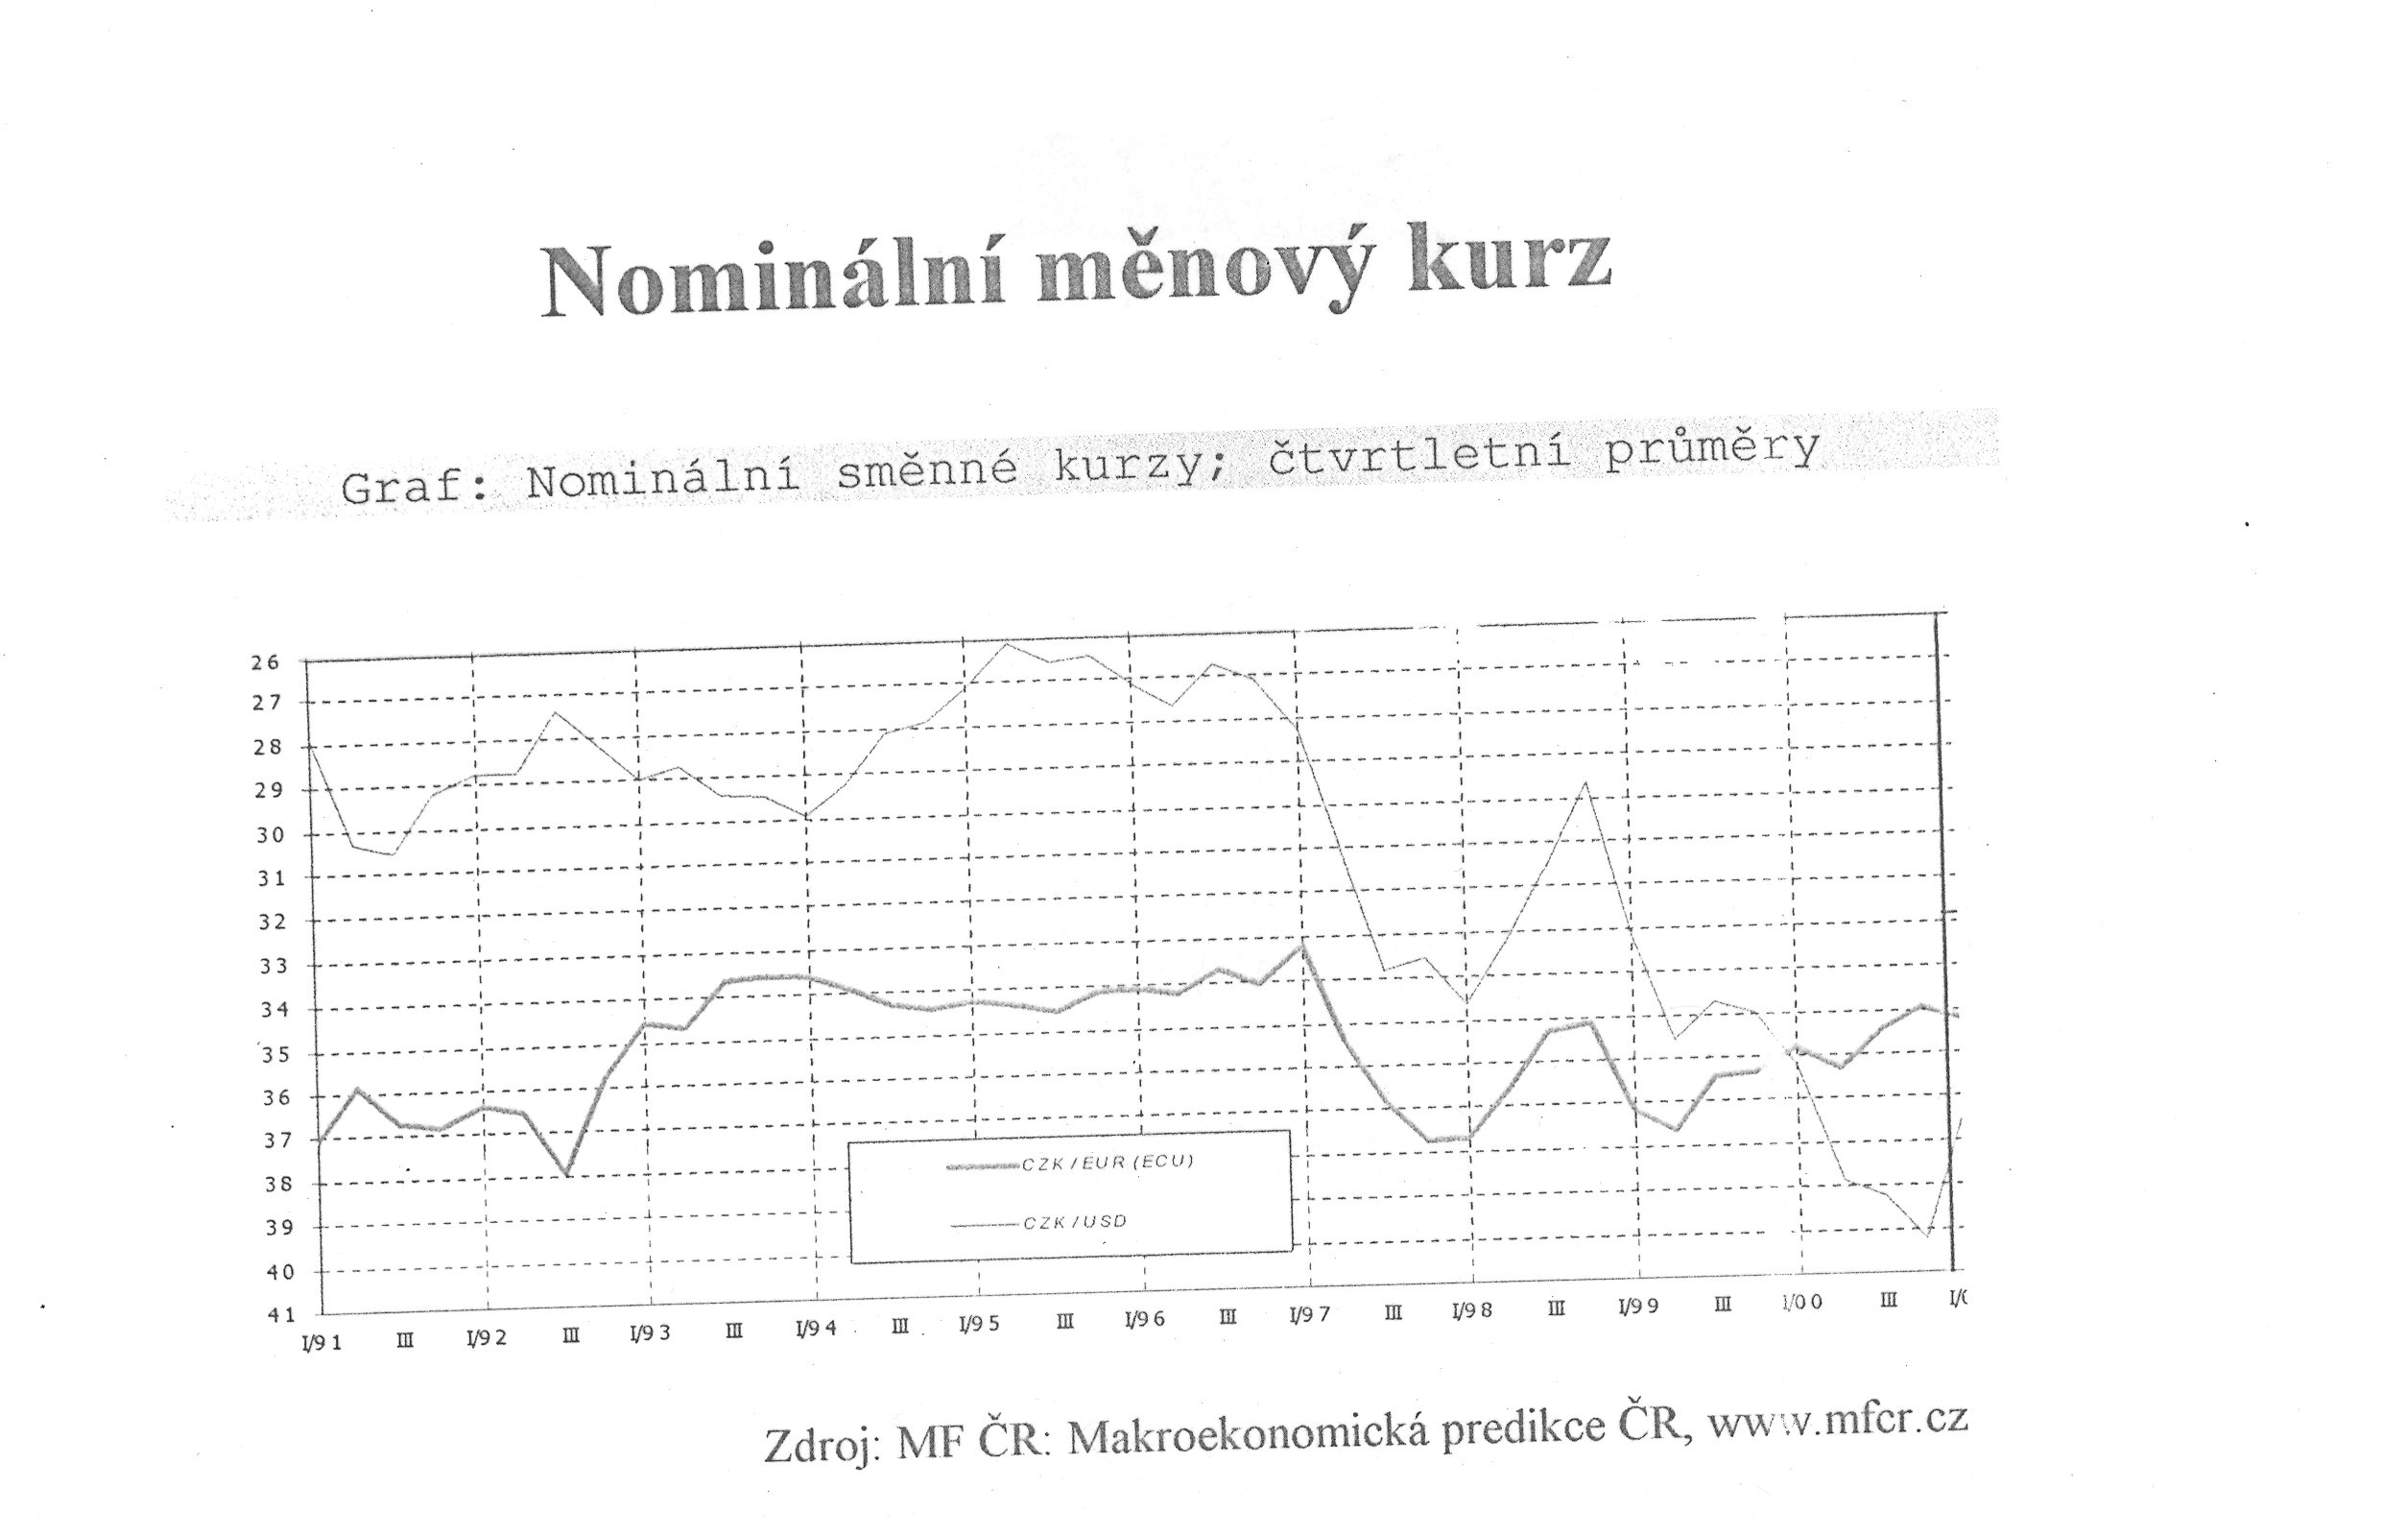
Nominal exchange rate

Slide 59
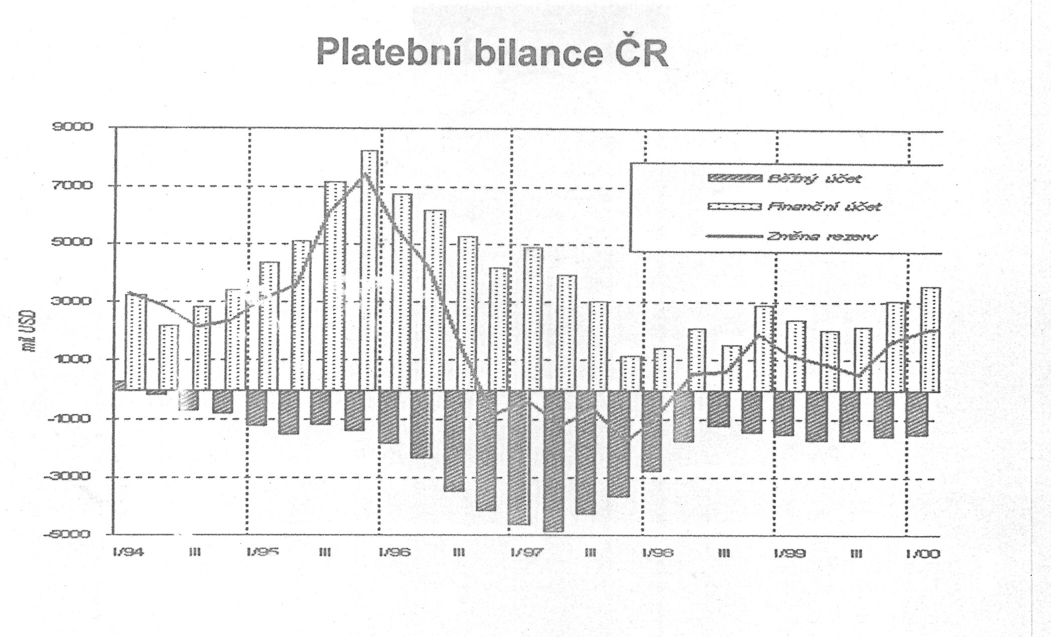
Balance of payments

Slide 60
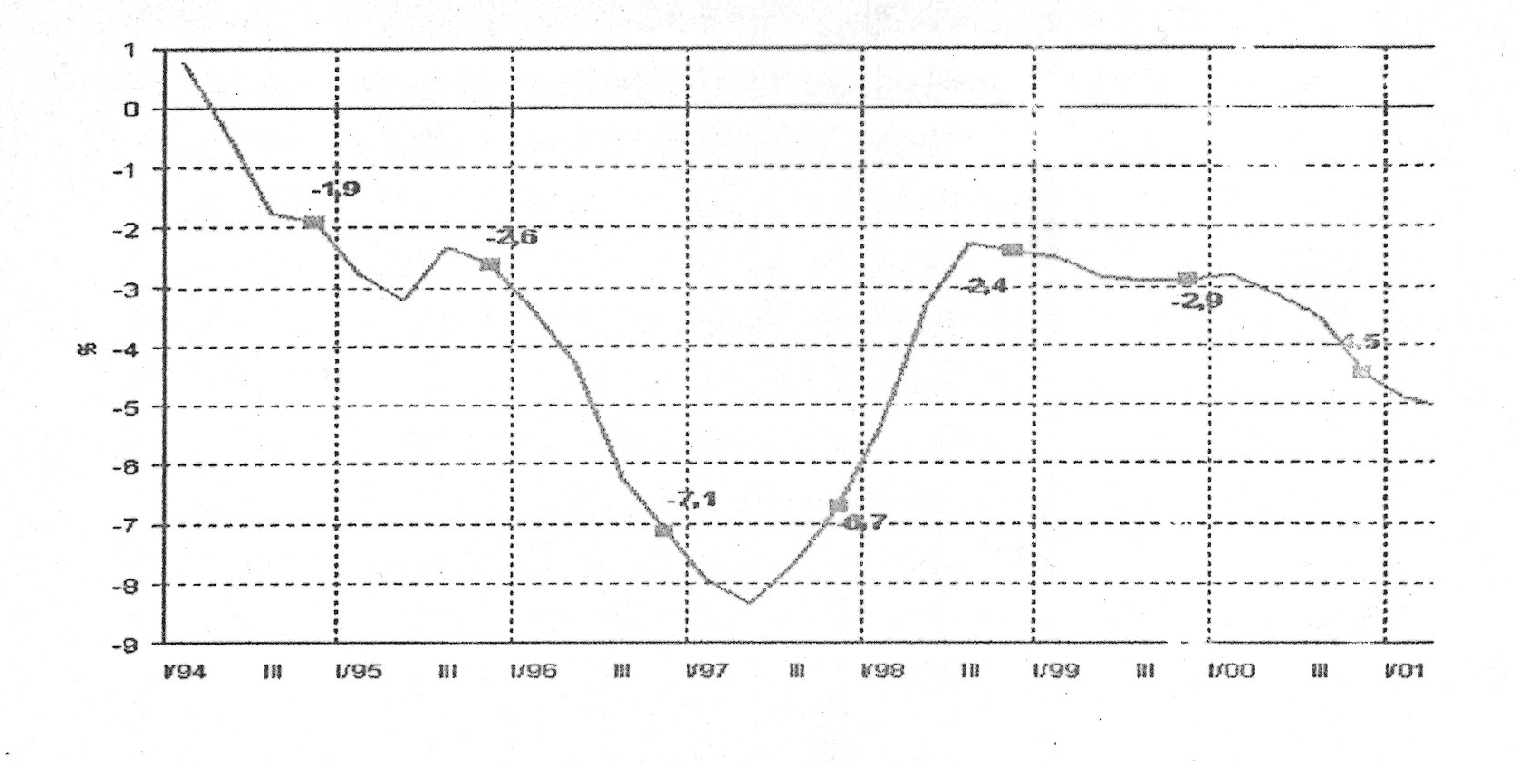
Current account of BP/GDP (%)

Slide 61
Drop of inflation
Change of monetary strategy
  Inflation targeting
Economic slowdown
Slowing down deregulation
Drop of import prices
Strong decrease of inflation

Slide 62
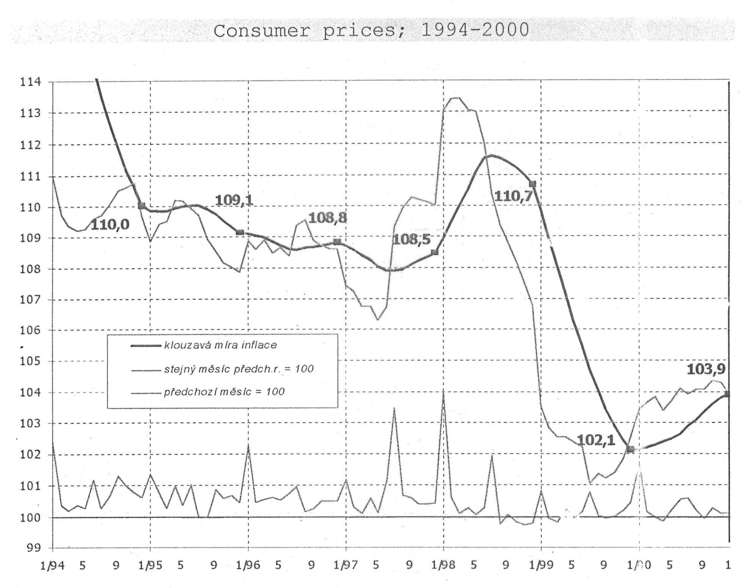
Consumer prices 1994-2000

Slide 63
This is the end…

