Slide 1
Cultural Differences in Business
Ondřej Částek

Slide 2
What can you expect
What is culture (a bit of theory)
Cultural differences (and a few examples)
Short videos (hopefully interesting)
2

Slide 3
What is culture
Shared system of values, which as a process leads to automatic solutions of often repeated problems (Nový, Schroll-Machl)
A set of learnt behaviour, collection of opinions, customs and traditions shared among group of people... (Mead)
A set of shared attitudes, values, goals, and practices that characterizes an institution, organization or group (Wikipedia)
Notes:
a) shared
b) Solutions of problems: the best solutions become part of culture, they form patterns for future behaviour.
2. Learnt behaviour. However, latest researches sugest that some cultural features depend on genetic code
3. Be careful with Wikipedia, but this one is used by more authors. I would add basic assumptions.

Slide 4
Culture is subjective to
Time
Place
Group
  Nation
  Ethnic group
  Religious group
  Any other subgroup
Notes:
Attitude toward Afro-Americans hundred years ago and now
Attitude toward slavery in 1860s (American Civil War)

Slide 5
Cultural standards (Thomas and others)
Cultural standards are methods of perceiving, thinking, evaluating and acting, which are common in a particular culture
Behaviour of myself and of others conforms with it
It has a regulatory function in many different situations
Individual use/application of cult. stand. Can vary inside a certain tolerance zone
Behaviour outside this zone is refused and sanctioned
Notes:
3. It gives me a lead, how to act – unconscious self-regulation
4. We are all different, but among one culture also similar
5. i.e. you will not talk to such people

Slide 6
Elements of culture (Šroněk)
Time
Language
Non-verbal communication
Religion
Formality/social hierarchy

Slide 7
Cultural dimensions (Hofstede, G.)
Power Distance Index
Individualism
Masculinity
Uncertainty Avoidance
Long-Term Orientation
Visit http://www.geert-hofstede.com for countries’ scores.
Notes:
1980: 53 countries, 20 languages, 116 000 employees (IBM)
The extent to which the less powerful members of organizations and institutions accept and expect unequal distribution of power
Loose ties between individuals vs. Strong integration in groups (from birth)
assertivity and competitiveness vs. Modest and caring values
One opinion, one truth (religiously), one system/structure vs. More tolerance towards other opinions
Added later. How shall the traditions influence future: a lot or not at all. Short term orientation – easier to make social changes

Slide 8
Hall’s Cultural dimensions
Communication context
Proximity
Time
Notes:
Low and High communication context
Physical distance people keep from other people
Monochronic or polychronic handling of time

Slide 9
Trompenaars’ Cultural dimensions
Cultural differences come from:
Attitude to time (1 dimension)
Attitude to the environment (1)
Attitude to other people (5)
Notes:
The Past, The Present, The Future. The Present: enjoying life. The Future: goalseeking. The Past: traditions influence future a lot.
Cultures that try to control the nature and cultures that try to live in harmony with nature.
5 other dimensions.

Slide 10
Application of Cultural dimensions (Demorgon)
Matter of level
Area of life
History and circumstances
Problems with application of C. D. or C. S.
One dimension contains more aspects
Point of view
Judgements
Notes:
What is the sample we draw conclusions from? Is it one man (individual level), small group, certain social level, or does it describe whole nation through the social levels and subcultures?
Business, religious, family, friends? Culture is subjective to the nation, ethnic or religious group.
Is it momentary? i. E. plundering at Haiti.
1. Low power index vs. High power index: matter of hierarchy - its existence, its application (strict, loose) or its acceptance?
2. Different perspectives of different observers: for Czech observer the difference between German and Japanese hierarchy would be different than for French observer.
3. Some terms may have negative connotations, like diffused culture (not separate different areas of life: private, business, religious...; opposite specific), affective culture (how much will you express your feelings; opposite neutral)...

Slide 11
Culture shock
„Honeymoon Phase“
„Negotiation Phase“
„Adjustment Phase“
„Mastery Phase“
Notes:
You see the better from the other culture – getting to know new foods, habits, etc.
Differences become apparent, first excitement is gone, now you feel how it is hard in everyday life.
You get accustomed to new habits and you develop new routines suiting the new environment.
You feel comfortable and you are able to accept new features to your advancement.

Slide 12
The differences in leadership style and organization (Mole)
Individual
France
Spain
USA
Portugal
Belgium
Germany
Luxembourgh
Leadership style
Ireland
UK
Denmark
Greece
Italy
Netherlands
Group
Organical
Systematical
Organization

Slide 13
Czech cultural standards (Nový, Schroll-Machl)
Relationships orientation (prefer relationships to material aspect)
Underestimating structures (love for improvisation)
Simultaneity (parallel work)
Control aims people not rules
Diffusion culture
High communication context
Avoiding conflicts
Variable self-confidence
Fall 2009, MWCC
13
Notes:
Relationship and good feel on first place, factual content on second place
Improvisation is valued a lot, structures are underestimated, even feared of – loss of freedom
More things at once, not a goal seeking behavior unless under pressure
Control is applied in relation to people and not to rules. Rules are broken, when people and their relationships are needed to come first. Again this relates to a feel of personal freedom.
Mixing business and personal life, roles and personalities, formal and informal structures.
If you want to interpret a message, the message itself is not sufficient. You need to know who told it to whom, under what circumstances, what preceded etc.
Avoiding conficts as long as possible, postponing, pretending it does not exist. Contextual communication if problem is to be solved. From an outside view Czechs are passive.
Substantive variation in self-confidence.

Slide 14
Human Communication
Three major parts in human face to face communication. According to the research:^{[1]}
55% of impact is determined by body language—postures, gestures, and eye contact,
38% by the tone of voice, and
7% by the content or the words used in the communication process.
^{[1]} Mehrabian and Ferris (1967). "Inference of Attitude from Nonverbal Communication in Two Channels". In: The Journal of Counselling Psychology Vol.31, 1967, pp.248-52.
14

Slide 15
Verbal Communication
Just 7 % of human communication accounts for words.
But:
Native or second language.
And:
Active or passive use.
Also:
Slang, colloquial or contextual expressions.
15
Notes:
Language is not only a product of culture, but it also forms the culture.
Ambiguity (dyke: drain, bank, lesbian)
Interference (actual: up-to-date or real; 5 expressions for shy in chinese; meny expressions for sand in Arabic)
Absence of appropriate expression – one needs to describe situation instead of translating one single word

Slide 16
Non Verbal Communication and Other Differences
Japanese and smiling
Just-in-time manufacturing systems
Formality
Korean exercising
Slovak interjections
Slovak dining
Not-moving attitude and impacts on labor market
16

Slide 17
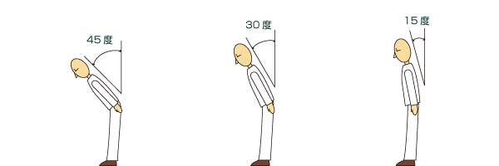
Bows in Japan
Fall 2009, MWCC
17

Slide 18
Cultural dimensions (Hofstede, G.)
Power Distance Index
Individualism
Masculinity
Uncertainty Avoidance
Long-Term Orientation
Notes:
1980: 53 countries, 20 languages, 116 000 employees (IBM)
The extent to which the less powerful members of organizations and institutions accept and expect unequal distribution of power
Loose ties between individuals vs. Strong integration in groups (from birth)
assertivity and competitiveness vs. Modest and caring values
One opinion, one truth (religiously), one system/structure vs. More tolerance towards other opinions
Added later. How shall the traditions influence future: a lot or not at all. Short term orientation – easier to make social changes

Slide 19
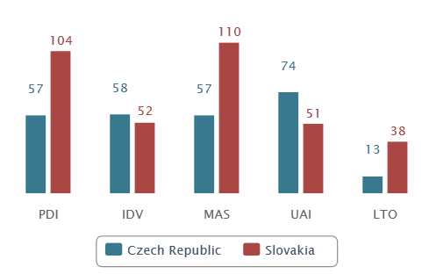
Hofstede`s dimensions

Slide 21
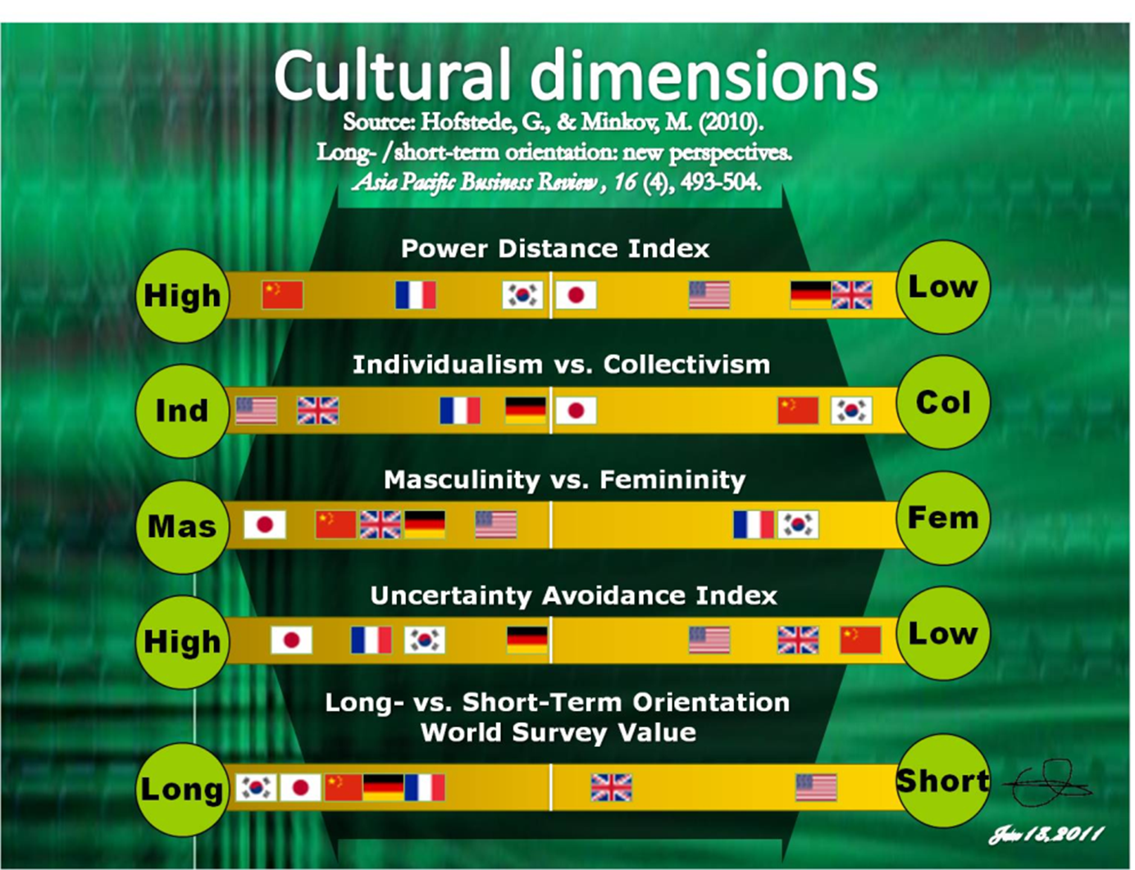

Slide 22
Sources
DEAL, T. E., KENNEDY, A. A. Corporate Cultures. Reading : Addison Wesley Publishing Company, 1982. ISBN 0-201-10277-3.
DENISON, D. R. Corporate Culture and Organizational Effectiveness. New York : Wiley and Sons, 1990. ISBN 0-471-80021-X.
DRENNAN, D. Transforming Company Culture. London : McGraw-Hill Book Company, 1992. ISBN 0-07-707660-5.
HALL, W. Managing Cultures: Making Strategic Relationships Work. Chichester : Wiley and Sons, 1995. ISBN 0-471-95571-X.
HOFSTEDE, G. Cultures and Organizations: Software of the Mind. London : McGraw-Hill book Company, 1991. ISBN 0-07-707474-2.
HOFSTEDE, Geert. Kultury a organizace. Software lidské mysli: Spolupráce mezi kulturami a její důležitost pro přežití. 1. vyd. Praha: Linde, 2007. 335 s. ISBN 978-80-86131-70-2.

Slide 23
Sources
KOTTER, J. P., HESKETT, J. L. Corporate Culture and Performance. New York : Maxwell Macmillan, 1992. ISBN 0-02-928467-3.
LUKÁŠOVÁ, R. Organizační kultura a její změna. Praha : Grada Publishing, 2010. ISBN 978-80-247-2951-0.
LUKÁŠOVÁ, R.; NOVÝ, I. Organizační kultura: Od sdílených hodnot a cílů k vyšší výkonnosti podniku. 1. vyd. Praha : Grada Publishing, 2004. 176 s. ISBN 80-247-0648-2.
NOVÝ, I. Interkulturální management: Lidé, kultura a management. 1. vyd. Praha : Grada Publishing, 1996. 143 s. ISBN 80-7169-260-3.
SCHEIN, E. Organizoational culture and Leadership. San Francisco : Jossey Bass Publishers, 1992. ISBN 1-55542-487-2.
TROMPENAARS, F. Riding the Waves of Culture: Understanding Cultural Diversity in Business. London : The Economist Books, 1993. ISBN 0-85058-428-0.

Slide 24
Short videos
http://www.kwintessential.co.uk/intercultural/french-business-etiquette.html
http://www.youtube.com/watch?v=bspFbFytRiM (Cultural Issues in Arab World Business Deals)
http://www.kwintessential.co.uk/intercultural/highcontext-lowcontext-cultures.html
http://www.kwintessential.co.uk/intercultural/individualism-collectivism.html
24

