Slide 1
Ishikawa and Pareto
Skorkovsky ,KPH MU

Slide 2
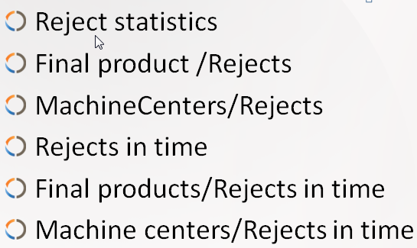
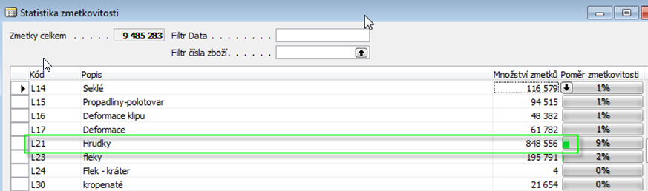
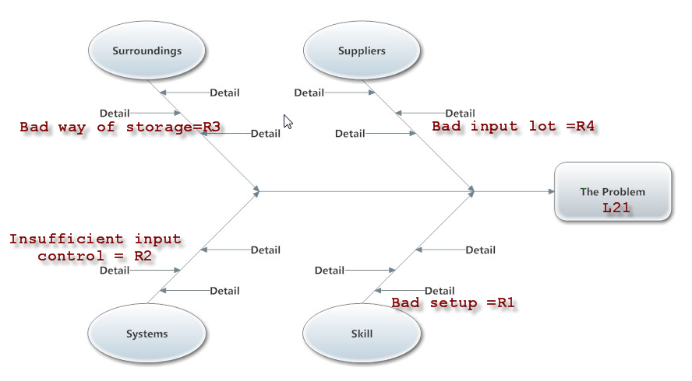

TQM and Ishikawa FBD
Reject type (effects); | R1 | R2 | R3 | R4
L19 | 8 | 9 | 2 | 4
L20 | 0 | 1 | 4 | 6
L21 | 7 | 2 | 3 | 5
Inventory
Suppliers
Score
Manual for urgent
reject cause elimination
(to establish correct priority of remedy actions)
Measurments
Machine s
Every reject type ->one Ishikawa diagram (electronic version)

Slide 3
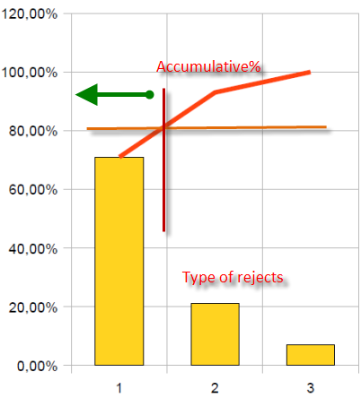
Pareto chart : a posibility to split up reject and setup priorities
High priorities
Lorenz curve

Slide 4
Pareto analysis per every type of reject
Type of reject | Cause 1 | Cause 2 | Cause 3 | Cause 4 | Cause 5 | Cause 6 | Total
L1 | 7 | 2 | 4 | 1 | 8 | 0 | 22
L2 | 2 | 4 | 6 | 8 | 0 | 9 | 29
L3 | 4 | 0 | 0 | 5 | 6 | 7 | 22
L4 | 5 | 7 | 2 | 0 | 1 | 3 | 18
L5 | 0 | 2 | 7 | 3 | 0 | 1 | 13
L6 | 9 | 7 | 5 | 2 | 3 | 6 | 32
L7 | 0 | 7 | 0 | 2 | 3 | 4 | 16
L8 | 1 | 8 | 6 | 2 | 4 | 0 | 21
L9 | 2 | 0 | 5 | 7 | 1 | 4 | 19
L10 | 7 | 2 | 8 | 9 | 7 | 5 | 38
C | C5 % | C1 % | C3 % | C2 % | C4 % | C6%
L1 | 36,36 | 31,82 | 18,18 | 9,09 | 4,55 | 0,00 | 100
Lorenz curve | 36,36 | 68,18 | 86,36 | 95,45 | 100,00
Higher priorities for reject type L1
Type – what happened
Cause – the reason why we have got it
22=7+2+4+……+8+…
36,36=7/22; …..
68,18=36,36+31,82;…..

Slide 5
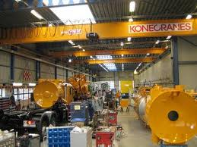
Good day to everybody
TQM

