Slide 1
Six sigma very basic concise explanation and use of it
Skorkovský
KPH_ESF_MU BRNO_Czech Republic

Slide 2
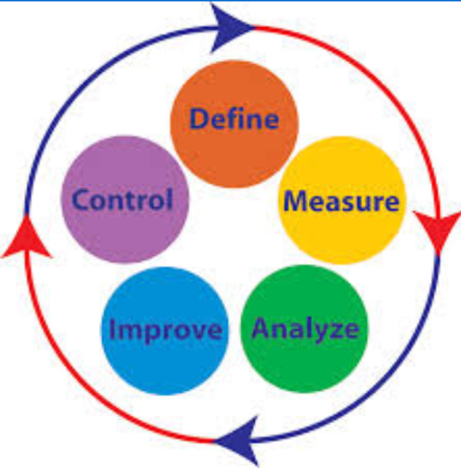
Six Sigma method
Motorola 1985
Use in order to produce better products nad less problem processes
PPM- parts per million ->4,4 defects /million opportunities
Six-Sigma-DMAIC methodology

Slide 3
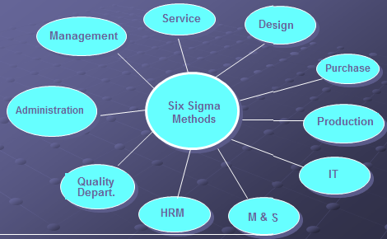
Where Six Sigma method can be applied

Slide 4

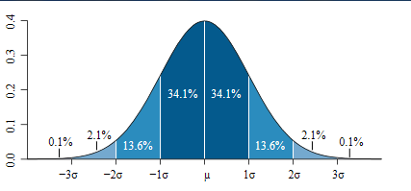

Normal distribution
Normal distribution curve that illustrates standard deviations. Each band has 1 standard deviation, and the labels indicate the approximate proportion of area (note: these add up to 99.8%, and not 100% due to rounding for presentation.)

Slide 5
SIX SIGMA Statistical background
Some Key measure
Target = μ
Resource : Pro-Enbis

Slide 6
Statistical background
‘Control’ limits
+
/
−
3
σ
Target = μ

Slide 7
Statistical background
Required Tolerance
L
S
L
U
S
L
+
/
−
3
σ
Lower specification level
Upper specification level
Target = μ

Slide 8
Statistical background
Tolerance
L
S
L
U
S
L
+
/
−
3
σ
Target = μ
+
/
−
6
σ
Six-Sigma

Slide 9
Statistical background
Tolerance
L
S
L
U
S
L
+
/
−
3
σ
1
3
5
0
1
3
5
0
p
p
m
p
p
m
Target = μ
+
/
−
6
σ
Ppm= parts per million

Slide 10
Statistical background
Tolerance
L
S
L
U
S
L
+
/
−
3
σ
1
3
5
0
1
3
5
0
0
.
0
0
1
p
p
m
p
p
m
0
.
0
0
1
p
p
m
p
p
m
Target = μ
+
/
−
6
σ

Slide 11
Statistical background
Six-Sigma allows for un-foreseen ‘problems’ and longer term issues when calculating failure error or re-work rates
Allows for a process ‘shift’ (1,5 σ)

Slide 12
Statistical background
Tolerance
L
S
L
1
.
5
σ
U
S
L
3
.
4
6
6
8
0
3
0
p
p
m
p
p
m
p
p
m
3
.
4
p
p
m
μ
+
/
−
6
σ

Slide 13
Performance Standards
σ
PPM
Yield
2
3
4
5
6
308537
66807
6210
233
3.4
69.1%
93.3%
99.38%
99.977%
99.9997%
Current standard
World Class
Process
performance
Defects per
million
Long term
yield

