Slide 1
Introduction to MS Dynamics NAV III.
Ing.J.Skorkovský,CSc.
MASARYK UNIVERSITY BRNO, Czech Republic
Faculty of economics and business administration
Department of corporate economy

Slide 2
Basic source tables I.(purchase)
Vendor
  Balance
  General Posting group (we will go over it later in this course in section General Ledger setup)
  VAT Posting Group (we will go over it later in this course in section General Ledger setup)
  Vendor Posting Group (we will go over it later in this course in section General Ledger setup)
  Purchaser
  Pay to Vendor
  Payment Term Code
  Location Code (Inventory)
  Currency Code
  Language Code

Slide 3
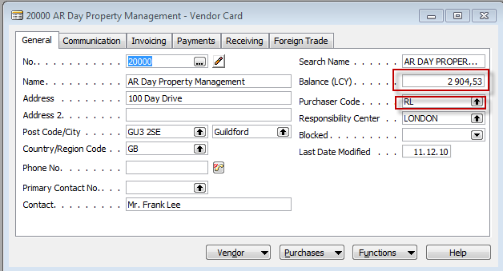
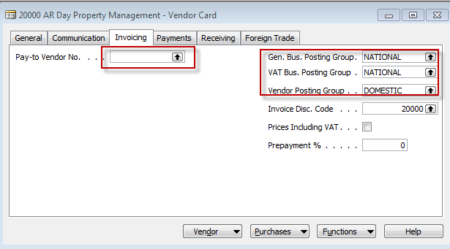
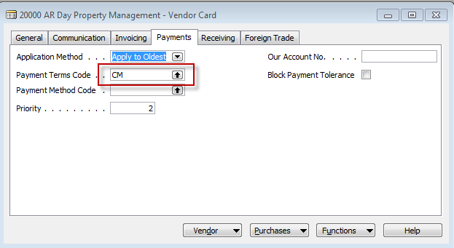
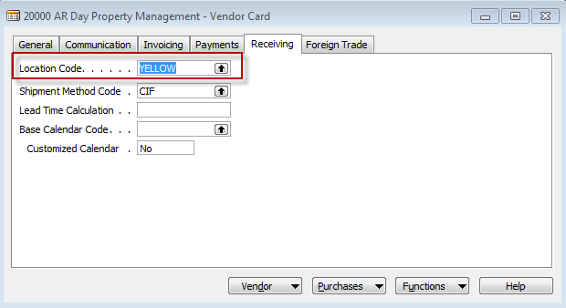

Slide 4
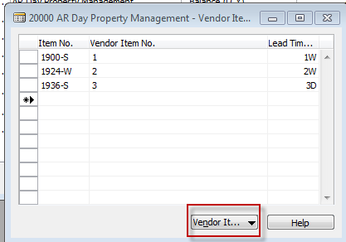
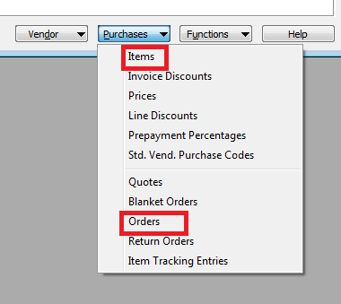
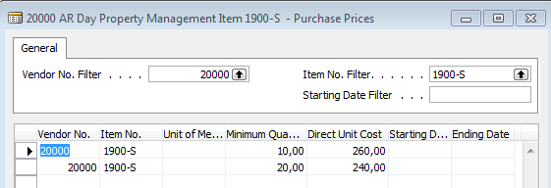
Basic information- some of them - buttons (purchases)
List of PO (if any)

Slide 5
Basic source tables II.(purchase
Item
  Number
  Basic Unit of Measure
  Item Category Code
  Product Group Code
  Inventory
  Quantity of this item on diverse types of document
  Costing method
  Unit Cost
  General Production Posting Group (we will go over it later in this course in section General Ledger setup and Inventory Costing)
  VAT Production Posting Group (we will go over it later in this course in section General Ledger setup and Inevntory Costing)
  Inventory Posting (we will go over it later in this course in section General Ledger setup and (we will go over it later in this course in section General Ledger setup and Inventory Costing)
  Allow Invoice Discount
  Replenishment System and Vendor Number (for purchase= Purchase)
  Reordering Policy (we will go over it later in this course in section Requisition worksheet and netting calculation)
  Safety Stock Quantity and Reordering point (we will go over it later in this course in section Requisition worksheet and netting calculation)
  Item Tracking Code (if applied)

Slide 6
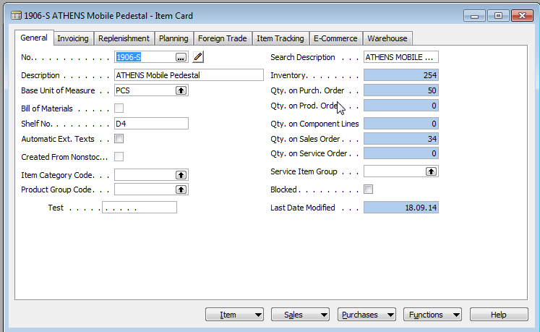
Item card
Some basic information related to the button Item will be presented
on-line during tuition

Slide 7
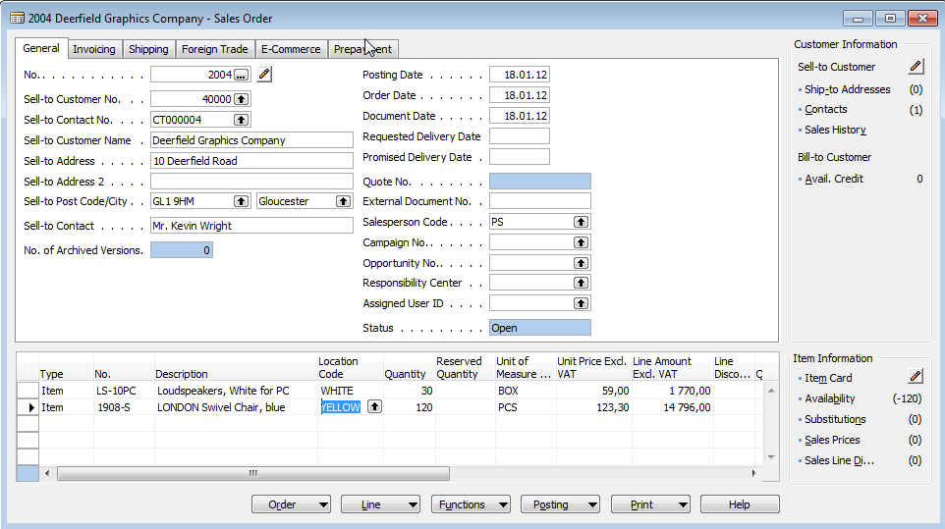
Purchase Order
Purchase Order Header
Vendor
Item 1
Purchase Order Lines
Item 2

Slide 8
How to create a simple Purchase Order
Purchase menu
Order Processing->Orders
F3 to create new document- by confirming by use of ENTER a new and unique document number is created
Look-up by use of F6 from the field Vendor
Chosen Vendor must be confirmed by one click on the key Enter
Lines->Type Item->from the field No. By use of F6 pick your chosen item ->ENTER to confirm your choice
Enter stock location BLUE and specify Quantity of the Item
See Statistics of this document by F9
Button Print->Order Confirmation->Preview
Post it by use of F11
Make a choice (for this first simple purchase order model)

Slide 9
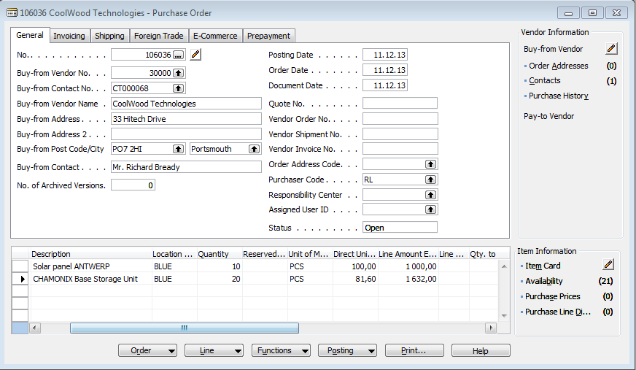
Purchase Order

Slide 10
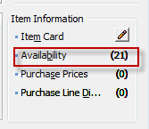
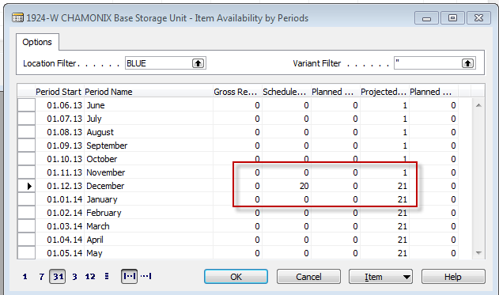
Item availability

Slide 11
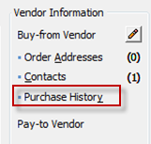
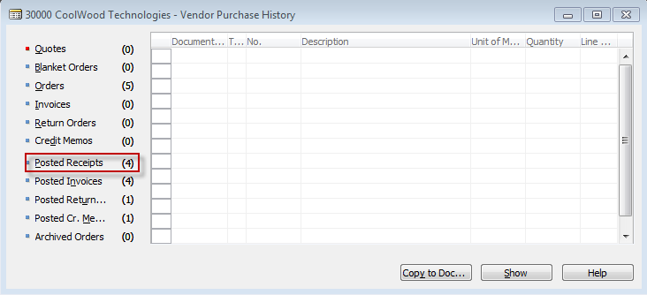
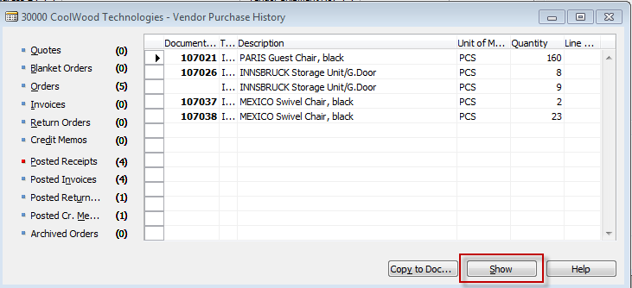
History
You can see chosen document

Slide 12
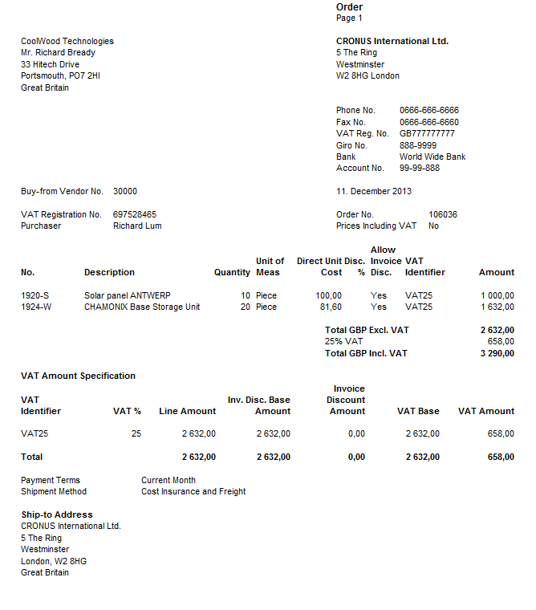
Purchase Order confirmation (preview)

Slide 13
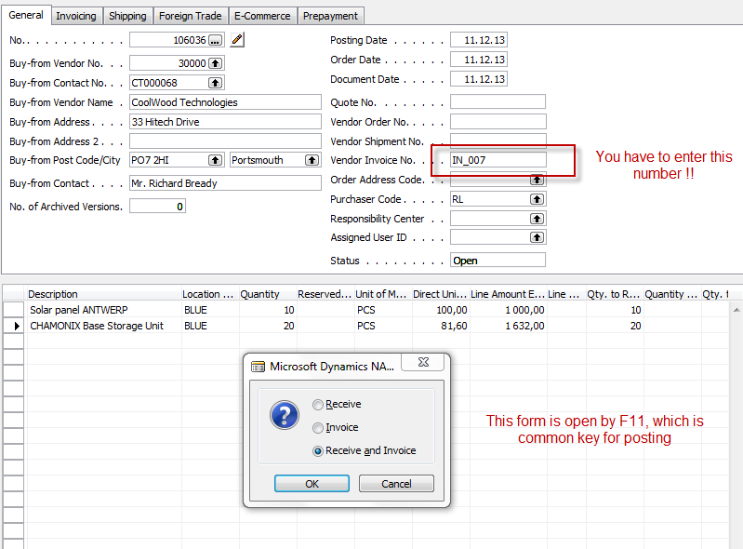
Posting PO
See next slide

Slide 14
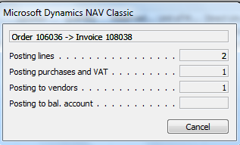
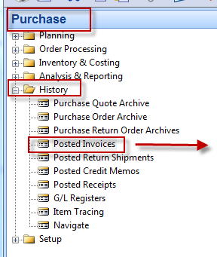
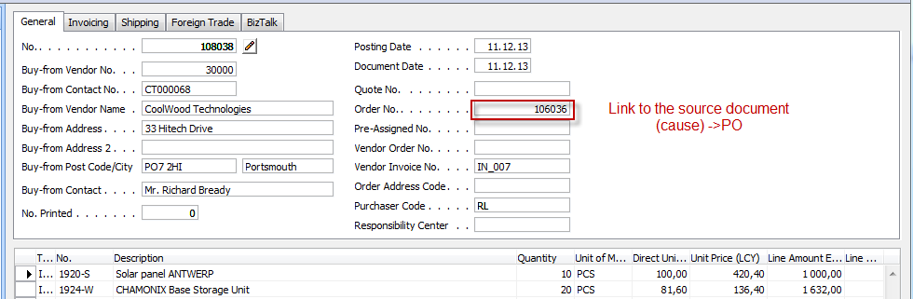
Posted Purchase Invoice and Receipt document

Slide 15
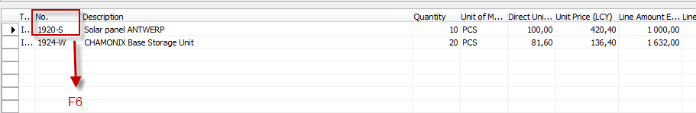
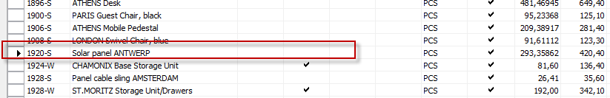
Direct „jump“to the Item card from Posted Invoice (F6)
Posted Purchase
Invoice Lines
See next slide
Shift-F5

Slide 16
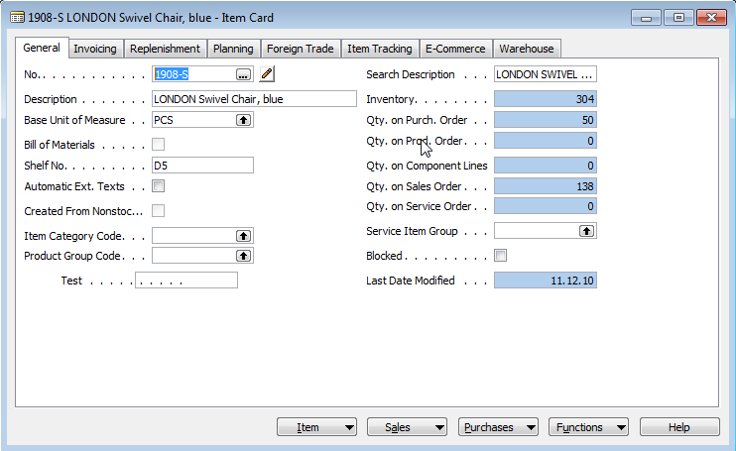
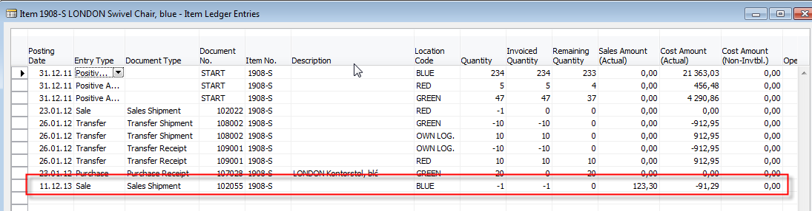
Item card and its entries (Ctrl-F5)
Ctrl-F5

Slide 17
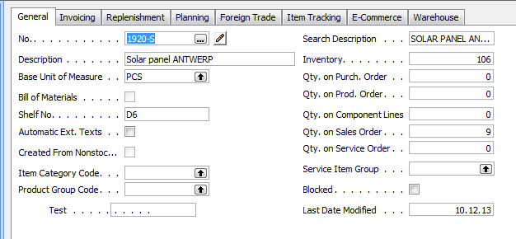
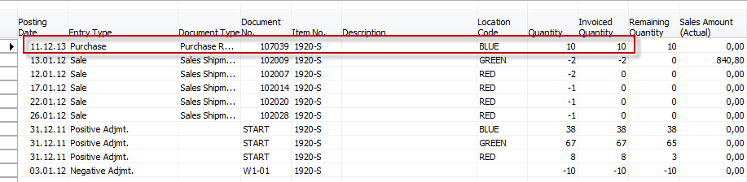
Item card and its entries
Ctrl-F5 – or from Inventory by mouse click

Slide 18
Item card and its entries
Ctrl-F5 – or from Inventory by mouse click

Slide 19
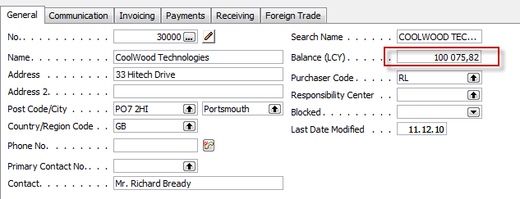

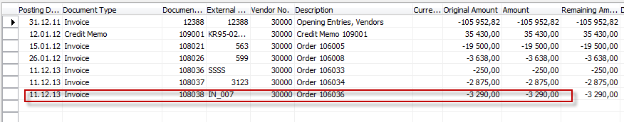
Vendor Card and its entries (Ctrl-F5)
Ctrl-F5

Slide 20
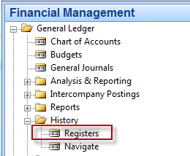
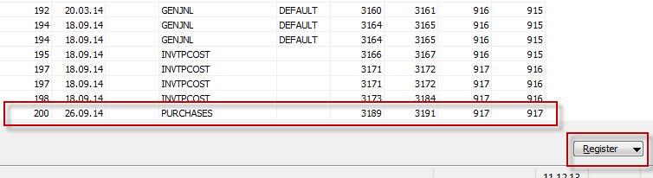
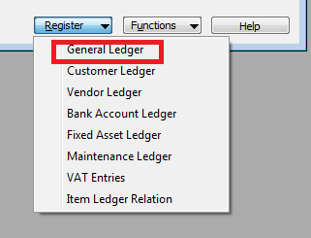
Impacts to G/L

Slide 21
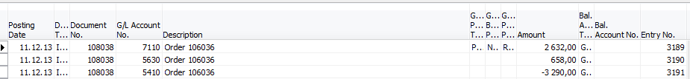
Impacts to G/L (General Ledger Entries)
5630 Purchase VAT 25%
658,00
5410 Vendor Domestic
3290,00
7110 Purchase Retail Domestic
2632,00

Slide 22



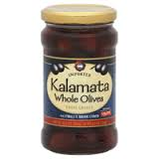
Posting Groups
Vendor
Purchase Order Header
Purchase Order Lines
Item 1
= General Business Posting Group (chosen code=NATIONAL)
= General Product Posting Group (chosen code=Retail)

Slide 23
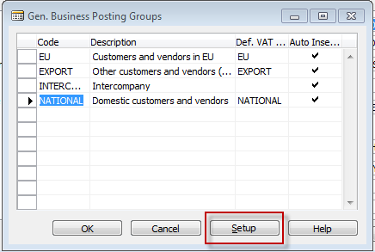
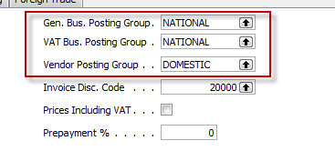
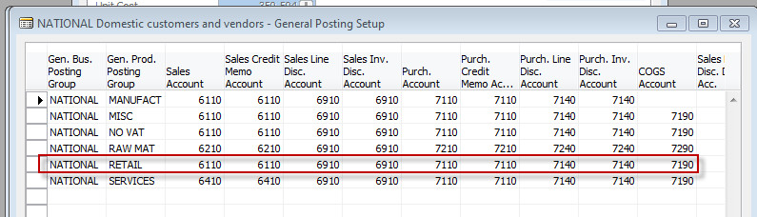
Posting Groups

Slide 24

End of the section III.

