Slide 1
Introduction to MS Dynamics NAV V.
Ing.J.Skorkovský,CSc.
MASARYK UNIVERSITY BRNO, Czech Republic
Faculty of economics and business administration
Department of corporate economy

Slide 2
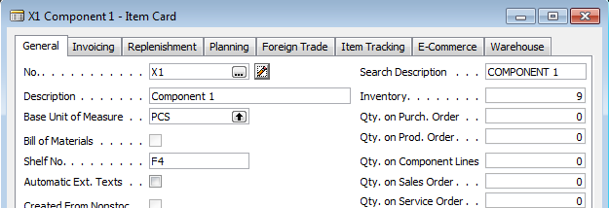
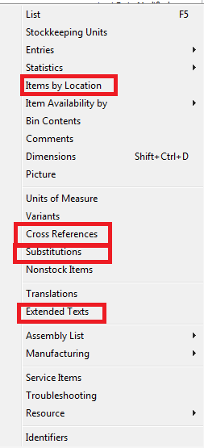
Cross References, Extended texts and Subtitutions

Slide 3

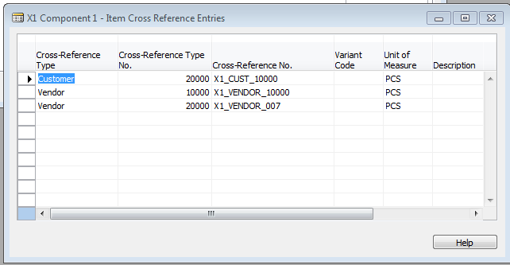
Cross refences setup

Slide 4
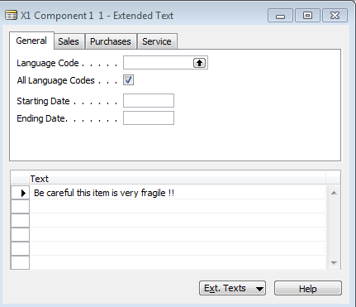
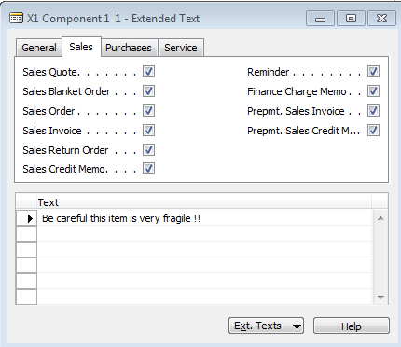

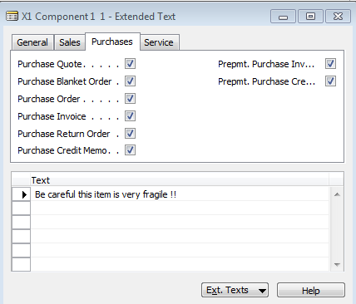
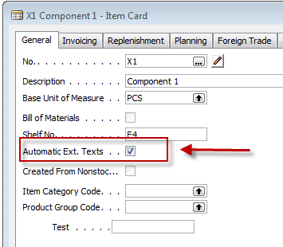
Extended texts setup

Slide 5
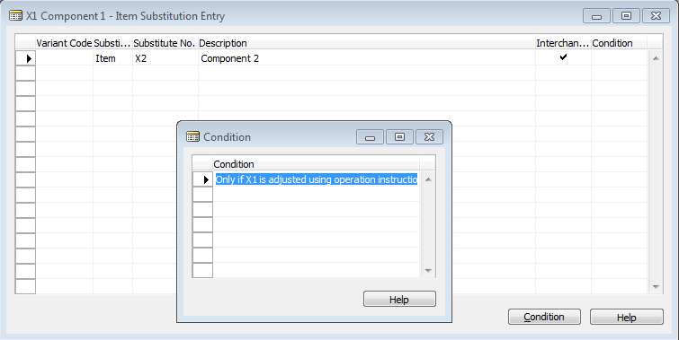
Substitution setup (firstly create new item X2)
Use the same instruction set as it was shown in INTRO IV !!!
Substitution setup from Item Card X1

Slide 6
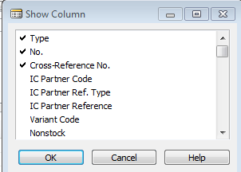

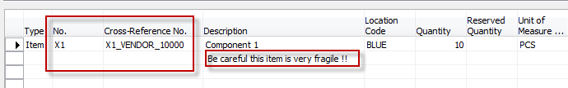
Purchase Order (X1)
It is necessary to modify purchase line by right click and
show column Cross-Reference No.
Purchase line
Purchase line

Slide 7
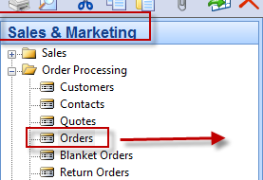
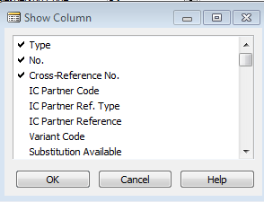
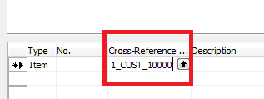
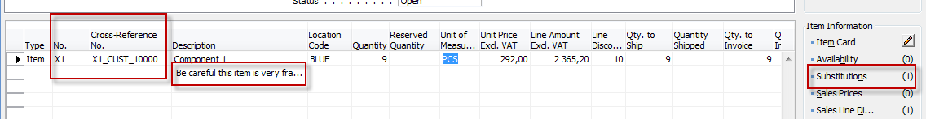
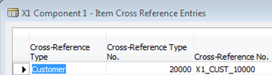
Sales Order
Sales line modification
Use customer whose card had been
modified for cross-reference

Slide 8
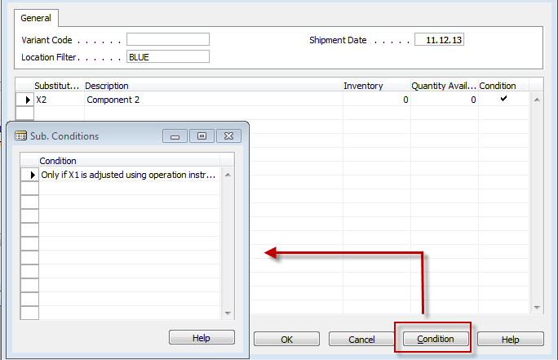
Sales Order line

Slide 9
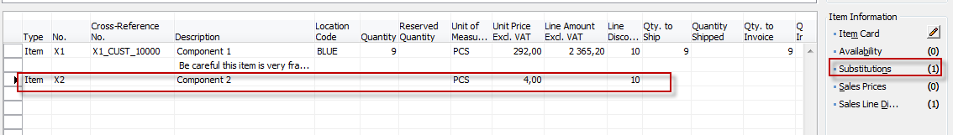

Sales order line another Item added
X1
X2

Slide 10
Substitution rules
X1 can replace X2 only if
X2 is stainless
Change
Inter = 0
Cond = 0
Inter = 1
Cond = 0
Inter = 1
Cond = 1
ITEMí X1
ITEM X1
ITEM X1
TIME
TIME
ITEM X2
ITEM X2
ITEM X2
Inter = 0
Cond = 0
Inter = 1
Cond = 0
Inter = 1
Cond = 1
X2 can replace X1
X1 cannot replace X1
X2 can replace X1
X1 can replace X2
X2 can replace X1 only if
X1 is adjusted

Slide 11

End of the section IV.

