Slide 1
Introduction to MS Dynamics NAV VIII.
Ing.J.Skorkovský,CSc.
MASARYK UNIVERSITY BRNO, Czech Republic
Faculty of economics and business administration
Department of corporate economy

Slide 2
Stockkeeping Units
Stockkeeping units are a supplement to item cards, they do not replace them, although they are related to them.
Stockkeeping units allow you to differentiate information about an item for a specific location (such as a warehouse or distribution center) or a specific variant (such as different shelf numbers and different replenishment information), for the same item.

Slide 3
How to create a new SKU
Open an Item Card
Button Function
Create SKU
Specify Location
You can specify also condition such as Item in inventory only
OK

Slide 4
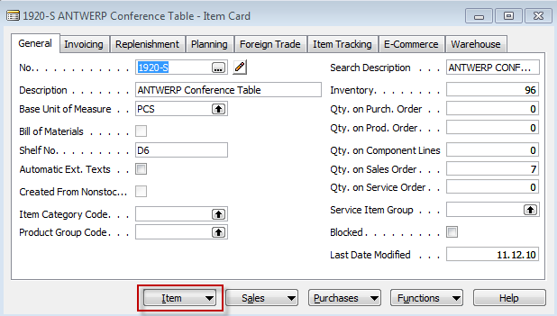
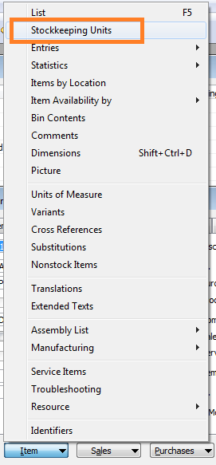
Do we have some SKU already ?

Slide 5
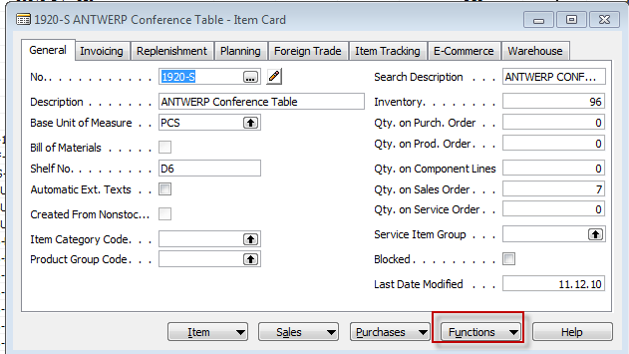
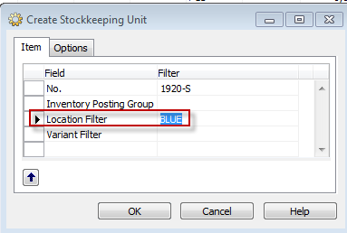
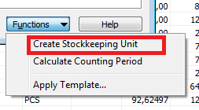
Creation of the SKU

Slide 6


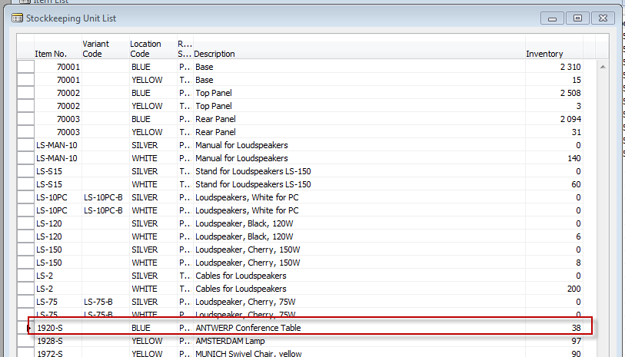
SKU list
See all (filter „killer“)

Slide 7
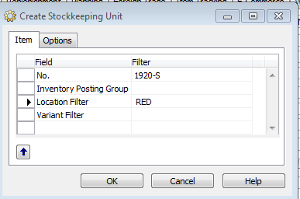
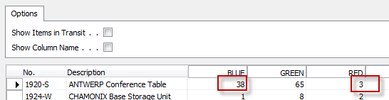
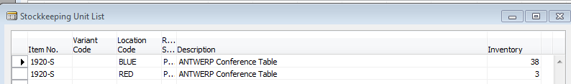
Creation of the second SKU (RED)
Quantity in both locations (SKU) are the same as before
Items by location were :

Slide 8
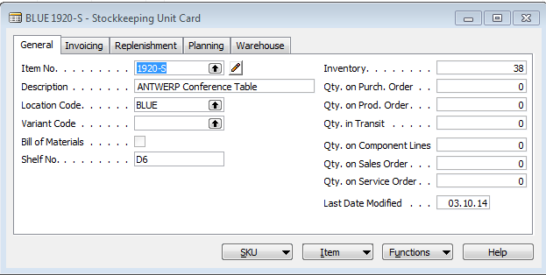
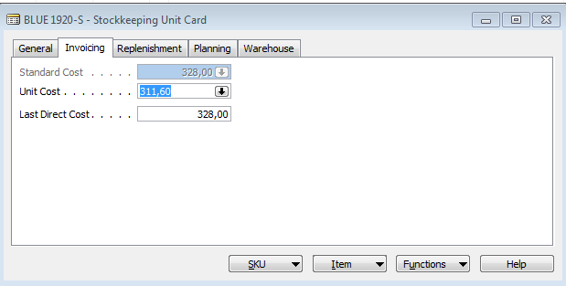
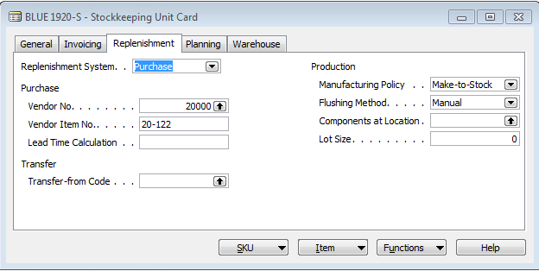
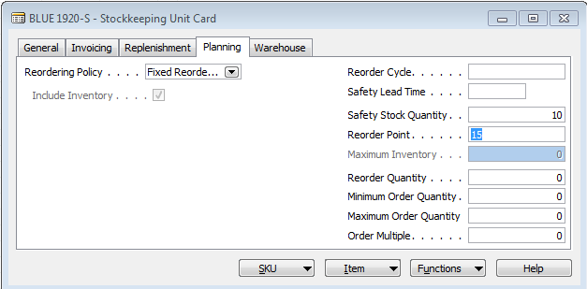
SKU Card is more simpler than original Item Card
SKU has priority over original Item Card

Slide 9
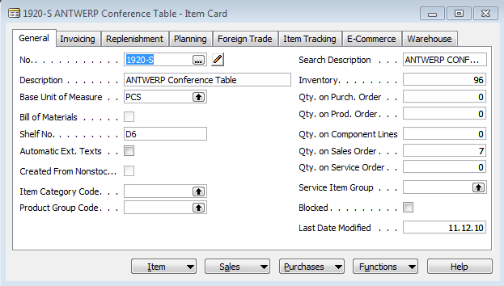
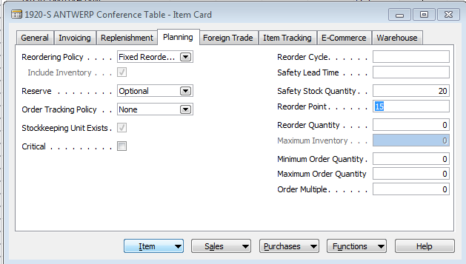
Item Card <->SKU Card

Slide 10
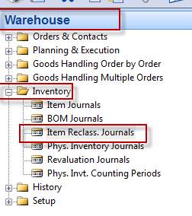
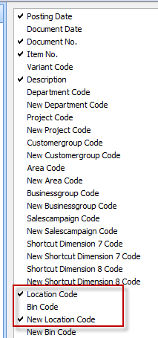
Transfer from SKU Blue->SKU Red
By use of Show Column add to the
Item Reclass. Journal New Location Code field !!!!

Slide 11
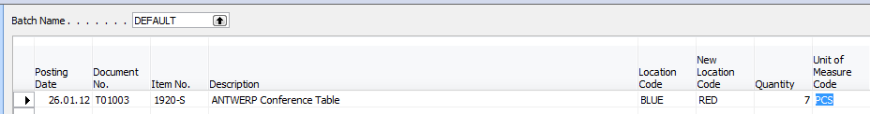
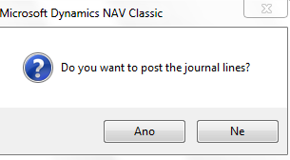
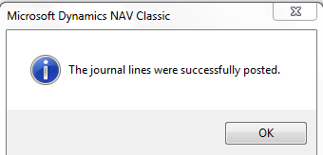
Transfer from SKU Blue->SKU Red
F11

Slide 12
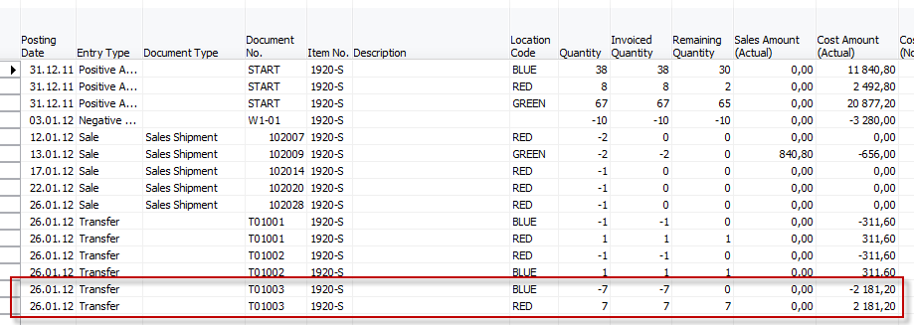
Item Ledger Entries and SKU cards
38-7=31 and 3+7=10

Slide 13

End of the section VIII.

