Slide 1
Introduction to MS Dynamics NAV XII.
Ing.J.Skorkovský,CSc.
MASARYK UNIVERSITY BRNO, Czech Republic
Faculty of economics and business administration
Department of corporate economy

Slide 2
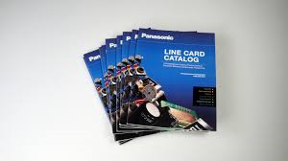
Nonstock Items
It enables to decrease quantity of Items cards
It enables to market many times more Items that you have currently in your stock
Nonstock Items (Catalog)
e.g. 2 000 000 pcs
Stock
e.g. 50 000 pcs

Slide 3
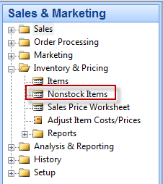
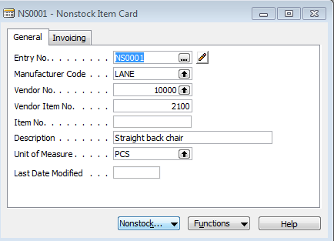
Nonstock Items

Slide 4
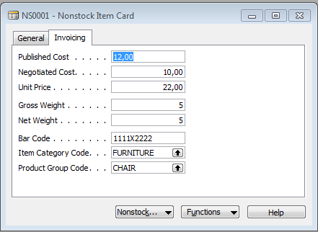
Nonstock Items

Slide 5
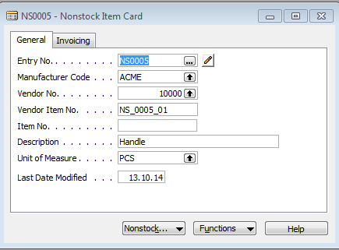
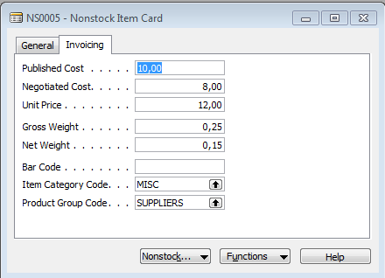
Creation of the new Item

Slide 6
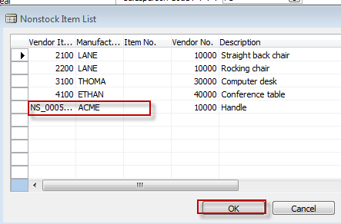
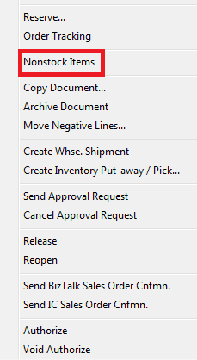
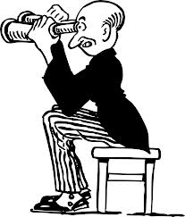
Sales Order
Sales Order

Slide 7
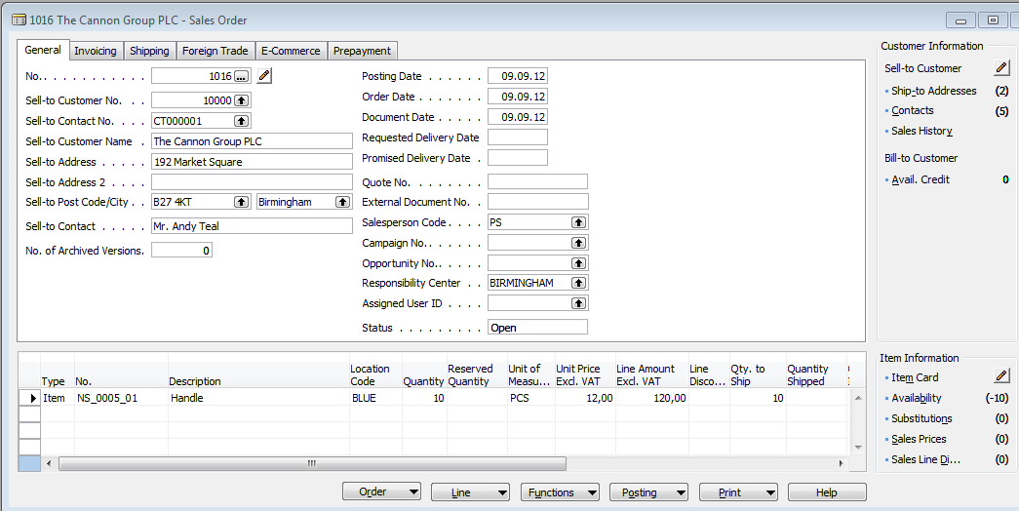
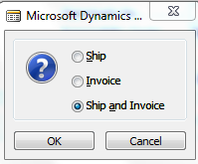
Created Sales Order

Slide 8
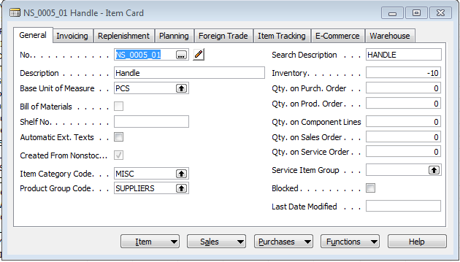
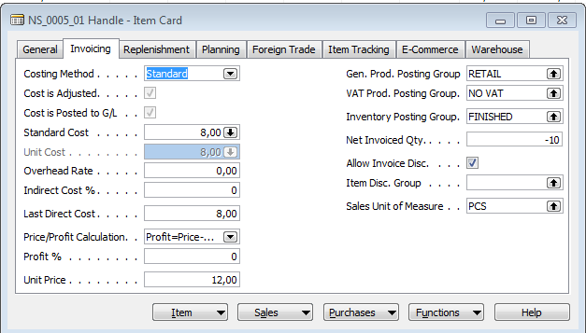
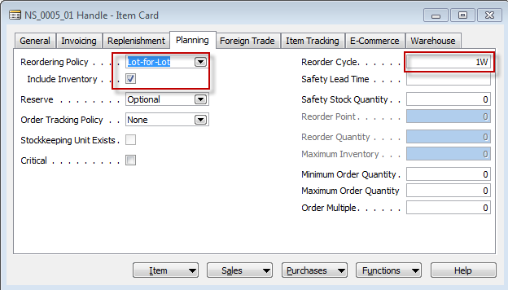
Item Card
Was modified
after creation

Slide 9
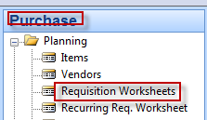
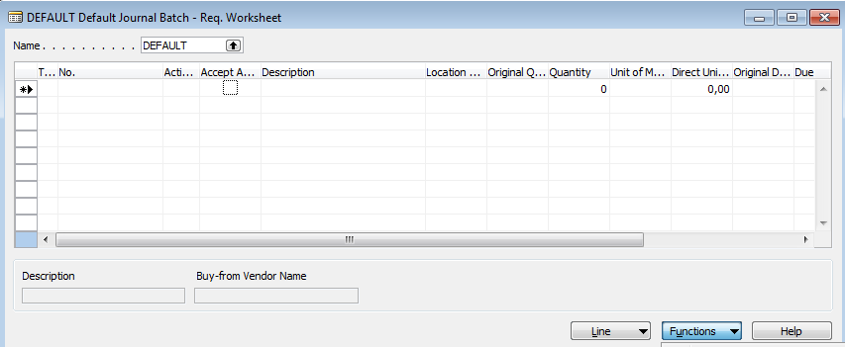
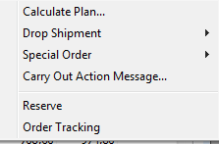
Requisition Worksheets (replenishment suggestion)

Slide 10
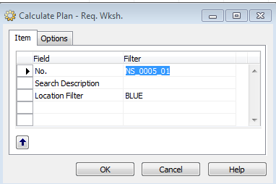
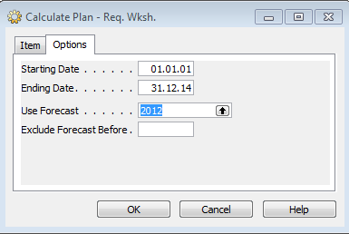
Requisition Worksheets
Function-Carry Out Message - >PO will be created

Slide 11
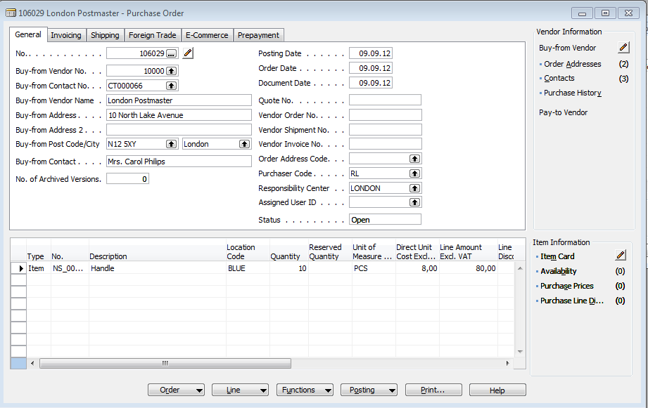
PO

Slide 12
End of the section XII.

