Slide 1
Introduction to MS Dynamics NAV XIII.
Ing.J.Skorkovský,CSc.
MASARYK UNIVERSITY BRNO, Czech Republic
Faculty of economics and business administration
Department of corporate economy

Slide 2
General Journals and its use in G/L
It enables to post and apply payment to „open“ invoices
It enables to post an amount from one account to another
Recurring operations (periodic posting of similar transactions) are much more easier

Slide 3
General Journals and its use in G/L
You use the General Journal window to post transactions to G/L, bank, customer, vendor and fixed assets accounts. In a general journal, you enter the relevant information for the transaction, such as the posting date, amount and the accounts you want to post to. The information you enter in a journal is temporary and can be changed as long as it is in the journal.
If you often use the general journal to post the same or similar journal lines, for example, in connection with payroll expenses.

Slide 4
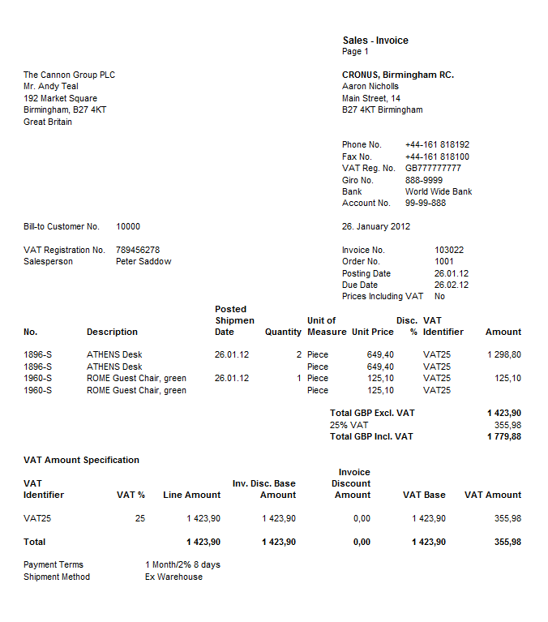

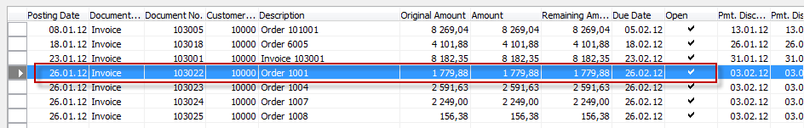
Applying principle
Apply
From customer 10000 by Ctrl-F5

Slide 5
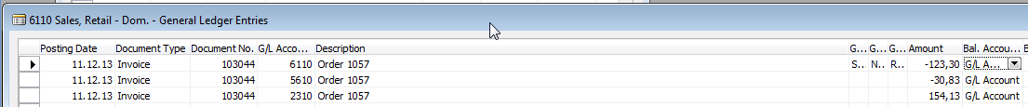
Impacts to G/L (General Ledger Entries)
5610 Sales VAT 25%
30,83
2920 Bank Account
2310 Customer Domestic
154,13
154,13
154,13
6110 Sales Retail Domestic
123,30

Slide 6
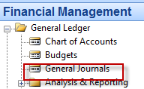
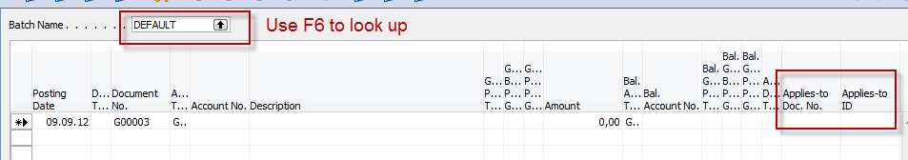
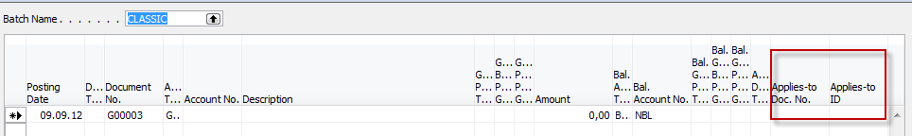
Setup of General Journal
Enter a new line by F3 and batch name
e.g. Classic and add balancing Banking Account with code NBL
and then click OK !!!!
Enter two new fields by right mouse click on the GJ bar. The name of the fields
are specified by red rectangle above. Then click OK.

Slide 7
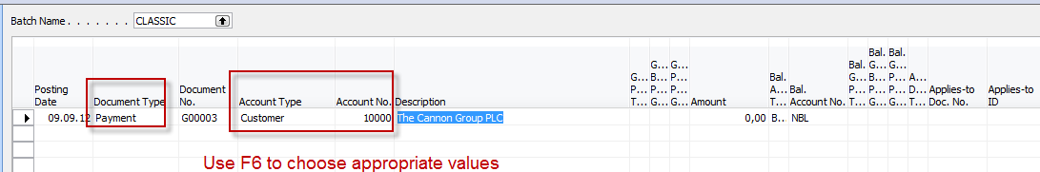
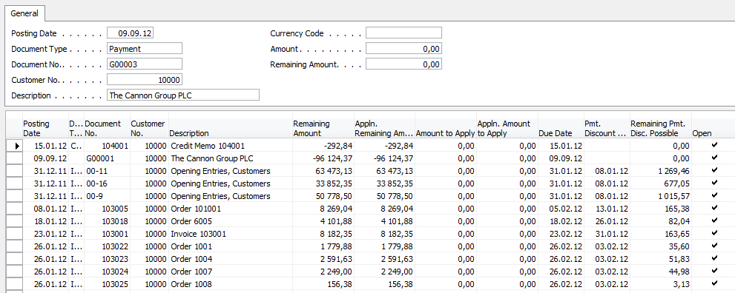
Entering data to G/L and Apply
F6
List of all open invoices

Slide 8
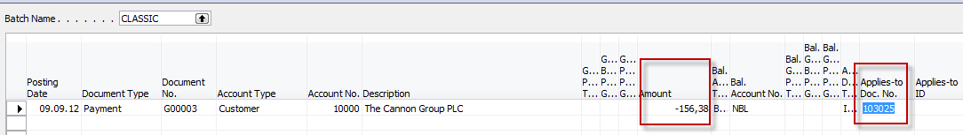
Entering data to G/L and Apply
Make a choice of one of them and enter OK

Slide 9
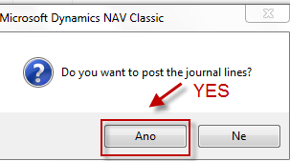
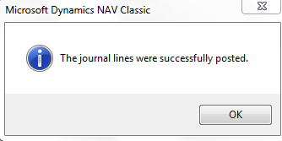
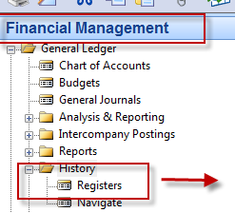
Post GJ with correct data by F11
See next slide

Slide 10

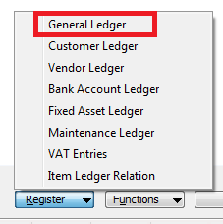

Results in General Ledger
2920 Bank Account
2310 Customer Domestic
156,38
156,38
156,38

Slide 11
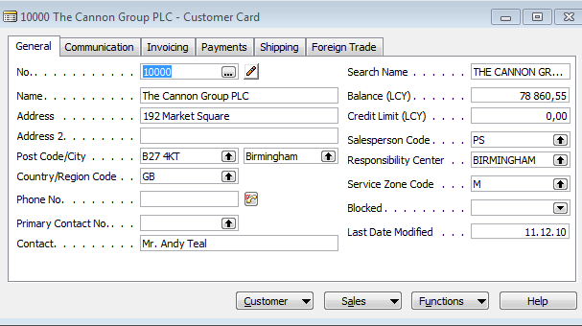
Results in Customer Ledger Entry
Find appropriate
Customer Card and CTRL-F5
See next slide

Slide 12
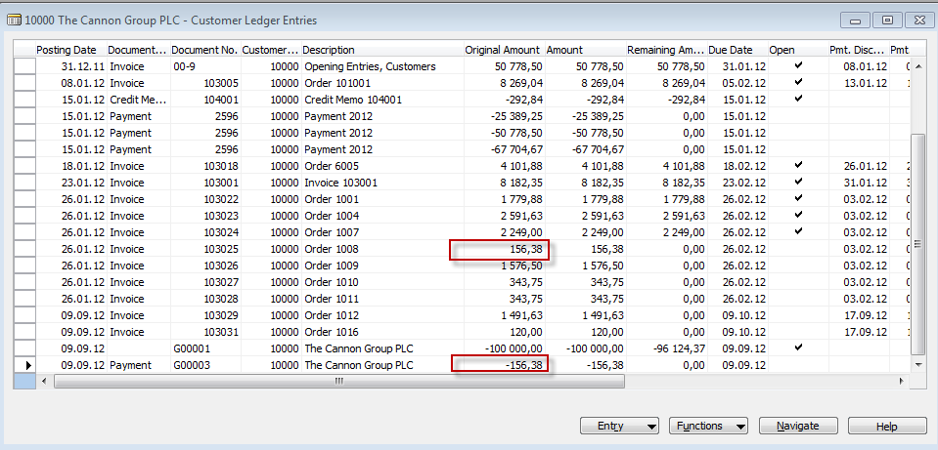
Results in Customer Ledger Entry
= Application

Slide 13

Unapply in Customer Ledger Entry

Slide 14
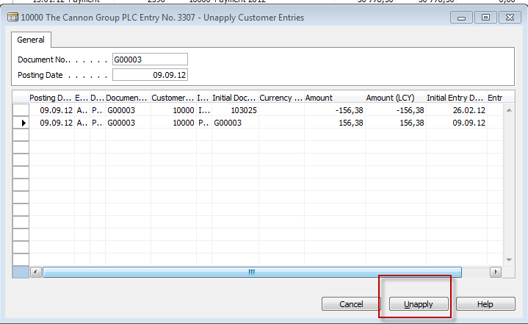
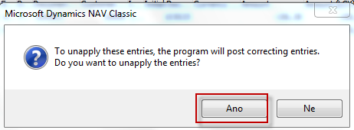
Unapply in Customer Ledger Entry
See next slide

Slide 15
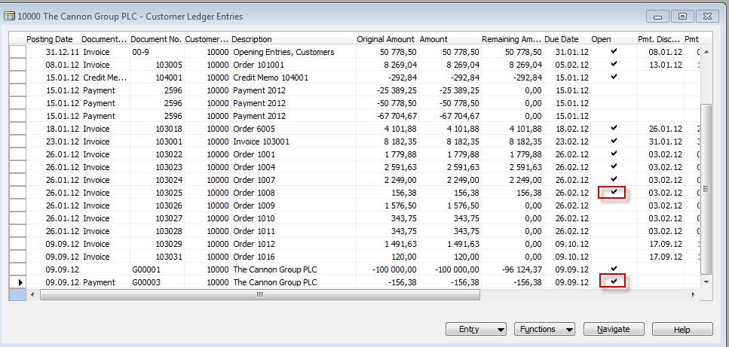
Unapply in Customer Ledger Entry
Both entries are open again !!!!

Slide 16
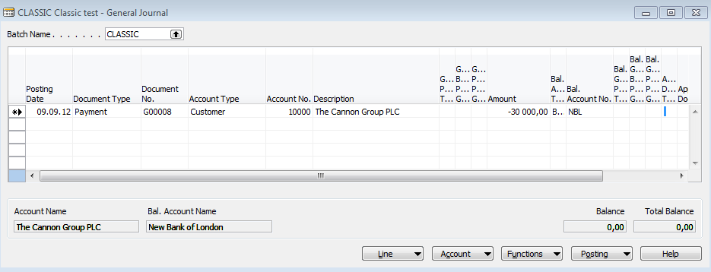

Apply Entries by use of Shift-F9
Shit-F9 Apply Entries
See next slide
Only for the course
BPH_PIS2 in Czech language

Slide 17
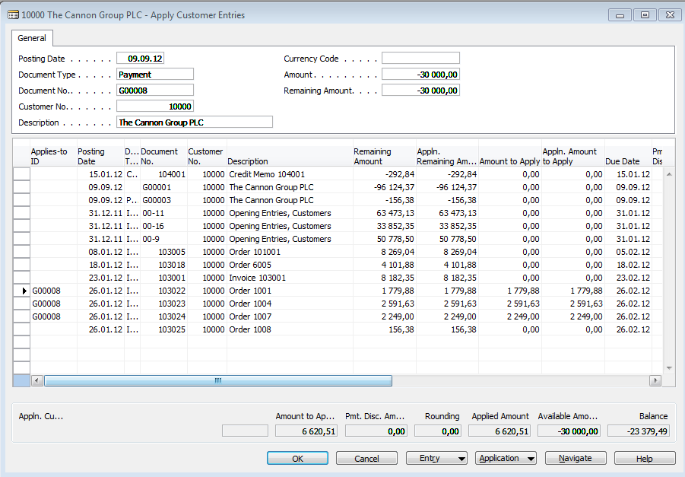
Apply Entries by use of Shift-F9
Only for the course
BPH_PIS2
By use of toggle switch (key) F9 and OK
in Czech language

Slide 18
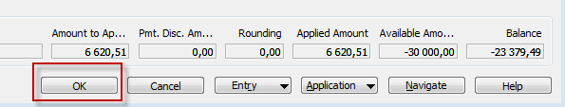
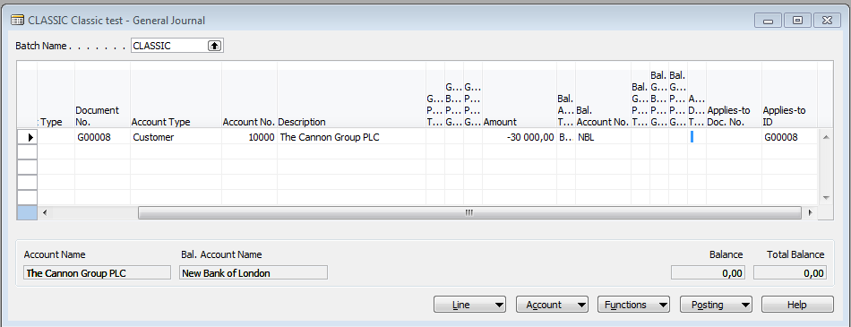
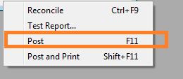
Apply Entries by use of Shift-F9
Only for the course
BPH_PIS2 in Czech language

Slide 19
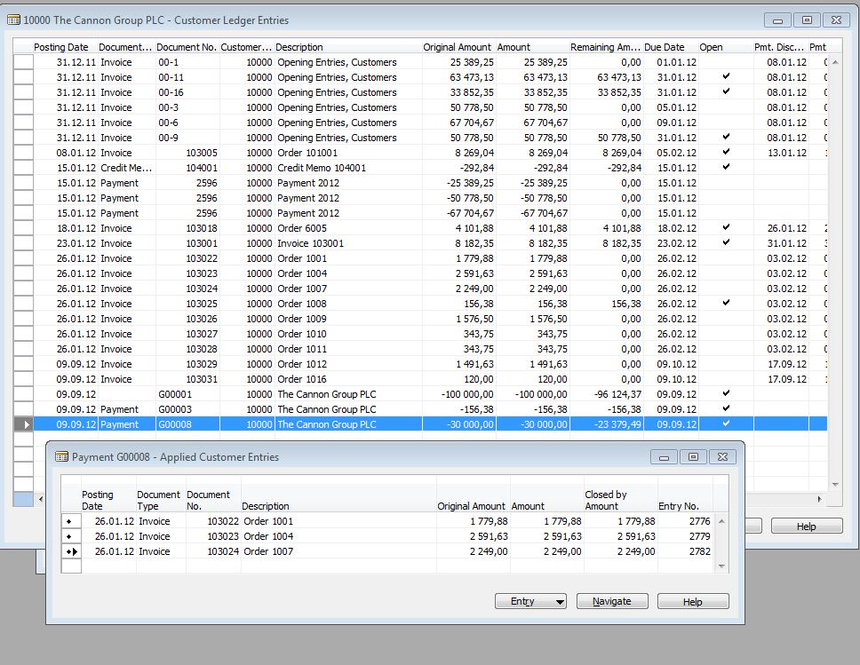
Apply Entries from Customer Card by use of Ctrl-F5 and Applied Entries
Only for the course BPH_PIS2 in Czech language

Slide 20
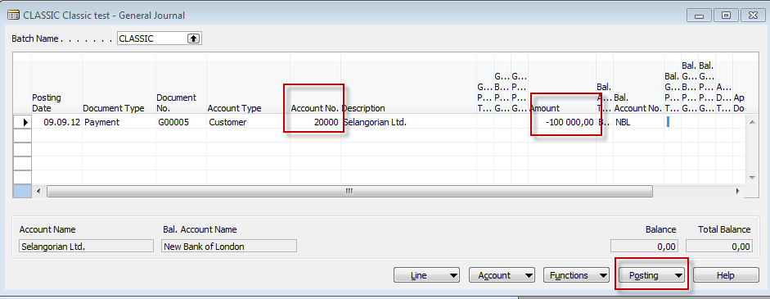
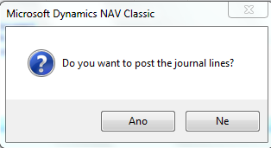

Enter payment 100 000 into GJ (Customer)
(another type of Payment application from Customer Ledger Entries : only presentation )
Only for the course BPH_PIS2 in Czech language

Slide 21
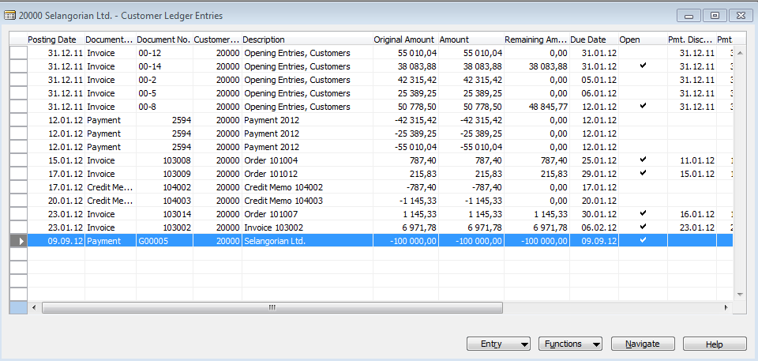

Open entries from Customer Card by Ctrl-F5 so you can see unapplied payment
(another type of Payment application from Customer Ledger Entries : only presentation)
Only for the course
BPH_PIS2 in Czech language
From Function Button
Enter Shift-F9

Slide 22
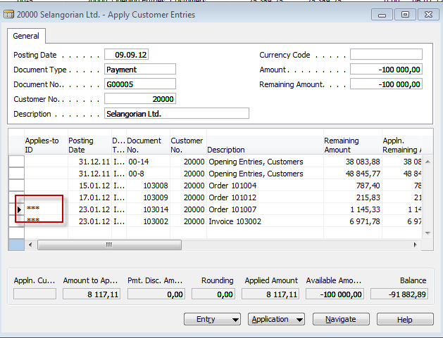
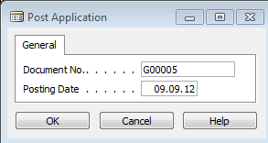


Apply open payment to more than one open invoices
(another type of Payment application from Customer Ledger Entries : only presentation)
Choice of two invoices by use of F9 key and then
Only for the course
BPH_PIS2 in Czech language

Slide 23

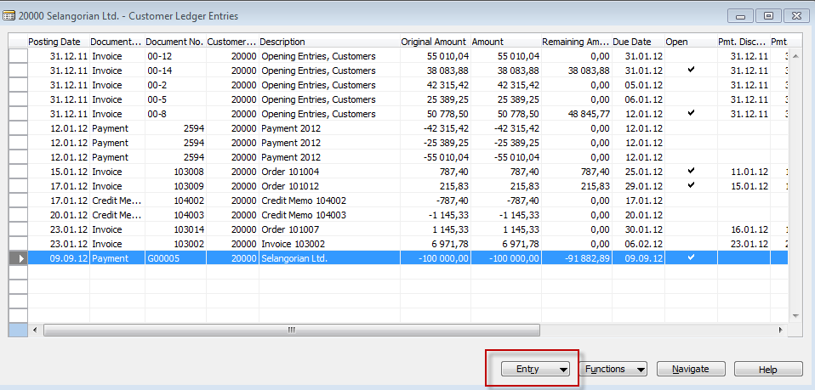
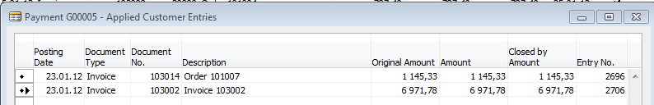

Applied Entries from Entry button
(another type of Payment application from Customer Ledger Entries : only presentation)
Only for the course
BPH_PIS2 in Czech language
Only for the course BPH_PIS2 in Czech language

Slide 24
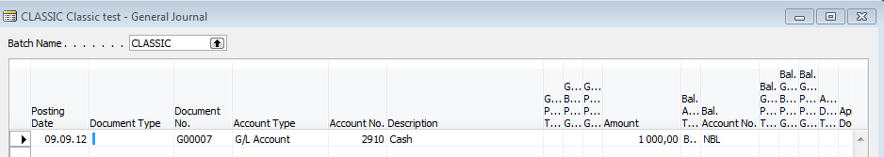
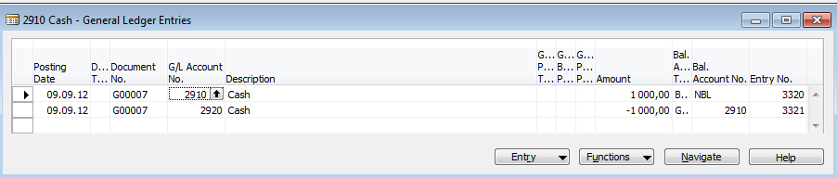
Amount transfer from one account to another one and Reverse
Account 2910 (261000 in Czech CHoA)
must have Direct Posting ticked
F11
Only for the course
BPH_PIS2 in Czech language

Slide 25
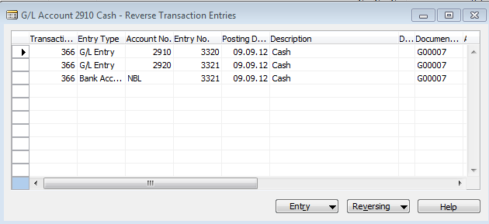
Amount transfer from one account to another one and Reverse
F11
Only for the course
BPH_PIS2 in Czech language

Slide 26
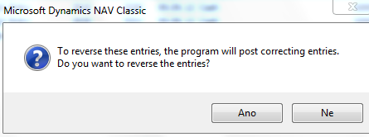
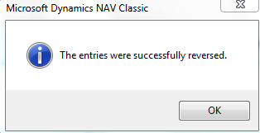
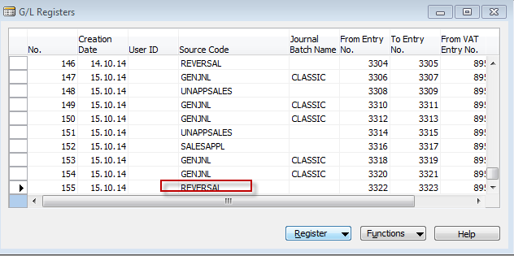
Amount transfer from one account to another and Reverse
Only for the course
BPH_PIS2 in Czech language

Slide 27
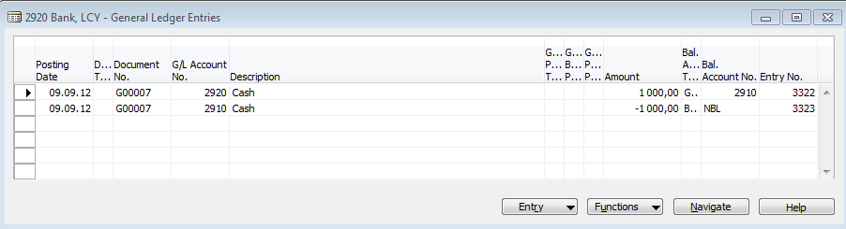
Amount transfer from one account to another and Reverse
Only for the course
BPH_PIS2 in Czech language

Slide 28

End of the section XIII.

